Slide 1
BEng (Hons) Control and Automation
Automation and Robotics
CRN: 50295
Dr Saber Mahboubi
Email: s.mahboubiheydarabad@salford.ac.uk

Slide 2
Lecture Content: Transfer Functions

Slide 3





Transfer Functions
The Transfer Function is the ratio of Laplace transform of the output to the Laplace transform of the input. Considering all initial conditions to zero.
Plant
y(t)
u(t)
●
If u(t)=U(S)
and
y(t)=Y(S)
●
●
Where is the Laplace operator.
Then the transfer function G(S) of the plant is given as
Y(S )
G(S)
G(S )
U(S)
Y(S)
U(S )

Slide 4








Laplace Transforms
By the use of Laplace transforms we can convert many common functions into an algebraic function of the complex variable s.
For example
● sin t
_{s}2 2
Or
1
at
e
s a
Where s is a complex variable (complex frequency) and is given as
s j

Slide 5



Laplace Transform of Derivatives
Not only common function can be converted into simple algebraic expressions but calculus operations can also be converted into algebraic expressions.
For example
dx(t)
●
sX (S ) x(0)
dt
d ² x(t )
dx(0)
●
2
s X (S )
x(0)
dt²
dt
In general
d ^{n} x(t )
●
n
n 1
n 1
s X (S )
s x(0) … x (0)
dt^{n}
Where x(0) is the initial condition of the system.

Slide 6
Laplace Transform of Integrals
The time domain integral becomes division by s in frequency domain.
1
● x(t)dt _{s} X (S )

Slide 7



Calculation of the Transfer Function
Consider the following ODE where y(t) is input of the system and x(t) is the output.
d ² x(t ) dy(t ) dx(t )
A C B
dt ²
dt dt
or
Ax''(t) Cy'(t) Bx'(t)
Taking the Laplace transform on either sides
A[s² X (s)
sx(0)
x'(0)]
C[sY (s)
y(0)]
B[sX (s)
x(0)]

Slide 8


Calculation of the Transfer Function
Considering Initial conditions to zero in order to find the transfer function of the system
A[s² X (s)
sx(0)
x'(0)]
C[sY (s)
y(0)]
B[sX (s)
x(0)]
As² X (s) CsY (s) BsX (s)
Becomes
Rearranging the above equation
As² X (s) X (s)[ As² X (s)
BsX (s) CsY (s)
Bs] CsY (s)
Cs C
As B
Y(s)
As² Bs

Slide 9

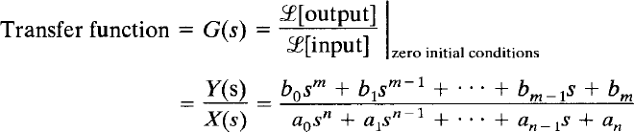
Transfer Functions
In general
Where x is the input of the system and y is the output of the system.
When the order of the denominator polynomial is greater than the numerator polynomial the transfer function is said to be ‘proper’.

Slide 10
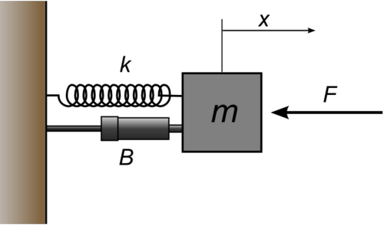


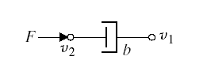
A Basic Mechanical System
Consider the following basic mechanical system
Translational Spring
i)
Translational Mass
ii)
Translational Damper
iii)

Slide 11
A Translational Spring
A translational spring is a mechanical element that can be deformed by an external force such that the deformation is directly proportional to the force applied to it.
If F is the applied force
Then is the deformation if
Or is the deformation.
The equation of motion is given as
Where is stiffness of spring expressed in N/m

Slide 12
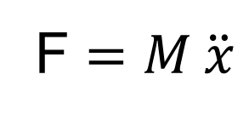
A Translational Mass
A translational Mass is an inertia element.
If a force F is applied to a mass and it is displaced to x meters then the relation b/w force and displacements is given by Newton’s law.
M
F $=M \ddot{x}$

Slide 13

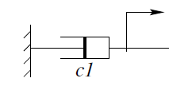

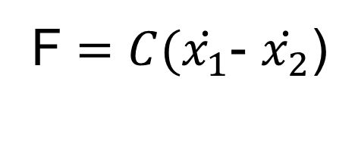
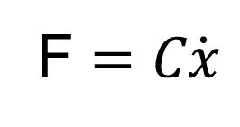
A Translational Damper
The damper opposes the rate of change of motion
All the materials exhibit the property of damping to some extent.
F $=C\dot{x}$
F $=C(\dot{x_{1}}$- $\dot{x_{2}}$)
Where C is damping coefficient (N/ms⁻¹).

Slide 14
Example
Consider the following system
Using a Free Body diagram
M

Slide 15
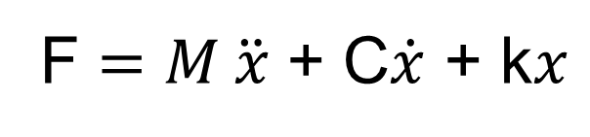
Example
Differential equation of the system is:
F $=M \ddot{x}$ + C$\dot{x}$ + k$x$
Taking the Laplace Transform of both sides and ignoring Initial conditions (set to zero) we get:

Slide 16
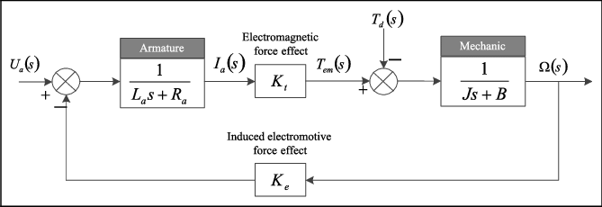
Application
An example of how transfer functions are applied to dc motors

Slide 17
Poles and Zeros
Roots of denominator polynomial of a transfer function are called ‘poles’.
And the roots of numerator polynomials of a transfer function are called ‘zeros’.
Poles of the system are represented by ‘x’ and zeros of the system are represented by ‘o’.
System order is always equal to number of poles of the transfer function.
Poles are also defined as “it is the frequency at which the system becomes infinite”. Hence the name pole where the field is infinite.
And zeros are the frequency at which system becomes 0.

Slide 18
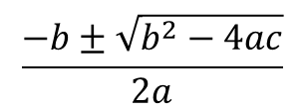
Example
if
Divide through by 1000
$$\frac{−b±\sqrt{b^{2}−4ac}}{2a}$$
Apply
and find roots

Slide 19
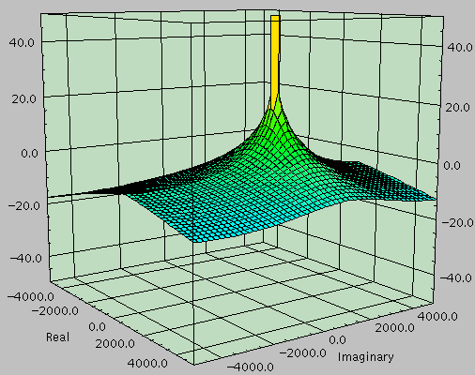
Poles and Zeros
The relationship between poles and zeros and the frequency response of a
system becomes apparent with 3D pole-zero plots.
Single pole system

Slide 20
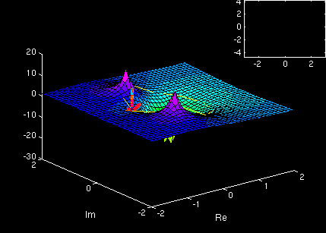
Poles and Zeros
system has 1 ‘zero’ and 2 ‘poles’.

Slide 21
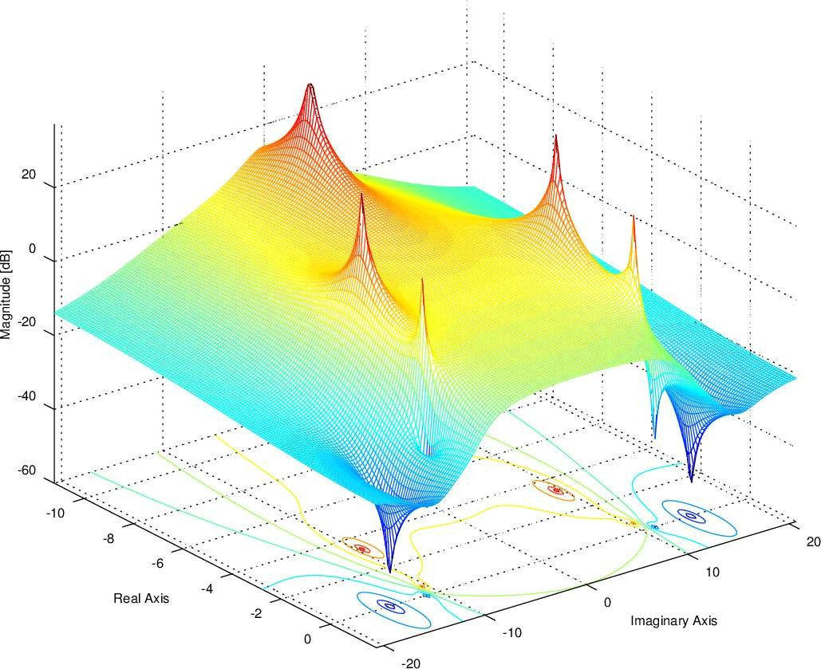
Poles and Zeros

Slide 22
Transfer Functions
Transfer functions help us to check
The stability of the system
Time domain and frequency domain characteristics of the system
Response of the system for any given input

Slide 23





Stability
The poles and zeros of the system are plotted in s-plane to check the stability of the system.
j
s
j
LHP
RHP
s-plane
If all the poles of the system lie in left half plane the system is said to be Stable
If any of the poles lie in right half plane the system is said to be Unstable
If pole(s) lie on imaginary axis the system is said to be Marginally stable

Slide 24

Simple Example
For example
C
As B
G(s)
, if A 1, B 3 and C 10
Then the only pole of the system lies at
pole 3
j
LHP
RHP
X
-3
s-plane

Slide 25

Tutorial 2: Have a go
Consider the following transfer functions.
Determine
Whether the transfer function is proper or improper
Poles of the system
zeros of the system
Order of the system
s 3
s(s 2)
s
i)
G(s)
ii)
G(s)
(s
2)(s 3)
(s 3)²
s (s 1)
iii)
G(s)
iv)
G(s)
s(s _10)
s² + s + 4

Slide 26
Time Domain Analysis
In time-domain analysis the response of a dynamic system to an input is expressed as a function of time.
It is possible to compute the time response of a system if the nature of input and the mathematical model of the system are known
The characteristics of common actual input signals are a sudden shock, a sudden change, a constant velocity, and constant acceleration
The dynamic behavior of a system is therefore judged and compared under application of standard test signals – an impulse, a step, a constant velocity, and constant acceleration
In some situations a standard signal of great importance is a sinusoidal signal

Slide 27
Standard Test Signals
The Impulse signal
The impulse signal imitate the sudden shock characteristic of actual input signal.
If A=1, the impulse signal is called unit impulse signal.
δ(t)
A
If A=1, the impulse signal is called unit impulse signal.
0
t

Slide 28
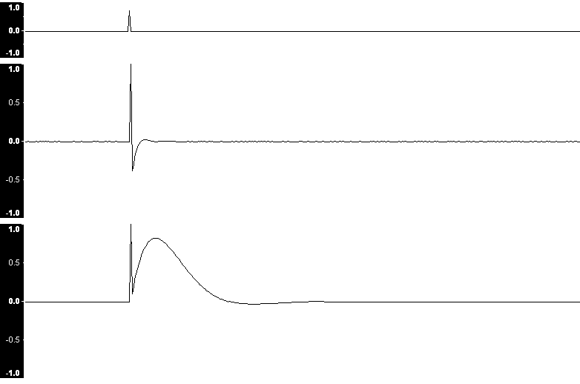
Standard Test Signals
Impulse signal
Source: English Wikipedia. Iain. Original image: [1]

Slide 29
Standard Test Signals
Step signal
The step signal imitate the sudden change characteristic of actual input signal.
If A=1, the step signal is called unit step signal
u(t)
A
0
t

Slide 30
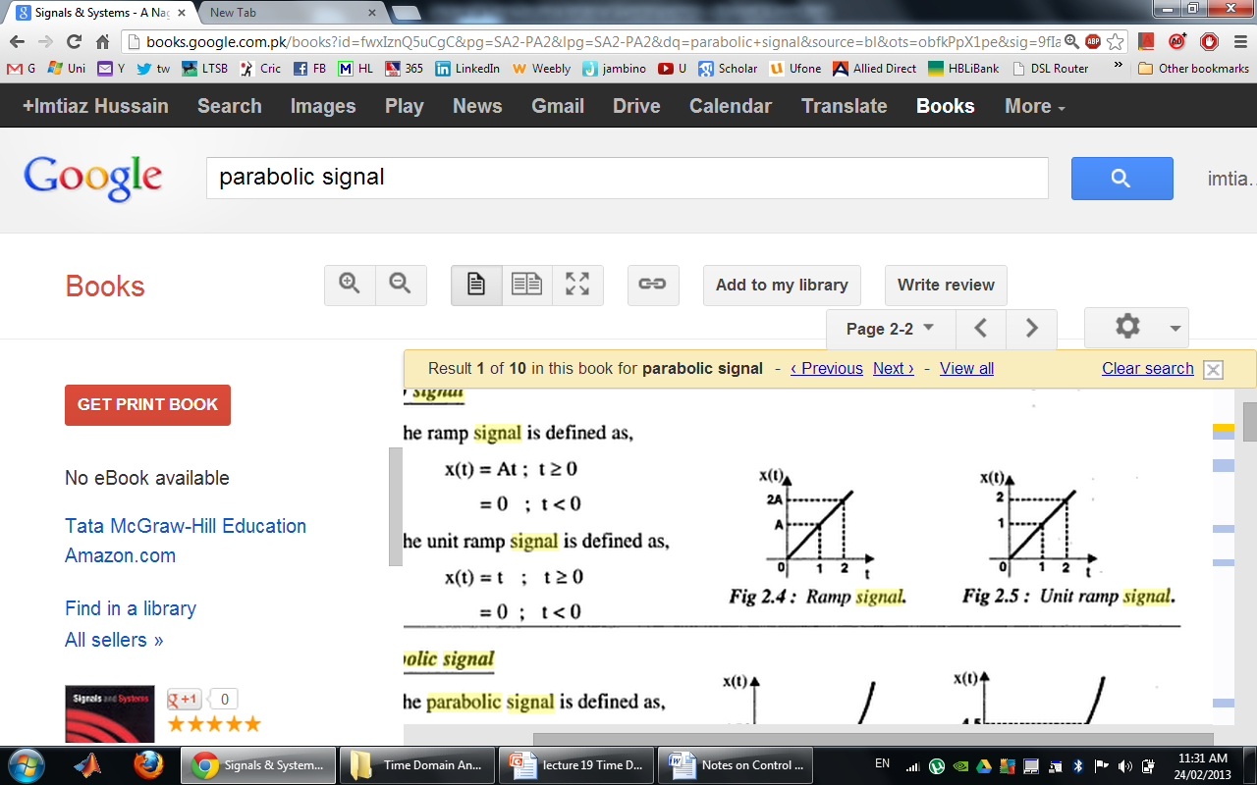
Standard Test Signals
Ramp signal
The ramp signal imitate the constant velocity characteristic of actual input signal.
If A=1, the ramp signal is called unit ramp signal
r(t)
0
t
r(t)
ramp signal with slope A
r(t)
unit ramp signal

Slide 31
Standard Test Signals
Parabolic signal
The parabolic signal imitate the constant acceleration characteristic of actual input signal.
If A=1, the parabolic signal is called unit parabolic signal.
p(t)
0
t

Slide 32
Relation Between Standard Test Signals
Impulse
Step
Ramp
Parabolic

Slide 33
Laplace Transform of Test Signals
Impulse
Step

Slide 34
Laplace Transform of Test Signals
Ramp
Parabolic

Slide 35
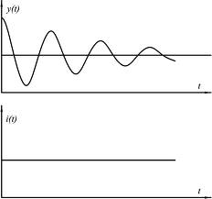
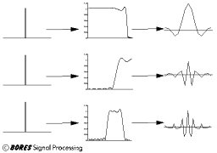
Time Response of Control Systems
The time response of a dynamic system is a response to an input expressed as a function of time.
The time response of any system has two components
Transient response
Steady-state response.
System

Slide 36
Time Response of Control Systems
When the response of the system is changed from rest or equilibrium it takes some time to settle down.
The transient response is the response of a system from rest or equilibrium to steady state.
The response of the system after the transient response is called steady state response.
Steady State Response
Transient Response

Slide 37
Time Response of Control Systems
The transient response dependents upon the system poles only and not on the type of input
It is therefore sufficient to analyze the transient response using a step input.
The steady-state response depends on system dynamics and the input quantity.
It is then examined using different test signals.

Slide 38
Time Responses of First Order systems
The first order system has the following generic format with only one pole.
Where K is the D.C gain and T is the time constant of the system.
The time constant is a measure of how quickly a 1st order system responds to a unit step input.
The D.C Gain of the system is ratio between the input signal and the steady state value of output.
For the first order systems given below
D.C gain is 10
time constant is 3 seconds
D.C gain is 3/5
time constant is 1/5 seconds.

Slide 39
Impulse Response of First Order System
δ(t)
1
0
t
In order to represent the response of the system in time domain we need to compute inverse Laplace transform of the above equation.

Slide 40
Impulse Response of First Order System
Example.
If K=3 and T=2s then

Slide 41
Step Response of First Order System
1
0
t
Forced
Response
Natural Response
Taking inverse Laplace transform of the above equation.
if u(t)=1

Slide 42
Step Response of First Order System
Example.
If K=10 and T=1.5s then using

Slide 43
Step Response of First Order System
If K=10 and T=1, 3, 5, 7 using

Slide 44
Impulse Response of First Order System
If T=1 and K=1, 3, 5, 7 using

Slide 45
Ramp Response of First Order System
0
t
Taking inverse Laplace transform of the above equation.

Slide 46
Ramp Response of First Order System
Example.
If K=1 and T=1 then using
Unit Ramp Response
10
Unit Ramp
Ramp Response
8
c(t)
6
4
error
2
0
0
5
10
15
Time

Slide 47
Ramp Response of First Order System
Example.
If K=1 and T=3 then using
Unit Ramp Response
10
Unit Ramp
Ramp Response
8
6
c(t)
4
2
error
0
0
5
10
15
Time

Slide 48
Parabolic Response of First Order System
The parabolic response is much the same as the ramp response for a first order system as it just produce the curve with a delay based on the time constant.
The ramp and parabolic inputs are known as unbounded as they keep changing and do not lead to a steady state response.
So it is the step response that is most useful to us in this case.
This can be useful if the system is closed, and the component parts are not easily identifiable.
The system's step response can lead to a representation even though the inner construction is not known
With a step input, we can measure the time constant and the steady-state value, from which the transfer function can be calculated

Slide 49
PZ-map and Step Response
jω
δ
-3
-2
-1

Slide 50
PZ-map and Step Response
jω
δ
-3
-2
-1

Slide 51
PZ-map and Step Response
jω
δ
-3
-2
-1

Slide 52
Comparison

