Slide 1
BEng (Hons) Control and Automation
Automation and Robotics
CRN: 50295
Dr Saber Mahboubi
Email: s.mahboubiheydarabad@salford.ac.uk

Slide 2
Lecture Content: Second Order Systems and PID controllers

Slide 3
Introduction
We have already discussed the affect of location of the pole on the transient response of 1st order systems.
Compared to the simplicity of a first-order system, a second-order system exhibits a wide range of responses that must be analyzed and described.
Varying a first-order system's parameters (T, K) simply changes the speed and offset of the response
Whereas, changes in the parameters of a second-order system can change the form of the response.
A second-order system can display characteristics much like a first-order system or, depending on component values, display damped or pure oscillations for its transient response.

Slide 4
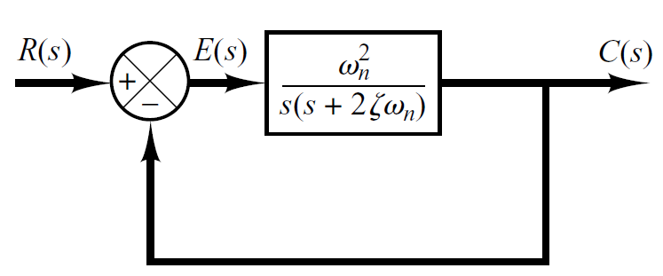
Introduction
A general second-order system (without zeros) is characterized by the following transfer function.
Open-Loop Transfer Function
Closed-Loop Transfer Function

Slide 5
Introduction
damping ratio of the second order system, which is a measure of the degree of resistance to change in the system output.
un-damped natural frequency of the second order system, which is the frequency of oscillation of the system without damping.

Slide 6
Example
Determine the un-damped natural frequency and damping ratio of the following second order system.
Compare the numerator and denominator of the given transfer function with the general 2nd order transfer function.

Slide 7
Introduction
The closed-loop poles of the system are

Slide 8
Introduction
Depending upon the value of , a second-order system can be set into one of the four categories:
Overdamped - when the system has two real distinct poles ( >1).
jω
δ
-c
-b
-a

Slide 9
Introduction
Depending upon the value of , a second-order system can be set into one of the four categories:
2. Underdamped - when the system has two complex conjugate poles (0 < <1)
jω
δ
-c
-b
-a

Slide 10
Introduction
Depending upon the value of , a second-order system can be set into one of the four categories:
3. Critically damped - when the system has two real but equal poles ( = 1).
jω
δ
-c
-b
-a

Slide 11
Introduction
Depending upon the value of , a second-order system can be set into one of the four categories:
4. Undamped - when the poles have no real component.
jω
δ

Slide 12
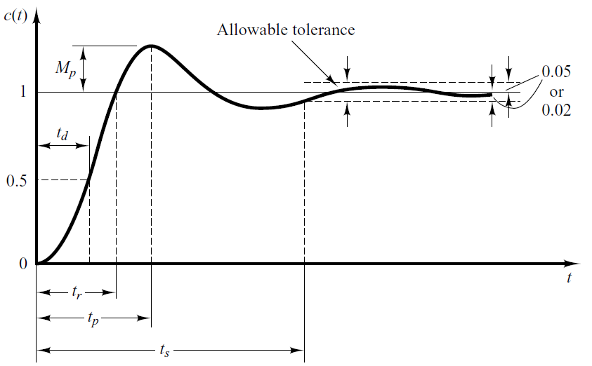
Time-Domain Specification
Most systems are underdamped where 0< <1 and ω_{n} > 0, these systems are of most interest. The 2nd order system’s response due to a unit step input looks like

Slide 13
Time-Domain Specification
The delay (t_{d}) time is the time required for the response to reach half the final value the very first time.

Slide 14
Time-Domain Specification
The rise time is the time required for the response to rise from 10% to 90%, 5% to 95%, or 0% to 100% of its final value.
For underdamped second order systems, the 0% to 100% rise time is normally used. For overdamped systems, the 10% to 90% rise time is commonly used.
14

Slide 15
Time-Domain Specification
The peak time is the time required for the response to reach the first peak of the overshoot.
15
15

Slide 16

Time-Domain Specification
The maximum overshoot is the maximum peak value of the response curve measured from unity. If the final steady-state value of the response differs from unity, then it is common to use the maximum percent overshoot. It is defined by
The amount of the maximum (percent) overshoot directly indicates the relative stability of the system.

Slide 17
Time-Domain Specification
The settling time is the time required for the response curve to reach and stay within a range about the final value of size specified by absolute percentage of the final value (usually 2% or 5%).

Slide 18
Using the S-Plane
Natural Undamped Frequency.
jω
Distance from the origin of s-plane to pole is natural undamped frequency in rad/sec.
δ

Slide 19
Using the S-Plane
Let us draw a circle of radius 3 in s-plane.
If a pole is located anywhere on the circumference of the circle the natural undamped frequency would be 3 rad/sec.
jω
3
-3
3
δ
-3

Slide 20
Using the S-Plane
Therefore the s-plane is divided into Constant Natural Undamped Frequency (ω_{n}) Circles.
jω
δ

Slide 21
Using the S-Plane
Damping ratio.
Cosine of the angle between vector connecting origin and pole and –ve real axis yields damping ratio.
jω
δ

Slide 22
Using the S-Plane
For Underdamped system therefore,
jω
δ

Slide 23
Using the S-Plane
For Undamped system therefore,
jω
δ

Slide 24

Using the S-Plane
For overdamped and critically damped systems therefore,
$$ζ=1$$
jω
δ

Slide 25
Using the S-Plane
Draw a vector connecting origin of s-plane and some point P.
jω
P
δ

Slide 26
Using the S-Plane
Therefore, s-plane is divided into sections of constant damping ratio lines.
jω
δ

Slide 27
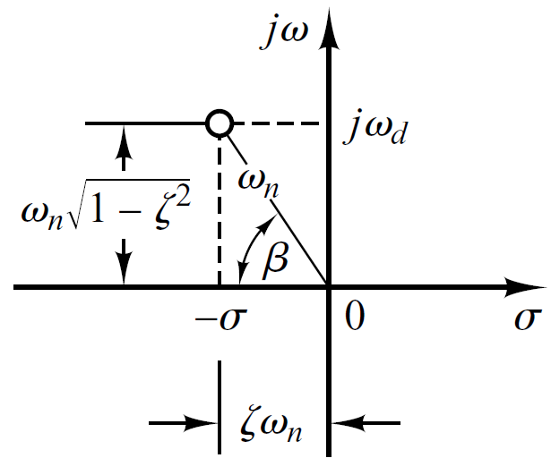
Using the S-Plane

Slide 28
Step Response of underdamped System

Slide 29
Step Response of underdamped System

Slide 30
Step Response of underdamped System

Slide 31
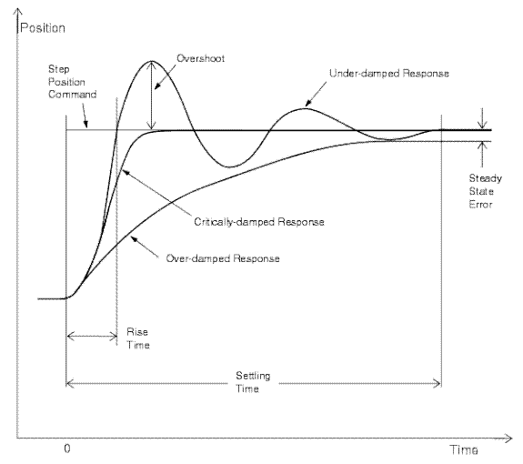
Other Step Responses

Slide 32
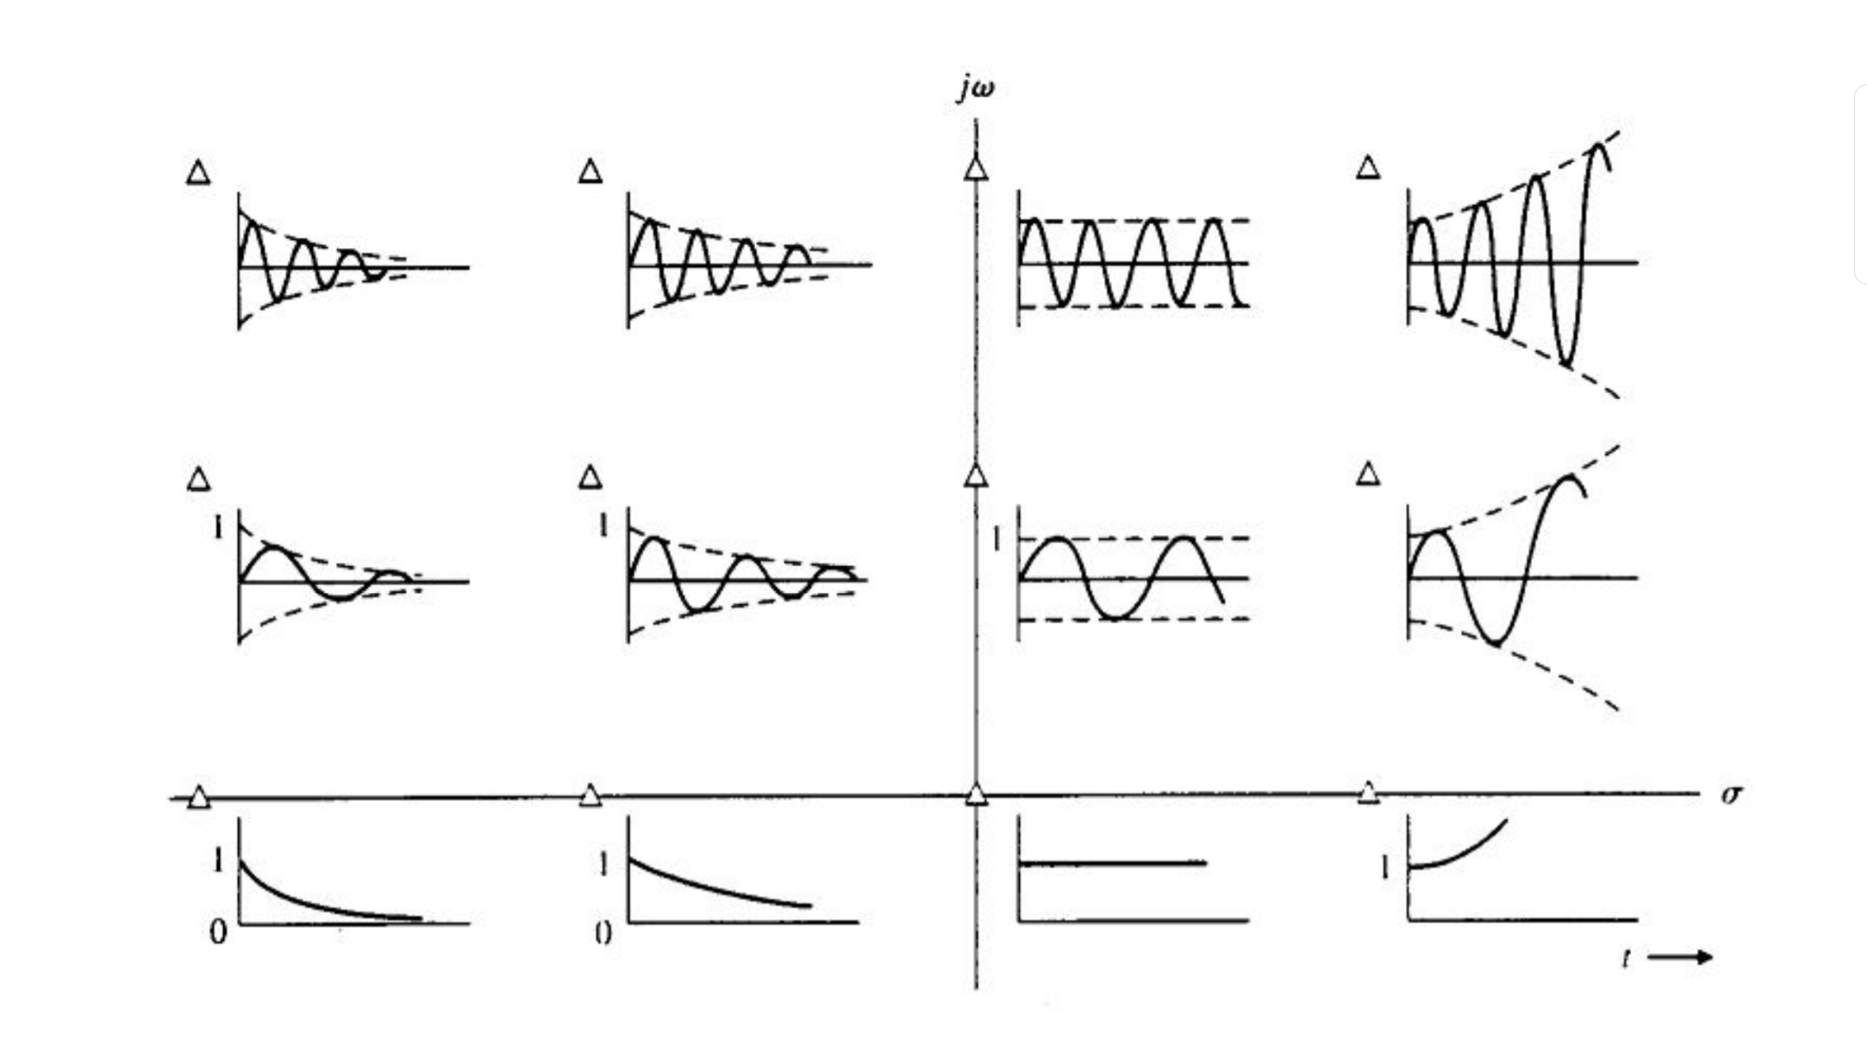
Step Responses by Pole Positions
Higher Frequency
Oscillation
Lower Frequency
Oscillation
No Oscillation
Oscillations
Mirrored
(+/- Nature
of poles)
Settling
Amplitude
Stable
Amplitude
Increasing
Amplitude

Slide 33
Time Domain Specifications of Underdamped system
Time Domain Specifications (Settling Time)

Slide 34
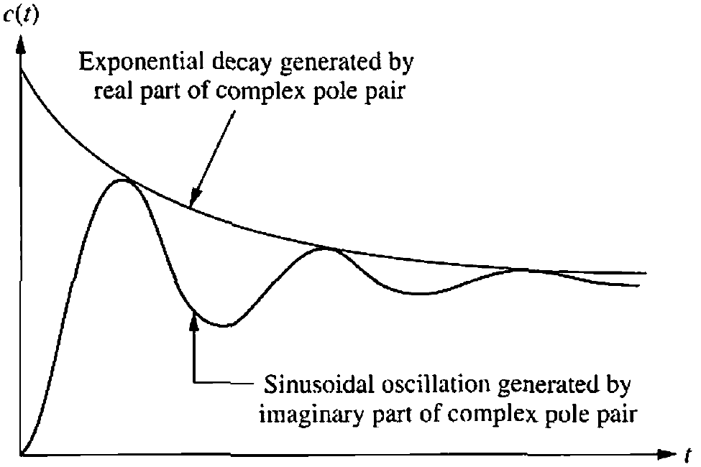
Time Domain Specifications (Settling Time)
Real Part
Imaginary Part

Slide 35
Time Domain Specifications (Settling Time)
Settling time (2%) criterion
Time consumed in exponential decay up to 98% of the input.
Settling time (5%) criterion
Time consumed in exponential decay up to 95% of the input.

Slide 36
Summary of Time Domain Specifications
Rise Time
Peak Time
Settling Time (2%)
Maximum Overshoot
Settling Time (5%)

Slide 37
Example
Consider the system shown in following figure, where damping ratio is 0.6 and natural undamped frequency is 5 rad/sec. Obtain the rise time t_{r}, peak time t_{p}, maximum overshoot M_{p}, and settling time 2% and 5% criterion t_{s} when the system is subjected to a unit-step input.

Slide 38
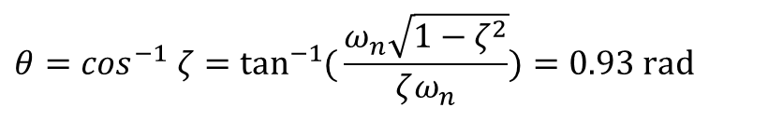
Example
Rise Time
$$θ=\cos^{−1} ζ=\tan^{−1}{(}\frac{ω_{n}\sqrt{1−ζ^{2}}}{ζω_{n}})=0.93 \text{rad}$$

Slide 39
Example
Peak Time
Settling Time (2%)
Settling Time (5%)

Slide 40
Example
Maximum Overshoot

Slide 41
PID Control

Slide 42
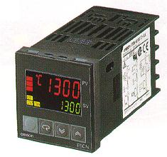
PID-Control – Introduction
The PID-controller is a “combination” of three different actions:
* The “P-Action”
* The “I-Action”
* The “D-Action”
Industrial controllers come with different classifications
Proportional controllers
Integral controllers
Proportional-plus-integral controllers
Proportional-plus-derivative controllers
Proportional-plus-integral-plus-derivative controllers
This Lecture will explain these actions “one-by-one”, so that each action will be easy to understand

Slide 43
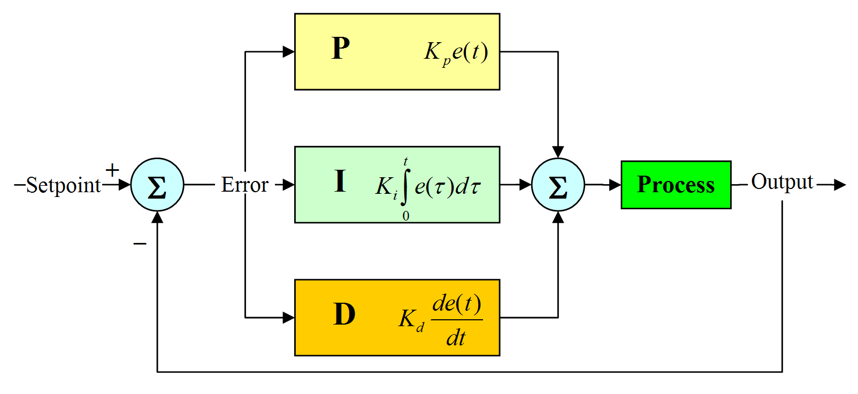

Proportional-Integral-Derivative (PID) Control
The PID-controller combines the three actions in parallel
Y
V
At any given time the Error signal will be:

Slide 44
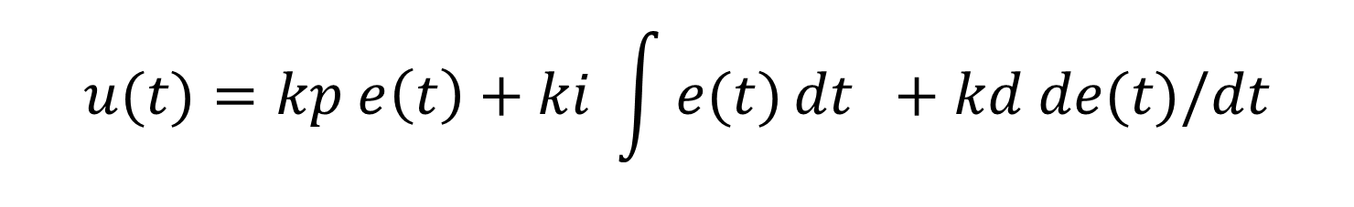
Proportional-Integral-Derivative (PID) Control
Hence the transfer function of the controller is the sum of the three elements
The gain k can be weighted to determine the relative influence of each control type.

Slide 45
Proportional-Integral-Derivative (PID) Control
 | Good | Bad
Proportional | Reduces steady-state error | Too much causes instability
Integral | Eliminates steady-state error | Too much causes instability
Derivative | Adds damping reduces overshoot | Amplifies noise

Slide 46
Proportional Control
C°
With a low gain the Setpoint temperature will never be reached!
This will create a large offset from the Set Point!
SV
gain too small
(t)
A correctly sized P gain results in an Overshoot, followed by an Undershoot and than Stabilization, with a small offset near the Set Point.
C°
SV
gain correct
(t)
C°
A Proportional gain that is too high causes hunting! The TC will than behave like an ON/OFF controller!
SV
PB too big
(t)
The right setting of the proportional gain is very important

Slide 47

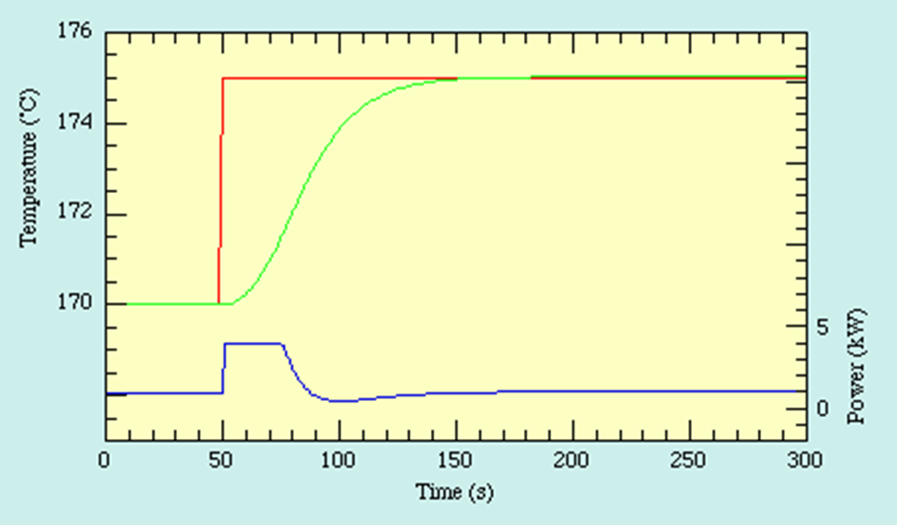
Integral Control of Systems.
Integral control of the system eliminates the steady-state error in the response to the step input..

Slide 48



Derivative Control
Derivative control introduces a damping effect. A typical response curve c ( t ) to a unit step input is shown

Slide 49
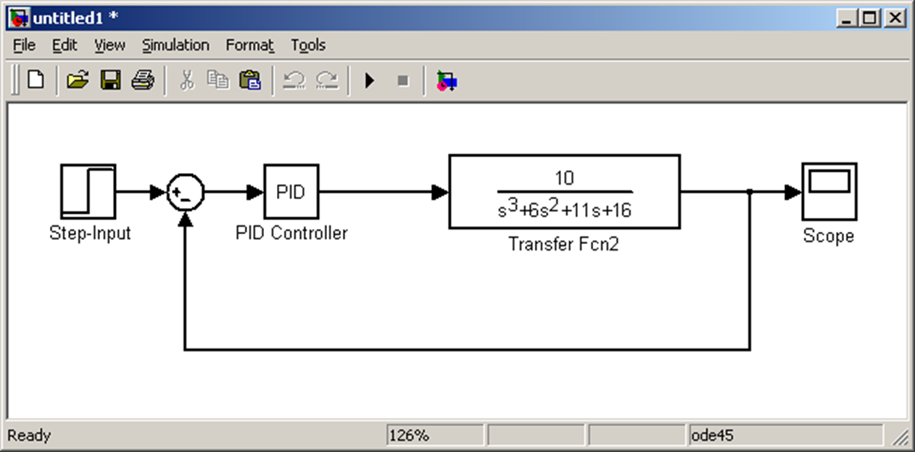
Simulink Simulation of PID control system

Slide 50
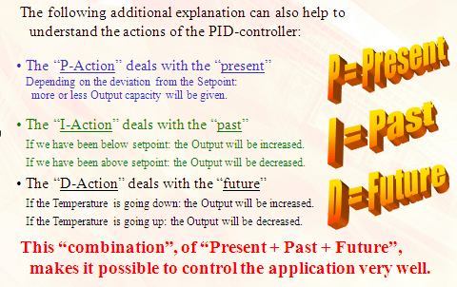

Slide 51
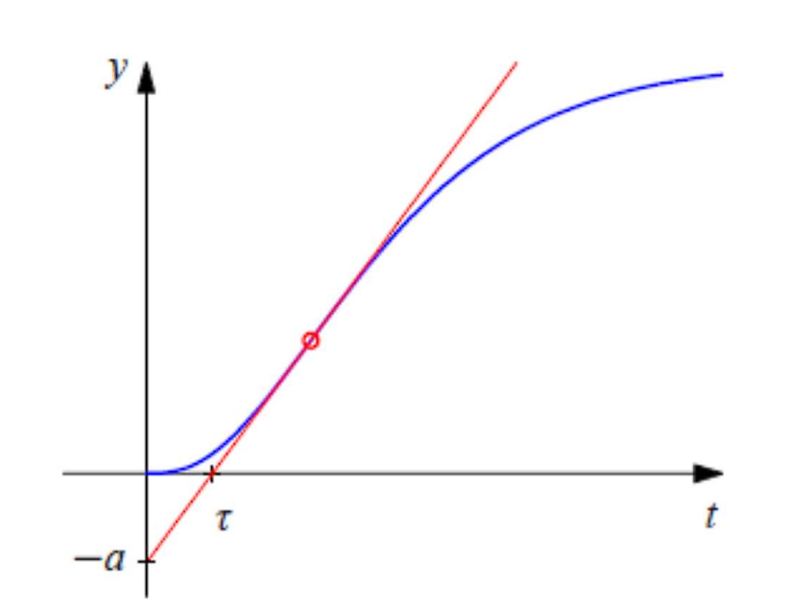
PID controller tuning- Ziegler-Nichols reaction curve method
Over 60 years ago, Ziegler and Nichols (1942) published a classic paper that introduced the continuous cycling method for controller tuning. It is based on the following trial-and-error procedure:
The open loop step response curve of the process is recorded and the steepest tangent to the reaction curve is
drawn

Slide 52
PID controller tuning- Ziegler-Nichols reaction curve method
The reaction curve is characterized by two parameters:
- Ƭ intercept of the steepest tangent with the time axis
- a modulus of the intercept of the steepest tangent with the time axis.
Note that Ƭ is an approximation of the time delay of the system and Ƭ/a is the steepest slope of the step response.

Slide 53
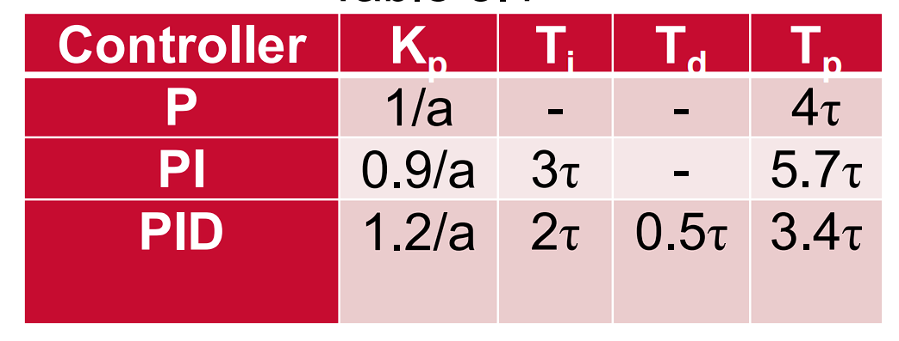
PID controller tuning- Ziegler-Nichols reaction curve method
Table shows the PID tuning rules based on the two reaction curve parameters. The table also shows an estimate of the period of oscillation Tp of underdamped step response the closed loop system.

Slide 54
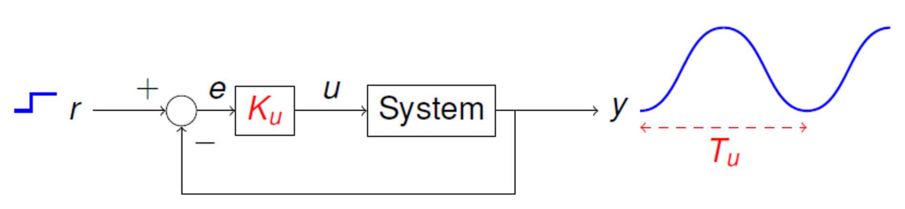
PID controller tuning- Ziegler-Nichols ultimate gain method
Also known as the Ziegler-Nichols frequency response (ZNFR) method.
With the system under proportional-only control, a unit step input is applied to the closed-loop system and the proportional gain is increased until the response is a sustained oscillation

Slide 55
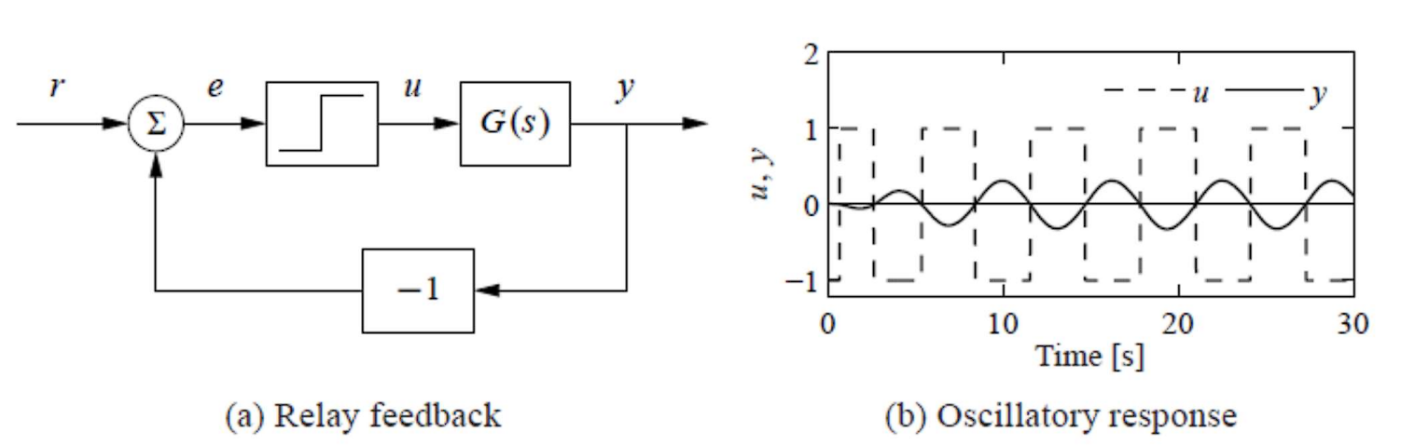
PID controller tuning- Ziegler-Nichols ultimate gain method
An alternative way to obtain the sustained oscillation required for the Ziegler–Nichols ultimate gain tuning method is to connect the process in a feedback loop with a nonlinear element having a square wave relay function

Slide 56
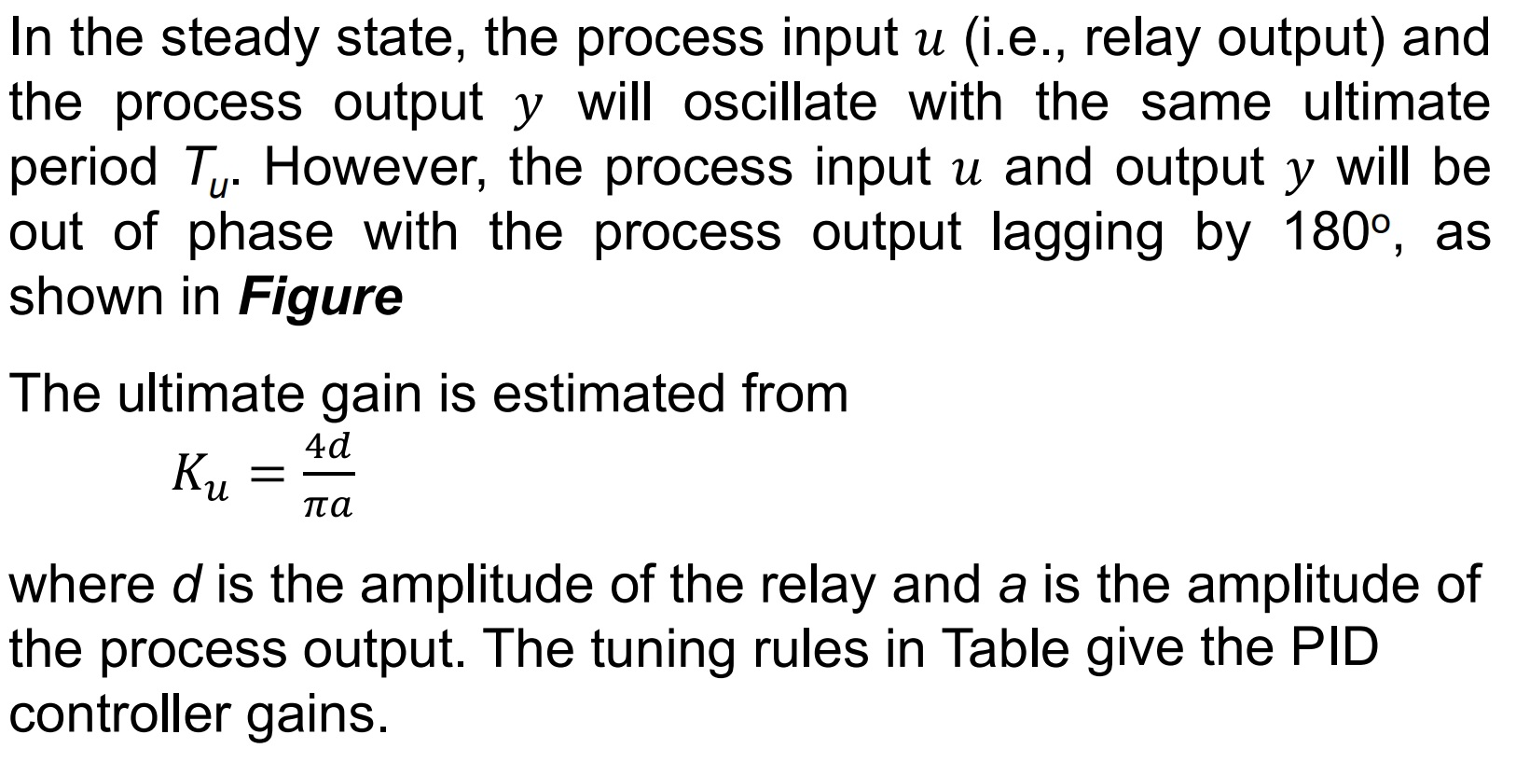
PID controller tuning- Ziegler-Nichols ultimate gain method

Slide 57
Ziegler-Nichols Table of Settings
Control Type | K_{P} | K_{I} | K_{D}
P | 0.50K_{U} | — | —
PI | 0.45K_{U} | 0.54K_{U}/T_{U} | —
PID | 0.60K_{U} | 1.2K_{U}/T_{U} | 3K_{U}T_{U}/40

Slide 58
Relay Auto Tuning

Slide 59
Modern Auto Tuning
With more capable processors the auto tuning process could consist of:
Trying a small impulse signal and calculating tuning parameters from the response .
Looking at historical process data to derive the tuning parameters.
Starting with the Z-N values and trying small changes to look for improvements.
Basing the parameter on an entirely mathematical model of the process.

