Slide 1

Automation & Robotics PID CONTROL Routh-Hurwitz Stability Criterion
Dr Saber Mahboubi
s.mahboubiheydarabad@salford.ac.uk

Slide 2
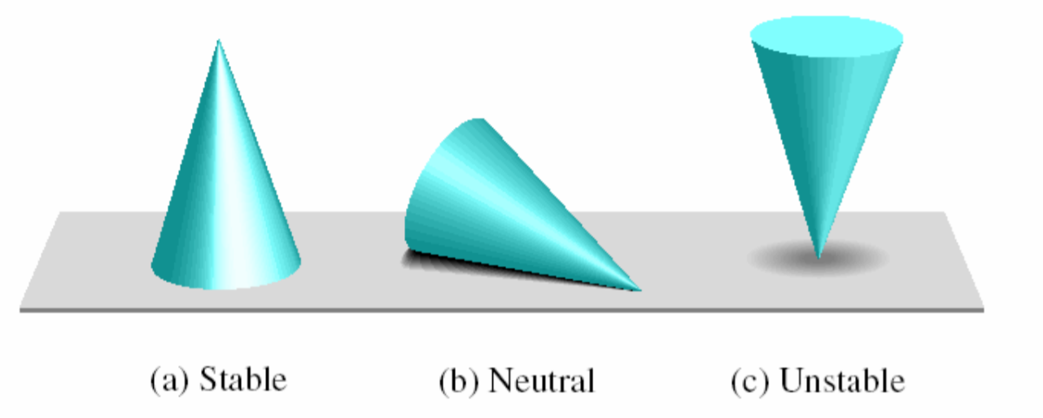
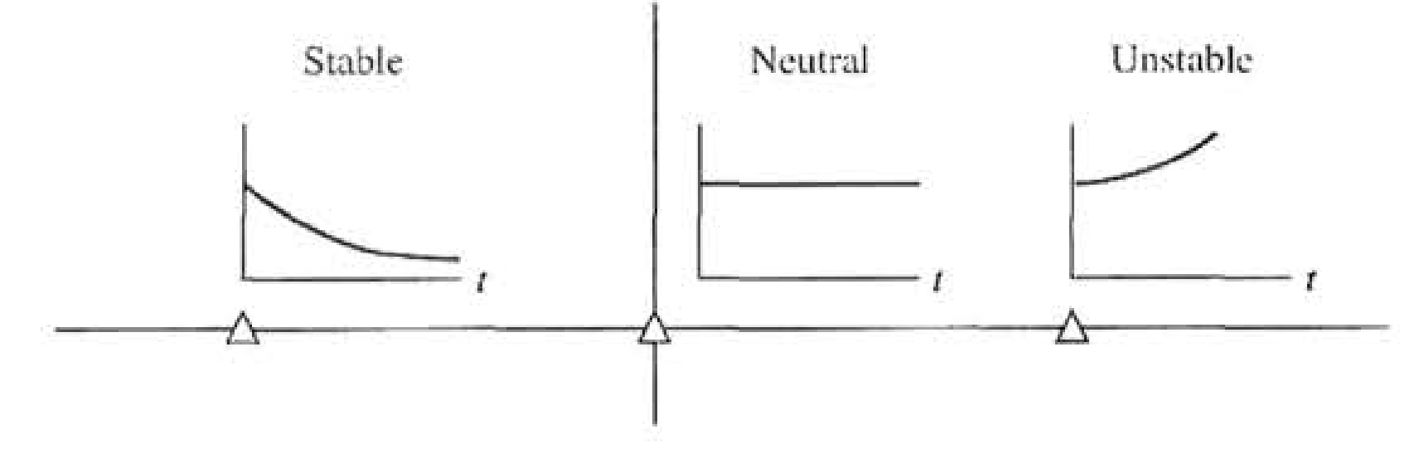
Routh-Hurwitz Criterion

Slide 3
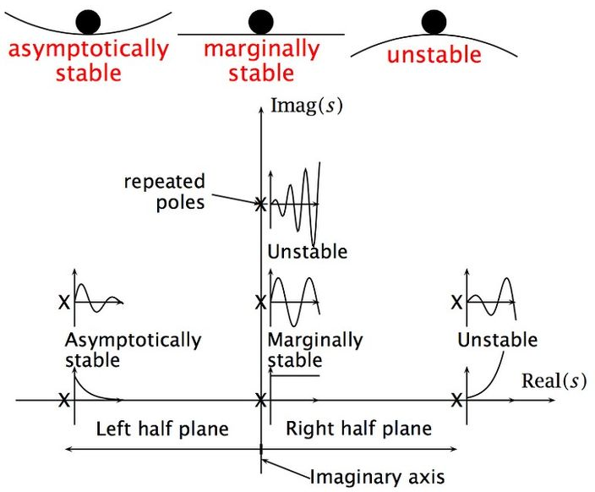
Routh-Hurwitz Stability Criterion

Slide 4
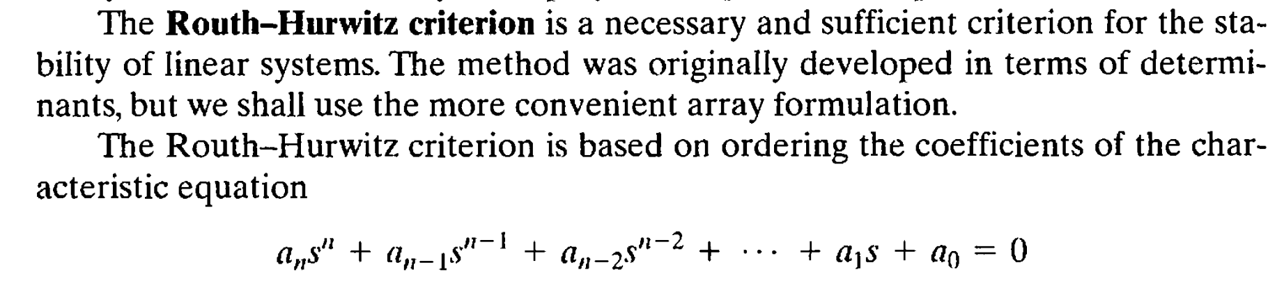
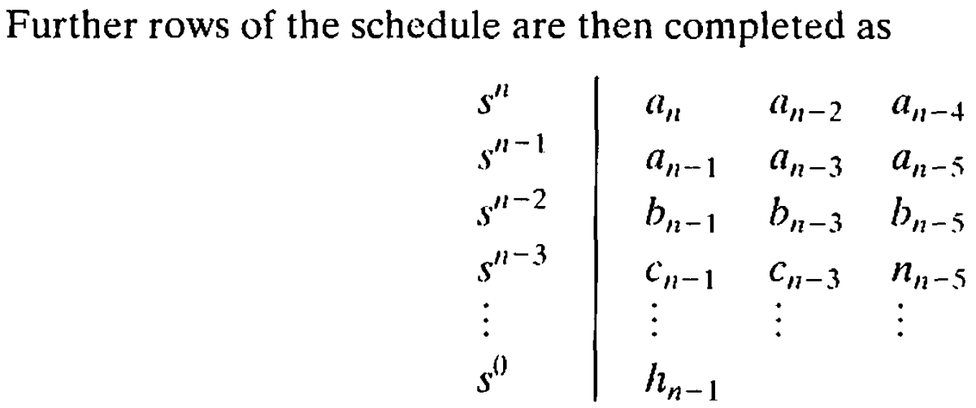
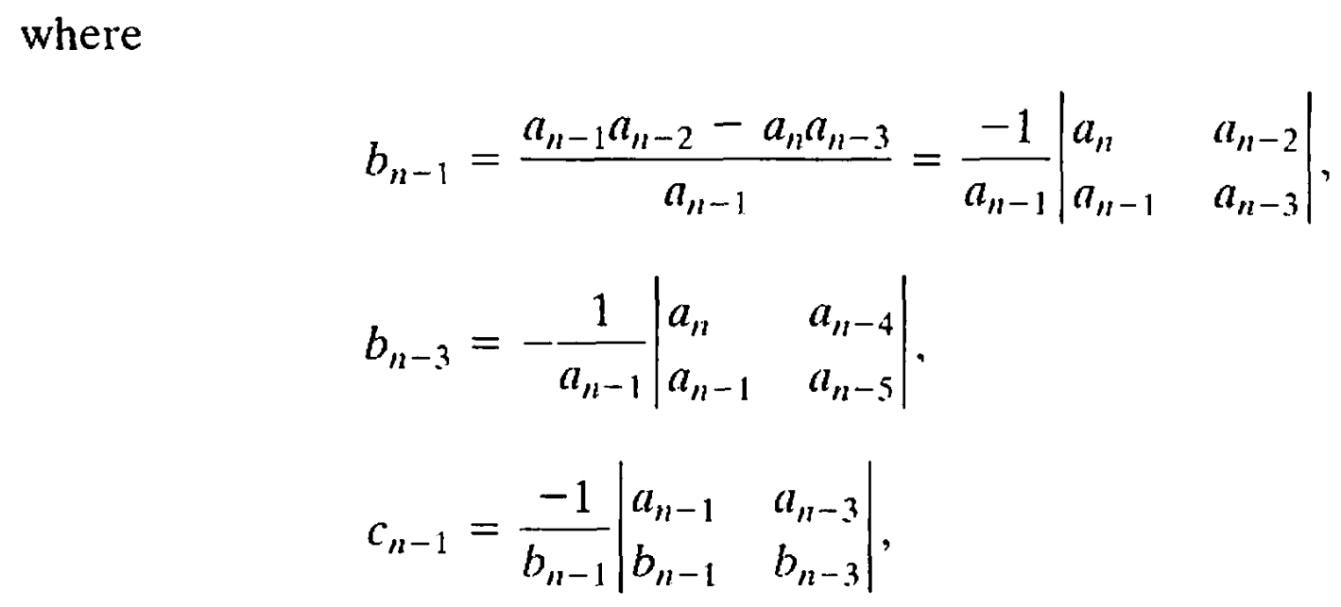
Routh-Hurwitz Stability Criterion

Slide 5
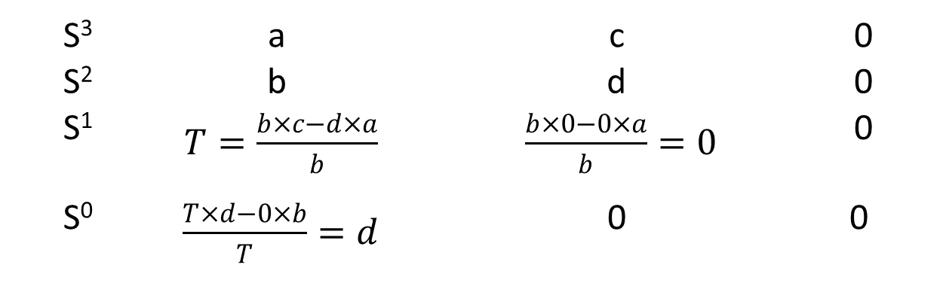
Routh-Hurwitz Stability Criterion
S³ | a | c | 0
S² | b | d | 0
S¹ | $T=\frac{b×c−d×a}{b}$ | $\frac{b×0−0×a}{b}=0$ | 0
S⁰ | $\frac{T×d−0×b}{T}=d$ | 0 | 0
aS³ + bS² + cS + d = 0

Slide 6
Routh-Hurwitz Stability Criterion
The Routh-Hurwitz criterion states that the number of roots of q(s) with positive real parts is equal to the number of changes in sign of the first column of the Routh array.

Slide 7
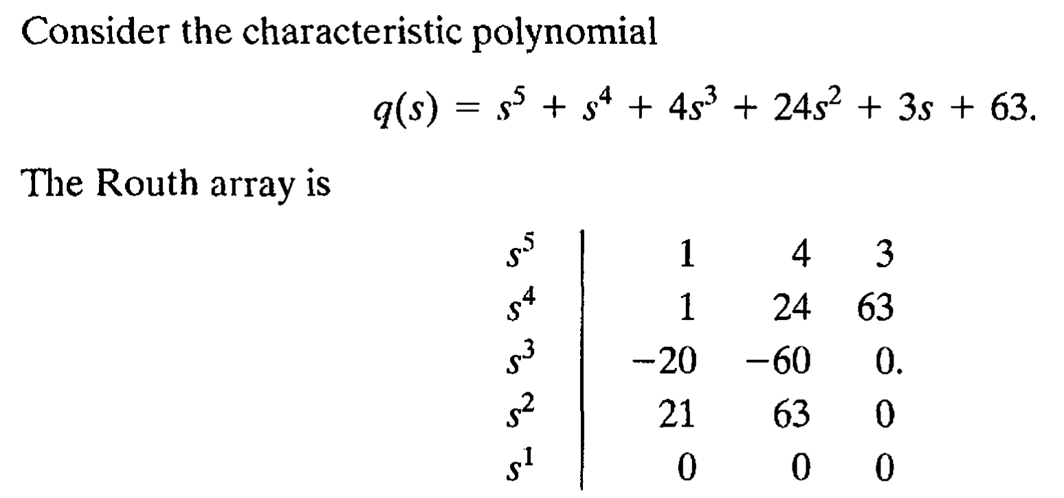
Routh-Hurwitz Stability Criterion
Simulink

Slide 8
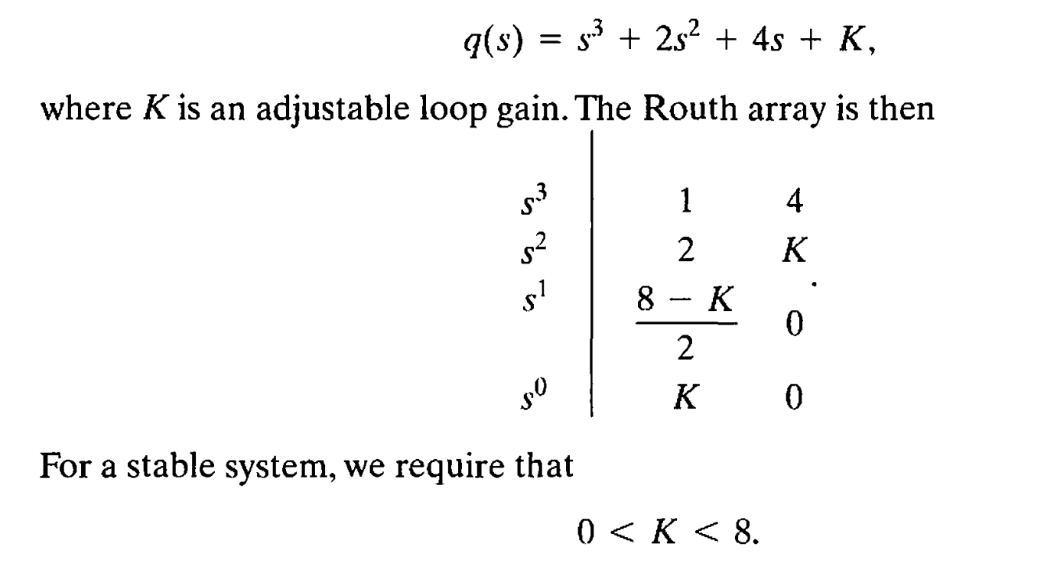
Routh-Hurwitz Stability Criterion
Simulink

Slide 9
Recap on the previous lecture
Mechanical interaction with objects/environment.
Mechanical interaction dynamics can be characterised by mechanical impedance.
Laplace-Transformed Impedance and Admittance Functions for Common Mechanical Elements

Slide 10

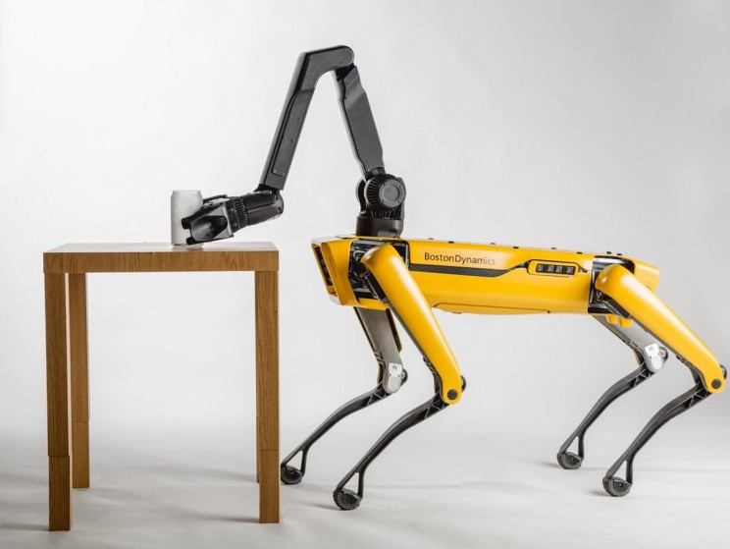
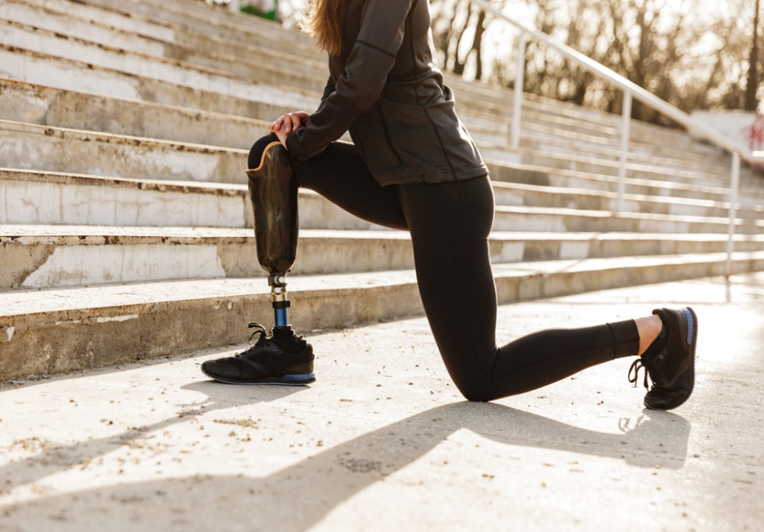
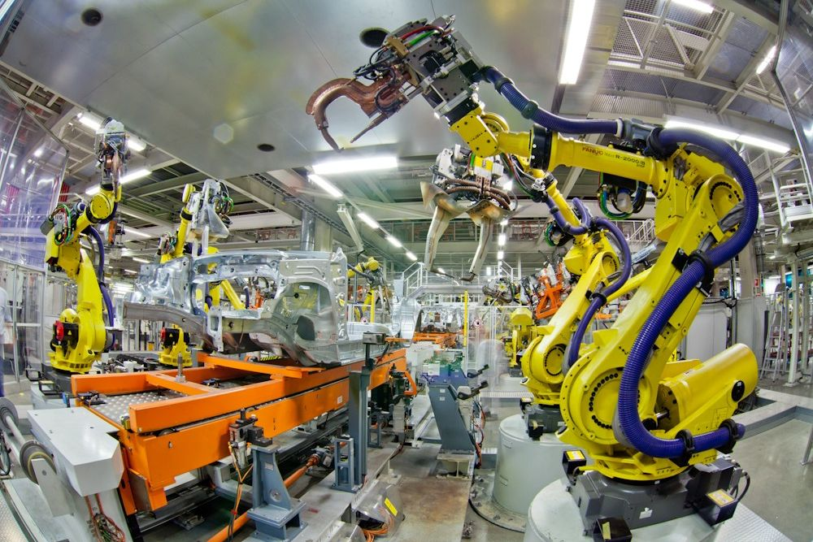
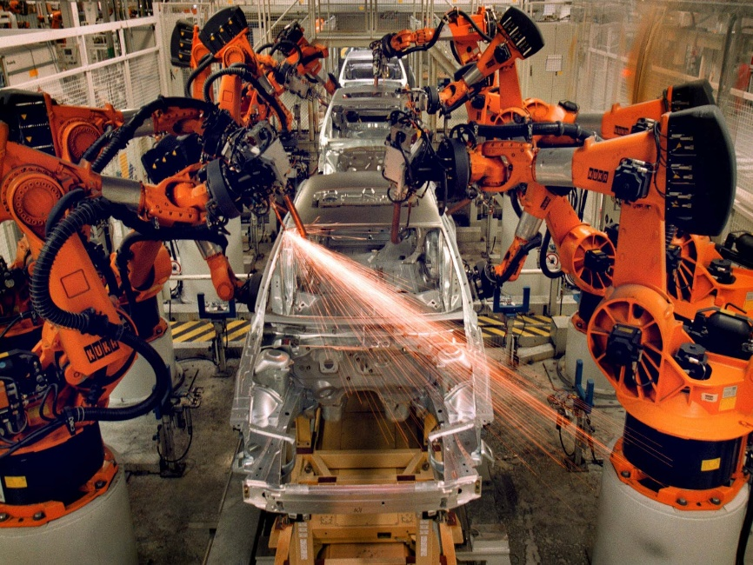
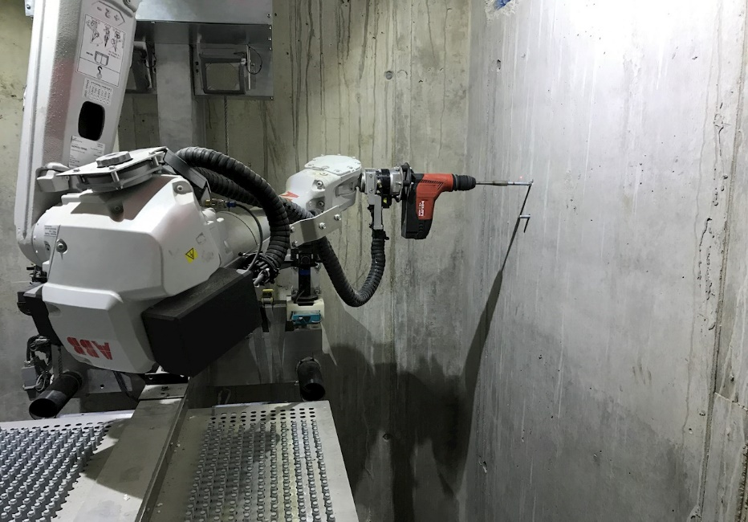
Examples of mechanical interactions

Slide 11
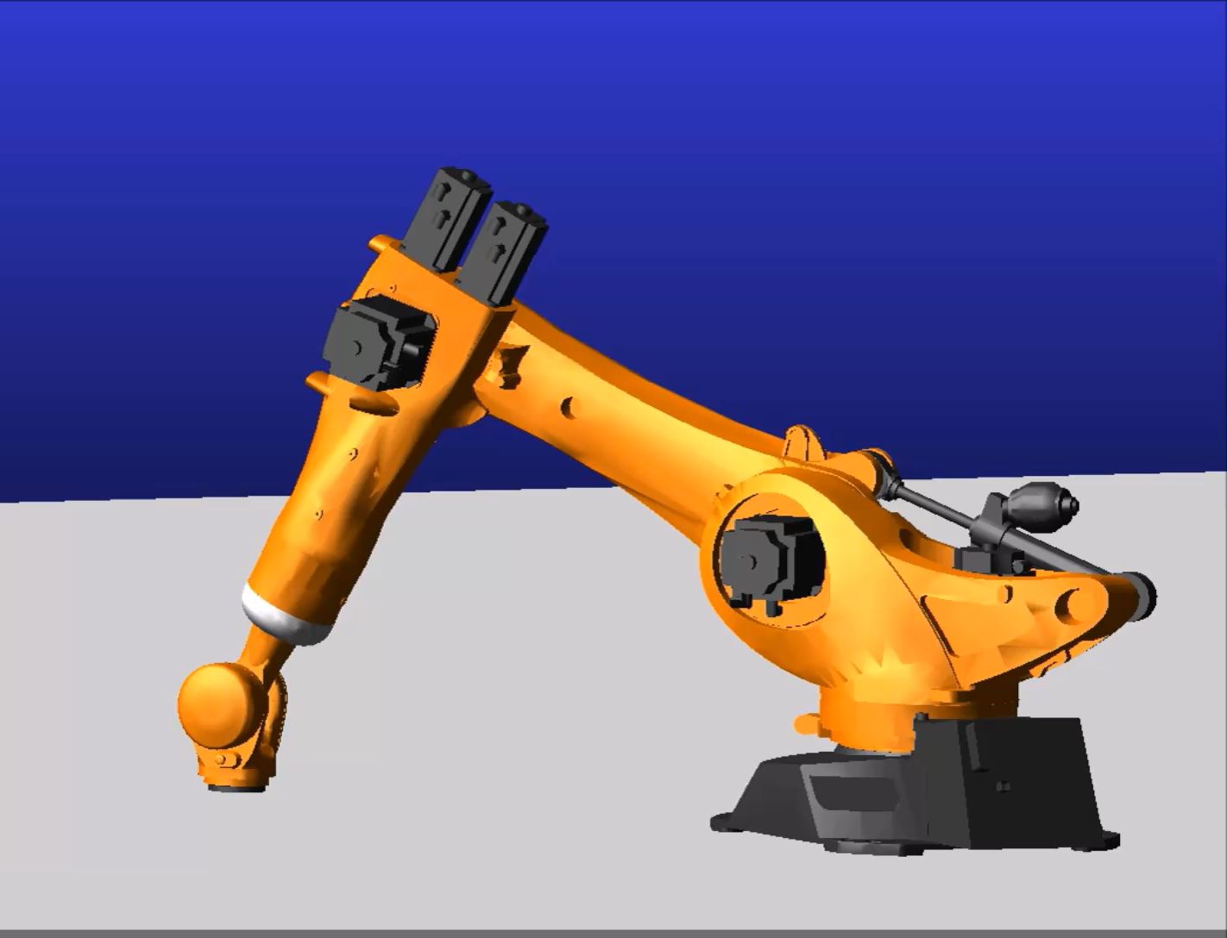
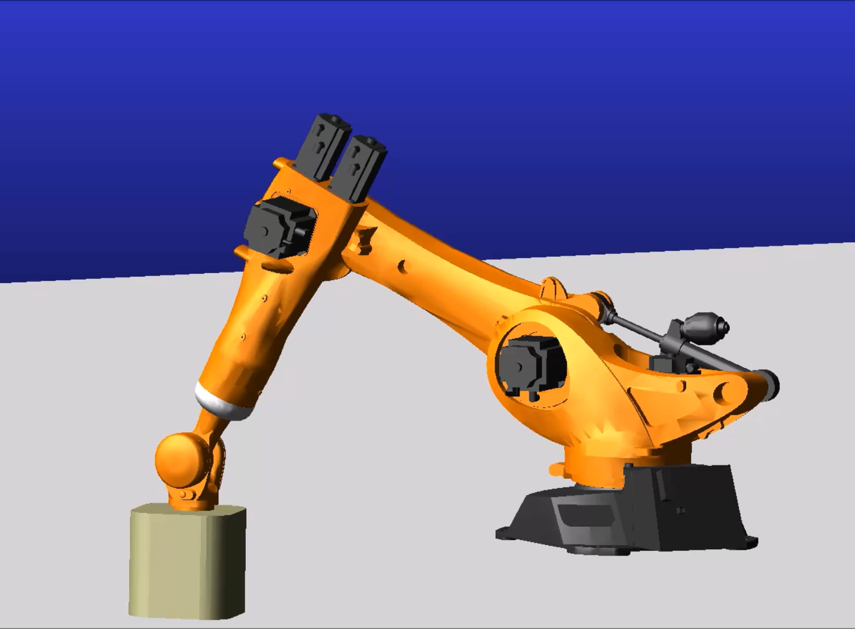
The Effect of Interaction on Performance and Stability
Robot in isolation Robot interacts with environment
Robot body: Aluminium (2740 kg/m^3)
Robot total mass: 636 Kg
Kp, KI: 4.9, 1.2
Robot body: Aluminium (2740 kg/m^3)
Robot total mass: 636 Kg
Kp, KI: 4.9, 1.2
Object weight: 26.5 Kg

Slide 12
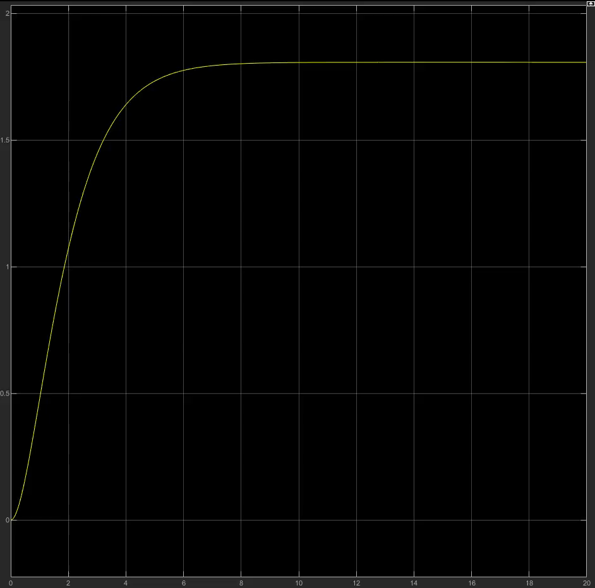
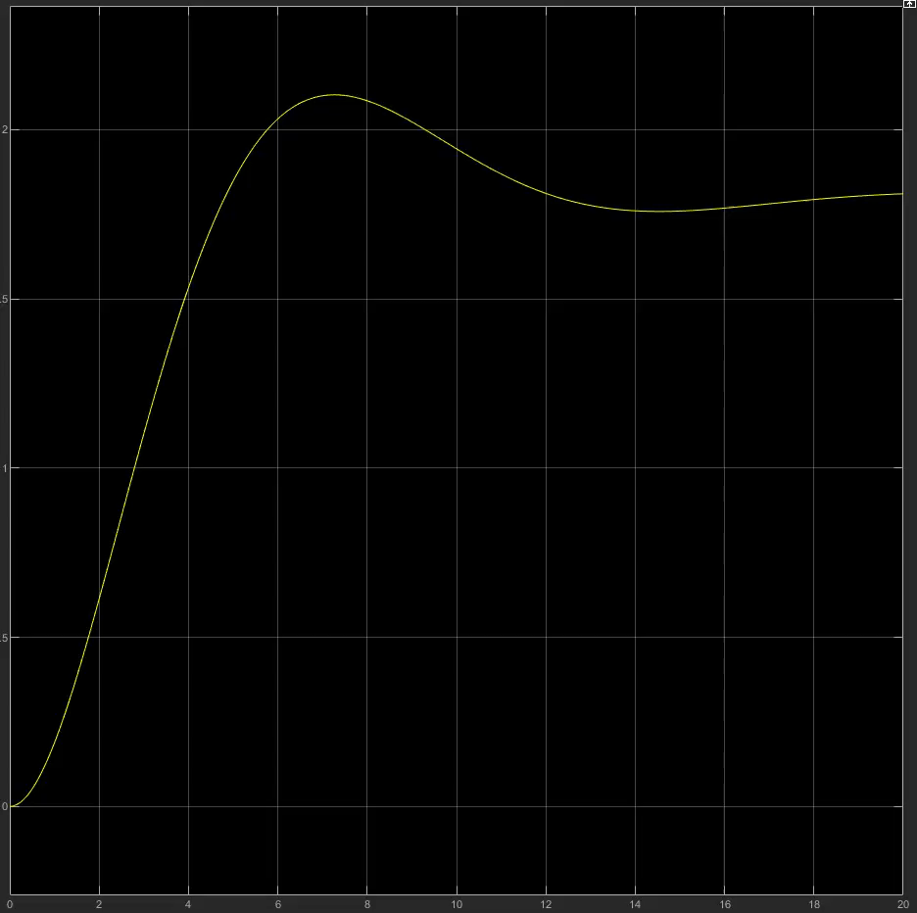
The Effect of Interaction on Performance and Stability
Displacement [m]
Isolation
Interaction
Time [sec] Time [sec]

Slide 13
The Effect of Interaction on Performance and Stability
When interaction occurs
The dynamic properties of the environment are important.
It can cause error on force or motion control.
Stability may also be compromised.
A system that is stable in isolation can become unstable
(coupled or contact instabilities)

Slide 14
Example1: Robot motion controller
M: represents the robot’s inertial properties
Fa: actuator forces
Fe: environmental forces
b: a damper represents frictional losses
Simplified model of a robot with inertial, frictional, actuator, and environmental forces.

Slide 15
Example1: Robot motion controller
Newton's laws of motion
$M\ddot{X}+b\dot{X}=F_{a}+F_{e}$ (1)
The Laplace-transformed equation of motion
$(MS^{2}+bS$)X = $F_{a}+F_{e}$ (2)

Slide 16

Example1: Robot motion controller
A proportional-integral motion controller is applied
$F_{a}=K_{p}\left(Xd−X\right)+\frac{K_{I}}{S}(Xd−X)$ (3)
R: Laplace transform of the reference position
Kp: Proportional gain
KI: Integral gain

Slide 17

Robot in isolation
In isolation Fe = 0
The closed-loop transfer function is
$\frac{X}{Xd}=G\left(s\right)=\frac{K_{p}S+K_{I}}{MS^{3}+bS^{2}+K_{p}S+K_{I}}$ (4)
From the Routh-Hurwitz stability criterion
(5)
A condition for isolated stability
Simplified model of a robot with inertial, frictional, actuator, and environmental forces in isolation
$$K_{I}<\frac{bK_{P}}{M}$$

Slide 18
Robot interacts with environment
However, this condition is not sufficient to ensure that the robot will remain stable when it interacts with objects in its environment. Even the simple act of grasping an object may be destabilizing. If the system is not isolated, and instead is coupled to a mass Me, this is equivalent to increasing the mass from M to (M + Me). Hence a condition for stability of the coupled system is
(6)
$$K_{I}<\frac{bK_{P}}{(M+M_{e})}$$

Slide 19
Robot interacts with environment
However, for any fixed controller gains, coupling the robot to a sufficiently large me will violate the condition for stability. Interaction with a large enough mass can always destabilize a system that includes integral-action motion control, even if that system is stable in isolation
(6)
$$K_{I}<\frac{bK_{P}}{(M+M_{e})}$$

Slide 20
Robot interacts with environment
This difficulty may be obscured by the facts that, at present, most robots have inertia far exceeding that of the payloads they may carry, the total mass M + Me is not much greater than the mass M of the robot alone, and the bounds of Equation (5) and Equation (6) are similar.
(5)
(6)
$$K_{I}<\frac{bK_{P}}{(M)}$$
$$K_{I}<\frac{bK_{P}}{(M+M_{e})}$$

Slide 21
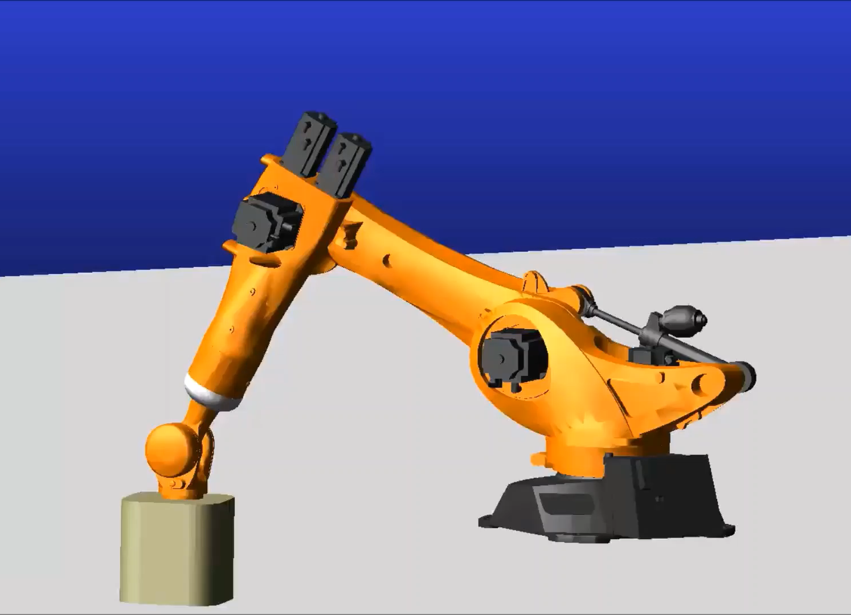
Example
Robot body: Cast Iron (7080 kg/m^3)
Robot total mass: 1643 Kg
KI: 1.2
Object weight: 26.5 Kg
Robot body: Aluminium (2740 kg/m^3)
Robot total mass: 636 Kg
KI: 1.2
Object weight: 26.5 Kg

Slide 22
Example
Displacement [m]
Cast Iron
Aluminium
Time [sec] Time [sec]

