Slide 1
BEng (Hons) Control and Automation
Automation and Robotics
CRN: 50295
Dr Saber Mahboubi
Email: s.mahboubiheydarabad@salford.ac.uk

Slide 2
Lecture Content: Robot Manipulator Kinamatics

Slide 3
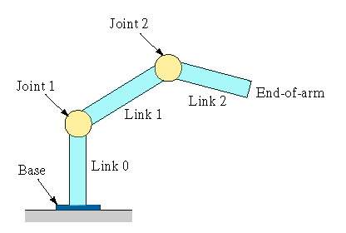
Robot Anatomy
Recall the construction of our manipulator arms
The manipulator consists of joints and links
Joints provide relative motion
Links are rigid members between joints
Various joint types: linear and rotary
Each joint provides a “degree-of-freedom”
Most robots possess five or six degrees-of-freedom
The manipulator normally consists of two sections:
Body-and-arm – for positioning of objects in the robot's work volume
Wrist assembly – for orientation of objects

Slide 4

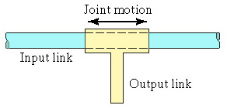
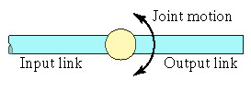
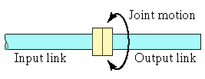
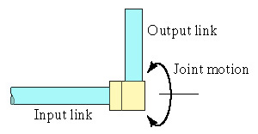
Robot Joints
The more common joints types used are:
For translational motion
Linear joint
Orthogonal joint
For rotary motion
Rotational joint
Twisting joint
Revolving joint

Slide 5
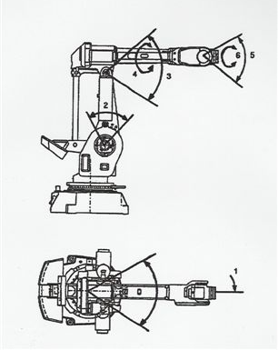
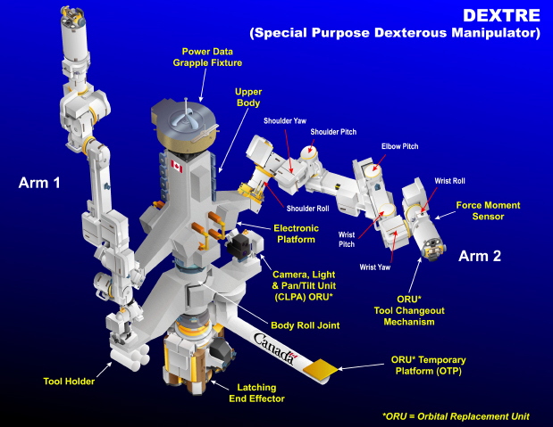
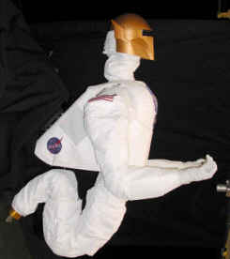
Degrees Of freedom
The ability of a joint to operate in one or more of the 3 translational axes or rotational orientation
The combination of these can give the overall manipulator multiple degrees of freedom
Complete flexibility require 6 DOF
More DOF leads to more complex control
More than 6 DOF is possible if the manipulator is build for redundency

Slide 6
Body and Arm Configurations
There are also a number of body and arm configurations
These are normally used as they reduce the complexity of the joints and the control in industrial environments where the workspace can be defined
The five common body-and-arm configurations for industrial robots are:
Polar coordinate body-and-arm assembly
Cylindrical body-and-arm assembly
Cartesian coordinate body-and-arm assembly
Jointed-arm body-and-arm assembly
Selective Compliance Assembly Robot Arm (SCARA)

Slide 7
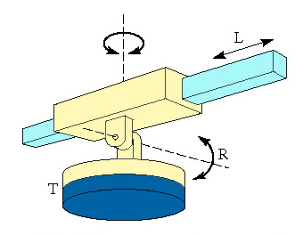
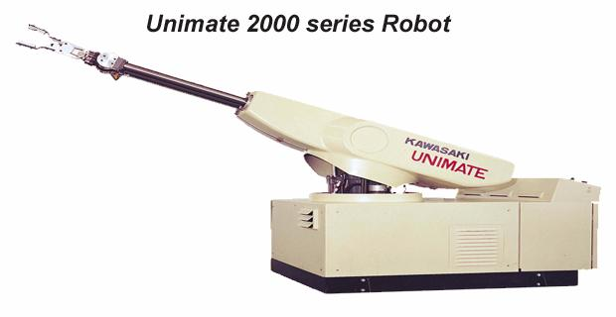
Polar coordinate body-and-arm assembly
Consists of a sliding arm actuated relative to the body, which can rotate about both a vertical axis and horizontal axis

Slide 8
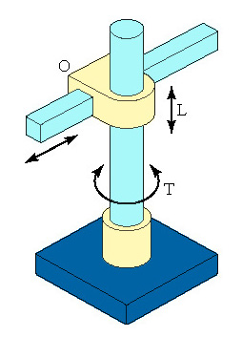
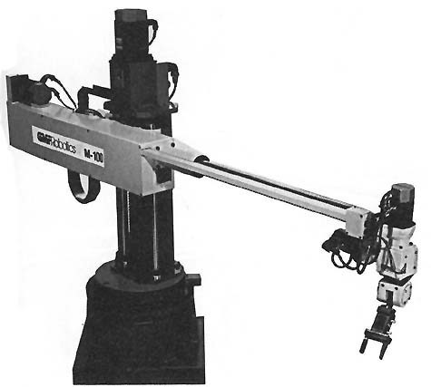
Cylindrical body-and-arm assembly
Consists of a vertical column, relative to which an arm assembly is moved up or downand the arm can be moved in or out relative to the column

Slide 9
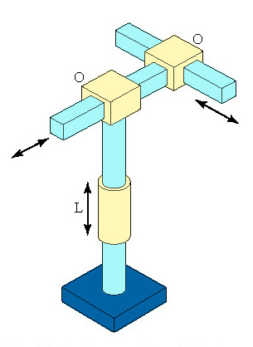
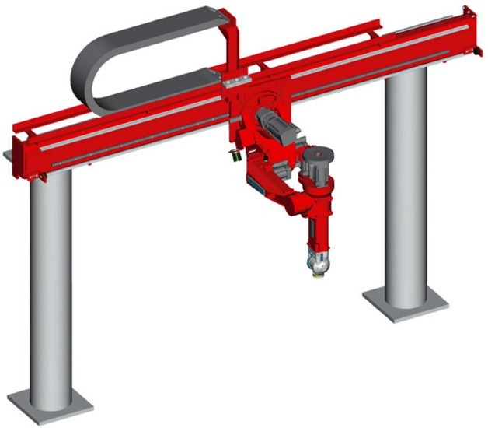
Cartesian coordinate body-and-arm assembly
Consists of three sliding joints, two of which are orthogonal, also known as the rectilinear robot

Slide 10
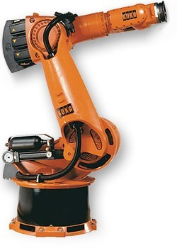
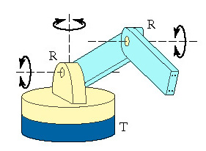
Jointed-arm body-and-arm assembly
Based on sets of revolute joints in a similar way to a human arm so mostly involving angular movement

Slide 11
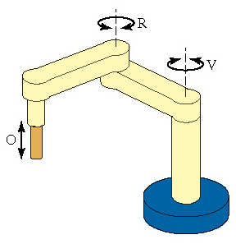
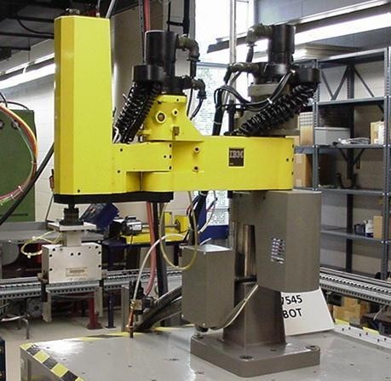
Selective Compliance Assembly Robot Arm (SCARA)
Similar to jointed-arm robot except that vertical axes are used for shoulder and elbow joints to be compliant in horizontal direction for vertical insertion tasks

Slide 12
Kinamatics
KINEMATICS - the analytical study of the geometry of motion of a robot arm
In order to control and programme a robot we must have knowledge of both it’s spatial arrangement and a means of reference to the environment
This is done:
with respect to a fixed reference co-ordinate system
without regard to the forces or moments that cause the motion
In order to describe the position and orientation of a body in space, we will always attach a coordinate system, or frame, rigidly to the object. We then proceed to describe the position and orientation of this frame with respect to some reference coordinate system

Slide 13
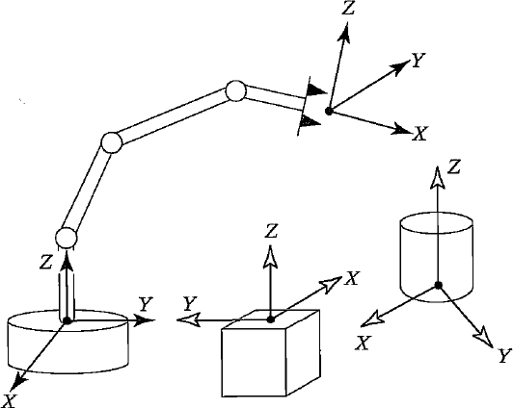
Kinamatics
Kinamatics is concerned with being able to determine the position and orientation of the end effector (tool) of a robot with respect to its co-ordinate system
This requires the need of representing positions and orientations
i.e. the location of the parts, tools, and of the mechanism itself
To define and manipulate mathematical quantities which represent position there are co-ordinate systems and conventions for representation

Slide 14
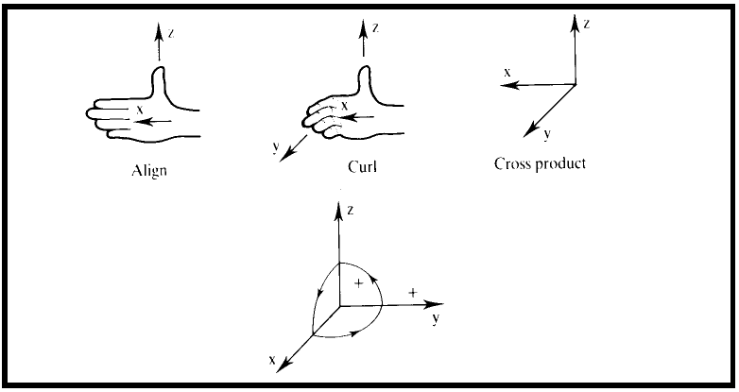
Axes
Axes are defined according to the right hand rule of orientation
Use z as the thumb, x as the direction the hand is pointing and y will be in the direction you curl your fingers.

Slide 15

Frames
All parts of the robot and items in work cell will have a reference frame
z
y
Right-handed
Co-ordinate frame
Camera Frame
x
x
Tool
Frame
x
Link Frame
Goal Frame
x
x
x
Base
Frame
Getting the correct position and orientation requires translation between the frames

Slide 16
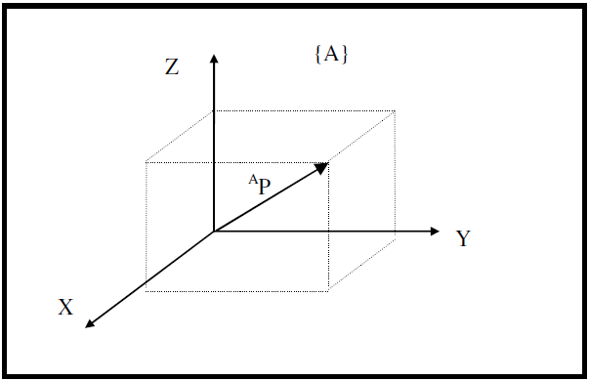
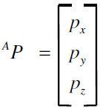
Co-ordinates
Co-ordinates are cartesian but normally represented as a vector
The 3 elemets of the vector are simply the 3 cartesian co-ordinates in an x-y-z system.

Slide 17
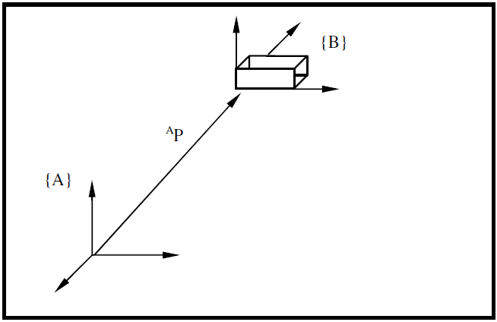
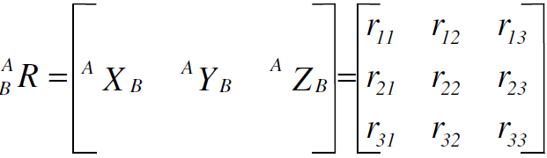
Orientation
In a robot system with rotational degrees of freedom you need represent a point in the space and describe the orientation of a body in space
Here the co-ordinate frame has got a positional relation to the original frame using A_{P} .
If the box is rotated in any way we need to describe that rotation with respect to its position.
This is done with a rotational matrix.

Slide 18
Orientation
In effect the rotational possibilities are represented by 3 vectors which are represented in a 3x3 matrix
So we have:
A vector to represent position
A 3x3 matrix to represent orientation
In this case 1=x, 2=y, 3=z

Slide 19
Rotational Transforms
There are three possible rotational transforms that can be represented by this matrix
Rotation about Z-axis.
Rotation about X-axis.
Rotation about Y-axis.
Each may be applied individually or together using the matrix

Slide 20
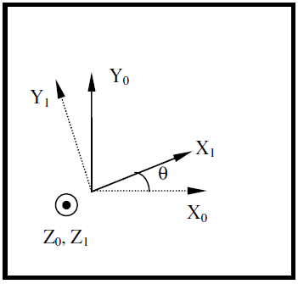
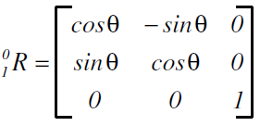
Z-axis rotation
Rotating around the z-axis by an angle θ
An axis that’s pointing out of the paper is denoted by ʘ, and an axis that’s pointing into the paper is denoted by O
X

Slide 21
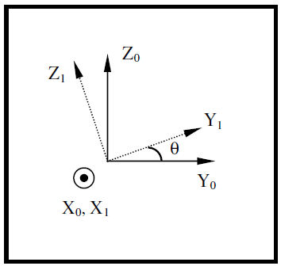
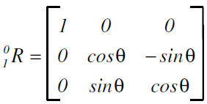
X-axis rotation
Rotating around the X-axis by an angle θ
An axis that’s pointing out of the paper is denoted by ʘ, and an axis that’s pointing into the paper is denoted by O
X

Slide 22
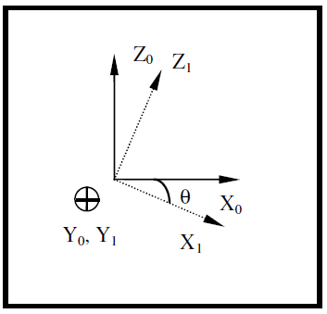
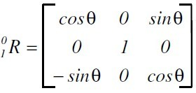
Y-axis rotation
Rotating around the Y-axis by an angle θ
An axis that’s pointing out of the paper is denoted by ʘ, and an axis that’s pointing into the paper is denoted by O
X

Slide 23
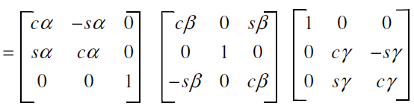
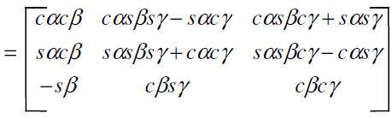
Multi axis transformation
Transformations through angles in all axes (γ: x-axis), (β : y -axis), (α: z-axis) can be done by applting each transformation individualy or by pre-calculating the resulting matrix.
c and s are used as a shortform for the cosine and sine functions

Slide 24
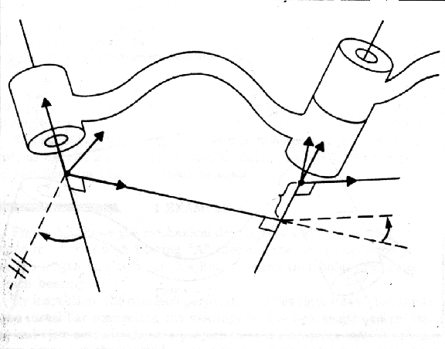
The Denavit-Hartenberg Notation
The Danavit-Hartenberg Notation is a set of parameters that can be assigned to each joint pair that allows the use of a common transformation matrix .
Z_{(i - 1)}
Y_{(i -1)}
Y _{i}
Z _{i}
X _{i}
a _{i}
a_{(i - 1 )}
d _{i}
X_{(i -1)}
θ _{i}
θ_{( i - 1)}
Each joint is assigned a coordinate frame
Using the Denavit-Hartenberg notation, you need 4 parameters to describe how a frame (i) relates to a previous frame ( i -1 ).
θ : A rotation about the z-axis.
d : The distance on the z-axis.
a : The length of each common normal (Joint offset).
α : The angle between two successive z-axes (Joint twist)

Slide 25
The ‘a’ Parameter
a_{(i-1)} is the length of the perpendicular between the joint axes.
If the link is prismatic, then a_{(i-1)} is a variable, not a parameter
Z_{(i - 1)}
Y_{(i -1)}
Y _{i}
Z _{i}
X _{i}
a _{i}
a_{(i - 1 )}
d _{i}
X_{(i -1)}
θ _{i}
θ_{( i - 1)}
The joint axes are the axes around which revolution takes place which are the Z_{(i-1)} and Z_{(i)} axes.
These two axes can be viewed as lines in space. The common perpendicular is the shortest line between the two axis-lines and is perpendicular to both axis-lines.

Slide 26
The ‘d’ Parameter
The displacement along the Z_{i} axis needed to align the a_{(i-1)} common perpendicular to the a_{i} common perpendicular.
Z_{(i - 1)}
Y_{(i -1)}
Y _{i}
Z _{i}
X _{i}
a _{i}
a_{(i - 1 )}
d _{i}
X_{(i -1)}
θ _{i}
θ_{( i - 1)}
Can also be the displacement along the Z_{i} to align the X_{(i-1)} and X_{i} axes.

Slide 27
The ‘α’ Parameter
Amount of rotation around the common perpendicular so that the joint axes are parallel.
Z_{(i - 1)}
Y_{(i -1)}
Y _{i}
Z _{i}
X _{i}
a _{i}
a_{(i - 1 )}
d _{i}
X_{(i -1)}
θ _{i}
θ_{( i - 1)}
How much you have to rotate around the X_{(i-1)} axis so that the Z_{(i-1)} is pointing in the same direction as the Z_{i} axis.

Slide 28
The ‘ϴ’ Parameter
Amount of rotation around the Z_{i} axis needed to align the X_{(i-1)} axis with the X_{i} axis.
Z_{(i - 1)}
Y_{(i -1)}
Y _{i}
Z _{i}
X _{i}
a _{i}
a_{(i - 1 )}
d _{i}
X_{(i -1)}
θ _{i}
θ_{( i - 1)}

Slide 29
The Denavit-Hartenberg Matrix
Just like our earlier matrix, the Denavit-Hartenberg Matrix is a transformation matrix from one coordinate frame to the next.
Using a series of D-H Matrix multiplications and the D-H Parameter table, the final result is a transformation matrix from some final frame to your initial frame.
Z_{(i - 1)}
Y_{(i -1)}
Y _{i}
Z _{i}
a_{(i - 1 )}
X _{i}
a _{i}
X_{(i -1)}
d _{i}
Θ_{( i - 1)}
Θ _{i}

Slide 30
The Denavit-Hartenberg Process
(I) Rotate about the z_{n}-axis an able of θ_{n+1}. (Coplanar)
(II) Translate along z_{n}-axis a distance of d_{n+1} to make x_{n} and x_{n+1}
colinear.
(III) Translate along the x_{n}-axis a distance of a_{n+1} to bring the origins
of x_{n+1} together.
(IV) Rotate z_{n}-axis about x_{n+1} axis an angle of α_{n+1} to align z_{n}-axis
with z_{n+1}-axis.
Note theY-axis is not used in D-H representation, so if the y-axis forms part of a robots physical movement capability the D-H method cannot be used.

Slide 31
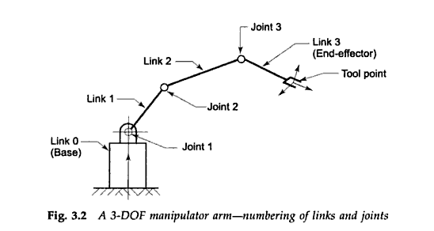
Position of End Effector
Hence it is possible to determine the position and orientation of the end effector in space with a manipulator having a full 6 degrees of freedom.
Each link requires a translational vector to describe the position of its end joint
Each joint requires a rotational matrix to describe the orientation of the next link
Chaining these together allows the position of the end effector to be found

Slide 32
Forward Kinematics
Forward kinematics is the process by which you determine the position of the end effector given the link dimensions and joint angles.
To avoid extensive matrix calculations we will just use simpler trigonometric solutions for a planer robot (SCARA type)
c
b
Θ₃
a
Θ₂
Θ₁
(0,0)
Knowing the length of each link and its orientation allows the calculation of the position of the end joint
Chaining these together for each joint allows the position of the end effector to be found

Slide 33
Forward Kinematics
Dividing the problem up into successive right angled triangles allow us to do this.
c
y₃
b
Θ₅
x₃
y₂
Θ₃
x₂
a
Θ₂
Θ₄
y₁
Θ₁
x₁
(0,0)
x₁=a cos θ_{1,} y₁=a sin θ₁
θ₄= θ₂ – 90 – (180- θ₁- 90)
x₂=b cos θ_{4,} y₂=b sin θ₄
θ₅= θ₃ – 90 – (180- θ₄- 90)
x₃=c cos θ_{5,} y₃=b sin θ₅
Final co-ordinate: (x₁ + x₂ + x₃, y₁ + y₂ + y₃)
This can be continued for any number of links

Slide 34
Inverse Kinematics
Inverse kinematics is more useful ( and harder ) as the process by which you determine the joint angles based on the required co-ordinates of the end effector.
Again to avoid extensive matrix calculations we will just use simpler trigonometric solutions for a planer robot (SCARA type)
b
a
Θ₂
(x,y)
(0,0)
Knowing the length of each link allows us to work back from the end effector to construct a geometric solution

Slide 35
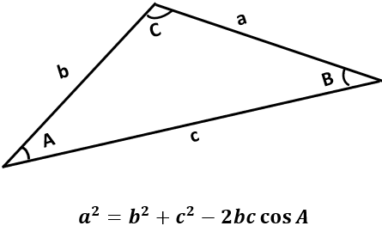

Inverse Kinematics
For this problem we need to construct linking triangles
L₂
L₁
Θ₂
B
(X,Y)
Θ₁
K₂
From this:
B² = X²+Y²
K₁=tan⁻¹(Y/X)
(A=K2, b=L1, a = L2, c = B)
$${L_{2}}^{2}={L_{1}}^{2}+B^{2}−2L_{1}B cos⁡K_{2}$$
$2L_{1}B cos⁡K_{2}$ = ${L_{1}}^{2}+B^{2}−{L_{2}}^{2}$
$cos⁡K_{2}$ = (L₁²-L₂²+B²)/2L₁B
K₂=cos⁻¹((L₁²-L₂²+B²)/2L₁B)
K₁
(0,0)
Θ₁= K₁+ K₂

Slide 36
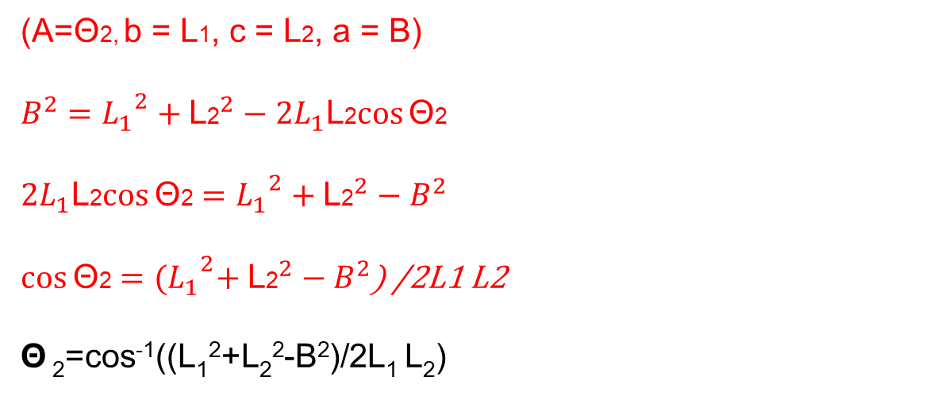
Inverse Kinematics
For this problem we need to construct linking triangles
L₂
L₁
Θ₂
B
(X,Y)
Θ₁
K₂
K₁
(0,0)
(A=Θ2, b = L1, c = L2, a = B)
$$B^{2}={L_{1}}^{2}+{\text{L}\text{2}}^{2}−2L_{1}\text{L}\text{2}cos⁡\text{Θ}\text{2}$$
$2L_{1}\text{L}\text{2}cos⁡\text{Θ}\text{2}$ $=$ ${L_{1}}^{2}+{\text{L}\text{2}}^{2}−B^{2}$
$cos⁡\text{Θ}\text{2}$ $=$ ${{(L}_{1}}^{2}+{\text{L}\text{2}}^{2}−B^{2}$) /2L1 L2
Θ ₂=cos⁻¹((L₁²+L₂²-B²)/2L₁ L₂)
This may need to be done for intermediate links for longer link chains

Slide 37
Other Considerations
There are a few other things to account for when solving kinematic problems
Most joints will have restrictions which need to be accounted for in the controller
Most inverse kinematic solutions may have more than one solution
Calculation complexity rises as the number of degrees of freedom increase.
Use restricted DOF manipulator where possible to reduce control complexity

Slide 38
Trajectory Planning
For a robot to operate efficiently it must be able to move from point to point in space.
A joint cannot instantly start moving at a constant velocity, there will be periods of acceleration and decceleration
So to provide an accurate position of any joint at any time the motion must be planned taking this into account
This is known as the trajectory.
A trajectory is a time history of position, velocity and acceleration for each joint
Trajectories are computed at run time and updated at a certain rate - the Path Update Rate

Slide 39
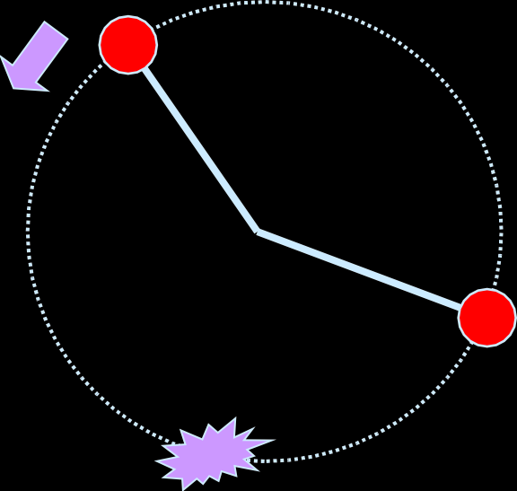
Joint Space Trajectory Planning
Take this simple example
Consider a robot with only one link moving from A to B
(θ₀ , t₀)
A
B
(θ , t )
f f
Kinematics gives one configuration for B
There is a choice of two trajectories to get there
Sometimes a via point is required to force a trajectory or an algorithm for shortest route

Slide 40
Joint Space Trajectory Planning
angle
θ_{f}
Lots of choices for continuous functions
θ₀
The trajectory from A to B as a function of time could be described by a number of functions
time
0
t
f
We can use the start and end constraints to construct a function for this

Slide 41
Cubic Polynomials
(θ₀ , t₀)
There are 4 constraints we can consider
A
B
We know the starting angle at A, θ₀
(θ , t )
.
f f
We assume the starting velocity at A will be 0 , θ₀ = 0
We know the finishing angle at B, θ_{f}
.
We assume the finishing velocity at B will be 0 , θ_{f} = 0
This requires a cubic polynomial with 4 coefficients to satisfy the 4 constraints
θ(t ) = a
a t + a t² + a t³
1 2 3
0

Slide 42
Cubic Polynomials
We can differentiate the polynomial to get:
.
θ(t ) =
a + 2a t +3a t²
1 2 3
With our starting conditions we get a₀=θ₀ and a₁= 0
So:
θ(t_{f} ) = θ
= θ_{f}
+ a t²+ a t³
2 3
0
and:
.
θ(t_{f} ) =
= 0
2a t+3a t²
2 3

Slide 43
Cubic Polynomials
From these simultaneous equations we get
a₀ = θ₀
a₁ = 0
3
2
a = (θ − θ₀ )
a = −
(θ − θ₀ )
2
t
2
f
f
3
t
3
f
f
Now using the original formula and its derivative it would be possible to plot the angular and velocity profile as a function of time.
In situations with more constraints higher order polynomials can be used to provide a trajectory solution.

Slide 44
Example
Lets try this with some actual numbers.
Angles will be in radians
(θ₀ , t₀)
A
B
(θ , t )
f f
Set the starting angle at A, θ_{0,} to -0.5rad
.
The starting velocity at A will be 0
Set the finishing angle at B, θ_{f,} to 1.7rad
.
The finishing velocity at B must also be 0
Lets make the movement take place over 2s of time. (t_{f} = 2)

Slide 45
Example
First calculate the coefficients
a₀ = θ₀
a₁ = 0
3
2
a = (θ − θ₀ )
a = −
(θ − θ₀ )
2
t
2
f
f
3
t
3
f
f
So:
a₀ = −0.5
a₁ = 0
3
2
a = (2.2)=1.65
a = −
(2.2)=0.55
2
4
3
8

Slide 46
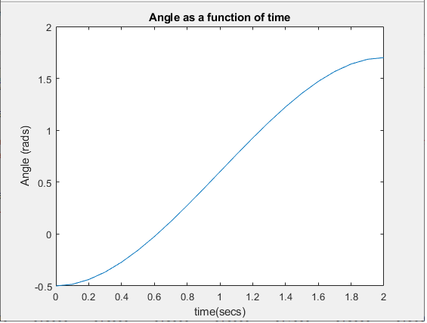
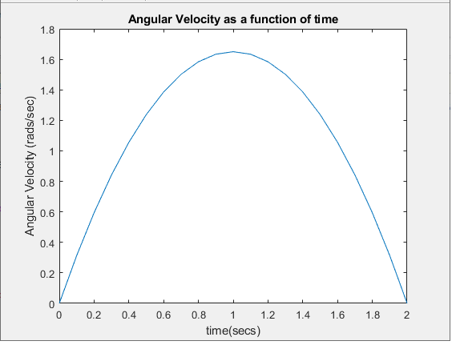
Example
Now we can put these into our two formula for angle at a given time and angular velocity at a given time:
θ(t ) = −0.5
+ 1.65t² -0.55 t³
and:
.
θ(t ) =
3.3 t −1.65 t²
By putting in values of t between 0 and 2 we can now plot the angle and velocity as a function of time.

