Slide 1
BEng (Hons) Control and Automation
Automation and Robotics
CRN: 50295
Dr Saber Mahboubi
Email: s.mahboubiheydarabad@salford.ac.uk

Slide 2
Lecture Content: Robot Manipulator Dynamics

Slide 3
Dynamics
Robot manipulator dynamics deals with the mathematical formulations of the equations of robot arm motion
They are concerned with:
Forces
Moments
Accelerations
Velocities
The effect of gravity
Velocities, Accelerations
Forces, moments
Gravity
They are useful as:
An insight into the structure of the robot system
A basis for model based control systems
A basis for computer simulations

Slide 4

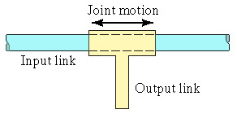
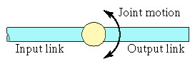
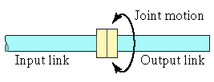
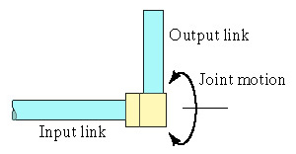
Robot Joints
Consider our joints again:
Use Force, linear acceleration, velocity for:
Linear joint
Orthogonal joint
Use Torque, angular acceleration,
angular velocity for:
Rotational joint
Twisting joint
Revolving joint

Slide 5
Equations of Linear Motion
Recall the basic Newtonian equations force and motion
F=ma
v_{f}= v_{i}+ at
d= v_{i}t + ½ at²
v_{f}² = v_{i}² + 2ad
t is the time
d is the displacement
v is velocity
a is the acceleration
F is the force
m is the mass
These formula can be applied at a basic level to any joint actuator combination that involves just linear motion

Slide 6
Consideration of Forces
To use the equations of motion consideration needs to be given to forces acting on the joint
←F_{D}
Actuator Force (F)
F→
←F_{B}
Friction Force (F_{F})
←F_{F}
Damping Force (F_{D})
Braking Force (F_{B})
Not forgetting gravity if our joint is acting at an angle
←F_{D}
F→
←F_{B}
F_{G}→
←F_{F}
F_{G}=mg cosθ
θ
m is the mass of the bar, g is acceleration due to gravity
If we get the forces right a reasonable attempt can be at solving some problems

Slide 7
Typical Dynamics Problem
You need your linear joint to move forward a distance d to connect the end effector with a part, it must not exceed the safe velocity v in transit.
Assume link is horizontal and we know the mass and forces involved
←F_{D}
Actuator Force available (F)
F→
m
←F_{B}
Friction Force (F_{F})
←F_{F}
Damping Force (F_{D})
Braking Force (F_{B})
Divide the problem into 3 phases
Velocity(m/s)
Acceleration phase
(full actuator force)
v
Cruising phase
(actuator force counters
resistances)
Braking phase
(actuator off, brake on)
Time (s)

Slide 8
Typical Dynamics Problem
Acceleration Phase.
Assume brake is off, so force available for acceleration is:
←F_{D}
F_{a} = F - F_{F} -F_{D}
F→
m
←F_{B}
←F_{F}
So acceleration a is: a=F_{a}/m
Obtain t_{a} from: v_{f}= v_{i}+ at
Obtain d_{a} from: d= v_{i}t + ½ at²
Braking Phase.
Assume brake is on, actuator is off so total braking force is:
F_{b} = F_{B} + F_{F} +F_{D}
So deceleration -a is: a=F_{b}/m
Obtain t_{b} from: v_{f}= v_{i}+ at
Obtain d_{b} from: d= v_{i}t + ½ at²

Slide 9
Typical Dynamics Problem
Cruising Phase.
Assume actuator force set to balance resistive forces
F_{c} = 0
We know the travel distance required is d and we know the distance travelled in the other two phases. So the distance required in the cruising phase is:
d_{c} =d -d_{a} -d_{b}
So the time in the cruising phase must be t_{c}= d_{c} /v
So the joint needs to spend t_{a} with the actuator full on and no brake
t_{c} with the actuator countering resistive forces and
t_{b} with the brake full on and no actuator
At which point it should reach its destination d at a full stop

Slide 10
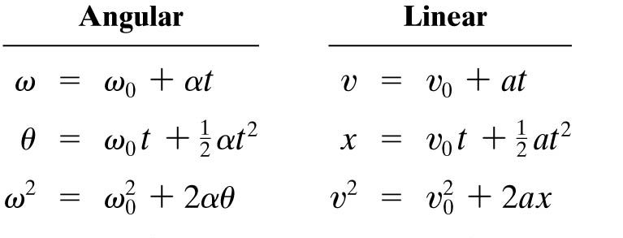
Equations of Angular Motion
Also recall the basic Newtonian equations angular force and motion which are direct equivalents to the linear equations of motion
t is the time
θ is the displaced angle
ω is angular velocity
α is the angular acceleration
The big difference with angular dynamics is the force based equation which uses torque (τ) and a quantity known as the moment of inertia (I)
τ=Iα

Slide 11
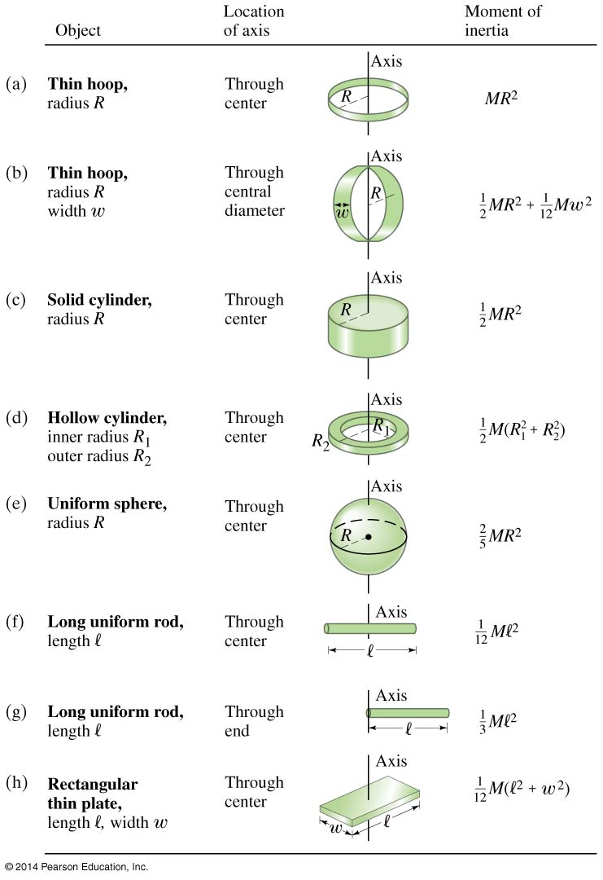
Moment of Inertia
Moment of inertia is a quantity which is based not just on the mass but the distribution of that mass in the object.
So unless the shape is well defined it is a less useful quantity for performing simple estimates

Slide 12
Consideration of Torques
We can consider the application of torques in much the same way we did with the linear case
Actuator Torque (τ)
τ
Friction Torque (τ _{F})
Damping Torque (τ _{D})
τ_{D}
τ_{F}
τ_{B}
Braking Torque (τ _{B})
Gravity cause more of a problem in situations like this as for a vertical joint the torque exerted due to gravity will change with angle
It will have no effect on a horizontal plane problem.

Slide 13
Similar Dynamics Problem
You need your link to move through an angle θ to connect the end effector with a part, it must not exceed the safe angular velocity ω in transit.
Assume link is horizontal and we know the mass of the link and torques involved but we also need to know the length of the link (l) and assume the mass is distributed evenly
Actuator Torque (τ)
τ
Friction Torque (τ _{F})
Damping Torque (τ _{D})
τ_{F}
τ_{D}
τ_{B}
Braking Torque (τ _{B})
Divide the problem into 3 phases
Acceleration phase
(full actuator torque)
Angular velocity(rads/s)
Cruising phase
(actuator torque counters
resistances)
ω
Braking phase
(actuator off, brake on)
Time (s)

Slide 14
Similar Dynamics Problem
Acceleration Phase.
Assume brake is off, so torque available for angular acceleration is:
τ _{a} = τ - τ _{F} - τ _{D}
So angular acceleration α is: α= τ_{a} /I for a rod with centered mass I=ml²/12
Obtain t_{a} from: ω _{f}= ω_{i}+ α t
Obtain θ_{a} from: θ = ω _{i}t + ½ α t²
Braking Phase.
Assume brake is on, actuator is off so total braking torque is:
τ _{b} = τ _{B} + τ _{F} + τ _{D}
So angular deceleration - α is: α = τ _{b}/I
Obtain t_{b} from: ω _{f}= ω _{i}+ α t
Obtain θ _{b} from: θ = ω _{i}t + ½ α t²

Slide 15
Similar Dynamics Problem
Cruising Phase.
Assume actuator force set to balance resistive forces
τ _{c} = 0
We know the travel angle required is θ and we know the angle travelled in the other two phases. So the angle required in the cruising phase is:
θ _{c} = θ - θ _{a} - θ _{b}
So the time in the cruising phase must be t_{c}= θ _{c} / ω
So the joint needs to spend t_{a} with the actuator full on and no brake
t_{c} with the actuator countering resistive torques and
t_{b} with the brake full on and no actuator
At which point it should reach its destination θ at a full stop

Slide 16
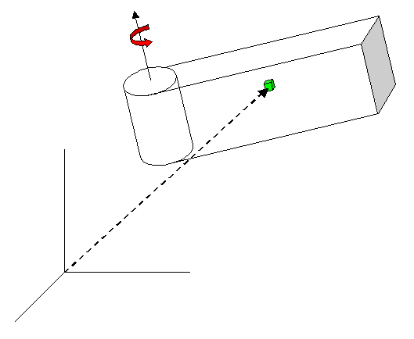
More Complex Inertia
From this we can get:
Each particle has mass, dm
Position of each particle can be obtained using our forward kinematics matrices from yesterday
ρ(x)
x

Slide 17
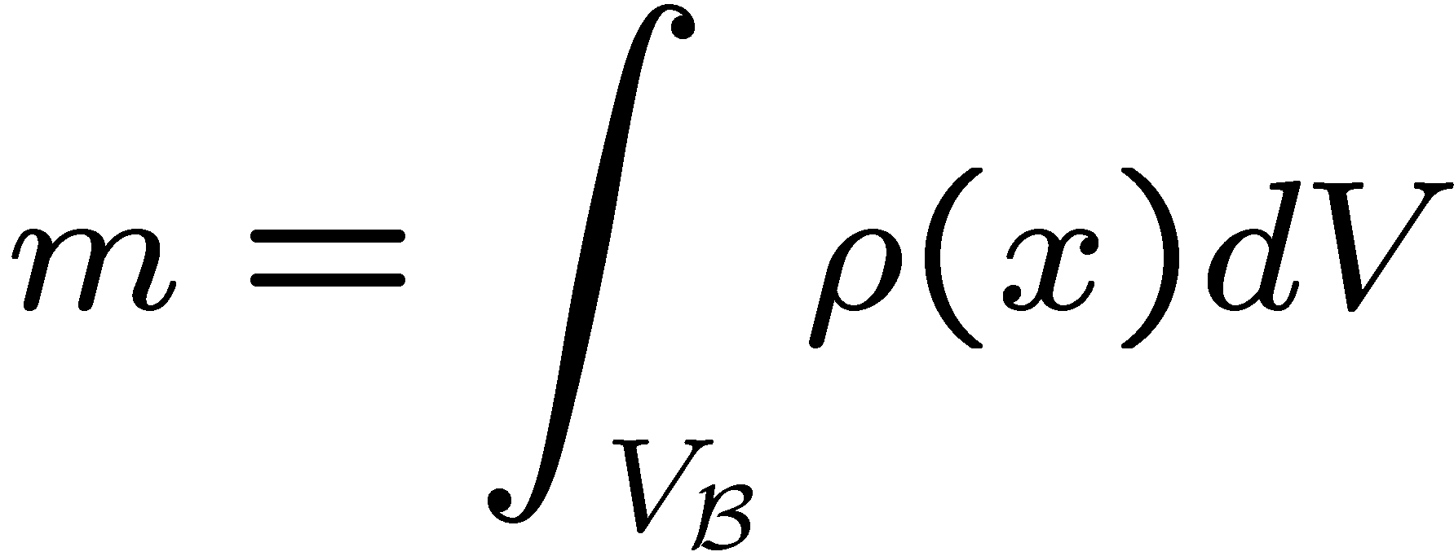
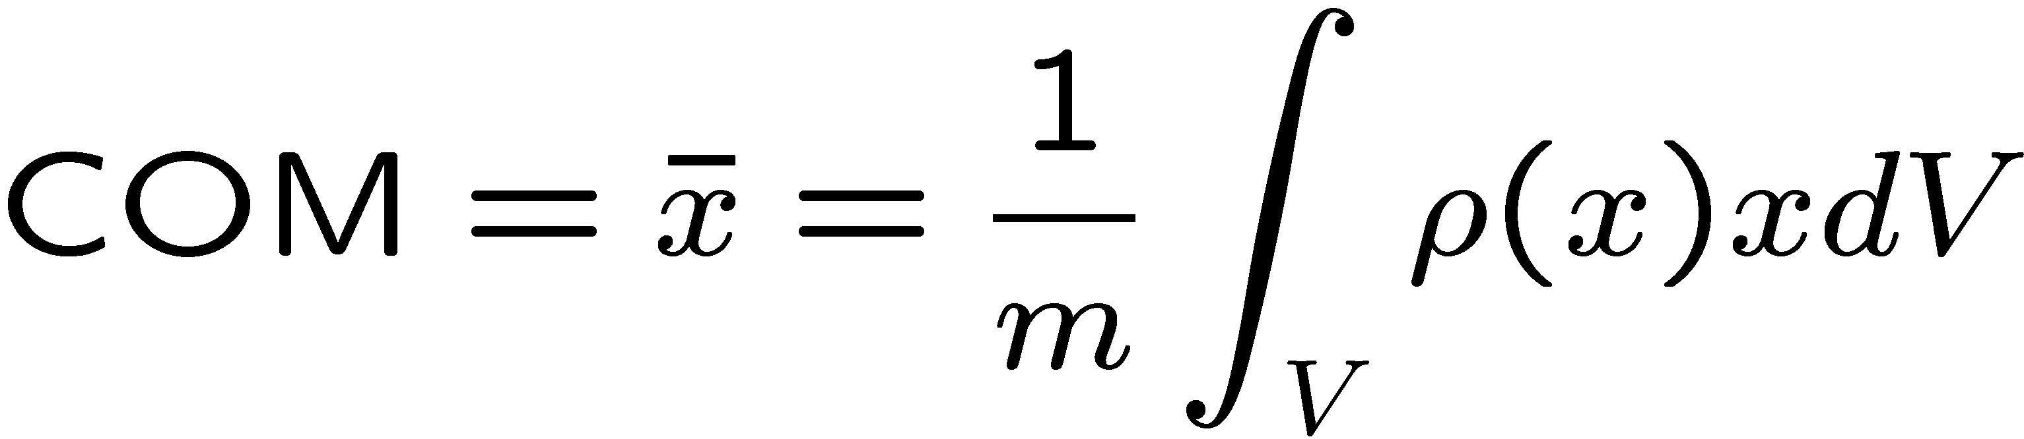
More Complex Inertia
To handle more complex moment of inertias we need to consider the link as a set of individual particle each with an inertia.
The density at a position x is ρ(x),
usually ρ is assumed constant
The mass of a link is given by:
The set of material points that comprise the body
The center of mass is:

Slide 18
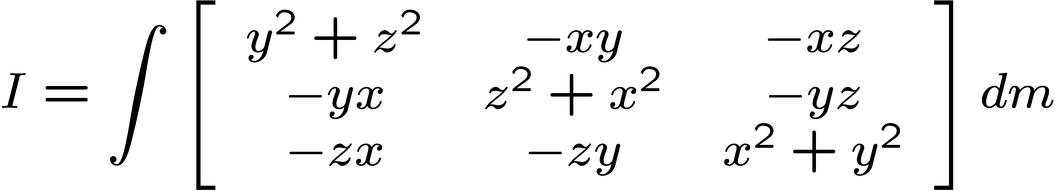
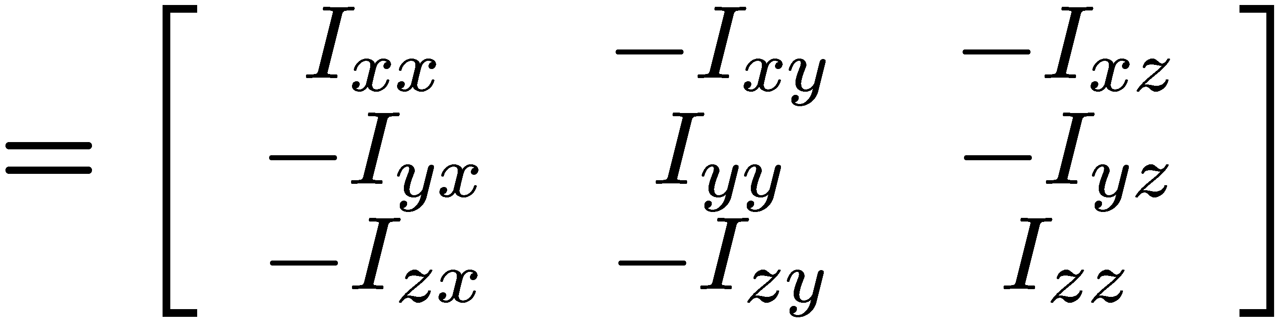
More Complex Inertia
Applying our kinematic matrices to the movement of the link we can get an inertial matrix for the link that can be use whatever direction we move in.

Slide 19
Countering Gravity
Working with torques can also be a good way of estimating actuator strengths to counter the force of gravity.
When a manipulator joint is working against gravity it will be subject to a number of torques generated by the various masses. In effect we need to know:
weight of each linkage
weight of each joint
weight of object to lift
length of each linkage
Joint 1
Joint 2
Joint 3
L1
L2
L3
End effector
W_{L1}
W_{J2}
W_{L2}
W_{J3}
W_{L3}
W_{EE}
Each joint must have sufficient actuator torque to counter the moments of the weights on the forward links and joints

Slide 20
Example
Consider the manipulator below
The robotic manipulator shown below needs to be designed to manipulate a 2kg end effector. Calculate the minimum required motor torques and masses of the structural elements that would be required to hold up the end effector under gravity.
0.6m
0.8m
0.1m
End effector
Joint 1
Joint 2
Joint 3
Motor torque is 1.8 Nm per kg of motor used
Required mass of structural members are 2.5 kg per metre for each kg of mass at end
Each joint must have sufficient actuator torque to counter the moments of the weights on the forward links and joints

Slide 21
Example
Need to consider the moments generating torque for each joint
L1
L2
L3
End effector
M_{J1}
gM_{L1}
gM_{L2}
gM_{L3}
gM_{J2}
gM_{J3}
gM_{E}
Torque on joint due to gravity = sum for each mass of (mass x distance from joint x g)
Working backwards from the end effector
Mass of structural member 3 from above criteria M_{L3}= 2.5 x M_{E} x L3
= 2.5 x 2 x 0.1 = 0.5 kg
(from holding end effector mass)
Torque on Joint 3 = (g x L3/2 x M_{L3}) + (g x L3 x M_{E})
= (9.81x 0.05 x 0.5) + (9.81x 0.1x 2) = 2.207 Nm
(from moments for end effector and structural member 3)

Slide 22
Example
So now we can work out the mass of the motorised joint 3
Mass of joint 3 (M_{J3}) from criteria for joint mass above = 2.207/1.8= 1.226Kg
Onto Joint 2
Mass of structural member 2 from criteria above
M_{L2}= 2.5 x (M_{J3 +} M_{L3 +}M_{E}) x L2
= 2.5 x (1.226+0.5+2) x 0.8 = 7.452 kg
(from holding joint 3, structural member 3 and end effector mass
Torque on Joint 2
= (g x L2/2 x M_{L2}) + (g x L2 x M_{J3}) + (g x (L2+ L3/2) x M_{L3}) + (g x (L2 + L3) x M_{E})
= (9.81x 0.4 x 7.453) + (9.81x 0.8 x 1.226) + (9.81x (0.8+0.05) x 0.5) + (9.81x (0.8+0.1) x 2) =60.69 Nm
(from moments for end effector, structural member 3, joint 3 and structural member 2)
Mass of joint 2 (M_{J2}) from criteria for joint mass above = 60.69/1.8= 33.72Kg

Slide 23
Example
Finally Joint 1
Mass of structural member 1 from criteria above
M_{L1}= 2.5 x (M_{J2 +} M_{L2 +} M_{J3 +} M_{L3 +}M_{E}) x L1
= 2.5 x (33.72+7.453+1.226+0.5+2) x 0.6 = 66.63 kg
(from holding joint 2, structural member 2, joint 3, structural member 3 and end effector mass)
Torque on Joint 1
= (g x L1/2 x M_{L1}) + (g x L1x M_{j2}) + (g x (L1 +L2/2) x M_{L2}) + (g x (L1 + L2) x M_{J3}) + (g x (L1 +L2+ L3/2) x M_{L3}) + (g x (L1+ L2 + L3) x M_{E})
= (9.81x 0.3 x 66.63) + (9.81x 0.6 x 33.72) + (9.81x (0.6+0.4) x 7.453) + (9.81x (0.6 +0.8) x 1.226) + (9.81x (0.6+0.8+0.05) x 0.5) + (9.81x (0.6+0.8+0.1) x 2)
=514.38Nm
(from moments for end effector, structural member 3, joint 3, structural member 2, joint 2 and structural member 1)
Mass of joint 1 is not required as this is part of the base and does not feature in any calculations

Slide 24
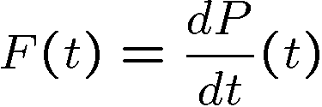
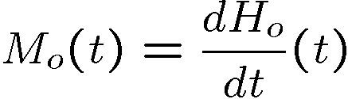
General Approach
When we are trying to deal with moving masses there are two general approaches used
Newton-Euler approach
P is absolute linear momentum
F is resultant external force
M_{o} is resultant external moment with respect to point o
H_{o} is moment of momentum with respect to point o
Lagrangian (energy methods)
Kinetic Energy (T)
Potential Energy (U)
L = K.E. – P.E. = T - U

Slide 25
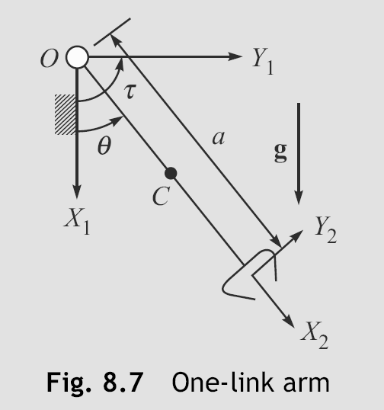
Accounting for Gravity Using Lagrange
In the case of a single link rotating with the effects of gravity it is possible to derive a time varying equation for the torque.
Kinetic Energy
1 a ˙ 1 ma²
2 2 2 12
˙2
m( θ ) +
θ ;
T ≡
2
Potential Energy
U = mg( ª − ª cosθ )
2 2
Total Energy
ma²
˙2
a
2
L = T -U ≡
θ − mg
(1− cosθ )
6
.
^{d} ( ^{∂L} ) = ¹ ma ² θ ; ^{∂L} = − ¹ mga sinθ
dt
∂θ˙
3 ∂θ 2
¹ ma²θ˙ + ¹ mga sinθ = τ
3 2

Slide 26
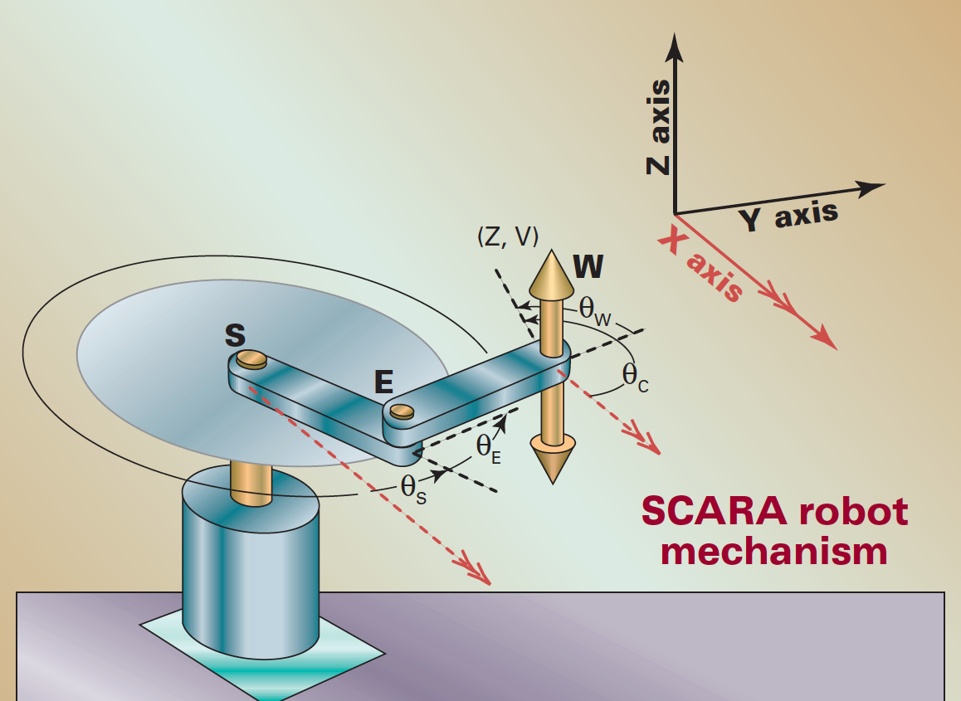
Other Forces
When your dynamic problem goes beyond a single link other forces come into play.
Coriolis Force
Centripetal Force
Centripetal Force is due to the effect on link 2 of being spun by link 1
Coriolis Force is due link 2 moving in the rotating reference frame of link 1

Slide 27
Multi Link Dynamics
For a multi link manipulator we must use matrix transformations again like the ones you saw in the kinematic lectures.
Static form (gravity only)
Joint accelerations
The Acceleration-related Inertia matrix term
The Coriolis and Centrifugal terms
Driving torque applied on each link
The Gravity terms

Slide 28
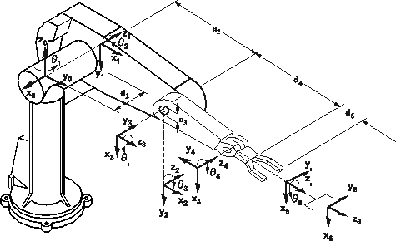
Puma 560
Example of calculation required for a PUMA 560

Slide 29
Example of calculation required for a PUMA 560
D, H, C terms

Slide 30
Example of calculation required for a PUMA 560
D, H, C terms

Slide 31
Example of calculation required for a PUMA 560
D, H, C terms

Slide 32
Example of calculation required for a PUMA 560
D, H, C terms

Slide 33
Reality
Even the matrix derived dynamics still requires accurate description of the moment of inertia for the given link
Most robot part are tested empirically to determine their characteristic first in order to simplify that application of a dynamic model

