Slide 1
Aims of this lecture
Understanding how kinematics can be used to analyse the forces and torque in a robot arm
Notes:
1

Slide 2
Torque and Force

Slide 3
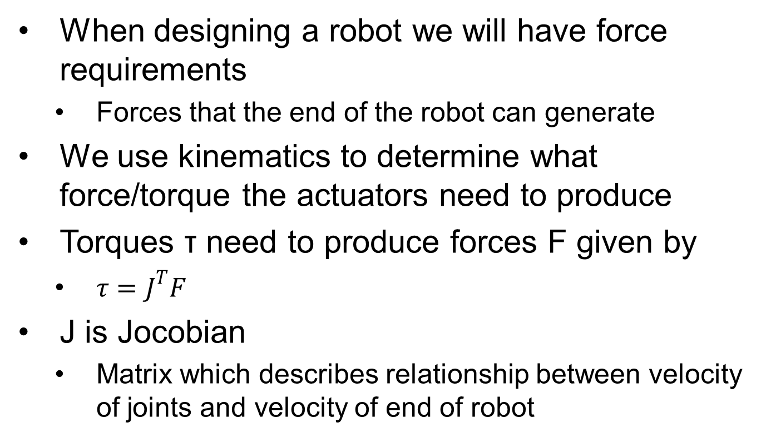
Torque and Force

Slide 4
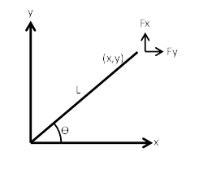
Torque and Force
1R Manipulator
Forces in the x and y directions generated by torque at joint
Fy
Fx

Slide 5
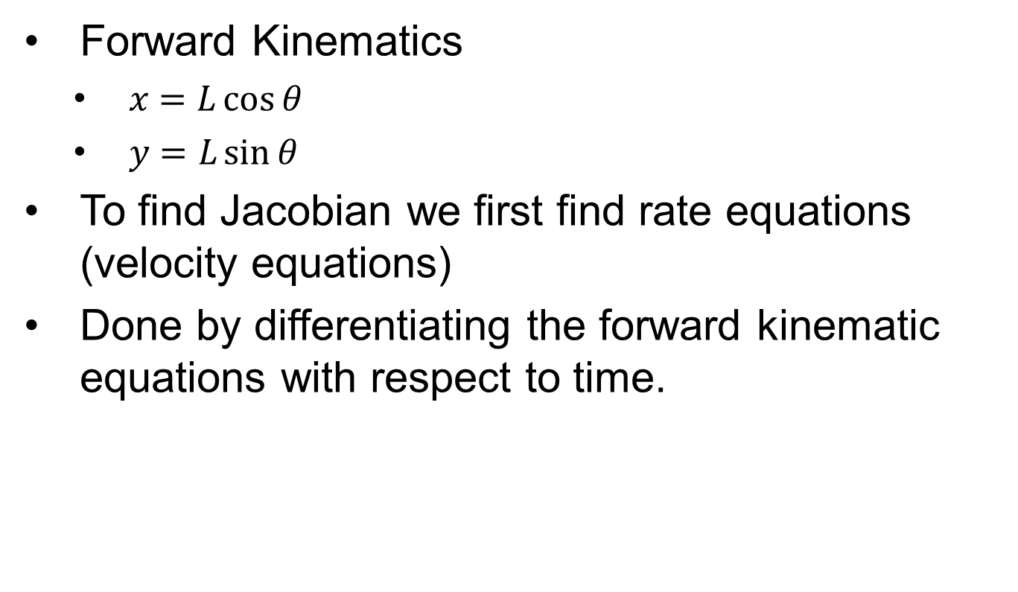
Torque and Force

Slide 6
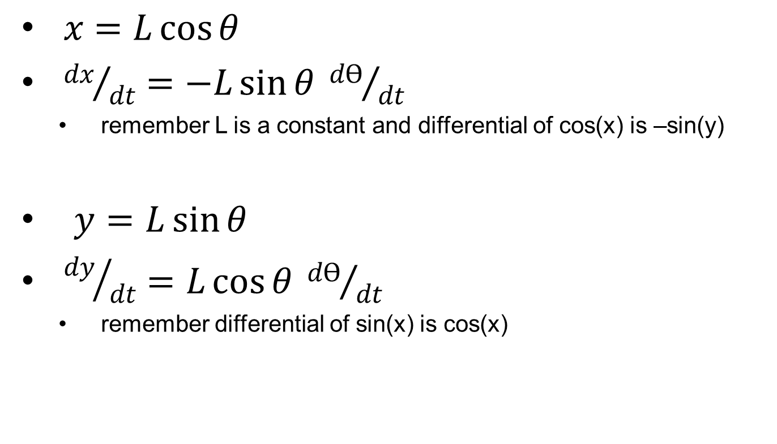
Torque and Force

Slide 7
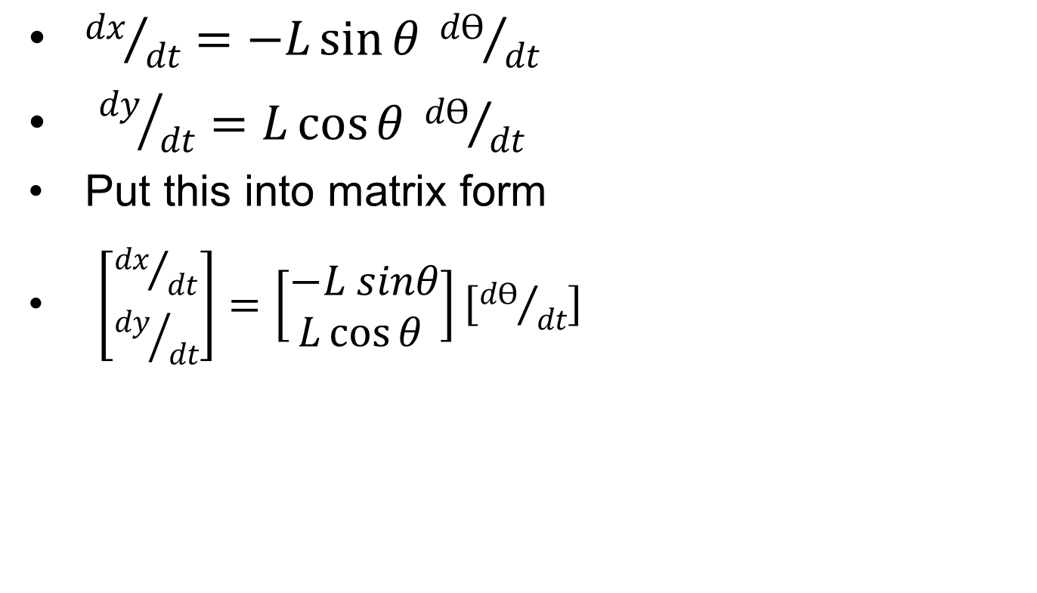
Torque and Force
Jacobian

Slide 8
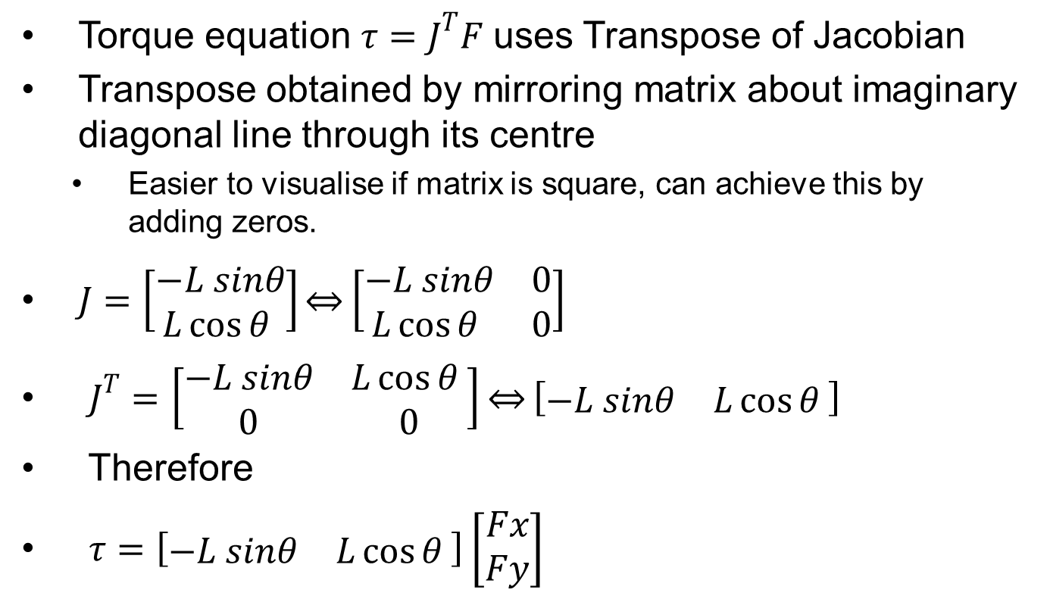
Torque and Force

Slide 9
Torque and Force
Calculate the motor torque needed to hold a 2.5kg mass at the end of the robot at an angle of Ѳ=30˚ if L=0.75m

Slide 10
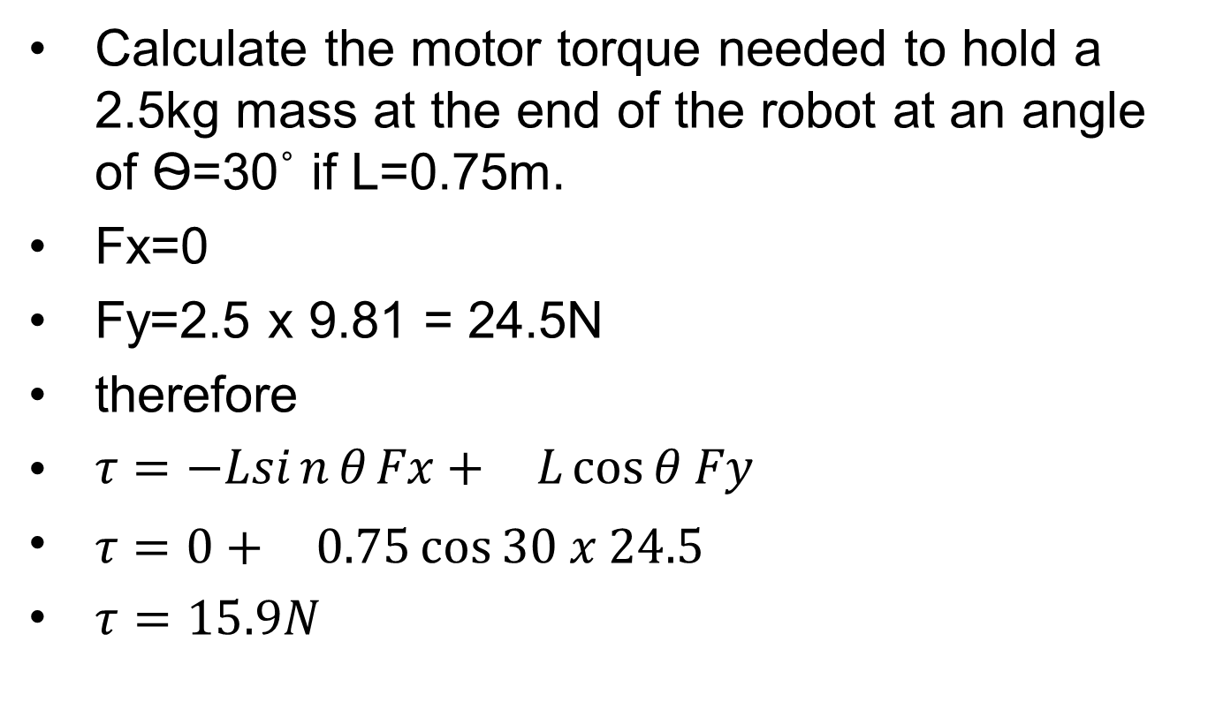
Torque and Force
m

Slide 11
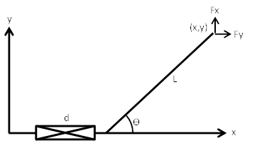
Torque and Force
PR Manipulator
Find d and Ѳ required to give end position of x=1.5m and y=0.5m. Assume L=1m.
Also find joint force and joint torque needed to produce output forces of Fx=50N and Fy=75N when Ѳ=30˚.
Fy
Fx

Slide 12

Torque and Force
Determine forward kinematics
$x=$
$y=$
Fy
Fx

Slide 13

Torque and Force
Determine forward kinematics
$x=d+L\cos{θ}$
$y=L\sin{θ}$
Fy
Fx

Slide 14

Torque and Force
Therefore determine d and theta to give x=1.5m and y=0.5m assuming L=1m
$θ=$
$d=$

Slide 15


Torque and Force
$x=d+L\cos{θ}$
$y=L\sin{θ}$
Therefore determine d and theta to give x=1.5m and y=0.5m assuming L=1m
$θ=\sin^{−1}\left(\frac{y}{L}\right) > θ=\sin^{−1}\left(\frac{0.5}{1}\right)=30˚$
$d=x−Lcosθ > d=1.5−1cos30=0.634m$

Slide 16

Torque and Force
Find rate equations
$x=d+L\cos{θ}$
${dx}/{dt}=$
$y=L\sin{θ}$
${dy}/{dt}=$

Slide 17
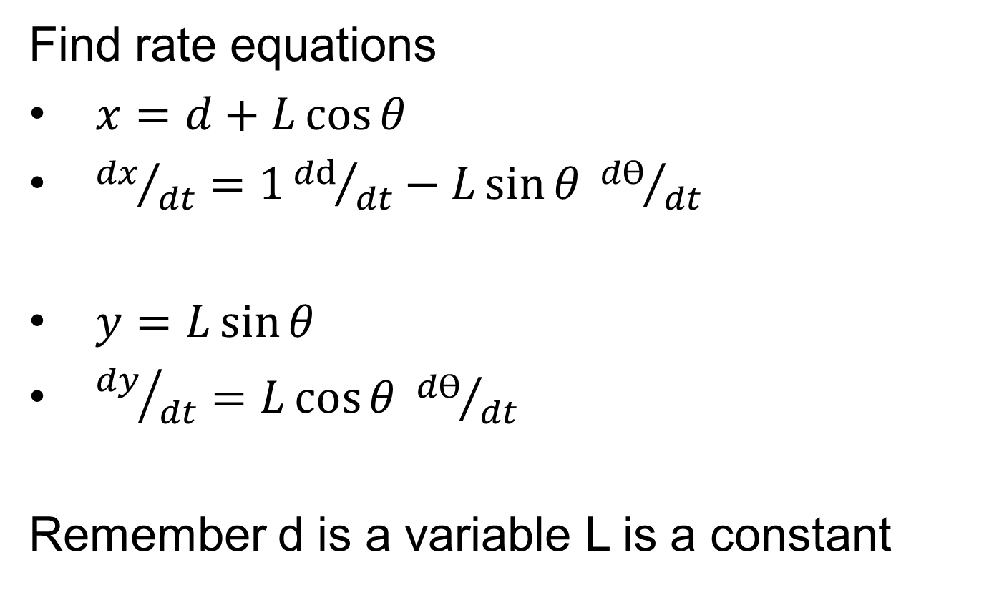
Torque and Force
Find rate equations
$x=d+L\cos{θ}$
${dx}/{dt}=1{dd}/{dt}−L\sin{θ {dѲ}/{dt}}$
$y=L\sin{θ}$
${dy}/{dt}=L\cos{θ {dѲ}/{dt}}$
Remember d is a variable L is a constant

Slide 18
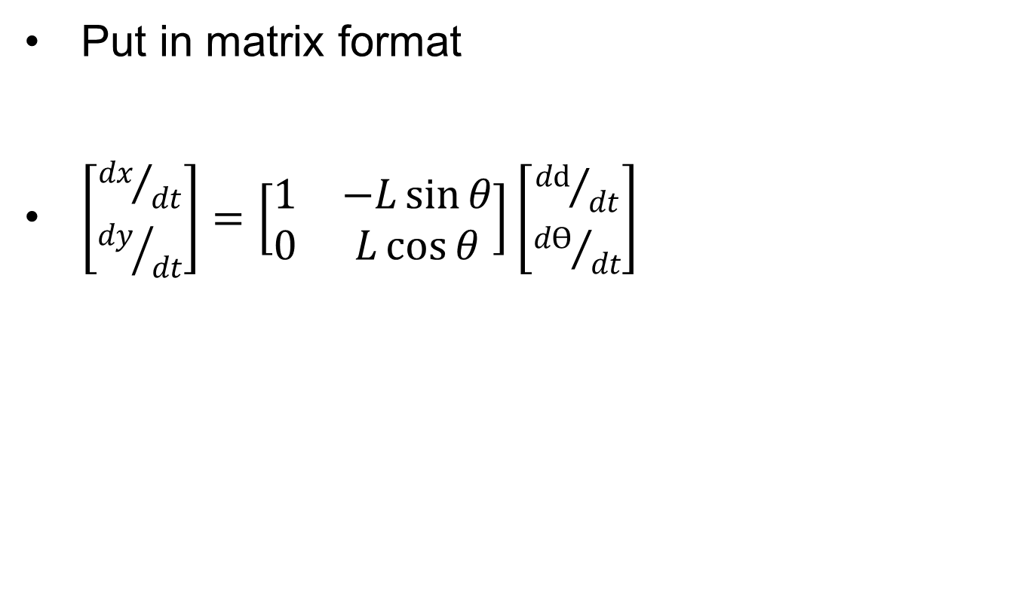
Torque and Force

Slide 19
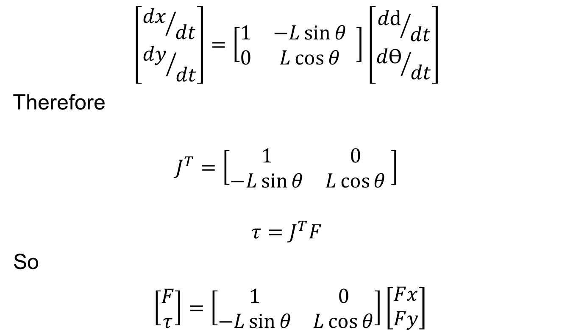
Torque and Force
$$\left[\begin{matrix}{dx}/{dt} \\ {dy}/{dt}\end{matrix}\right]=\left[\begin{matrix}1 & −L\sin{θ} \\ 0 & L\cos{θ}\end{matrix} \right]\left[\begin{matrix}{dd}/{dt} \\ {dѲ}/{dt}\end{matrix}\right]$$
Therefore
$$J^{T}=\left[\begin{matrix}1 & 0 \\ −L\sin{θ} & L\cos{θ}\end{matrix} \right]$$
$$τ=J^{T}F$$
So
$\left[\begin{aligned}F \\ τ\end{aligned}\right]=\left[\begin{matrix}1 & 0 \\ −L\sin{θ} & L\cos{θ}\end{matrix}\right]\left[\begin{matrix}Fx \\ Fy\end{matrix}\right]$

Slide 20
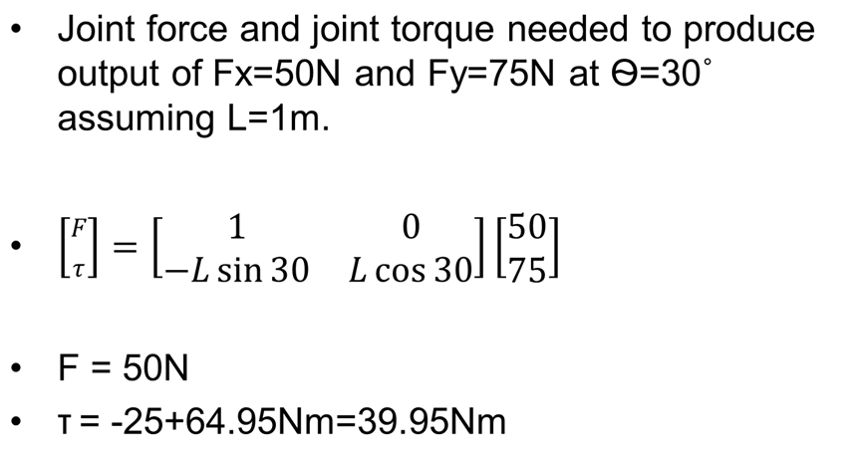
Torque and Force

Slide 21
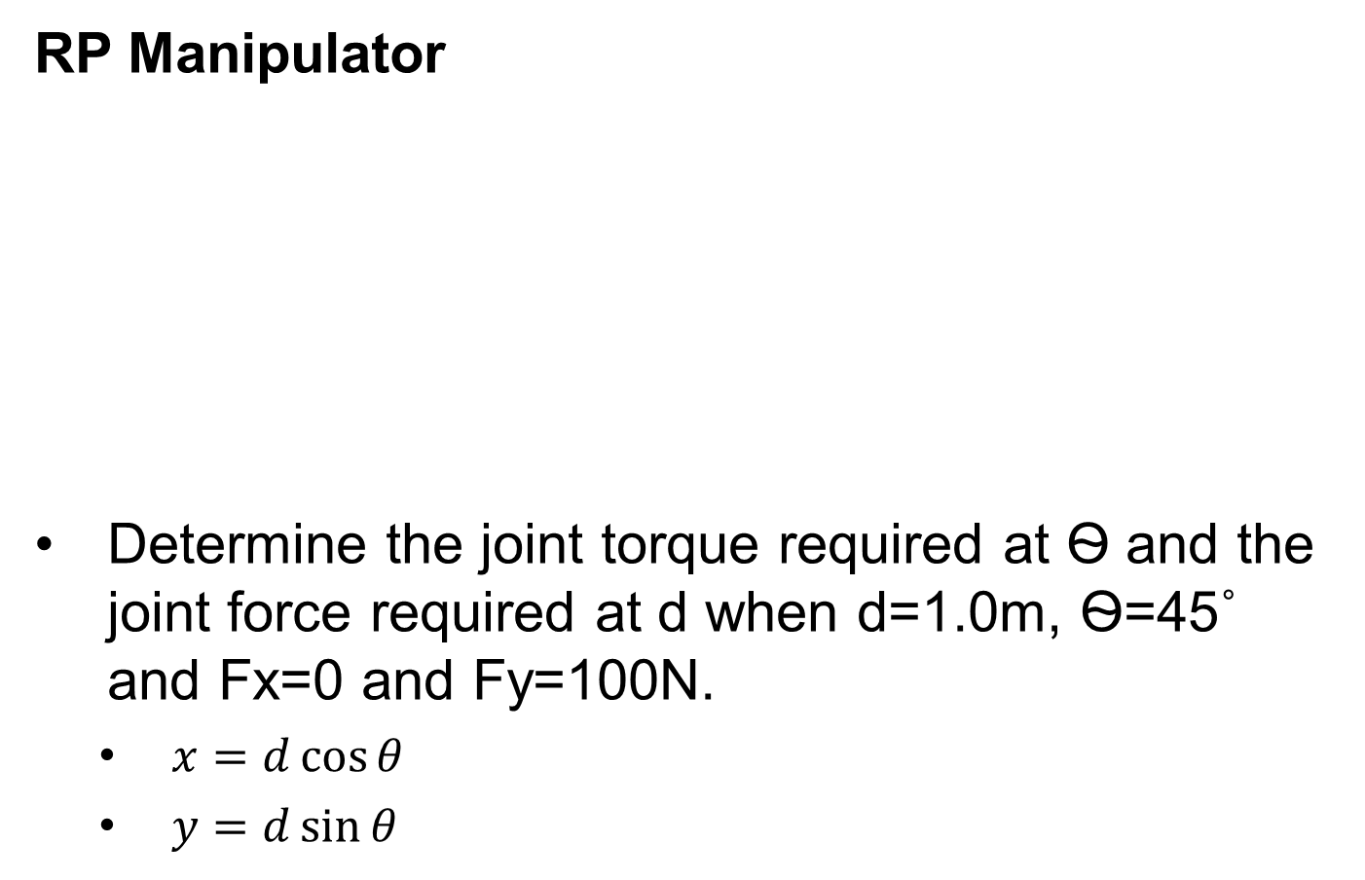
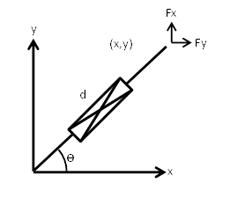
Torque and Force
Fy
Fx

Slide 22
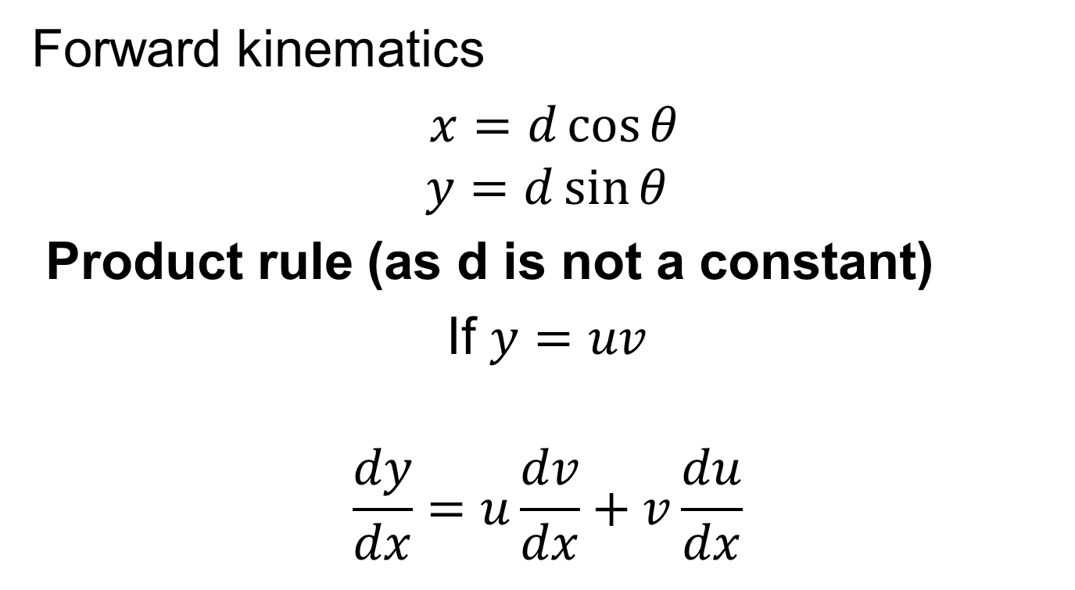
Torque and Force
Forward kinematics
$x=d\cos{θ}$
$$y=d\sin{θ}$$
Product rule (as d is not a constant)
If $y=uv$
$$\frac{dy}{dx}=u\frac{dv}{dx}+v\frac{du}{dx}$$

Slide 23

Torque and Force
u v
$$x=d\cos{θ}$$
$$\frac{dx}{dt}=u\frac{dθ}{dt}+v\frac{dd}{dt}$$
$$\frac{dx}{dt}=d\left(−sinθ\right)\frac{dθ}{dt}+cosθ\left(1\right)\frac{dd}{dt}$$

Slide 24

Torque and Force
u v
$$y=d\sin{θ}$$
$$\frac{dy}{dt}=$$

Slide 25

Torque and Force
u v
$$y=d\sin{θ}$$
$$\frac{dy}{dt}=u\frac{dθ}{dt}+v\frac{dd}{dt}$$
$$\frac{dy}{dt}=d\left(cosθ\right)\frac{dθ}{dt}+sinθ\left(1\right)\frac{dd}{dt}$$

Slide 26
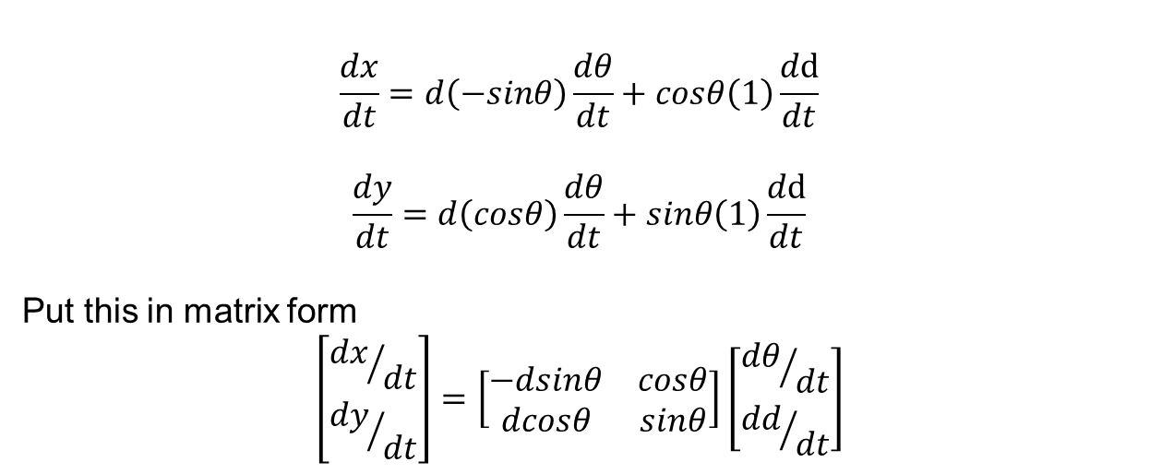
Torque and Force
$$\frac{dx}{dt}=d\left(−sinθ\right)\frac{dθ}{dt}+cosθ\left(1\right)\frac{dd}{dt}$$
$$\frac{dy}{dt}=d\left(cosθ\right)\frac{dθ}{dt}+sinθ\left(1\right)\frac{dd}{dt}$$
Put this in matrix form
$$\left[\begin{matrix}{dx}/{dt} \\ {dy}/{dt}\end{matrix}\right]=\left[\begin{matrix}−dsinθ & cosθ \\ dcosθ & sinθ\end{matrix}\right]\left[\begin{matrix}{dθ}/{dt} \\ {dd}/{dt}\end{matrix}\right]$$
Jacobian

Slide 27

Torque and Force
$$\left[\begin{matrix}{dx}/{dt} \\ {dy}/{dt}\end{matrix}\right]=\left[\begin{matrix}−dsinθ & cosθ \\ dcosθ & sinθ\end{matrix}\right]\left[\begin{matrix}{dd}/{dt} \\ {dθ}/{dt}\end{matrix}\right]$$
$τ=J^{T}F$
$J=\left[\begin{matrix}−dsinθ & cosθ \\ dcosθ & sinθ\end{matrix}\right]$
Transpose the Jacobian
$J^{T}=$
Jacobian

Slide 28
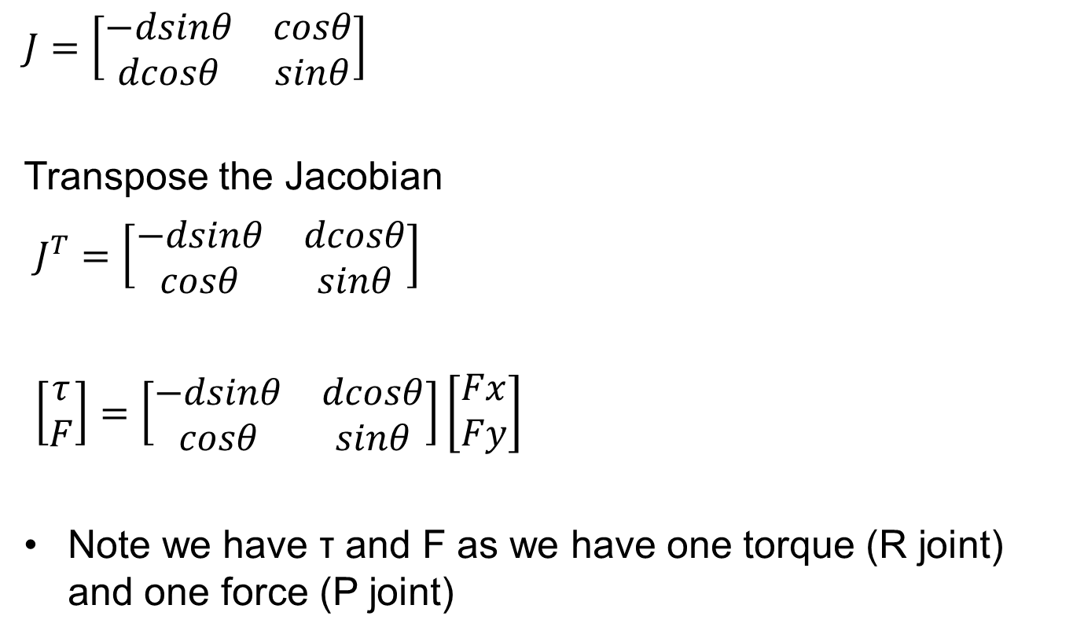
Torque and Force
$$J=\left[\begin{matrix}−dsinθ & cosθ \\ dcosθ & sinθ\end{matrix}\right]$$
Transpose the Jacobian
$J^{T}=\left[\begin{matrix}−dsinθ & dcosθ \\ cosθ & sinθ\end{matrix}\right]$
$\left[\begin{matrix}τ \\ F\end{matrix}\right]=\left[\begin{matrix}−dsinθ & dcosθ \\ cosθ & sinθ\end{matrix}\right]\left[\begin{matrix}Fx \\ Fy\end{matrix}\right]$
Note we have τ and F as we have one torque (R joint) and one force (P joint)

Slide 29
Torque and Force
Determine the joint torque required at Ѳ and the joint force required at d when d=1.0m, Ѳ=45˚ and Fx=0 and Fy=100N
Calculate F and τ

Slide 30

Torque and Force
At d=1.0m, Ѳ=45˚, Fx=0 and Fy=100
$\left[\begin{matrix}τ \\ F\end{matrix}\right]=\left[\begin{matrix}−dsinθ & dcosθ \\ cosθ & sinθ\end{matrix}\right]\left[\begin{matrix}Fx \\ Fy\end{matrix}\right]$
$$\left[\begin{matrix}τ \\ F\end{matrix}\right]=\left[\begin{matrix}−0.707 & 0.707 \\ 0.707 & 0.707\end{matrix}\right]\left[\begin{matrix}0 \\ 100\end{matrix} \right]$$
Therefore
τ=70.7Nm
F=70.7N

