Slide 1
BEng (Hons) Control and Automation
Automation and Robotics
CRN: 50295
Dr Saber Mahboubi
Email: s.mahboubiheydarabad@salford.ac.uk

Slide 2
Lecture Content: Actuators

Slide 3
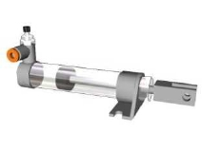
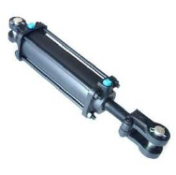
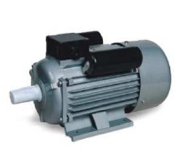
Actuators
Actuators come in three basic types depending upon their power source
Pneumatic Actuators.
These utilize pneumatic energy provided by the compressor and transforms it into mechanical energy by means of pistons or turbines
Hydraulic Actuators.
These transform the energy from a moving fluid into mechanical movement by means of suitable pumps and pistons
Electric Actuators.
Electric actuators are simply electro-mechanical devices which allow movement through the use of electromotive force

Slide 4
Considerations with Actuators
When choosing a suitable actuator for a robotic application you should consider the following
Load ( torque to overcome inertia)
Speed (fast enough but not too fast)
Accuracy (will it move to where you want?)
Resolution (can you specify exactly where?)
Repeatability (will it do this every time?)
Reliability (mean time between failures)
Power consumption
Energy supply & weight.

Slide 5
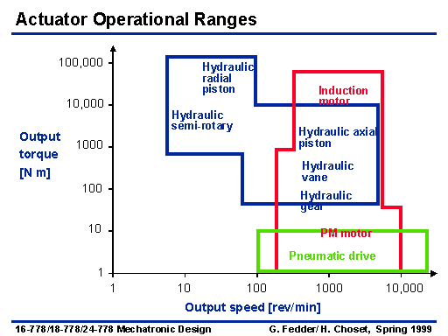
Considerations with Actuators
Actuator types should be chosen based on required output torques and speed

Slide 6
Pneumatic Advantages
There are some good reasons for choosing pneumatic actuation
Weight
Cylinders generally much lighter than motors
Compressed air can be stored and conveyed easily over long distances
Simple
Much easier to mount than motors
They have few moving parts making them inherently reliable and reducing maintenance costs
Fast on/off type tasks
They have quick action and response time thus allowing for fast work cycles
Big forces with elasticity
No leak contamination problems
No burnout
Cylinders can be stalled indefinitely without damage

Slide 7
Pneumatic Disadvantages
There are also some good reasons for not choosing pneumatic actuation
All the components are quite expensive
A properly designed system is more complex than an equivalent electromechanical system (electric motors, power screws, linear actuators, etc.)
All these components take up quite a bit of valuable space within a robot.
Limited fine control
No weight advantage if only one cylinder used (still need compressor, reservoir, pressure sensors, regulator)
Noise

Slide 8
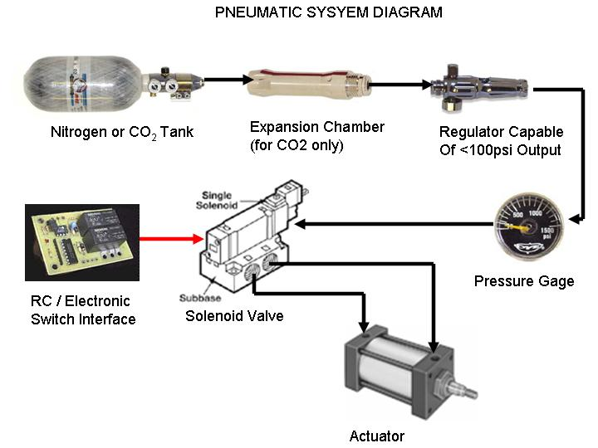
Typical Pneumatic Setup
A Pneumatic System is normally designed with the following components

Slide 9
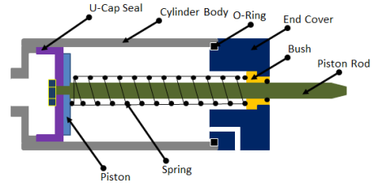
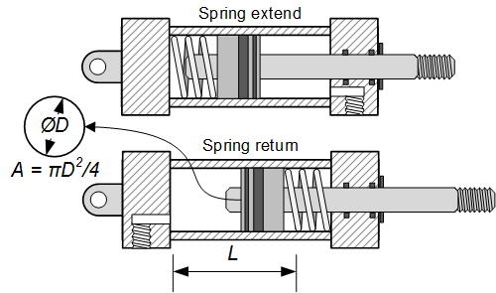
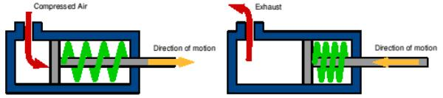
Pneumatic Actuators
Single Action Cylinder
Force =PA
A=effective area of cylinder
P=pressure

Slide 10
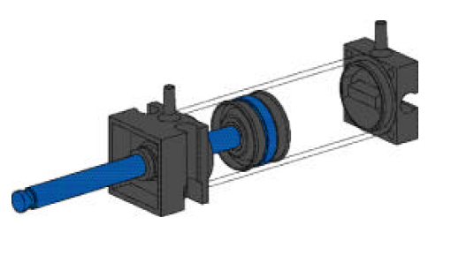
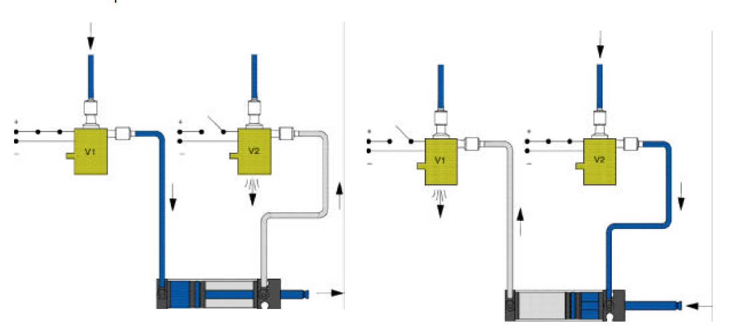
Pneumatic Actuators
Double Action Cylinder

Slide 11
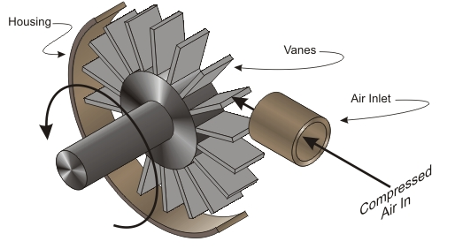
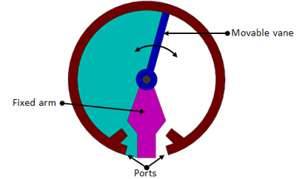
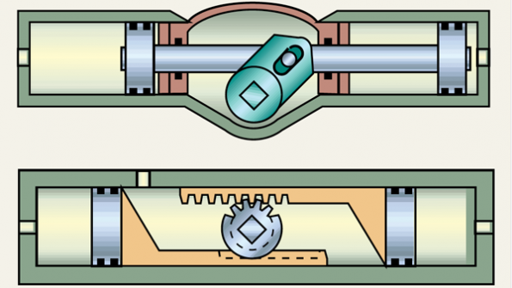
Pneumatic Actuators
Rotary actuators can come in continuous or limited action types

Slide 12
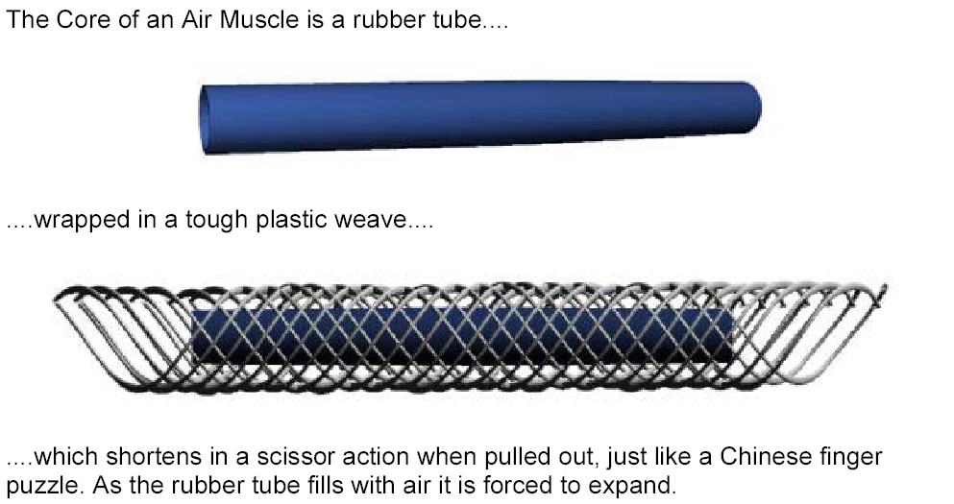
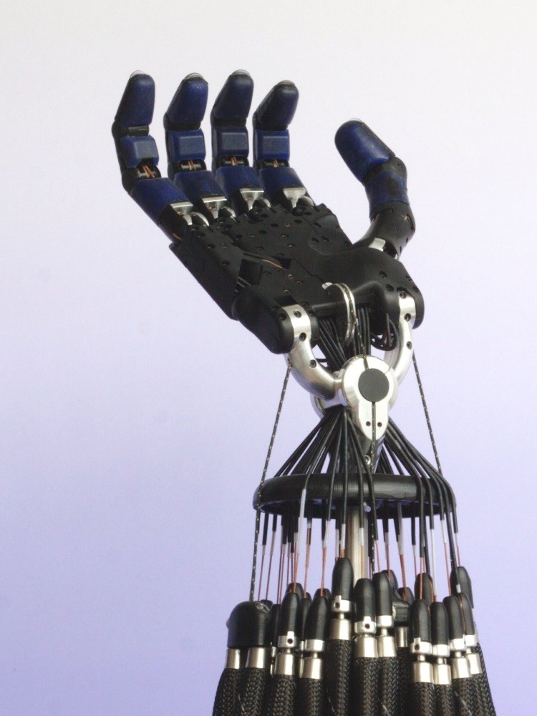
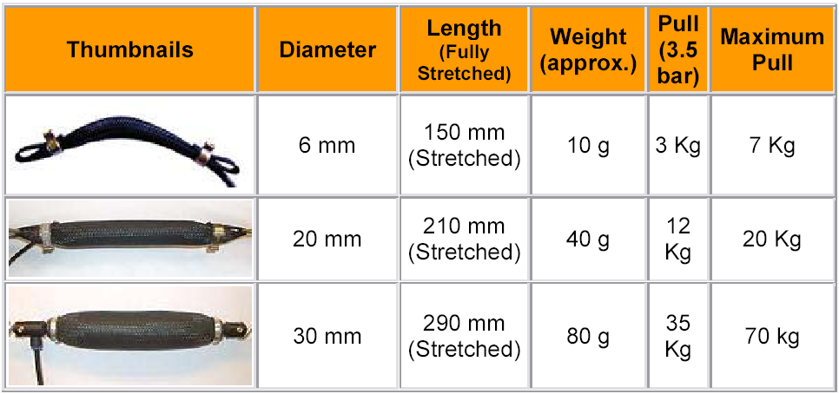
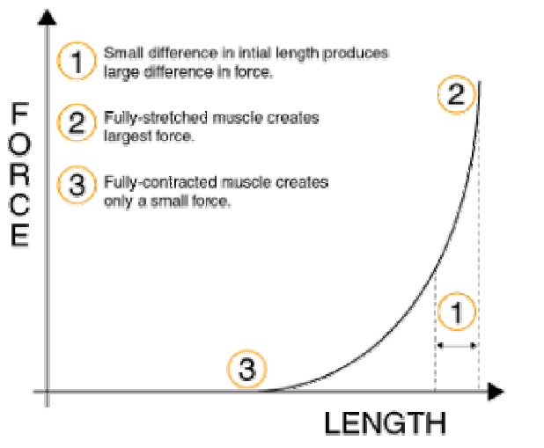
Pneumatic Actuators
Pneumatics can also be used to simulate muscle actions

Slide 13
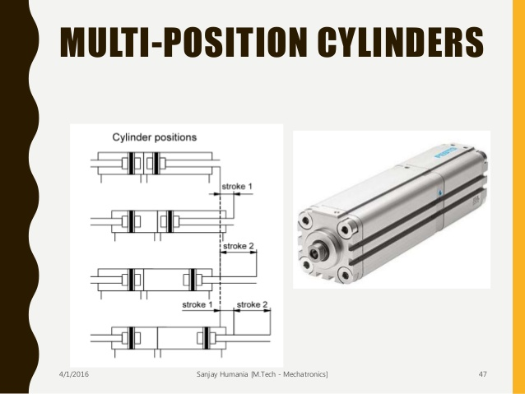
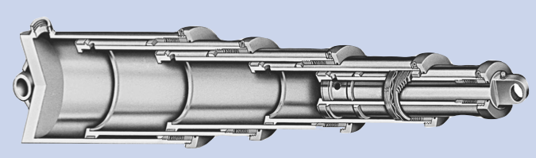
Pneumatic Actuators
Multi position and telescoping are also options

Slide 14
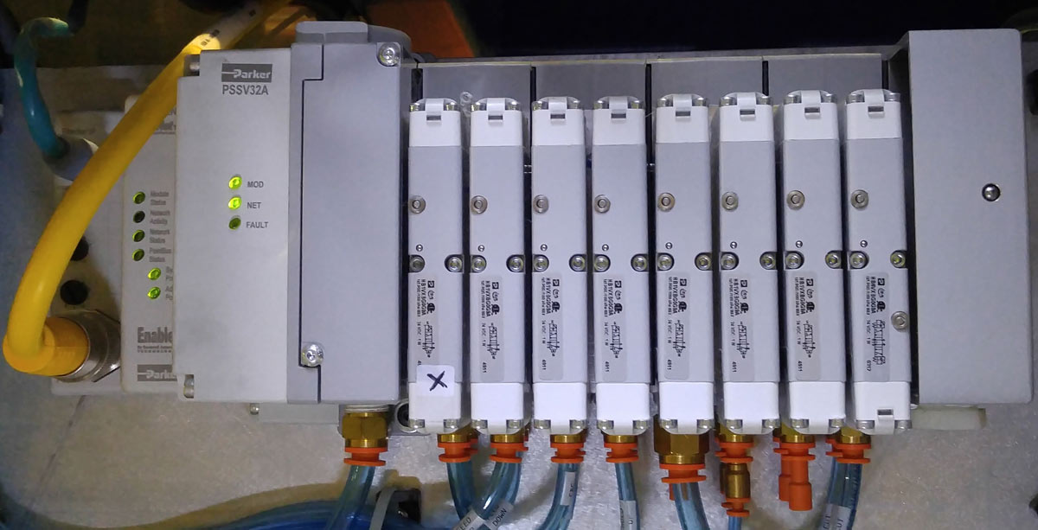
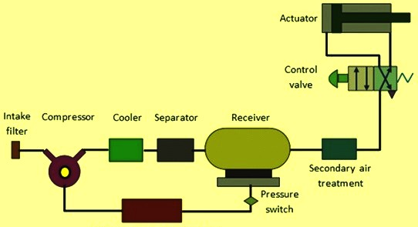
Pneumatic Actuators
Pneumatic control is normally achieved with electric solenoid valves
It is also important to treat your incoming air supply

Slide 15
Hydraulic Advantages
Reasons for choosing hydraulic actuation
High efficiency and high power to size ratio
Complete and accurate control over speed position and direction of actuators are possible
No mechanical linkage is required i.e., a direct drive is obtained with mechanical simplicity
They generally have a greater load carrying capacity than electric and pneumatic actuators
Self lubricating and non corrosive
Hydraulic robots are more capable of with standing shock loads than electric robots

Slide 16
Hydraulic Disadvantages
Reasons for not choosing Hydraulic actuation
Leakages can occur causing a loss in performance and general contamination of the work area. There is also a higher fire risk
The power pack can be noisy typically about 70 decibel or louder if not protected by an acoustic muffler
Changes in temp alter the viscosity of hydraulic fluid. Thus at low temperatures fluid viscosity will increase possibly causing sluggish movement of the robot
Bad efficiency

Slide 17
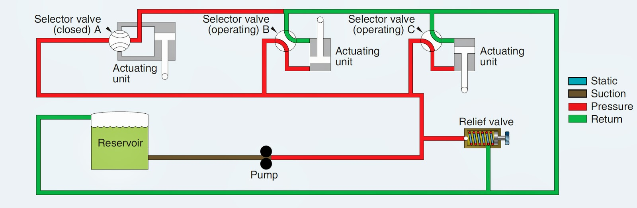
Typical Hydraulic Setup
Hydraulic setups are similar to pneumatic ones but need to include a fluid reservoir, pump and a return system

Slide 18
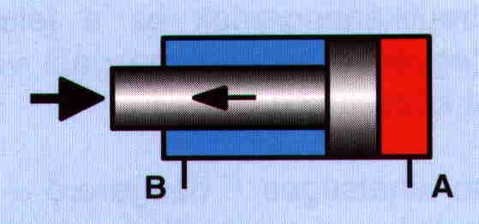
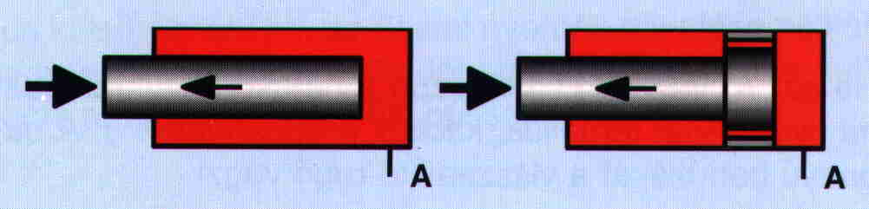
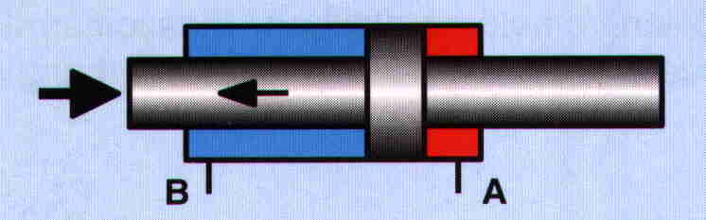
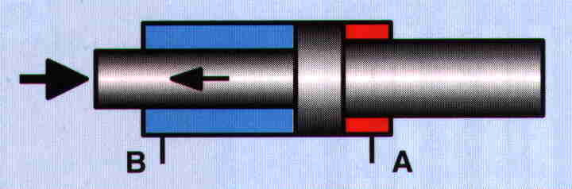
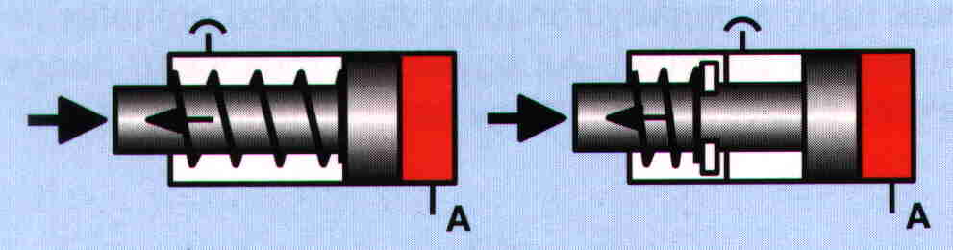
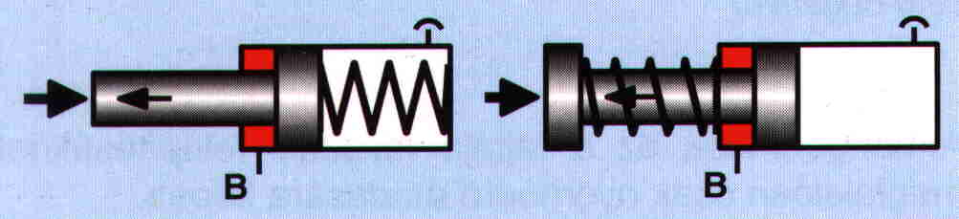
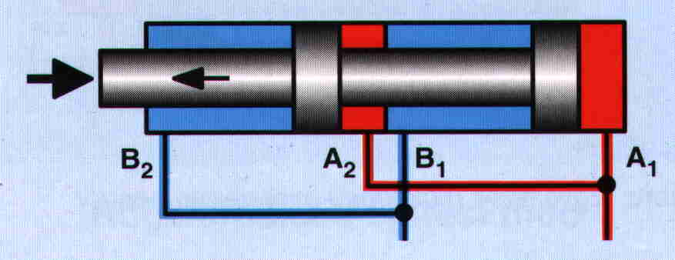
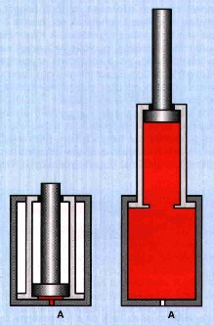
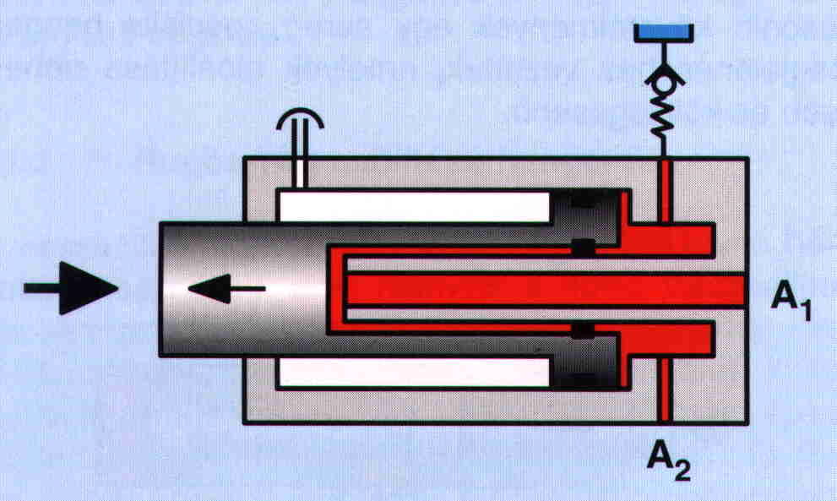
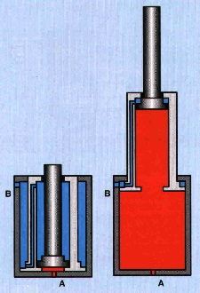
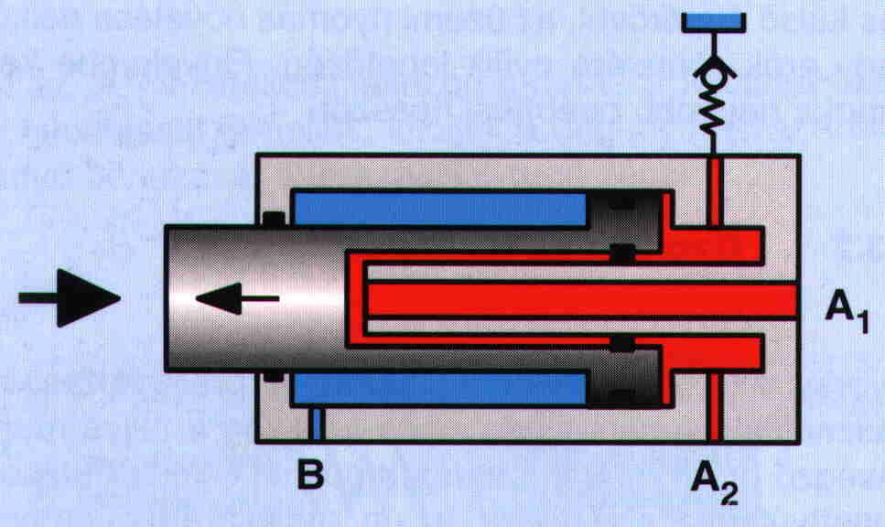
Hydraulic Actuators
Piston based actuator come in the same single and double action types as pneumatic actuators
Piston rod on both sides
Piston
Tandem
Telescopic
Telescopic
Fast moving
Fast moving
18

Slide 19
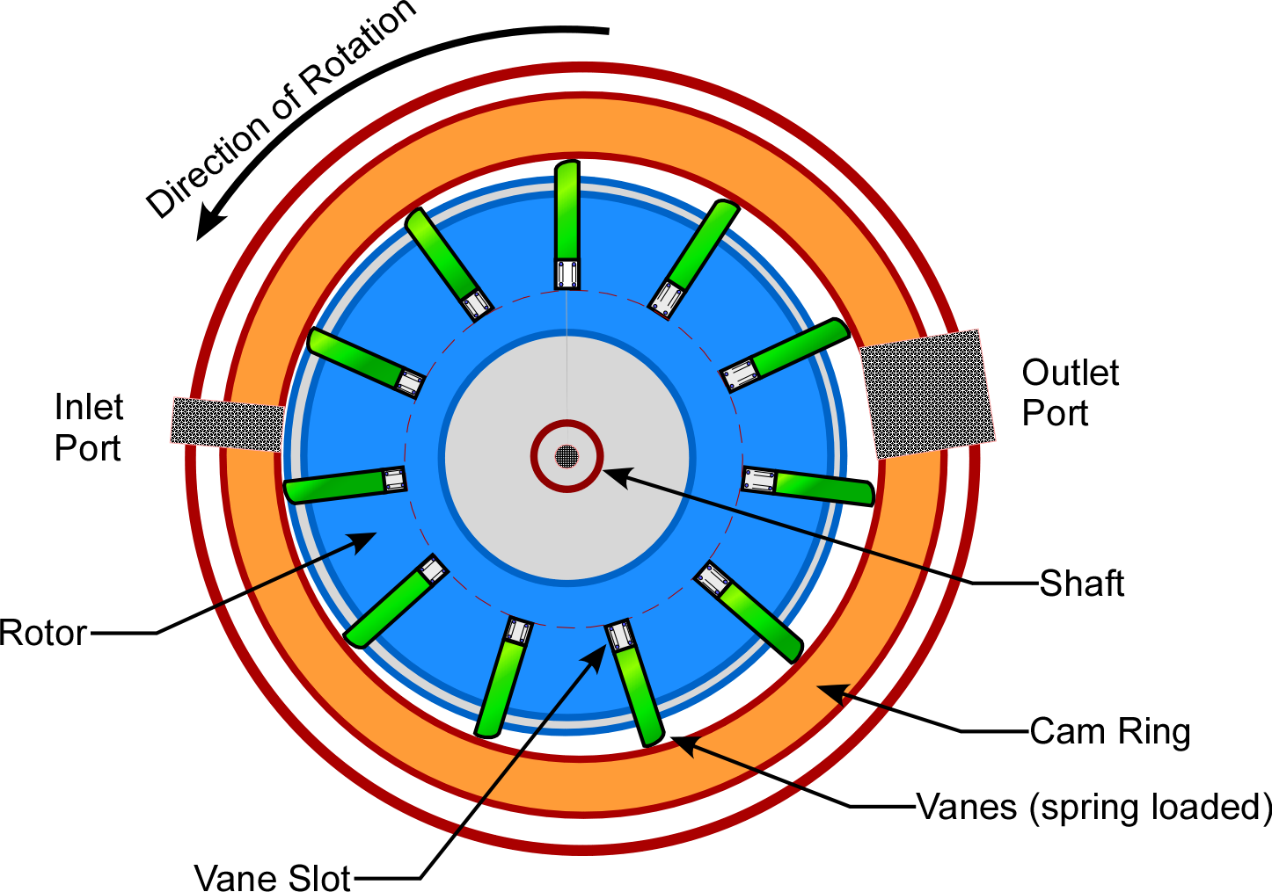
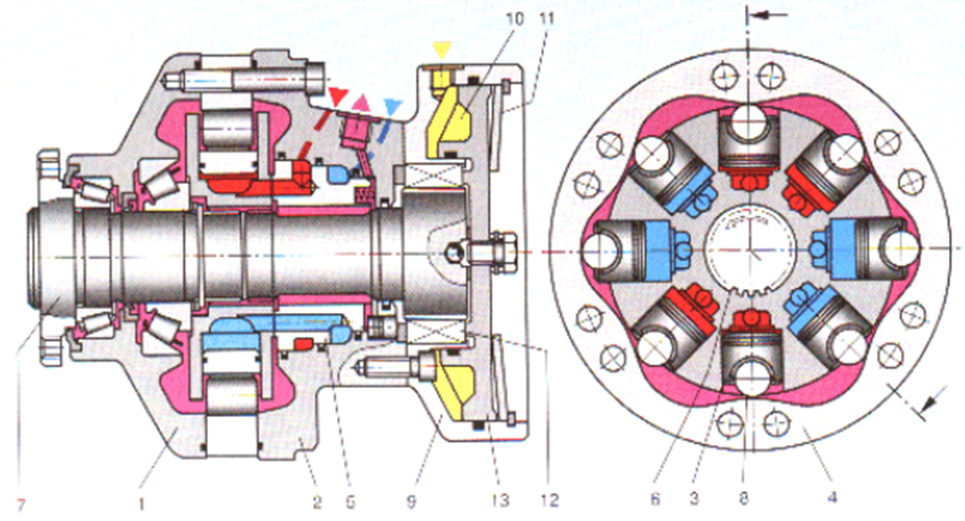
Hydraulic Actuators
The extra viscosity of hydraulic fluid make vane type motors practical
For high starting torques piston style motors also exist

Slide 20

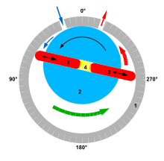
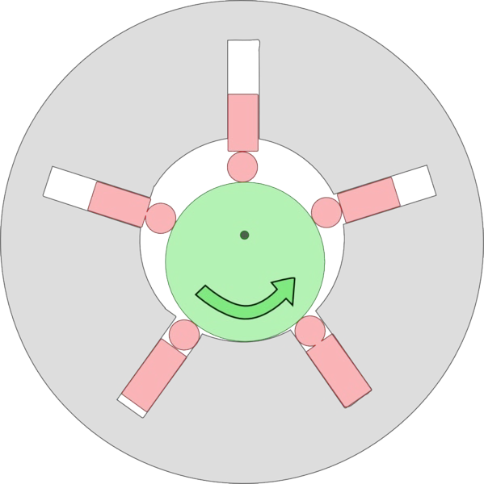
Hydraulic Actuators
Different pump options are available depending on the pressure required
Axial piston pumps (80bar)
Rotary vane pumps (180bar)
Radial piston pumps (650bar)

Slide 21
Electric actuators
Electric actuators are common and have a number of advantages
easy to control
from mW to MW
normally high velocities 1000 - 10000 rpm
several types
accurate servo control
ideal torque for driving
excellent efficiency

Slide 22
Electric actuators
Motors come in a variety of types
DC-motors
brushless DC-motors
asynchronous motors
synchronous motors
stepper motors
Brushless dc motors and stepper motors are most commonly used in robotics

Slide 23
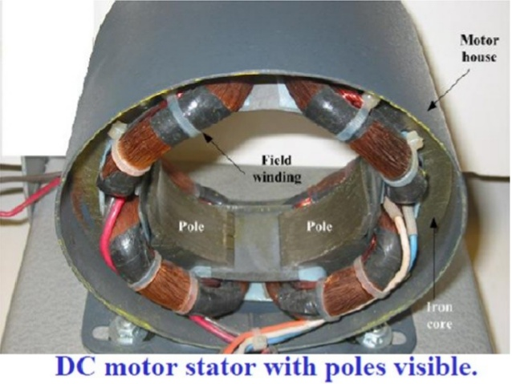
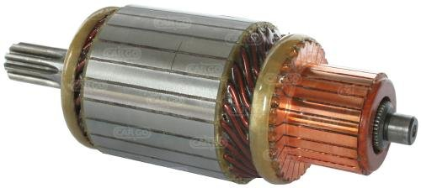
Electric actuators
DC motor terminology
Field pole
North pole and south pole
Receive electricity to form magnetic field
Armature
Cylinder between the poles
Electromagnet when current goes through
Linked to drive shaft to drive the load
Commutator overturns current direction in armature

Slide 24
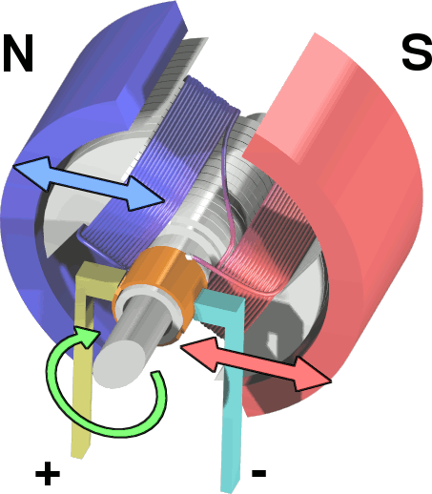
Electric actuators
DC motor operation

Slide 25
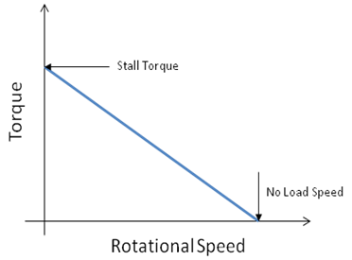
Electric actuators
DC motor operation
At fixed load, speed of rotation is proportional to applied voltage
Changing polarity reverses rotation
To first order, torque is proportional to current
Motors which approximate this ideal well are called DC servo motors.

Slide 26
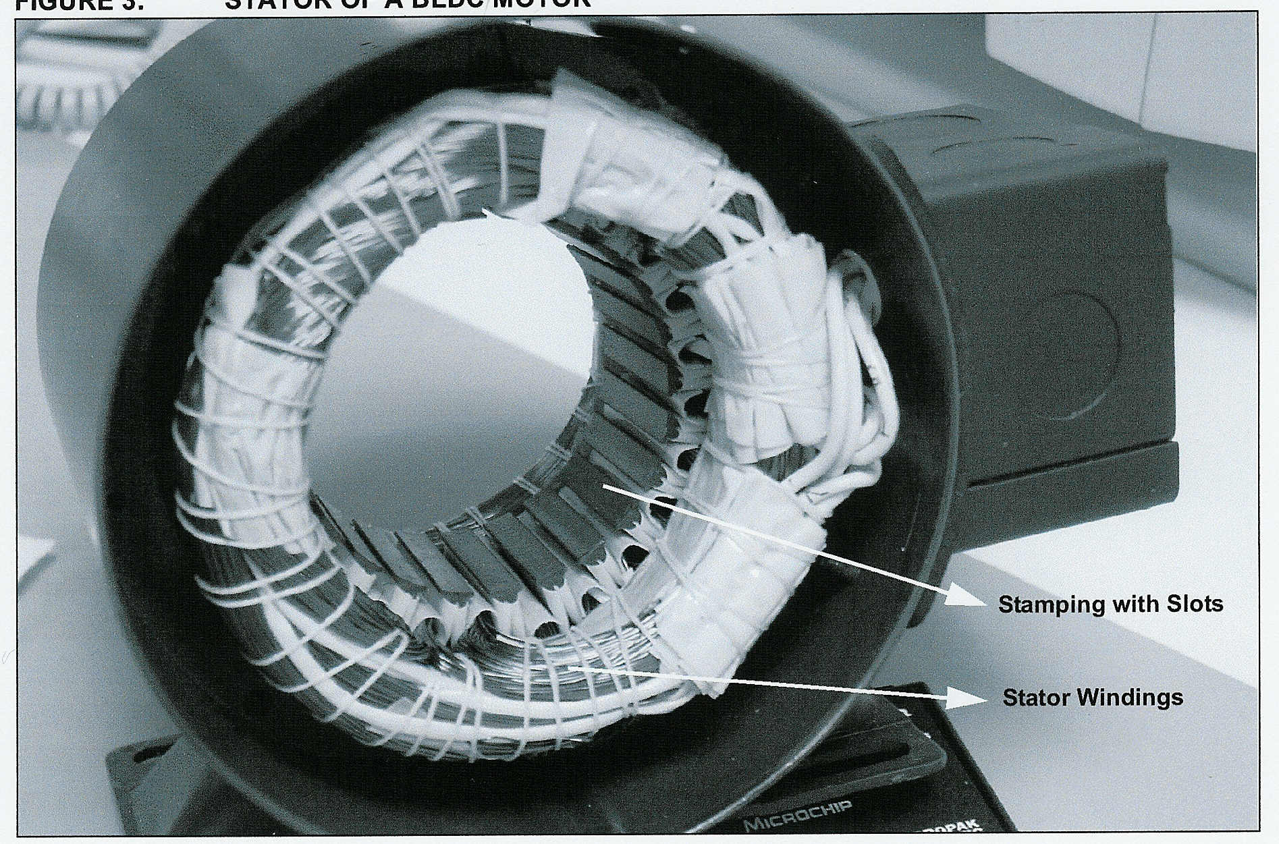
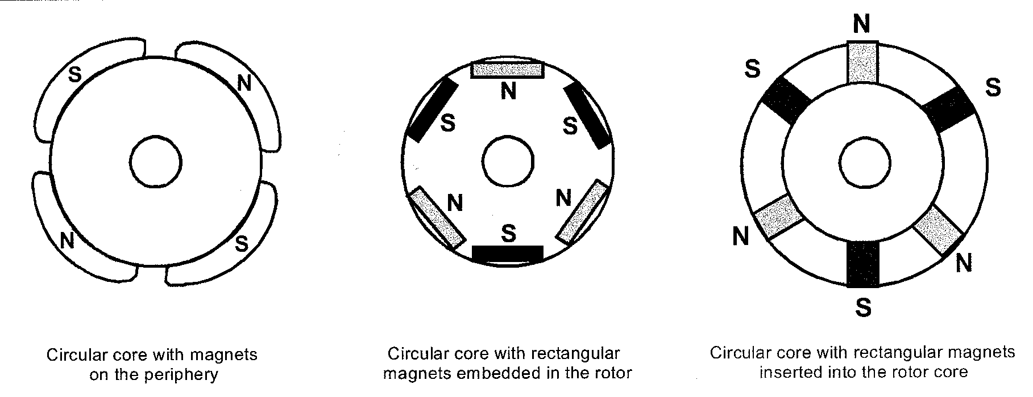
Electric actuators
Brushless DC motor

Slide 27
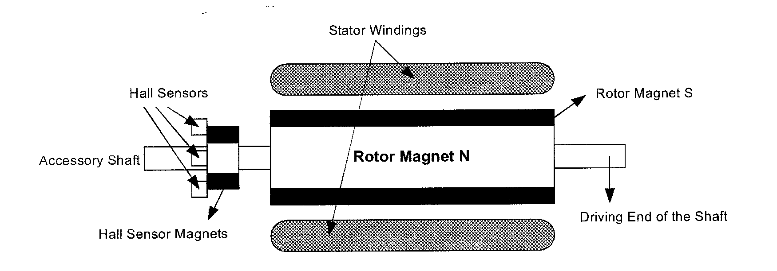
Electric actuators
Brushless DC motor transverse view of rotor
Hall effect sensors are the key to operation
Need 3 or more sensors to determine the position of the rotor
When a rotor pole passes a Hall-Effect sensor, get a high or low signal, indicating that a North or South pole

Slide 28
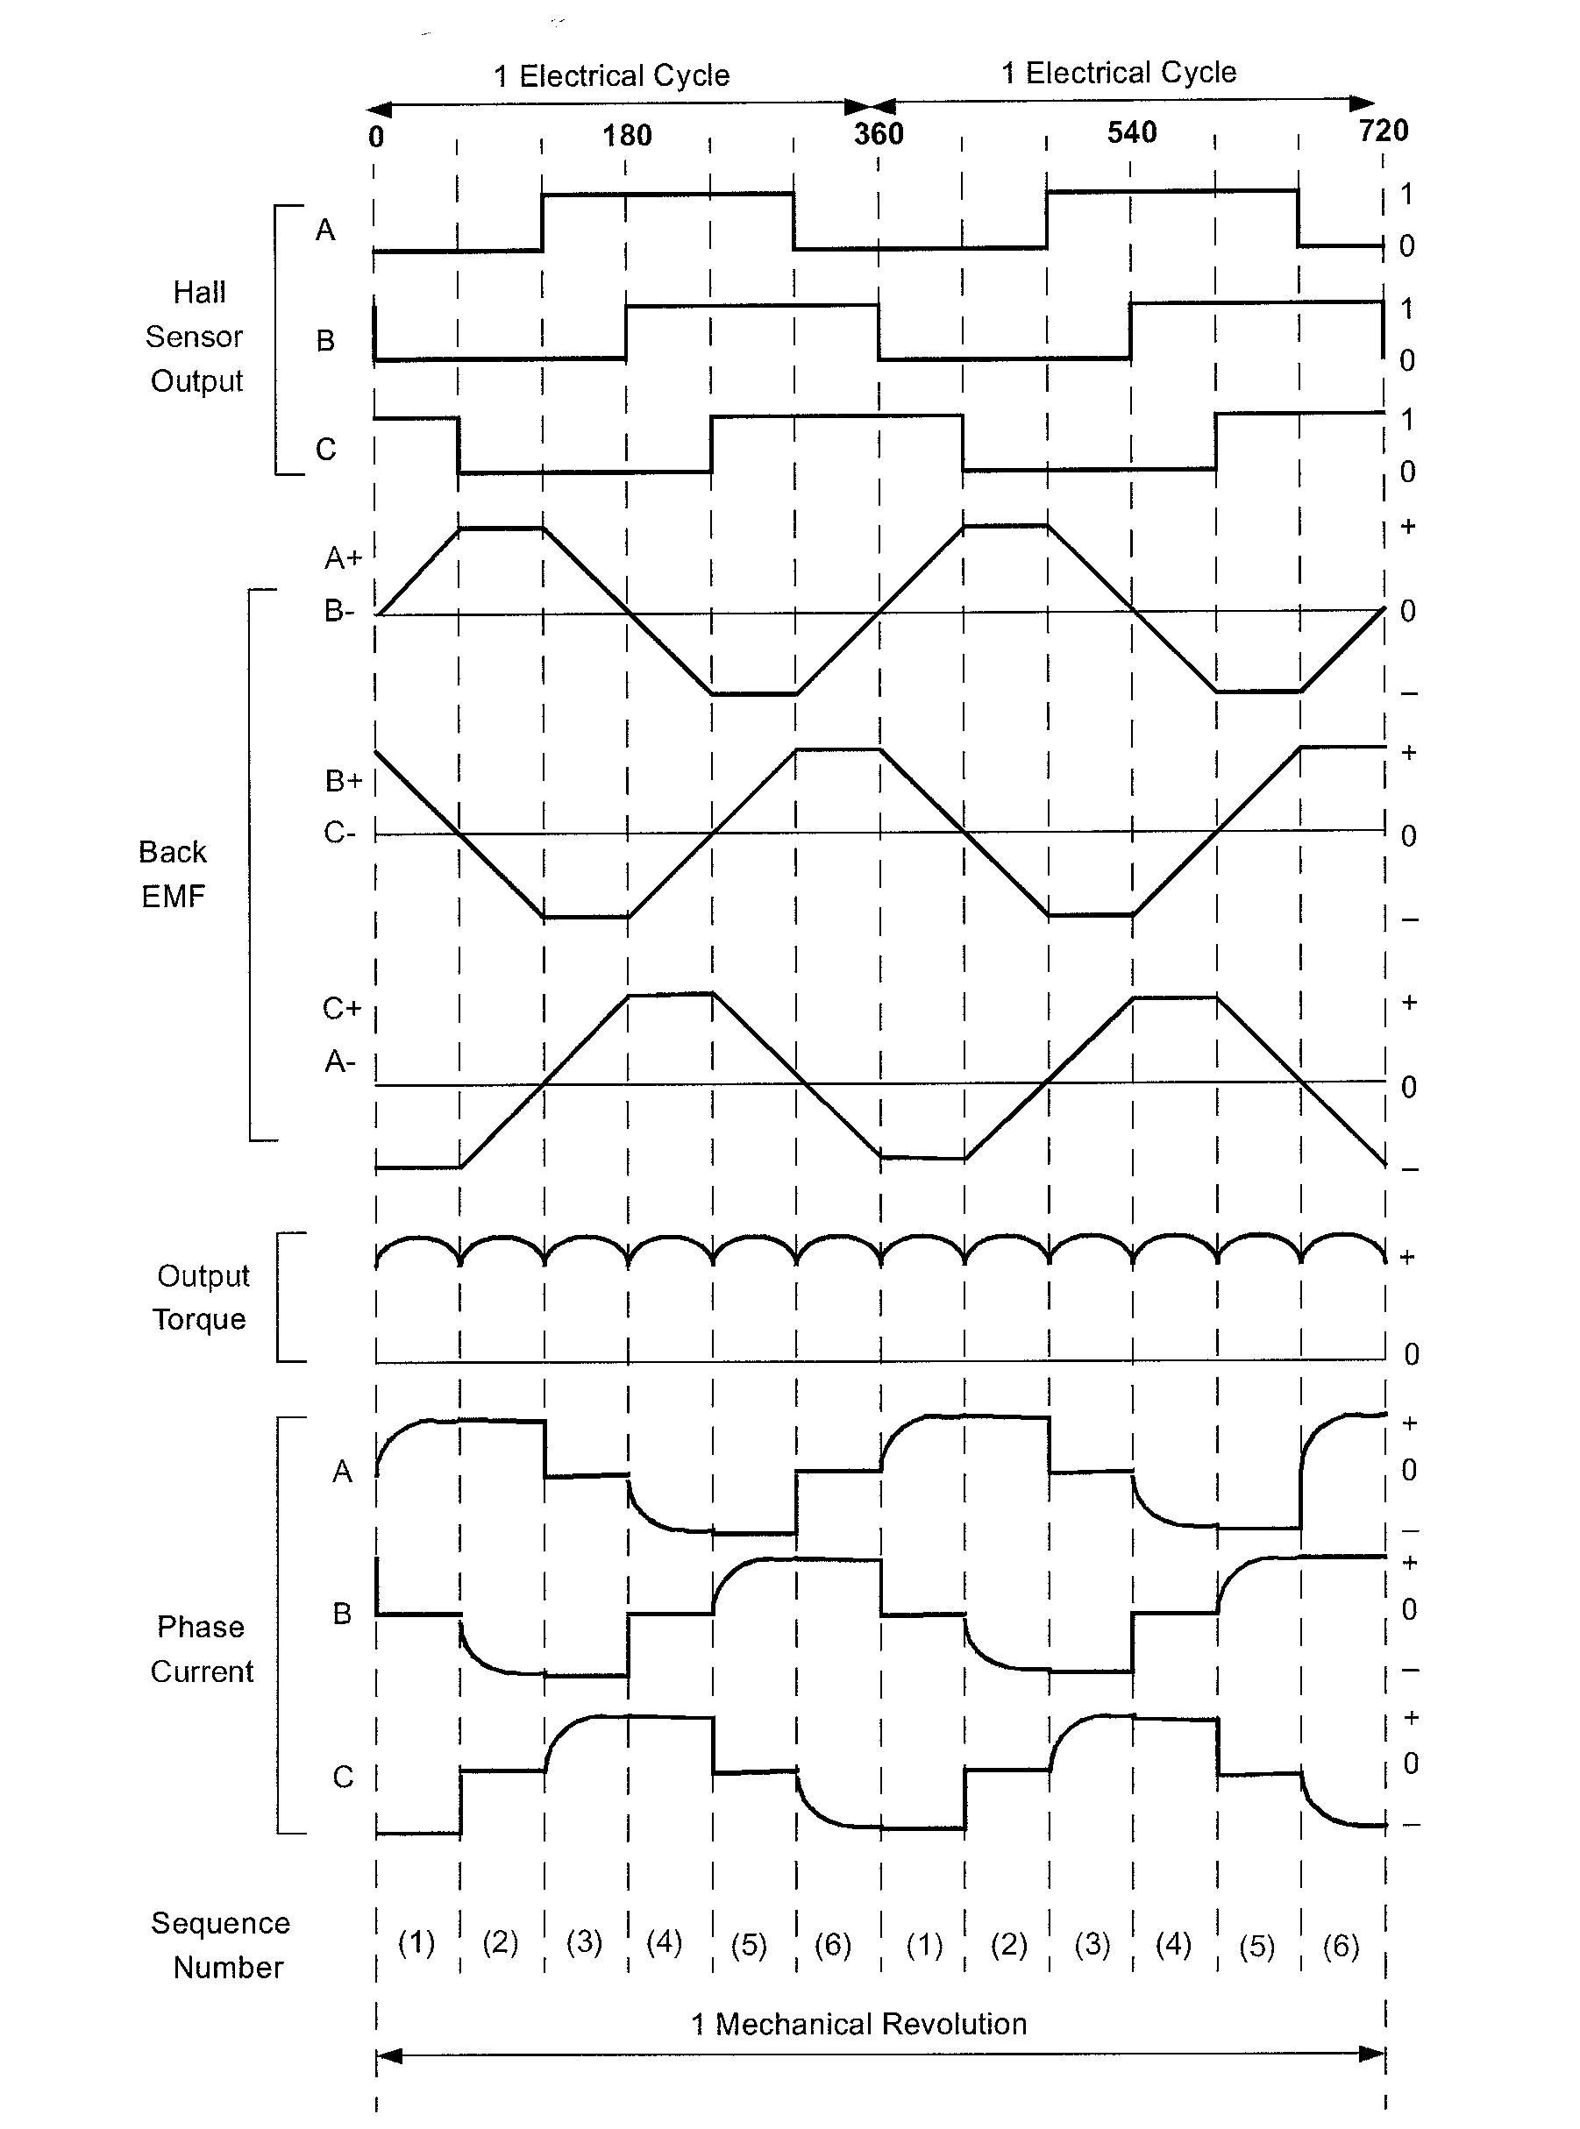
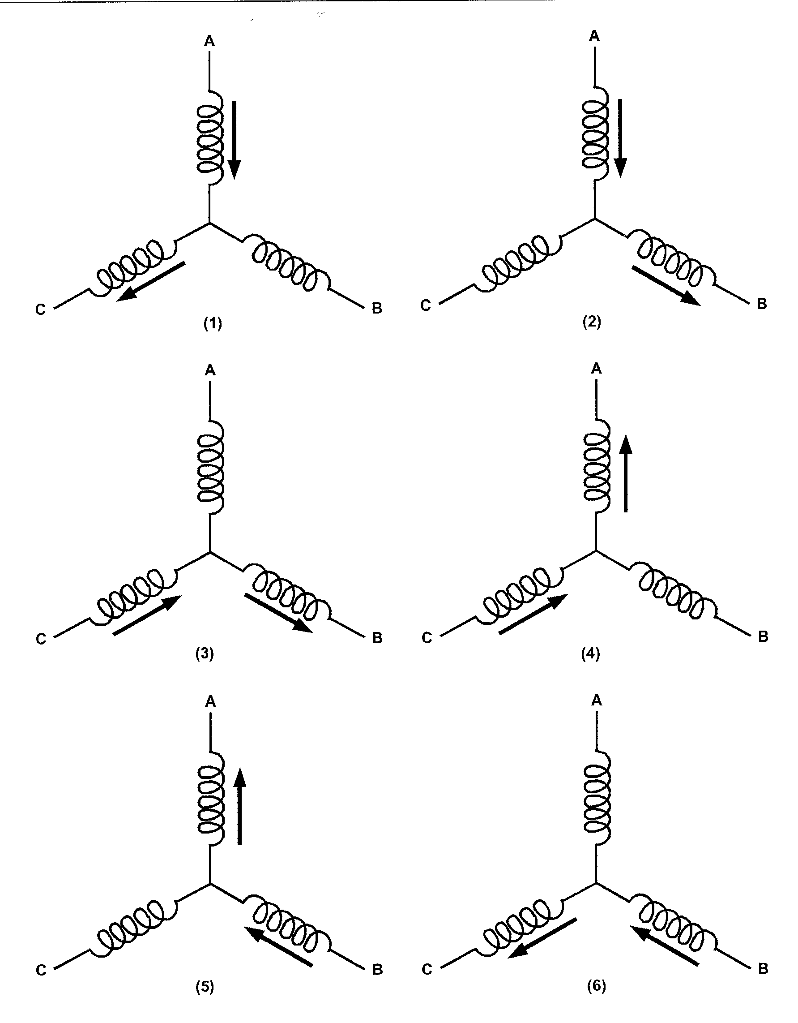
Electric actuators
Brushless DC motor commutation sequence
Each sequence has
one winding energized positive (current into the winding)
one winding energized negative (current out of the winding)
one winding non-energized

Slide 29
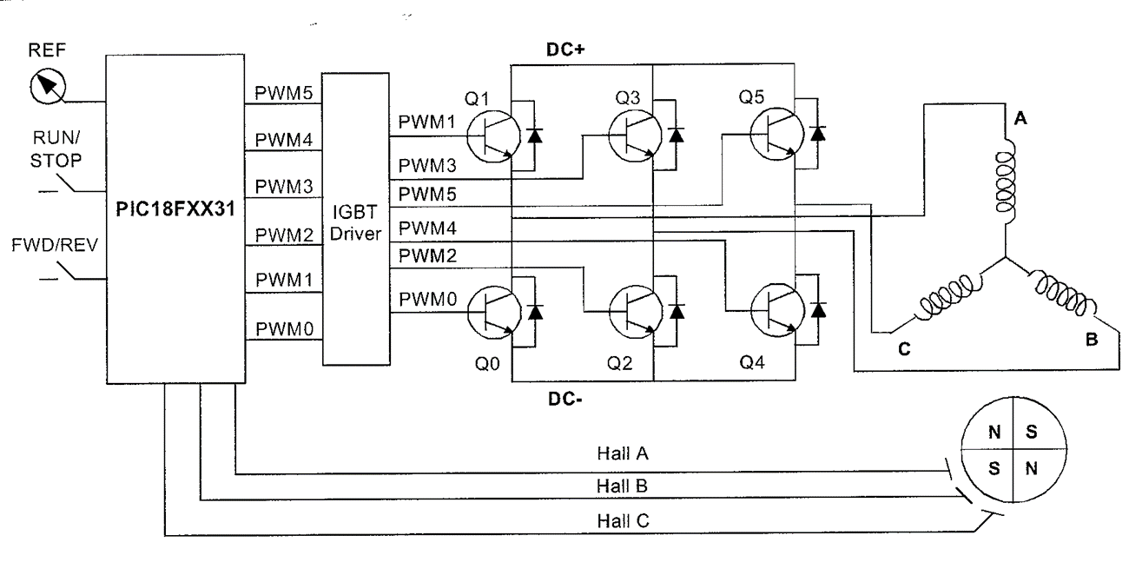
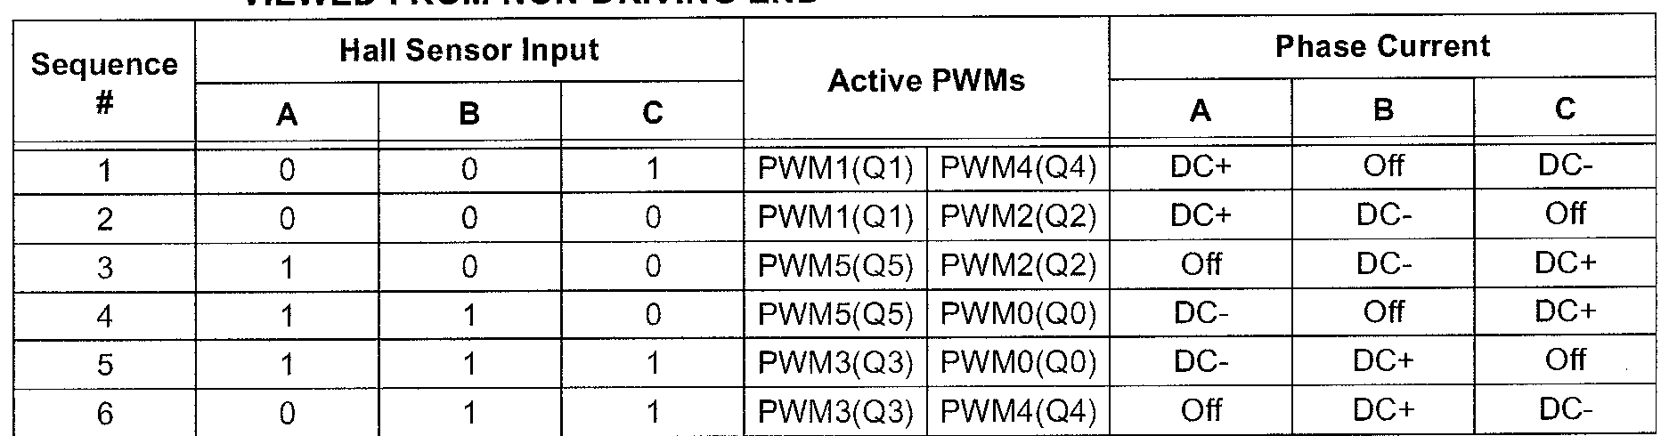
Electric actuators
Brushless DC motor control circuit

Slide 30
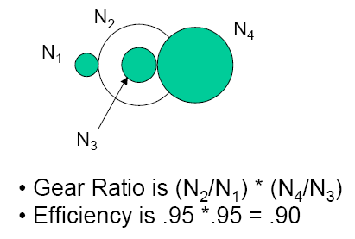
Electric actuators
Avoiding gears
Gears are useful for reducing speed and increasing torque but the are inefficient and take up space. In robotic systems motors that can generate torques at low speed without gears are preferred

Slide 31
Electric actuators
Stepping motors
When incremental rotary motion is required in a robot, it is possible to use stepper motors
A stepper motor possesses the ability to move a specified number of revolutions or fraction of a revolution in order to achieve a fixed and consistent angular movement
This is achieved by increasing the numbers of poles on both rotor and stator
Additionally, soft magnetic material with many teeth on the rotor and stator effectively multiplies the number of poles (reluctance motor)

Slide 32
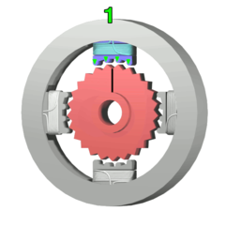
Electric actuators
Stepping motors
This design of a stepper motor, arranged with four magnetic poles arranged around a central rotor is a typical arrangement
Note that the teeth on the rotor have a slightly tighter spacing to those on the stator, this ensures that the two sets of teeth are close to each other but not quite aligned throughout
Movement is achieved when power is applied for short periods to successive magnets
Where pairs of teeth are least offset, the electromagnetic pulse causes alignment and a small rotation is achieved, typically 1-2º

Slide 33



Electric actuators
Stepping motors
The top electromagnet (1) is charged, attracting the topmost four teeth of a sprocket.
Electromagnet (1) is turned off, electromagnet (2) is charged, pulling the nearest four teeth to the right. This results in a rotation.
Electromagnet (4) is enabled, rotating again When the top electromagnet (1) is again charged, the teeth in the sprocket will have rotated by one tooth position
The bottom electromagnet (3) is charged; another rotation occurs.

Slide 34

Electric actuators
Stepping motors
Stepper motors have several advantages:
Their control is directly compatible with digital technology
They can be operated open loop by counting steps, with an accuracy of ±1 step
They can be operated in a half step mode for improved resolution
They can be used as holding devices, since they exhibit a high holding torque when the rotor is stationary
Can get a linear version

Slide 35


Electric actuators
Mega Torque motors
The stepping motor principle can be extended to give extremely high torques by increasing the number of teeth used:

Slide 36

Electric actuators
Direct drives
Another way of producing drives with good torque at low speed is to adopt the brushless motor concept with a large number of poles
High torque at low rpm
Faster positioning
Longer lifetime
Reduced noise
But..
Large diameter
Precise control

Slide 37




Other actuators
Piezoelectric actuators
These give very small displacements but are very accurate. Normally used for micropositioning

Slide 38


Other actuators
Ultrasonic motors
These use a vibrating sator and simple friction to drive the rotor
Commonly found as camara lens ring motors

Slide 39



Other actuators
Shape memory alloys
These give a change of shape (normally a change of angle) with a change of temperature. Small torque but very lightweight.

