Slide 1
BEng (Hons) Control and Automation
Automation and Robotics
CRN: 50295
Dr Saber Mahboubi
Email: s.mahboubiheydarabad@salford.ac.uk

Slide 2
Lecture Content: Sensors in Robotics

Slide 3
Robot Sensors
Why Do Robots Need Sensors?
Provides an awareness of surroundings
What’s ahead, around, “is it what I am looking for”
Allows interaction with environment
Correct positioning to undertake task
Protection & Self-Preservation
Safety, Damage Prevention
Gives the robot capability to goal-seek
Find specific objects

Slide 4
Robot Sensors
What can be sensed?
Light
Presence, color, intensity, direction
Sound
Presence, frequency, intensity, direction
Heat
Temperature, wavelength, magnitude, direction
Chemicals
Presence, concentration, identity, etc.
Electromagnetic fields
Presence/absence, magnitude, capacitance, inductance
Physical orientation/attitude/position/contact
Force, pitch, roll, yaw, distance.

Slide 5
Robot Sensors
What types of sensor are available?
Feelers (Whiskers, Bumpers) – Mechanical
Photoelectric (Visible) – Active & Passive
Infrared (light) – Active & Passive
Ultrasonic (sound) – Active & Passive
Sonic – Active & Passive
Resistive/Capacitive/Inductive – Active & Passive
Visual – Cameras & Arrays (Active & Passive)
Color Sensors (Active & Passive)
Magnetic (Active & Passive)
Orientation (Pitch & Roll)
GPS (location, altitude)
Compass (orientation, bearing)
Voltage – Electric Field Sensors
Current – Magnetic Field Sensors
Chemical – Smoke Detectors, Gas Sensors

Slide 6
Robot Sensors
Typical jobs robots would require sensors for:
Insertion Monitoring
Assembly Verification
Detection of Reject Parts
Recognition of Part Types/Location
Assembly Test Operations/Diagnostics
Check Gripper/Tool Operation/Orientation
Location & Orientation of Parts/Self
Workspace Intrusion Detection

Slide 7
Robot Sensors
General Sensor Principle:
Most of our control systems are electronic based so to use sensors in controlling robots we need an output from them in electronic form
Sensors are designed to measure a particular parameter, normally a physical quantity
Sensors should give a quantitative measure of that parameter in some electronic form (digital or analogue)
Sensors are often transducers in that they convert one form of energy to another in order to implement the sensing function

Slide 8
Robot Sensors
Sensor Selection
The general taxonomy for selecting a sensor for a task should be:
Specification of task requirements : slippage detection, size confirmation, inspection, defect testing etc.
Choice of modality :vision, force, tactile etc. (look for sources of interference)
Specification of sensor attributes : Binary or continuous, imaging or non-imaging, etc.
Specification of operational parameters : size, accuracy, cost
Selection of output mechanism :direct signal, digital value, specific bus protocol, etc.

Slide 9
Internal Robot Sensors
As we have seen with lectures on kinematics and dynamic to know the positioning of out robot we need to have information about joint positioning
This is known as kinesethic sensing
These are sensors designed to provide feedback for servo control to the joint/link controllers
There are analogue and digital versions
We will look at the 4 commonly used types
Potentiometers
Resolvers
Incremental Encoders
Absolute Encoders

Slide 10
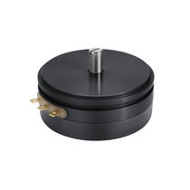
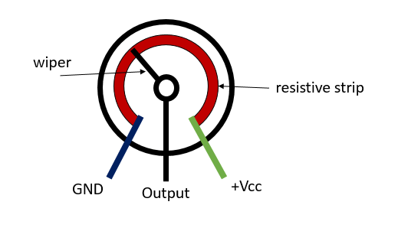
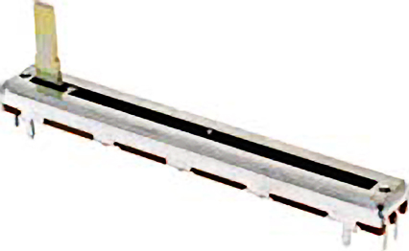
Internal Robot Sensors
Potentiometer
A basic way of sensing linear or rotary position by connecting the moving element of the joint to the wiper contact of a potentiometer.
The position is proportional to the resistance which can be used to produce a measurable voltage.
Usually made from conducting polymer
Position directly proportional to voltage
Poor resolution compared to other methods
360 degree version has dead zone
Susceptible to wear

Slide 11
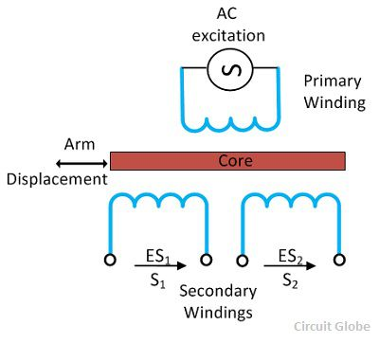
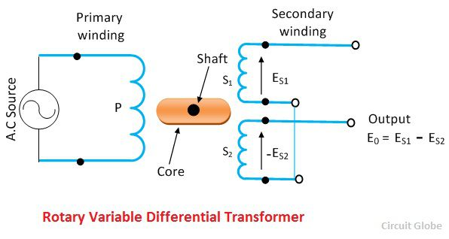
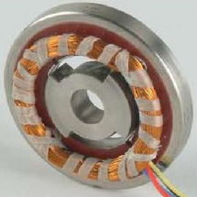
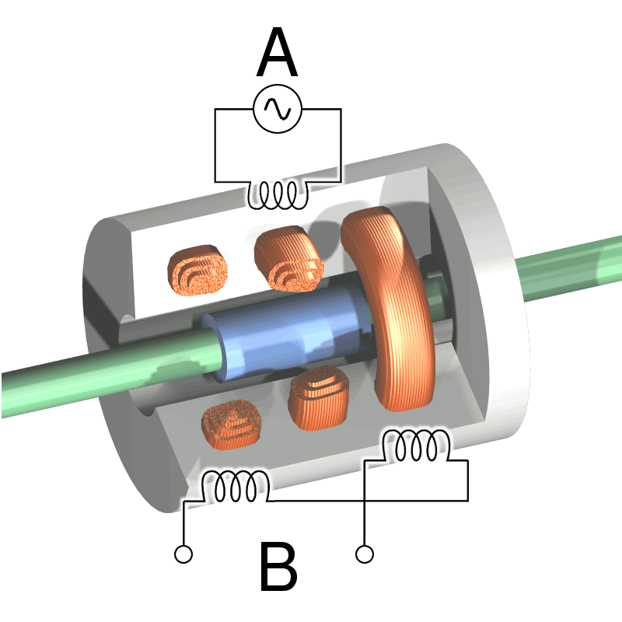
Internal Robot Sensors
Resolvers
Also known as LVDT (Linear Variable Differential Transformer) and RVDT (Rotary Variable Differential Transformer). They use the inductive coupling used by transformers to give a changing signal

Slide 12
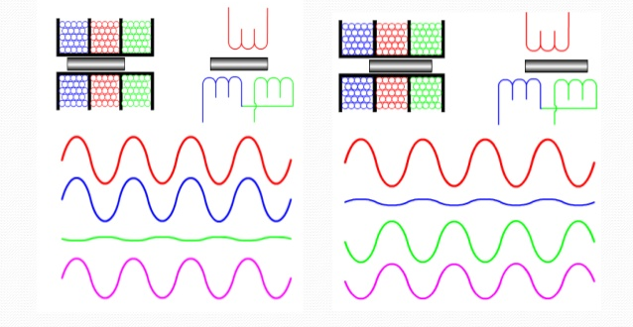
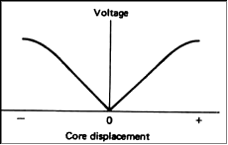

Internal Robot Sensors
Resolvers
As the device relies on inductive coupling for its function it must use ac voltages
Displacement ($D)=M∗\frac{{ES}_{1}−{ES}_{2}}{{ES}_{1}+{ES}_{2}}$
M is a calibration scaling factor

Slide 13
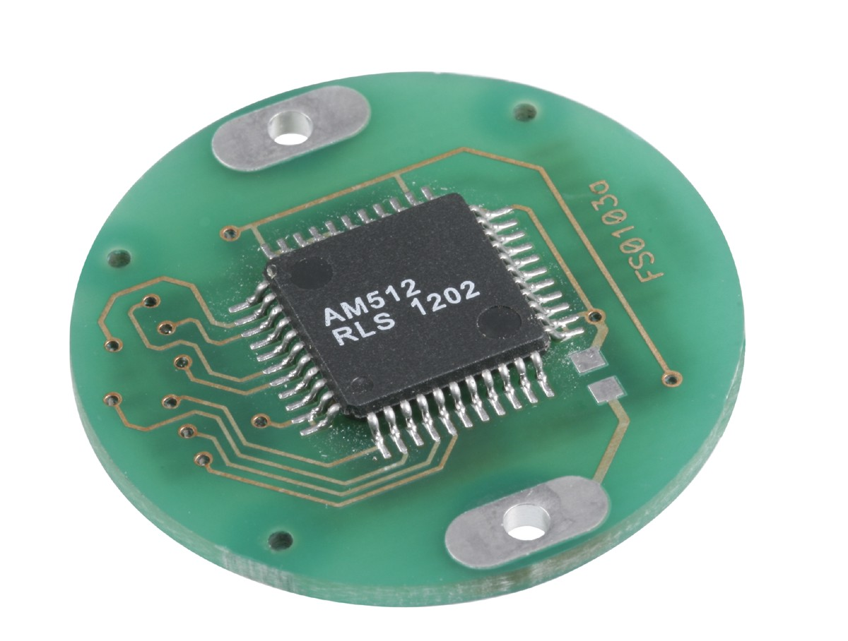
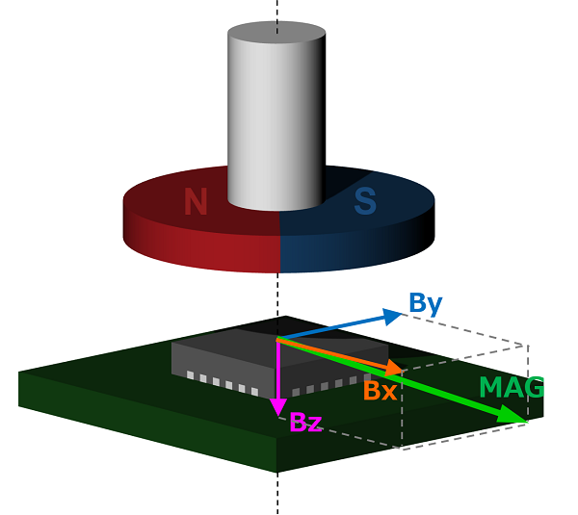
Internal Robot Sensors
Resolvers
A more modern take on the rotary resolver is the magnetic encoder
The orthogonally place hall effect sensor pick up the magnitude of the flux in their plane
This is resolved to give a magnetic vector which rotates with the motor shaft
Sensitive to external magnetic fields

Slide 14
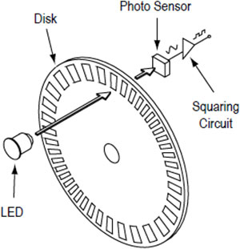
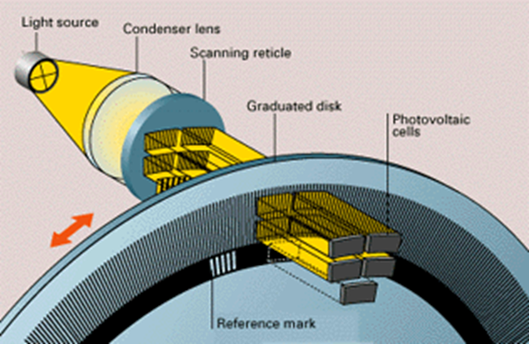
Internal Robot Sensors
Incremental Encoders
These devices use a number of photoemitter/photodetector pairs through a slotted disk to count the number of slots that pass between the pair
Multiple beams are often used to create a quadrature signal and create a ‘zero’ reference point
Magnetic versions exist using a fine multipole magnet ring

Slide 15
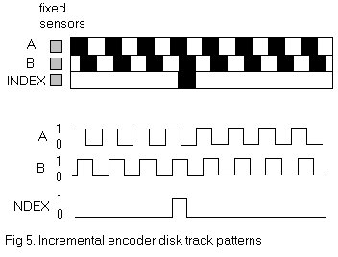
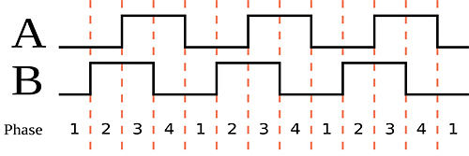
Internal Robot Sensors
Incremental Encoders
The quadrature signal can be used to determine the direction in which the joint is moving
The unique signal from each patch of 4 values from A and B can be used to increase the resolution of the encoder

Slide 16
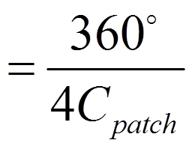
Internal Robot Sensors
Incremental Encoders
The resolution of the encoder can be obtained simply by using the number of these ‘patches’ on each ring
R
C_{patch}= number of slots on either A or B ring
R is the resolution of the encoder on degrees
Incremental encoders are usually cheaper than absolute encoders but need to use the index mark to re-zero them if power is lost or an error occurs

Slide 17
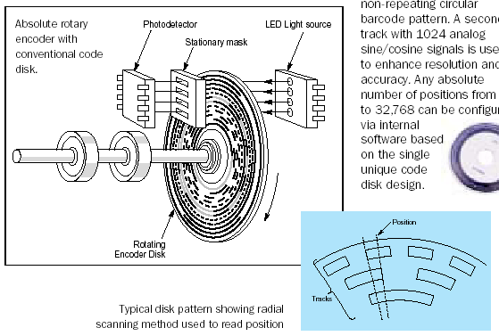
Internal Robot Sensors
Absolute Encoders
These encoders use a glass disc with a binary pattern on it to give the absolute position using photoemitter/receptor pairs again.
Each bit in the pattern requires a separate photodetector.

Slide 18
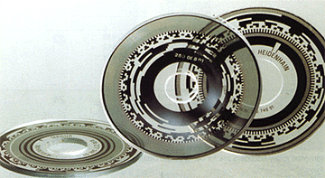
Internal Robot Sensors
Absolute Encoders
The resolution of the encoder depends on the number of bits in the pattern as this determines how many unique codes you can have.
The resolution (R) of an encoder is: R=360/2^{N}
Where n is the number of bits in the binary code

Slide 19
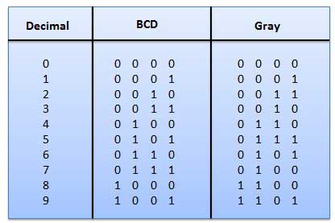
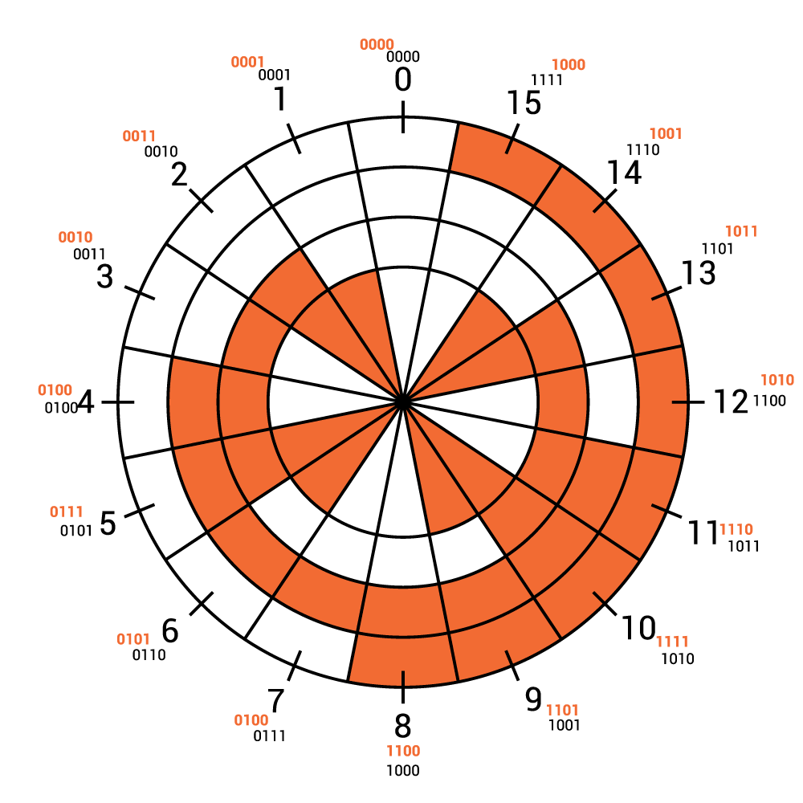
Internal Robot Sensors
Absolute Encoders
Absolute encoders normally use a binary pattern in Gray Code.
Gray Code has the advantage that only one bit changes at once when moving from one code to the next.
This helps prevent boundary positional errors but requires a decoding process to obtain the original binary to get the actual position

Slide 20
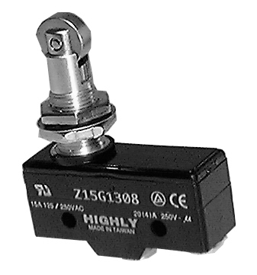
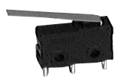

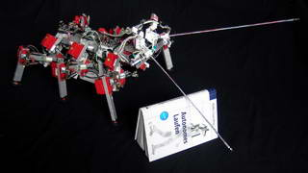
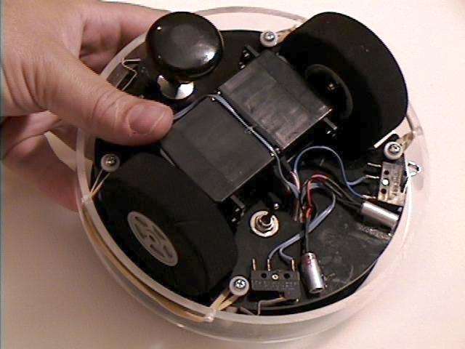
Contact Sensors
Contact sensors are any sensor that gives some form of response when it has actually made physical contact with an object
The simplest of these is a contact switch, normally in the form of a micro switch.
Reed Switch
Lever Switch
Roller Switch
These can be connected to whiskers or bumpers to increase their effective area.

Slide 21
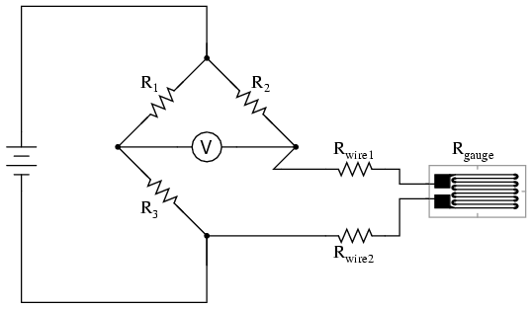
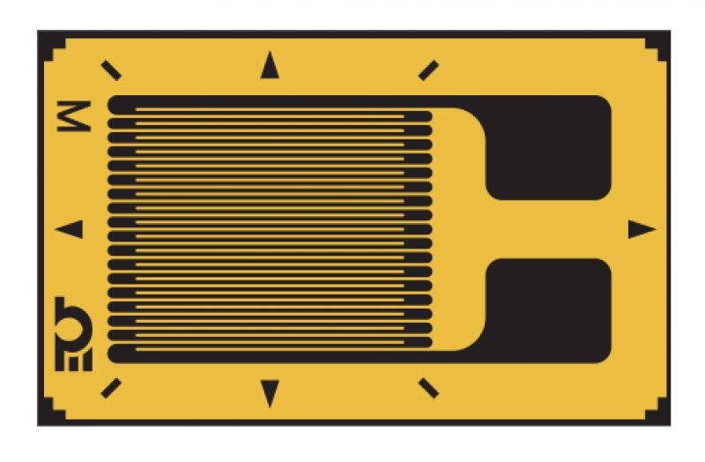
Contact Sensors
Force sensors
If the force of the contact is important then there is a number of ways of measuring this:
Strain gauge
Etched resistance wire that changes resistance when stretched
Will detect small deformation in the surface placed on which will be related to the force
Requires calibration

Slide 22
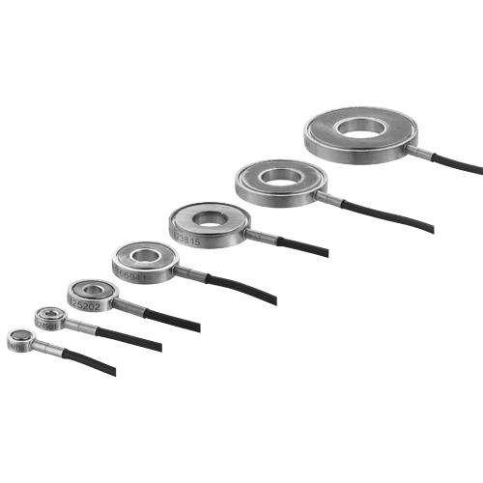
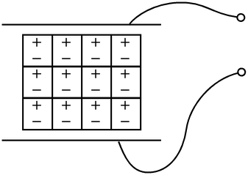
Contact Sensors
Force sensors
Piezoelectric sensor
Applied force produces a transient charge proportional to the force applied
Also requires calibration

Slide 23
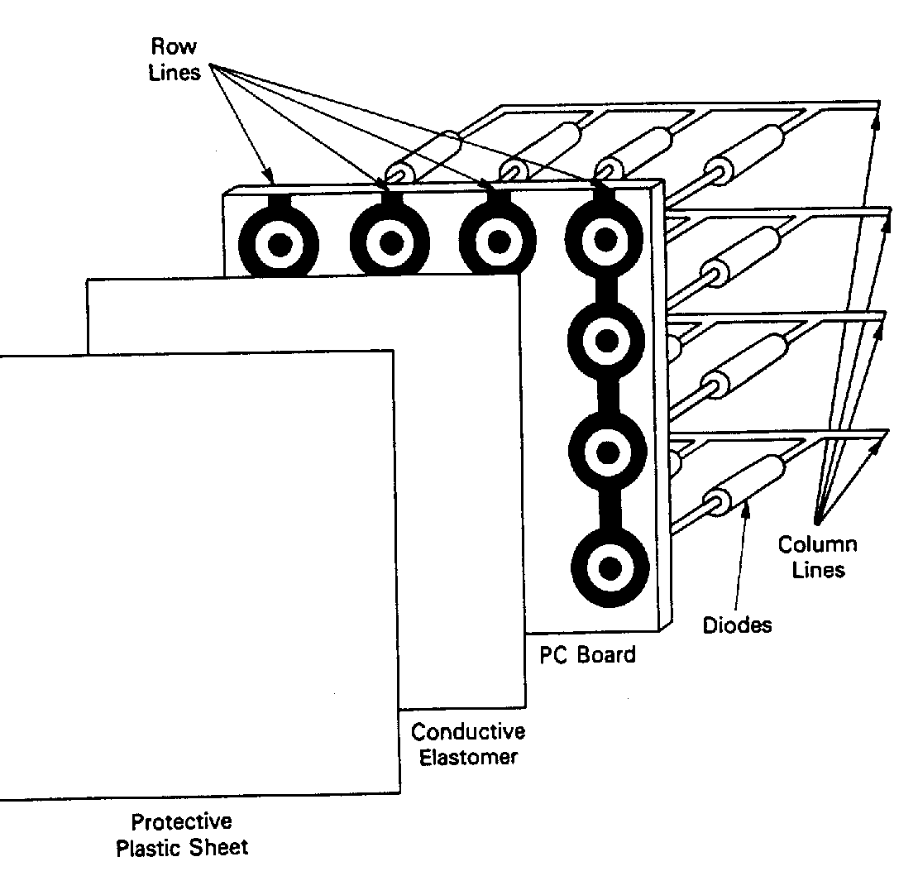
Contact Sensors
Force sensors
Tactile arrays
Both force sensor types can be arrange in arrays if the distribution of force on an object needs to be monitored rather than just the overall force
A similar arrangement can be used if some idea of the shape of the object being held is required by just using simple resistive sensing

Slide 24
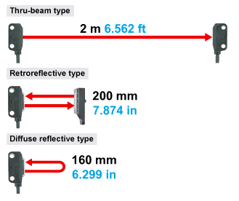
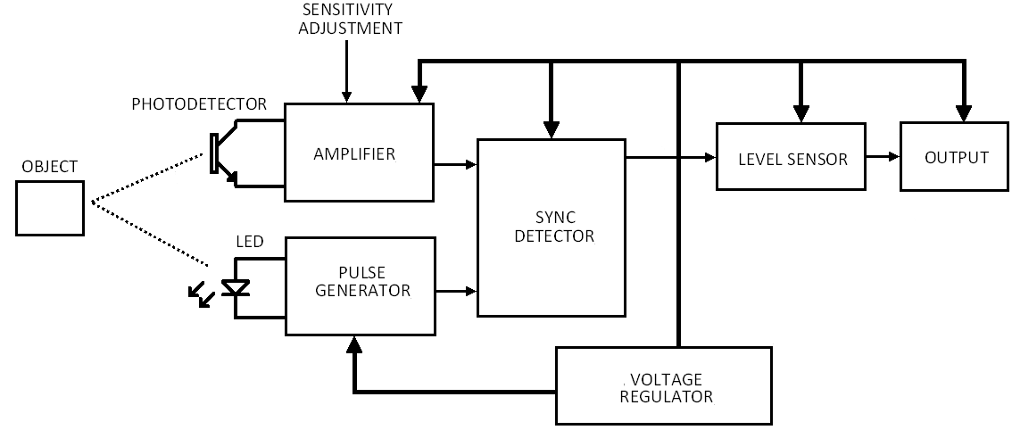
Proximity Sensors
Proximity sensors detect the presence of an object without actually touching it
Reflective photo sensors are very common using the reflection of a light source to detect an object they can be operated in a number of modes
Modulated light is used to prevent local lighting affecting the sensor

Slide 25
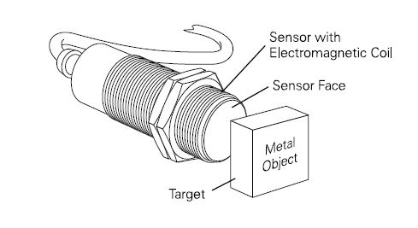
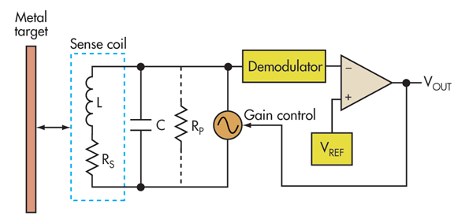
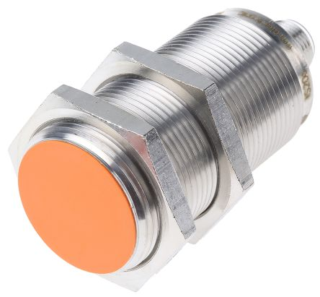
Proximity Sensors
Inductive Proximity Sensors
Inductive sensors generate magnetic fields and then use a second coil to sense inductive coupling
AC oscillation is required to generate a field that will induce coupling
This can vary from 3Khz to 1MHz

Slide 26
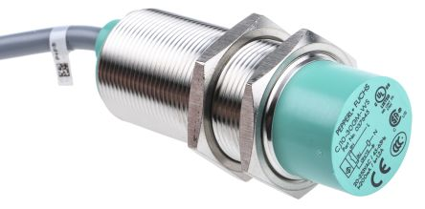
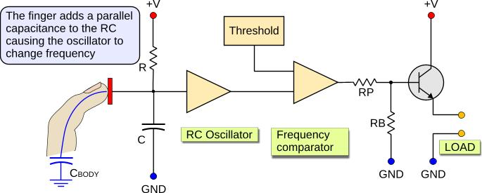
Proximity Sensors
Capacitive Proximity Sensors
Capacitive proximity sensors are very similar but detect changes in electric field coupling by the presence of a dielectric material
The oscillator circuit has its capacitance changed by the dielectric object by the plate which changes the frequency of the internal oscillator
Most objects are dielectrics, particularly polar liquids (i.e. Water)

Slide 27
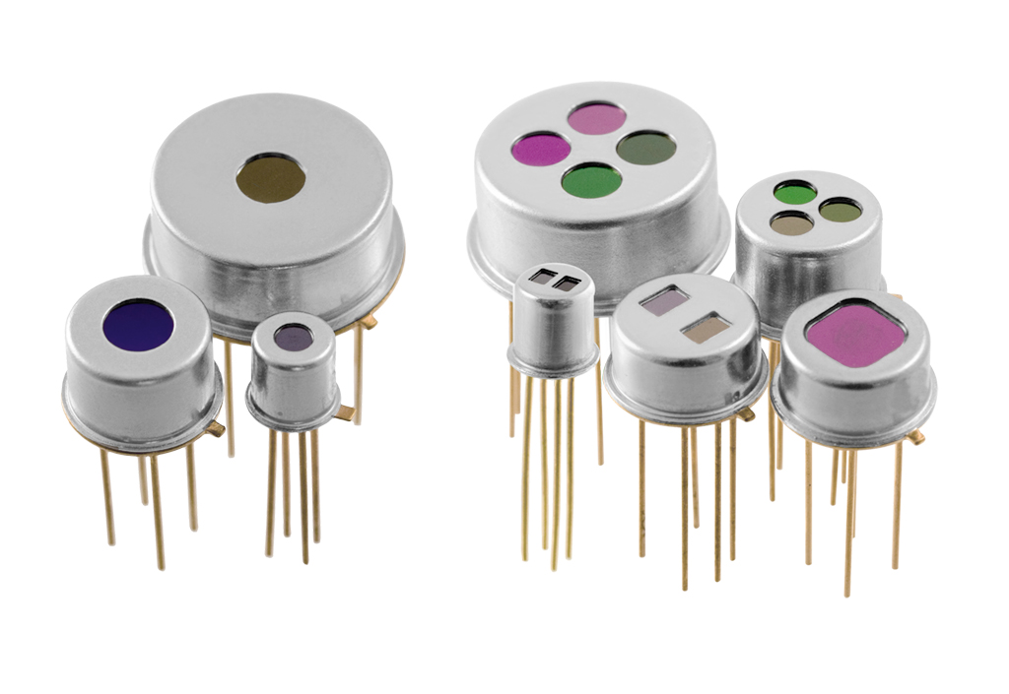
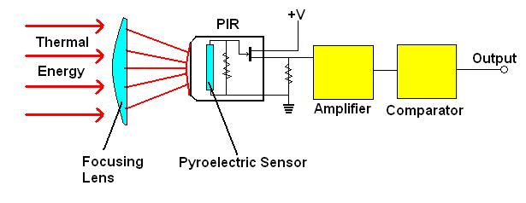
Proximity Sensors
Pyroelectric Proximity Sensors
Pyroelectric proximity sensors detect the presence of object emitting infra red light (heat)
Uses a crystal that produces an electric charge when exposed to IR radiation
Can be selected for particular wavelengths
Can measure temperature with calibration

Slide 28
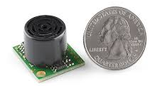
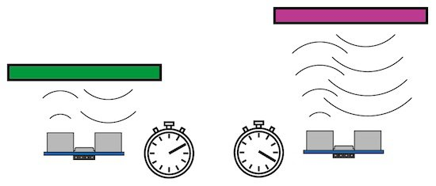
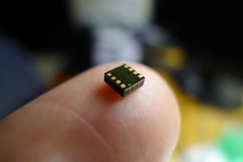
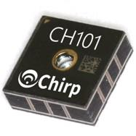
Range Finding Sensors
Range finding sensors tend to use light or sound to detect the range of an object
Ultrasonic range finding is the cheapest implementation but can have a number of drawbacks
Uses a timer to detect the round trip time (t) of a short ‘chirp’
Speed of sound is 343m/s so distance (d) is d=343 * t/2
Can have emitter and sensor as same unit but then has a short dead time while it changes function

Slide 29
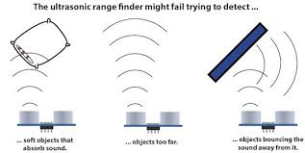
Range Finding Sensors
Ultrasonic rangefinder
Ultrasonic sound does place limitations on this sensor
Diffuse objects tend to absorb the sound
Ultrasonic wavelength are rapidly attenuated in air
The wavelength used is very long so most objects are good reflectors

Slide 30
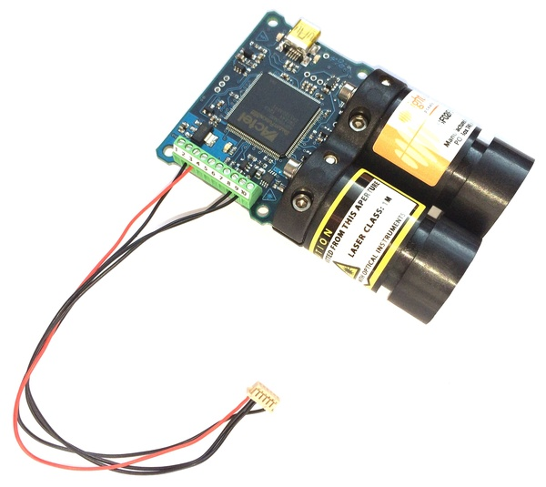
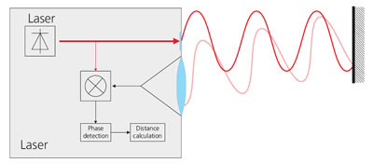
Range Finding Sensors
Laser rangefinder
Laser rangefinders can also use a time of flight method to accuracies of about 2mm but this does not work over very short distances due to the high velocity of light. Another method using phase shifts can also be used.
The light is modulated a high frequency (f) (in MHz region)
The phase difference in the returning light is measured
The distance is given by d= cθ/4пf: c is speed of light, θ is phase shift (rad)

Slide 31
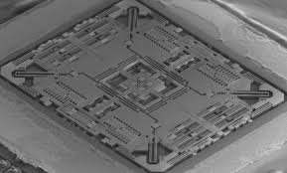
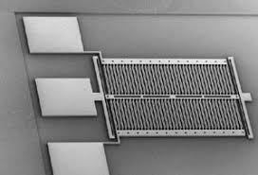
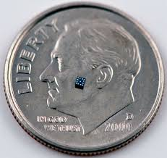
Motion Sensors
It is also possible to measure linear and angular accelerations
Some robot companies use independent gyroscopes and accelerometers to detect vibrations in high speed robot and counter the effect during movement. These devices are now created with MEMS technology.
Gyroscope
Accelerometer
One device is needed per axis

Slide 32
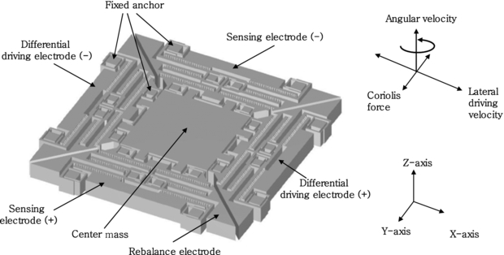
Motion Sensors
MEMS Gyroscope
This utilises the fact that if an object free to vibrate is rotated then that place of vibration tries to remain the same.
The central mass is driven to vibrate by the driving electrodes
If the device rotates the plane of vibration tries to remain the same
This is detected as capacitance changes by the sensing electrodes and gives a measure of the angular acceleration

Slide 33
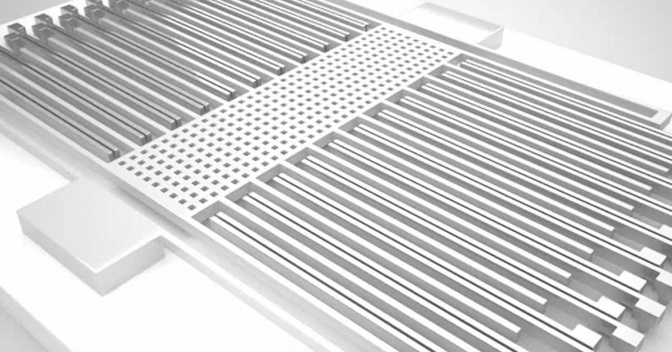
Motion Sensors
MEMS Accelerometer
This utilises the fact that a free mass will try to stay in place if the mass around it is accelerated.
The proof mass move when the device is accelerated
The movement of the finger with respect to the fixed fingers changes capacitance
This is detected and gives a measure of the linear acceleration

Slide 34
Conclusions
Sensors are crucial to most automation processes and essential in robotics
They form the vital feedback link in the control processes we have discussed
Careful selection with consideration of the environment is required
A sensor is often only as good as its calibration!!!

