Slide 1
Peternity
Pet Adoption Website

Slide 2
Introduction
This site will allow you to adopt a pet online, it has database of pets being housed by animal shelters and rescue groups, and are searchable by the public.
It also cooperates with different organizations for animals around the Philippines that help encourage people to adopt, care, and acknowledge pets.

Slide 3
About the website
This Website greatly emphasizes the importance of animals. We showcase different kinds of animals including rescued ones that will surely touch the hearts of the people.
This website does not only serve to bridge the gap between people in dealing with animals as their pets. It will feed new knowledge to both pet lovers and first-time pet owners.

Slide 4
Vision:
Peternity envision a motherland where pets has a safe and forever loving home.
Mission:
Peternity’s mission is to provide a safe place and permanent homes for the animals through care and rescue.

Slide 5
Target Audience
Animal lovers in general who may be interested about adopting a pet.
The public looking for a non-profit organization to voluntarily help animals in foster homes awaiting new owners.
Social Media because it helps to spread the word for animals.

Slide 6
Website activities and objectives
Objectives:
To foster animals especially those in need.
To showcase a variety of animals that are capable to be pets.
To bridge the gap of people and rescued animals.
To raise awareness regarding animal welfare.

Slide 7
Activities that user’s can perform:
Adopt a pet
Fill up form for adoption
Share stories
Participate in discussions
Like and comment
Upload photo for stories
Be updated about news and events

Slide 8
Navigation and Structure
Home
Pet Catalogue
  Rescued Pets
  Pets for Adoption
Community
  Discussion
News and Events
  News
  Upcoming events

Slide 9
FAQ’s
Adopt a pet!
  Steps for adoption
Admin
  Pets
  News
  FAQ’s
  Users
  Logout

Slide 10
User
  Your Profile
  Settings
  Logout
Contact Us
Follow Us
About Us

Slide 11
Competitor Websites
Forest Animal Rescue-https://www.forestanimalrescue.org
We like how they use simple design but we don’t like how they organize their web contents because it may confuse the users.
Happy Animals Club-https://www.happyanimalsclub.org
We don’t like where they put their menu, it was on the bottom together with the least important contents. The user won’t easily see it.

Slide 12
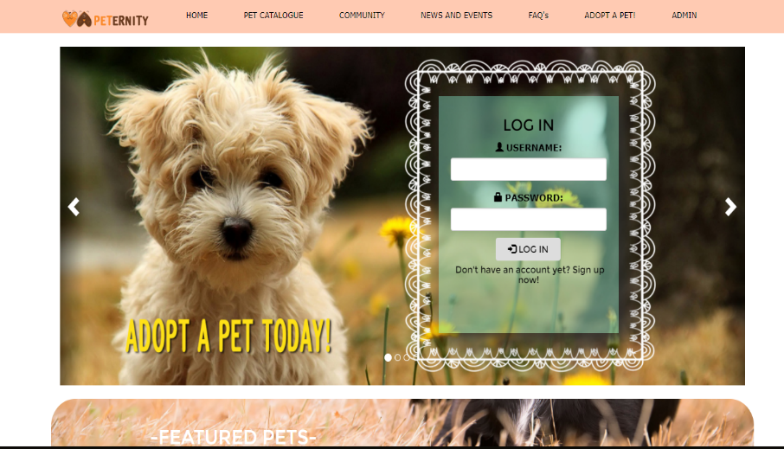
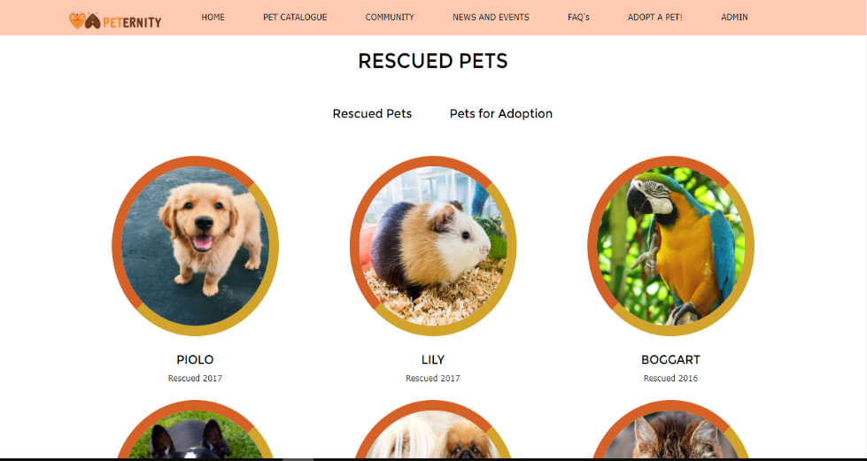
Design
We use the website http://preview.themeforest.net or “petz” for our reference in designing our website.

