Slide 1
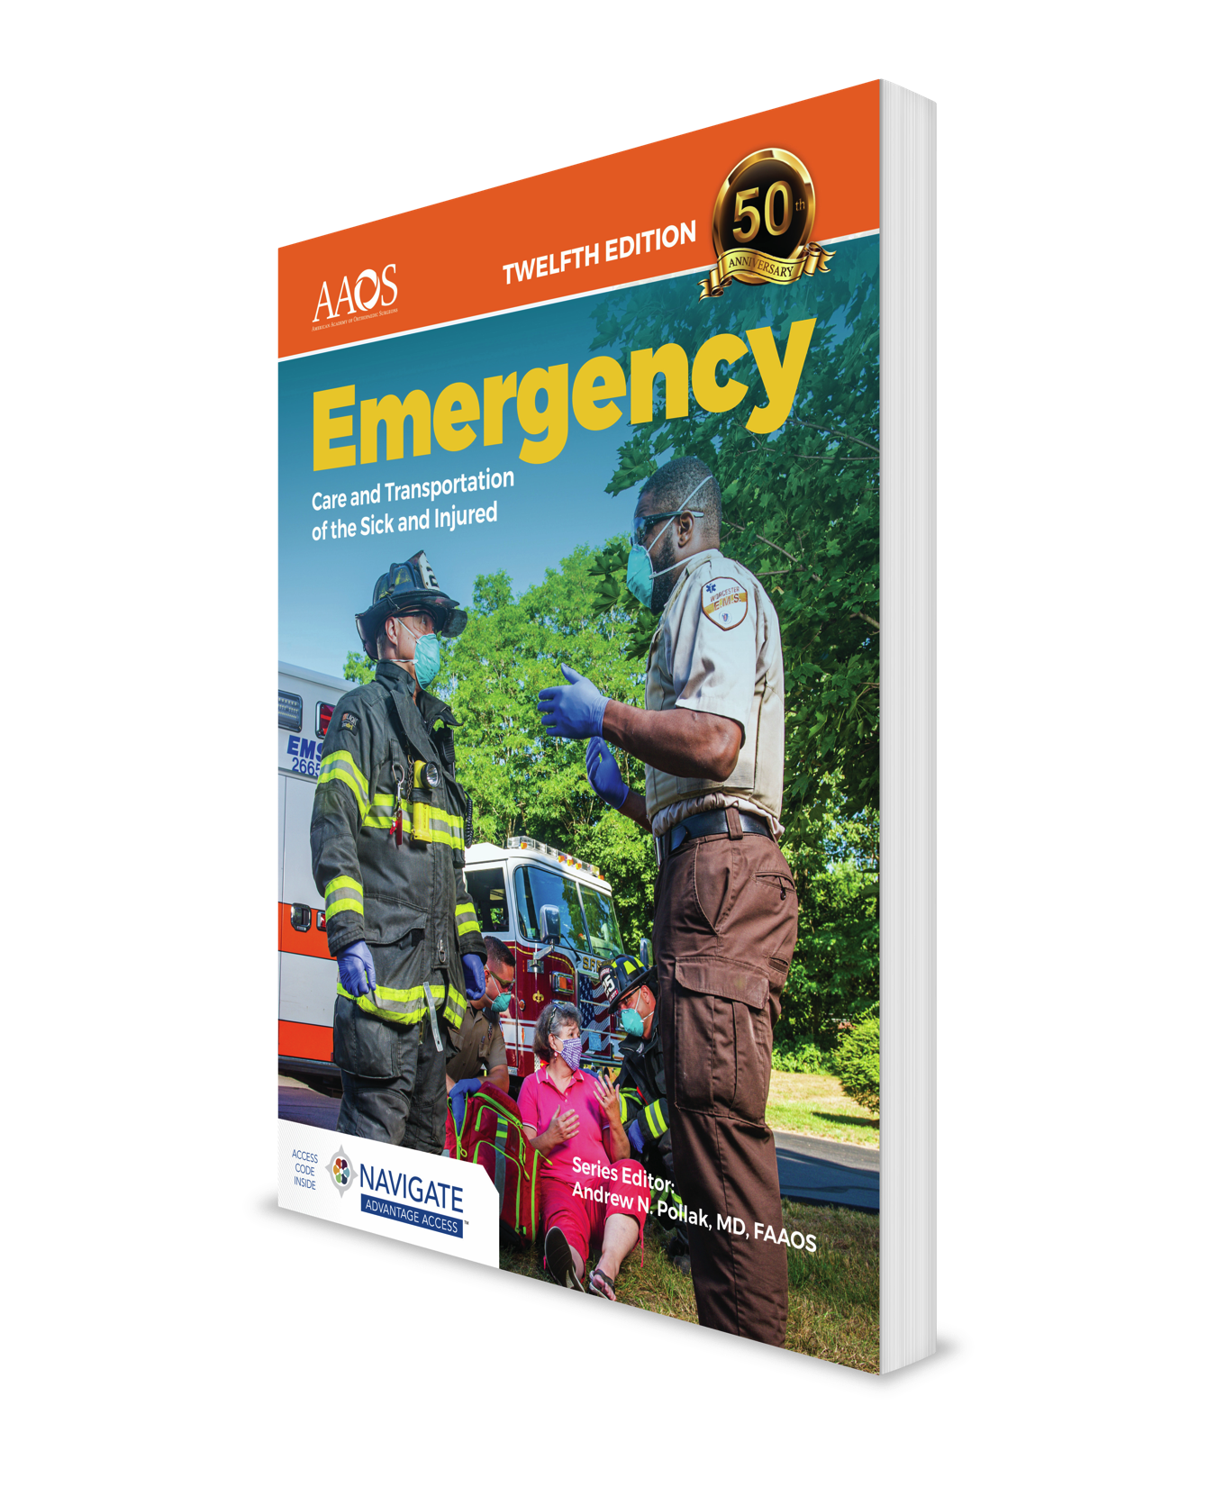
Airway Management
CHAPTER 11 Case Study

Slide 2
Part 1
It’s a warm summer day outside, the temperatures are mild, and rain is in the forecast. You are sitting with your partner when the call comes in: “University Ambulance 2, respond to the lobby of the Maple Tree Hotel for a man with respiratory distress.”
Approximately one out of every four EMS calls is either airway or respiratory related.
Notes:
Instructor Notes
Begin presenting the case.

Slide 3
Part 1
Why is it critical to maintain a patient’s airway and ensure adequate breathing at all times?
How frequently should you assess the condition of a patient’s airway and his or her ability to breathe?
What impact will inappropriate assessment and management of a patient’s airway and breathing have on patient care?
Notes:
Instructor Note
Anything that compromises a patient’s airway patency and ability to breathe also decreases the body’s ability to move the oxygen to the cells that is essential for adequate metabolism and functioning. Cells deprived of oxygen start to die and, in a short time, can lead to organ damage and eventually death.
The quality of a patient’s airway and breathing status should be continuously monitored, with frequent documentation of the patient’s respiratory rate and regularity. Vital signs should be taken every 15 minutes if the patient is stable and every 5 minutes is the patient is unstable.
A patient’s condition can quickly deteriorate, and any delay in assessing or treating airway or respiratory compromise can lead to marked hypoxia in the tissues. As stated before, cells deprived of oxygen start to die and in a short time can lead to organ damage and eventually death.

Slide 4
Part 2
En route to the hotel, you consider the potential causes of your patient’s respiratory distress. Could it be an asthma attack or a heart attack? Could there be some sort of trauma preventing him from breathing well? You are pleased that you thoroughly checked your respiratory equipment and the oxygen cylinders before you left the station that morning. You begin putting on your gloves.
Notes:
Instructor Notes
Continue presenting the case.

Slide 5
Part 2
What are the specific causes of respiratory distress? Which are serious and which are not?
What type of equipment would you anticipate needing to treat a patient with difficulty breathing?
Notes:
Instructor Notes
4. Respiratory distress can be caused by internal factors such as infections, allergic reactions, asthma, chronic obstructive lung disease, airway obstruction, or fluid in the lungs from heart failure or drowning. External factors causing chest or airway trauma, foreign body aspiration, decreased oxygen, or increased toxic products in the environment can also cause respiratory compromise. Shock, a pulmonary embolism, or a pneumothorax can lead to hypoxia and result in respiratory distress as the patient’s body tries to compensate. Head or spinal trauma can also compromise breathing. Any of these can be serious depending on the extent of the compromise that occurs. For example, a simple upper respiratory infection may cause minimal distress, but if it develops into pneumonia, it may cause significant distress.
5. Patients with difficulty breathing will usually need supplemental oxygen, but the device utilized can vary from a nasal cannula to a nonrebreathing mask or even a bag-mask device if the patient’s ventilation is compromised. If the patient’s airway is compromised, a nasopharyngeal or oropharyngeal airway device may be needed to maintain a patent airway. In some cases, a continuous positive airway pressure (CPAP) device may be utilized to increase airway pressures. If ALS is available, the patient may be intubated, and in some cases an automatic transport ventilator/resuscitator (ATV) may be utilized to maintain ventilation.

Slide 6
Part 3
As you arrive at the hotel, you are greeted by hotel security, who report that the man was attending a conference when suddenly he began complaining of difficulty breathing and confusion. He then passed out in his chair. The security officer informs you that the ushers have carefully moved him into the aisle and are trying to keep his airway open.
Notes:
Instructor Notes
Continue presenting the case.

Slide 7
Part 3
As you walk into the room, you notice that the conference session is on break, so few people are around, and there are no immediate hazards. You see only one large patient who appears to be unresponsive. You ask your partner to call dispatch to send ALS.
Notes:
Instructor Notes
Continue presenting the case.

Slide 8
Part 3
How does the information given by hotel security and bystanders help you prepare for your patient?
What are some potential hazards in this situation?
Notes:
Instructor Notes
The history of a sudden onset of trouble breathing and confusion may indicate a heart attack, stroke, anaphylactic reaction, or exacerbation of a chronic respiratory condition. The fact that the patient is unresponsive indicates that he will probably need oxygen administration and possibly ventilation.
As he is the only patient, there is little likelihood of an environmental toxin, although there is still a possibility that he is just the first patient to feel the effects of carbon monoxide, another toxic gas, or a foodborne toxin such as botulism. The patient may also have had a preexisting infection that suddenly worsened or have a yet undiagnosed illness, such as COVID.

Slide 9
Part 4
The ushers step out of the way as you kneel beside the patient. You confirm with the ushers that the patient, in fact, did not fall off his chair but that they lifted him off carefully. You then open his airway using the head tilt–chin lift technique and listen for breathing. You hear snoring respirations that persist even after adjusting his head position. You decide to use an oropharyngeal airway to keep his airway patent. He does not have a gag reflex, so you successfully place the OPA.
Notes:
Instructor Notes
Continue presenting the case.

Slide 10
Part 4
What is the most appropriate method to open an unresponsive patient’s airway when you are considering a chief complaint of difficulty breathing?
Notes:
Instructor Notes
In this patient, who does not appear to have a traumatic injury, a head tilt–chin lift maneuver should be utilized. If needed, the mouth can be opened with a cross-finger technique. Patients with a potential spinal injury should have their airway opened with a jaw-thrust maneuver. If a patent airway cannot be maintained once opened, then an airway adjunct should be considered.

Slide 11
Part 5
Several minutes after inserting an oral airway, your patient begins to gag and vomits. You immediately remove the oral airway and roll the patient to his side. When he finishes vomiting, you clean the large debris from his face and mouth. Your partner has set up the portable suction for you. As you reevaluate the patient’s breathing and airway, you now hear gurgling sounds.
Notes:
Instructor Notes
Continue presenting the case.

Slide 12
Part 5
You grab a rigid tipped catheter, turn on the machine, and open his mouth using a cross-finger technique. After measuring the depth of the catheter against the patient’s face, you insert the catheter into the patient’s mouth and begin counting the seconds. After about 10 seconds, the mouth appears clear of fluids and the gurgling has stopped.
Notes:
Instructor Notes
Continue presenting the case.

Slide 13
Part 5
How important is it to reevaluate the interventions you use to treat your patient?
If your suction catheter does not remove the large debris from the patient’s mouth, how would you remove it?
Notes:
Instructor Notes
9. Some interventions such as oxygen administration levels or airway adjuncts or may have a temporary effect and you may need to repeat the interventions to maintain the patient’s airway patency. Additionally, there is a small possibility that suctioning can cause additional problems such as increased swelling if performed too vigorously or increased hypoxia if performed for too long. In this case, the oral airway caused vomiting when he regained his gag reflex, so it is important to notice that change and remove the oral airway.
The patient can be rolled onto his side into the recovery position and a gloved finger can be used to clear the mouth of any visible debris, being careful not to push any of the debris into the airway.

Slide 14
Part 6
Now that you have cleared your patient’s airway by suctioning, you place the patient in the recovery position and continue with your assessment. You find that breathing is present and adequate in rate and depth. A pulse is present, and there is no evidence of bleeding. Findings from your secondary assessment are normal except for a low pulse oximetry reading of 88%.
Notes:
Instructor Notes
Continue presenting the case.

Slide 15
Part 6
You place your patient on a nonrebreathing mask at 15 L/min and prepare the patient for transport to the hospital. Dispatch reports that the ALS unit is delayed in traffic due to construction.
Notes:
Instructor Notes
Continue presenting the case.

Slide 16
Part 6
This patient needs oxygen. What type of patients should not receive oxygen?
Earlier in your assessment you called for additional help, but now that help is delayed, how does that change your immediate decisions toward the patient’s care?
Notes:
Instructor Notes
11. Although oxygen should be used with caution in some patients, such as patients with chronic obstructive pulmonary disease, oxygen should never be withheld from a patient who is significantly hypoxic and needs oxygen.
When ALS is not available at the scene, the patient should be rapidly transported to the hospital. If ALS can rendezvous en route, that may be beneficial, but transport of patients with significant respiratory compromise should not be delayed to wait for ALS.

Slide 17
Part 7
Despite supplemental oxygen therapy, your patient’s condition has deteriorated. He is more cyanotic and has shallow, slow respirations. You insert a nasopharyngeal airway and begin assisting his ventilations at one breath every 5–6 seconds with a bag-mask device attached to 100% supplemental oxygen.
Notes:
Instructor Notes
Continue presenting the case.

Slide 18
Part 7
He does not resist your attempts to ventilate, and his chest rises and falls with each ventilation. He tolerates the nasal airway. Dispatch reports that paramedics will rendezvous in 5 minutes.
Notes:
Instructor Notes
Continue presenting the case.

Slide 19
Part 7
Is an airway adjunct needed to provide assisted ventilations with a bag-mask device? How does it help?
The patient’s condition is deteriorating, and you have begun ventilations at one every 5 seconds. Is this enough? How do you know if your ventilations are effective?
Notes:
Instructor Notes
13. An airway adjunct would help to maintain a patent airway and provide improved passage of air to the lungs.
14. One breath every 5–6 seconds (10–12/min) is the usual rate for adults, but rates up to one every 3 seconds (20/min) are acceptable for younger patients. Effective ventilations should result in equal, bilateral chest rise and breath sounds on auscultation. Pulse oximetry or capnography can also help to monitor the effectiveness of ventilations.

Slide 20
Part 8
After approximately 2 minutes of assisted ventilation, the patient’s cyanosis has resolved, and his level of consciousness has improved. You continue bag-mask ventilations to maintain adequate tidal volume and rendezvous with the paramedics, who intubate the patient and assist you with transporting him to the hospital, where he is diagnosed with a stroke.
Notes:
Instructor Notes
Continue presenting the case.

Slide 21
Part 8
Following a 2-day stay in the hospital, the patient was discharged to an extended-care facility for continued recovery.
Notes:
Instructor Notes
Continue presenting the case.

Slide 22
Summary
Many factors contribute to respiratory problems. Some are as simple as seasonal allergies and allergic reactions. Other factors are more complex, such as trauma, stroke, or an industrial exposure. Oftentimes the situation may be different on scene from what dispatch has reported.
Notes:
Instructor Notes
Discuss the lessons learned from this case including the causes of respiratory compromise.

Slide 23
Summary
Keeping an open mind to all possibilities will help you to better assess and manage your patient. Few situations will require more equipment than a serious problem with an airway or breathing. Inspect your equipment often so you are prepared to use it when needed.
Notes:
Instructor Notes
Discuss the lessons learned from this case including the devices or treatments that may be used to manage a patient’s airway and the need to be prepared by checking equipment and supplies before a call happens.

Slide 24
Summary
Many hazards may exist on a call. In particular, you should be cautious of unusual odors and the involvement of multiple people. Information from individuals on scene can help you to remain safe and understand the situation better. The assessment and treatment of airway and breathing problems always begins with securing an adequate airway.
Notes:
Instructor Notes
Discuss the lessons learned from this case including scene evaluation for causes of respiratory compromise.

Slide 25
Summary
When treatment is provided, careful reevaluation of the patient is needed to ensure that treatment is effective.
Notes:
Instructor Notes
Discuss the lessons learned from this case, including the need for reevaluation of the patient and the interventions used.

