Slide 1

<CS2111>
Web Application <//OTAKO METER//>
Prepared by:
Jana Mufti - S21106991
Afnan Kamel - S22208066
Aya Mohammed - S21207588
Afrah Bashaddadah - S22107697
Supervised by: Dr. Mohammad Nauman

Slide 2




<//
(Introduction)
//>
(OTAKU METER) is a user-friendly website designed for anime fans. Our platform makes it simple to explore, track, and engage with your favorite anime content. Whether you're looking for new anime to watch, want to keep track of your watchlist, or share your thoughts through ratings and comments, OTAKU METER provides all these features in one place.

Slide 3
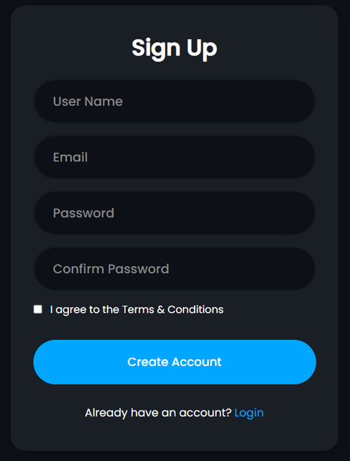
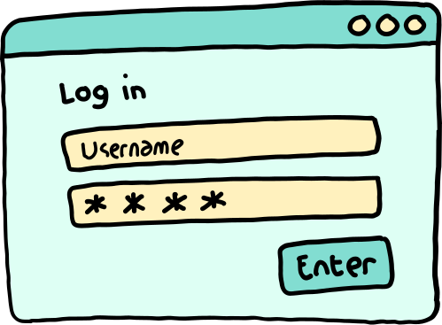
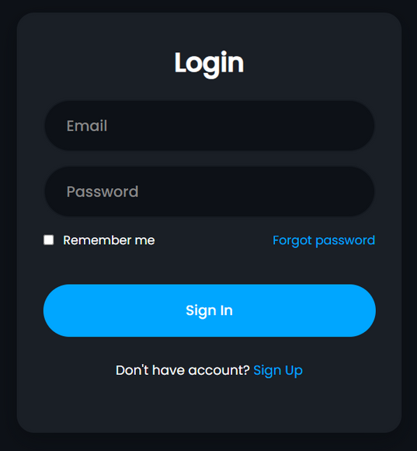

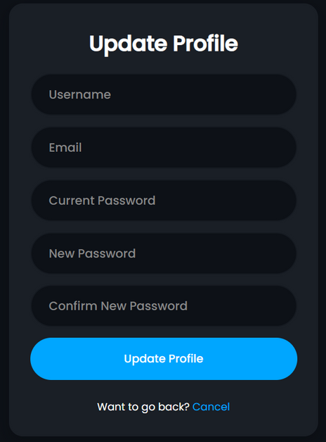

(USER AUTHENTICATION SYSTEM)
  User registration with validation
  Secure login system
  Password hashing
  Profile update functionality
  Error handling and feedback

Slide 4
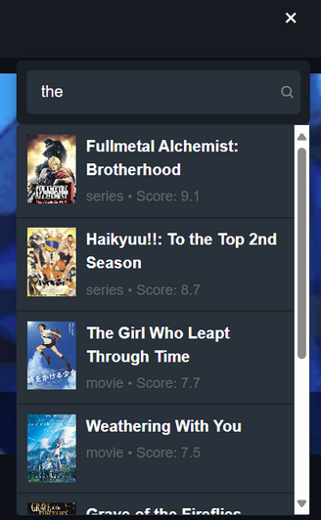
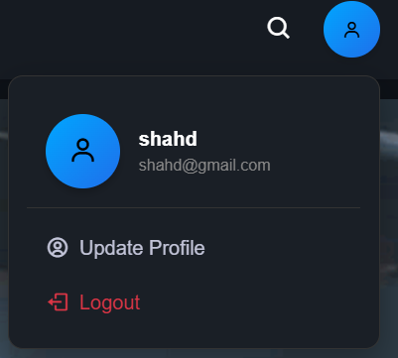



<//
(Navigation Bar and Search Functions)
//>
  Navigation Menu: Home, Top 10, Series, Movies, Watchlist, Contact.
  User Profile: Show info, Logout.
  Search: Toggle, Clear Input, Real-time.

Slide 5

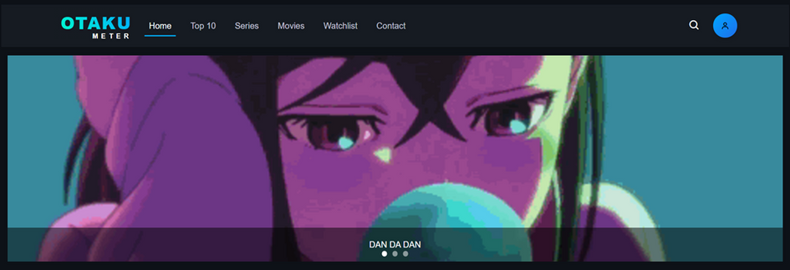
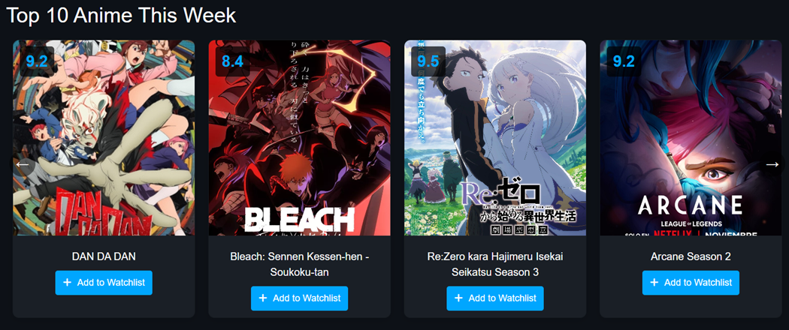
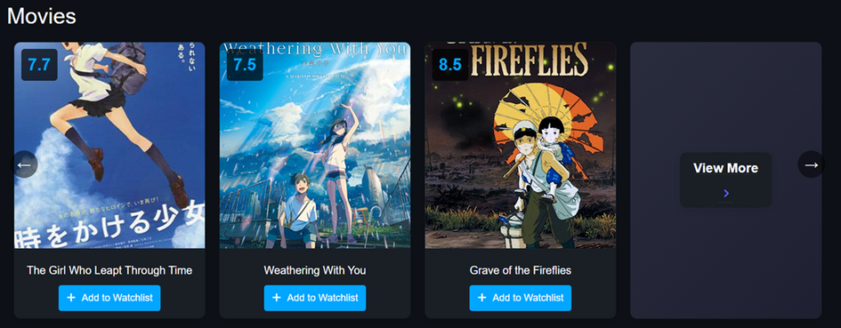
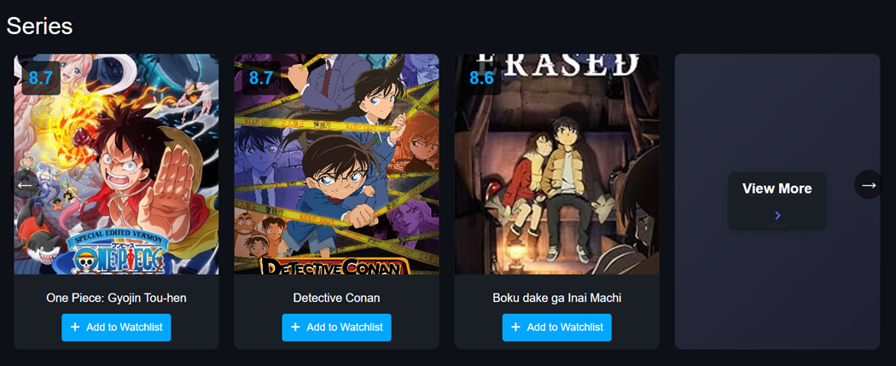
(Home Page)
Featured Anime Showcase
  Large banner highlighting a featured anime with title overlay.
Top Rated Shows
  Section showcasing the week’s highest-rated anime.
  Cards include thumbnails, titles, scores, and "Add to Watchlist" buttons.
Latest Series and Movies
  Sections for newly updated series and movies.
  Consistent card design with thumbnails, scores, and watchlist functionality.
Browse by Categories
  Explore content by type (e.g., Series, Movies).
  Includes a "View More" card for easy access to full lists.

Slide 6


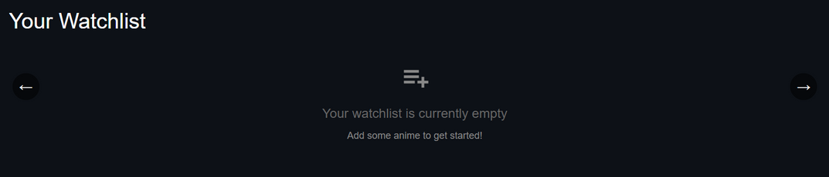
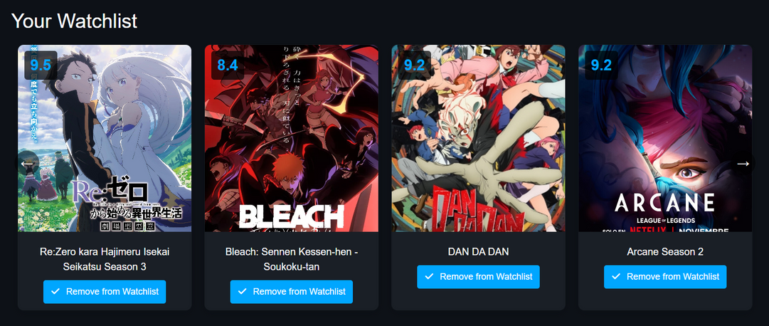

<//
(Watchlist Functions)
//>
  Personal anime collection
  Add/remove functionality
  Real-time updates
  Empty state handling
  Status tracking

Slide 7
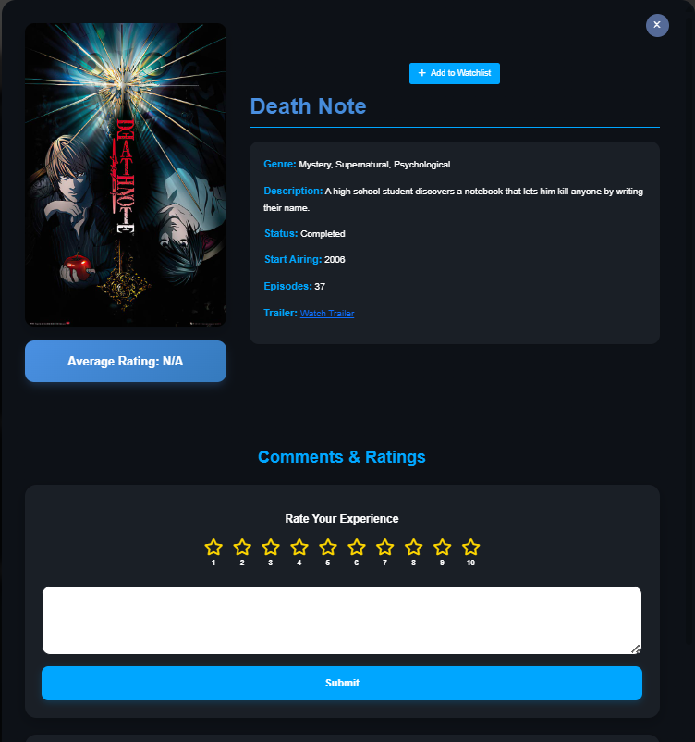


<//
(Anime Details & Interaction Card)
//>
Anime Info: Displays the title, genre, description, status, start year, episode count, and a link to the trailer.
Average Rating: Shows the overall user rating.
Watchlist: Quick "Add to Watchlist" button for saving the anime.
Browse all series and movies

Slide 8
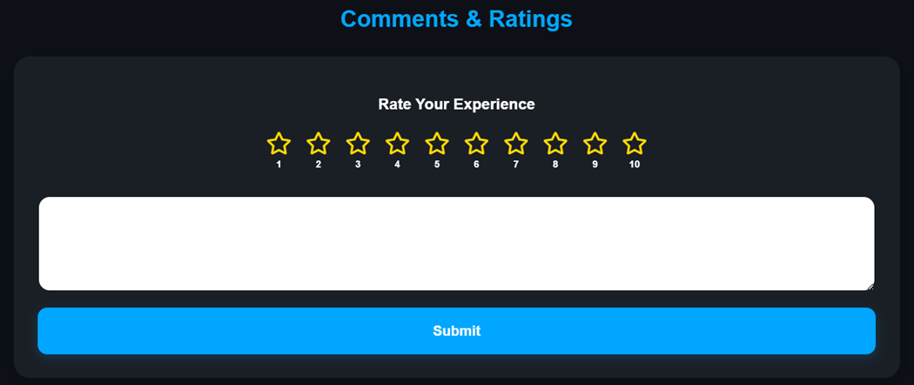
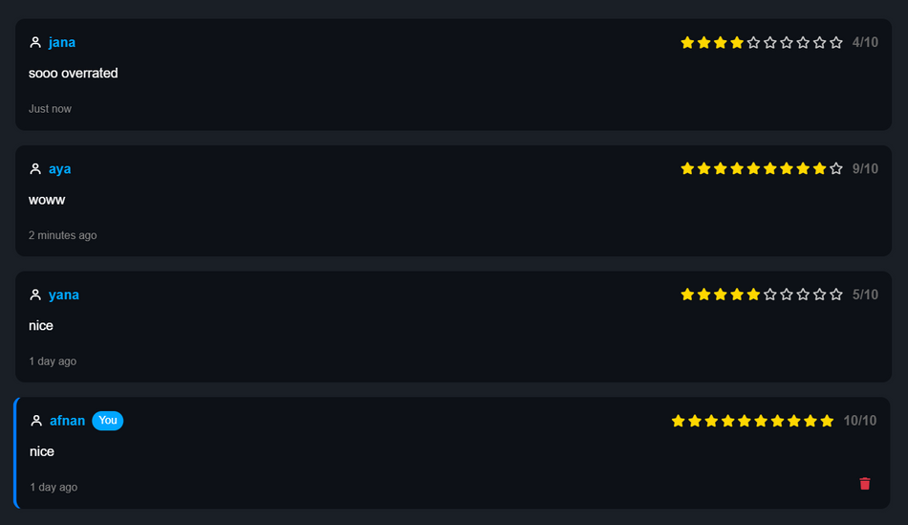


<//
(Ratings & Comments Function)
//>
- 10-star rating implementation
- Comment submission
- Average rating calculation
- Comment deletion
- Timestamp display

Slide 9
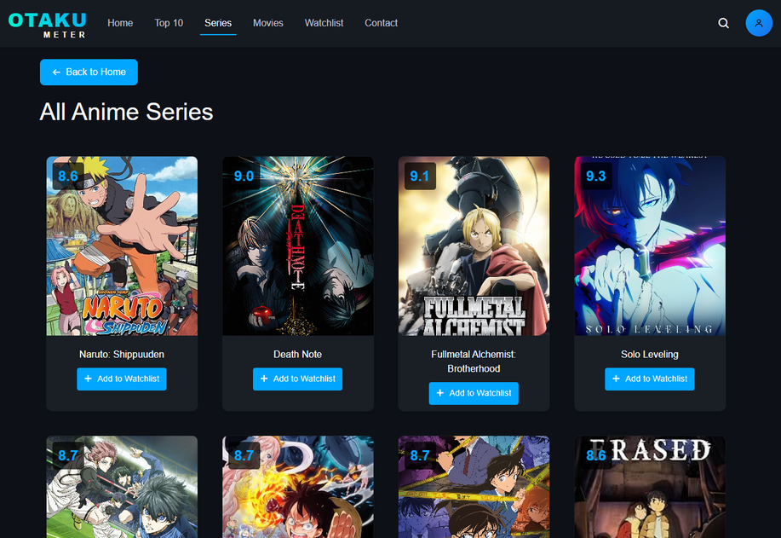


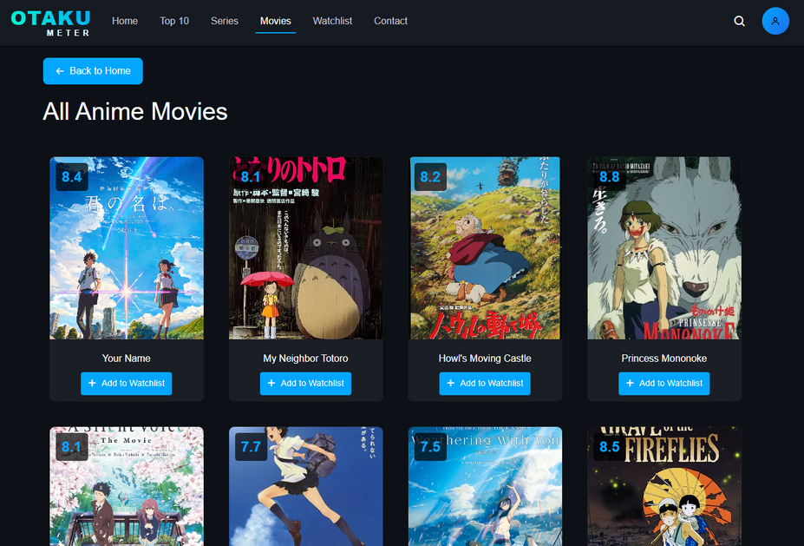


(Series and Movies Pages)
  Organized grid layout
  Detailed anime cards
  Rating display
  Add to watchlist option
  Modal information view
  Back to Home option

Slide 10






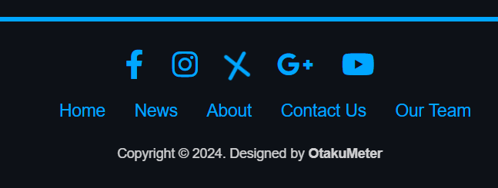












<//
(Footer Section)
//>
  Social media links
  Site navigation links
  Copyright information
  Contact details

Slide 11







<CS2111>
<//THANK YOU//>
A TRULY AMAZING DOCTOR IS RARE TO FIND DIFFICULT TO PART WITH AND IMPOSSIBLE TO FORGET

