Slide 1

InsightIQ
AI research for your
next sales conversation
Cited claims. Conditional fit. Questions worth asking.
Alibaba Bano Qabil AI Hackathon 2026
Notes:
InsightIQ helps people prepare for a sales conversation using public research, their offer, and evidence they can inspect.

Slide 2
The idea behind InsightIQ
For people who sell
Before the conversation
B2B sales teams
Agencies pitching clients
Founders finding customers
What is sourced?
What is inferred?
What should I ask?
Each angle connects a public claim to your offer.
A hypothesis explains the possible fit. A question helps you test it.
Notes:
Our starting point was a common sales problem: knowing a company fact is useful, but knowing how to discuss its possible relevance takes more work. InsightIQ separates the fact, possible fit, and question.

Slide 3
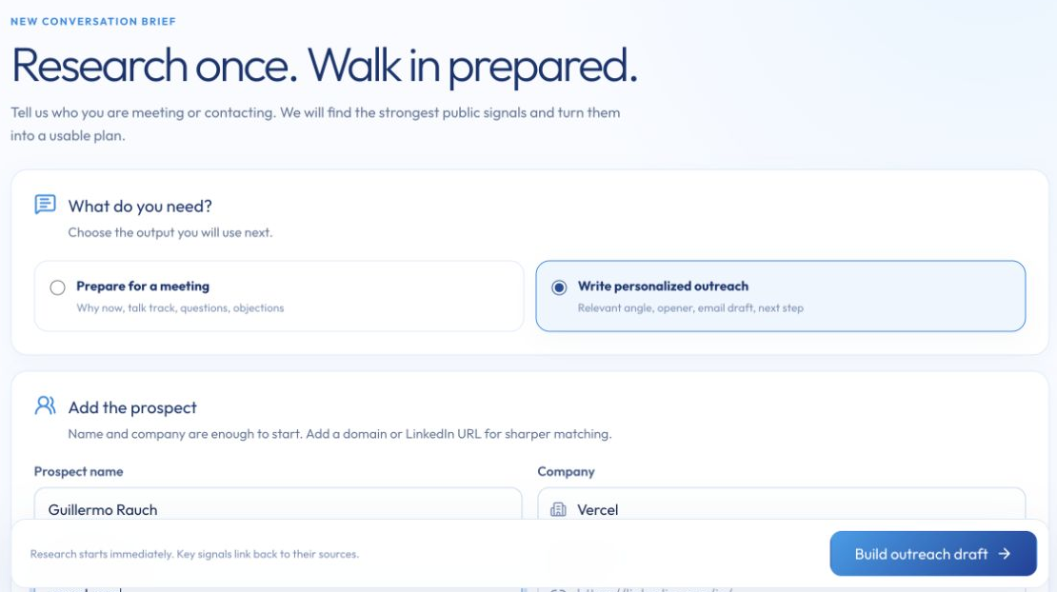
Meeting prep
or outreach
You choose the goal.
Add a prospect and explain
what you sell. InsightIQ
keeps both in context.
Meeting: talking points and questions
Outreach: an opener and draft to adapt
Notes:
The seller chooses meeting preparation or outreach, adds a prospect, and explains the offer. That context shapes the research and output.

Slide 4
How a Deal Brief takes shape
01
02
03
04
05
Context
Discovery
Evidence
Brief
Review
Prospect, offer,
and chosen goal
Relevant public
company signals
Claims with
source links
Brief and
citation checks
Check gaps and
adapt the output
Sources stay attached so the seller can review the reasoning.
Notes:
The workflow saves the context, finds public sources, extracts evidence, and builds a brief. The seller reviews sources and gaps before using the result.

Slide 5
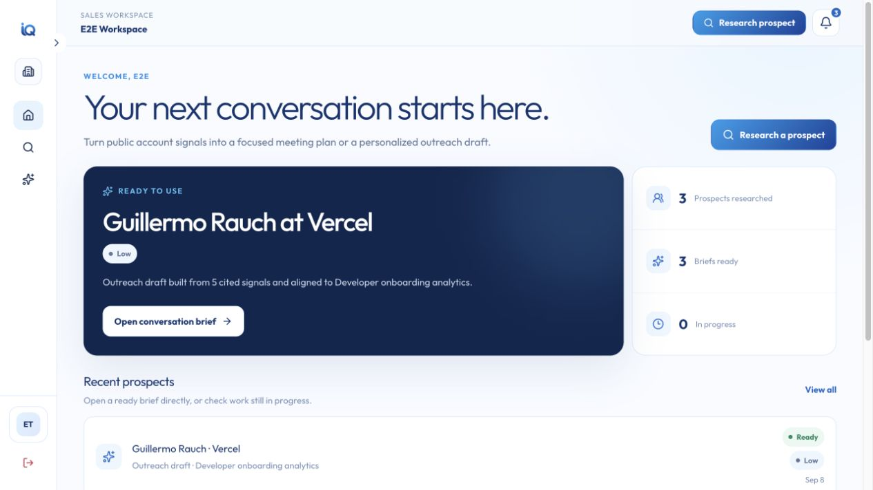
Your research, in one workspace
Research progress
See what is running and what is ready.
Saved briefs
Open the latest research and continue preparing.
Team workspace
Keep prospect research together.
Notes:
This dashboard keeps research progress and saved briefs in the same workspace. A seller can open completed research and continue preparing.

Slide 6
Conversation angles you can test
Vercel example: product detail
Source claim
Why it could matter
Guillermo Rauch created Next.js and Vercel with a focus on developer experience (DX) to make the Web faster.
If the stated focus on developer experience to make the Web faster means Vercel actively tracks where new users struggle, then onboarding funnel analytics combining usage metrics and session feedback might help prioritize documentation and product fixes more effectively.
Hypothesis to validate
Ask in the conversation
How do you currently identify which parts of the initial developer setup cause the most friction?
Notes:
This is an example from a Vercel brief. The source claim stays separate from the possible fit. The conditional wording matters: the seller still needs to test the hypothesis by asking the question.

Slide 7
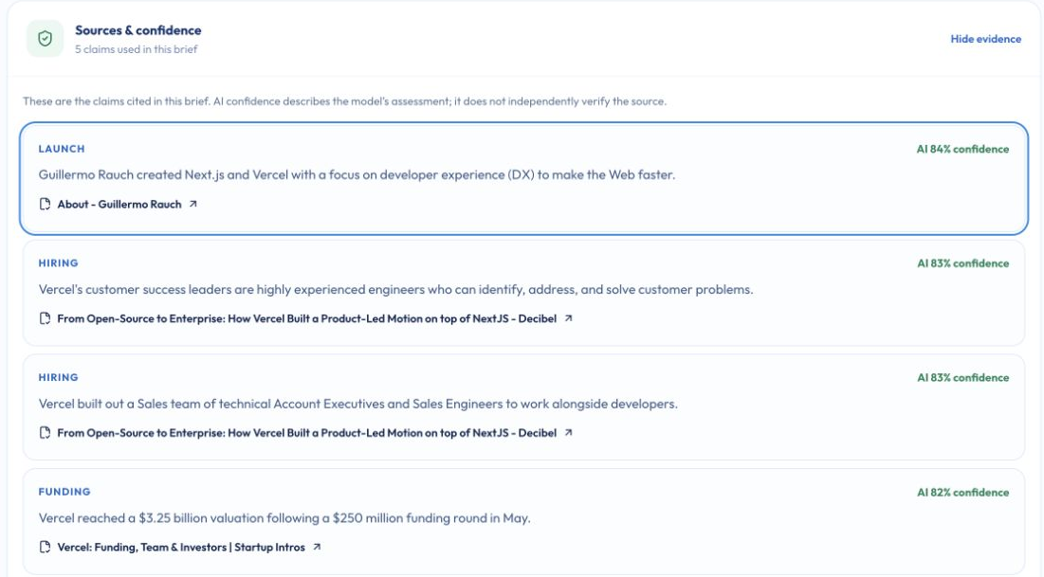
The evidence stays within reach
Trace each signal
Key signals must match a stored claim and its source URL.
Check the gaps
Review freshness and contradictions before using the brief.
AI-generated demo research. Source links make claims traceable, not guaranteed.
Notes:
A seller can inspect the evidence behind a signal and check source freshness or contradictions. A citation makes a claim traceable, but human judgment still matters.

Slide 8
Architecture
A responsive app, with research running in the background
Web dashboard
Next.js
API and accounts
NestJS
Data and job queue
PostgreSQL
Research worker
Python + LangGraph
Public discovery
Tavily
AI inference
Qwen
DashScope
PostgreSQL stores workspace data and queues research jobs.
Notes:
The Next.js dashboard talks to a NestJS API. PostgreSQL stores the workspace and research jobs. A Python and LangGraph worker runs the research, using Tavily discovery and Qwen through DashScope.

Slide 9
An outreach draft for your review
A source-based opener, a conditional fit, and a question that invites a reply.
Hi Guillermo,
I noticed Vercel’s stated vision includes providing analytics as part of an end-to-end platform. With 3 product tiers and technical Account Executives working alongside developers, I’m curious how your team identifies where developers get stuck during onboarding.
We help developer platforms combine usage metrics and session feedback to prioritize documentation and product fixes. If improving onboarding visibility is a current focus, would it make sense to connect?
Best,
E2E Tester
Personalize the message and verify its claims before sending.
Notes:
The outreach draft connects the research to the offer and invites a reply. The seller can personalize the message and verify its claims before sending.

Slide 10
InsightIQ
Turn research into
a conversation
worth having.
Built by
Afnan Ahmad Tariq
Danyal Rana
Hassan
insightiq.zerotools.online
Notes:
InsightIQ was built by Afnan Ahmad Tariq, Danyal Rana, and Hassan. The product is available at insightiq.zerotools.online.

