Slide 1

Lead Trace
Discover prospects.
Keep sales moving.
Lead discovery, a built-in CRM, and cited sales research in one workspace.
Current product · 24 October 2026 · leadtrace.online
Notes:
Product screenshots: current code at 9b48d53, captured 24 October 2026 in an isolated sample-data workspace. All people, companies, deal values and research in screenshots are fictional. Screens show the actual application UI, not a live provider run. Source: repository README.md; apps/web/components/crm; apps/api/src/leads; apps/api/src/crm.

Slide 2

InsightIQ is now Lead Trace
We listened to feedback from industry professionals and shaped our next stage around the needs of sales teams.
InsightIQ
Lead Trace
Industry feedback shaped a connected workflow: discover leads, manage relationships, and prepare with evidence.
Notes:
Product screenshots: current code at 9b48d53, captured 24 October 2026 in an isolated sample-data workspace. All people, companies, deal values and research in screenshots are fictional. Screens show the actual application UI, not a live provider run. Source: repository README.md; apps/web/components/crm; apps/api/src/leads; apps/api/src/crm.

Slide 3
A connected sales workflow
For people who sell
Questions the workspace answers
B2B sales teams
Agencies pitching clients
Founders finding customers
Who fits our buyer profile?
What should happen next?
Which evidence supports the brief?
Keep discovery, CRM, and preparation connected.
Source quotes support review. Follow-ups keep the next action visible.
Notes:
Product screenshots: current code at 9b48d53, captured 24 October 2026 in an isolated sample-data workspace. All people, companies, deal values and research in screenshots are fictional. Screens show the actual application UI, not a live provider run. Source: repository README.md; apps/web/components/crm; apps/api/src/leads; apps/api/src/crm.

Slide 4
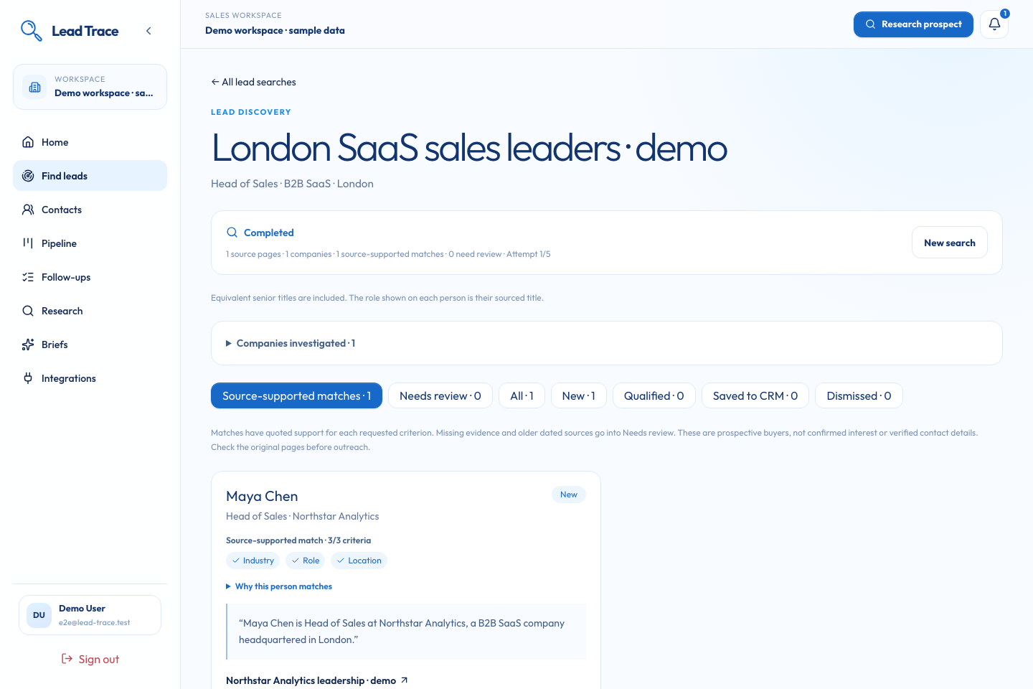
Find leads
with evidence
Start with a buyer profile
Search companies, then people.
Check role, industry, and
location evidence before saving.
Search, full-page reads, and site crawls
GLEIF · Wikidata · SEC EDGAR
Fictional demonstration workspace
Notes:
Product screenshots: current code at 9b48d53, captured 24 October 2026 in an isolated sample-data workspace. All people, companies, deal values and research in screenshots are fictional. Screens show the actual application UI, not a live provider run. Source: repository README.md; apps/web/components/crm; apps/api/src/leads; apps/api/src/crm.

Slide 5
Lead Trace
Discovery to the next sales action
From buyer profile to the next action, with source evidence attached
01 Discover
02 Review
03 Save
04 Prepare
05 Act
Buyer profile
and sourced
companies
Current role,
buyer-fit evidence,
and qualification
Reviewed lead
becomes a
CRM contact
Offer context
and a cited
conversation brief
Deal, note,
follow-up, or
Calendar meeting
Evidence stays attached when a reviewed lead becomes a CRM contact.
leadtrace.online
Notes:
Product screenshots: current code at 9b48d53, captured 24 October 2026 in an isolated sample-data workspace. All people, companies, deal values and research in screenshots are fictional. Screens show the actual application UI, not a live provider run. Source: repository README.md; apps/web/components/crm; apps/api/src/leads; apps/api/src/crm.

Slide 6
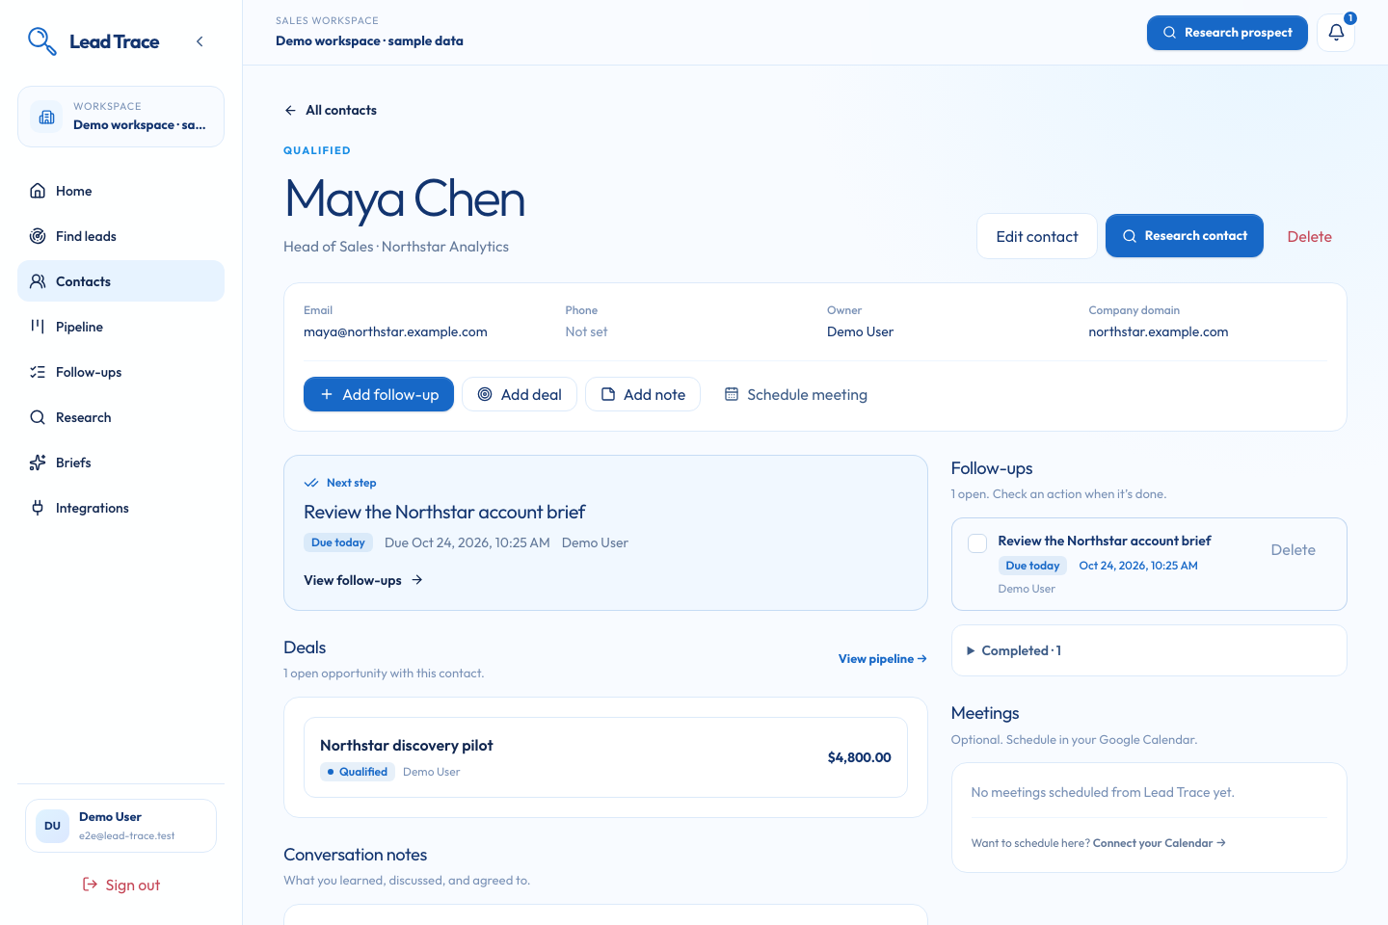
CRM built around the next action
Contact context
Keep ownership, notes, and research with the person.
Deal tracking
Track stage, value, currency, and expected close.
Next action
Set a follow-up or schedule a meeting.
Fictional demonstration data
Notes:
Product screenshots: current code at 9b48d53, captured 24 October 2026 in an isolated sample-data workspace. All people, companies, deal values and research in screenshots are fictional. Screens show the actual application UI, not a live provider run. Source: repository README.md; apps/web/components/crm; apps/api/src/leads; apps/api/src/crm.

Slide 7
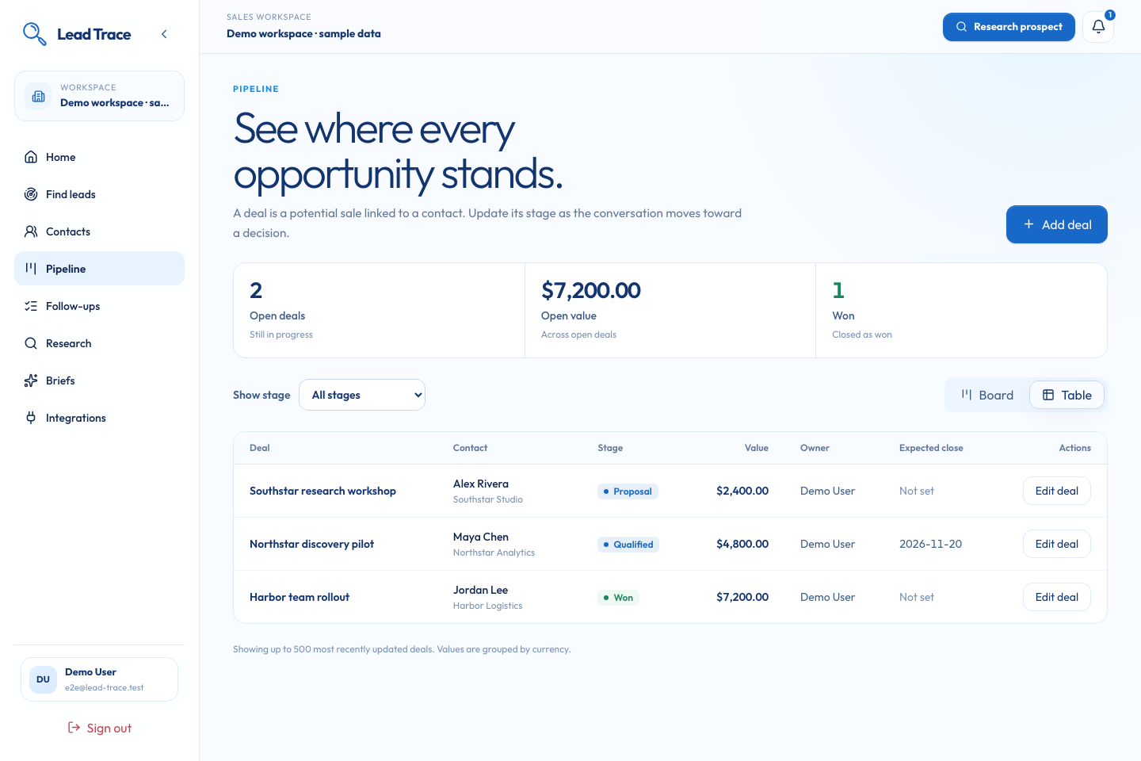
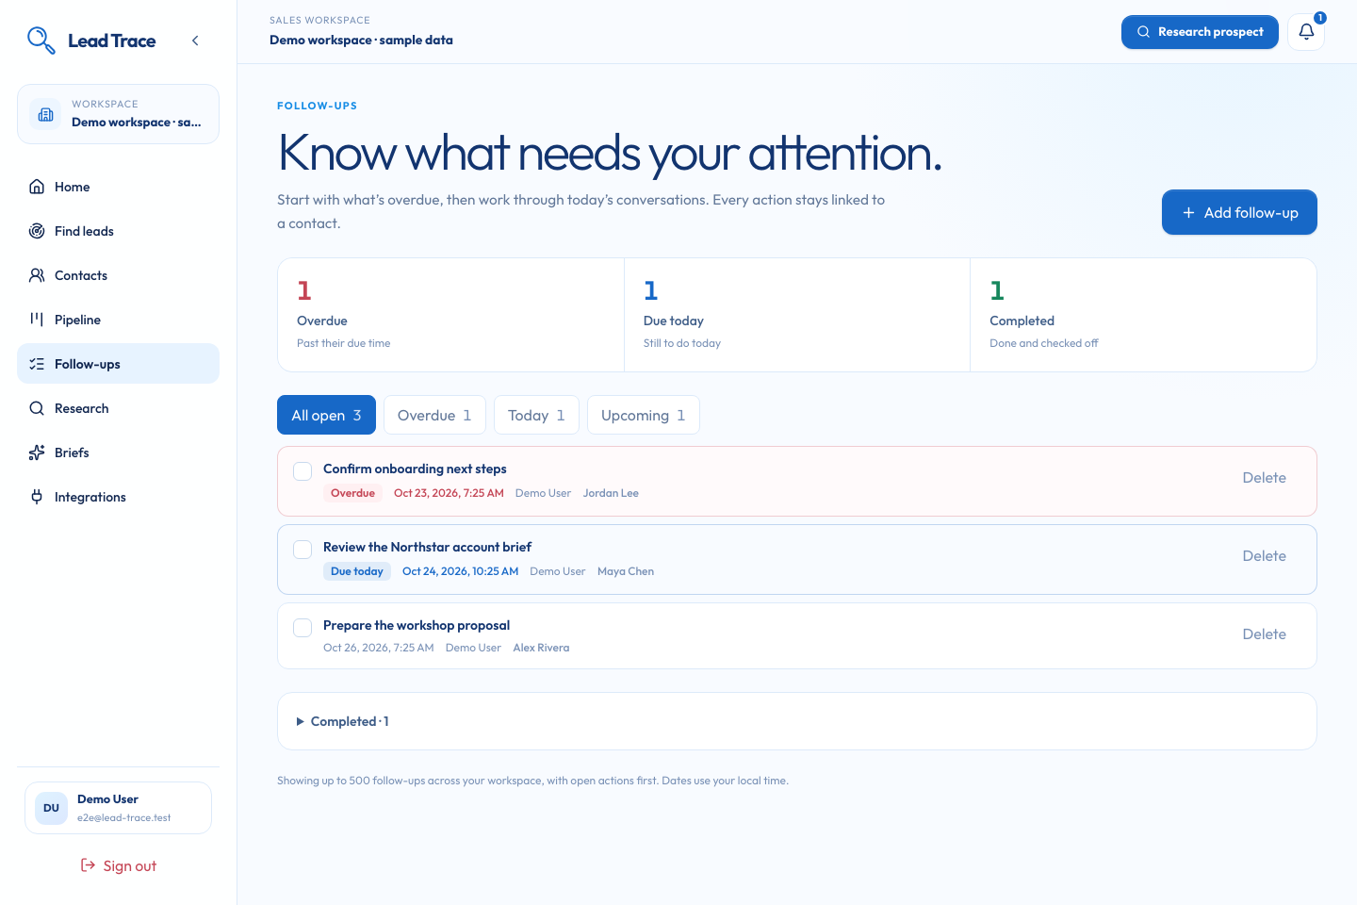
Pipeline and follow-ups
Track the opportunity and the next action in the same workspace
Board and Table views
Due today, overdue, or upcoming
Deal stages, ownership, and value remain visible. Completed follow-ups can be reopened.
Fictional demonstration data. Follow-ups are tracked actions; automatic reminders are not implemented.
Notes:
Product screenshots: current code at 9b48d53, captured 24 October 2026 in an isolated sample-data workspace. All people, companies, deal values and research in screenshots are fictional. Screens show the actual application UI, not a live provider run. Source: repository README.md; apps/web/components/crm; apps/api/src/leads; apps/api/src/crm.

Slide 8
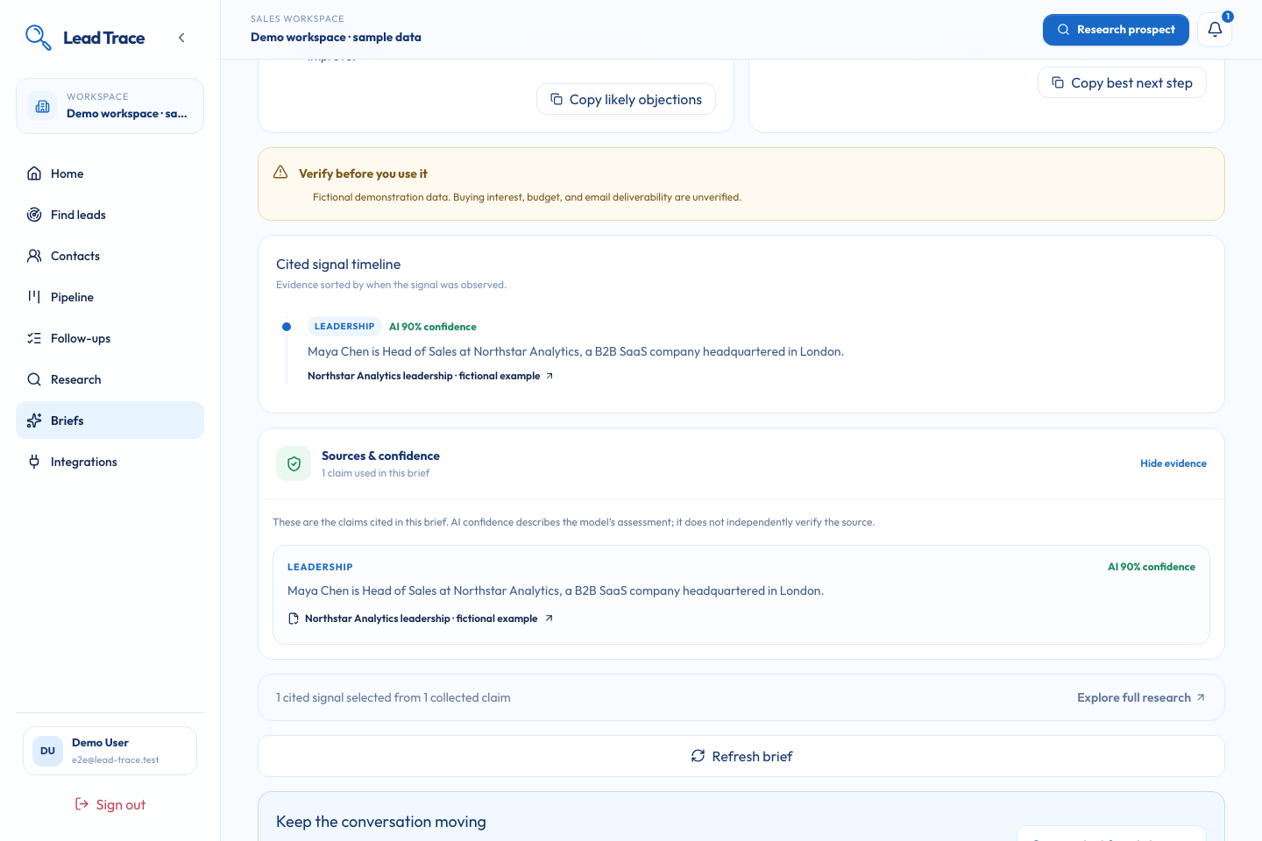
Cited research for the next conversation
Inspect the source
Each key signal links to its stored claim and source URL.
Review and reuse
Check gaps, adapt the outreach draft, then copy or export.
Fictional demo data. A source claim, a hypothesis, and a question stay distinct.
Notes:
Product screenshots: current code at 9b48d53, captured 24 October 2026 in an isolated sample-data workspace. All people, companies, deal values and research in screenshots are fictional. Screens show the actual application UI, not a live provider run. Source: repository README.md; apps/web/components/crm; apps/api/src/leads; apps/api/src/crm.

Slide 9
Lead Trace
Lead Trace architecture
Discovery and CRM in the API; research in a separate background worker
Web dashboard
API and accounts
Data and jobs
Research worker
Next.js
Cloudflare / OpenNext
NestJS · Better Auth
CRM + lead jobs
PostgreSQL
Prisma · job leases
Python
LangGraph
Public discovery and company registries
Optional integration
AI inference
Tavily Search · Extract · Crawl
GLEIF · Wikidata · SEC EDGAR
Google Calendar
OAuth · meetings
Qwen / DashScope
Qualification + briefs
The API and research worker share source evidence and the configured model provider.
leadtrace.online
Notes:
Product screenshots: current code at 9b48d53, captured 24 October 2026 in an isolated sample-data workspace. All people, companies, deal values and research in screenshots are fictional. Screens show the actual application UI, not a live provider run. Source: repository README.md; apps/web/components/crm; apps/api/src/leads; apps/api/src/crm. Architecture sources: apps/api/src/leads/lead-discovery-worker.ts; apps/api/src/leads/lead-deep-discovery.service.ts; apps/worker/src/lead_trace_worker; docker-compose.yml. Calendar is OAuth event creation, not two-way sync.

Slide 10
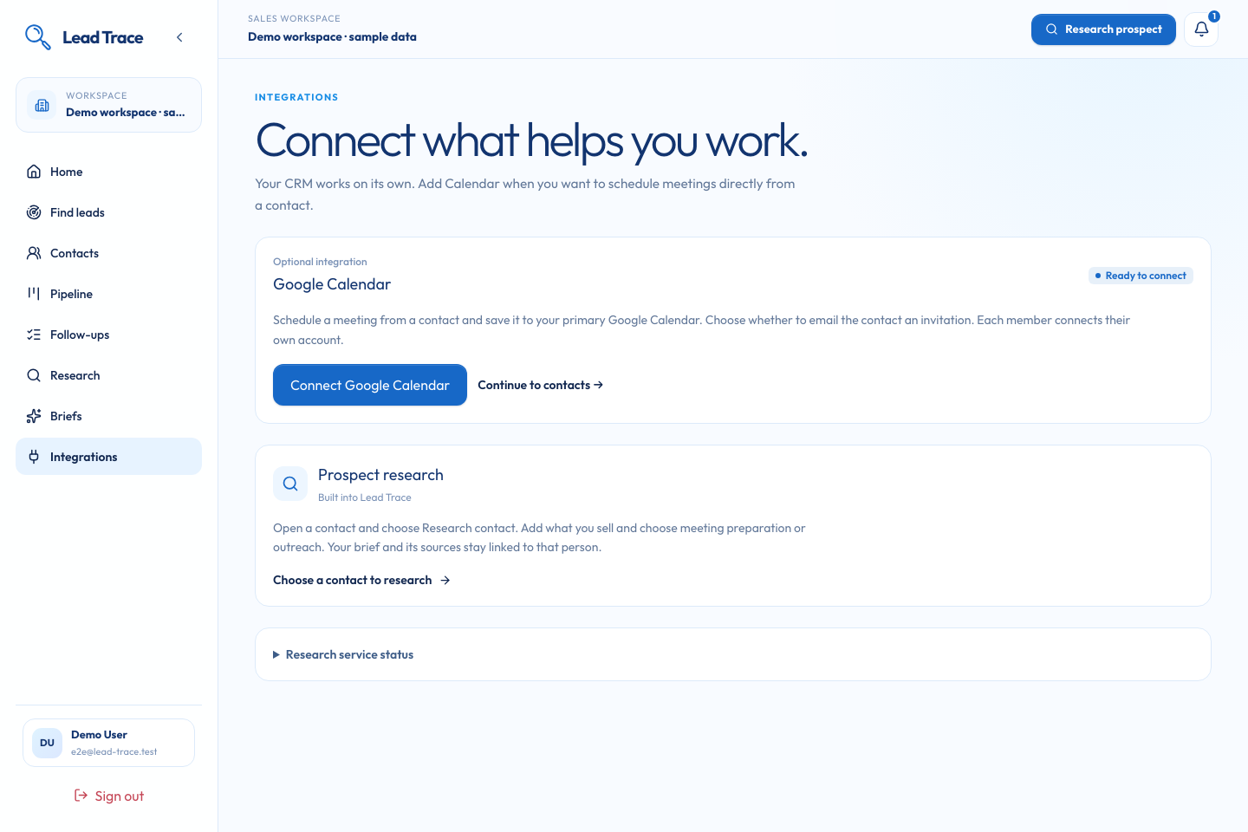
Meetings and follow-ups
Optional Google Calendar scheduling, with explicit invitation control
Connect your own Calendar
Create an event from a contact.
Choose whether to invite the contact.
You can track a follow-up
without connecting Calendar.
Account authorization is required. Invitations are opt-in; two-way Calendar sync remains planned.
Notes:
Product screenshots: current code at 9b48d53, captured 24 October 2026 in an isolated sample-data workspace. All people, companies, deal values and research in screenshots are fictional. Screens show the actual application UI, not a live provider run. Source: repository README.md; apps/web/components/crm; apps/api/src/leads; apps/api/src/crm.

Slide 11
Live validation and next priorities
What has been demonstrated, and what remains ahead
Live audit · 23 October 2026
Next priorities
9 prospective buyers discovered
1 matched all sourced criteria
CRM save to a completed cited brief
11 research sources · 15 evidence items
Shared company records
Contact merging
Recurring lead searches
Email integration
Two-way Calendar sync
One live cohort, not a market-coverage benchmark. Buying intent and contact details remain unverified.
Notes:
Recorded live cohort: docs/lead-generation-live-audit.html, captured 23 October 2026. https://github.com/afnanahmadtariq/lead-trace/blob/v1.4.0/docs/lead-generation-live-audit.html . The audit found 9 prospects and 1 fully source-supported match, then completed the CRM-to-research journey with 11 sources and 15 evidence items. Counts describe one small audit, not precision/recall, sales outcomes, or current live results. Future scope is uncommitted and subject to development feedback. Latest implemented CRM deletion controls are not listed as future work.

Slide 12
Lead Trace
Find the lead.
Know the context.
Track the next step.
Built by
Afnan Ahmad Tariq
Danyal Rana
Hassan
leadtrace.online
Notes:
Product screenshots: current code at 9b48d53, captured 24 October 2026 in an isolated sample-data workspace. All people, companies, deal values and research in screenshots are fictional. Screens show the actual application UI, not a live provider run. Source: repository README.md; apps/web/components/crm; apps/api/src/leads; apps/api/src/crm.

