Slide 1

Department of Computer Science and Engineering
AI-Powered Legal Document Analysis System:
Clause Detection, Category-Level Risk Prioritization
and Plain-Language Explanation on CUAD
Submitted by
Group ID: P25301051
Jerin Aktar, 22101279
Afnan Mazumder, 24141229
Shoyeb Hasan Sayem, 22101386
Supervisor
Utsha Kumar Roy
Department of Computer Science and Engineering
Brac University . January 2027
Notes:
Good morning. Our project is a tool that reads a contract for the person signing it. It finds which of 41 types of clause are in the contract, shows the clause, gives it a High, Medium or Low risk level, and explains it in one simple sentence. It runs in an app called Clausify. We will cover the data, how the system works, training, the problems we solved, how we tested it, and the results.

Slide 2
INTRODUCTION
Contracts are long, but the risky parts are short
Why we built a tool that reads a contract for the person signing it
Contracts are long
A normal contract has about 33,000 characters (5,000 words). The longest has more than 338,000.
Lawyers cost money
Checking a contract takes a lawyer hours. Many freelancers and small businesses cannot pay, so they sign without knowing the risks.
CUAD-based tools only find text
The CUAD dataset can find where a clause is. It does not say how risky the clause is or what it means.
What we add
A risk level for each clause, a one-line explanation in simple English, and an app called Clausify that shows risky clauses first.
Notes:
Contracts are long, but the clauses that can hurt you, like unlimited liability or a non-compete, are short and easy to miss. A lawyer is expensive, so many people sign without help. CUAD can find clauses, but it does not say how risky they are. We add the risk level, a simple explanation and an app.

Slide 3
INTRODUCTION
Our goals
Four goals that guide the rest of this talk
Find which clauses are in a contract
Check each contract for 41 types of clause, and compare a modern AI model with a simple word-count model.
1
Find the exact words of each clause
Point to the place in the contract where each clause is written.
2
Show the risk in simple English
Mark each clause High, Medium or Low risk, with a reason and a one-line explanation.
3
Test fairly, then build an app
Test on 102 contracts the models never saw, then put everything into the Clausify app.
4
Notes:
We had four goals: find which clauses are present, find their exact words, show the risk in simple English, and test everything fairly before building the app.

Slide 4
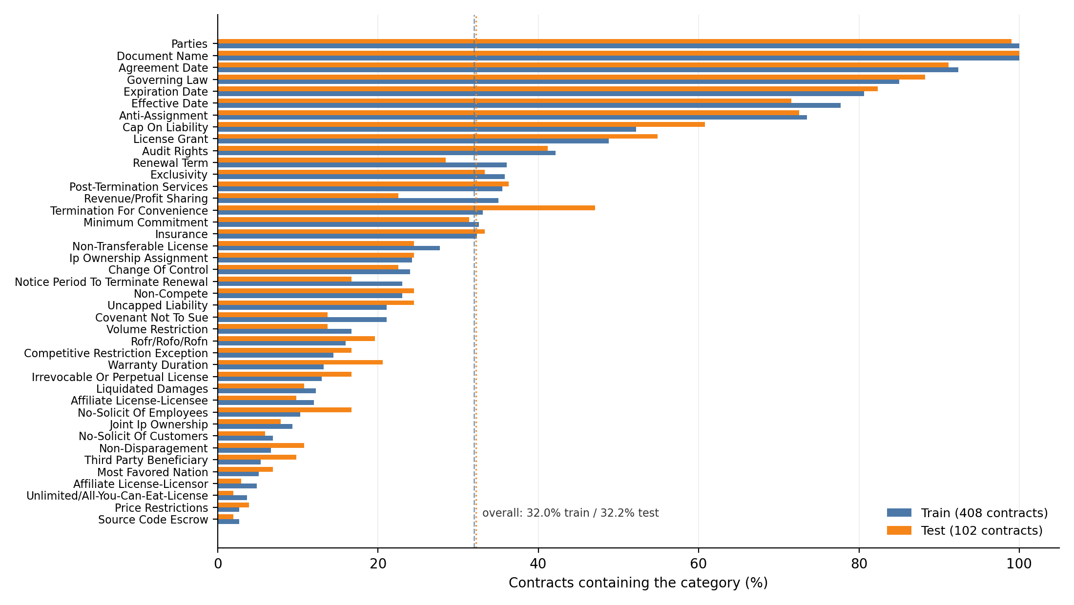
DATA
Our data: CUAD
510 real business contracts, marked by legal experts for 41 types of clause
510
41
33,143
196
80/20 split by contract
408 contracts for training and 102 for testing, the same for every model. No test contract is ever seen in training.
contracts
clause types
characters in a normal contract
characters in a normal clause
Some clause types are rare
Document Name is in every contract, but Source Code Escrow is in only 2.5%. A typical clause type is in 23% of contracts.
A small, fixed dataset
The experts' labels reportedly cost about $2M, so we cannot add more. We start from models that are already pre-trained.
How often each clause type appears, training vs test (Fig. 4.8)
Notes:
CUAD has 510 contracts and 41 clause types. We split by whole contract: 408 for training and 102 for testing. The chart shows that training and test look almost the same (32.0% and 32.2% of clauses present).

Slide 5
DATA
Preparing the data
Turning two CUAD files into examples the models can learn from
Clean the labels
Empty cells mean the clause is missing. Lists saved as text are read properly, and blank answers are removed.
1
Fix a typo in a column name
One column name had an extra space, so we matched columns by their position, not their name.
2
One row per contract and clause type
510 × 41 = 20,910 rows. In 32.1% of them the clause is present.
3
Cut contracts into windows
Windows are 2,000-character pieces that overlap by 500 characters, so no clause is cut in half. This gives 53,662 training windows.
4
Notes:
The data was already checked by experts, so cleaning was about format: empty cells, lists stored as text, and one column name with an extra space. Then we cut each contract into overlapping windows that the model can read.

Slide 6
PIPELINE
How the system reads a contract
Four steps, from contract text to a report sorted by risk
Contract
1 Find clauses
2 Find text
3 Risk
4 Explain
pasted text, PDF or Word
›
word model + small BERT
›
question-answering model
›
risk table for 41 types
›
FLAN-T5 writes one line
which clauses?
the exact words
High / Medium / Low
one simple sentence
the clause (196 characters)
No clause is missed
window 1
0.04
Windows overlap by 500 characters, which is longer than a normal clause.
window 2
0.11
highest = 0.91
→ clause found
window 3
0.07
window 4
0.91
Settings chosen fairly
⋮ 22 windows for a normal contract, 226 for the longest
Each model's threshold for each clause type was chosen on 81 training contracts kept aside, never on the test set.
We checked first: a “search first” design could reach at most 64% of clauses, so we read every window instead.
Notes:
The model reads every window and keeps the highest score for the whole contract. A simple word model reads the whole contract too. Each model gets a threshold for each clause type, chosen on contracts we kept aside. Then the text model finds the words, the risk table adds the level, and FLAN-T5 adds one simple sentence.

Slide 7
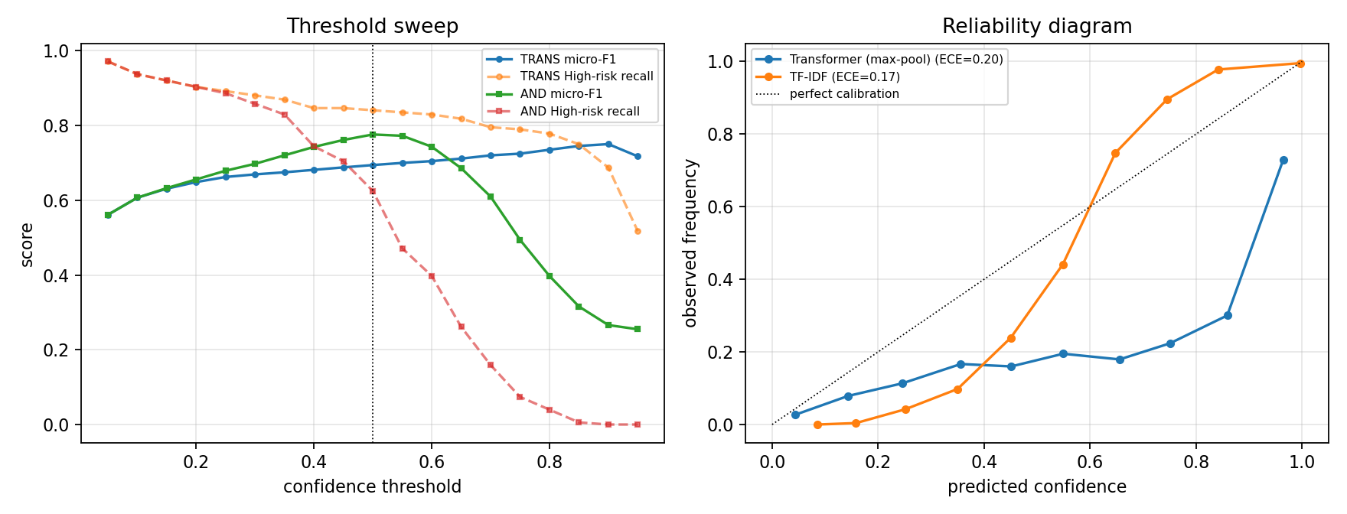
PIPELINE
How we set the risk level
One fixed level for each of the 41 clause types, from the weaker side's point of view
Five questions for each type
Can it cost money? Can it be undone? Does it limit you later? Is it one-sided? Does it last after the contract?
The rule
High: no money limit, cannot be undone, or limits you later. Low: only records a fact. Medium: the rest.
Number of clause types at each risk level (full list in Appendix A)
Examples (the app shows a one-line reason for each)
High: Uncapped Liability, Liquidated Damages, IP Ownership Assignment, Non-Compete. Medium: Cap on Liability, Anti-Assignment, Renewal Term. Low: Parties, Agreement Date, Governing Law.
The “weaker side” is the party with less say over the wording, usually the one who did not write the contract. A fixed table is easy to check and never changes by itself.
Notes:
Each clause type gets one risk level, decided by five simple questions. 8 types are High, 22 are Medium and 11 are Low.

Slide 8
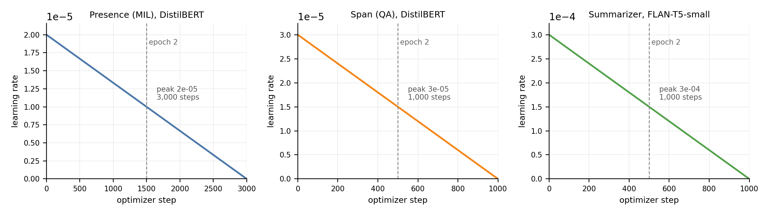
TRAINING
How we trained the models
One Apple laptop, standard settings, and the same 80/20 split for every model
Find clauses
DistilBERT · 24,000 windows · 512 tokens
≈3 h
Simple model first
Find text
DistilBERT-QA · 11,967 chunks
≈46 min
A word-count model (TF-IDF) with one classifier for each clause type. It trains in under a minute and scores 0.775, or 0.785 once tuned.
Explain
FLAN-T5-small · 4,000 examples
≈13 min
Training went well
The held-back loss was lowest after the second of three passes (0.245), so we kept that pass and the model did not just memorise.
No peeking at the test set
The learning rate starts high and falls steadily (Fig. 4.9)
We kept 81 training contracts aside and chose every setting on them. The 102 test contracts were scored once, at the end.
Apple M4 laptop with 16 GB memory and no NVIDIA GPU. The clause finder reads all 512 tokens of each window, and we kept the best of three passes over the data.
Notes:
All three models learned only from the 408 training contracts, and for the clause finder we kept 81 of them aside to choose its settings. We built the simple word-count model first, so the AI models had a fair score to beat. The final clause finder reads all 512 tokens of each window; the first one read only 256. The text model shown here is the retrained one: it learned from the same 1,200-character chunks it reads in the app, with the 81 aside contracts used to choose its settings.

Slide 9
PROBLEMS
Problems we met while building the models
What went wrong, and how we fixed it
Contracts are too long for the model
A normal contract is 16 times longer than the model can read at once. We read it in overlapping windows and keep the highest score.
The first model crashed on the Mac
DeBERTa-v3 failed on the Mac's graphics chip and was very slow on the CPU, so we switched to the smaller DistilBERT.
The model read only half of each window
At 256 tokens it saw about 1,000 of 2,000 characters, and 23% of its examples were about text it never read. 512 tokens fixed this.
No simple-English examples in CUAD
We wrote 41 one-line explanations ourselves, one for each clause type, and trained FLAN-T5 on them.
Notes:
These were practical problems, and each one had a clear fix. The most important one we found late: our first clause model read only about half of each window, so many of its training examples pointed at text it never saw. Fixing that is what made the transformer competitive. Before choosing windows we also checked a 'search first' design; it could reach at most 64% of clauses, so we did not use it.

Slide 10
PROBLEMS
Problems we met while building the app
Found by testing the app, then fixed and tested again
6 clauses gave 14 cards
We added a clause mode: each paragraph gets one clause type and one card. Now 18 numbered clauses give 18 cards.
Clause types were often wrong
Reusing the clause finder picked the right type 44.9% of the time. A classifier trained for the job now gets 72.1%.
The quoted text was often wrong
We retrained the text model on the chunks it really reads. It now finds the clause in the right window 76% of the time.
Long contracts were only partly read
Reading the first 30 windows found 77% of High-risk clauses. Adding 5 windows per type, picked by the word model, finds 89%.
Notes:
We found each of these by testing the app with real inputs, then fixed it and tested again. Two were real model problems, not just app problems. Clause mode reused the clause finder, which was trained to scan windows, so we trained a classifier for the job; it is right 72.1% of the time on 721 test clauses, against 44.9% before. And the app read only the first 30 windows of a long contract, which cut the share of High-risk clauses found from 90% to 77%; letting the word model pick 5 more windows per clause type brings it back to 89%. Automatic tests check these cases every time.

Slide 11
EVALUATION
How we tested
Every number comes from contracts the models never saw
510 CUAD contracts
↓ split once, by whole contract
102 test contracts kept aside (408 for training, 81 of them to choose settings)
↓ a separate notebook loads the saved models
4,182 clause checks · 2,667 text windows · 150 explanations
10,000
re-runs on random mixes of the
test contracts, for a 95% range
We report accuracy and the F1 score (a balance of finding clauses and avoiding false alarms), a word-overlap score for clause text, and ROUGE-L for explanations. We checked the first setup with 3 random seeds, all the training data and 20 different splits, and the final one with a run that changes only the window length.
Notes:
We kept 102 contracts completely aside for testing, and 81 of the training contracts aside to choose settings. To see how sure each score is, we re-ran the test 10,000 times on random mixes of these contracts. Nothing was chosen by looking at the test results.

Slide 12
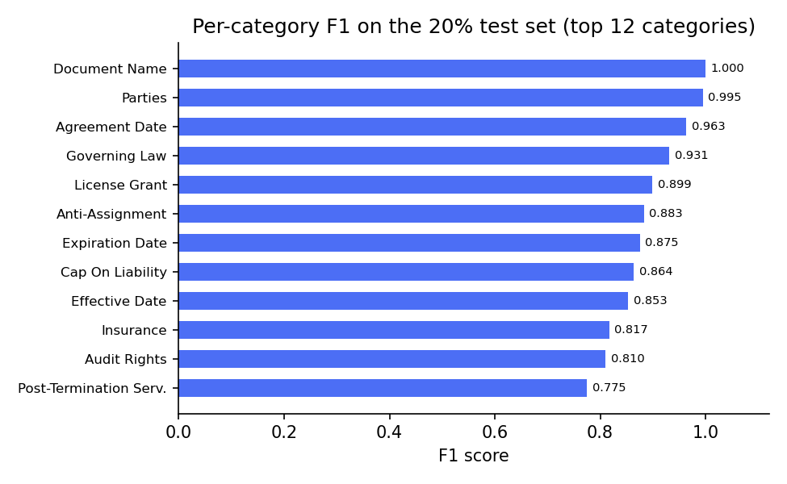
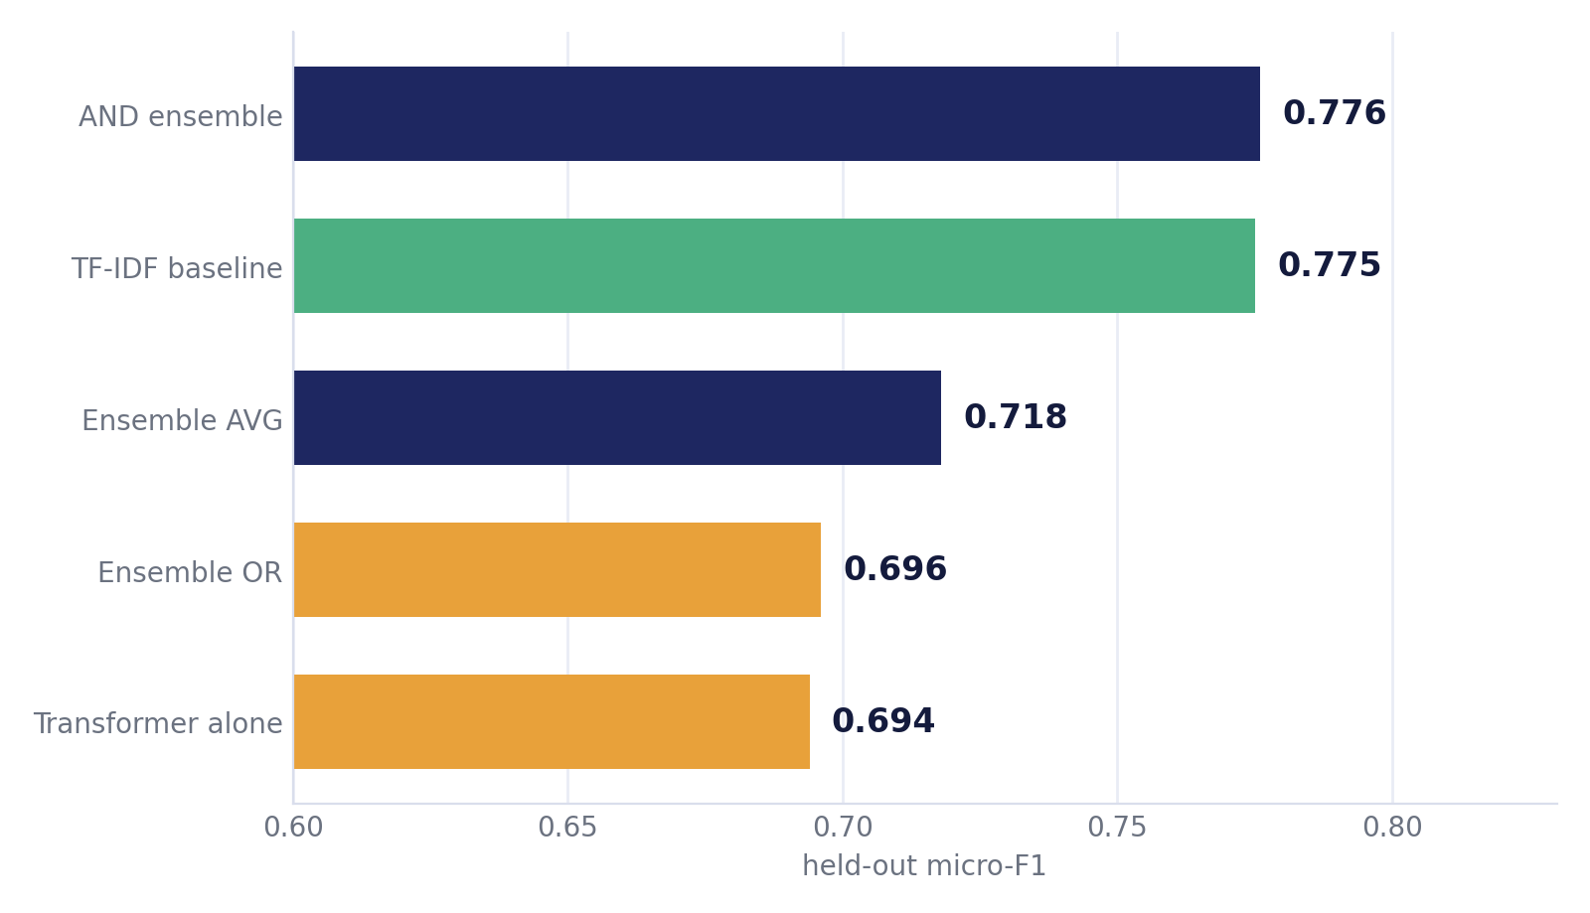
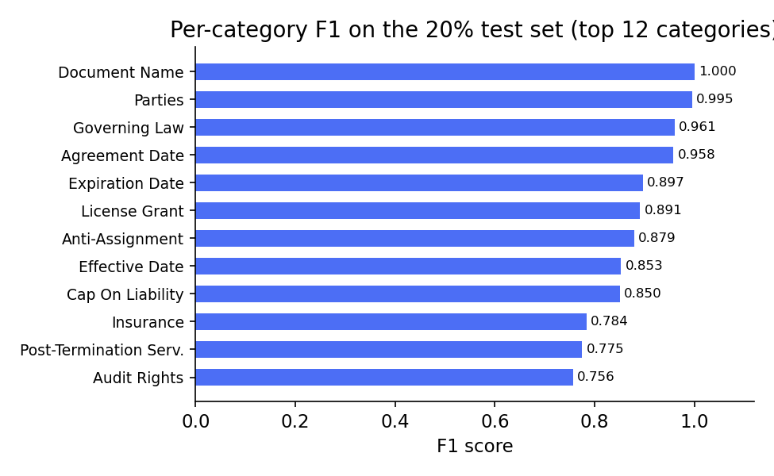
RESULTS
Result 1: finding which clauses are present
F1 on 4,182 test checks: first setup, then both models tuned on held-out contracts
Best: both models agreeing
F1 0.809 and accuracy 88.43%, with every setting chosen on contracts kept aside. It beats the tuned word model (0.785) by more than the error margin.
Reading the whole window mattered
Our first model read half of each window and lost (0.692 vs 0.775). Reading all of it and tuning both fairly: 0.797 vs 0.785, a tie.
Common clauses are almost perfect
F1 score of the 12 best
clause types, first setup (Fig. 5.3)
Document Name 1.000, Parties 0.995, Agreement Date 0.963, Governing Law 0.931. The rarest types have only 2 to 7 test examples; the app's setting still finds 49 of the 70 rare clauses.
Notes:
Our first transformer lost to the simple word model, 0.692 to 0.775. We then found it was reading only half of each window. With the whole window read and both models tuned on contracts kept aside, the two tie, 0.797 to 0.785, and when both must agree the F1 is 0.809, a lead the bootstrap confirms. A second run that changed only the window length shows that reading the whole window is worth 0.036 on its own.

Slide 13
RESULTS
Result 2: clause text and simple English
How well we find the words of a clause and explain it
clause text
“any attempted assignment … will be void”
Anti-Assignment sentence
right 70%
FLAN-T5-small
picks the matching sentence
›
›
Cap on Liability sentence
ROFR sentence
other 30%
⋮ one of the 41 sentences we wrote
0.779
59.6%
0.775
word overlap with the real clause
retrained text model (first: 0.366)
of real clauses get a good quote
end to end (first model: 22.1%)
ROUGE-L word-match score
against our 41 sentences
How to read these numbers
The first text model only saw answers near the start of its input, so it rarely found a clause in a window's second half. Retrained on the chunks it really reads, it works in both halves (76%), and 59.6% of clauses now get a good quote. The explanation describes the clause type, so it scores 0.116 against clause-specific references.
Notes:
For example, for a clause that blocks transferring the contract, the app shows: 'You cannot transfer this contract to someone else without permission.' The model picks the right sentence 70% of the time. We also tried bigger FLAN-T5 models without fine-tuning: they mostly copy the clause instead of explaining it, so the app keeps the sentence for the clause type. Our first text model was trained with the answer always near the start of its input, so it almost never found a clause in the second half of a window, and only 22.1% of real clauses got a good quote. We retrained it on the same chunks it reads in the app, including chunks with no clause. Now it finds the clause in either half about 76% of the time, and 59.6% of real clauses get a good quote. What is left is split about evenly: the clause finder picks the right window 82.6% of the time, and in the right window the text model misses about a quarter of clauses.

Slide 14
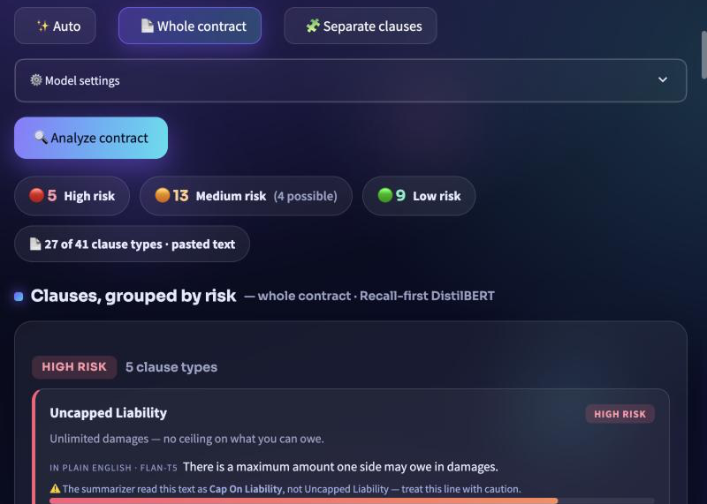
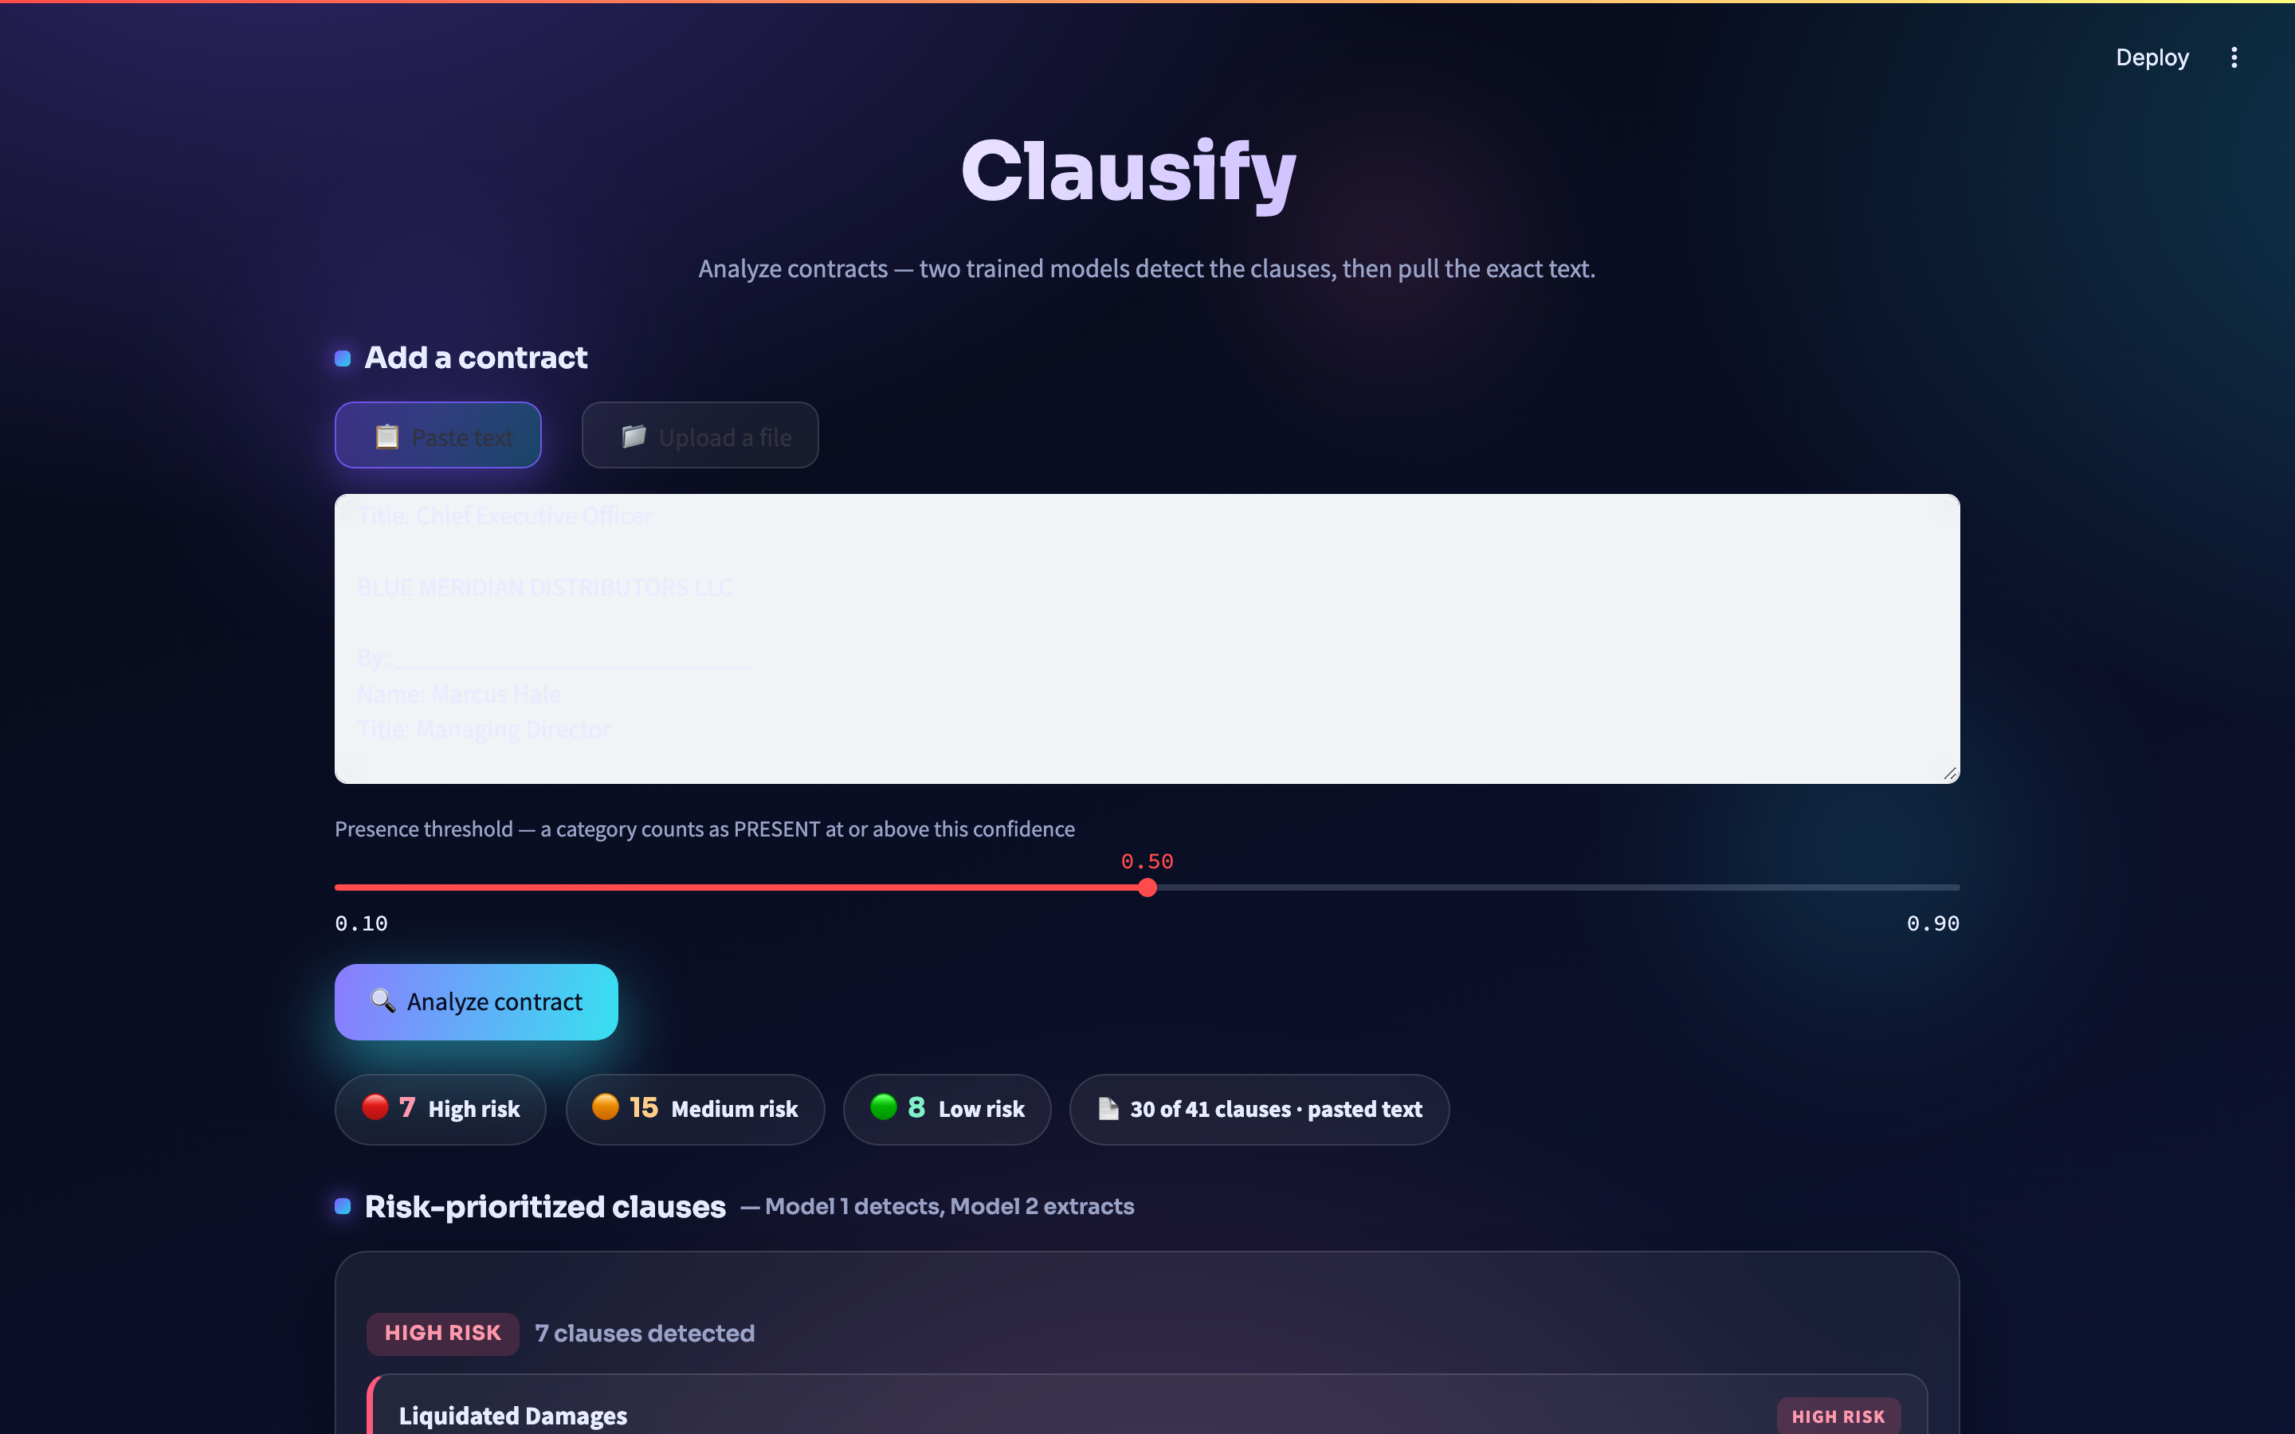
RESULTS
Result 3: Clausify, the working app
All the trained models running on any contract, risky clauses first
Speed
Finds risky clauses
About a minute for a normal contract; about 2 minutes at most.
As it reads contracts, the app finds 89% of High-risk clauses.
Clause mode
Private
One card per clause: 18 clauses give 18 cards.
Run on your own computer, nothing is saved or sent.
The report, sorted by risk (Fig. 4.15)
What the app does
Upload or paste
Cards sorted by risk
PDF, Word or text; a whole contract or a list of clauses
clause type, risk level and reason, a calibrated chance (under 50%: “possible, check”), a simple-English line and the quoted text
Highlighted contract
Download a report
every clause marked in its risk color, plus a checklist of missing protections
PDF and CSV files; all 46 app tests pass
Notes:
Clausify runs all our models on any contract you paste or upload. It shows the risky clauses first, with a reason and a simple explanation. By default it uses the recall-first setting, which finds 90% of High-risk clauses when it reads whole contracts. To stay fast, the app checks the first 30 windows of a long contract plus 5 more per clause type picked by the word model, and finds 89% that way; with the first 30 windows alone it found only 77%. Each card shows a calibrated chance, fitted on contracts we kept aside, so 80% means about 80%. Cards under 50% are marked 'possible, check' and listed after the others, because they still hold about a quarter of the High-risk clauses we find. It says clearly on screen that it is not legal advice.

Slide 15
DISCUSSION
Conclusion and next steps
What we built, and what we would do next
What we achieved
Next steps
A complete system, tested fairly
Judge each clause, not just its type
read the actual amount, limit or period in the clause
finds clauses, shows the text, gives a risk level and a simple explanation
Pick the right window
Good at finding clauses
the wrong window now costs about as much as the text model
best F1 0.809 (balanced); the app's recall-first setting finds 89% of High-risk clauses
Test with real users
5 to 10 non-lawyers, timing how fast they find clauses
Finds the right part of the contract
82.6% of the time; 60% of clauses now get a good quote
Explain each clause, not just its type
write a few thousand clause-specific explanations
A working app
Go beyond CUAD
Clausify takes about a minute per contract; all 46 tests pass
bigger models on a GPU, and contracts from Bangladesh
Notes:
We built a complete system that works on contracts it has never seen, and a working app. The clause finder picks the right part of the contract 82.6% of the time, and after retraining the text model, 60% of real clauses get a good quote. Next, we want to judge each clause's own wording, train a model to pick the right window, test the app with real users, write explanations for each clause, and try contracts from outside CUAD, such as from Bangladesh.

