Slide 1
Welcome to sse AfNOG - 2016 TUNIS
Scalable Services – English

Slide 2
What is SS-E?
Scalable Services – English is a track that teaches advanced topics on designing, configuring and managing large scale Internet Services run on UNIX/Linux servers
It builds on Track Zero which covered introductory topics on UNIX/Linux and Internet Services
What sort of services?
DNS, Web Email
Monitoring, Authentication
Many others
Basically any service that can be offered on a Linux/UNIX server over the Internet

Slide 3
Your instructors
Joe Abley – from Canada
Kevin Chege – from Kenya
Frank Kuse – from Ghana
Michuki Mwangi – from Kenya
Chris Wilson – from UK

Slide 4
How about you….?
Introduce yourself:
Name
Country
Work
Hobbies ☺
How did you fly to get to Tunis?

Slide 5
Course teaching style
Theory explained first then followed by a practical session
Each of you has been assigned a Virtual Machine running Debian 8.0.0 (Jessie) that you will access from your laptop
Feel free to ask questions anytime
If you need help during the practical labs, raise your hand so the instructors can assist
Kindly mute your phones during classes ☺
Please close your laptops during theory sessions ☺

Slide 6
Timetable – please keep time ☺
Breakfast starts at 6am*
First Session 9am to 11.00am
Tea break 11.00am to 11:30am
Second Session from 11:30am to 1:00pm
Lunch from 1:00pm to 2:00pm
Third Session- from 2pm to 4pm
Tea break – 4pm to 4.30pm
Fourth Session – 4.30pm to 6pm
Breakfast, lunch and dinner are at the main Hotel Restaurant
Tea breaks are at the small lobby as you get to the training rooms. Washrooms are at the lobby area, others towards main restaurant

Slide 7
Inventory
You should have received:
Name badges
Folder with notepad, pen, information pack
Keep your name badge with you
At the end of the week you will receive:
A USB stick with some O'Reilly eBooks
Possibly a FreeBSD CD-ROM
Please share with your colleagues back at home.

Slide 8
Connectivity
Use your own laptops for:
Web browsing
Control your virtual machines
Virtualization exercises
Wireless Internet
Use the AIS network if possible, otherwise AIS-bgn
Password for both is "success!”
Hotel wifi is available in your rooms

Slide 9
Access Your Virtual Machines
Virtual servers (named pc1 – pc35)
DNS names are pc1.sse.ws.afnog.org (etc)
Debian 8.0.0 OS installed
Use SSH to access your server (e.g. Putty for Windows)
Login with afnog/afnog
Use sudo to execute commands as root
Don't change passwords
Don't "close security holes"
Don't shutdown your server (there's no power button!)
Your servers are accessible over the Internet

Slide 10
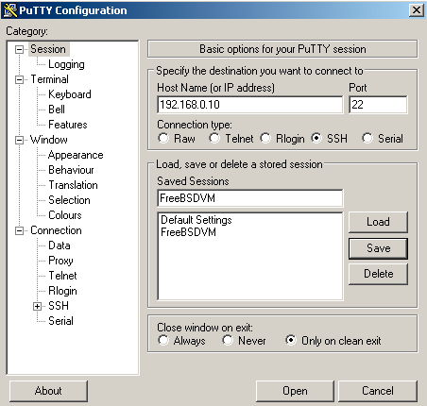

Try and access your machines
Install putty from: http://197.4.11.139/putty.exe
After downloading you will see the above icon. Double click on it and you should see a window similar to the one on the right

Slide 11
Electronic Resources
Web site: http://www.ws.afnog.org/afnog2015/
AfNOG Mailing List:
Q&A on Internet operational and technical issues.
No foul language or disrespect for other participants.
No blatant product marketing.
No political postings.
Please subscribe while at the Workshop:
So we can help you if you have problems subscribing.
Please raise any questions related to the workshop content.

Slide 12
Safety
Please be careful in class:
trip on power cords
pull cables out of sockets
knock equipment off tables
fall from leaning back too far in your chair

Slide 13
Core topics to be covered this week
DNS
Resolver
Authoritative DNS
Apache
Web server
RADIUS
For centralising authentication
Virtualisation
How to build virtual servers and deploy
Monitoring
How to monitor services and devices

Slide 14
Additional topics
Preconfigured Appliances (4 hours)
Quickly deploy servers – SpaceWalk, Juju, Docker
File servers ( 4 hrs) -
Samba, how to build a file server, CEPH, storage
Backups (1hr theory and maybe 2hrs lab) –
Offsite backups (shell scripting with Rsync), duplicity, S3, Amanda, Bacula
SMTP email servers – find out more information from students
IMAP, POP3, SPAM filtering
Centralising authentication
LDAP (2 hrs) – centralising authentication (Single sign ons)
Eduroam (evening session with GJ?) – hierachy centralisation of credentials
DNSSEC (evening session with Joe?) –
intro to DNSSEC and validation
Cryptography (evening session with Joe?) –
how CAs work, PGP (evening session?), Public key authentication with SSH,

Slide 15
Rough agenda for the week
Monday:
First Session: intro, nano bootcamp
Second Session: DNS
Third Session: Apache
Fourth Session: Apache
Tuesday:
First Session: DNS resolver, using unbound
Second Session: RADIUS
Third and Fourth Session: Monitoring (Nagios)
Wednesday:
First and Second Session: Virtualisation
RADIUS (continuation)
Load balancing

Slide 16
Any questions?

Slide 17
Nano bootcamp
We will use an editor called “nano” on the Debian machines
However, you should learn “vi” as it has way more features than most editors
Install nano: $sudo apt-get install nano
For nano you can open a file by:
$nano /path/to/filename OR $nano filename
Save the changes by:
ctrl X
answer “y”
Search the file for a specific word:
ctrl W <then the search term>

Slide 18
Short nano exercise
Go to your home directory
$cd /home/afnog
Copy a file with some text: $cp /etc/default/apache2 .
Open with nano:
$nano apache2
Search for 300
Ctrl W 300
Change it to 600. Then Save and Exit
Ctrl X
Then answer y. Maintain the same filename (press enter)

Slide 19
More commands
Ctrl y – previous Page
Ctrl v – next page
Nano provides a menu at the bottom:

Slide 20
Thank you! Questions?

