Slide 2
Email Gateways
Kevin Chege

Slide 3
What is a Mail Gateway?
A software/service/appliance that is able to receive and filter emails before they reach the email boxes
Typically, a mail gateway will not contain mail box accounts and will only receive emails, filter them based on configured parameters, and then forward them to the mail server that contains the mailboxes
The purpose is to remove dangerous or harmful content (like spam and viruses) on email before they reach user boxes
A mail filter can process incoming emails and or outgoing emails

Slide 4
How it flows
Some MTA
Email from the Internet
Mail Gateway receives Email and filters out based on criteria. Forwards the clean email to the mail server
Mail Server
with mailboxes delivers the emails to the mailboxes.

Slide 5
Advantages
Remove harmful email before it reaches mail boxes
Phishing emails, malware, viruses etc
Remove the work of filtering email from the server that is handling email boxes
Highly configurable and can block emails based on a number of criteria including content that is in the body of the email
If hosted outside the network, can reduce load on the network connection/link (also known as far side scrubbing)

Slide 6
Disadvantages
Mistakes in configuration may mean mail is not delivered. They are highly customisable with hundreds of options and parameters which you must be careful with
Increase the number of email servers to be managed

Slide 7
Common tools used in Mail Gateways
Spamassassin – No. 1 Open Source anti-spam platform giving system administrators a filter to classify email and block spam (unsolicited bulk email)
ClamAV – Virus scanning software. Can be used for email scanning and web scanning
Amavisd – interface between the MTA and the above tools. A common mail filtering installation with Amavis consists of an MTA, ClamAV and Spamassassin
MailScanner - open source email security system design for Linux-based email gateways

Slide 8
Mail Gateway Appliances
These are solutions that can be installed on servers and provide Mail Gateway services
Software:
Anti Spam SMTP Proxy - http://en.wikipedia.org/wiki/Anti-Spam_SMTP_Proxy
Mail Border - http://www.mailborder.com/
ScrolloutF1 - http://www.scrolloutf1.com/
Xeams - http://www.xeams.com/
Hardware (Blackbox):
Barracuda - https://www.barracuda.com/products/emailsecuritygateway

Slide 9
MailScanner
MailScanner is a highly respected open source email security system design for Linux-based email gateways.
It is used at over 30,000 sites around the world
Has fast become the standard email solution at many ISP sites for virus protection and spam filtering.
MailScanner scans email for viruses, spam, phishing, malware, and other attacks against security vulnerabilities and plays a major part in the security of a network.
MailScanner supports a wide range of MTAs and virus scanners to include the popular open source Clam AV. Spam detection is accomplished via Spamassassin, which is by far the most popular and standardized spam detection engine.
Written and Founded by: Julian Field

Slide 10
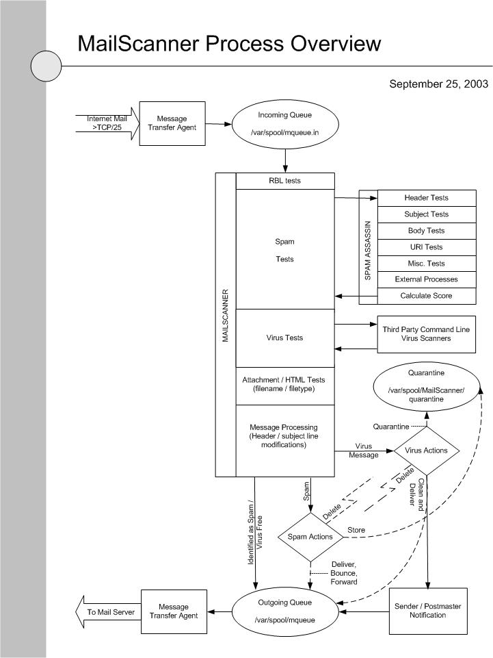

Slide 11
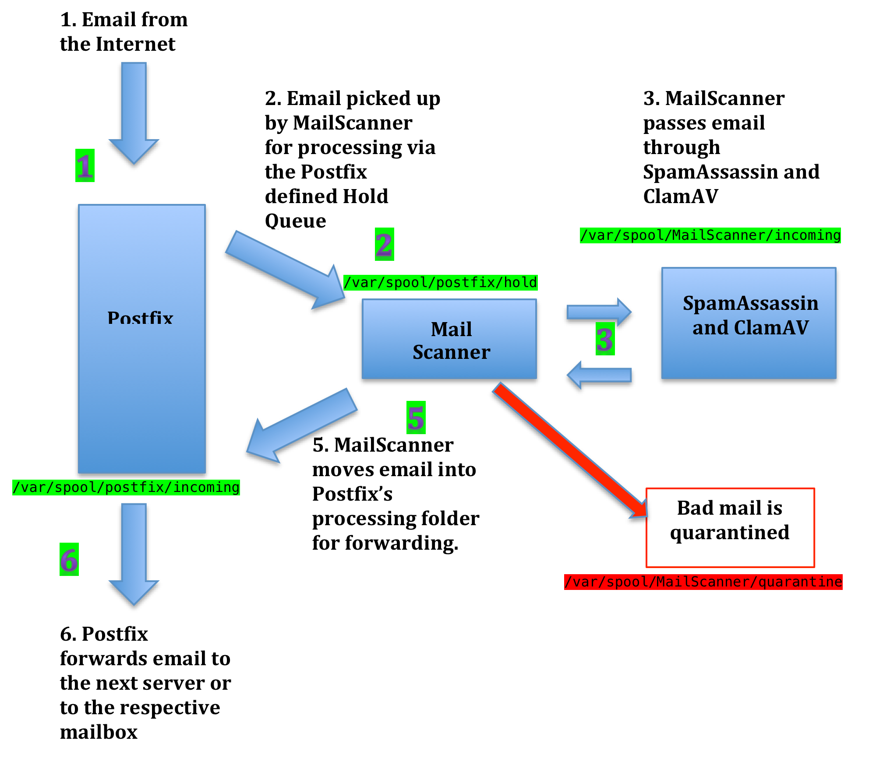
A bit simpler…

Slide 12
MailScanner as an Appliance
MailScanner can be combined with a frontend to become a Mail Gateway appliance
Two frontends are available:
Baruwa – http://baruwa.org
Mailwatch - http://mailwatch.org/
When properly managed and configured with Postfix or Exim as the MTA, one can build a powerful mail gateway

Slide 13
MailScanner has hundreds of Knobs
https://www.mailscanner.info/MailScanner.conf.index.html
The defaults mostly work but for a production environment, please read the manual!
We will install with basic features of
Process email and check for SPAM and viruses
Log all emails to MySQL (SPAM and Not SPAM)
Store all emails in the quarantine

Slide 14
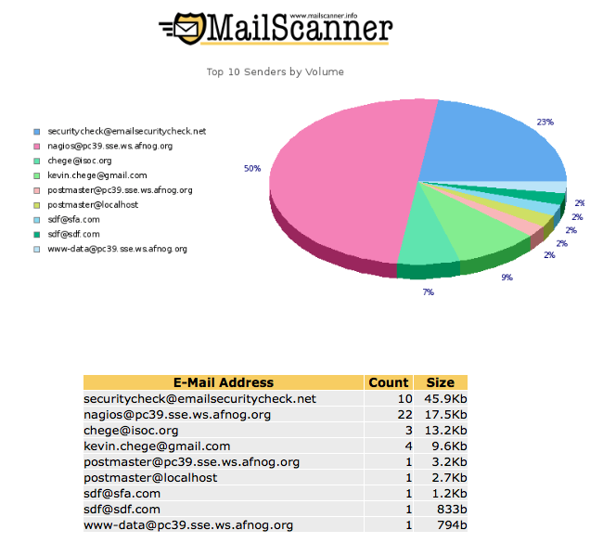

Slide 15
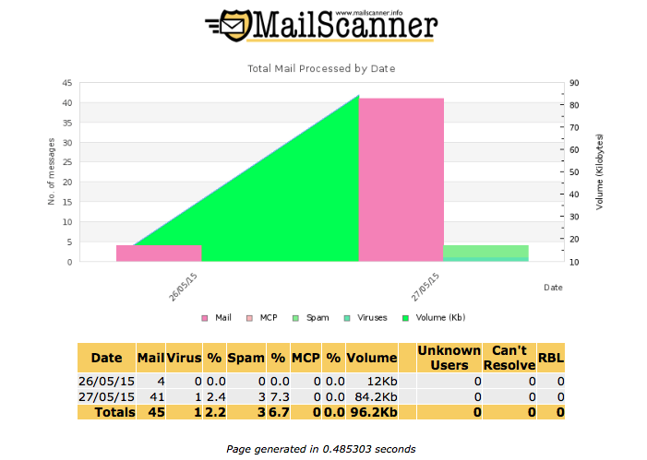

Slide 16
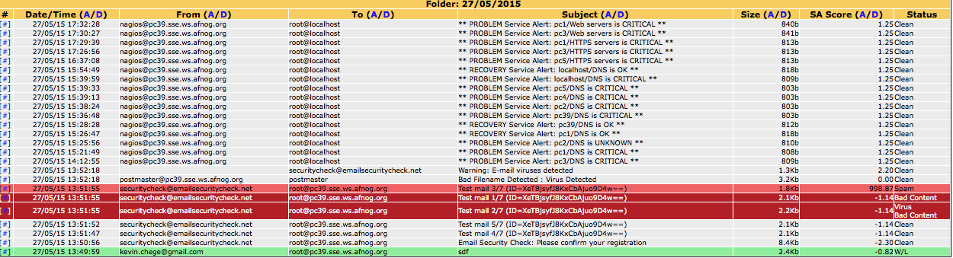
MailScanner Reports

Slide 17
Let us build our Mail Gateway
We will now setup a mail gateway
Configuring a mail filter is not easy. You must be aware of what you are enabling or disabling. Preconfigured files will be provided due to time limitation
Setting the correct DNS entries is key
You will filter email for your neighbor and he will filter your email
At the end, you should have a fairly strong and working mail filter

Slide 18
References
https://www.mailscanner.info
https://en.wikipedia.org/wiki/DomainKeys_Identified_Mail
http://postfix.org
https://www.safaribooksonline.com/library/view/postfix-the-definitive/0596002122/ch04s05.html

