Slide 1
Nagios SS-E
Slide adapted from 2013 Slides from Ayiteh.

Slide 2
Introduction
To monitor or monitoring generally means to be aware of the state of a system.
To observe a situation for any changes which may occur over time, using a monitor or measuring device of some sort.
The term network monitoring describes the use of a system that constantly monitors a computer network for faults and notifies the network administrator (via email, SMS or other alarms) in case of outages. It is a subset of the functions involved in network management.

Slide 3
What can you monitor?
Environmental Monitoring
Temperature, humidity
Network Monitoring
Device uptime
Internet Bandwidth consumption
System Monitoring
Resource usage eg RAM and CPU
Website Monitoring
Number of hits to certain pages

Slide 4
Why do we monitor?
Deliver on targets (KPIs/SLAs)
Is your ISP providing the service as agreed?
As an ISP, are you providing your customers what you promised?
Early detection and fault resolution (MTTR)
Packet loss or flapping signifies a problem somewhere
Are the investments on equipment delivering?
Are your devices underutilized?

Slide 5
Some Monitoring Tools
Nagios
Availability of services, servers and network devices.
Cacti
Utilization of resources such as bandwidth, CPU, memory, disk space etc.
Smokeping
Network latency, RTT
Others: Observium, OpenNMS, Zabbix, Zenoss
Others:
For monitoring IP services, we will focus on monitoring availability (Nagios) and reliability (Smokeping)

Slide 6
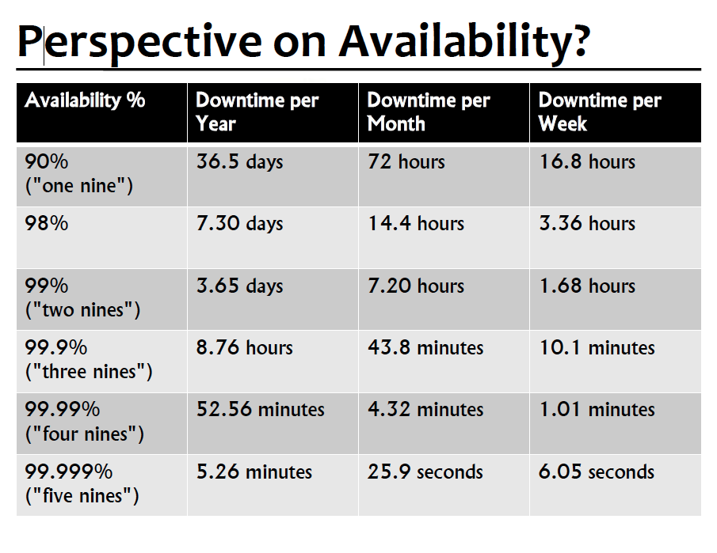

Slide 7
Nagios
Nagios actively monitors the availability of devices and services
Possibly the most used open source network monitoring software.
Sends alerts and/or triggers alerts
Logs history and generates SLA reports
Can support thousands of devices and services.
Several plugins available to extend its abilities eg to allow it to monitor CPU or Fan temperature on a router

Slide 8
Dependencies
Dependencies:
Apache & PHP. MySQL depending on what you enable
Install nagios from ports:
$sudo pkg install nagios
Key directories:
/usr/local/etc/nagios
/usr/local/etc/nagios/objects
/usr/local/libexec/nagios
/usr/local/www/nagios
Nagios web interface sample is here:
http://pc1.sse.ws.afnog.org/nagios

Slide 9
Nagios Architecture
Plugins are used to verify the state of devices & services.
Small, self-contained applications which make a single connection to test a service then quit
Return OK, Warning, Critical or Unknown
Many plugins supplied, even more available
http://exchange.nagios.org
http://nagiosplugins.org
Data storage: plain text files
Data visualisation: CGI web interface
Configuration: plain text files but there are some web based tools for managing it like Nconf, Webmin, Fruity

Slide 10
Configuration Files
Located in /usr/local/etc/nagios:
cgi.cfg
Controls the web interface and security options
nagios.cfg
Main configuration file
resource.cfg
Used to specify an optional resource file that can contain $USERn$ macro definitions.
objects/
All other configuration files go here.

Slide 11
Config Files
The /usr/local/etc/nagios/objects directory:
commands.cfg
The commands that nagios uses for notifications
contacts.cfg
Users and groups
localhost.cfg
Definition of the nagios host
printer.cfg, switch.cfg
Definition of printers and switches
templates.cfg
Sample object templates
timeperiods.cfg
Defines when to check the state of objects

Slide 12
Nagios Features
Allows you to acknowledge an event
i.e I am aware of the problem so stop alerting
A user can add comments via the GUI
Useful in a NOC where it will be possible to tell who is working on a problem
You can define maintenance periods
i.e. do not monitor the device at this time
By device or a group of devices
i.e. these devices are similar so group them together on the map
Maintains availability statistics
Can detect flapping and suppress additional notifications
Allows for multiple notification methods:
e-mail, pager, SMS, win-popup, audio, etc...
Allows you to define notification levels for escalation

Slide 13
Nagios Exercise
Lets install Nagios!

