Slide 1
Email server/Email Gateway – Part 2
MailScanner Installation

Slide 2
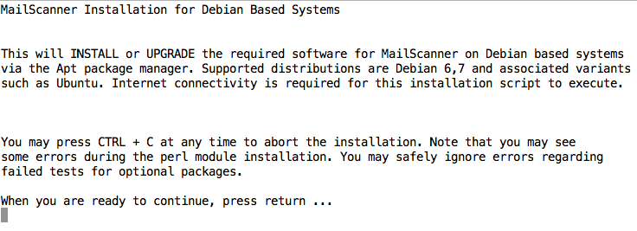
After you run ./install.sh

Slide 3
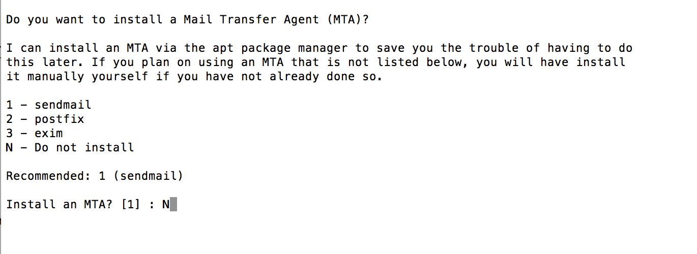
Do NOTInstall any MTA

Slide 4
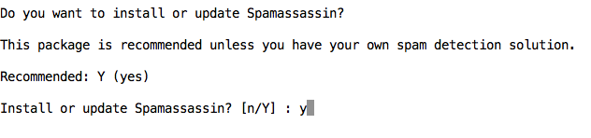
Select yes for Spamassassin

Slide 5
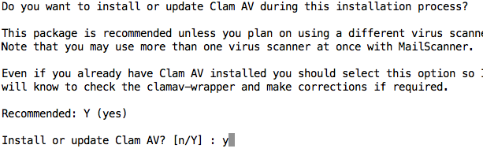
Install Clam-AV

Slide 6
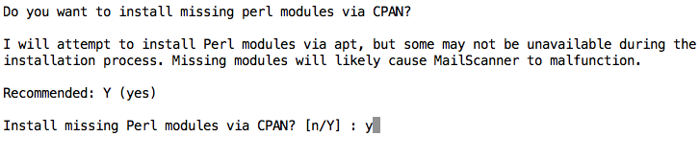
Install Perl Modules

Slide 7
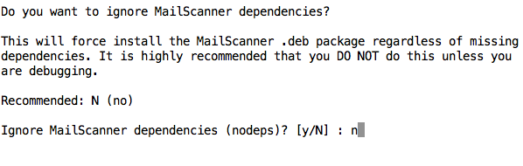
Follow the advice ☺

Slide 8
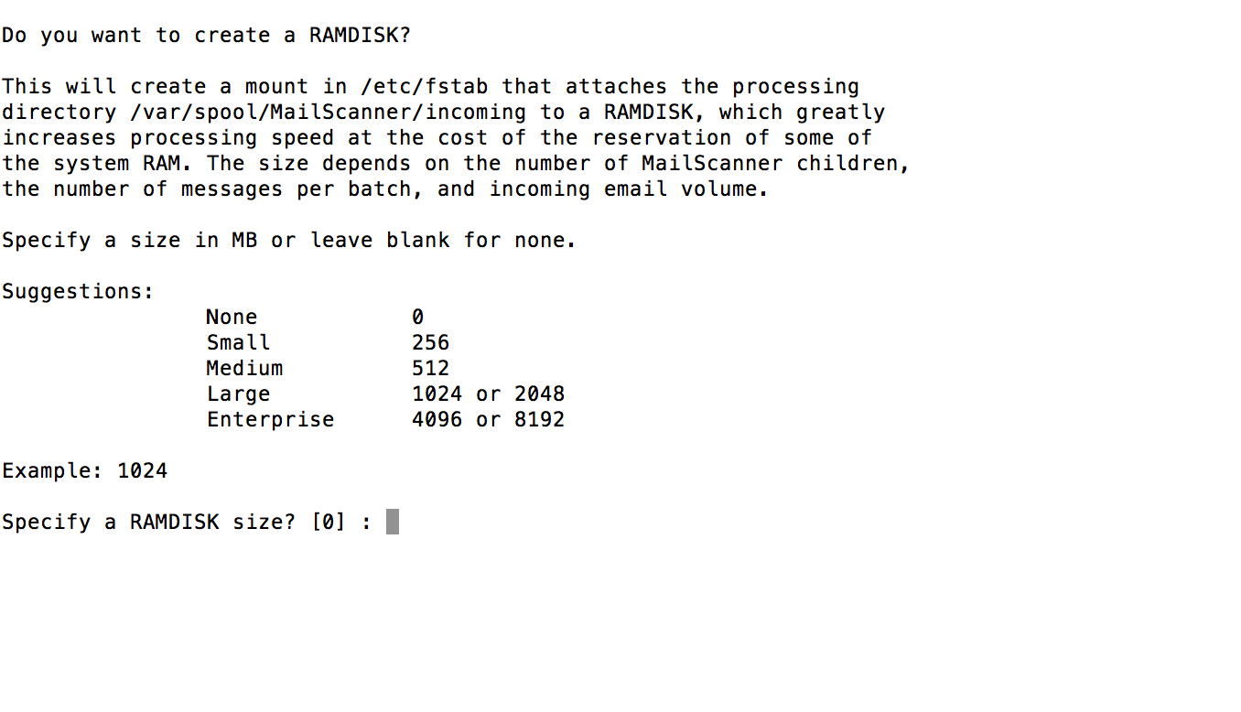
Ramdisk – Use the default

Slide 9
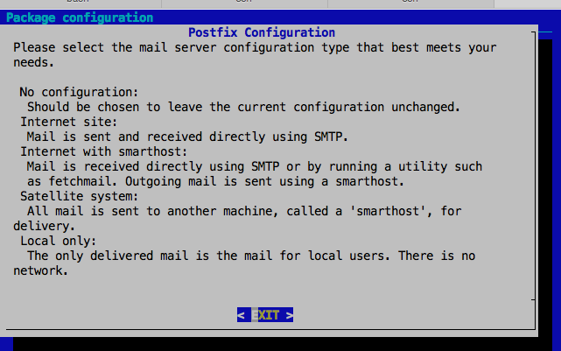
Postfix Screen: Read then press enter

Slide 10
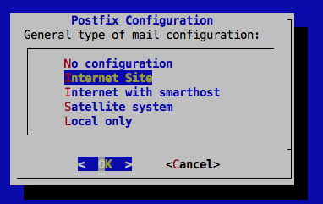
Select Internet Site

Slide 11
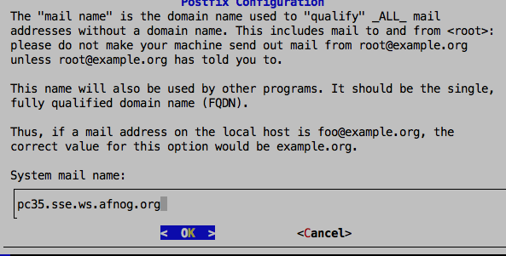
Enter your Name
yourname.afnog.guru
yourname.afnog.guru

Slide 12
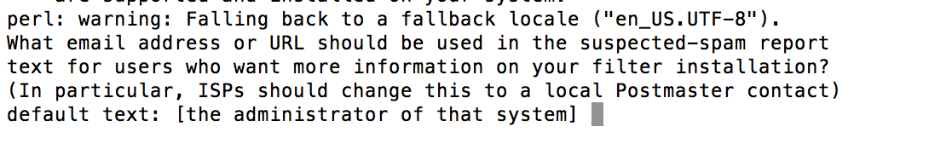
Set your afnog email address to receive spam reports
afnog@XXX.afnog.guru

Slide 13
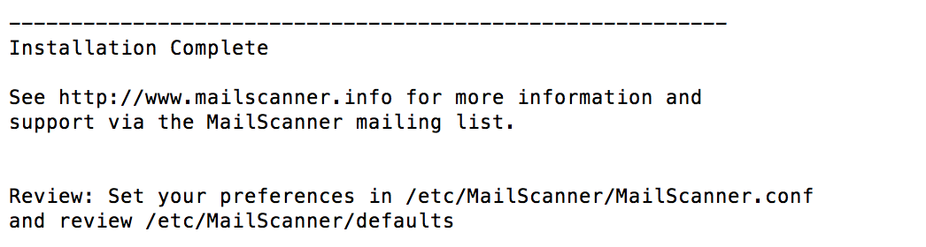
End of installation

