Slide 1
Apache Web Server
Quick and Dirty
for AfNOG 2015
(Originally by Joel Jaeggli for AfNOG 2007)‏

Slide 2
About Apache
Apache http server project
http://httpd.apache.org
Apache foundation started to support the web server project, but now extends to a multitude of other projects.

Slide 3
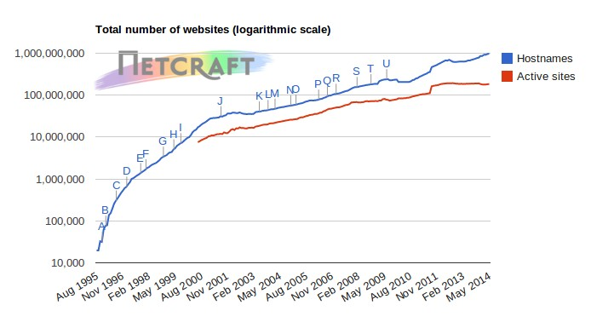
No. of websites

Slide 4
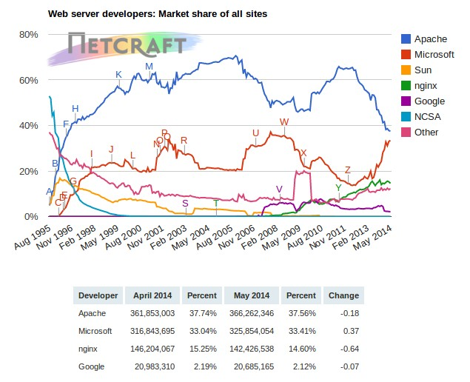
Top Server Market share from 1995 - 2014
http://news.netcraft.com/archives/category/web-server-survey/

Slide 5
Apache Installation on Debian
Apache can be installed from APT-GET
  Apt-get install apache2
Can be installed from dpkg
Or from source if one requires a more recent version than what's on Debian source list

Slide 6
File System Layout
/etc/apache2/
|-- apache2.conf
| `-- ports.conf
|-- mods-enabled
| |-- *.load
| `-- *.conf
|-- conf-enabled
| `-- *.conf
|-- sites-enabled
| `-- *.conf

Slide 7
Starting Apache
Startup scripts are located at
/etc/init.d/
Take a look in startup script
/etc/init.d/apache2
Add Apache to startup
update-rc.d apache2 enable
Run
  $ /etc/init.d/apache2 restart
  $ sudo service apache2 start
Restart
  $ sudo service apache2 restart

Slide 8
Apache features
Server Side Programming Language Support
  Apache supports some common language interfaces which include Perl, Python, Tcl, and PHP. It also supports a variety of popular authentication modules like mod_auth, mod_access, mod_digest and many others.
IPv6 Support
  On systems where IPv6 is supported by the underlying Apache Portable Runtime library, Apache gets IPv6 listening sockets by default.
Virtual Hosting
  Apache will allow one installation instance to serve multiple websites. For instance one Apache installation can serve sse.afnog.org, ws.afnog.org etc
Simplified configuration
Native Windows NT Unicode Support
More at: http://httpd.apache.org/docs/2.2/new_features_2_0.html

Slide 9
Apache SSL
Secure Socket Layer (SSL) port is 443
SSL is important to protect communication between client browser and web-server
Requires the creation of SSL certificates and Certificate Signing Requests (CSR)
For integrity, SSL certificates are signed by a Certificate Authority’s (CA) such as Verisign
Self signed Certificates will also work but your browser will not trust it and will give a warning to users (which most don’t read)
Refer to the Creating SSL Certificate Exercise Section

Slide 10
How SSL Works
Each SSL certificate has a Public and Private key
The Public Key is used to encrypt the information
The Public Key is accessible to everyone
The private Key is used to decipher the information
The private should be not be disclosed

Slide 11
Role of Certificate Authority
There are a number of CA that certify certificates
Most browsers have pre-included public Keys from the CA’s
A CA certified certificate will have validation information signed by the CA’s private key
The browser will decrypt the validation information using the public key and verify that the certificate is certified by the CA
If this fails a warning is given

Slide 12
Virtual Hosting
Apache Provides multiple options of virtual hosting and scales
  Name Based virtual hosts
  IP Based Virtual Hosts
  Aliases
Its recommended to use name based virtual hosting over IP based hosting in virtual hosting configuration
Refer to virtual hosting Exercise section

Slide 13
Installing PHP & Mysql
PHP and Mysql implementations have increased driven mainly by development requests
LAMP and WAMP are the most common implementations
Installation via “dkpg” and “apt-get” and relatively straight forward
See PHP & Mysql installation exercise section

Slide 14
Apache and IPv6
Apache supports IPv4 and IPv6 by default
Set the listen option to port 80 will listen for both IPv4 and IPv6
listen option with IPv4 and IPv6 specific addresses will invoke different sockets for each protocol
  Listen 196.200.219.xx:80
  Listen [2001:43f8:0:219:196:200:219:xx]:80
Refer to IPv6 & php test exercise

Slide 15
Start Apache!
/etc/init.d/apache2 start
Check that you can access http://your.ip.add.ress in your browser
Check that you can access https://your.ip.add.ress in your browser, and that you get a certificate warning
Click on the padlock icon in your browser and check that the certificate details are correct

Slide 16
Apache use cases
Apache is widely used to serve many content applications
Webmail, Blogs, Wiki’s, CMS etc

Slide 17
Start Exercises

