Slide 1
APACHE
Isabel Odida
2018

Slide 2
About this presentation
Based on a previous talk by Joel Jaeggli with thanks!
You can access this presentation at:
Online: http://afnog.github.io/sse/apache/
Local: http://www.ws.afnog.org/afnog2018/sse/apache/Apachepresentation.pdf
Github: https://github.com/afnog/sse/blob/master/apache/presentation.md
Download PDF:
http://www.ws.afnog.org/afnog2018/sse/apache/Apachepresentation.pdf
2 / 17

Slide 3
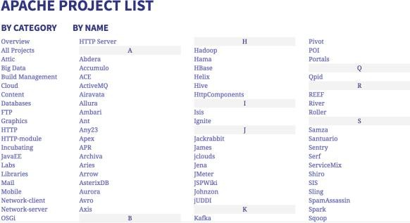

What
is
Apache?
A foundation supporting several web-related
software projects
For clarity it might help to talk about "Apache Server" to mean the HTTPD server.

Slide 4
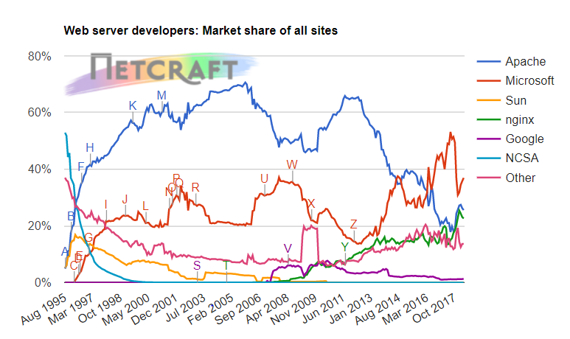
Other HTTP servers
What other HTTP (web) servers are commonly used?
4 / 17

Slide 5
Which one to use?
Apache
Popular, well-documented, flexible, secure, big, slow, heavy, SSL support, PHP integration.
Nginx
Increasingly popular, quite well-documented, very fast, reverse proxy, SSL support, no PHP.
Lighttpd
Simple, fast, no PHP.
Thttpd
Tiny, fast, no PHP.

Slide 6
Apache Features
Server Side Programming Language Support
Apache supports some common language interfaces which include Perl, Python, Tcl, and PHP. It also supports a variety of popular authentication modules like mod_auth, mod_access, mod_digest and many others.
IPv6 Support
On systems where IPv6 is supported by the underlying Apache Portable Runtime library, Apache gets IPv6 listening sockets by default.
Virtual Hosting
Apache will allow one installation instance to serve multiple websites. For instance one
Apache installation can serve sse.afnog.org, ws.afnog.org etc Simplified configuration (!)
More at: http://httpd.apache.org/
6 / 17

Slide 7
Virtual Hosting
What does it mean?
Apache support virtual hosting (deciding which website to display) using:
Name based virtual hosts
IP based virtual hosts
Aliases (subdirectories)

Slide 8
PHP and MySQL
Many web applications written in PHP and using a MySQL database.
Relatively easy to deploy under Apache (and most web hosting).
We will install the necessary software shortly.
8 / 17

Slide 9

Install Apache
sudo apt install apache2
How do you test that it worked?
telnet localhost 80
And visit http://pcXX.sse.ws.afnog.org in your browser.

Slide 10
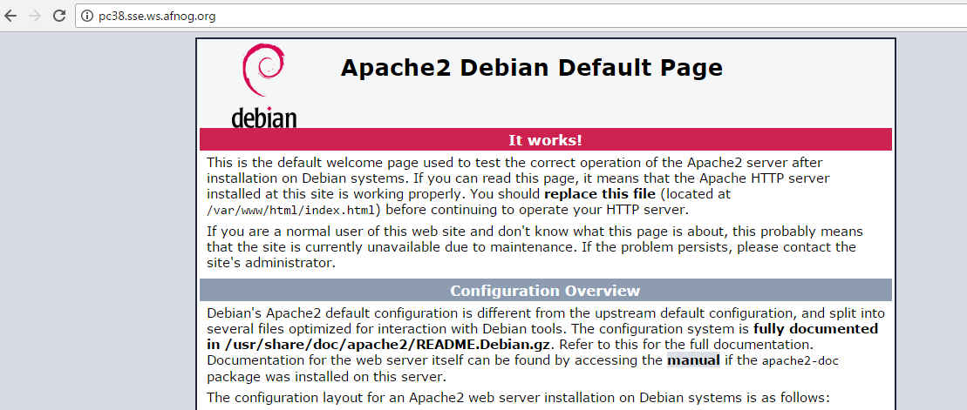
What content is it serving? How do we change it?
/var/www/html/index.html
10 / 17

Slide 11
Enable and test IPv6
Set your IPv6 address to match your IPv4 address (replace
100):
XX
with your PC number plus
$ sudo ip -6 addr add 2001:43f8:220:219::XX/64 dev ens3
Then add your default route for IPv6:
$ sudo ip -6 route add default via 2001:43f8:220:219::1
On the above if you get the error message
RTNETLINK answers: File exists
, it means that
the gateway is already in place, as it was auto-configured.
Test your IPv6 connectivity:
$ ping6 www.google.com
Then browse your IPv6 address at http://[2001:43f8:220:219::XX] (the square brackets are
deliberate and essential!).

Slide 12
Apache
configuration
files
* /etc
* /apache2
* apache2.conf
* ports.conf
* conf-available
* *.conf
* conf-enabled
* symlinks to mods-available for services which are enabled
* mods-available (and mods-enabled)
* *.load
* *.conf
* sites-available (and sites-enabled)
* 000-default.conf
* default-ssl.conf
* /var/www/html (content) * index.html (the test page)
https://httpd.apache.org/docs/2.4/configuring.html
12 / 17

Slide 13
Starting Apache
Startup scripts are located in
/etc/init.d/
/etc/init.d/apache2 start
Service apache2 start
Other useful commands:
/etc/init.d/apache2 stop
/etc/init.d/apache2 restart
(stop+start)
/etc/init.d/apache2 reload
(graceful reload config)
Install MySQL
$ wget http://repo.mysql.com/mysql-apt-config_0.8.9-1_all.deb
$ sudo dpkg -i mysql-apt-config_0.8.9-1_all.deb
During installation of MySQL apt config package, It will prompt to select MySQL version to install. Select the MySQL 5.7 or 5.6 option to install on your system.

Slide 14
$ sudo apt update
$ sudo apt install mysql-server
When the mysql-server prompts for a password to be entered use 'afnog' as the password. If
not prompted, don't worry, we will set it later.
Install PHP
$ sudo apt install php7.0 libapache2-mod-php7.0 php7.0-mysql php7.0-gd php7.0-opcache

Slide 15
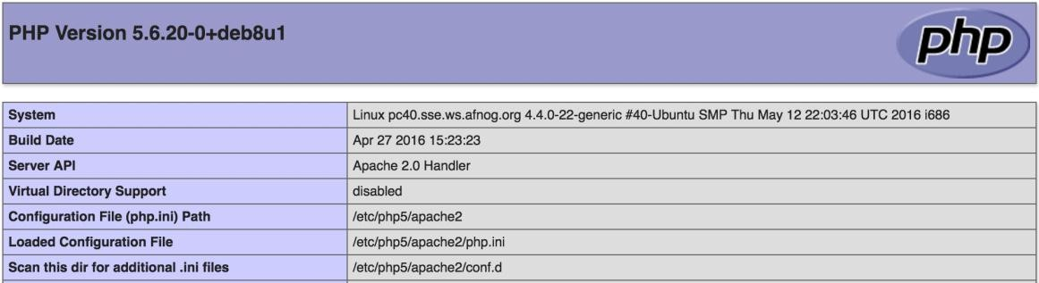
Testing PHP
Create the file
/var/www/html/test.php
with the following contents:
<?php echo phpinfo(); ?>
Load it in your browser at http://pcXX.sse.ws.afnog.org/test.php. You should see this:
Securing MySQL
Please read the instructions and use the letters "y" or “n” on the keyboard.
$ sudo mysql_secure_installation
14 / 17

Slide 16
The password for MySQL is probably
during the installation above).
afnog
(unless you entered a different password
Enter current password for root (enter for none):
OK, successfully used password, moving on...
Remove anonymous users? [Y/n] y
... Success!
Disallow root login remotely? [Y/n] n
... Success!
Remove test database and access to it? [Y/n] y
Reload privilege tables now? [Y/n] y
... Success! Cleaning up...
Testing MySQL
Log in to mysql console to check if the password was set properly using command below.
$ mysql -u root -p
Password:

Slide 17
Type the password at the prompt. Then you should see a
mysql>
prompt, which means that
you authenticated successfully and can enter SQL commands.
16 / 17

Slide 18
FIN
Any questions?
(yeah, right!)
17/17

