Slide 1
Installing RainLoop WebMail
Part 2

Slide 2
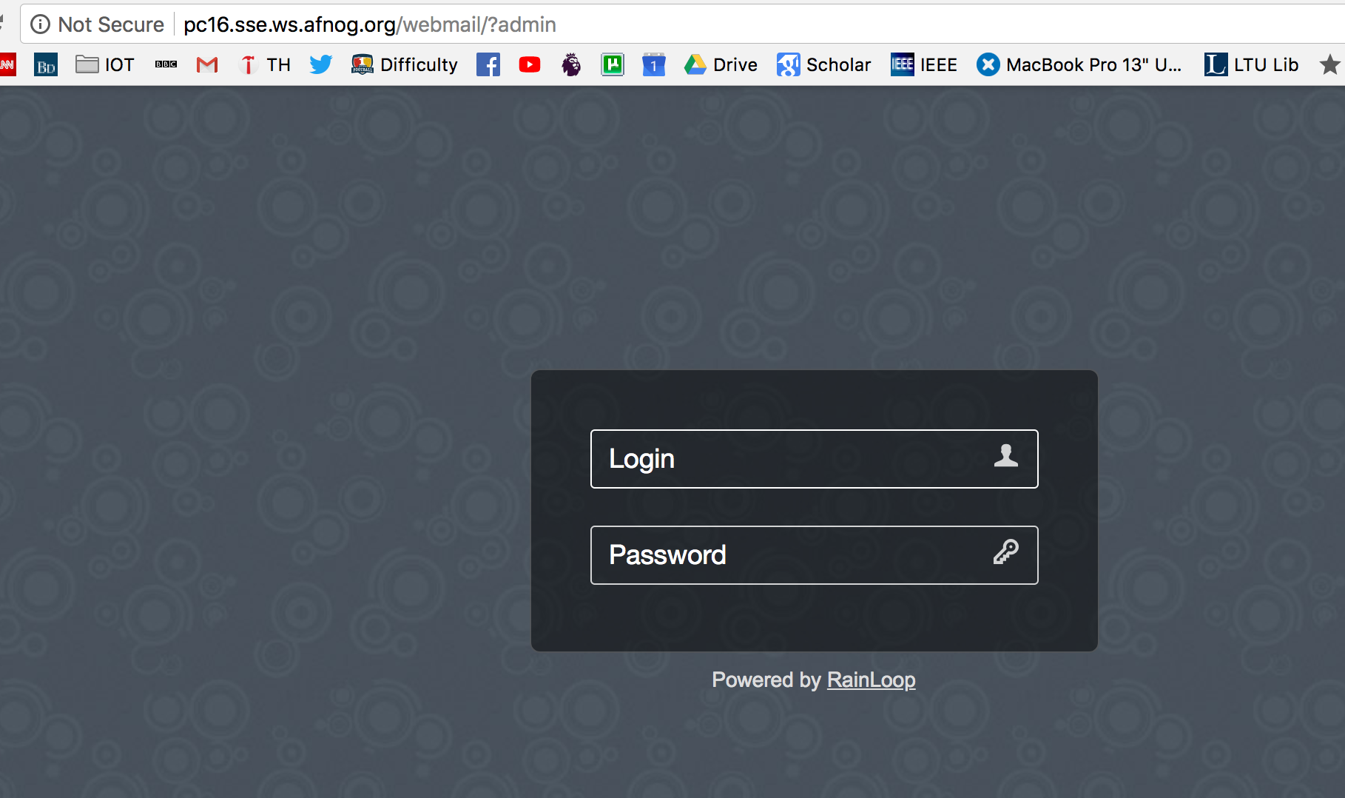
Username: admin
Password: 12345

Slide 3
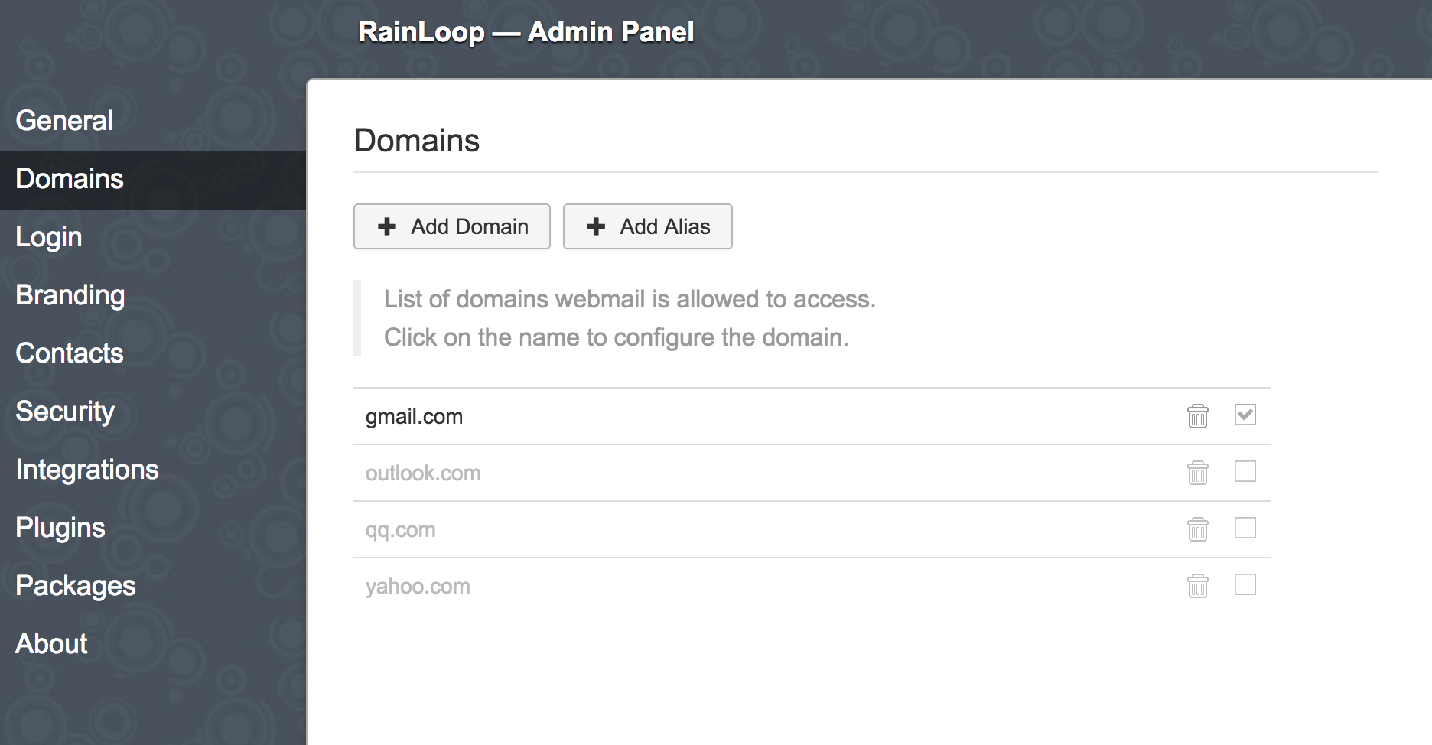
Go to Domains and click add Domains

Slide 4
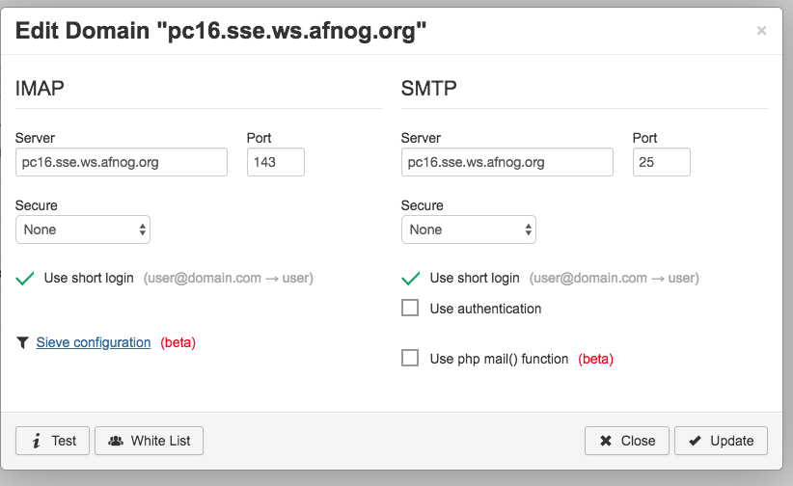
Edit as below. Make sure to enable “Use short Login” on both IMAP and SMTP. Disable authentication on SMTP as well

Slide 5
Browse to the webmail page
You can also add your YYY.afnog.nog-oc.org
Save and close the admin page
Then go to:
Http://YYY.afnog.nog-oc.org/webmail
Login with full user name ie afnog@pcYY.sse.ws.afnog.org OR afnog@YYY.afnog.nog-oc.org

