Slide 1
Implementing POP3 and IMAP4
Using Dovecot
AfNOG 2017
Scalable Internet Services (SS-E)
Nairobi, Kenya
Presented by Kevin Chege
(Built on materials developed by Joel Jaeggli)‏

Slide 2
What is POP3
POP3 stands for Post Office Protocol ver 3
Described in RFC1913
Runs on TCP Port 110 as a client server function
Allows for a maildrop service (similar to the post box mail service ) hence the name
By design its limited in features to download and delete email from server
Security was also limited to using APOP (md5 hash for authentication
RFC 2449 proposed POP3 extensions which included SASL Mechanism, Expiry, Pipelining, etc.
RFC 2595 describes using TLS with POP3 also known as POP3s and runs on port 995

Slide 3
What is IMAP4?
Internet Message Access Protocol version 4
Described in RFC 1730
Runs on TCP Port 143 as client-server function
More advanced in features compared to POP3
IMAP4 stores mail on server and copies can be transferred to the client on request.
By default only the message headers are sent to the client, the rest of the message is accessed on opening the email.
Allows client to access and manipulate email residing on a server, creation of folders, filters, etc.
RFC 1731 describes the IMAP Authentication Mechanisms
RFC 2595 describes using TLS with IMAP4 running on TCP port 993

Slide 4
Mail Storage Formats
Mailbox Format (Mbox)
Defined in RFC 4155
All messages in an Mbox mailbox are concatenated and stored as a plain text in a single file
Mails are stored in RFC822 format with a blank space separating each message (2 spaces as each message has one space) and “From” determining start of next message.
Mbox has a distinct disadvantage in cases of large mailbox (a single large file) requires more resources to read/open and can be slow depending on the servers load.

Slide 5
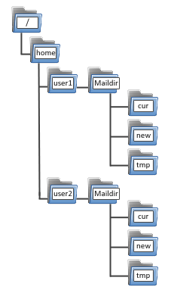
Maildir Storage Format
Mail Directory Format (Maildir)
Each message is stored in a separate file with a unique name and each folder in a directory
Maildir++ provides extension to the Maildir specification providing support for subfolders and quotas.
Maildir directory has 3 folders temp, new and current

Slide 6
How Maildir Works
The mail delivery agent stores all new emails to the mailbox in the tmp directory with a unique filename. (unique = time + hostname+ random generated number)
The MDA creates a hard link to the file in tmp/unique to new/unique
The Mail User Agent will check for new emails in new folder and move them to current folder
The MUA modifies the filename to add a colon (:), a ‘2’ and various flags to represent message status i.e read, replied, forwarded, deleted, etc

Slide 7
Why Dovecot?
High-performance POP and IMAP server
Developed byTimo Sirainen
Unlike say UW IMAP it wasn't written in the 80s
Supports both mbox and maildir formats
Graceful around failures (index repair for example)
Designed with Security in mind – support for Authentication Mechanism and SSL/TLS

