Slide 1
RADIUS and FreeRADIUS
Frank Kuse
Presented at AfNOG 2015

Slide 2
Ingredients
Theory
  What is RADIUS
  Why use RADIUS
  How RADIUS works
  User databases
  Attributes
Practical
  Installing FreeRADIUS
  Adding RADIUS users
  Authenticating services that use PAM

Slide 3
What is RADIUS?
Remote Authentication Dial In User Service
Authentication
  “Who are you?”
Authorization
  “What services am I allowed to give you?”
Accounting
  “What did you do with my services while you were using them?”

Slide 4
Enabling Network Clients (2)
Test again:
  ~/check_radius/check_radius_adv -r pcXX.sse.ws.afnog.org -u afnog -p afnog -s afnog
  OK: Access ACCEPT. (code = 2)
Success! Now check Nagios again.
Also note that this still works:
  ~/check_radius/check_radius_adv -r localhost -u afnog -p afnog -s testing123
  OK: Access ACCEPT. (code = 2)
Why? What are the differences between them?

Slide 5
Why RADIUS?
What are the alternatives?
  LDAP, Kerberos, Active Directory
Advantages of RADIUS:
  Lightweight and efficient
  Supported by many clients, e.g. 802.1x, switches and routers
Disadvantages of RADIUS:
  Limited attribute set, limited use for desktop authentication

Slide 6
How does RADIUS work?
Authentication
  Password authentication, plain text and hashed
  Lookup in various user databases: passwd, SQL, text
Authorization
  Using a set of rules or other templates
Accounting
  Measuring, communicating and recording resources accessed by user
See Wikipedia for list of RFCs

Slide 7
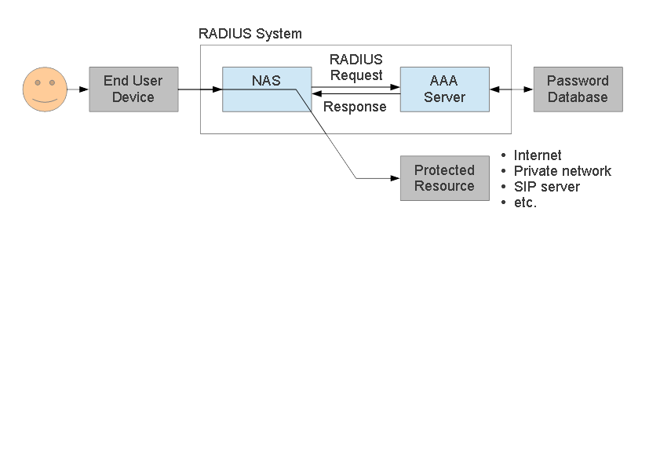
RADIUS Architecture
RADIUS protocol is between NAS and AAA server
NAS controls access to protected resource

Slide 8
What does RADIUS do?
NAS sends an Authentication-Request to AAA server
  user name
  password hashed with secret shared
  some client specific information
AAA server receives an Authentication-Request
  consults password databases:
  looks up the username and client-specific info
  retrieves unhashed password, and other Check Items
  hashes and compares with request contents
  sends an Access-Accept or Access-Reject packet

Slide 9
Why do we need RADIUS?
Many services require password authentication!
Users don't want to remember many passwords
Easier to change password regularly or if compromised
Easier to secure a single password database
Enables user-password auth with 802.1x
Alternative to TACACS for network equipment
Used for PPP authentication in ISPs (PAP/CHAP)

Slide 10
RADIUS message types
Access-Request
Access-Challenge
Access-Accept
Access-Reject
Accounting-Request
Accounting-Response
Status-Server (experimental)
Status-Client (experimental)

Slide 11
RADIUS attributes
Name=Value
  User-Name
  User-Password
  NAS-IP-Address
  NAS-Port
  Service-Type
  NAS-Identifier
  Framed-Protocol
  Vendor-Specific
  Calling-Station-ID
  Called-Station-Id

Slide 12
RADIUS users database (file)
Flat text file
  Easy to understand and edit
  Alternatives include Kerberos, LDAP and SQL
Each user entry has three parts:
  Username
  List of check items (requirements)
  List of reply items (assignments)

Slide 13
RADIUS users database (file)
Flat text file
  Easy to understand and edit
  Alternatives include Kerberos, LDAP and SQL
Each user entry has three parts:
  Username
  List of check items (requirements)
  List of reply items (assignments)

Slide 14
User entry example
Franko Password = 'testing12'
Service-Type = Frame-User,
Framed-protocol = PPP,
Framed-IP-Address = 192.168.1.4
Framed-IP-Netmask = 255.255.255.0
Username is Franko (case sensitive!)
Check items (first line, all must match Access-Req):
  password = testing12
Reply items (indented lines):
  Service-Type, Framed-IP-Address...

Slide 15
User name and check items
Username
  First part of each user entry
  Up to 63 printable, non-space, ASCII characters
Check Items
  Listed on the first line of a user entry, after username
  Multiple items are separated by commas
  Entry only matches if all check items are present in the Access-Request and match
  Fall-Through = Yes allows server to try other entries
First line (user name + check items) must not exceed 255 characters.

Slide 16
Operators in user entries
The “=” and “==” operators mean different things in check items and reply items!
In check items:
  Use “=” for server configuration attributes (Password, Auth-Type)
    Sets the value if not already set (set without override)
  Use “==” for RADIUS protocol attributes
    True if value is present and has the same value, never sets
In reply items:
  Use “=” for RADIUS protocol attributes
  Do not use “==”, it is never valid

Slide 17
The Auth-Type check item
Used to specify where (how) to lookup the password:
  Local (in the users file)
  System (query the OS, /etc/shadow or PAM)
  SecurID
Defaults to Local
Example:
Franko Auth-Type = Local, Password = 'test123'

Slide 18
Password expiration
Disable logins after a particular date
Use the Expiration check item:
Franko Password=”test12”, Expiration=“May 12 2009”
Date must be specified in “Mmm dd yyyy” format!
Use the Password-Warning check item to warn the user before their password expires:
VALUE Server-Config Password-Expiration 30
VALUE Server-Config Password-Warning 5

Slide 19
Checking the NAS IP address and port
NAS-IP-Address check item
  Matches a particular NAS (by IP address)
  Will only match if the user connected to (Access-Request came from) that specific NAS.
NAS-Port-Type check item
  Will only match if the NAS reports that the user connected to a specify the type of port
  Options include: Async, Sync, ISDN
NAS-Port check item
  Will only match if the NAS reports that the user connected to a specific port (ethernet or serial)

Slide 20
Reply items
If all check items in the user entry are satisfied by the access-request, then:
Radius server sends an Access-Accept packet to the NAS, containing the reply items
Gives information to the NAS about the user
  For example, which IP address to assign to them

Slide 21
Reply items
Service Type
  Must be specified
  Login-User → User connects via telnet, rlogin
  Framed-User → User uses PPP or SLIP for connection
  Outbound-User → User uses telnet for outbound connections.
Framed-User is by far the most used now
Simple example:
Franko Auth-Type = System
Service-Type = Framed-User

Slide 22
The Service-Type reply item
Service Type
  Must be specified
  Login-User → User connects via telnet, rlogin
  Framed-User → User uses PPP or SLIP for connection
  Outbound-User → User uses telnet for outbound connections.
Framed-User is by far the most used now
Framed-User requires a Framed-Protocol:
Franko Auth-Type = System
Service-Type = Framed-User
Framed-Protocol = PPP

Slide 23
The Framed-IP-Address reply item
Specifies the user's IP address to the NAS
Set to 255.255.255.255 to force the NAS to negotiate the address with the end-node (dial-in user)
Set to 255.255.255.254, or leave out, to force the NAS to assign an IP address to the dial-in user from the assigned address pool
Franko Auth-Type = System
Service-Type = Framed-User
Framed-Protocol = PPP
Framed-IP-Address = 192.168.1.4

Slide 24
Netmask and Route reply items
Use Framed-IP-Netmask to specify a netmask for the user's IP address
  The default subnet mask is 255.255.255.255
Use Framed-Route to add a route to NAS routing table when service to the user begins
  Three pieces of information are required:
    the destination IP address
    gateway IP address
    metric
  For example:
    Framed-Route = “196.200.219.0 196.200.219.4 1”

Slide 25
Accounting records
FreeRADIUS writes to its Detail log file
Typically Start and Stop accounting records
Tue May 12 14:12:14 2009
Acct-Session-Id = “25000005”
User-Name = “franko”
NAS-IP-Address = 196.200.219.2
NAS-Port = 1
NAS-Port-Type = Async
Acct-Status-Type = Start
Acct-Authentic = RADIUS
Service-Type = Login-User
Login-Service = Telnet
Login-IP-Host = 196.200.219.254
Acct-Delay-Time = 0
Timestamp = 838763356

Slide 26
Accounting attributes
Acct-Status-Type attribute
  indicates whether the record was sent when the connection began (Start) or when it ended (Stop)
Acct-Session-Id attribute
  ties the Start and Stop records together, indicating that it's the same session

Slide 27
What is FreeRADIUS?
The premier open source RADIUS server
Similar to Livingston RADIUS 2.0
Many additional features
Free!

Slide 28
Practical exercise overview
Build and install FreeRADIUS
Configure and start FreeRADIUS
Test authentication using FreeRADIUS
Convert a service to authenticate using RADIUS

Slide 29
Installing Nagios RADIUS Plugin
So we can check our RADIUS server with Nagios:
  fetch -o check_radius_adv_2006_08_23.tar.gz 'http://exchange.nagios.org/components/com_mtree/attachment.php?link_id=295&cf_id=29'
  mkdir check_radius
  cd check_radius
  tar xzvf ../check_radius_adv_2006_08_23.tar.gz
  make CC=cc LIBS=
  sudo cp check_radius_adv /usr/local/libexec/nagios

Slide 30
Configuring Nagios to monitor RADIUS
So we'll know when our RADIUS server is working
Add to /usr/local/etc/nagios/servers/pcXX.cfg:
  define command {
  command_name check_radius
  command_line $USER1$/check_radius_adv -r $HOSTADDRESS$ -u afnog -p afnog -s testing123
  }
  define service {
  use generic-service
  host_name pcXX
  service_description RADIUS
  check_command check_radius
  }
Then restart Nagios

Slide 31
Installing FreeRADIUS
Installing a binary package:
  sudo pkg install freeradius3
Or, if you want to install from ports (not now!)
  /usr/ports/net/freeradius
  sudo make install
  Select any options you might need (none)
Edit /etc/rc.conf (with sudo):
  Add this line: radiusd_enable="YES"
Start FreeRADIUS server:
  sudo /usr/local/etc/rc.d/radiusd start

Slide 32
Checking FreeRADIUS
Check that radiusd is running:
  sudo /usr/local/etc/rc.d/radiusd status
  radiusd is not running.
Oh no! What's wrong?
  sudo /usr/local/sbin/radiusd -X
  …
  Refusing to start with libssl version OpenSSL 1.0.1e-freebsd …
  Security advisory CVE-2014-0160 (Heartbleed)
Need to update FreeBSD first!

Slide 33
Updating FreeBSD
Install FreeBSD updates:
  sudo freebsd-update fetch install
  Press q to close the file list
Tell FreeRADIUS that it's been patched:
  Edit /usr/local/etc/raddb/radiusd.conf (with sudo)
  Find this line: allow_vulnerable_openssl = no
  Change the value no to 'CVE-2014-0160'
Now start FreeRADIUS again:
  sudo /usr/local/etc/rc.d/radiusd start
  sudo /usr/local/etc/rc.d/radiusd status
  radiusd is running as pid XXXX.

Slide 34
Configuring and debugging
You should review the configuration files carefully
  /usr/local/etc/raddb/*
Debugging mode is extremely useful:
  sudo /usr/local/etc/rc.d/radiusd stop
  sudo radiusd -X (capital X)
Output should end with:
  Ready to process requests.
Server is now running in debugging mode
  Leave it running, and open another window/session on the server to run more commands

Slide 35
Testing the default configuration
FreeRADIUS should now respond to RADIUS requests
Test by running:
  radtest test test localhost 0 testing123
  What happens?
Try a local user that does exist, with password:
  radtest afnog afnog localhost 0 testing123
  What happens?
You should see the server receive the access-request and respond with an access-reject in both cases

Slide 36
Testing Unix authentication
Unix authentication is not working!
We don't know why!
Look carefully at the debug output
  WARNING: pap : No "known good" password found for the user. Not setting Auth-Type.
  This means that no (enabled) user database recognises the user.

Slide 37
Enabling PAM Authentication
Check the list of enabled modules:
  sudo ls /usr/local/etc/raddb/mods-enabled
See that pam is not listed
Link /usr/local/etc/raddb/mods-enabled/pam:
  sudo ln -s ../mods-available/pam /usr/local/etc/raddb/mods-enabled/pam
Edit /usr/local/etc/raddb/sites-enabled/default (using sudo):
  Find the line that says: # pam and remove the #
  Find the line that says: # unix and remove the #
    Not the one that just says “unix” without the hash!

Slide 38
Enabling PAM Authentication
Restart the radiusd server, in the other window:
  Press Ctrl+C to stop the radiusd in debug mode
  Start it again with: sudo radiusd -X
Test again:
  radtest afnog afnog localhost 0 testing123
  Received Access-Accept Id … from 127.0.0.1:1812 …
Success!

Slide 39
Fixing the Nagios check (1)
Does Nagios show that the service is up?
Why not? It's running this command:
  $USER1$/check_radius_adv -r $HOSTADDRESS$ -u afnog -p afnog -s testing123
In fact that means:
  /usr/local/libexec/nagios/check_radius_adv -r pcXX.sse.ws.afnog.org -u afnog -p afnog -s testing123
  failed to receive a reply from the server, authentication FAILED.
Why no reply?

Slide 40
Fixing the Nagios check (2)
If you weren't already running FreeRADIUS in debug mode:
  sudo /usr/local/etc/rc.d/radiusd stop
  sudo radiusd -X
  Run the same check_radius_adv command again
Check the debugging output:
  Ignoring request to auth address * port 1812 as server default from unknown client 196.200.219.1xx port 48550 proto udp
Server ignored request from unknown client

Slide 41
Fixing the Nagios check (2)
If you weren't already running FreeRADIUS in debug mode:
  sudo /usr/local/etc/rc.d/radiusd stop
  sudo radiusd -X
  Run the same check_radius_adv command again
Check the debugging output:
  Ignoring request to auth address * port 1812 as server default from unknown client 196.200.219.1xx port 48550 proto udp
Server ignored request from unknown client

Slide 42
Secret (digression)
From RFC 2865:
  The secret (password shared between the client and the RADIUS server) SHOULD be at least as large and unguessable as a well-chosen password. It is preferred that the secret be at least 16 octets. This is to ensure a sufficiently large range for the secret to provide protection against exhaustive search attacks. The secret MUST NOT be empty (length 0) since this would allow packets to be trivially forged.
How to generate a new, secure random key:
  sudo pkg install base64
  dd if=/dev/random bs=16 count=1 | base64
  eAiYEcnU/nxEsp6of5DaGQ== (for example)

Slide 43
Changing the Shared Secret
We've been using the default shared secret, testing123
  Not very secret, so let's change it!
Edit /usr/local/etc/raddb/clients.conf
  Find the section client localhost
  Find the line secret = testing123
  Generate a new secret and set it here
Restart FreeRADIUS and test with the new secret:
  ~/check_radius/check_radius_adv -r localhost -u afnog -p afnog -s <your new secret>

Slide 44
Change the shared secret in Nagios
What happened to our Nagios service when we changed the secret?
  Nothing
  We changed the secret for localhost, not localnet
  Nagios is contacting the server using its hostname, pcXX.sse.ws.afnog.org
  Uses the localnet client definition, whose secret didn't change

Slide 45
Creating users in RADIUS
So far we have only shared our Unix password database using RADIUS
Edit /usr/local/etc/raddb/users:
  Add this line at the beginning of the file:
  john Cleartext-Password = "Smith"
Edit /usr/local/etc/raddb/sites-available/default:
  Find the authorize {…} section
  Find the users line in that section
  Move that line above the pam line
Restart FreeRADIUS

Slide 46
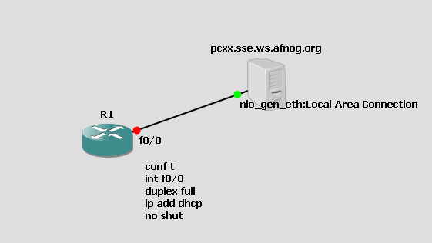
Authenticating Cisco Devices using FreeRadius
Diagram Below is a GNS3 simulation topology for this exercise

Slide 47
Installing FreeRADIUS
Installing a binary package:
  sudo apt-get install freeradius freeradius-utils
Check if FreeRadius is running using below command
Start FreeRADIUS server:

Slide 48
Creating Local user Accounts
sudo vi /etc/freeradius/users :
  Add a new section:
Restart FreeRADIUS:
  sudo service freeradius restart

Slide 49
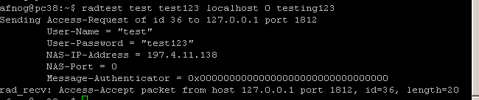
Testing the default configuration(1)
FreeRADIUS should now respond to RADIUS requests
Test by running:
  radtest test test123 localhost 0 testing123
  What happens?
  You should see the server receive the access-request and respond with an access-accept in both cases

Slide 50
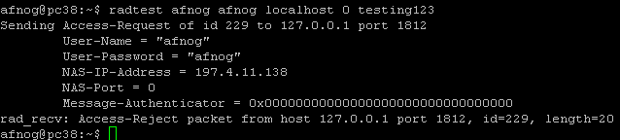
Testing the default configuration(2)
Try a local user that does exist, with password:
  radtest afnog afnog localhost 0 testing123
  What happens?
You should see the server receive the access-request and respond with an access-reject in both cases

Slide 51
Changing the Shared Secret
We've been using the default shared secret, testing123
  Not very secret, so let's change it!
Edit /etc/freeradius/clients.conf
  sudo vi /etc/freeradius/clients.conf
  Find the section client localhost
  Find the line secret = testing123
  Generate a new secret and for our example use afnog123
Restart FreeRADIUS and test with the new secret:
  radtest afnog afnog localhost 0 afnog123

Slide 52

Enabling Network Clients
sudo vi /etc/freeradius/clients.conf:
  Add a new section:
Restart FreeRADIUS:
  sudo service freeradius restart

Slide 53
What have we achieved?
Debian RADIUS server answers authentication requests:
  Flat text file (users file)
  telnet authentication for a Cisco Router
We can deploy new services without having to create separate password databases

Slide 54
What more could we do?
Store credentials in:
  a database (MySQL, PostgreSQL)
  LDAP
  Kerberos
Integrate with network access control (802.1x)
Generate accounting data
  so that we could bill for timed access to resources
  for example a wireless hotspot or a hotel network
Generate reports from accounting data

Slide 55
Bibliography
FreeRADIUS website
  http://www.freeradius.org/
FreeBSD PAM
  http://www.freebsd.org/doc/en_US.ISO8859-1/articles/pam/index.html
PAM RADIUS man page
  http://www.freebsd.org/cgi/man.cgi?query=pam_radius&sektion=8

