Slide 1
Mail Gateway – Part 2
MailScanner Installation

Slide 2
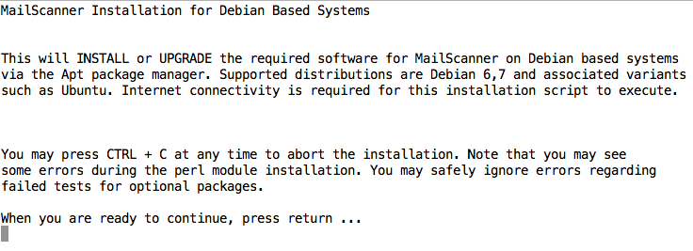
After you run ./install.sh

Slide 3
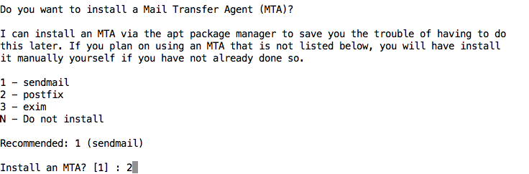
Install Postfix

Slide 4
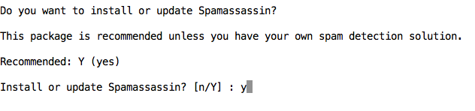
Select yes for Spamassassin

Slide 5
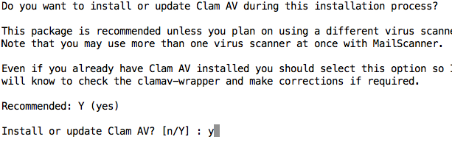
Install Clam-AV

Slide 6
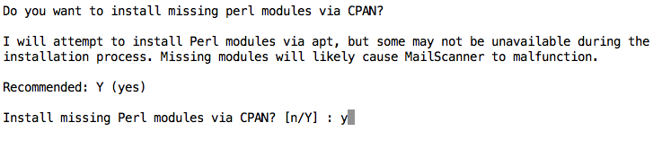
Install Perl Modules

Slide 7
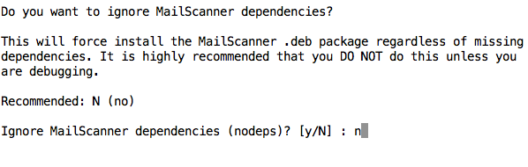
Follow the advice ☺

Slide 8
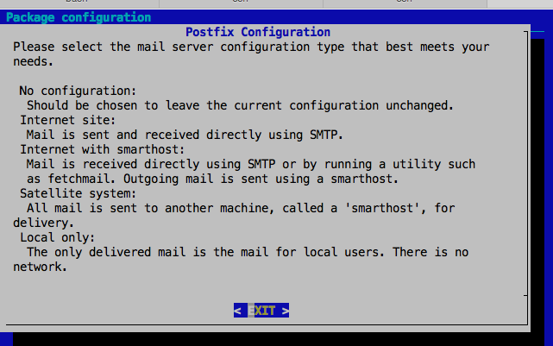
Postfix Screen: Read then press enter

Slide 9
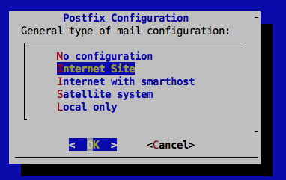
Select Internet Site

Slide 10
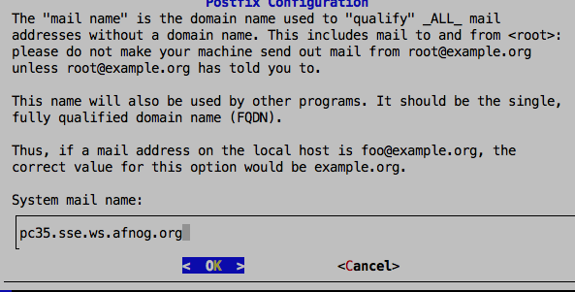
Enter your Name
yourname.afnog.guru
yourname.afnog.guru

Slide 11
Install the MySQL Database
$sudo apt-get mysql-server libdbd-mysql-perl php5-gd php5-mysql
When prompted for the root password enter afnog

Slide 12
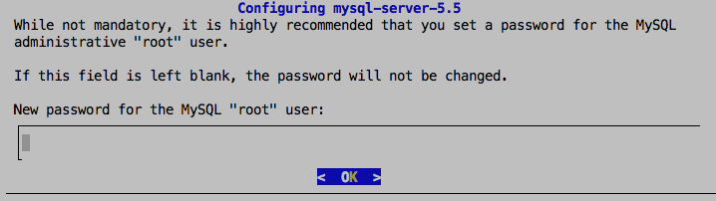
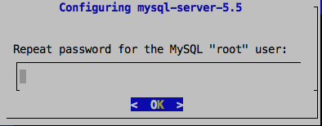
Enter afnog as the MySQL Password

