Slide 1
SquirrelMail for Webmail
AfNOG 2016
Scalable Internet Services (SS-E)
Presented by Michuki Mwangi
Gaborone, Botswana
(Original Materials by Joelja)

Slide 2
What is Webmail?
Webmail provides a web-based (HTTP) Mail User Agent (Front end) to access emails
This makes webmail available anywhere which is practical for most users.
Use the default http port 80 but can ran on other user defined ports.
Webmail systems will access the mail server using IMAP4(s), POP3(s). Some read the files directly from the mailbox stored in Maildir format e.g Sqwebmail.

Slide 3

Background
Started in 1998 by two brothers Luke and Nathan Ehresman
Named after squirrels for their agility
www.squirrelmail.org
It supports IMAP and SMTP protocols and can be setup to support a wide range of MTA and implementations
Its written in PHP

Slide 4
Why Squirrelmail
Squirrelmail is stable and scales well in most environments
Continues to have features support in plugins including password change and server-side filters
Its fast with options header caching and supports server side indexing – works well with Dovecot and Cyrus IMAP
It has a light interface due to php
Additional resources would be required to make it scale for large scale implementations

Slide 5
Summary on Apache
In configuring apache the configuration files are in /etc/apache2/
  Uncommenting all the required includes are done here
  This file is also responsible for loading library module e.g php
  Additional system wide configurations are done here.
  More specific configs should be done in included files and folders
Virtual-hosts are defined in the /etc/apache2/sites-available/
Installation of Squirrelmail will require PHP to be preinstalled.

Slide 6
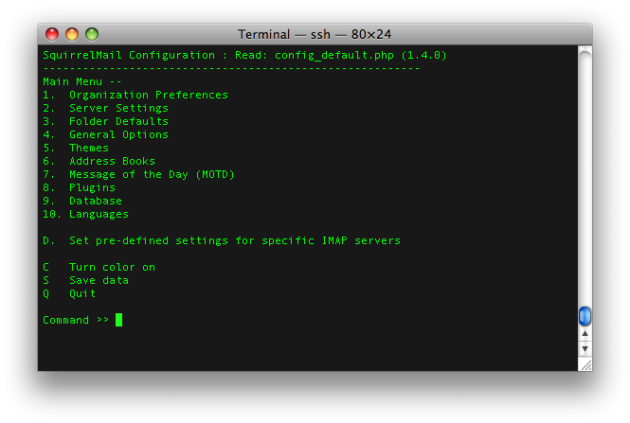
Configuring Squirrelmail
SquirrelMail has its own configure options
  afnog@pcXX:~$ sudo squirrelmail-configure

Slide 7
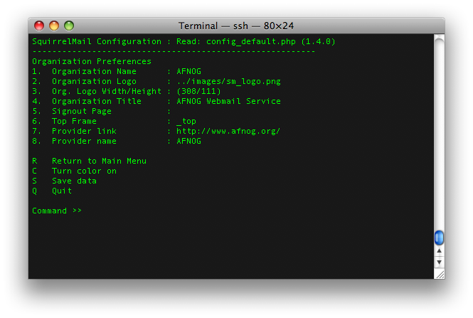
1. Organizational Preferences

Slide 8
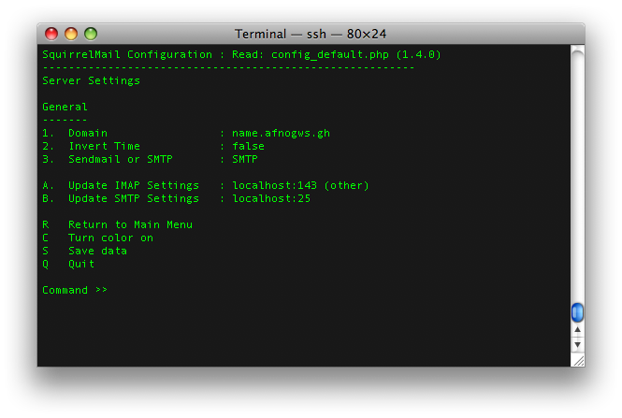
2. Server Settings
Select 2 for Server settings and 1 to change domain. Domain is “______.afnog.guru”

Slide 9
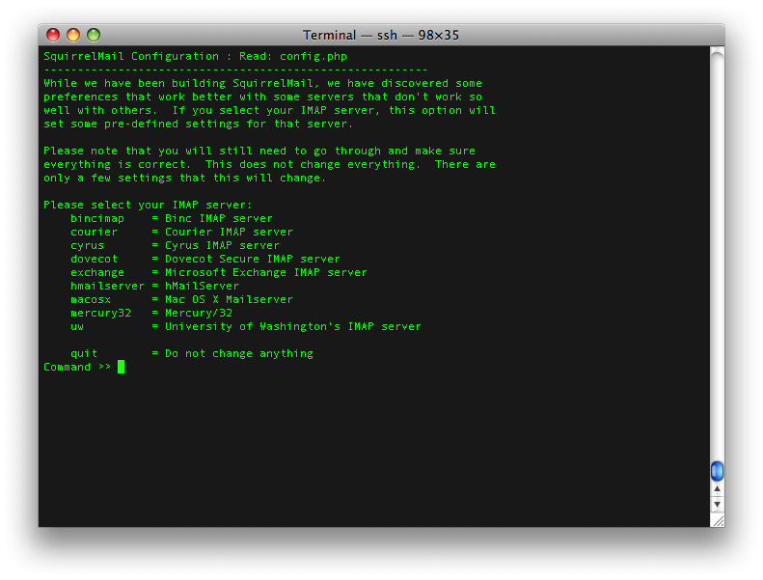
2 a. Set Predefined IMAP Servers
Select A for option to set the type of Server
Type “dovecot” and press enter
Press S to save and R to return to previous menu

Slide 10
4. General Options
From the main menu Press 4 to go to “General Options”
Select option 1 for Data Directory
Type the path of the data directory created earlier i.e /var/squirrelmail/data
Press enter
Press option 2 for Attachments Directory
Type the path of the attachments directory created earlier i.e /var/squirrelmail/attachment
Press “s” to save and “r” to return to main menu

Slide 11
Other Squirrelmail Options
Folder options: - directory default features and behavior of squirrelmail
General Options: - Server side activities and optimizations
Themes : - Look and Feel
Addressbook : - Create or configure LDAP AB
Plugins: - Install additional plugin features
Database: - Define database for AddrBook
Languages: - Change Languages

Slide 12
Configuring Squirrelmail as Apache Virtual-Host
Squirrelmail is a web-mail service
First step to do is add the virtual hosts on apache.
Open /etc/apache2/sites-available/squirrelmail.conf and add the following lines.
<VirtualHost *:80>
ServerAdmin afnog@pcXX.sse.ws.afnog.org
DocumentRoot /usr/share/squirrelmail
ServerName webmail.____.afnog.guru
ErrorLog /var/log/mail-error_log
CustomLog /var/log/mail-access_log common
</VirtualHost>
Save the file and close
Restart apache
$ sudo service apache2 restart

Slide 13
DNS Entry for Webmail
A Resource Record for “webmail” subdomain should be created in your DNS Servers
Edit /var/cache/bind/master/____.afnog.guru
Add an Address Record (A) and (AAAA) for webmail.____.afnog.guru pointing to the IPv4 and IPv6 addresses assigned to the PC/virtual machine
Update the serial number and restart Bind – sudo rndc reload

Slide 14
Accessing Webmail
Open the browser as per the configuration it should be http://webmail._______.afnog.guru
Logon using the system username and password (user afnog/pass afnog)

Slide 15
Happy Webmailing

Slide 16
Additional Information

Slide 17
SSL Mod-rewrite for Squirrelmail
Squirrelmail is a web-mail service as such for security reasons its important to use secure access https
Since we require and want to force everyone to go through an SSL interface we set it up as follows;
  <VirtualHost *:80>
  ServerName webmail.XXX.bogus.gh
  RewriteEngine on
  RewriteCond %{HTTPS} ^off$
  RewriteCond %{HTTP_HOST} (.*)
  RewriteRule ^(.*)/? https://%1/$1 [L,R]
  </VirtualHost>
CAVEAT: SSL does not work in Name Based Virtual Hosting environment only in an IP Based Virtual Hosting. On a shared server it will generate name warnings

