Slide 1
Email: Postfix and Anti-SPAM
What we will cover
Email in General – How it works
The Postfix Email server
We will install a simplified configuration of the Postfix email server
Send emails from the Internet and receive emails to our afnog user accounts
Cover some email best practices
Setup an Email Server/Mail gateway plus an Anti-SPAM and Anti-Virus solution
Filter incoming emails
View logs via the shell and web browser of emails

Slide 2
Postfix Mail Server
Kevin Chege
ISOC

Slide 3
What is Postfix?
Postfix is a free and open-source mail transfer agent (MTA) that routes and delivers electronic mail, intended as an alternative to the widely used Sendmail MTA.
Postfix is released under the IBM Public License 1.0 which is a free software licence.
Originally written in 1997 by Wietse Venema at the IBM Thomas J. Watson Research Center and first released in December 1998, Postfix continues as of 2014 to be actively developed by its creator and other contributors. The software is also known by its former names VMailer and IBM Secure Mailer.
In January 2013 in a study performed by E-Soft, Inc. found that approximately 25% of the publicly reachable mail-servers on the Internet ran Postfix.

Slide 4
Postfix
Works on UNIX-like systems including AIX, BSD, HP-UX, Linux, MacOS X, Solaris, and more.
It is the default MTA for the OS X, NetBSD^{[3]} and Ubuntu operating systems
Used by: AOL, Apple Server, Stanford University, United States Navy, NASA, Rackspace, many ISPs
Able to process thousands

Slide 5
Some Key Features
SASL authentication – Simple Auth Security Layer
Mail forwarding or delivery
"Virtual" domains with distinct address-namespaces
A large number of database lookup mechanisms including Berkeley DB, CDB, OpenLDAP LMDB, Memcached, LDAP and multiple SQL database implementations
Extended
Deep content inspection before or after a message is accepted into the mail queue;
Mail authentication with DKIM, SPF, or other protocols;
SMTP-level access policies such as greylisting or rate control.

Slide 6
Postfix on Debian
Installed via: $sudo apt-get install postfix
Directories: /etc/postfix
Configuration files
main.cf - stores site specific Postfix configuration parameters while
master.cf – defines daemon processes

Slide 7
master.cf
defines how a client program connects to a service, and what daemon program runs when a service is requested.
For exampleMost daemon pro-
cesses are short-lived and terminate voluntarily after serving max_use
clients, or after inactivity for max_idle or more units of time.

Slide 8
main.cf
specifies a very small subset of all the parameters that control the operation of the Postfix mail system
you will have to set up a minimal number of configuration parameters.
Postfix configuration parameters resemble shell variables
parameter = value
other_parameter = $parameter
Postfix uses database files for access control, address rewriting and other purposes

Slide 9
main.cf Key Settings
myorigin = $myhostname
specifies the domain that appears in mail that is posted on this machine. Defaults to the value of the machine’s hostname
mydestination = $myhostname, localhost
specifies what domains this machine will deliver locally
if your machine is a mail server for its entire domain, you must list $mydomain as well in this setting
The mydomain parameter specifies the parent domain of $myhostname. By default, it is derived from $myhostname by stripping off the first part (unless if the result would be a top-level domain)

Slide 10
Relaying Mail – From
Postfix will forward mail from clients in authorized network blocks to any destination
Authorized networks are defined with the mynetworks configuration parameter
The default is to authorize all clients in the IP subnetworks that the local machine is attached to.
By default, Postfix will NOT be an open relay ie it will not forward from IPs outside your network to the Internet
mynetworks_style = subnet
mynetworks = 127.0.0.0/8 168.100.189.2/32

Slide 11
Relaying mail - to
By default, Postfix will forward mail from strangers (clients outside authorized networks) to authorized remote destinations only.
Authorized remote destinations are defined with the relay_domains configuration parameter.
The default is to authorize all domains (and subdomains) of the domains listed with the mydestination parameter.
This means that by default, your Postfix mail server will accept mail from anyone to recipients to the local Postfix server

Slide 12
Outbound emails
By default, Postfix tries to deliver mail directly to the Internet.
Depending on your local conditions this may not be possible or desirable
For example, your system may be behind a firewall, or it may be connected via a provider who does not allow direct mail to the Internet.
In those cases you need to configure Postfix to deliver mail indirectly via a relay host.
relayhost = [mail.isp.tld]
Note that the [] disables MX lookups so is necessary

Slide 13
Reporting problems
You should set up a postmaster alias in the aliases table that directs mail to a real person
The postmaster address is required to exist, so that people can report mail delivery problems.
While you're updating the aliases(5) table, be sure to direct mail for the super-user to a human person too. /etc/aliases: postmaster: afnog root: afnog
After editing the aliases file, run the command $sudo newaliases

Slide 14
Default reports
bounce
Inform the postmaster of undeliverable mail. Either send the postmaster a copy of undeliverable mail that is returned to the sender, or send a transcript of the SMTP
2bounce
When Postfix is unable to return undeliverable mail to the sender,
delay
Inform the postmaster of delayed mail. In this case, the postmaster receives message headers only.
policy
Inform the postmaster of client requests that were rejected because of (UCE) policy restrictions. The postmaster receives a transcript of the SMTP session.
protocol
Inform the postmaster of protocol errors (client or server side) or attempts by a client to execute unimplemented commands.
resource
Inform the postmaster of mail not delivered due to resource problems (for example, queue file write errors)
software
Inform the postmaster of mail not delivered due to software problems.

Slide 15
Logging
Postfix will log all messages to /var/log/mail.log
Done using the syslogd daemon
All transactions of messages coming in being sent out of the server will be logged
Logs will contain details like hostnames, recipients, time and date, and whether the email was queued or dropped

Slide 16
Postfix Daemon process chrooted
Postfix daemon processes can be configured (via the master.cf file) to run in a chroot jail
The processes run at a fixed low privilege and with file system access limited to the Postfix queue directories (/var/spool/postfix).
This provides a significant barrier against intrusion.
The barrier is not impenetrable (chroot limits file system access only)

Slide 17
Interfaces and Protocol
The inet_interfaces parameter specifies all network interface addresses that the Postfix system should listen on
inet_interfaces = all
inet_protocols parameter specifies which protocols Postfix will attempt to use
inet_protocols = ipv4, ipv6

Slide 18
Starting, stopping and logs
Starting/Stopping $sudo service postfix start $sudo service postfix stop
Reloading rules $sudo postfix reload
Checking logs $sudo tail –f /var/log/mail.log

Slide 19
Email Best Practices
Kevin Chege

Slide 20
SPF
SPF – Sender Policy Framework
SPF allows administrators to specify whichhosts are allowed to send mail from a given domain by creating a specific SPF record (or TXT record) in the Domain Name System (DNS).
@ IN TXT “v=spf1 include:gmail.com ip4:1.2.3.4 mx -all”
The above will only allow mail from IP 1.2.3.4 and any server in the domain with an MX record
If not sure use a generation tool online
http://www.mtgsy.net/dns/spfwizard.php

Slide 21
Reverse Records
Have reverse records (PTR) for your mail server so that it is resolveable from the IP
Mandatory by most servers these days
Used to verify authenticity of the sending mail server
The IP Address must resolve back to the mail server name
You can have multiple reverse records
You can have an SPF record that states that any IP that has a reverse record can send email from your domain
IN TXT “v=spf1 ptr:domain.co.tz ip4:1.2.3.4 mx -all”

Slide 22
Use Anti Spam and Anti Virus software
Will reduce overall spam and email received
You can also have a mail “firewall” or gateway aka Mail Filter to stop spam before it reaches your server
Some softwares are:
Spamassassin (AntiSpam)
ClamAV (AntiVirus)
MailScanner and Amavisd (use the above)
Maia Mail Guard
When setup try a penetration testing site to see how well your server can protect you from SPAM and Viruses

Slide 23
GreyListing
Valid mail servers will have no problem if the receiving gives a soft error (4xx)
They will attempt to send the mail again after some time
Greylisting configured on a receiving mail server will give a soft error (4xx) to the sending server and store the IP/Hostname of the sending server in a file
If the sending server returns again after some time (can be specified usually 5min) the email is accepted
Used as a measure to deny mail from bots that are compromised to send mass mail. They often do not try again if the server did not accept the mail

Slide 24
Accept only well formatted messages
Sender must be a valid name not an IP ie not user@192.14.5.6
Mail server HELO name must be resolvable ie FQDN
Server identification must resolve ie HELO/EHLO name must be resolveable
Email should be from a valid email address format eg: from tom@example.com and not from tom@example

Slide 25
Security
Run secure pages from the mail server and secure SMTP to clients
Secure Webmail – port 443
Secure SMTP – port 465/587
Force clients to use secure IMAP or Secure POP
Secure POP – port 995
Secure IMAP – port 993
Require authentication on your mail server before a mail enters the queue from a sending client aka SMTP AUTH

Slide 26
Use Blacklist databases
Use DNSBL – DNS Based Blackhole Lists or RBL (Real Time Blackhole lists) to deny mail from well known spamming machines
Some well known good ones are
SORBS – http://sorbs.net
SPAMHAUS – http://spamhaus.org
SPAMCOP – http://spamcop.net
MANITU – http://manitu.net

Slide 27
Require strong Passwords
Advise users to use strong passwords or passphrases for their email
Alphanumeric passwords are better than normal passwords ie combine letters with numbers
Passphrases are even better, more difficult to break

Slide 28
Backup and Redundancy
Have multiple MX records so that your server is not the only one able to receive mail for you
Backup your mail, use tools like Rsync to copy mail to another server as often as you can
Ensure your DNS records (MX, NS etc ) are correct and test them when you complete you setup
Use online tests like
http://intodns.net

Slide 29
The question of Ethics
As an email administrator, its easy to view other people’s email at any time with admin rights

Slide 30
References
Wikipedia
http://www.linuxmagic.com/best_practices

Slide 31
Building a Mail Gateway aka Mail Firewall or Mail Filter appliance

Slide 32
What is a Mail Gateway?
A software/service/appliance that is able to receive and filter emails before they reach the email boxes
Typically, a mail gateway will not contain mail box accounts and will only receive emails, filter them based on configured parameters, and then forward them to the mail server that contains the mailboxes
The purpose is to remove dangerous or harmful content (like spam and viruses) on email before they reach user boxes
A mail filter can process incoming emails and or outgoing emails

Slide 33
How it flows
Email from the Internet
Mail Gateway receives Email and filters out based on criteria. Forwards the clean email to the mail server
Mail Server
with mailboxes delivers the emails to the mailboxes.

Slide 34
Advantages
Remove harmful email before it reaches mail boxes
Remove the work of filtering email from the server that is handling email boxes
Highly configurable and can block emails based on a number of criteria including content that is in the body of the email
If hosted outside the network, can reduce load on the network connection/link (also known as far side scrubbing)

Slide 35
Disadvantage
Mistakes in configuration may mean mail is not delivered. They are highly customisable with hundreds of options and parameters which you must be careful with
Increase the number of email servers to be managed

Slide 36
Common tools used in Mail Gateways
Spamassassin – No. 1 Open Source anti-spam platform giving system administrators a filter to classify email and block spam (unsolicited bulk email)
ClamAV – Virus scanning software. Can be used for email scanning and web scanning
Amavisd – interface between the MTA and the above tools. A common mail filtering installation with Amavis consists of an MTA, ClamAV and Spamassassin
MailScanner - open source email security system design for Linux-based email gateways

Slide 37
Mail Gateway Appliances
These are solutions that can be installed on servers and provide Mail Gateway services
Software:
Anti Spam SMTP Proxy - http://en.wikipedia.org/wiki/Anti-Spam_SMTP_Proxy
Mail Border - http://www.mailborder.com/
ScrolloutF1 - http://www.scrolloutf1.com/
Xeams - http://www.xeams.com/
Hardware (Blackbox):
Barracuda - https://www.barracuda.com/products/emailsecuritygateway

Slide 38
MailScanner
MailScanner is a highly respected open source email security system design for Linux-based email gateways.
It is used at over 30,000 sites around the world
Has fast become the standard email solution at many ISP sites for virus protection and spam filtering.
MailScanner scans email for viruses, spam, phishing, malware, and other attacks against security vulnerabilities and plays a major part in the security of a network.
MailScanner supports a wide range of MTAs and virus scanners to include the popular open source Clam AV. Spam detection is accomplished via Spamassassin, which is by far the most popular and standardized spam detection engine.
Written and Founded by: Julian Field

Slide 39
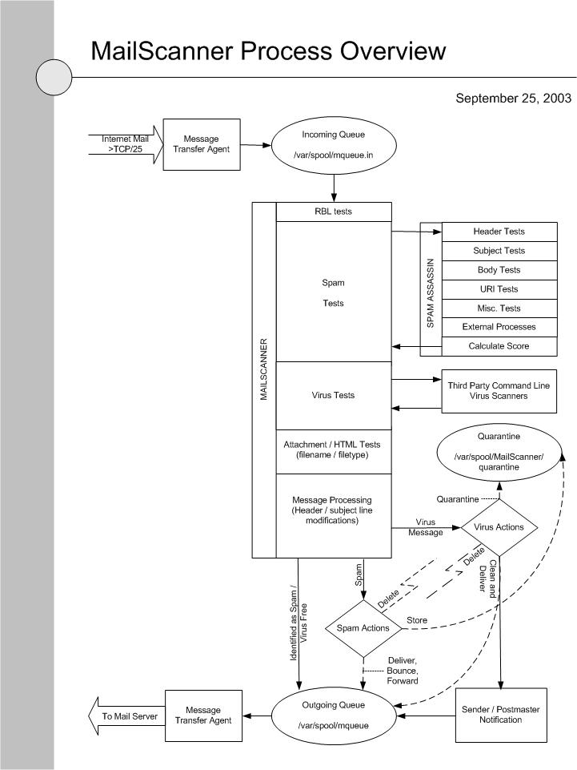

Slide 40
MailScanner as an Appliance
MailScanner can be combined with a frontend to become a Mail Gateway appliance
Two frontends are available:
Baruwa – http://baruwa.org
Mailwatch - http://mailwatch.org/
When properly managed and configured with Postfix or Exim as the MTA, one can build a powerful mail gateway

Slide 41
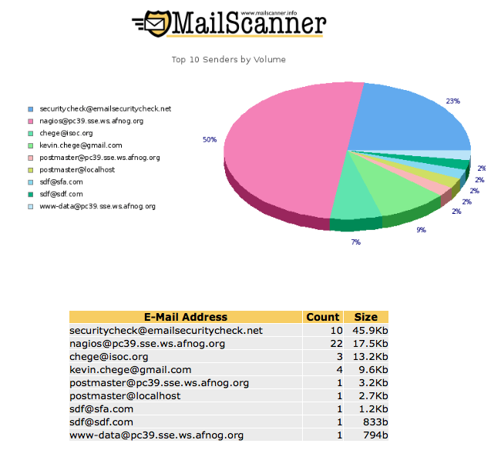

Slide 42
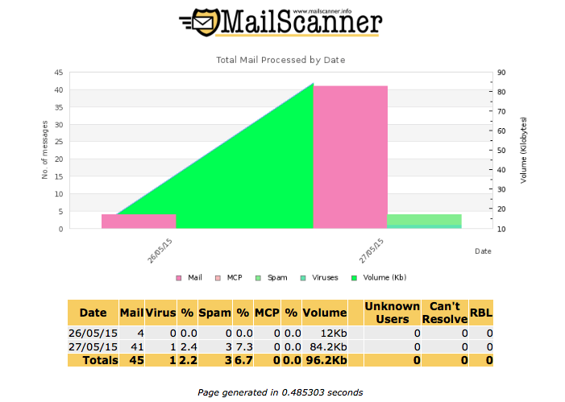

Slide 43
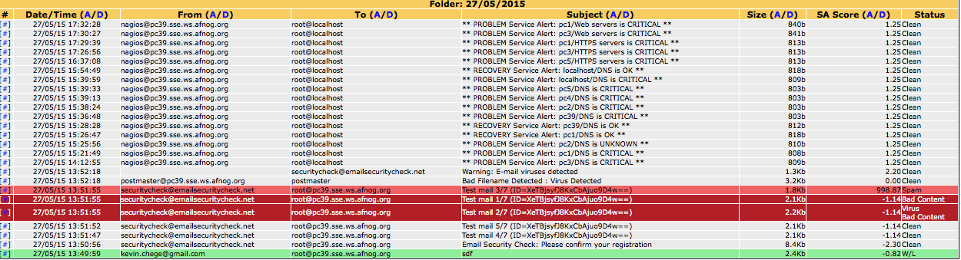

Slide 44
Mailscanner has hundreds of Knobs
https://www.mailscanner.info/MailScanner.conf.index.html
All have implications on how legitimate emails, SPAM emails and emails containing viruses will be treated
Defaults are safe to start with but you should read and understand
We will install with basic features of
Log all emails to MySQL (SPAM and Not SPAM)
Store all emails in the quarantine

Slide 45
Let us build our Mail Gateway
We will now setup a mail gateway
Configuring a mail filter is not easy. You must be aware of what you are enabling or disabling.
Preconfigured files will be provided due to time limitation
Setting the correct DNS entries is key
You will filter email for your neighbor and he will filter your email
At the end, you should have a fairly strong and working mail filter

Slide 46
Reference
https://www.mailscanner.info

