Slide 1
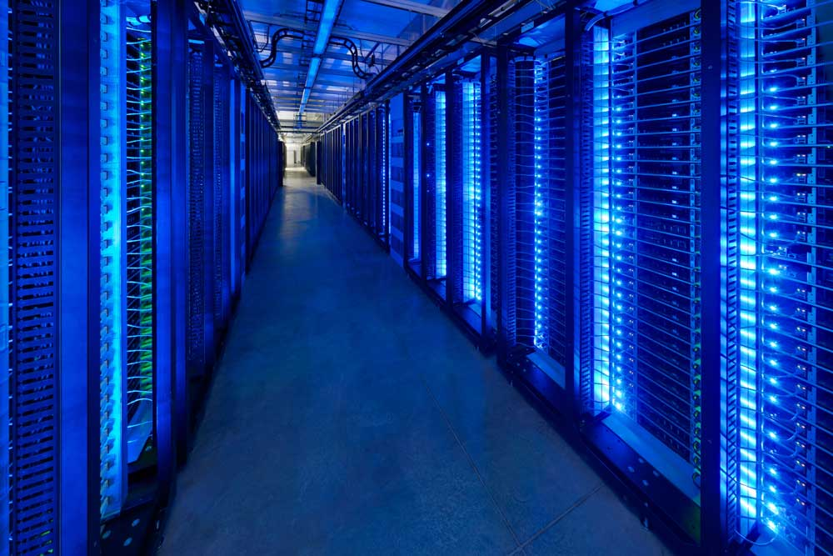
Virtualisation Intro
By Laban Mwangi (lmwangi _at_gmail.com)
Based on notes by Joel Jaeggli
For AFNOG SS-E 2014

Slide 2
What is it?
An abstraction that allows for easy subdivision an allocation of resources
What Computing/Network resources can be virtualized?
  OS virtualization
  Application virtualisation
  Service virtualisation
  Network virtualisation
  Storage virtualisation
  And much more...

Slide 3
Anything?
In the context of this course. We're interested in virtualization along two dimensions:
  Resource virtualisation
  OS virtualisation

Slide 4
Resource/Service virtualization
Examples:
  Load-balancers
  DNS Based GLB
  HTTP(S) Virtual Hosting
  MX records
  Virtual Switches
  Virtual Routers
  Virtual Firewalls

Slide 5
Resource Virtualization - Continued
HTTP virtual hosts
  Multiple websites on one system
Load Balancing
  One (or many sites or applications) across many systems
  Can be done at Layer-3/4/7

Slide 6
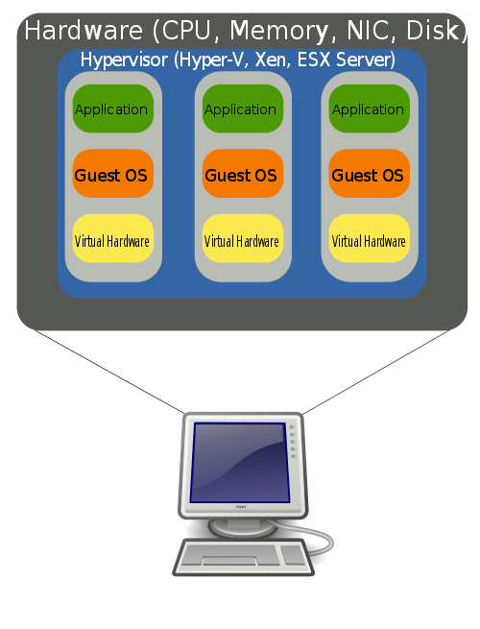
Host Virtualization
Examples
  Vmware
  Virtual-Box (used in class)
  KVM
  XEN
  FreeBSD and Linux Jails
  Windows Hyper-V

Slide 7
What problem are we attempting to solve with host virtualization.
Problem 1 – Idle capacity.
  Most of the machines in your datacenter are idle most of the time.
  Capacity you're not using:
    Cost money up front
    Cost money to operate
    Reduces you return on capital
  Packing discreet systems into a smaller number of servers provides savings along virtually every dimension.

Slide 8
Problems - Continued
Problem 2 – Provisioning
  Spinning up a new service involves:
    Acquiring the hardware
    Building the server
    Integration with existing services
  With virtualization we're aiming to short-circuit that
    Capacity is a resource
    Machine instances my be cloned or provisioned from common basic images
    Resources are purchased in bulk and assigned to applications as necessary.

Slide 9
Problems - Continued
Problem 3 – Hardware abstraction
  Operating systems, servers, and applications evolve at different rates.
  Providing a common set of infrastructure resources means, virtualized systems are portable across servers
  Hardware failure can more easily be managed.
Abstraction may come at a performance cost however. (some workloads are more expensive than others)
  See: http://blog.xen.org/index.php/2011/11/29/baremetal-vs-xen-vs-kvm-redux/

Slide 10
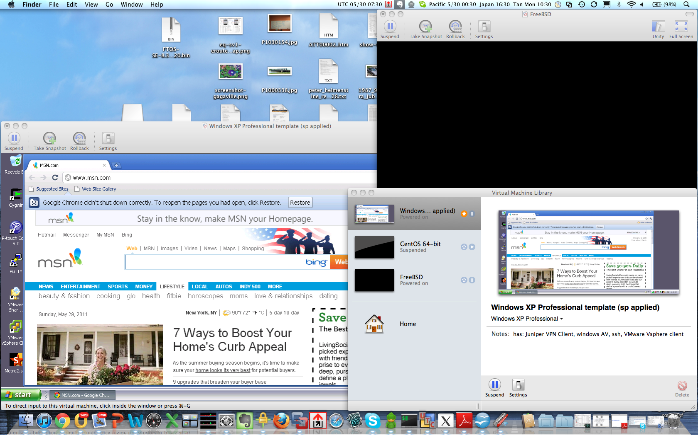
Examples – Desktop Virtualization

Slide 11
Desktop Virtualization
Uses
  Prototyping services or applications before deployment
  Utilities that don't run on your operating system
  Isolation of sandbox environments from your desktop
  Maintaining multiple versions of an environment for support purposes.
  Staying familiar with unix while running windows (consider compared to the alternative (dual-booting)
Issues
  Emulating multiple computers on your laptop/desktop is somewhat resource intensive
Vmware player and VirtualBox are free.
  http://www.virtualbox.org/wiki/Downloads
  http://downloads.vmware.com/d/info/desktop_downloads/vmware_player/3_0?ie=UTF-8&q=vmwareplayer

Slide 12
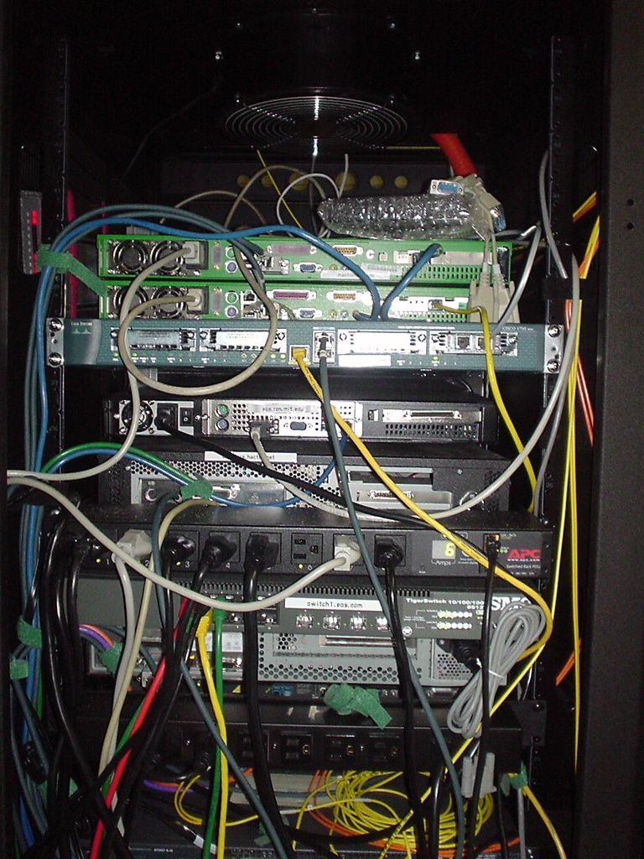
Examples – Server Virtualization

Slide 13
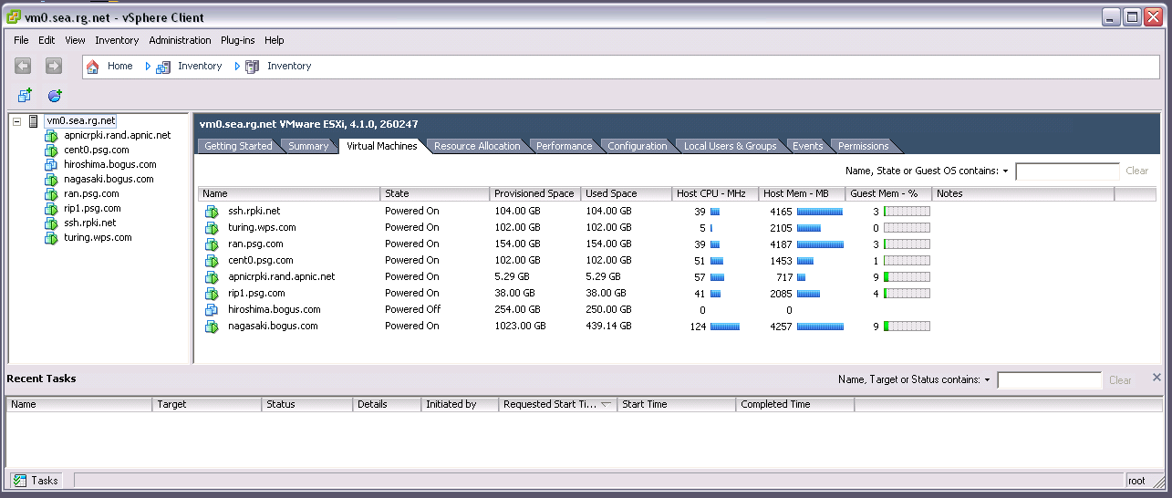
Server Virtualization - Continued

Slide 14
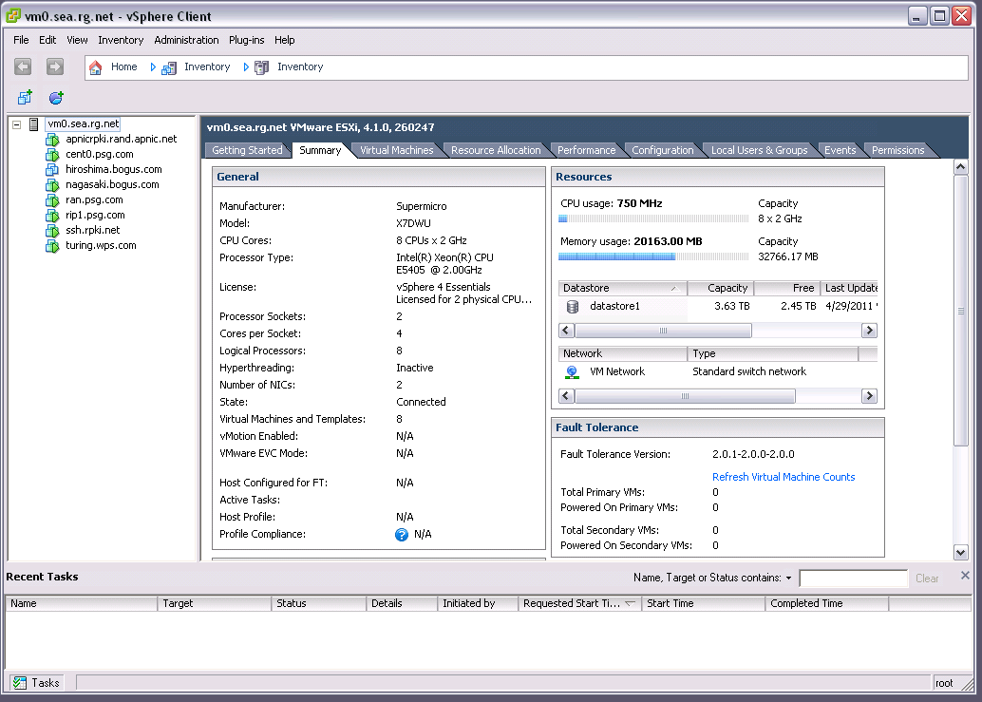
Server Virtualization

Slide 15
Virtualized Servers as a Service
(Amazon Web Services)
Much as colocated servers, are available from a hosting provider, virtual servers are also available.
Model is:
  You pay for what you use.
  Flexibility, need fewer servers today then you used, yesterday.
  Leverage other amazon tools (storage/map-reduce/load-balancing/payments etc)

Slide 16
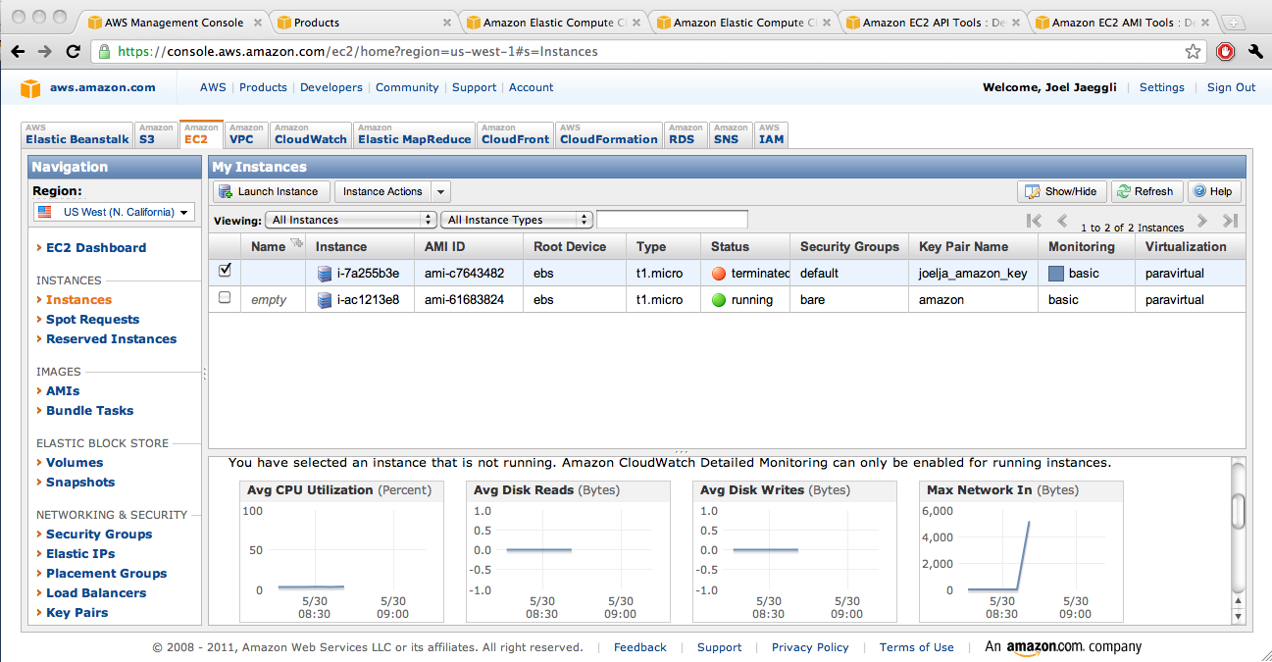
AWS

Slide 17
AWS Steps
Select availability zone
Launch new instance
Select appropiate ami
Associate with ssh key
Launch instance
Add ip
SSH into new machine instance.
t1-micro-instances run $54 a year + bandwidth

Slide 18
Try it for free...
Free tier for the first Calender year is (per month):
  750 hours of EC2 running Linux/Unix Micro instance usage
  750 hours of Elastic Load Balancing plus 15 GB data processing
  10 GB of Amazon Elastic Block Storage (EBS) plus 1 million IOs, 1 GB snapshot storage, 10,000 snapshot Get Requests and 1,000 snapshot Put Requests
  15 GB of bandwidth in and 15 GB of bandwidth out aggregated across all AWS services
Which is not to say that, at scale EC2 is particularly cheap, (It isn't)
  Limited capital at risk is in the context of prototyping or experimentation however.

Slide 19
AWS - Continued
For provisioning purposes cli interaction is possible:
  http://aws.amazon.com/developertools/351
Along with tools to support the provisioning and destruction of virtual machines.

Slide 20
Provisioning and management
Is the glue that makes virtualization usable
In commercial virtualization environments the provisioning/management toolkits represent the bulk of the licensing cost (VMware) and the secret sauce (VMotion, disaster recovery, backup, etc)
Examples:
  XEN tools – a collection of perl scripts for spinning VMs http://www.xen-tools.org/software/xen-tools/
  KVM tools - http://www.linux-kvm.org/page/Management_Tools
  Cloud.com/cloud-stack (orchestration) - http://www.cloudstack.org/
  Rightscale – (orchestration multiple public/private clouds) http://www.rightscale.com
  Puppet (host / configuration management) - http://puppetlabs.com/puppet/
  PDSH – (Parallel Shell execution) http://code.google.com/p/pdsh/

Slide 21
Virtualbox
Download virtualbox and install it.
Dowload the openbsd install iso.
Create an openbsd 32bit virtual machine.
Adjust the virtual machine settings to boot off the iso.
Install and accept the defaults for prompts.

Slide 22
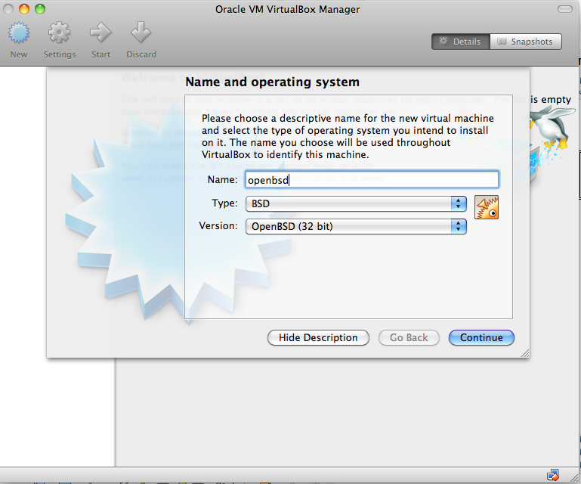

Slide 28
Choose interactive install (I
Choose defaults by pressing <enter> on the prompts below
Image below should give you an idea...

Slide 29
Elect not to run X windows
Image below should give you an idea...

Slide 30
Auto layout and auto partition...
Image below should give you an idea...

Slide 31
Ignore the SHA256 signature verification prompt!
Image below should give you an idea...

Slide 32
Wait for the installation to complete?
Image below should give you an idea...

Slide 33
Reboot the instance
Image below should give you an idea...

Slide 34
Stop the instance and adjust the settings of the VM
Make sure that CD/DVD comes after Hard disk as shown below
Restart the instance

Slide 36
Class Exercise
Good engineers are lazy, lazy, lazy, lazy!
vagrant profiter de la vie!!

Slide 37
Vagrant
Install vagrant from the local server on your laptop
Make a vagrant file by issuing vagrant init
Edit the vagrantfile
Change the line:
  From: config.vm.box = "base"
  To: config.vm.box = "http://mini1.sse.ws.afnog.org/~inst/vagrant_boxes/hashicorp/precise32/version/1/provider/virtualbox.box"

Slide 38
Create a new dir and change to it
Run vagrant init
Run ee Vagrantfile to edit the generated file
Create a new dir and change to it
Run vagrant init
Run ee Vagrantfile to edit the generated file
Change the line config.vm.box to the one below
  http://mini1.sse.ws.afnog.org/~inst/vagrant_boxes/hashicorp/precise32/version/1/provider/virtualbox.box

Slide 39
Run vagrant up to start the instance

Slide 40
Run vagrant ssh to connect to the instance
You just provisioned an instance in minutes
You can now configure this instance for a service
You can change to another directory and repeat the process to get another instance
  Run: vagrant init
  Edit the file: Vagrantfile
  Run: vagrant up
Exercise: Create a new FreeBSD vm using this box:
  http://mini1.sse.ws.afnog.org/~inst/vagrant_boxes/chef/freebsd-9.2/version/1/provider/virtualbox.box

Slide 41
Other vagrant commands
List instances: vagrant global-status
Stop an instance: vagrant halt
Suspend an instance: vagrant suspend
Resume an instance: vagrant resume
Terminate an instance: vagrant destroy
Snapshot and store/share an instance: vagrant package

