Slide 1
Email Intro
SS-E AFNOG 2019
Kevin Chege

Slide 2
Goals
Install a Mail Server (Debian)
Put a web interface to access our emails
Go through email best practices
Build a mail filter to clean emails on other system (FreeBSD)

Slide 3
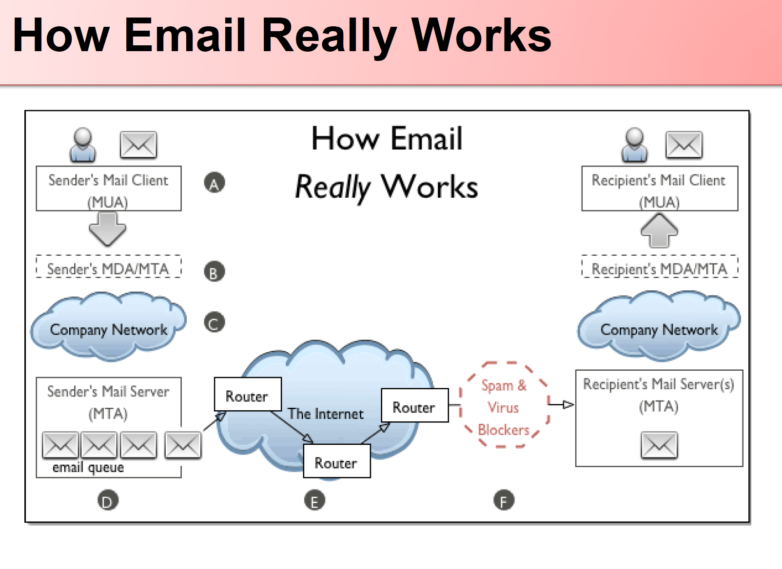

Slide 4
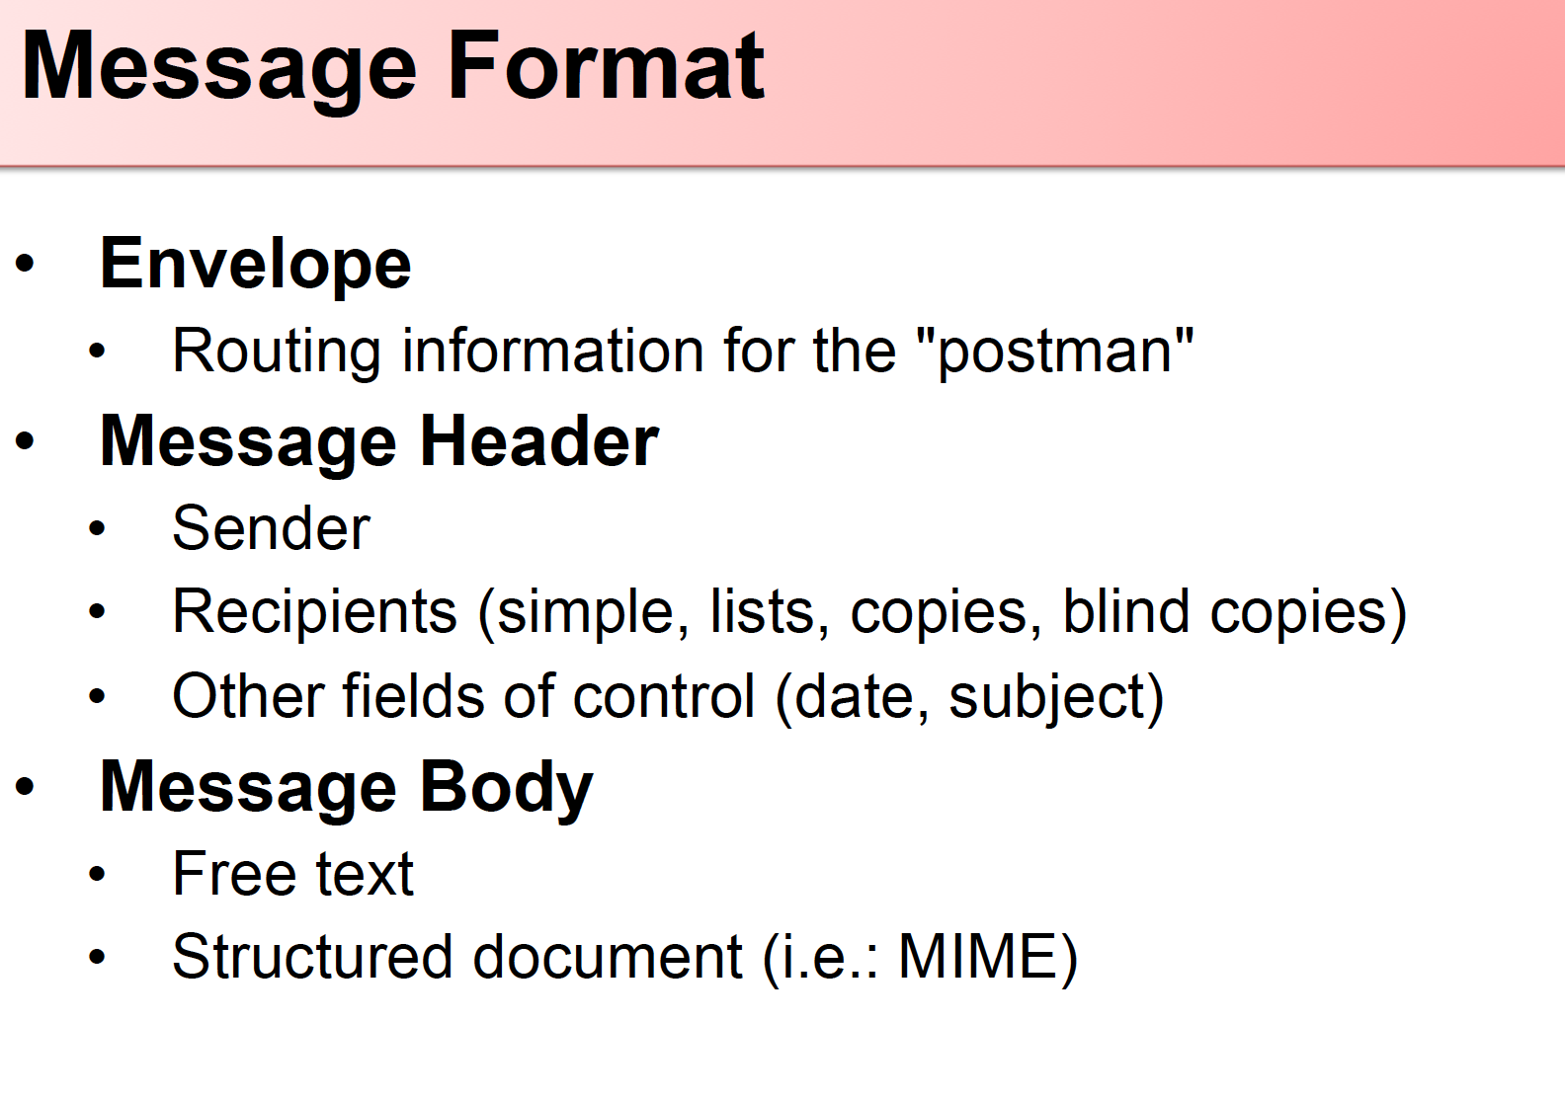

Slide 5
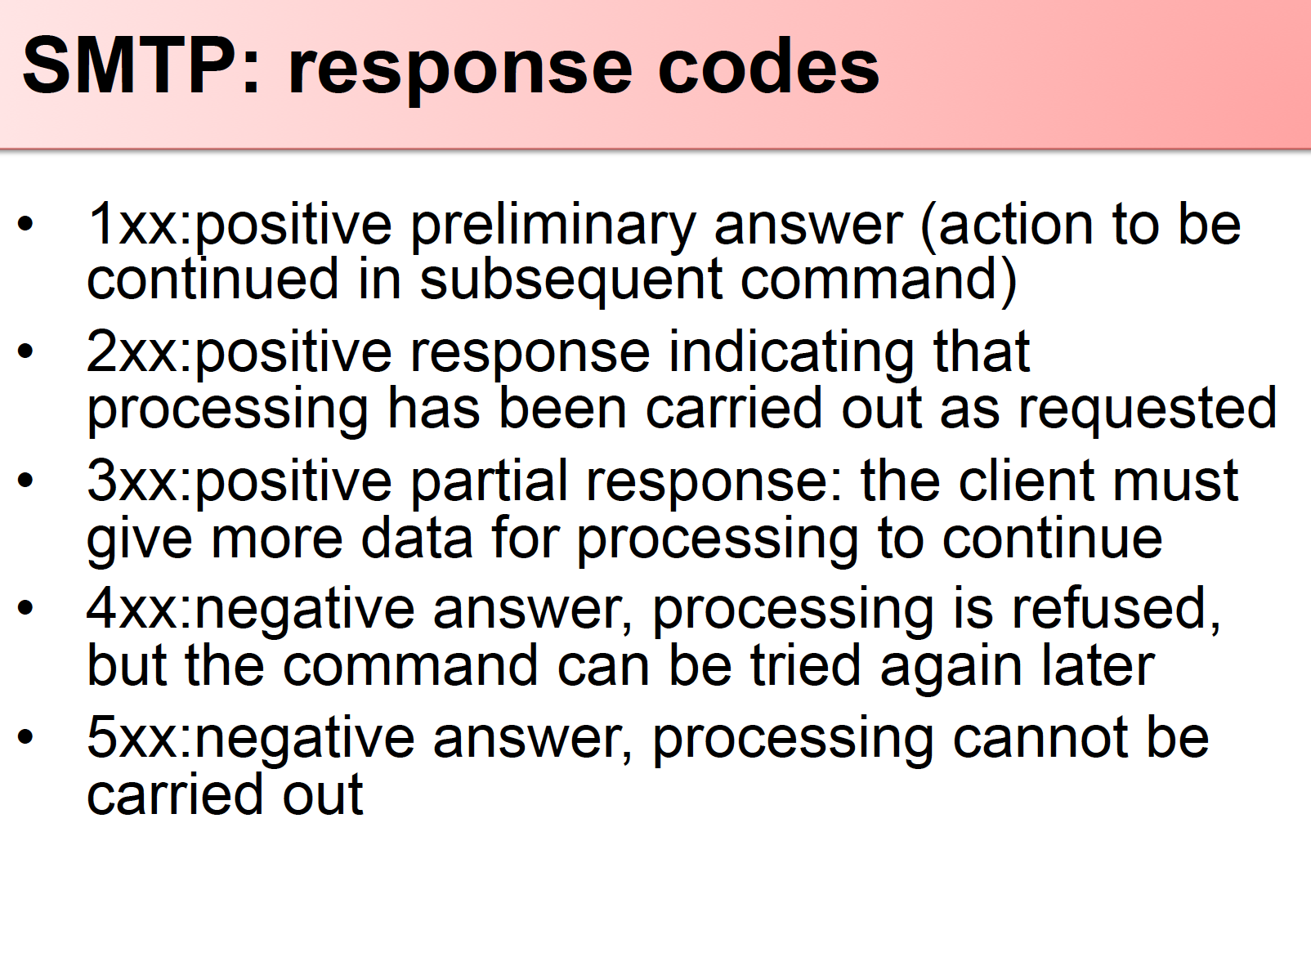

Slide 6
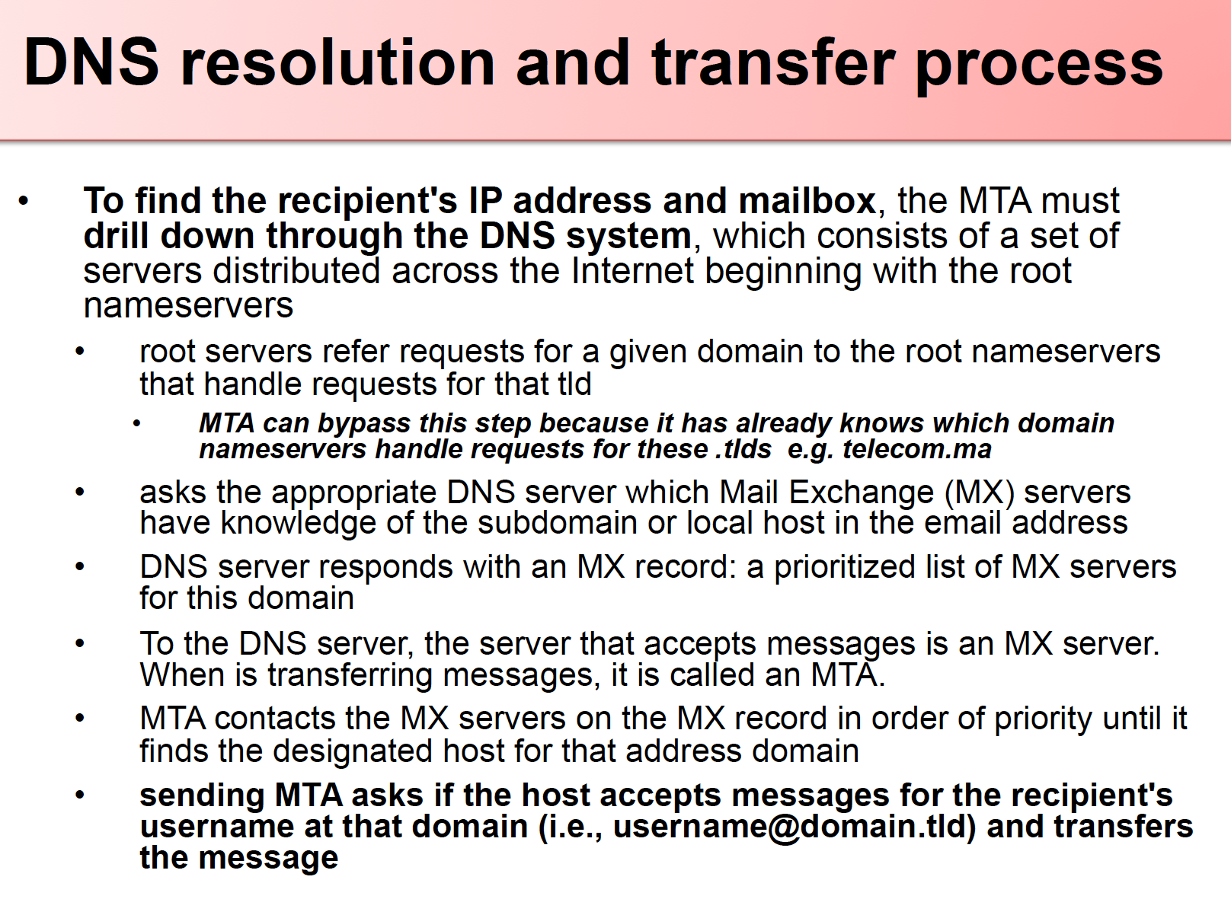

Slide 7
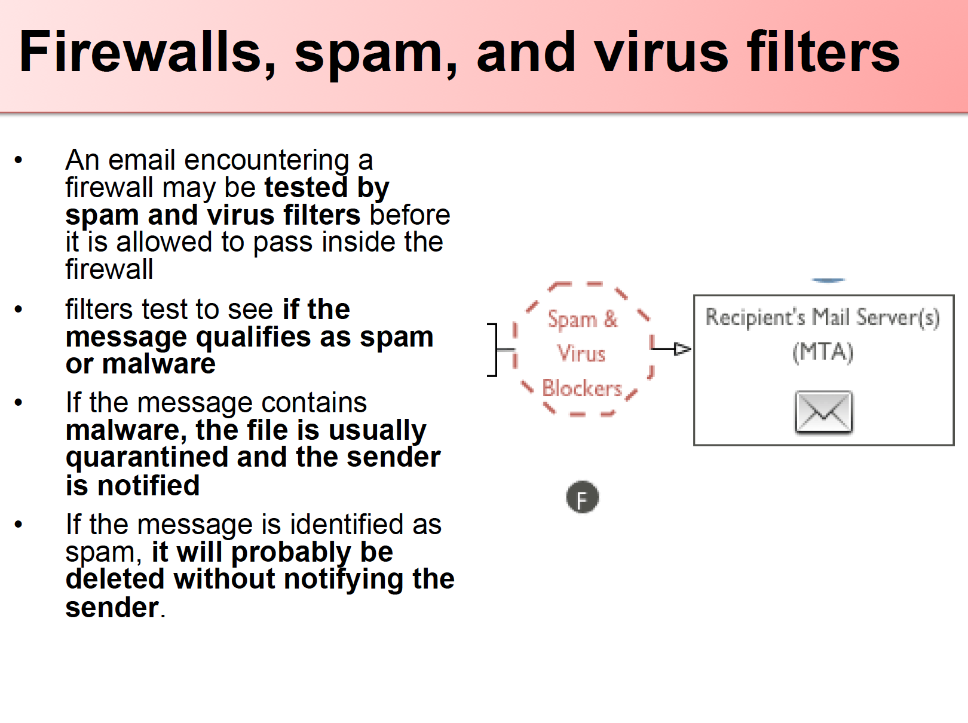

Slide 8
Postfix Mail Server
Kevin Chege
ISOC

Slide 9
What is Postfix?
Postfix is a free and open-source mail transfer agent (MTA) that routes and delivers electronic mail, intended as an alternative to the widely used Sendmail MTA.
Postfix is released under the IBM Public License 1.0 which is a free software licence.
Originally written in 1997 by Wietse Venema at the IBM Thomas J. Watson Research Center and first released in December 1998, Postfix continues as of 2014 to be actively developed by its creator and other contributors. The software is also known by its former names VMailer and IBM Secure Mailer.
In January 2013 in a study performed by E-Soft, Inc. found that approximately 25% of the publicly reachable mail-servers on the Internet ran Postfix.

Slide 10
Postfix
Works on UNIX-like systems including AIX, BSD, HP-UX, Linux, MacOS X, Solaris, and more.
It is the default MTA for the OS X, NetBSD^{[3]} and Ubuntu operating systems
Used by: AOL, Apple Server, Stanford University, United States Navy, NASA, Rackspace, many ISPs
Able to process thousands

Slide 11
Some Key Features
SASL authentication Simple Auth Security Layer
Mail forwarding or delivery
"Virtual" domains with distinct address-namespaces
A large number of database lookup mechanisms including Berkeley DB, CDB, OpenLDAP LMDB, Memcached, LDAP and multiple SQL database implementations
Extended
Deep content inspection before or after a message is accepted into the mail queue;
Mail authentication with DKIM, SPF, or other protocols;
SMTP-level access policies such as greylisting or rate control.

Slide 12
Postfix on Debian and FreeBSD
Debain
Installed via: $sudo apt-get install postfix
Directories: /etc/postfix
FreeBSD
Installed via: $sudo pkg install postfix
Directories: /etc/postfix or /usr/local/etc/postfix
Configuration files
main.cf - stores site specific Postfix configuration parameters while
master.cf – defines daemon processes

Slide 13
master.cf
defines how a client program connects to a service, and what daemon program runs when a service is requested.
The Postfix master daemon launches all of the other Postfix services as they are needed. The various services, and how they are run, are specified in the master.cf file.
The SMTP service is defined in this file as well as third party apps like an SPF program or a DKIM Program

Slide 14
main.cf
specifies a very small subset of all the parameters that control the operation of the Postfix mail system
you will have to set up a minimal number of configuration parameters.
Postfix configuration parameters resemble shell variables
parameter = value
other_parameter = $parameter
Postfix uses database files for access control, address rewriting and other purposes

Slide 15
main.cf Key Settings
myorigin = $myhostname
specifies the domain that appears in mail that is posted on this machine. Defaults to the value of the machine’s hostname
mydestination = $myhostname, localhost
specifies what domains this machine will deliver locally
if your machine is a mail server for its entire domain, you must list $mydomain as well in this setting
The mydomain parameter specifies the parent domain of $myhostname. By default, it is derived from $myhostname by stripping off the first part (unless if the result would be a top-level domain)

Slide 16
Relaying Mail – From
Postfix will forward mail from clients in authorized network blocks to any destination
Authorized networks are defined with the mynetworks configuration parameter
The default is to authorize all clients in the IP subnetworks that the local machine is attached to.
By default, Postfix will NOT be an open relay ie it will not forward from IPs outside your network to the Internet
mynetworks_style = subnet
mynetworks = 127.0.0.0/8 168.100.189.2/32

Slide 17
Relaying mail - to
By default, Postfix will forward mail from strangers (clients outside authorized networks) to authorized remote destinations only.
Authorized remote destinations are defined with the relay_domains configuration parameter.
The default is to authorize all domains (and subdomains) of the domains listed with the mydestination parameter.
This means that by default, your Postfix mail server will accept mail from anyone to recipients to the local Postfix server

Slide 18
Outbound emails
By default, Postfix tries to deliver mail directly to the Internet.
Depending on your local conditions this may not be possible or desirable
For example, your system may be behind a firewall, or it may be connected via a provider who does not allow direct mail to the Internet.
In those cases you need to configure Postfix to deliver mail indirectly via a relay host.
relayhost = [mail.isp.tld]
Note that the [] disables MX lookups so is necessary

Slide 19
Reporting problems
You should set up a postmaster alias in the aliases table that directs mail to a real person
The postmaster address is required to exist, so that people can report mail delivery problems.
While you're updating the aliases(5) table, be sure to direct mail for the super-user to a human person too. /etc/aliases: postmaster: afnog root: afnog
After editing the aliases file, run the command $sudo newaliases

Slide 20
Default reports
bounce
Inform the postmaster of undeliverable mail. Either send the postmaster a copy of undeliverable mail that is returned to the sender, or send a transcript of the SMTP
2bounce
When Postfix is unable to return undeliverable mail to the sender,
delay
Inform the postmaster of delayed mail. In this case, the postmaster receives message headers only.
policy
Inform the postmaster of client requests that were rejected because of (UCE) policy restrictions. The postmaster receives a transcript of the SMTP session.
protocol
Inform the postmaster of protocol errors (client or server side) or attempts by a client to execute unimplemented commands.
resource
Inform the postmaster of mail not delivered due to resource problems (for example, queue file write errors)
software
Inform the postmaster of mail not delivered due to software problems.

Slide 21
Logging
Postfix will log all messages to /var/log/mail.log
Done using the syslogd daemon
All transactions of messages coming in being sent out of the server will be logged
Logs will contain details like hostnames, recipients, time and date, and whether the email was queued or dropped

Slide 22
Postfix Daemon process chrooted
Postfix daemon processes can be configured (via the master.cf file) to run in a chroot jail
The processes run at a fixed low privilege and with file system access limited to the Postfix queue directories (/var/spool/postfix).
This provides a significant barrier against intrusion.
The barrier is not impenetrable (chroot limits file system access only)

Slide 23
Interfaces and Protocol
The inet_interfaces parameter specifies all network interface addresses that the Postfix system should listen on
inet_interfaces = all
inet_protocols parameter specifies which protocols Postfix will attempt to use
inet_protocols = ipv4, ipv6

Slide 24
Starting, stopping and logs
Starting/Stopping $sudo service postfix start $sudo service postfix stop
Checking non-default running config $sudo postconf –n
Reloading rules $sudo postfix reload
Checking logs Debian: $sudo tail –f /var/log/mail.log FreeBSD: $sudo tail –f /var/log/maillog

Slide 25
Further Postfix Reading
Queue manipulation
http://www.tech-g.com/2012/07/15/inspecting-postfixs-email-queue/
Postfix on Debian
https://wiki.debian.org/Postfix

