Slide 1
MailScanner Installation
Part 2

Slide 2
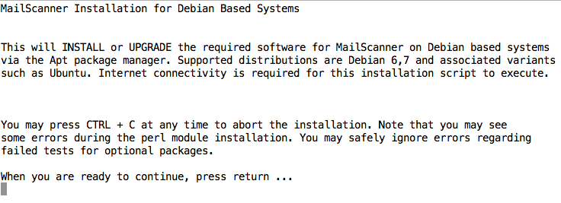

Slide 3
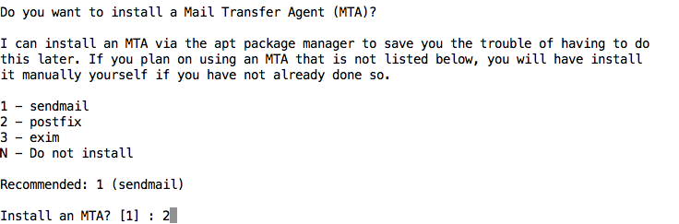

Slide 4
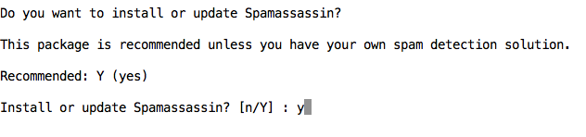

Slide 5
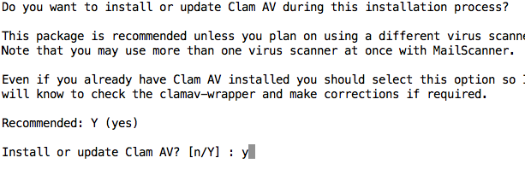

Slide 6
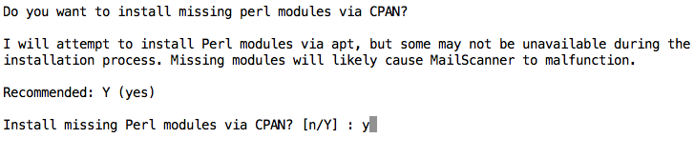

Slide 7
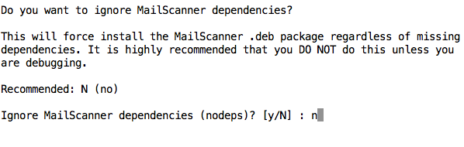

Slide 8
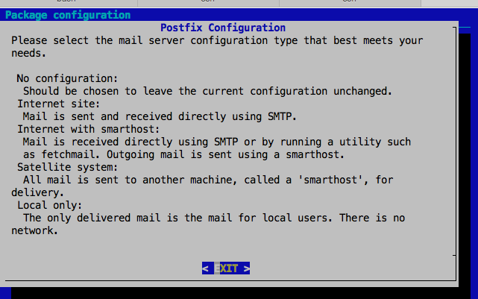

Slide 9
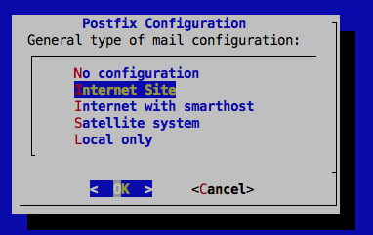

Slide 10
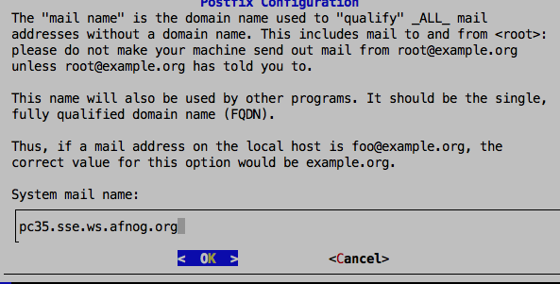

Slide 11
Install the MySQL Database
sudo apt-get mysql-server libdbd-mysql-perl php5-gd php5-mysql

Slide 12
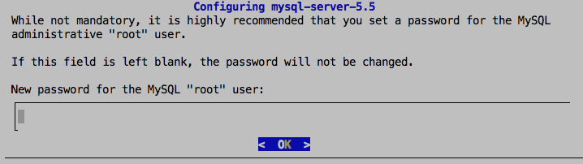
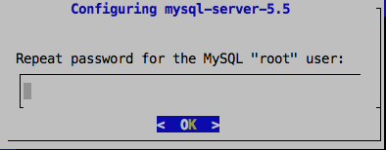
Enter afnog as the MySQL Password

Slide 13
Install MailWatch (Fronted for Mailscanner)
$cd /home/afnog
$wget http://197.4.11.139/1.2.0-mailwatch.zip
$unzip 1.2.0-mailwatch.zip
$cd 1.2.0-mailwatch
$mysql –u root –p < create.sql The password is afnog

Slide 14
Configure MySQL
$mysql –u root –p
mysql>GRANT ALL ON mailscanner.* TO mailwatch@localhost IDENTIFIED BY 'afnog';
(All on one line)
mysql>GRANT FILE ON *.* TO mailwatch@localhost IDENTIFIED BY 'afnog';
(All on one line)
mysql> FLUSH PRIVILEGES;
mysql> exit

Slide 15
$mysql mailscanner -u mailwatch –p
password is afnog
INSERT INTO users SET username = ‘mailwatch’, password = MD5(‘afnog’), fullname = ’mailadmin’, type = ‘A’;

