Slide 1
Load-Balancing
Introduction (with examples...)
For AFNOG 2015
By Frank Kuse
(Rework of slides from Joel Jaeggli and Laban Mwangi)

Slide 2
Load-Balancing
Introduction (with examples...)
For AFNOG 2015
By Frank Kuse
(Rework of slides from Joel Jaeggli and Laban Mwangi)

Slide 3
What is Load-balancing
The act of dividing a workload between N > 1 devices capable for performing a task.
Multiple contexts in internet services where this concept occurs.
  DNS
  MX records
  Multiple links (L2 trunks, L3 ECMP)
  Multiple servers

Slide 4
Goals
Greater scalability
  Horizontal scaling. Just add more switches/servers...
Higher availability
  Don't care about single device failure. Route around failures automatically!
Reduced cost
  Cheaper to use commodity hardware and architecture for failure. Examples: AWS/GCE...

Slide 5

amaze..

Slide 6
Quick Survey
L2
  LACP (Switches)
L3
  L3 ECMP (Switches, Routers, OS kernel)
L4
  HAProxy (OS userland)
L4+
  NGINX (OS userland)
  HAProxy (OS userland)
  F5, A10, Netscalar... (Hardware..)

Slide 7
Examples: L2 – Link aggregation
Widespread support for LACP (Link Aggregation Control Protocol)
Bond two physical layer 2 channels into one logical one.
  Resilience against single port/channel failure.
  L2 Bandwidth scaling
Balancing and dynamic behaviour is important!

Slide 8
Examples: L3 - Equal-cost multi-path routing (ECMP)
Packets are forwarded to the next hop over links having an equal routing cost.
Stateless mode breaks TCP (PMTU)
  Different hops may have different MTU settings
  TCP sensitive to re-ordering
We need a way to make flows stateful.....

Slide 9
Examples: L4 - Equal-cost multi-path routing (ECMP) + hashing
If packets in a TCP session take the same path...
  Path MTU issues would be fixed
  Re-ordering would be fixed
Different TCP sessions can take different paths.
We need a way to uniquely identify L4 sessions ....
What attributes do you think would identify a TCP session?

Slide 10
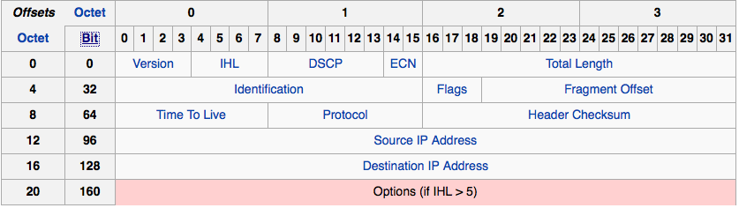
Flow identification (5-tuple)
XOR hash of fields to generate a flow id.
Hash src & dest ip addresses, protocol number from the IP header and ....

Slide 11
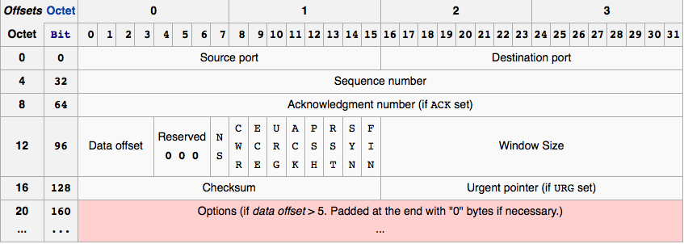
5-tuple continued
… hash of port numbers.
How?
  Example: CRC32(src_ip, dst_ip, pr_no, src_port, dst_port) % count of links

Slide 12
What does an L4 load Balancer do?
Looks and the Destination IP and Port to determine which endpoint to send a packet/flow to in a pool of servers.
Forwards the incoming connection to one pool member on the basis of policy (liveness, load).
May keep the connection pinned to the particular pool member by tracking the connection.
But... This breaks scaling!
  Existing flows won't be remapped dynamically!
  An LB/server failure would break a session!

Slide 13
What does an L7 load balancer do?
An L7 load balancer answers incoming connection requests.
It understands the protocol being spoken across the connection (e.g. HTTP IMAP FTP etc).
On the basis of either 5-tuple hash or some higher layer value, (example a URI or a cookie or both) the request is directed to a member of the appropriate pool.
L7 is another word for proxy or ALG (Application Layer Gateway).

Slide 14
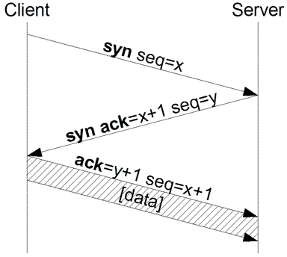
Isn't L7 going to be slower than L4?
Probably but not always.
Importantly there are optimizations that can reduce the expense.
  TCP syn-cookies
  Connection pooling
  Consider 3-way handshake

Slide 15
Applications - Cont
Open source
  Apache mod_proxy_balance
  Squid
  Haproxy
  NGNIX
  LVS

Slide 16
Applications Commercial
Commercial
  F5
  Netscalar
  A10
Benefits of a commercial approach
  Coordination of supporting elements
    Routing
    DNS
    Complex health checks
    HA
  Can have ASIC based acceleration.

Slide 17
High Availability Approaches
Active-Passive
  VRRP
  State replication
Active-Active
  State-replication considerations
Horizontally scaled
  GTM – DNS based approach
  L3ECMP (routed)

Slide 18
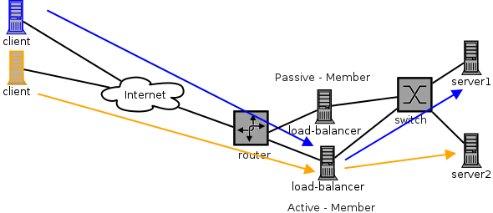
HA – active/passive

Slide 19
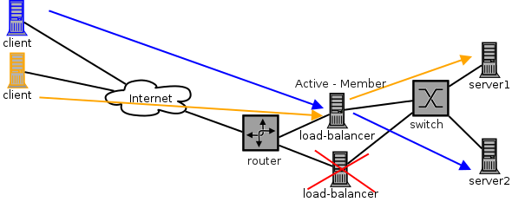
HA – active/passive - failover
Connections terminated:
  Stateless secondary
    Secondary won't know which server to send packets to
    TCP sessions will timeout and a new session initiated
    Failover in the order of seconds (Thumb suck: 3-20s)

Slide 20
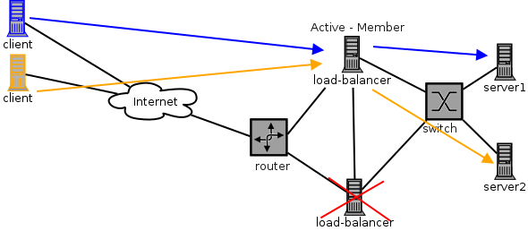
HA – active/passive failover with replication
Connections work:
  Secondary knows the hash state
  Packets lost retransmitted

Slide 21
Active / Passive
Active-passive failover requires a mechanism
Could use:
  VRRP (Virtual Router Redundancy Protocol)
  CARP (Common Address Redundancy Protocol)
If failover is not coordinated with load-balancer-health, a failed load-balancer may remain active (coordination problem).
If state is not replicated between load balancers, failover will not account for existing connections (not a problem for short-lived connections with no affinity)

Slide 22
Active / Passive Cont
Affinity can be preserved with a Cookie
LVS (linux virtual server) can do state-replication (using a kernel module)
State-replication doesn't help with scaling performance-wise (at all)

Slide 23
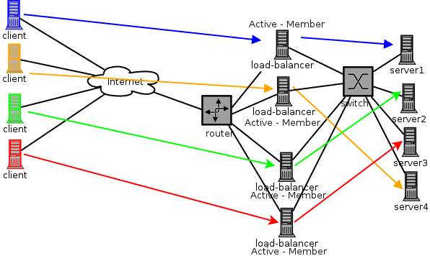
Active/Active

Slide 24
Active/Active – How?
Need a mechanism to distribute requests to multiple front end load-balancers. In effect, a load balancer for your load balancers.
HOW?
  DNS e.g. each LB has a separate ip address associated with resources it's load-balancing
    Return one or more resource records either randomly or on some externally instrumented basis.
    Fail load balancers in or out using health check or manually
  L2 or L3 stateless plus sticky mechanism.

Slide 25

Turtles all the way...
When do we stop?

Slide 26
Active/Active – Stateful vs Not
Stateful is typically done by clusters of commercial load-balancers. State replication can be expensive and imperfect.
  At scale, can be extremely expensive
  Memory on cluster members and bandwidth/cpu for replication is the limiting factor for state and connections per section.
Stateless
  In the DNS case resource records for a failed LB have to time out of caches before that LB stops being used.
  In the L3-ECMP case a failure will cause some fraction of connections to rehash across other load-balancers anywhere from a quarter to half (they will then be rendered out of state and lost).

Slide 27
Our Exercise - HAProxy
We're going to deploy HAProxy to load-balance connections to two http servers.
HAProxy can do L4 (any TCP) or L7 (HTTP) load balancing
We're going to do L7, this allows us to access http related features, including for example including a cookie.

Slide 28
HAProxy vs NGINX
  L4 vs L7
  HAProxy can load balance anything over TCP or do L7.
  NGINX is L7 only (HTTP(s) and IMAP/POP3).
SSL
  HAProxy doesn't support (can't only treat as TCP)
  NGINX does, so cookies for example can be parsed, can be used for SSL offload etc.
Model
  HAProxy is threaded, effectively allowing it to engage multiple cpus in the activity.
  NGINX uses an event driven single threaded model.
  Both have merit, HAProxy is probably more scalable.

Slide 29
Goals
Install and perform a basic configuration of HAProxy.
Configure two additional webserver instances on alternate ports.
Demonstrate load-balanced-http connections between them.
Log X-Forwarded-For.
Bonus: use a cookie to pin a requesting host to one server or another.
Bonus: Remove failing servers from LB pool.

Slide 30
Exercise Details (1)
Install HAProxy using commands below
sudo apt-get install haproxy
Get your secondary IP address from your VM using commands below.
sudo ip addr ls
The detail instruction for getting the address on on the next slide.

Slide 31
Exercise Details (1)
Install HAProxy using commands below
sudo apt-get install haproxy
Get your secondary IP address from your VM using commands below.
sudo ip addr ls
The detail instruction for getting the address on on the next slide.

Slide 32
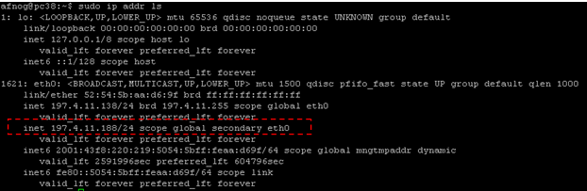
Exercise Details (2)
For the primary server runing the Haproxy application needs to make use of the secondary address on the block which can be gotten from commands below.

Slide 33
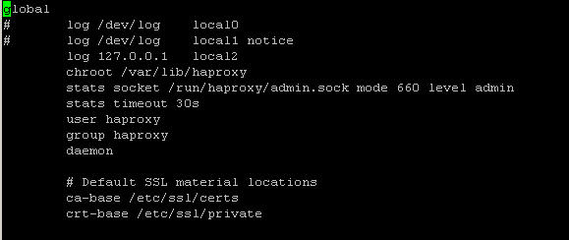
Exercise Details (3)
The HAProxy configuration file should be configured as below.
It can be located on the file system by opening the haproxy.cfg in the /etc/haproxy directory

Slide 34
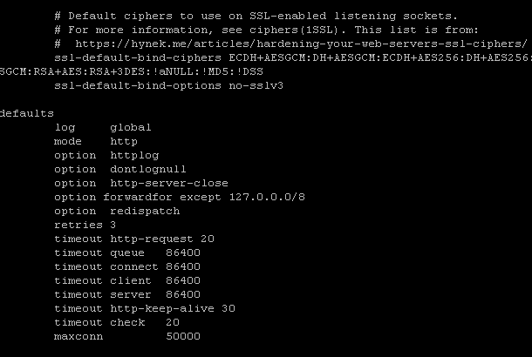
Exercise Details (4)

Slide 35
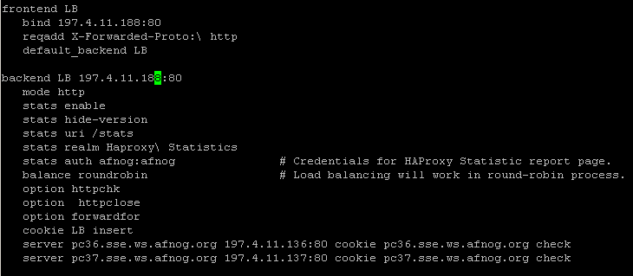
Exercise Details (5)

Slide 36

Exercise Details (6)
Change the configuration of the syslog to help in debugging purposes sudo vi /etc/rsyslog.conf
Make sure you remove commend on the following port 514 and module as shown below.
Restart your syslog service as well as haproxy service as below. sudo service rsyslog restart sudo service haproxy restart

Slide 37
Exercise Details (7)
Create an html file for testing purposes with below content inside the web servers that you wish to load balance
For our example, we are going to create an index2.html file with content on next slide. sudo nano /var/www/html/index2.html
Repeat the same for all the other web server that you wish to help load balance your apache page.

Slide 38
Exercise Details (8)
<html>
<head>
<title>Afnog 2015 HAProxy Test Page</title>
</head>
<body>
<!-- Main content -->
<h1>My Afnog HAProxy Test Page</h1>
<p>Welcome to our Afnog HA Proxy test page!
<p> Welcome to this year's Afnog tutorials
We hope you get answers to most of your queries :p.
<address>Made 27 May 2015<br> by Frank Kuse .</address>
</body>
</html>

Slide 39
Exercise Details (9)
Try accessing the created content via the link below http://pc38.sse.ws.afnog.org/index2.html
Check the message logs to see which web server is serving the content by running the below command sudo tail -f /var/log/haproxy.log
Try accessing the stats page on the haproxy server with the following credentials to see the statistic of your haproxy performance.
Http://pc38.sse.ws.afnog.org//stats
Username: afnog password: afnog

Slide 40
Bibliography
HAProxy - http://haproxy.1wt.eu/
NGNIX - http://wiki.nginx.org/Main
F5 LTM - http://www.f5.com/products/big-ip/local-traffic-manager.html
A10 Networks - http://www.a10networks.com/
Apache mod_proxy_balance - http://httpd.apache.org/docs/2.2/mod/mod_proxy_balancer.html
Linux virtual server - http://www.linuxvirtualserver.org/index.html
Wikipedia CARP - http://en.wikipedia.org/wiki/Common_Address_Redundancy_Protocol
Wikipedia VRRP - http://en.wikipedia.org/wiki/Virtual_Router_Redundancy_Protocol

