Slide 1

Presented by
Manhal Mohammed
AFNOG 2019

Slide 2

Manual Process
Slower process
Struggles in efficiently scale as demand changes
Inconsistency in data entry, room for errors.
Large ongoing staff training cost.
is dependent on good individuals.
Time consuming and costly to produce reports.
Duplication of data entry.

Slide 3

Automation and Orchestration
Automation is setting up a single task to run on its own – automating one thing. This single task can be anything from launching a web server, stopping a service, or integrating a web app.
Orchestration is the term we mean when we refer to automating a lot of things at once.

Slide 4

Why Automation?
Tasks in code
Collaboration
Eliminate errors
Write once
Laziness
Etc….
Automation tools : Bamboo ,Docker, Kubernetes, Puppet , Ansible.

Slide 5

Introduction to Ansible
Ansible is a radically simple IT automation platform that makes your applications and systems easier to deploy.
It support configuration management with examples as below.
Configuration of servers
Application deployment
Continuous testing of already install application
Provisioning
Orchestration
Automation of tasks

Slide 6

Why Ansible
It is a free open source application
Agent-less – No need for agent installation and management
Phython/yaml based
Highly flexible and configuration management of systems.
Large number of ready to use modules for system management
Custom modules can be added if needed
Configuration roll-back in case of error
Simple and human readable
Self documenting

Slide 7
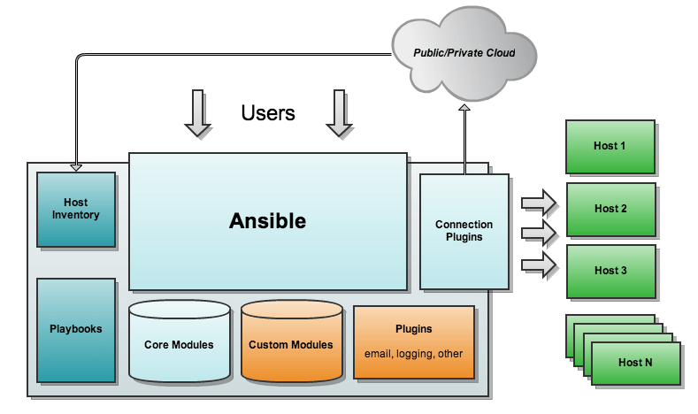
Ansible Architecture

Slide 8

Installation of Ansible
Install packages below on the Server Machine
# sudo apt-get install ansible ; for Debian
# sudo yum install ansible ; for REHL
# sudo pkg install py27-ansible ; for FreeBSD
That’s it ☺

Slide 9
How Ansible Works
Ansible works by connecting to your nodes and pushing out small programs, called "Ansible modules" to them.
These programs are written to be resource models of the desired state of the system.
Ansible then executes these modules (over SSH by default), and removes them when finished.

Slide 10
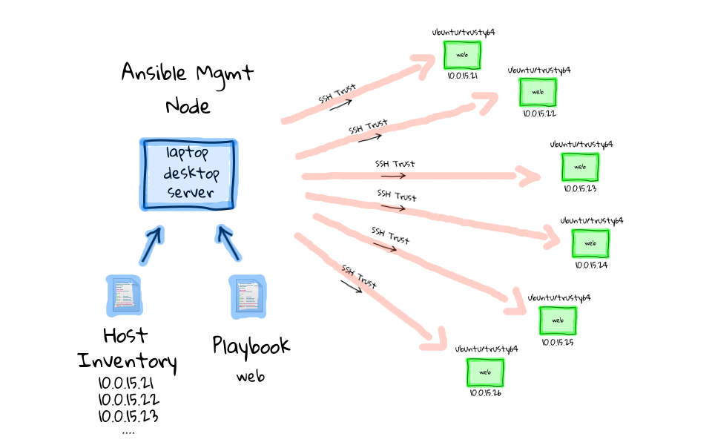

Slide 11

Modules
Modules are bits of code transferred to the target system and executed to satisfy the task declaration.
Ansible ships with several hundred today!
apt/yum/package
Copy/file
git
ping
debug
service
Template
List out all modules installed
# ansible-doc -l
Read documentation for installed module
# ansible-doc
Modules Documentation : https://docs.ansible.com/

Slide 12
Modules: Run Commands
If Ansible doesn’t have a module that suits your needs there are the “run command” modules:
command: Takes the command and executes it on the host. The most secure and predictable.
shell: Executes through a shell like /bin/sh so you can use pipes etc. Be careful.
script: Runs a local script on a remote node after transferring it.
raw: Executes a command without going through the Ansible module subsystem “clients with no pyhton installed ”.

Slide 13
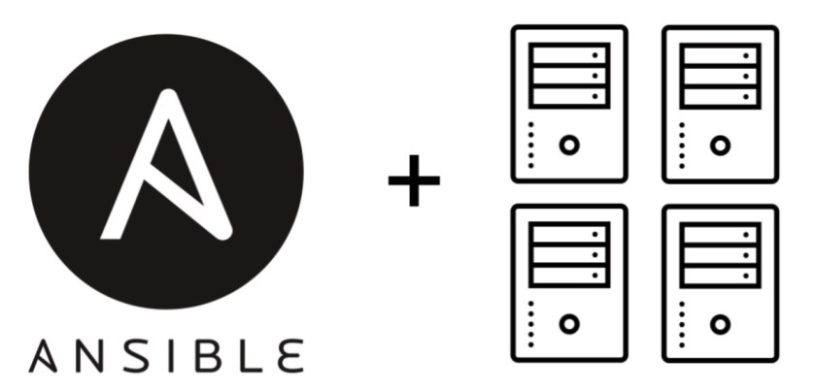
Inventory
Inventory is a collection of hosts (nodes) with associated data and groupings that Ansible can connect and manage
Hosts (nodes)
Groups
Inventory-specific data (variables)
Static or dynamic sources
which defaults to be saved in the location /etc/ansible/hosts.

Slide 14

Inventory example:
Open the /etc/ansible/hosts and edit the following :
[me]
localhost
[group1] -> group of hosts name
pc1.sse.ws.afnog.org -> defining host
pc2.sse.ws.afnog.org
pc3.sse.ws.afnog.org ansible_ssh_port=22
pc4.sse.ws.afnog.org ansible_user=afnog
[group2]
pc[5:8].sse.ws.afnog.org
[all:vars] -> setting global variable for all groups
ansible_user=afnog -> specifying user to be connected with
ansible_sudo_pass=PassWord -> passing the root password for sudo users

Slide 15

SSH Keys Are Your Friends ☺
Passwords are supported by ansible , but SSH keys with ssh-agent are one of the best ways to use Ansible.
Though if you want to use Kerberos, that's good too. Lots of options! Root logins are not required, you can login as any user, and then su or sudo to any user.

Slide 16
Creating KEY pairs:
The first step is to create the key pair on your machine
# ssh-keygen -t rsa
Once you have entered the Gen-Key command, you will get a few more questions:
Enter file in which to save the key (/home/test/.ssh/id_rsa):
Enter no password for the next prompt
Copy the Public Key
# ssh-copy-id afnog@pcX.sse.ws.afnog.org
Repeat the same process for other machines you wish to login automatically with.
Ensure the afnog username has sudo access to the remote clients

Slide 17

Ad-Hoc Commands
An ad-hoc command is a single Ansible task to perform quickly, but don’t want to save for later.
check all my inventory hosts are ready to be managed by Ansible
# ansible all -m ping
collect and display the discovered *facts for the localhost
# ansible localhost -m setup
# ansible pcX.sse.ws.afnog.org -m setup -a "filter=*ipv4 "
run the uptime command on all hosts in the group 2 group
# ansible group2 -m command -a "uptime "
fetch hard drives utilization
# ansible -m command -a 'df -h’ pcX.sse.ws.afnog.org
* Ansible facts are system properties that are collected by Ansible when it executes on a remote system. The facts contain useful details such as storage and network configuration about a target system.

Slide 18
Plays & Playbooks
Plays are ordered sets of tasks to execute against host selections from your inventory.
A playbook is a file containing one or more plays.
Every playbook configuration begins with triple dash ( ---)
The hosts, tasks, name, action are various instructions commands to help automate your play installation process , using yaml and jinja2
Jinja2 is a modern and designer-friendly templating language for Python.
YAML is a human friendly data serialization standard for all programming languages. It is less and essentially allows you to provide powerful configuration settings, without having to learn a more complex code type.

Slide 19

Tasks
Tasks are the application of a module to perform a specific unit of work.
file: A directory should exist
apt: A package should be installed
service: A service should be running
template: Render a configuration file from a template

Slide 20
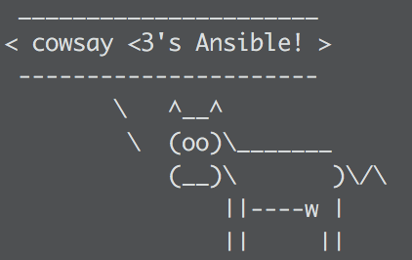
Example Tasks in a Play
---
- hosts: me ; host selection
tasks:
- name: INSTALLING COWSAY
apt:
name: cowsay
state: latest
- name: restart DNS
service:
name: bind9
state: restarted

Slide 21


Handler Tasks
Handlers are special tasks that run at the end of a play if notified by another task when a change occurs.
If a configuration file gets changed notify a service restart task that it needs to run.

Slide 22

tasks:
- name: httpd package is present
yum:
name: httpd
state: latest
notify: restart httpd
- name: latest index.html file is present
copy:
src: files/index.html
dest: /var/www/html/
handlers:
- name: restart httpd
service:
name: httpd
state: restarted

Slide 23

Join my Telegram Group “Learn Ansible” for more ansible materials and discussions , and please share it with your interested friends ☺
https://t.me/learnAnsible

Slide 24

References :
Ansible Hands-on Introduction : Jon Jozwiak, Minneapolis RHUG, 2017
Introduction to Ansible : Frank Kuse, Afnog 2017

