Slide 1
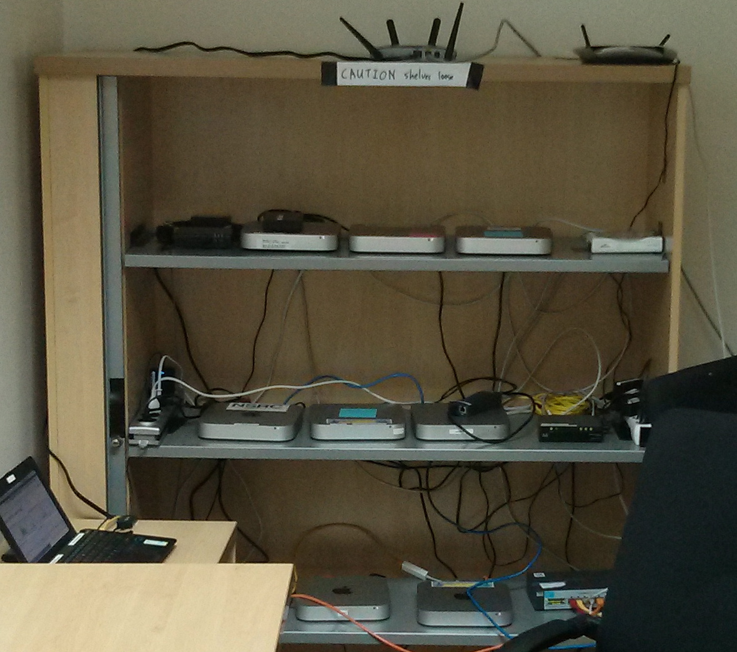
Virtualization Overview
Joel Jaeggli
AFNOG SS-E 2013

Slide 2
What are we using this Year?
Mac-mini servers
Intel core i7 quad core 8 hyperthreads
16GB of ram
2 x 256GB SATA SSD
A pretty hefty server
Less than $2k
Drawbacks
  One psu
  OOB is kind of a pain
Ubuntu / KVM

Slide 3
What is it?
Virtualization of is the abstraction of the manifestation of a resource from the actual physical instance of that resource.
What Computing/Network resources can be virtualized?
  Virtually anything! :)

Slide 4
Anything?
In the context of this course. We're interested in virtualization along two dimensions:
  Services
  Hosts

Slide 5
Resource/Service virtualization
Examples:
  Load-balancers
  DNS Based GLB
  HTTP(S) Virtual Hosting
  MX records
  Virtual Switches
  Virtual Routers
  Virtual Firewalls

Slide 6
Resource Virtualization - Continued
HTTP virtual hosts
  Multiple websites on one system
Load Balancing
  One (or many sites or applications) across many systems
  Can be done at Layer-3/4/7

Slide 7
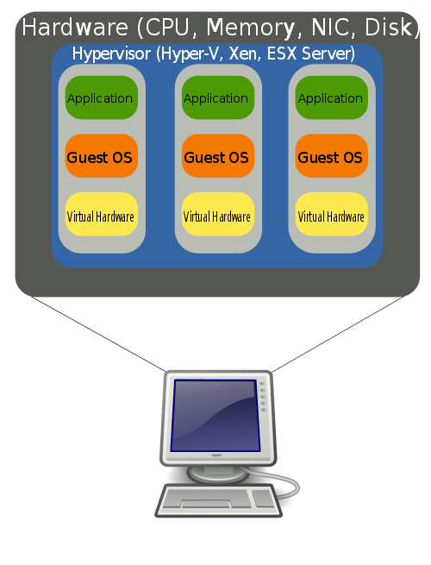
Host Virtualization
Examples
  VMware
  Virtual-Box (used in class)
  KVM
  XEN
  FreeBSD and Linux Jails
  Windows Hyper-V

Slide 8
What problem are we attempting to solve with host virtualization.
Problem 1 – Idle capacity.
  Most of the machines in your datacenter are idle most of the time.
  Capacity you're not using:
    Cost money up front
    Cost money to operate
    Reduces you return on capital
  Packing discreet systems into a smaller number of servers provides savings along virtually every dimension.

Slide 9
Problems - Continued
Problem 2 – Provisioning
  Spinning up a new service involves:
    Acquiring the hardware
    Building the server
    Integration with existing services
  With virtualization we're aiming to short-circuit that
    Capacity is a resource
    Machine instances my be cloned or provisioned from common basic images
    Resources are purchased in bulk and assigned to applications as necessary.

Slide 10
Problems - Continued
Problem 3 – Hardware abstraction
  Operating systems, servers, and applications evolve at different rates.
  Providing a common set of infrastructure resources means, virtualized systems are portable across servers
  Hardware failure can more easily be managed.
Abstraction may come at a performance cost however. (some workloads are more expensive than others)
  See: http://blog.xen.org/index.php/2011/11/29/baremetal-vs-xen-vs-kvm-redux/

Slide 11
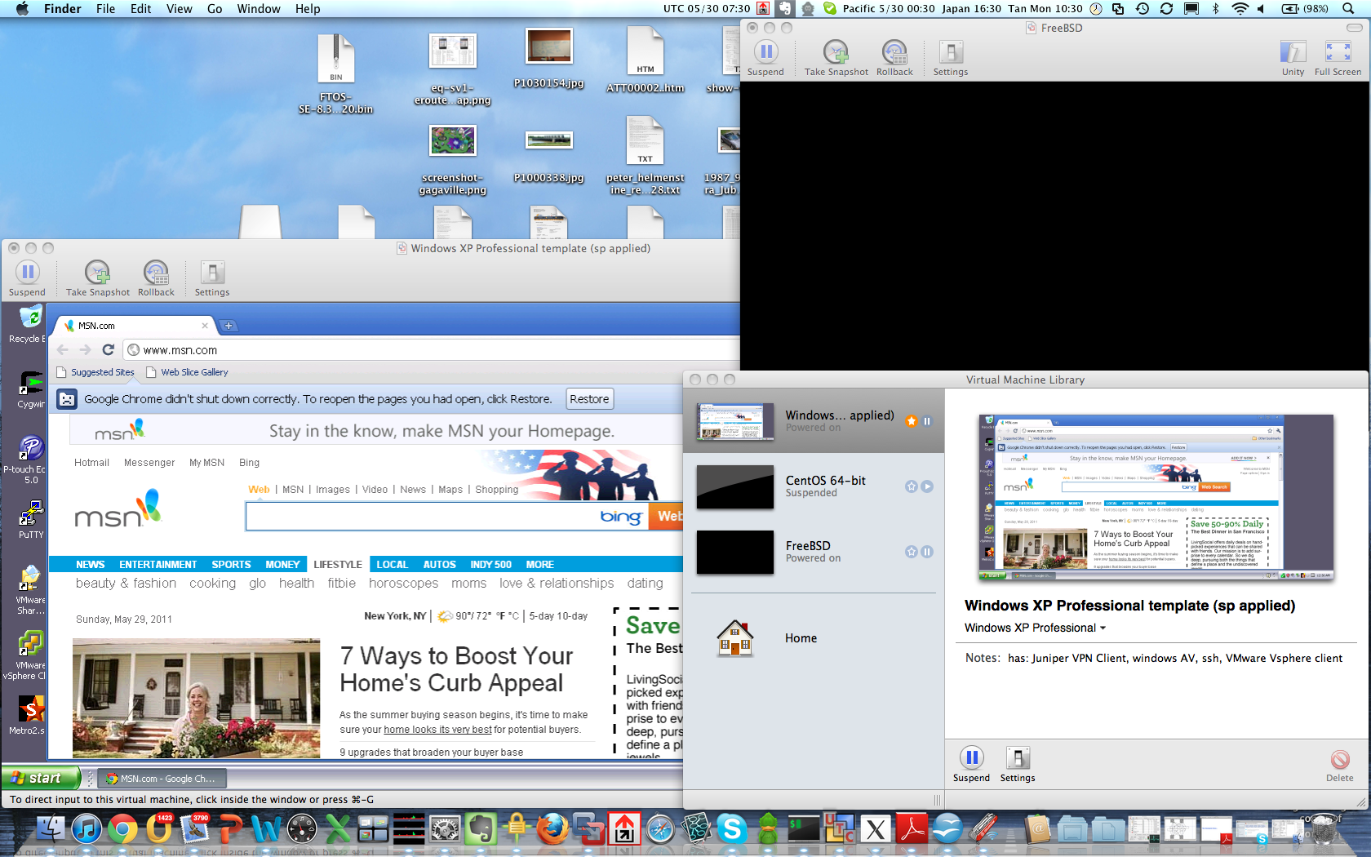
Examples – Desktop Virtualization

Slide 12
Desktop Virtualization
Uses
  Prototyping services or applications before deployment
  Utilities that don't run on your operating system
  Isolation of sandbox environments from your desktop
  Maintaining multiple versions of an environment for support purposes.
  Staying familiar with unix while running windows (consider compared to the alternative (dual-booting)
Issues
  Emulating multiple computers on your laptop/desktop is somewhat resource intensive
Vmware player and VirtualBox are free.
  http://www.virtualbox.org/wiki/Downloads
  https://my.vmware.com/web/vmware/downloads

Slide 13
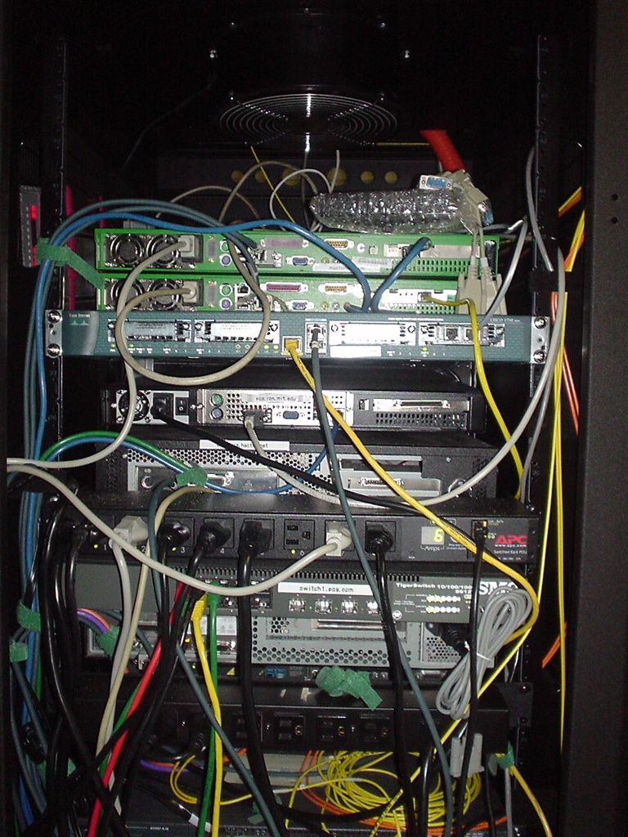
Examples – Server Virtualization

Slide 14
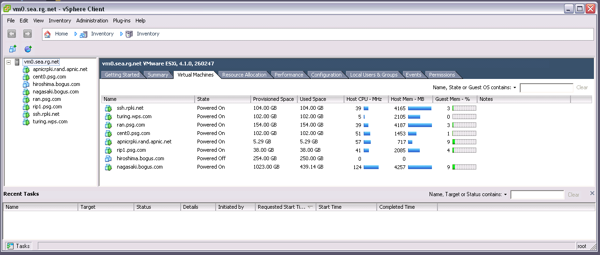
Server Virtualization - Continued

Slide 15
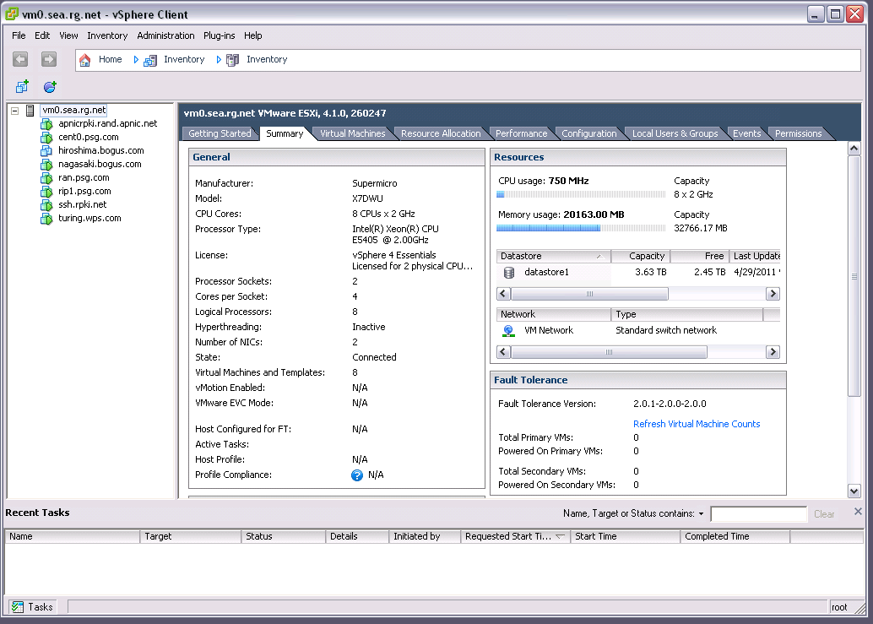
Server Virtualization

Slide 16
Virtualized Servers as a Service
(Amazon Web Services)
Much as collocated servers, are available from a hosting provider, virtual servers are also available.
Model is:
  You pay for what you use.
  Flexibility, need fewer servers today then you used, yesterday.
  Leverage other amazon tools (storage/map-reduce/load-balancing/payments etc)

Slide 17
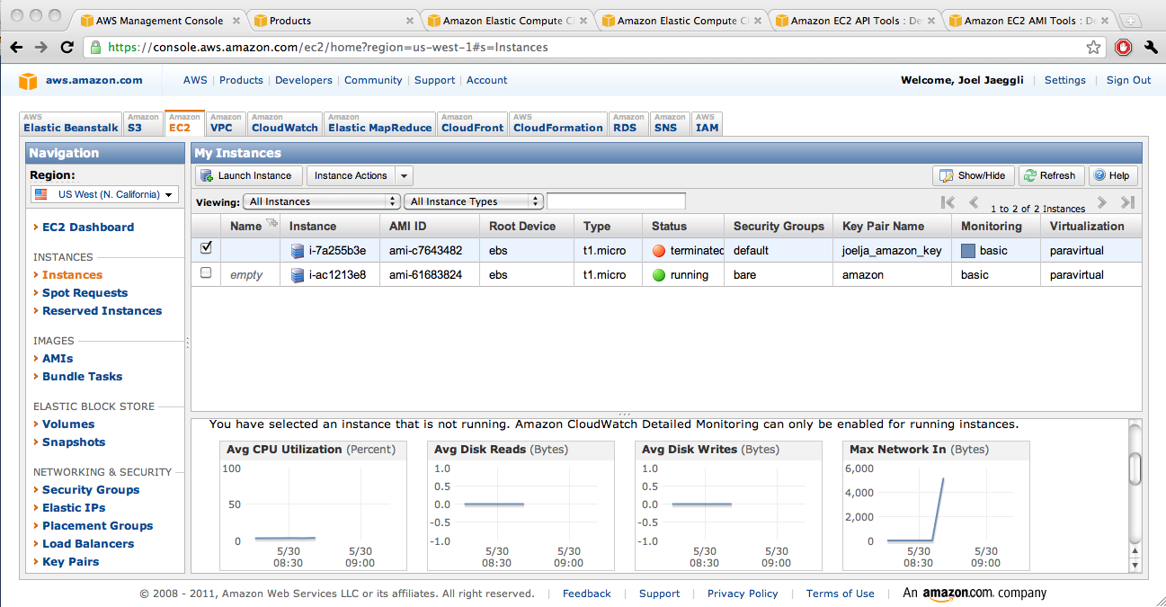
AWS

Slide 18
AWS Steps
Select availability zone
Launch new instance
Select appropriate ami
Associate with ssh key
Launch instance
Add ip
SSH into new machine instance.
t1-micro-instances run $54 a year + bandwidth

Slide 19
Try it for free...
Free tier for the first Calender year is (per month):
  750 hours of EC2 running Linux/Unix Micro instance usage
  750 hours of Elastic Load Balancing plus 15 GB data processing
  10 GB of Amazon Elastic Block Storage (EBS) plus 1 million IOs, 1 GB snapshot storage, 10,000 snapshot Get Requests and 1,000 snapshot Put Requests
  15 GB of bandwidth in and 15 GB of bandwidth out aggregated across all AWS services
Which is not to say that, at scale EC2 is particularly cheap, (It isn't)
  Limited capital at risk is in the context of prototyping or experimentation however.

Slide 20
AWS - Continued
For provisioning purposes cli interaction is possible:
  http://aws.amazon.com/developertools/351
Along with tools to support the provisioning and destruction of virtual machines.

Slide 21
Provisioning and management
Is the glue that makes virtualization usable
In commercial virtualization environments the provisioning/management toolkits represent the bulk of the licensing cost (VMware) and the secret sauce (VMotion, disaster recovery, backup, etc)
Examples:
  XEN tools – a collection of perl scripts for spinning VMs http://www.xen-tools.org/software/xen-tools/
  KVM tools - http://www.linux-kvm.org/page/Management_Tools
  Cloud.com/cloud-stack (orchestration) - http://www.cloudstack.org/
  Rightscale – (orchestration multiple public/private clouds) http://www.rightscale.com
  Puppet (host / configuration management) - http://puppetlabs.com/puppet/
  PDSH – (Parallel Shell execution) http://code.google.com/p/pdsh/

Slide 22
Variation In virtualized environments
Enterprise and Government virtualized environments may tend towards heterogeneity.
  e.g. the applications (servers) that are being virtualized have accumulated over time
  Are different enough that management may be depressingly manual
ASP/Internet services environments may be more homogenous.
  Leverage a common set infrastructure primitives
  Thousands of like-systems providing overlapping functionality across hundreds of servers
  Traditional network elements (e.g. loadblancers/firewalls) may be virtualized along with the application.

Slide 23
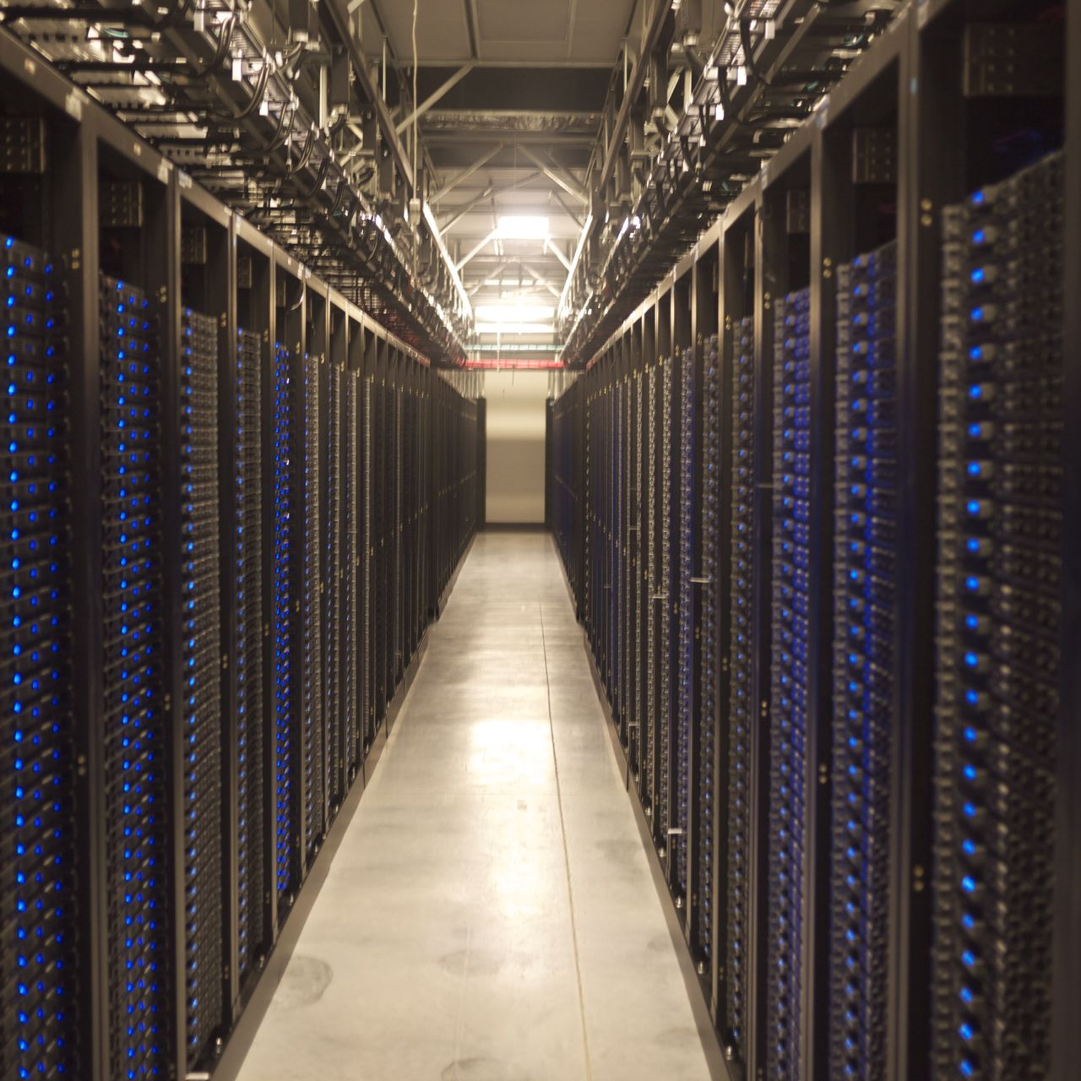
Can you spot the...
Web-node?
Database-node?
Load-balancer?
Nameserver?
DHCP Server?
Email cluster?
Devnodes?

Slide 24
Complimentary technologies
NIC teaming or Link aggregation
Network attached storage and network centric filesystems
  NFS
  Hadoopfs
  GFS2
Distributed databases
  Example mysql cluster
  Couchbase/Membase
  OracleRAC

