Slide 1
Introduction to Ansible
Brian Candler
Network Startup Resource Center
brian@nsrc.org

Slide 2
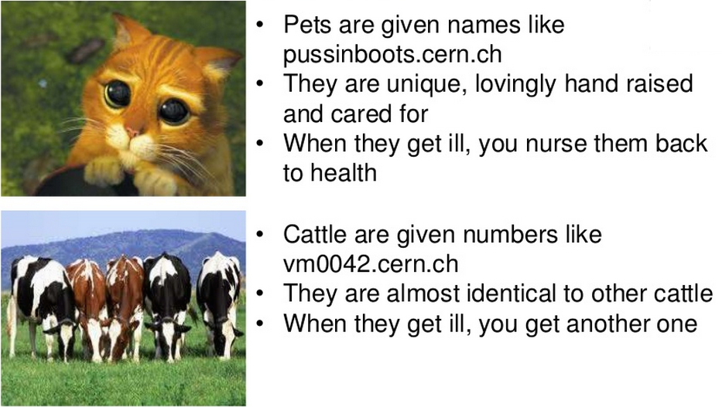
Are your servers Pets or Cattle?
Source:
http://www.slideshare.net/gmccance/cern-data-centre-evolution

Slide 3
What is Ansible?
A configuration management tool
Applies changes to your system to bring it to a desired state
Similar applications include puppet, chef, salt, juju, cfengine

Slide 4
Why choose Ansible?
Target system requires only sshd and python
  No daemons or agents to install
Security
  Relies on ssh
Easy to get started, compared to the others!

Slide 5
Ansible running with cowsay
____________________________
< TASK: [install /etc/hosts] >
----------------------------
\ ^__^
\ (oo)\_______
(__)\ )\/\
||----w |
|| ||
ok: [pc1.example.com]

Slide 6
Modules
Ansible “modules” are small pieces of code which perform one function
  e.g. copy a file, start or stop a daemon
Most are “idempotent”: means that they only do something when a change is required
Many modules supplied as standard
  http://docs.ansible.com/modules.html

Slide 7
Invoking modules from shell
Host or group
Module name
$ ansible s1.ws.nsrc.org -m service \
-a "name=apache2 state=running"
Module arguments

Slide 8
Configuring Ansible behaviour
Tasks are modules called with specific arguments
Handlers are triggered when something changes
  e.g. restart daemon when a config file is changed
Roles are re-usable bundles of tasks, handlers and templates
All defined using YAML

Slide 9
Diversion: YAML
A way of storing structured data as text
Conceptually similar to JSON
  String and numeric values
  Lists: ordered sequences
  Hashes: unordered groups of key-value pairs
String values don't normally need quotes
Lists and hashes can be nested
Indentation used to define nesting

Slide 10
YAML list (ordered sequence)
Single line form
[birth, taxes, death]
Multi-line form
- birth
- taxes
- death
Space after dash required

Slide 11
YAML hash (key-value pairs)
Single line form
{item: shirt, colour: red, size: 42}
Space after colon required
Multi-line form
item: shirt
colour: red
size: 42
description: |
this is a very long multi-line
text field which is all one value

Slide 12
Nesting: list of hashes
Compact
- {item: shirt, colour: red, size: 42}
- {item: shirt, colour: blue, size: 44}
Multi-line
Note alignment
- item: shirt
colour: red
size: 42
- item: shirt
colour: blue
size: 44

Slide 13
More complex YAML example
A list with 3 items
Each item is a hash (key-value pairs)
- do: laundry
items:
- trousers
- shirts
- do: polish
items:
- shoes
- buckle
- do: relax
eat:
- chocolate
- chips
Simple value
List value (note indentation)

Slide 14
Ansible playbook
Top level: a list of "plays"
Each play has "hosts" plus "tasks" and/or "roles"
- hosts:
- pc1.example.com
- pc3.example.com
tasks:
- name: install Apache
action: apt pkg=apache2 state=present
- name: ensure Apache is running
action: service name=apache2 state=running
- hosts: dns_servers
roles:
- dns_server
- ntp

Slide 15
Roles
A bundle of related tasks/handlers/templates
roles/<rolename>/tasks/main.yml
roles/<rolename>/handlers/main.yml
roles/<rolename>/defaults/main.yml
roles/<rolename>/files/...
roles/<rolename>/templates/...
### Recommended way to make re-usable configs
### Not all these files need to be present

Slide 16
Tags
Each role or individual task can be labelled with one or more "tags"
When you run a playbook, you can tell it only to run tasks with a particular tag: -t <tag>
Lets you selectively run parts of playbooks

Slide 17
Inventory
Lists all hosts which Ansible may manage
Simple "INI" format, not YAML
Can define groups of hosts
Default is /etc/ansible/hosts
  We will instead use ./hosts.local
  Can override using -i <filename>

Slide 18
Inventory (hosts) example
[dns_servers]
pc1.example.com
pc2.example.com
[misc]
pc3.example.com
pc4.example.com
# Note: the same host can be listed under
# multiple groups.
# Group "all" is created automatically.
Name of group
Hosts in this group

Slide 19
Inventory variables
You can set variables on hosts or groups of hosts
Variables can make tasks behave differently when applied to different hosts
Variables can be inserted into templates
Some variables control how Ansible connects

Slide 20
Setting host vars
Directly in the inventory (hosts) file
[core_servers]
pc1.example.com ansible_connection=local
pc2.example.com
In file host_vars/pc2.example.com
ansible_ssh_host: 10.10.0.241
ansible_ssh_user: root
flurble:
- foo
- bar
# This is in YAML and is preferred

Slide 21
Setting group vars
group_vars/dns_servers
# More YAML
flurble:
- baz
- qux
group_vars/all
# More YAML, applies to every host
# Note: host vars take priority over group vars

Slide 22
"Facts"
Facts are variables containing information collected automatically about the target host
Things like what OS is installed, what interfaces it has, what disk drives it has
Can be used to adapt roles automatically to the target system
Gathered every time Ansible connects to a host (unless playbook has "gather_facts: no")

Slide 23
Showing facts
Invoke the "setup" module
$ ansible s1.ws.nsrc.org -m setup | less
s1.ws.nsrc.org | success >> {
"ansible_facts": {
"ansible_distribution": "Ubuntu",
"ansible_distribution_version": "12.04",
"ansible_domain": "ws.nsrc.org",
"ansible_eth0": {
"ipv4": {
"address": "10.10.0.241",
"netmask": "255.255.255.0",
"network": "10.10.0.0"
}, … etc

Slide 24
jinja2 template examples
Insert a variable into text
INTERFACES="{{ dhcp_interface }}"
Looping over lists
search ws.nsrc.org
{% for host in use_dns_servers %}
nameserver {{ host }}
{% endfor %}

Slide 25
Many other cool features
Conditionals
- action: apt pkg=apache2 state=present
when: ansible_os_family=='Debian'
Loops
- action: apt pkg={{item}} state=present
with_items:
- openssh-server
- acpid
- rsync
- telnet

Slide 26
Getting up-to-date Ansible
Your package manager's version may be old
For Ubuntu LTS: use the PPA
apt-get install python-software-properties
add-apt-repository ppa:rquillo/ansible
apt-get update
apt-get install ansible

Slide 27
More info and documentation
http://docs.ansible.com/
http://docs.ansible.com/faq.html
http://jinja.pocoo.org/docs/templates/

