Slide 1
RADIUS and FreeRADIUS
Frank Kuse
Modification of Chris’ last year presentation
and addition of borrowed materials
from Peter R. Egli of Indigoo.com
Presented at AfNOG 2015

Slide 2
Ingredients
Theory
  What is RADIUS
  Why use RADIUS
  How RADIUS works
  User databases
  Attributes
Practical
  Installing FreeRADIUS
  Adding RADIUS users
  Network User Authenticating using Cisco IOS image

Slide 3
What is RADIUS?
Remote Authentication Dial In User Service
Authentication
  “Who are you?”
Authorization
  “What services am I allowed to give you?”
Accounting
  “What did you do with my services while you were using them?,,Accounting information may be used to track the user's usage for charging purposes

Slide 4
Why RADIUS?
What are the alternatives?
  LDAP, Kerberos, Active Directory
Advantages of RADIUS:
  Lightweight and efficient
  Supported by many clients, e.g. 802.1x, switches and routers
Disadvantages of RADIUS:
  Limited attribute set, limited use for desktop authentication

Slide 5
How does RADIUS work?
Authentication
  Password authentication, plain text and hashed
  Lookup in various user databases: passwd, SQL, text
Authorization
  Using a set of rules or other templates
Accounting
  Measuring, communicating and recording resources accessed by user
See Wikipedia for list of RFCs

Slide 6
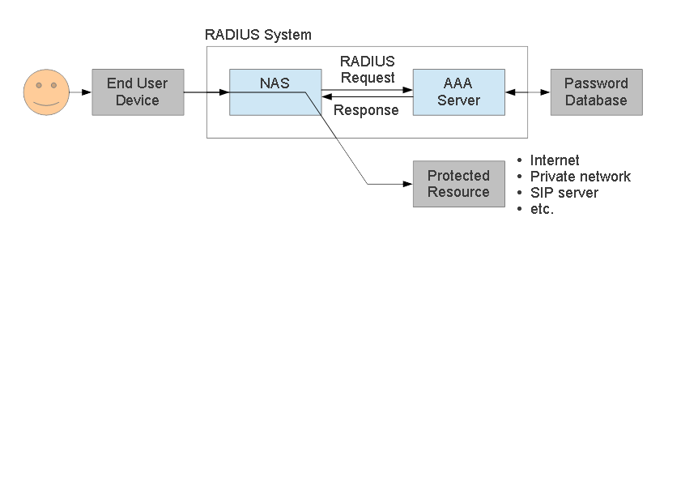
RADIUS Architecture (1)
RADIUS protocol is between NAS(Network Access Server) or a RAS(Remote Access server) and AAA server
NAS controls access to protected resource

Slide 7




RADIUS Architecture (2)
Scenario 1
In this scenario, a front-end NAS (network access server) or RAS (remote access server)
performs authentication of a user with a backend RADIUS server.
The NAS/RAS sends user information (credentials) to the RADIUS server carried in RADIUS packets. The RADIUS server implements the access policy (who is granted access with what authorizations) or may retrieve policies from a database through LDAP (Lightweight Directory Access Protocol).
RADIUS server may optionally contain policy DB
LDAP
SQL
RADIUS Server
LDAP/SQL
RADIUS
Access Line
(e.g. PPP)
Towards the Internet
User
NAS / RAS

Slide 8
RADIUS Architecture (3)
Scenario 2
In this scenario, a first RADIUS server does not perform authentication but acts as a proxy that
routes RADIUS requests to the appropriate home RADIUS server. The routing is based on username and realm.
The home RADIUS server performs the actual authentication by accessing a user DB.
A concurrency RADIUS server may be employed to make sure that a user is not logged in more
than once, e.g. in scenarios with multiple RADIUS servers for redundancy / load balancing.
RADIUS Server #2
Concurrency RADIUS Server
RADIUS Server #1
Home RADIUS Server
RADIUS Proxy Server
RADIUS
RADIUS
Access Line
(e.g. PPP)
Towards the Internet
User
NAS / RAS

Slide 9













RADIUS Authentication
RADIUS transaction
A RADIUS transaction typically starts with an Access-Request carrying user credentials followed
by a RADIUS server response with a grant or denial of access.
Userr
NAS
RADIUS
DB
ser
ver
User data packet
Reject access
Access-Request
hashed password (RSA MD5)
Access-Reject
Lookup credentials for authorization
'Wrong credentials'
with username and
Auth. failure
User data packet
Grant access
Access-Request with username and
hashed password (RSA MD5)
Access-Accept
Lookup credentials for authorization. Create session record.
'Correct credentials'
Auth. success

Slide 10
RADIUS Accounting (1)
RADIUS accounting
Once a network session is up and running (successful authentication), the NAS may request
to start counting network usage of the user.
User
NAS
RADIUS
DB
ser
ver
ce
User data packet
Accounting-Request
(Start)
Start counting resour
usage (e.g. online time)
Accounting-Response
End of network session
Accounting-Request
(Stop)
Stop counting resource
usage
Accounting-Response

Slide 11
RADIUS Accounting (2)
RADIUS accounting
Accounting with RADIUS is specified in a separate RFC (RFC2866).
A set of special accounting RADIUS attributes (attribute values 40 – 59) are used to transfer
accounting data between the RADIUS client (NAS)
and server.
Value
Type
Description
40
Acct-Status-Type
Indicates start or stop of accounting.
41
Acct-Delay-Time
Delay between event causing accounting request and server response (used to compensate for processing delay time).
42
Acct-Input-Octets
Used by client to report number of received octets to server.
43
Acct-Output-Octets
Used by client to report number of transmitted octets to server.
44
Acct-Session-Id
Used by client to identify user session to server.
45
Acct-Authentic
Used by client to report authentication method to server, e.g. user autenticated by NAS
itself, user authenticated by RADIUS or user authenticated by external protocol.
46
Acct-Session-Time
Used by client to report to server how many seconds the user session is running.
47
Acct-Input-Packets
Used by client to report number of packets received by a user.
48
Acct-Output-Packets
Used by client to report number of packets sent by a user.
49
Acct-Terminate-Cause
Used by client to report cause of service termination (e.g. error, termination upon user request, timeout).
50
Acct-Multi-Session-Id
Similar to Acct-Session-Id, but used to link multiple sessions to one for correlation in log file.
51
Acct-Link-Count
Used by client to report number of links used by user.

Slide 12



RADIUS Applications(1)
NAS network access (ISP):
A user dials in on a NAS server run by the Internet provider.
Prior to granting access to the Internet, the NAS authenticates the user with RADIUS.
DB
RADIUS Server
Access Line
(e.g. PPP)
RADIUS
Internet
User
NAS
RAS Intranet access (enterprise dial-in):
This application is similar to the NAS scenario. The RAS (Remote Access Server) sits at the
edge of the company network and authenticates a user prior to granting access to the network.
DB
RADIUS Server
RADIUS
Internet /
Intranet
Intranet /
company network
User
NAS

Slide 13






RADIUS Applications(2)
802.1X backend control for Ethernet and WLAN network access:
IEEE 802.1X is a generic protocol for authentication and authorization in IEEE 802 based
networks.
The 802.1X supplicant ('the user') sends an EAPOL (Extensible Authentication Protocol Over
LAN) message to the 802.1X authenticator (switch, access point).
The switch or access point enables the Ethernet or WiFi port if the backend authentication
based on credentials provided via 802.1X is successful.
Using a central server for authentication
administration in large networks.
(username and password storage) eases
RADIUS Server
802.11 WLAN
with 802.1X EAPOL
8
Ethernet with
02.1X EAPOL
RADIUS
RADIUS
LAN
PDA
802.1X Supplicant
* 802.1X capable
Ethernet switch
* 802.1X authenticator
* RADIUS client
* 802.11 Access point
* 802.1X authenticator
* RADIUS client

Slide 14
Why do we need RADIUS?
Many services require password authentication!
Users don't want to remember many passwords
Easier to change password regularly or if compromised
Easier to secure a single password database
Enables user-password auth with 802.1x
Alternative to TACACS for network equipment
Used for PPP authentication in ISPs (PAP/CHAP)

Slide 15
RADIUS message types
Access-Request
Access-Challenge
Access-Accept
Access-Reject
Accounting-Request
Accounting-Response
Status-Server (experimental)
Status-Client (experimental)

Slide 16
RADIUS attributes
Name=Value
  User-Name
  User-Password
  NAS-IP-Address
  NAS-Port
  Service-Type
  NAS-Identifier
  Framed-Protocol
  Vendor-Specific
  Calling-Station-ID
  Called-Station-Id

Slide 17
RADIUS users database (file)
Flat text file
  Easy to understand and edit
  Alternatives include Kerberos, LDAP and SQL
Each user entry has three parts:
  Username
  List of check items (requirements)
  List of reply items (assignments)

Slide 18
RADIUS users database (file)
Flat text file
  Easy to understand and edit
  Alternatives include Kerberos, LDAP and SQL
Each user entry has three parts:
  Username
  List of check items (requirements)
  List of reply items (assignments)

Slide 19
User entry example
Franko Password = 'testing12'
Service-Type = Frame-User,
Framed-protocol = PPP,
Framed-IP-Address = 192.168.1.4
Framed-IP-Netmask = 255.255.255.0
Username is Franko (case sensitive!)
Check items (first line, all must match Access-Req):
  password = testing12
Reply items (indented lines):
  Service-Type, Framed-IP-Address...

Slide 20
User name and check items
Username
  First part of each user entry
  Up to 63 printable, non-space, ASCII characters
Check Items
  Listed on the first line of a user entry, after username
  Multiple items are separated by commas
  Entry only matches if all check items are present in the Access-Request and match
  Fall-Through = Yes allows server to try other entries
First line (user name + check items) must not exceed 255 characters.

Slide 21
Operators in user entries
The “=” and “==” operators mean different things in check items and reply items!
In check items:
  Use “=” for server configuration attributes (Password, Auth-Type)
    Sets the value if not already set (set without override)
  Use “==” for RADIUS protocol attributes
    True if value is present and has the same value, never sets
In reply items:
  Use “=” for RADIUS protocol attributes
  Do not use “==”, it is never valid

Slide 22
The Auth-Type check item
Used to specify where (how) to lookup the password:
  Local (in the users file)
  System (query the OS, /etc/shadow or PAM)
  SecurID
Defaults to Local
Example:
Franko Auth-Type = Local, Password = 'test123'

Slide 23
Password expiration
Disable logins after a particular date
Use the Expiration check item:
Franko Password=”test12”, Expiration=“May 12 2009”
Date must be specified in “Mm dd yyyy” format!
Use the Password-Warning check item to warn the user before their password expires:
VALUE Server-Config Password-Expiration 30
VALUE Server-Config Password-Warning 5

Slide 24
Checking the NAS IP address and port
NAS-IP-Address check item
  Matches a particular NAS (by IP address)
  Will only match if the user connected to (Access-Request came from) that specific NAS.
NAS-Port-Type check item
  Will only match if the NAS reports that the user connected to a specify the type of port
  Options include: Async, Sync, ISDN
NAS-Port check item
  Will only match if the NAS reports that the user connected to a specific port (ethernet or serial)

Slide 25
Reply items
If all check items in the user entry are satisfied by the access-request, then:
Radius server sends an Access-Accept packet to the NAS, containing the reply items
Gives information to the NAS about the user
  For example, which IP address to assign to them

Slide 26
The Service-Type reply item
Service Type
  Must be specified
  Login-User → User connects via telnet, rlogin
  Framed-User → User uses PPP or SLIP for connection
  Outbound-User → User uses telnet for outbound connections.
Framed-User is by far the most used now
Framed-User requires a Framed-Protocol:
Franko Auth-Type = System
Service-Type = Framed-User
Framed-Protocol = PPP

Slide 27
The Framed-IP-Address reply item
Specifies the user's IP address to the NAS
Set to 255.255.255.255 to force the NAS to negotiate the address with the end-node (dial-in user)
Set to 255.255.255.254, or leave out, to force the NAS to assign an IP address to the dial-in user from the assigned address pool
Franko Auth-Type = System
Service-Type = Framed-User
Framed-Protocol = PPP
Framed-IP-Address = 192.168.1.4

Slide 28
Netmask and Route reply items
Use Framed-IP-Netmask to specify a netmask for the user's IP address
  The default subnet mask is 255.255.255.255
Use Framed-Route to add a route to NAS routing table when service to the user begins
  Three pieces of information are required:
    the destination IP address
    gateway IP address
    metric
  For example:
    Framed-Route = “196.200.219.0 196.200.219.4 1”

Slide 29
Accounting records
FreeRADIUS writes to its Detail log file
Typically Start and Stop accounting records
Tue May 12 14:12:14 2009
Acct-Session-Id = “25000005”
User-Name = “franko”
NAS-IP-Address = 196.200.219.2
NAS-Port = 1
NAS-Port-Type = Async
Acct-Status-Type = Start
Acct-Authentic = RADIUS
Service-Type = Login-User
Login-Service = Telnet
Login-IP-Host = 196.200.219.254
Acct-Delay-Time = 0
Timestamp = 838763356

Slide 30
Accounting attributes
Acct-Status-Type attribute
  indicates whether the record was sent when the connection began (Start) or when it ended (Stop)
Acct-Session-Id attribute
  ties the Start and Stop records together, indicating that it's the same session

Slide 31
What is FreeRADIUS?
The premier open source RADIUS server
Similar to Livingston RADIUS 2.0
Many additional features
Free!

Slide 32
Practical exercise overview
Build and install FreeRADIUS
Configure and start FreeRADIUS
Test authentication using FreeRADIUS
Configure a service to authenticate using RADIUS

Slide 33
Installing FreeRADIUS
Installing a binary package:
  sudo apt-get install freeradius freeradius-utils
Check if FreeRadius is running using below command
Start FreeRADIUS server:

Slide 34
Creating Local user Accounts
sudo vi /etc/freeradius/users :
  Add a new section:
Restart FreeRADIUS:
  sudo service freeradius restart

Slide 35

Running FreeRadius in debug mode
You should review the configuration files carefully
  /etc/freeradius/ *
Debugging mode is extremely useful:
  sudo /usr/sbin/freeradius -X (capital X)
Output should end with as shown below:
Server is now running in debugging mode
  Leave it running, and open another window/session on the server to run more commands

Slide 36
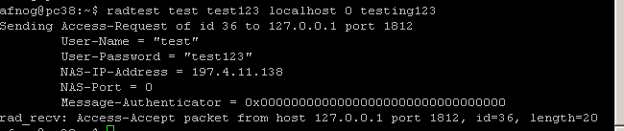
Testing the default configuration(1)
FreeRADIUS should now respond to RADIUS requests
Test by running:
  radtest test test123 localhost 0 testing123
  What happens?
  You should see the server receive the access-request and respond with an access-accept in both cases

Slide 37
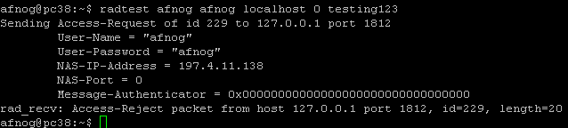
Testing the default configuration(2)
Try a local user that does exist, with password:
  radtest afnog afnog localhost 0 testing123
  What happens?
You should see the server receive the access-request and respond with an access-reject in both cases

Slide 38
Changing the Shared Secret
We've been using the default shared secret, testing123
  Not very secret, so let's change it!
Edit /etc/freeradius/clients.conf
  sudo vi /etc/freeradius/clients.conf
  Find the section client localhost
  Find the line secret = testing123
  Generate a new secret and for our example use afnog123
Restart FreeRADIUS and test with the new secret:
  radtest afnog afnog localhost 0 afnog123

Slide 39
Secret (digression)
From RFC 2865:
  The secret (password shared between the client and the RADIUS server) SHOULD be at least as large and unguessable as a well-chosen password. It is preferred that the secret be at least 16 octets. This is to ensure a sufficiently large range for the secret to provide protection against exhaustive search attacks. The secret MUST NOT be empty (length 0) since this would allow packets to be trivially forged.
How to generate a new, secure random key:
  dd if=/dev/random bs=16 count=1 | base64
  eAiYEcnU/nxEsp6of5DaGQ== (for example)

Slide 40
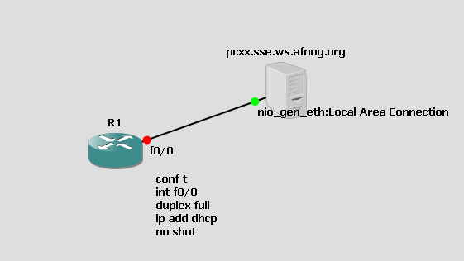
Authenticating Cisco Devices using FreeRadius
Diagram Below is a GNS3 simulation topology for this exercise

Slide 41
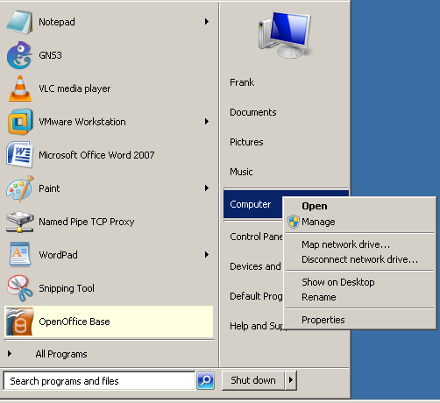
Create A Windows Loopback Adapter (1)
On windows, the following guidelines below by click on Manage
Click here

Slide 42
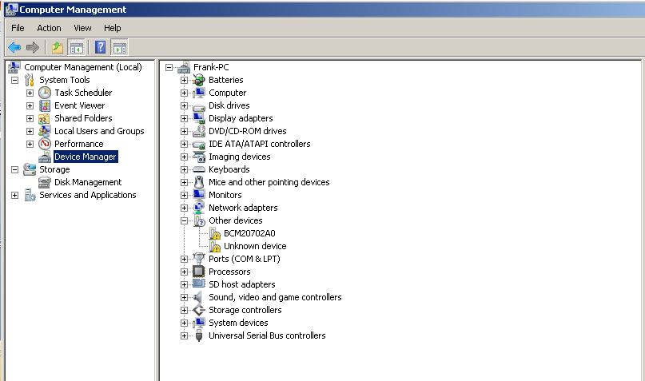
Create A Windows Loopback Adapter (2)
Click on Device Manager
Click here
Click Here

Slide 43
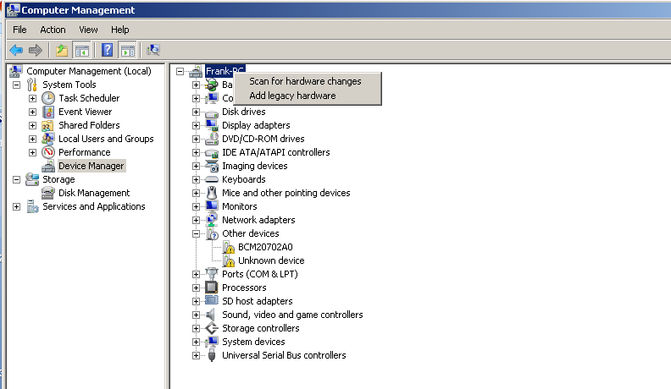
Create A Windows Loopback Adapter (3)
Click on Add legacy hardware
Click here

Slide 44
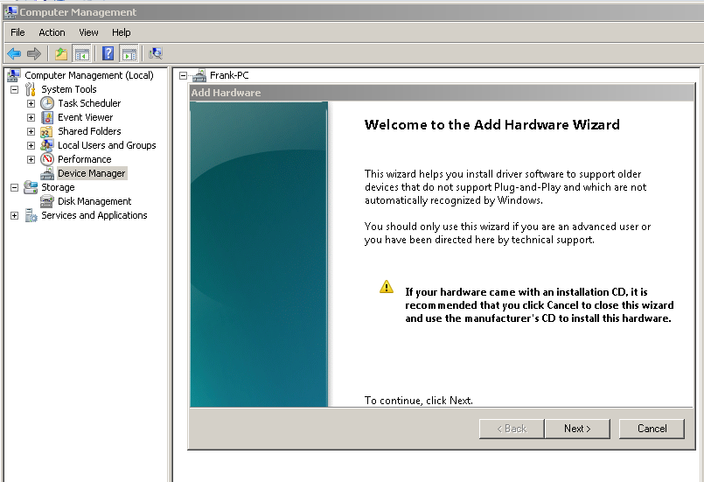
Create A Windows Loopback Adapter (4)
Click on Next
Click Here

Slide 45
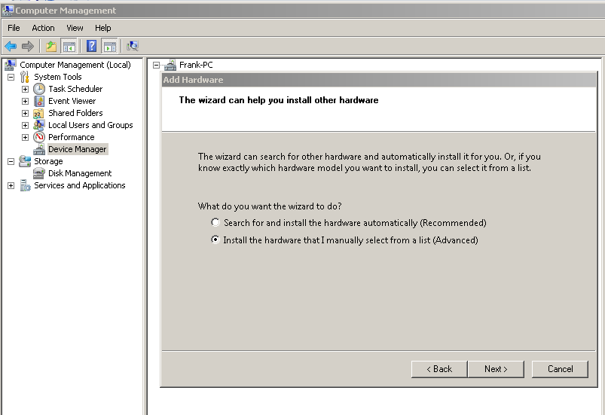
Create A Windows Loopback Adapter (5)
Click on Radio Button ( install the hardware that I manually select from a list) and Click Next
Click Here
Click Here

Slide 46
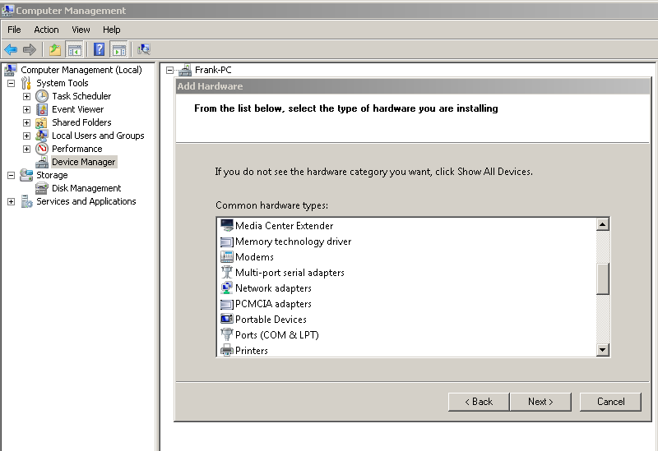
Create A Windows Loopback Adapter (6)
Select Network Adapters from dopbox menu and Click Next
Click Here
Click Here

Slide 47
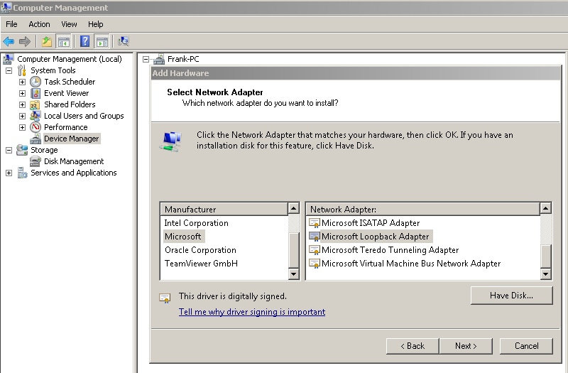
Create A Windows Loopback Adapter (7)
Select Microsoft from first dopbox menu
Select Microsoft Loopback Adapter from the second dopbox menu and Click Next
Click Here
Click Here
Click Here

Slide 48
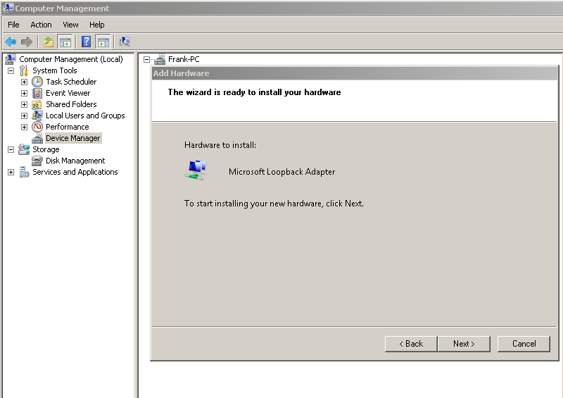
Create A Windows Loopback Adapter (8)
Click Next menu
Click Here

Slide 49
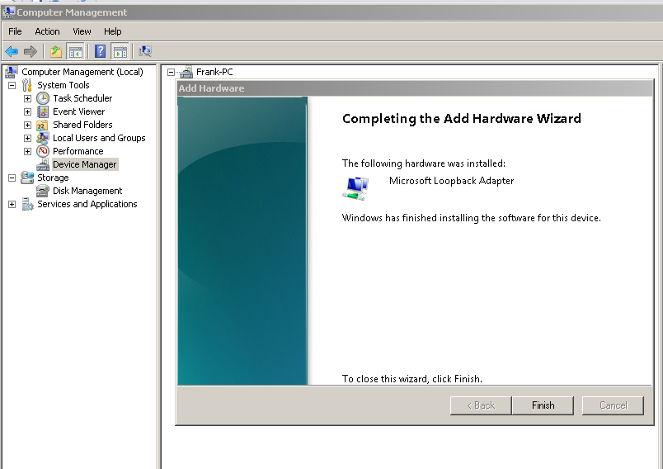
Create A Windows Loopback Adapter (9)
Click Finish menu
Click Here

Slide 50
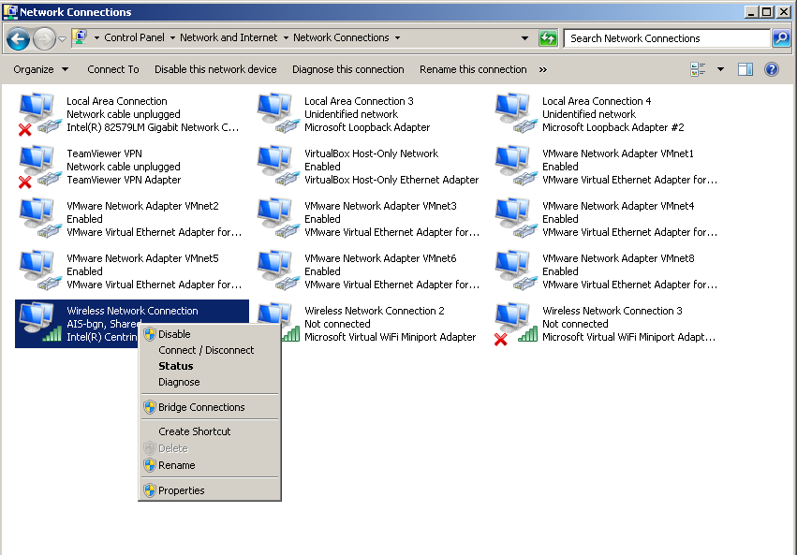
Sharing Internet Connection over Wireless Adapter with Loopback Adapter (1)
Click Properties on the AIS-bgn Wireless Network Connection Adapter
Click Here

Slide 51
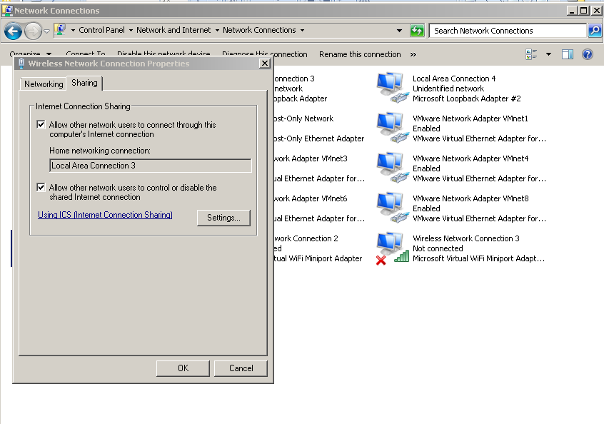
Sharing Internet Connection over Wireless Adapter with Loopback Adapter (2)
Select Sharing Tab; Select Loopback Adapter and check Radio Buttons and click Ok menu
Select Sharing Tab
Click Here

Slide 52
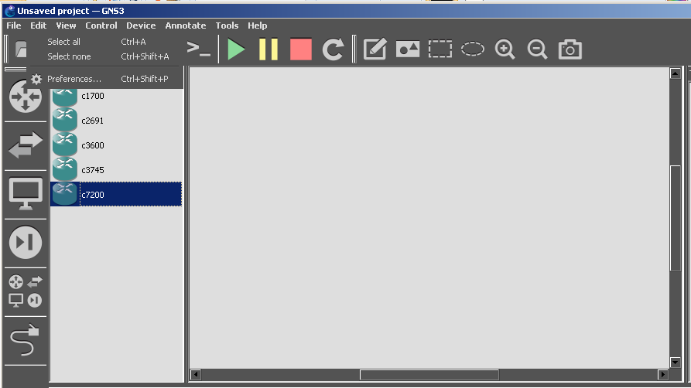
Configuring Gns3 topology as above (1)
Select the Edit Menu and click on Preferences Button
Click Here

Slide 53
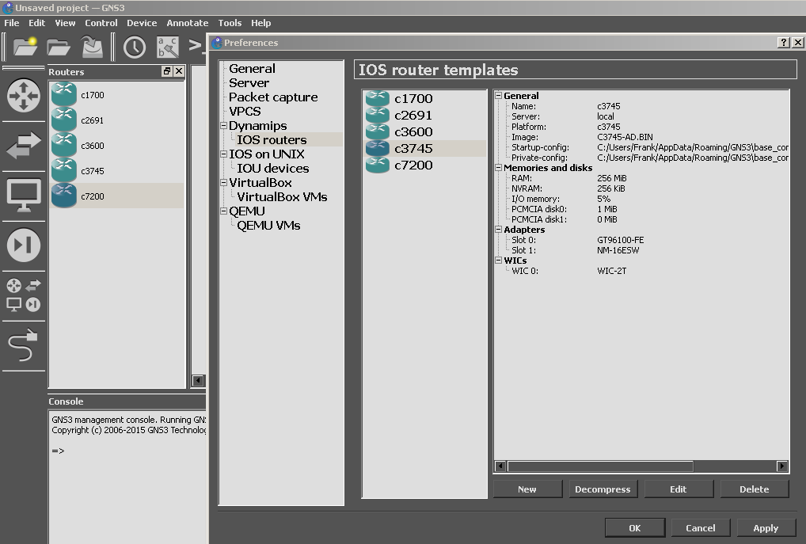
Configuring Gns3 topology as above (2)
Select the IOS routers and click on New Button
Click Here
Click Here

Slide 54
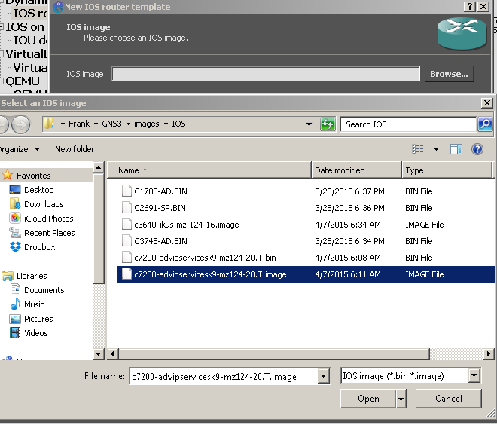
Configuring Gns3 topology as above (3)
Select the IOS Image and click on Open Button N.B: Copy of it can be gotten from Afnog Site
Click Here
Click Here
Click Here

Slide 55
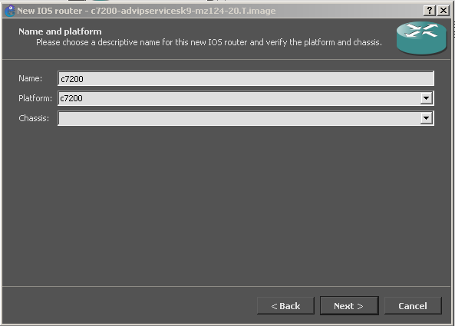
Configuring Gns3 topology as above (4)
Click on Next Button
Click Here

Slide 56
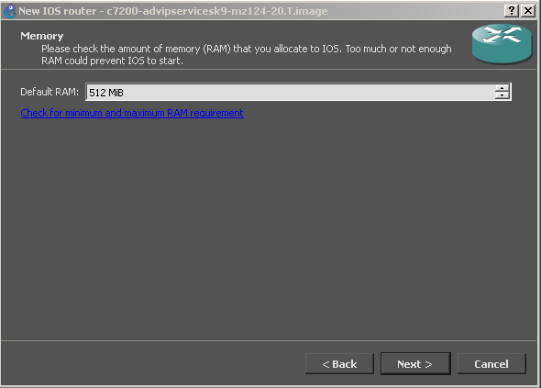
Configuring Gns3 topology as above (5)
Click on Next Button
Click Here

Slide 57
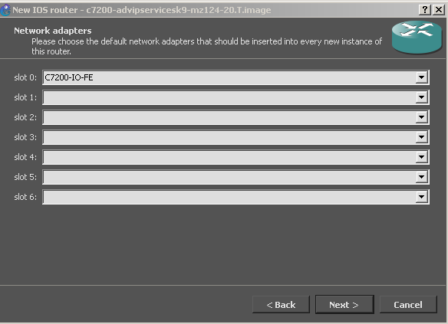
Configuring Gns3 topology as above (4)
Click on Next Button
Click Here

Slide 58
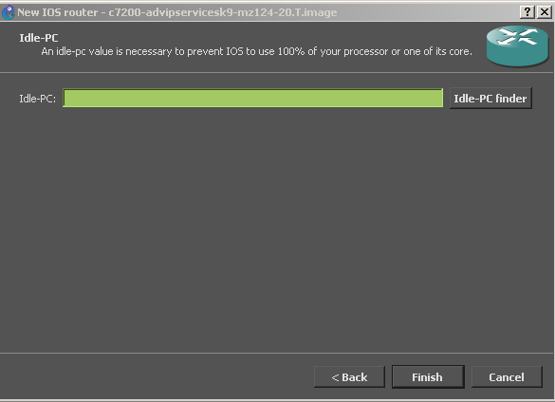
Configuring Gns3 topology as above (5)
Click on Finish Button
Click Here

Slide 59
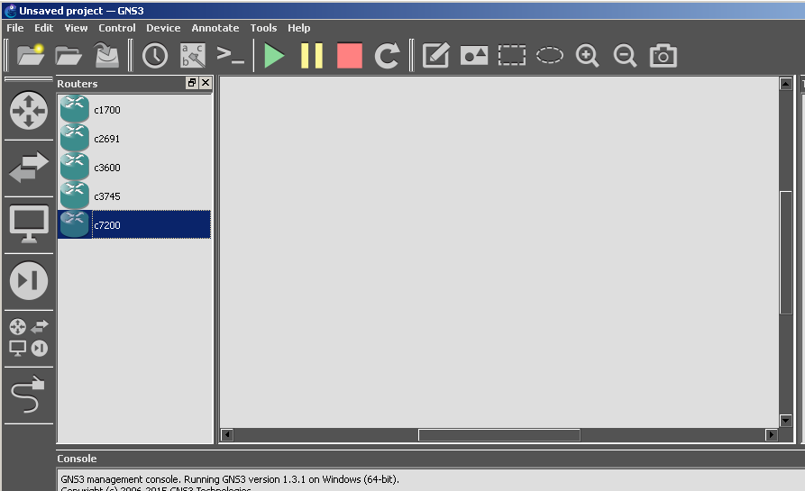
Configuring Gns3 topology as above (6)
Click on Router sign and Drag c7200 image onto the Topology pane
Click Here
Drag Here

Slide 60
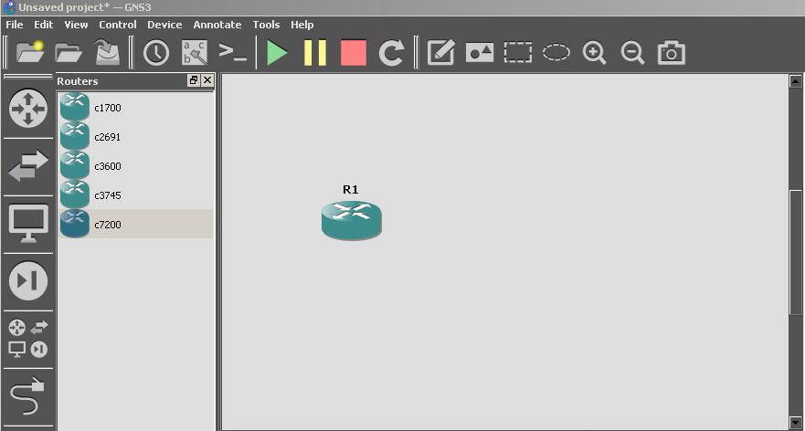
Configuring Gns3 topology as above (7)
You should see the c7200 image onto the Topology pane as shown below

Slide 61
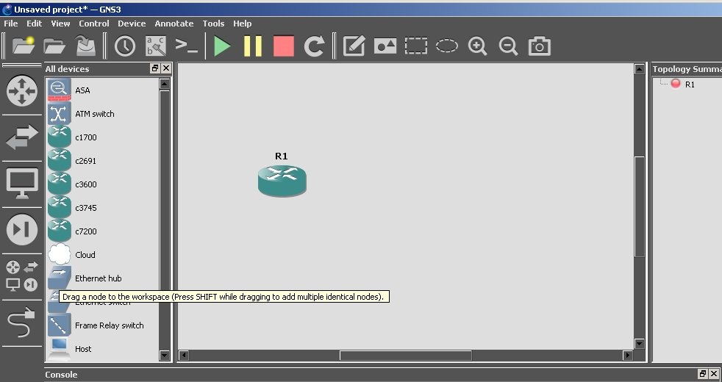
Configuring Gns3 topology as above (8)
Click on Multiple Device Box and Drag a cloud image onto the Topology pane
Drag Here
Click Here

Slide 62
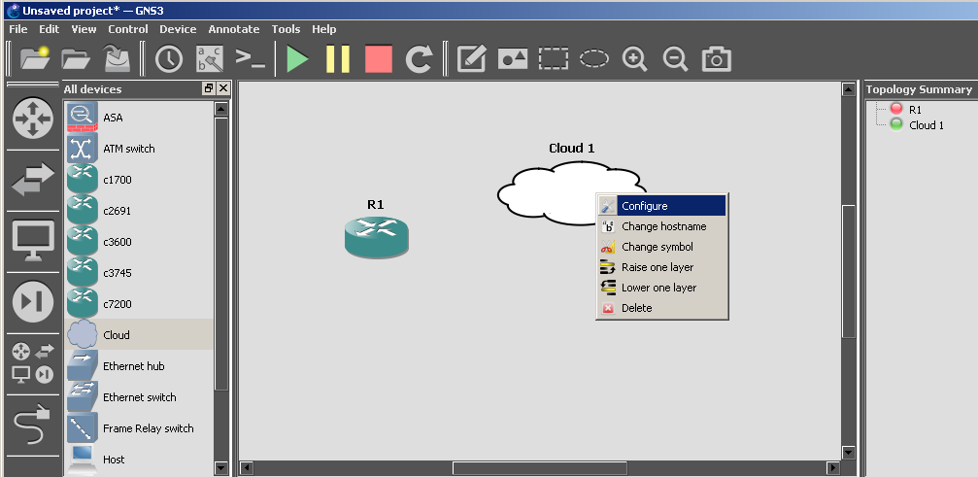
Configuring Gns3 topology as above (9)
Right Click on the Cloud1 icon and click Configure from the Topology pane
Click Here

Slide 63
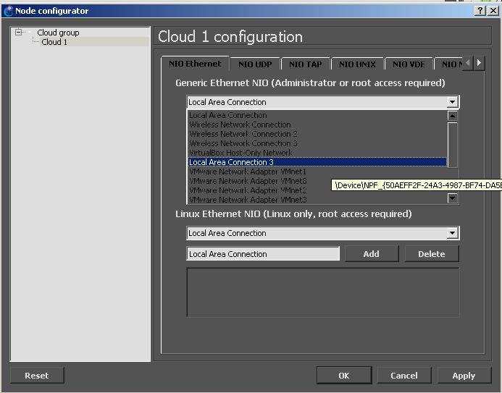
Configuring Gns3 topology as above (10)
Click on Cloud1 icon from left pane and select the Local Loopback Adapter you configured
Click Here
Click Here

Slide 64
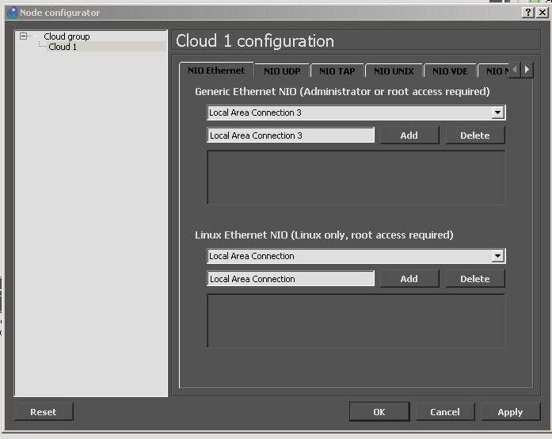
Configuring Gns3 topology as above (11)
Click Add Button to add Loopback Adapter to your Cloud1 you configured and click OK Button
Click Here
Click Here

Slide 65
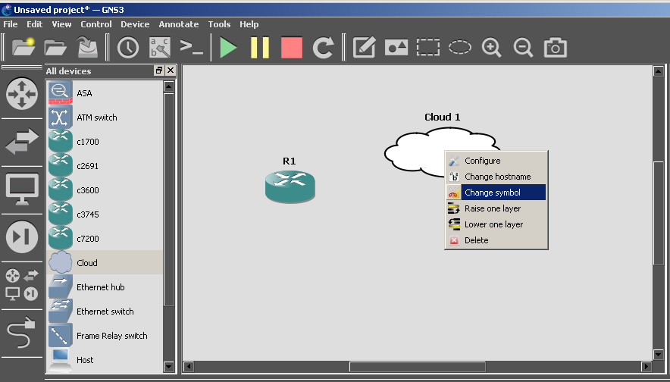
Configuring Gns3 topology as above (12)
Change the symbol of the cloud1 into the PC symbol
Click Here

Slide 66
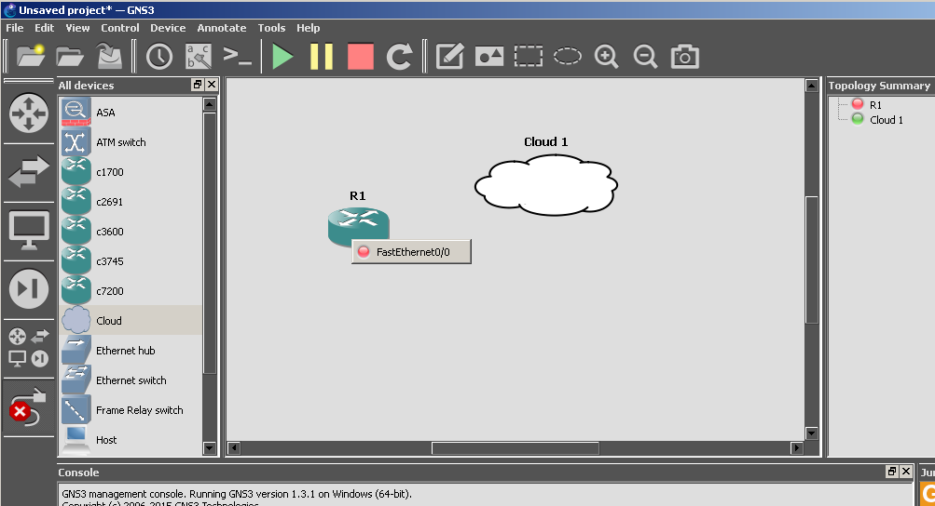
Configuring Gns3 topology as above (13)
Add a Link to Connect the Router F0/0 interface to the PC symbol
Click Here
Click Here

Slide 67
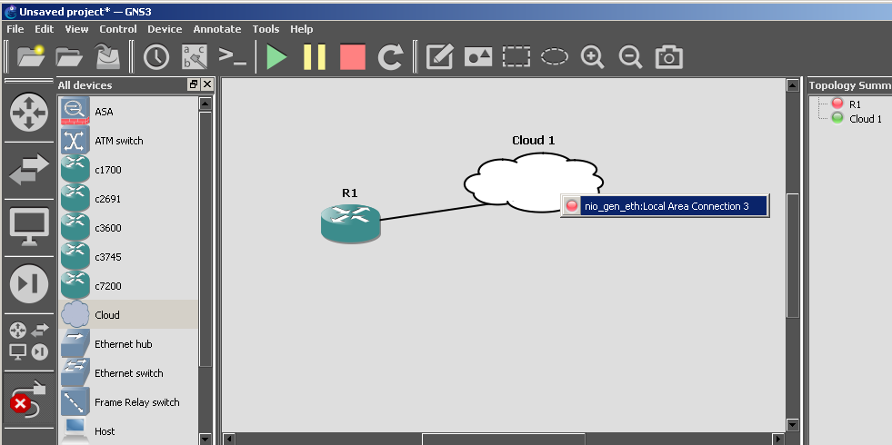
Configuring Gns3 topology as above (14)
Add a Link to Connect the Router F0/0 interface to the PC symbol
Click Here
Click Here

Slide 68
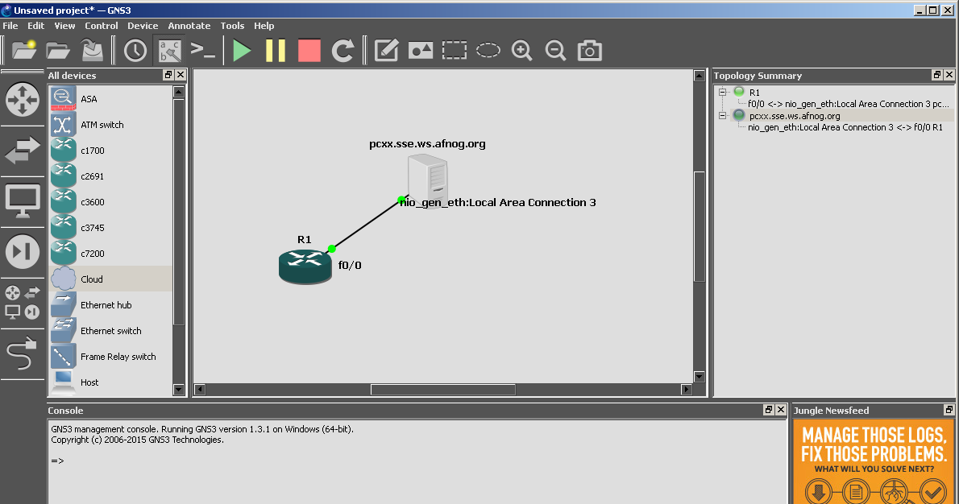
Configuring Gns3 topology as above (15)
A completed design should look like below and click on the start button to start the router
Click Here

Slide 69
Configuring Gns3 topology as above (16)
A completed design should look like below and click on the start button to start the router
Click Here

Slide 70

Enabling Network Clients
sudo vi /etc/freeradius/clients.conf:
  Add a new section:
N.B: the 197.4.11.14 should be replaced with your laptop’s Wireless Interface Ip Address
Restart FreeRADIUS:
  sudo service freeradius restart

Slide 71
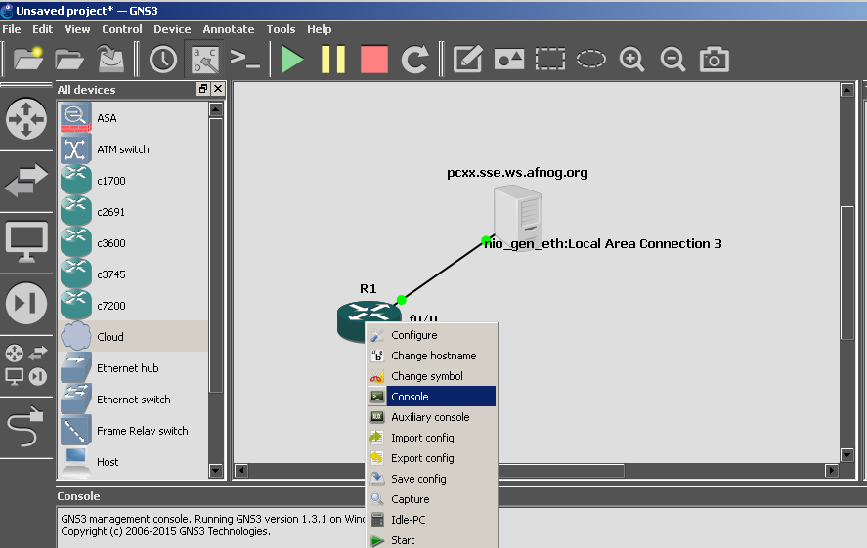
Router Configuration (1)
Connect to the Router by Right Clicking it and clicking on Console
Click Here

Slide 72
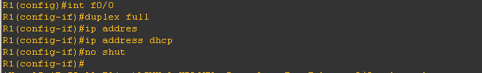

Router Configuration (2)
Configure the IP address for the interface connecting to the PC
  Configure an IP address for the router to enable remote connectivity
  Check to ensure interface f0/0 has an IP address by running below command

Slide 73
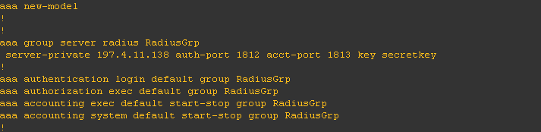

Router Configuration (3)
Configure users authentication for remote access to the router
  Configure the Radius commands to allow authentication and accounting request
  Ensure commands are entered using conf t
  Ensure you replace the 197.4.11.138 with your Server IP address
Configure the vty session to allow remote connection to the router
  Enable telnet and ssh session over it using the command below.

Slide 74

Creating Network user Accounts
sudo vi /etc/freeradius/users :
  Add a new section:
Restart FreeRADIUS:
  sudo service freeradius restart

Slide 75
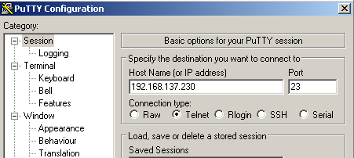
Testing Remote Connectivity (1)
Get the IP address of the f0/0 interface using the command below
  Configure an IP address for the router to enable remote connectivity
  Configure Putty with the following features as below.

Slide 76
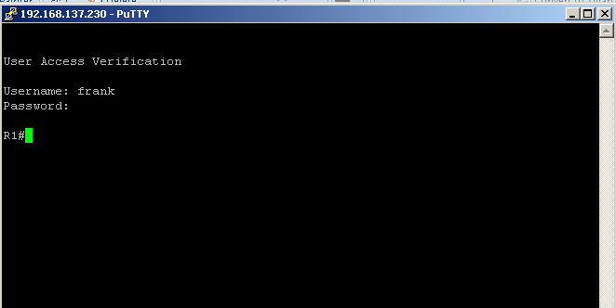
Testing Remote Connectivity (2)
Test user login using Accounts created above
Note, a Successful login will allow the created users inside the Radius access to the Router.

Slide 77
What have we achieved?
Debian RADIUS server answers authentication requests:
  Flat text file (users file)
  Installation and configuration of Gns3
  Mounting a Cisco Router image
  Network authentication for Cisco NAS equipment
We can deploy new services without having to create separate password databases

Slide 78
What more could we do?
Store credentials in:
  a database (MySQL, PostgreSQL)
  LDAP
  Kerberos
Integrate with network access control (802.1x)
Generate accounting data
  so that we could bill for timed access to resources
  for example a wireless hotspot or a hotel network
Generate reports from accounting data

Slide 79
Bibliography
FreeRADIUS website
  http://www.freeradius.org/
GNS3
  www.gns3.net
Other resource
  http://www.indigoo.com/dox/itdp/09_Access/AAA_RADIUS.pdf

