Slide 1
Name of Project Project Overview
Data ^{X}
You don’t have to use this template In fact, create your own look if its helpful
Name of team members

Slide 2
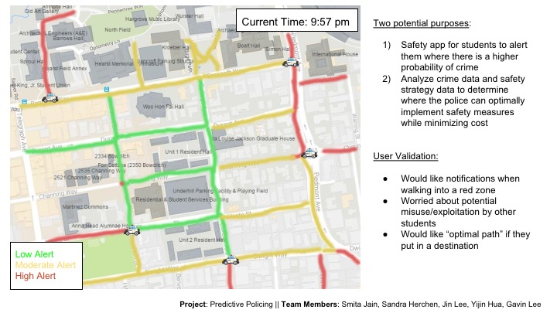
Slide 1: What is Your Project
High Level Description
Any validation information (is did you talk with anyone who wants it)
Can use NABC or other past info from earlier
Example: Sport Prediction
Example: Predictive Policing

Slide 3
Slide 2: User Perspective. Illustrate UI or Input /Output
Example Intended Screenshot
List Top 3 User Requirements
(your best guess)
Performance..
Presentation..
…

Slide 4
Technical Components of Project
Top Components in order of Importance
UI
Ability to send emails
Use of Neural Network Algorithms
Where will we get the data
..
Color Code Orange or Red: Lines you need to learn to do
Color Code Green: Lines which will be easy to develop

Slide 5
Put Sample Architecture (SA) and /or Data Model (DM) Replace the diagram below with your SA / DM (it is okay to use two slides, one for SA and one for DM)
Possible Inputs Code Blocks
Possible Output Code Blocks
Compute including test, train, split
Web or Poll
Algorithm Options w/ Tables/Matrix
Prediction / Classification
Natural Language, State Space
Feature Extraction
Web
Download
Email
Stream
Social Net
Pandas: Short
Term Storage
Chatbot
…
…
Crawl
Long Term Storage: SQL and File Formats (JSON, CSV, Excel)
Control Decision
Feedback from External System (World)

Slide 6
What will you do next
What is the initial set of tasks (3-5) tasks?
What would you like to accomplish before the class is over?
What issues (architecture/business/technical) are you facing that we can discuss tomorrow?
Week 1
Task 1
Task 2
Week 2
Wait to decide
Week 3..
Wait to decide
Hint: start with the red items on your list of technical components

