Slide 1
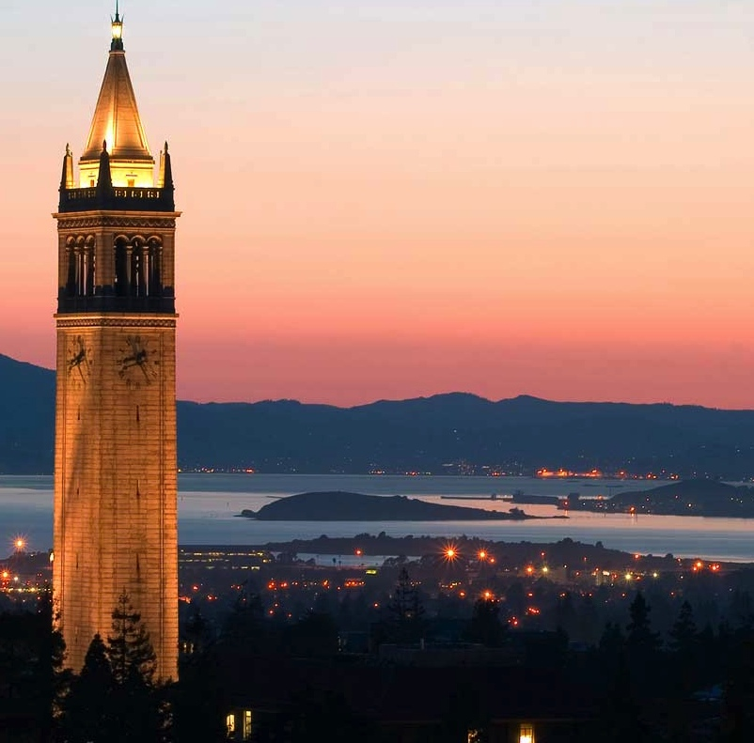


Reflection and Next Steps
Kuwait Nov 2018
Ikhlaq Sidhu Chief Scientist & Founding Director Sutardja Center for Entrepreneurship & Technology Department of Industrial Engineering & Operations Research IEOR Emerging Area Professor Award
Notes:
Welcome
* Introduce self and each other
* Parts of Talk:
Data Models (Biz)
ML Topics (slightly technical, but will make it understandable)
Then considerations for Organizations and Leadership/Innovation
<number>

Slide 2
Reflection and Next Steps
Continue in context of project discussion if time permits …
Learning Summary and Discussion – reflect on valuable portions to you.
Future Roadmap – what are your next challenges?
More materials at data-x.blog
Staying Connected – How can we continue to help with networks, student projects, or other ideas?

Slide 3
Our Agenda and Purpose
3-Day Version of full course
Learn AI / ML / Blockchain business use cases
Code samples / basic theory
Starting point to go further
Project Options:
Learning basics
Defining Work Project
Improving Existing Project
Additional Goals:
Teams – meet each other
Diversity in perspective
Pay it forward
Global resources
Staying connected

