Slide 1
T-test with equal variance and unequal variance
Paired t-test
The t-test in Java
Does a dataset meet the parametric assumptions?
Non-parametric equivalents to the t-test.
The algebra of linear regressions

Slide 2
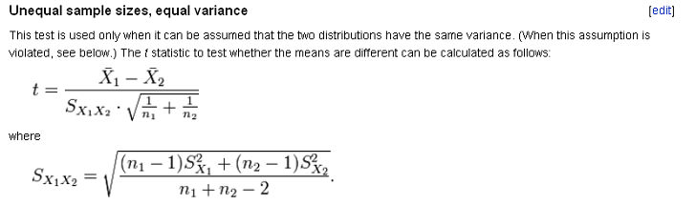
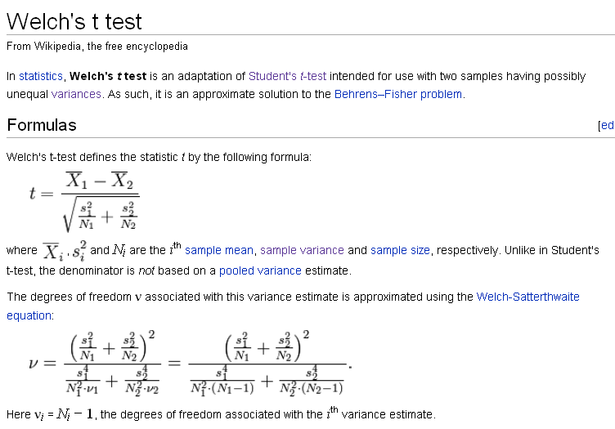
Two forms of the t-test
This is a weighted average
Here the “biggest” variance wins

Slide 3
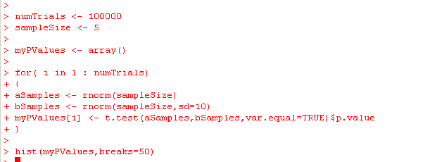
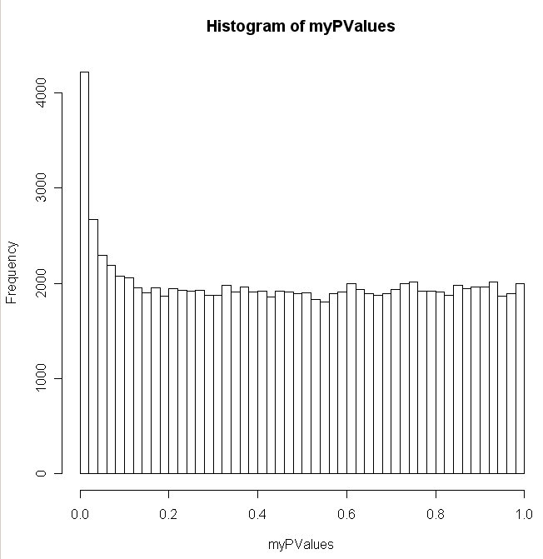
The t-test breaks if you mess with the assumption of equal variance

Slide 4
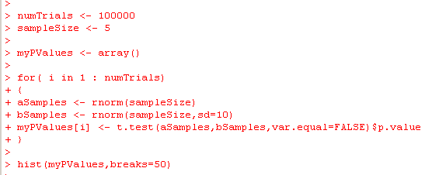
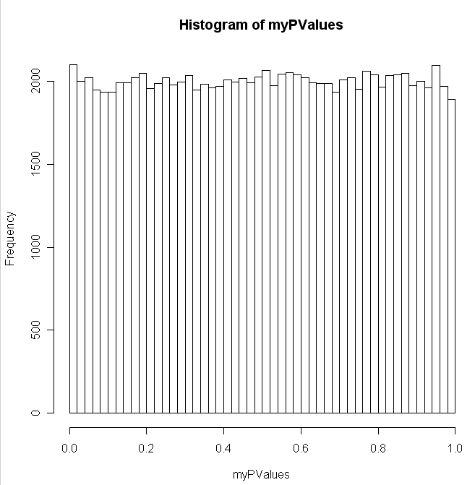
Of course, you can fix this easily in R

Slide 5
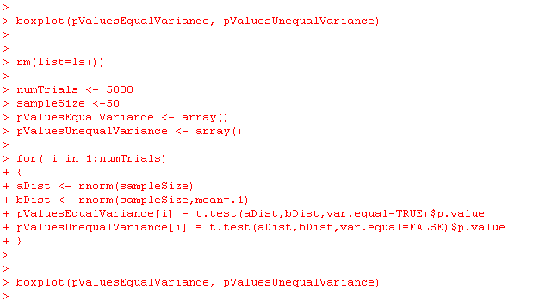
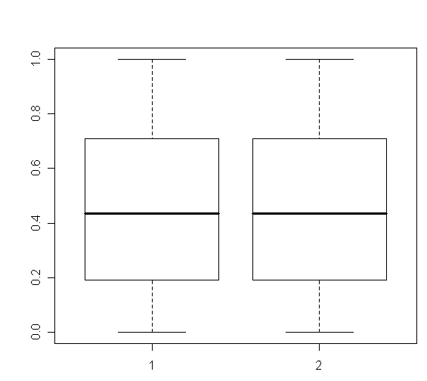
Should we always just use the t-test with the assumption of
unequal variance?
The answer seems to be “yes”.
There is no sensitivity penalty for
dropping the assumption of equal variances…

Slide 6
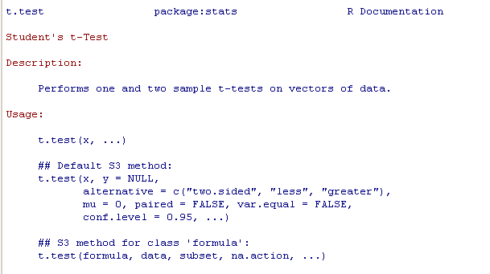
This is probably why R sets var.equal=false as the default.
There is no reason not to use it…

Slide 7
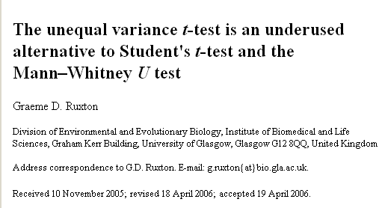
Because the math is easier to understand (or maybe just because
people don’t know any better, the assumption of equal variance is
often left in…)

Slide 8
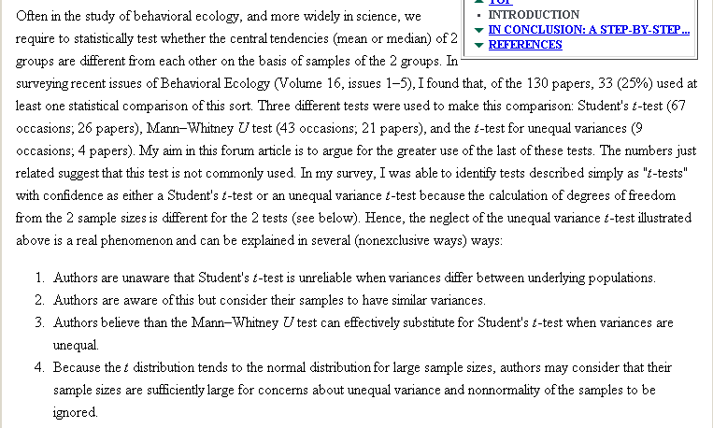

Slide 9
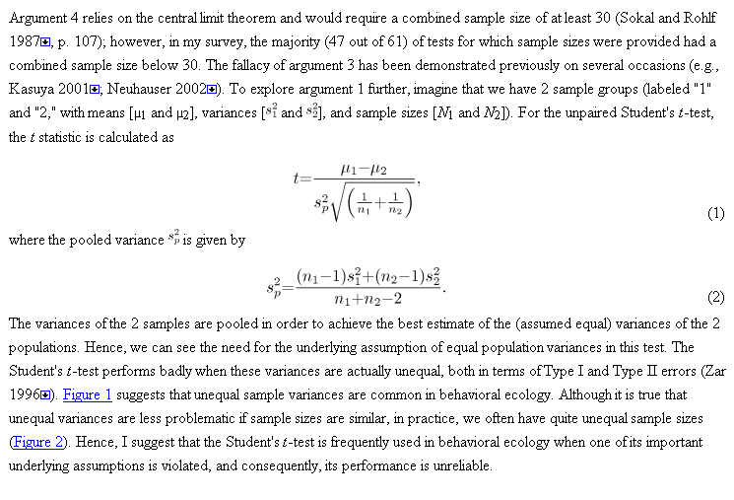

Slide 10
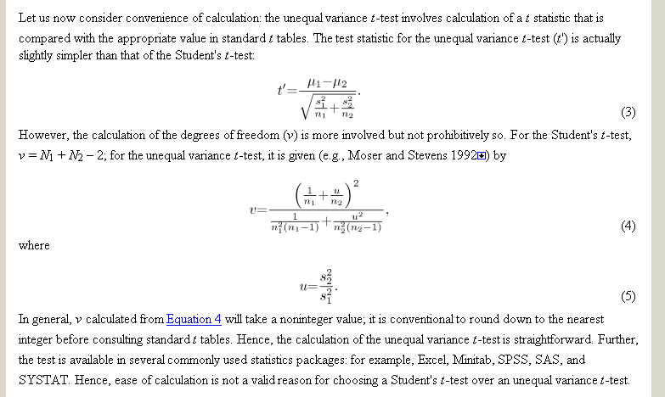
Round down for calculating d.f.

Slide 11
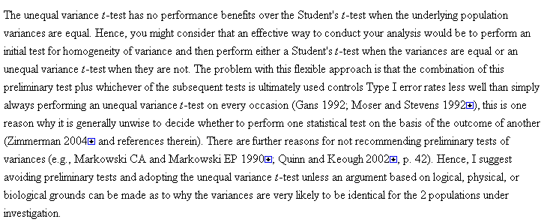
This conclusion is consistent with the mini-experiment we just
did in R!

Slide 12
T-test with equal variance and unequal variance
Paired t-test
The t-test in Java
Does a dataset meet the parametric assumptions?
Non-parametric equivalents to the t-test.
The algebra of linear regressions

Slide 13
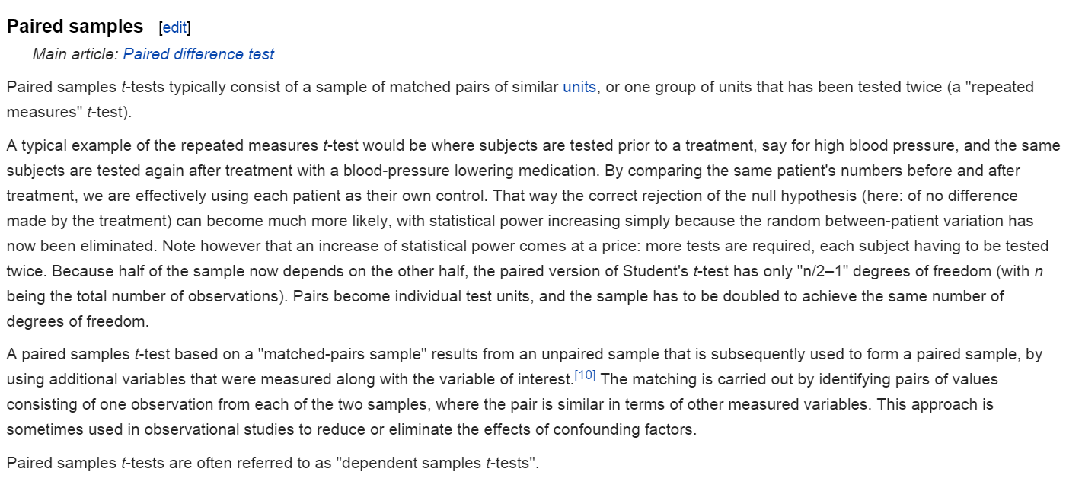
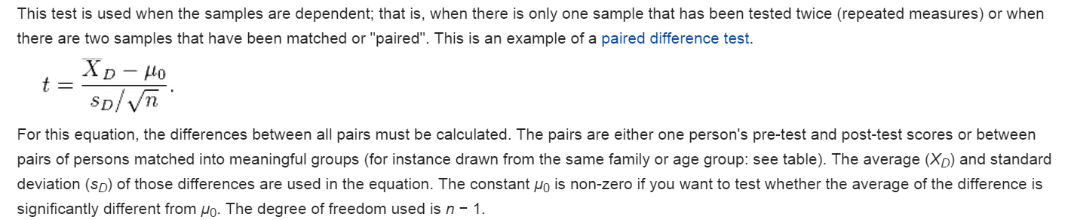
You can tell R whether the t-test is paired or un-paired
Uo is usually zero
http://en.wikipedia.org/wiki/Student%27s_t-test#Dependent_t-test_for_paired_samples

Slide 14
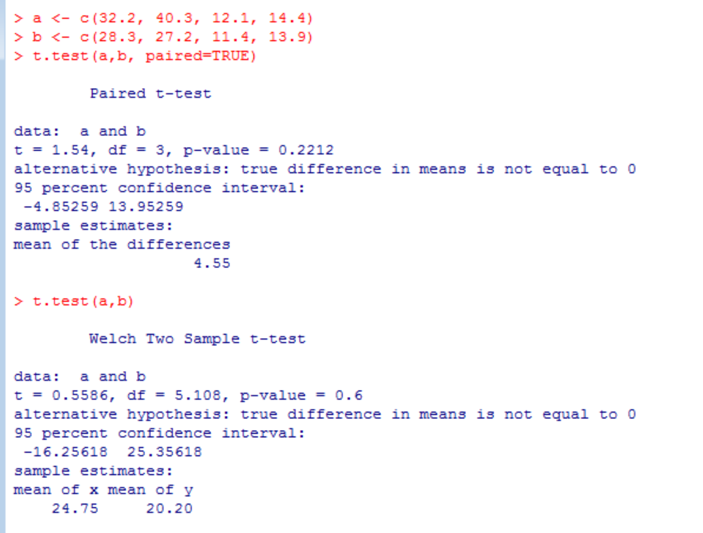
Using the paired t-test can lead to increased power
Mouse ID | Weight before treatment | Weight after treatment
1 | 32.2 | 28.3
2 | 40.3 | 27.2
3 | 12.1 | 11.4
4 | 14.4 | 13.9

Slide 15
T-test with equal variance and unequal variance
Paired t-test
The t-test in Java
Does a dataset meet the parametric assumptions?
Non-parametric equivalents to the t-test.
The algebra of linear regressions

Slide 16
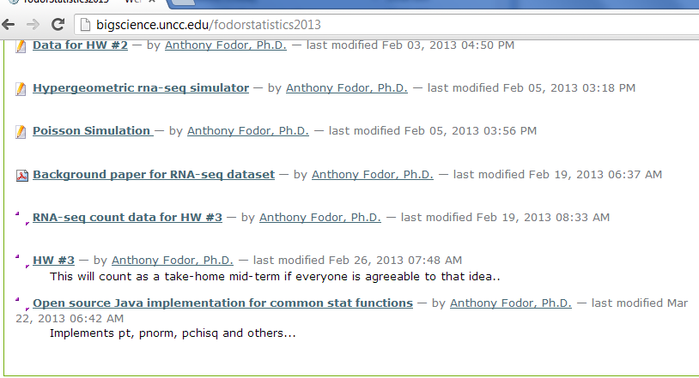
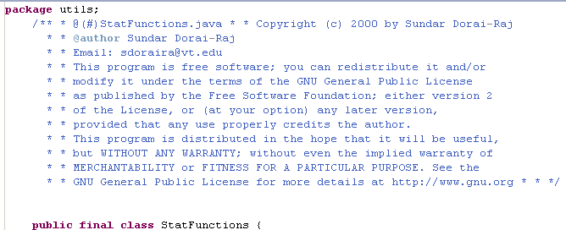
http://bigscience.uncc.edu/fodorstatistics2013/statFunctions.zip/view

Slide 17
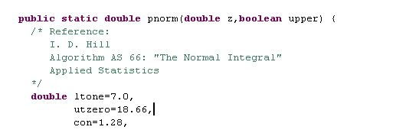
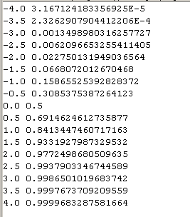
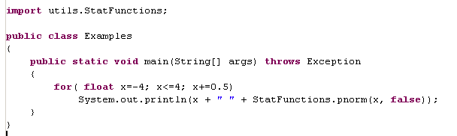
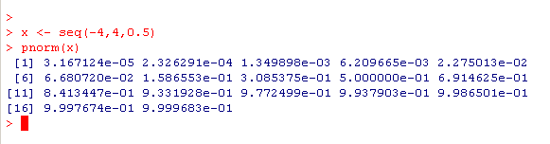
pnorm for the standard normal distribution

Slide 18
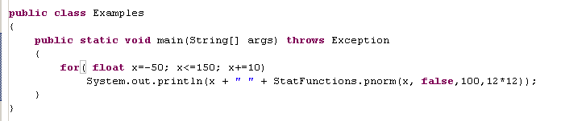
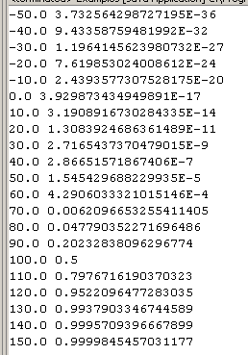
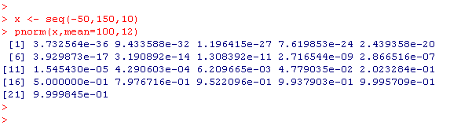
Alternatively, you can specify mu and sigma…

Slide 19

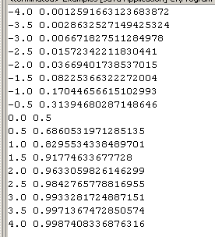
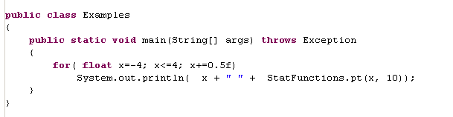
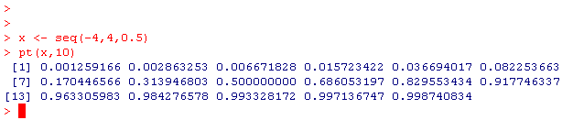
pt is there too….

Slide 20
Once you have pt all you have to do is calculate this….

Slide 21
or this…
which are both trivial…
(likely this is all easy to do in Python as well…)

Slide 22
T-test with equal variance and unequal variance
Paired t-test
The t-test in Java
Does a dataset meet the parametric assumptions?
Non-parametric equivalents to the t-test.
The algebra of linear regressions

Slide 23
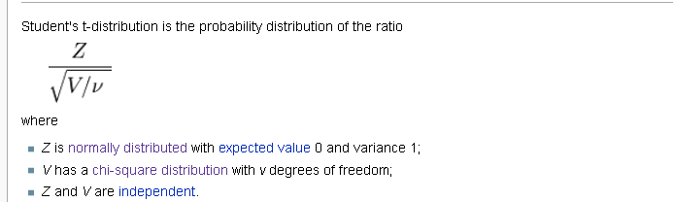
Assumptions of the t-test:
Independence
Normality
Equal Variance ( or not )
How can we evaluate these assumptions?
We must meet the assumption of independence, because our test statistic is
built from an independent sum of the square of independent, normal variables.
But the numerator and denominator are built on an assumption of normality.
We can relax the assumption of equal variance, but not the other two or our
calculations of p-values don’t have much meaning…

Slide 24
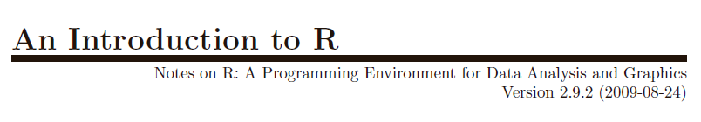
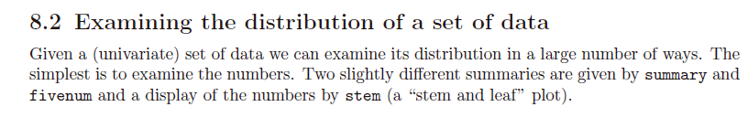
http://cran.r-project.org/doc/manuals/R-intro.pdf

Slide 25

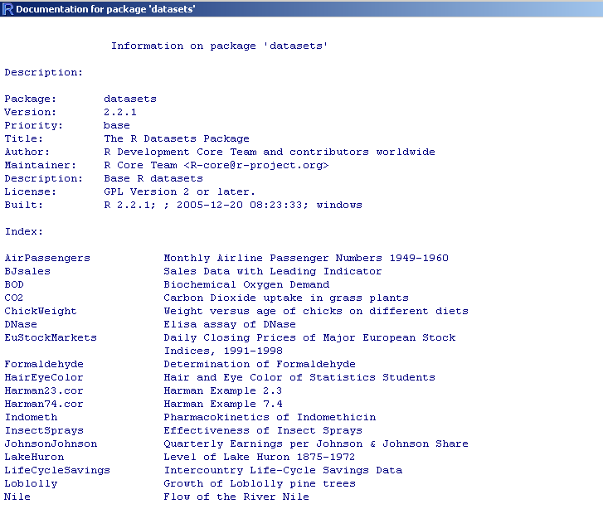
R has built in practice datasets to play with….

Slide 26

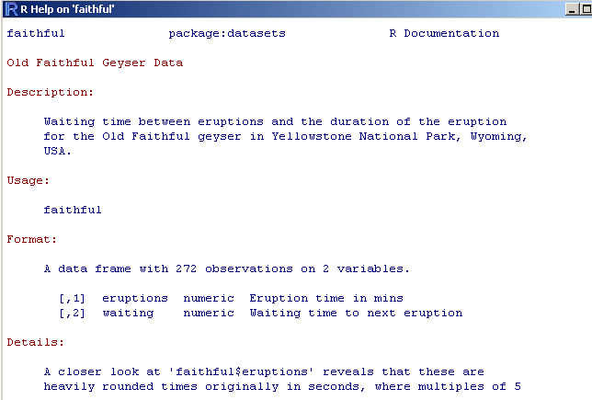

Slide 27
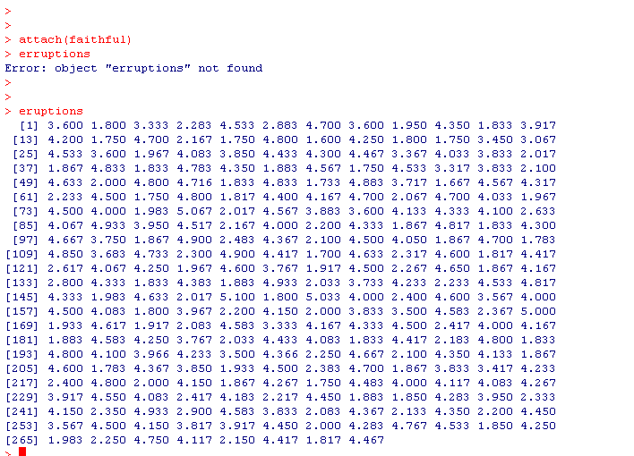

Slide 28
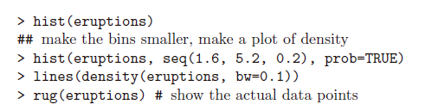
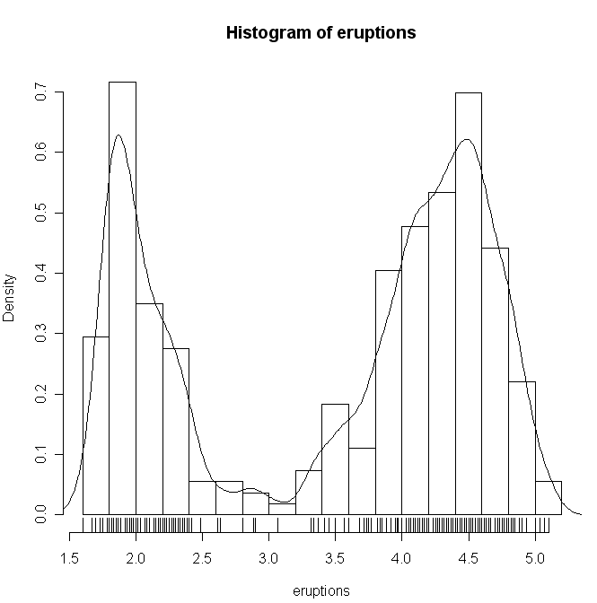
R has lots and lots of way to see if a distribution is normal….
Scales the y-axis in probability space
Show the raw data on the histogram
Obviously this is not normal…
(An introduction to R; section 8.3)

Slide 29
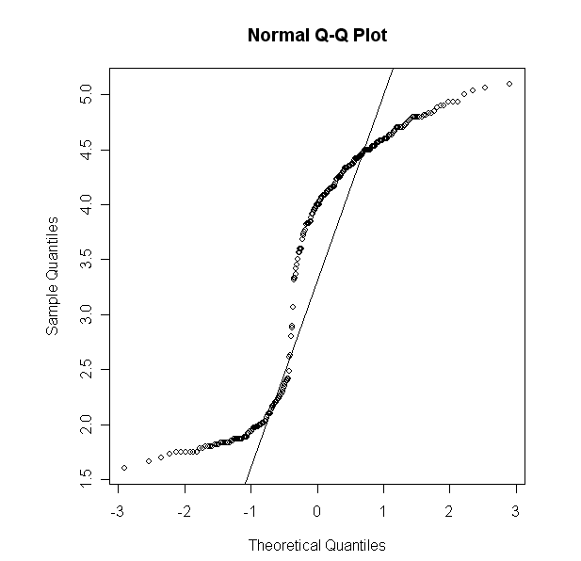

We can, of course, use qqnorm to visually
test for normality…

Slide 30
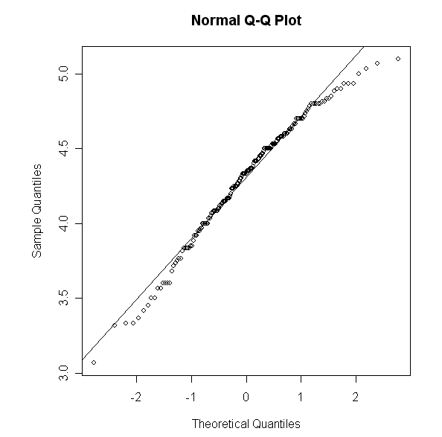
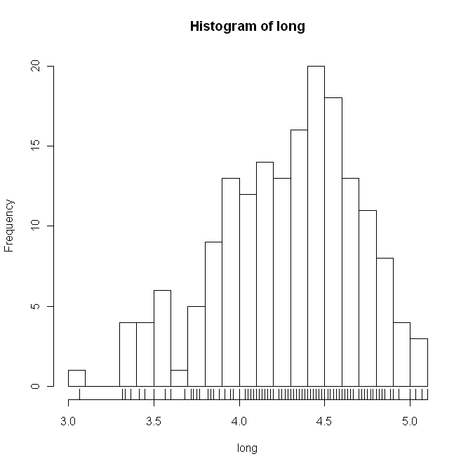
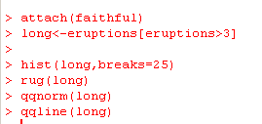
What about just the long eruptions?
Not too far off…
We would like a statistical test that tells us if this is normal or not…
We could use the chi-square test…

Slide 31
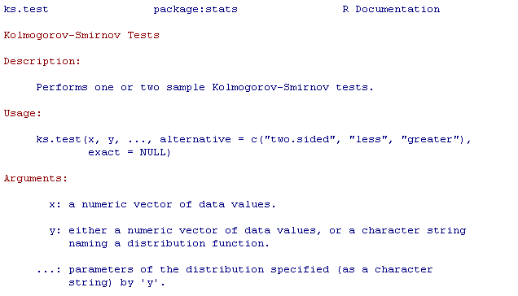
Or, alternatively,
?ks.test

Slide 32
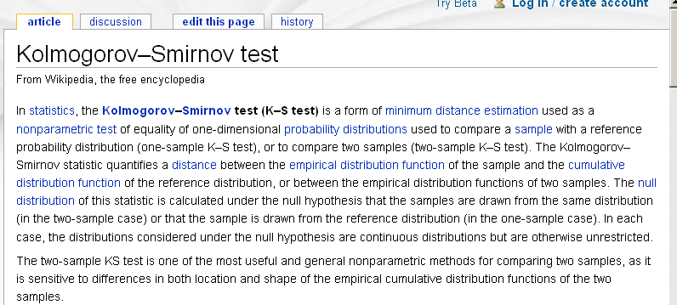

Slide 33
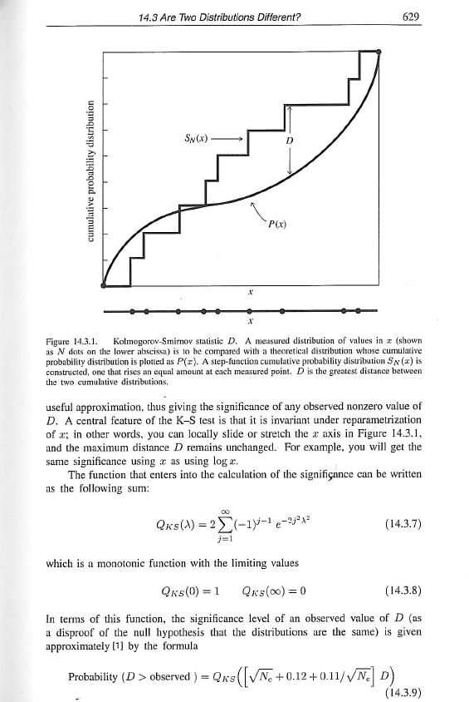
From the numerical recipes book…
We are going to have to take
their word for this!
(i.e. we won’t prove this works)

Slide 34
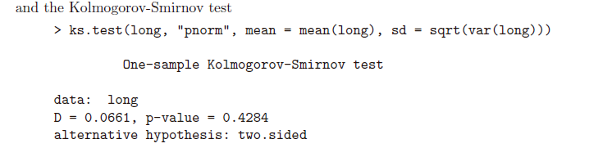
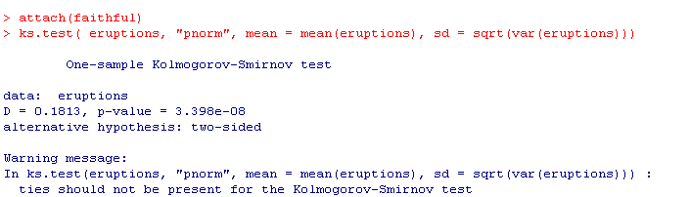
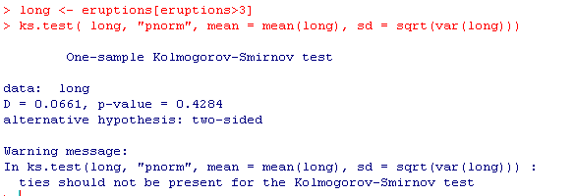
We reject a null hypothesis that the
second eruption data is non-normal
Albeit with some warnings
(that we will ignore for now)

Slide 35
T-test with equal variance and unequal variance
Paired t-test
The t-test in Java
Does a dataset meet the parametric assumptions?
Non-parametric equivalents to the t-test.
The algebra of linear regressions

Slide 36
What can you do when you don’t have a normal distribution (or you don’t know?)
You can transform
log(x), sqrt(x), cubeRoot(x), etc. etc.
Alternatively, you can use a non-parametric test….
Replace every value by its rank…

Slide 37
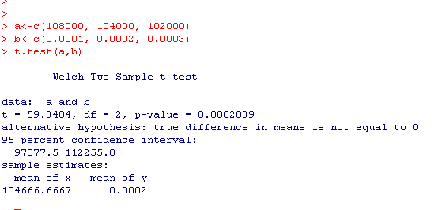
Some made up data:
The weight of three blue whales (kg) : 108000, 104000, 102000
The weight of three mice (kg): 0.0001, 0.0002, 0.0003
Null hypothesis: the weight of blue whales is the same at the weigh of mice
except for sampling error…
To use a t-test:
But this p-value is subject to the assumption of normality..

Slide 38
The Wilcoxon test. Replace each value by its rank.
Replacing an unknown distribution with a known one.
We ask.. What are the odds that we would see a separation of ranks as good
as the separation we did see..
The weight of three blue whales (kg) : 108000, 104000, 102000
The weight of three mice: 0.0001, 0.0002, 0.0003
Becomes….
The weight of three blue whales (kg) : 1,2,3
The weight of three mice: 4,5,6
We know (6,3) = 20.
We could choose 1,2,3 (with a prob. of 0.05) or 4,5,6 (with a prob. of 0.05).
Our p-value for the two-sided test is therefore .1
(or the one-sided test is 0.05)

Slide 39
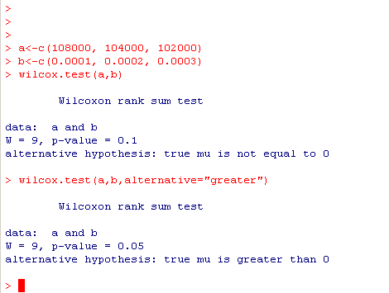
In R….

Slide 40
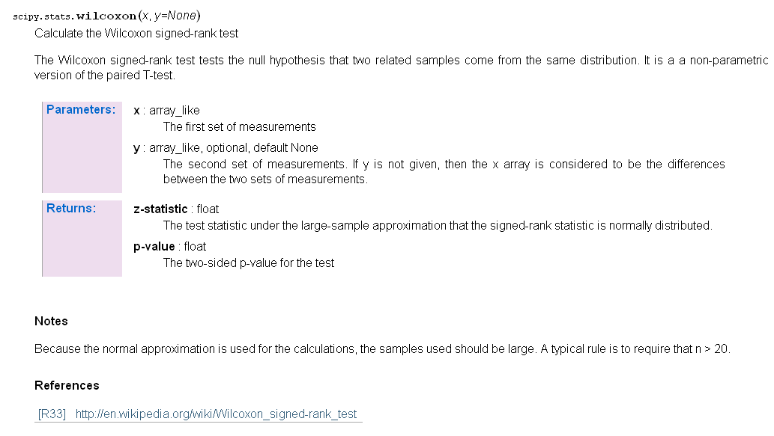
In scypy (but only for large sample sizes)

Slide 41

Wilcox.test has the options we have come to expect in R

Slide 42
Advantage of Wilcoxon test: No parametric assumptions!
Disadvantage: Low power for small sample sizes…
Often in genomics, we don’t have a big enough sample size to take
full advantage of the non-parametric tests..

Slide 43
T-test with equal variance and unequal variance
Paired t-test
The t-test in Java
Does a dataset meet the parametric assumptions?
Non-parametric equivalents to the t-test.
The algebra of linear regressions

Slide 44

Neter et al - Applied Linear Statistical Models

Slide 45


Linearity
Independence
Normality
Equal Variance
Neter et al - Applied Linear Statistical Models

Slide 46

This is the example from the 3rd edition of “Applied Linear Statistical Models” (3rd edition)
X <- c(30,20,60,80,40,50,60,30,70,60)
Y <- c(73,50,128,170,87,108,135,69,148,132)
plot(X,Y)

Slide 47

R has an extremely simple syntax for linear regression
> X <- c(30,20,60,80,40,50,60,30,70,60)
> Y <- c(73,50,128,170,87,108,135,69,148,132)
> myLinearModel = lm( Y ~ X )
The kinds of models are summarized on p. 50-1 in
“An introduction to R”

Slide 48
> X <- c(30,20,60,80,40,50,60,30,70,60)
> Y <- c(73,50,128,170,87,108,135,69,148,132)
> myLinearModel = lm( Y ~ X )
Hiding in that Y ~ X is an intercept and an error term
The full model is:
Y_{i} and X_{i} are the i th observation
B₀ and B₁ are parameters
ε_{i} is the error-term or i th residual
We seek parameters B₀ and B₁ that minimize the sum-squares of the error terms.

Slide 49

Neter et al - Applied Linear Statistical Models
Linearity
Independence
Normality
Equal Variance
σ² is the variance of the error terms

Slide 50

The actual value
The error
The expected value under the model
Assumption: The error terms are normally distributed with a constant variance ( σ² )
independent of the x-value
Neter et al - Applied Linear Statistical Models

Slide 51

We define two terms: MSE and SSE
We seek parameters for B0 and B1 that will minimize these terms
Neter et al - Applied Linear Statistical Models

Slide 52

R makes it easy to find these parameters
> X <- c(30,20,60,80,40,50,60,30,70,60)
> Y <- c(73,50,128,170,87,108,135,69,148,132)
> myLinearModel = lm( Y ~ X )
summary(myLinearModel)
Slope

Slide 53


You can also easily find these parameters with minimal programming…
Q =
We want to minimize Q
Neter et al - Applied Linear Statistical Models

Slide 54


Graphically, we want to find the minimum of the sumSquaredError function

Slide 55



Trivial to implement
In Python or Java
Neter et al - Applied Linear Statistical Models

Slide 56

We can find these coefficients with a trivial amount of code…

Slide 57
We can test the hypothesis that the slope = 0
H₀: The slope is zero
H₁: The slope is non-zero

Slide 58

This proof tells us how we can use the t-distribution to perform inference on our parameter
You are not responsible for the proof, but note the use of the assumptions….
Neter et al - Applied Linear Statistical Models

Slide 59



So a test that with a null hypothesis that the true slope (B1) = 0 is
b1 (estimated slope ) / s{b₁}

Slide 60



A trivial amount of code to do inference on
linear regression…

Slide 61




R can also just hand you the residuals
MSE =

Slide 62

SQRT(MSE)
A measure of how much is NOT explained by the model

Slide 63
A test that is useful much less often…
H₀: The intercept is zero
H₁: The intercept is non-zero

Slide 64




There is another path to inference based on ANOVA…
SSTO = SSE + SSR
ANOVA test partitions the “good” variance SSR vs.
the “bad” variance SSE.

Slide 65


Total Sum of Squares in R
or

Slide 66
Sum squared error in R

Slide 67

Regression squared sum in R:

Slide 68
SSTO = SSE + SSR
13600 = 60 + 13000
ANOVA test partitions the “good” variance SSR vs.
the “bad” variance SSE.

Slide 69

Define r-squared
Alternatively…
> cor(Y,X) * cor(Y,X)
[1] 0.9956076

Slide 70
Revisiting the assumptions:
Linearity
Independence
Normality
Equal Variance

Slide 71

Most straightforward thing to do is just look at the data
plot(X,Y)

Slide 72

Some built in graphs to help see how well you meet
the assumptions
> myLm <- lm(Y ~ X)
> plot(myLm)

Slide 73

Some built in graphs to help see how well you meet
the assumptions
> myLm <- lm(Y ~ X)
> plot(myLm)
or
qqnorm(residuals(myLm))
Deviations from line = non-normality

Slide 74
Next time:
Continuing linear models with the F-test and the ANOVA approach
to regression (chapter 3 in the 3rd edition of the Neter text book)

