Slide 1
Summary of inference models so far…
From the binomial to the normal
qqnorm
The Central Limit Theorem
Standard Normal Distribution
Preview: Chi-square and t-distributions

Slide 2
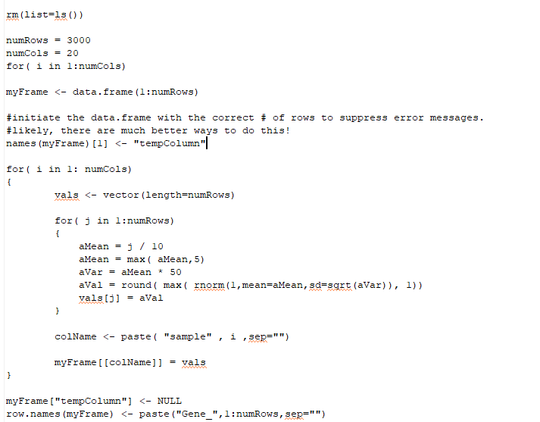
Consider code that generates a simulated dataset with 3,000 genes and 20 samples…
https://github.com/afodor/metagenomicsTools/blob/master/src/classExamples/modelsOnSimData.txt

Slide 3
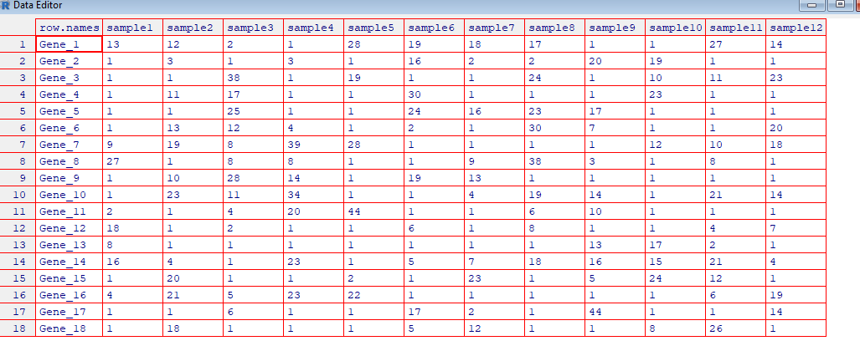
We end up with a simulated count table
20 samples
3,000 genes

Slide 4
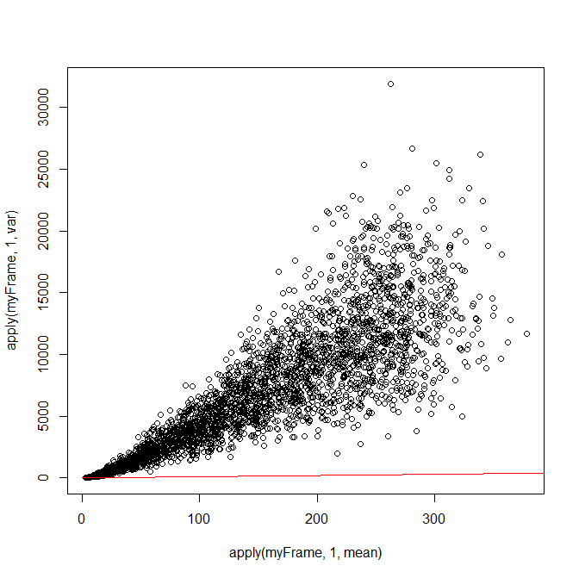
By design, the mean does not equal the variance
> plot( apply(myFrame,1,mean), apply(myFrame,1,var))
> lines( c(0:1000000), c(0:1000000), col="red")

Slide 5
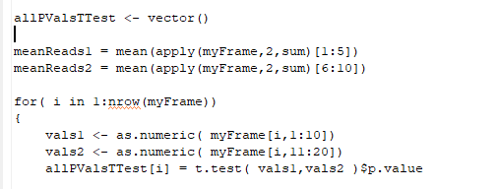
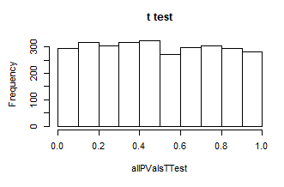
We say that the first 10 sample represent one condition (e.g. “cancer samples”) and
the last 10 columns represent another condition (e.g. “control samples”).
We can think of many statistical tests that will generate a frequentist p-value.
For example (coming up in the next few lectures), a t-test
hist(allPValsTTest, main="t test")
The t-test has an estimate for the variance and therefore produces an approximately uniform distribution
(for this case where the null hypothesis is always true)
https://github.com/afodor/metagenomicsTools/blob/master/src/classExamples/modelsOnSimData.txt

Slide 6
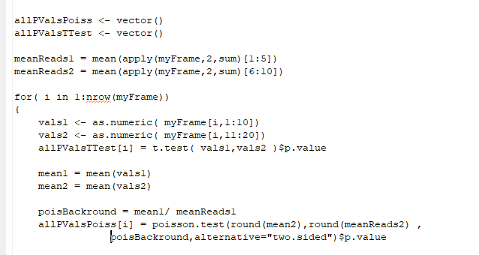
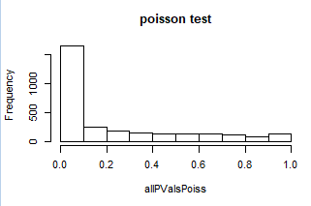
If we use a test on the Poisson distribution, the assumption that the mean equals the variance
causes the p-values to be too small…
https://github.com/afodor/metagenomicsTools/blob/master/src/classExamples/modelsOnSimData.txt

Slide 7
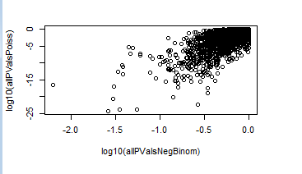
However, the Poisson test and the t-test generally agree on which are the most significant genes,
they just disagree on the magnitude of that significance
plot( log10(allPValsNegBinom), log10(allPValsPoiss))
The results of different statistical models are often disagreements about how to interpret the threshold of significance

Slide 8
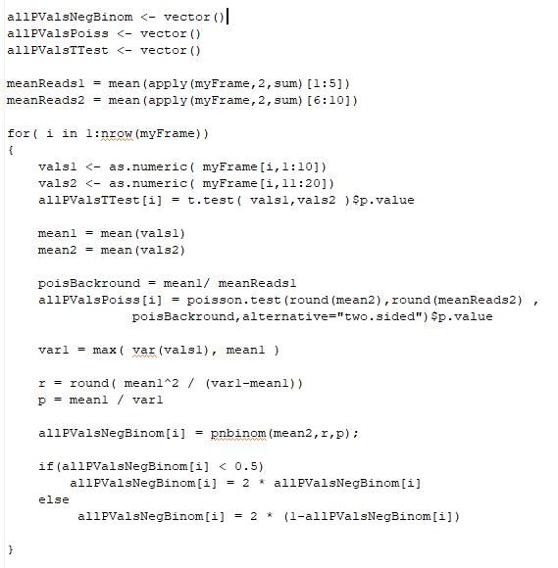
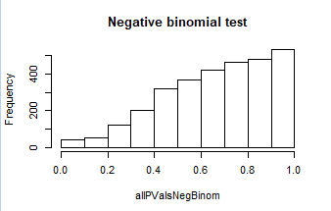
We can imagine a test based on the negative binomial distribution
(this is a drastic simplification of the DeSeq algorithm….)
hist(allPValsNegBinom,main="Negative binomial test")
Our approximate tests yields p-values that are
too conservative…

Slide 9
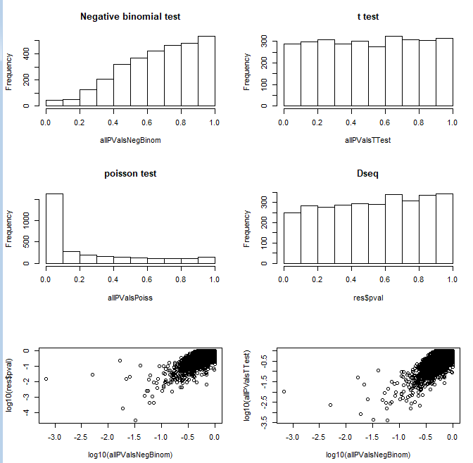
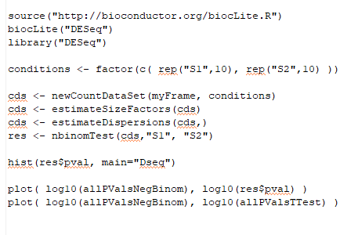
We can also run our data through DeSeq 1 (with the default “curve-fitting” for the variance)
This comes close to uniform (but not as close as
the t-test!)
But again, these different algorithms generally
agree on which genes are the most significant,but
disagree on how significant those genes are)

Slide 10
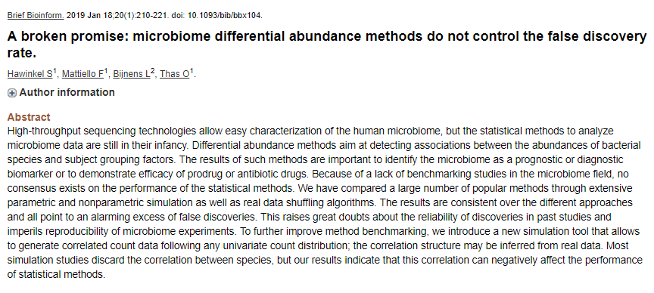
How to set threshold of significance in genomics is not a solved problem..

Slide 11
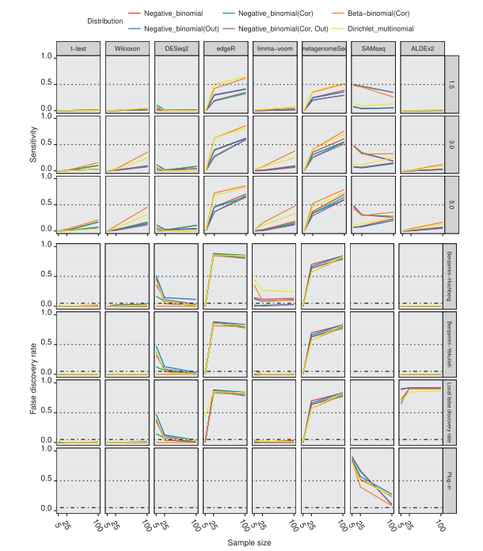
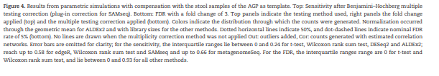
It is not difficult to find simulated datasets that “break”
the FDR thresholds produced by popular software
packages (such as DeSeq and FDR).
Often simpler models (such as the t-test and
Wilcoxon, that we will cover shortly) offer better
performance…

Slide 12
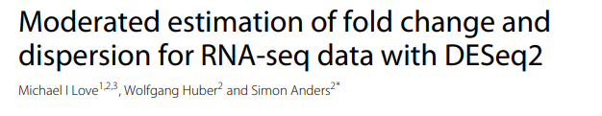
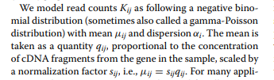

Methods are still being tweaked to find the appropriate balances between sensitivity and
reporting false positives…
DESeq2 continues to explore the correct ways to model variance
Introduces models of fold-change thresholds to help remove false positives
Replaces DESeq’s model of multiplying two negative binomial distributions together with a
more straight-forward generalized linear model
(We will cover generalized linear models later in the semester….)
But despite these tweaks, simpler models (like the t-test) remain viable…

Slide 13
Summary of inference models so far…
From the binomial to the normal
qqnorm
The Central Limit Theorem
Standard Normal Distribution
Preview: Chi-square and t-distributions

Slide 14
We’ve seen the Poisson distribution is an approximation to the binomial with large N
and small p.
Likewise, the normal distribution is an approximation to the binomial with a large N

Slide 15
Proving that the Gaussian distributions is the approximate limit of a binomial when N is large
is pretty involved…
http://mathforum.org/library/drmath/view/56600.html
You are not responsible for this proof!

Slide 16
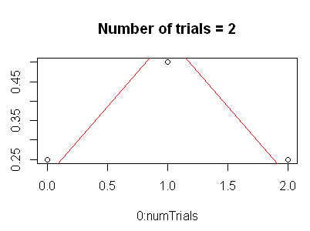
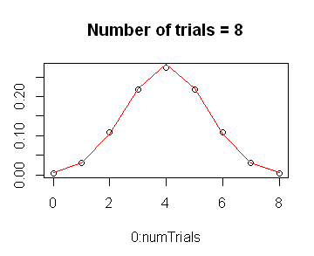
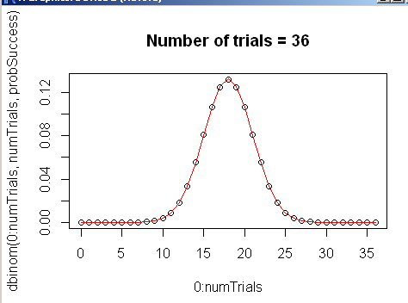
We can as usual demonstrate this effortlessly in R…
probSuccess = 0.5
for( numTrials in 2:500)
{
titleStr <- paste("Number of trials = ", numTrials,sep="")
plot( 0:numTrials, dbinom(0:numTrials, numTrials,probSuccess),main=titleStr)
lines( 0: numTrials, dnorm( 0:numTrials, mean=numTrials * probSuccess,
sd= sqrt(numTrials * probSuccess * (1-probSuccess))),col="RED");
Sys.sleep(1);
}
Note that N doesn’t have to get very large for the approximation to become quite good

Slide 17
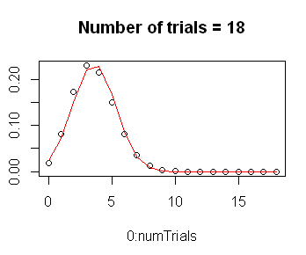
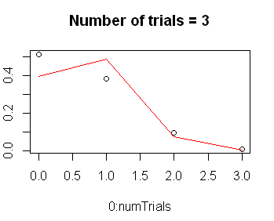
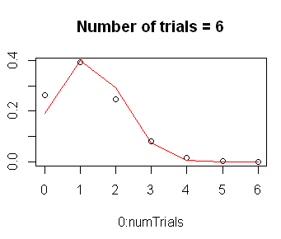
This works for p-values other than 0.5!
probSuccess = 0.2
for( numTrials in 2:500)
{
titleStr <- paste("Number of trials = ", numTrials,sep="")
plot( 0:numTrials, dbinom(0:numTrials, numTrials,probSuccess),main=titleStr)
lines( 0: numTrials, dnorm( 0:numTrials, mean=numTrials * probSuccess,
sd= sqrt(numTrials * probSuccess * (1-probSuccess))),col="RED");
Sys.sleep(1);
}

Slide 18
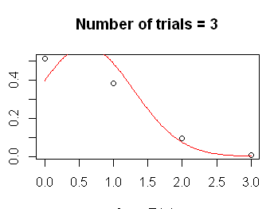
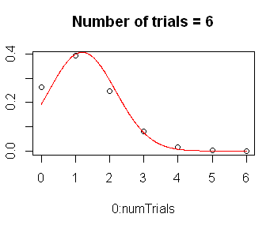
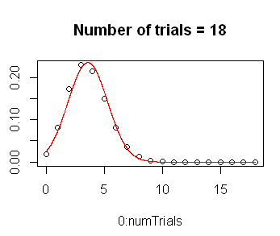
Of course, because the normal value is continuous, we can graph results intermediate
to the integer number of successes
probSuccess = 0.2
for( numTrials in 2:500)
{
titleStr <- paste("Number of trials = ", numTrials,sep="")
plot( 0:numTrials, dbinom(0:numTrials, numTrials,probSuccess),main=titleStr)
xVals <-seq( 0, numTrials,by=1/(numTrials*20))
lines( xVals, dnorm( xVals, mean=numTrials * probSuccess,
sd= sqrt(numTrials * probSuccess * (1-probSuccess))),col="RED");
Sys.sleep(1);
}
The continuous nature of the normal distribution makes it appropriate for non-count experiments
(such as microarrays)

Slide 19
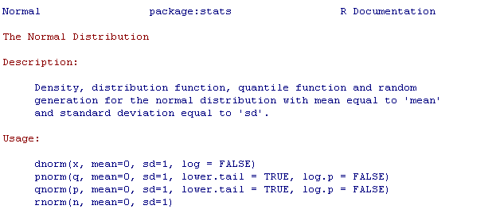
We have (as usual) dnorm, pnorm, qnorm, rnorm
dnorm – probability density function
pnorm - cumulative probability function
qnorm – inverse of pnorm
rnorm – generates random Gaussians

Slide 20
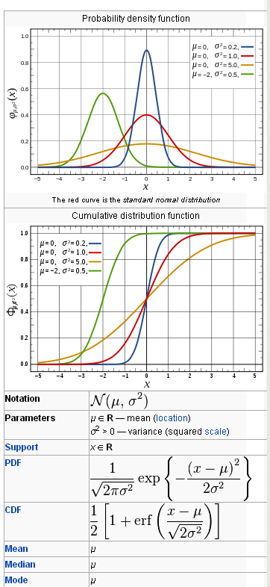

The PDF is defined in terms of the normal distribution’s mean and variance
http://en.wikipedia.org/wiki/Normal_distribution

Slide 21
Summary of inference models so far…
From the binomial to the normal
qqnorm
The Central Limit Theorem
Standard Normal Distribution
Preview: Chi-square and t-distributions

Slide 22


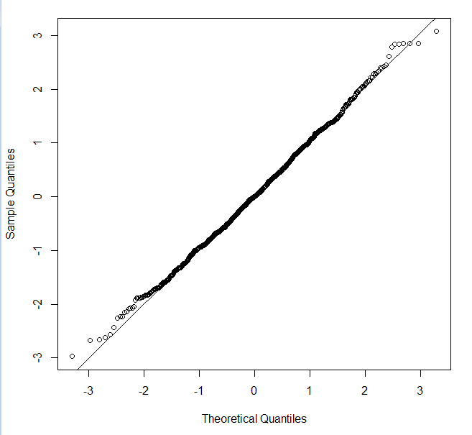
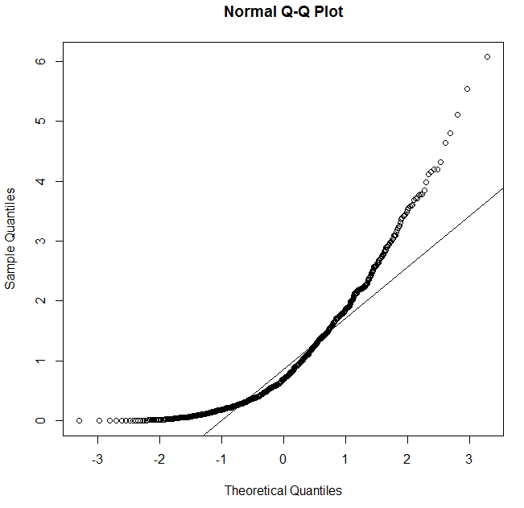
qqnorm and qqline can be used very quickly to visually tell if a distribution is normal

Slide 23
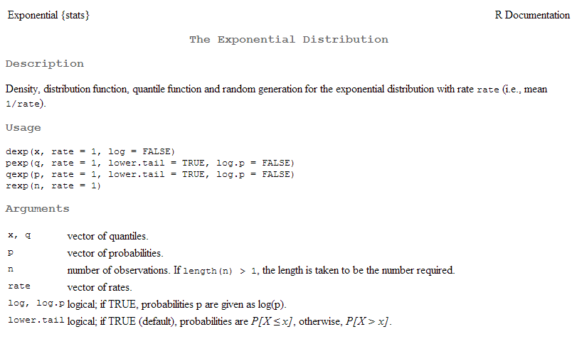
(A non-normal distribution….)

Slide 24
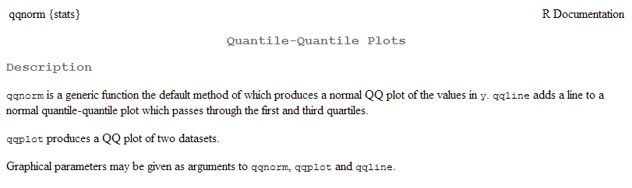

Slide 25
Summary of inference models so far…
From the binomial to the normal
qqnorm
The Central Limit Theorem
Standard Normal Distribution
Preview: Chi-square and t-distributions

Slide 26
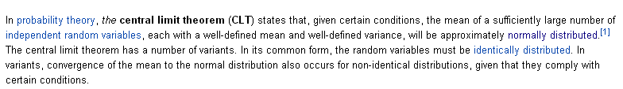
The central theorem gives us a surprising fact about the normal distribution!
http://en.wikipedia.org/wiki/Central_limit_theorem
The central limit theorem applies when you are taking the mean of a
distribution where each sample comes from a distribution with a constant mean and variance
and the samples are identically and independently distributed.

Slide 27
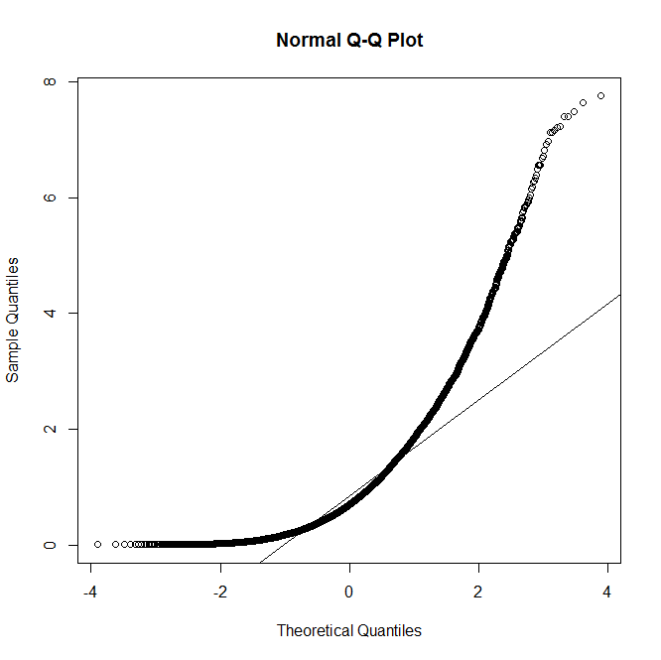
So here is an example of a random variable that is not normally distributed
someDist <- function() { x <- rexp(1)}
sampleSize <- 10000
results <- vector(length=sampleSize)
for( i in 1:sampleSize)
results[i] <- someDist()
myHist <- hist(results,breaks=50)
plot(myHist$breaks, myHist$density[1:length(myHist$breaks)])
lines( myHist$breaks, dnorm(myHist$breaks,mean=mean(results),sd=sd(results)),col="RED")
windows()
qqnorm(results) ; qqline(results)
We sample the exponential distribution (at n=1) and it absolutely not normal!

Slide 28
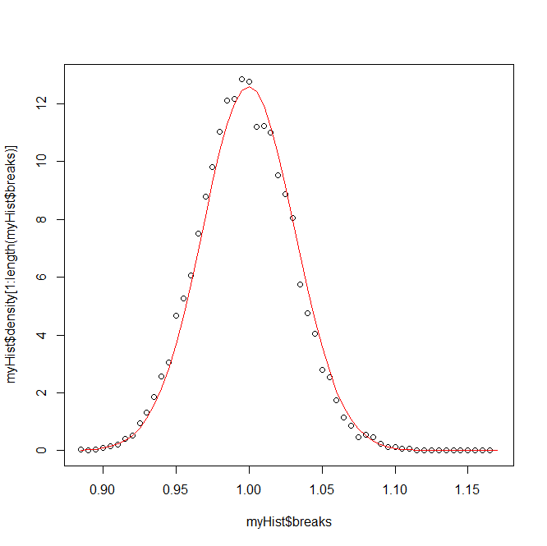
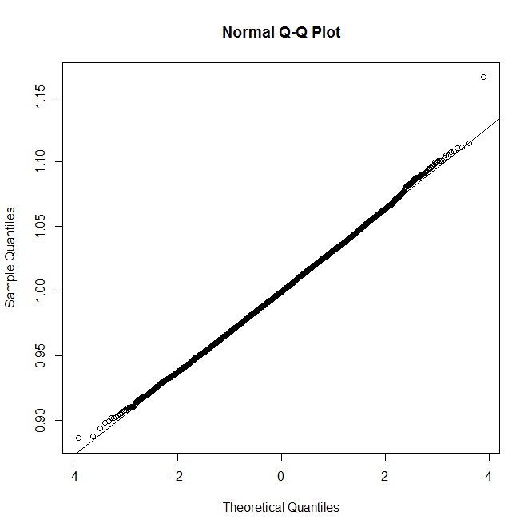
Now we take the average of the distribution (instead of a single read from the distribution)
Generate 1,000 numbers
someDist <- function() { x <- rexp(1000) }
sampleSize <- 10000
results <- vector(length=sampleSize)
for( i in 1:sampleSize)
results[i] <- mean( someDist())
myHist <- hist(results,breaks=50)
plot(myHist$breaks, myHist$density[1:length(myHist$breaks)])
lines( myHist$breaks, dnorm(myHist$breaks,mean=mean(results),sd=sd(results)),col="RED")
windows()
qqnorm(results) ; qqline(results)
Store the average of those 1,000 numbers
As advertised, the results are nearly perfectly normally distributed!

Slide 29
What the central theorem does say:
Taking the mean from an idd distribution will (eventually) lead to a normal
distribution
What the central theorem does not say:
Your particular dataset is normal
In biology, unfortunately, datasets are often not normally distributed.
Sample size may be insufficient for central limit theorem to kick in.
Sampling may not be from the same distribution across subjects.
(What actin does in patient X is different from patient Y)
We will still have to test for normality before applying parametric statistics!

Slide 30
Summary of inference models so far…
From the binomial to the normal
qqnorm
The Central Limit Theorem
Standard Normal Distribution
Preview: Chi-square and t-distributions

Slide 31

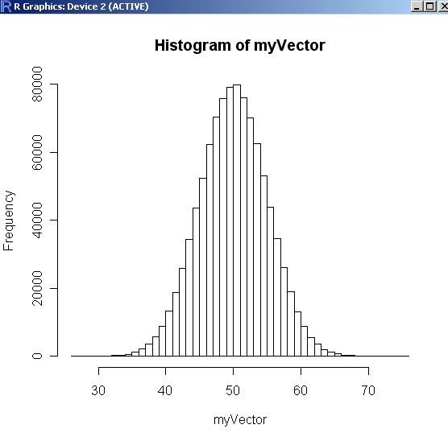
If you add a subtract a constant to a normally distributed
set of values, they are still normally distributed…
“Before”
Centered at 50

Slide 32

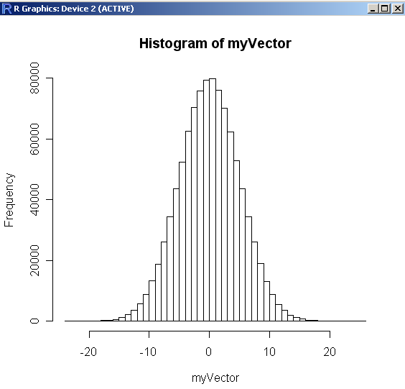
“After”
Now centered at 0

Slide 33
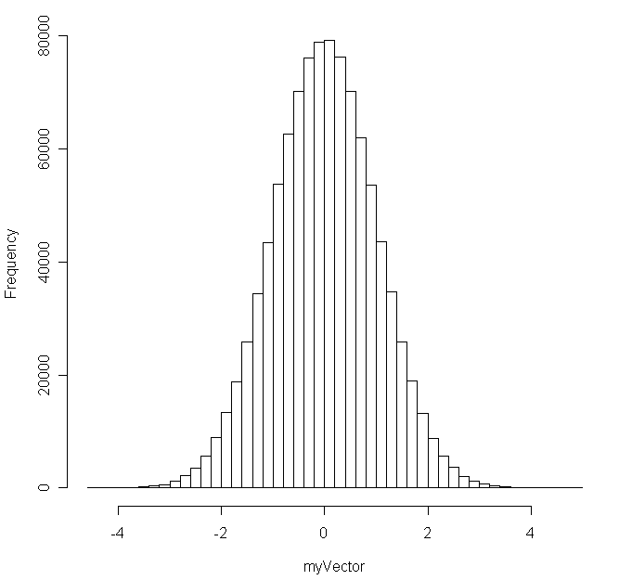
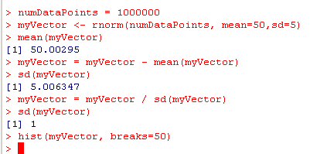
Likewise if you divide a normally distributed set of values
by a constant, it is still normally distributed…
All we’ve done is
re-scale the x-axis here

Slide 34
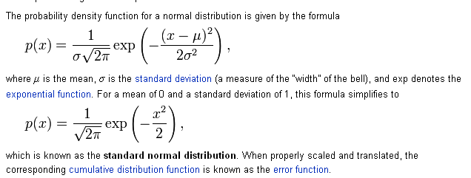
We define a standard normal distribution as a normal
distribution with mean=0 and SD = 1
Given any normal distribution, we can transform it to the
standard distribution via
Y is some random variable
u is the mean of that variable
s is the sd of that variable
Z = Y – u
s
http://en.wikipedia.org/wiki/Normal_distribution

Slide 35
False Discovery Rate
From the binomial to the normal
qqnorm
The Central Limit Theorem
Standard Normal Distribution
Preview: Chi-square and t-distributions

Slide 36
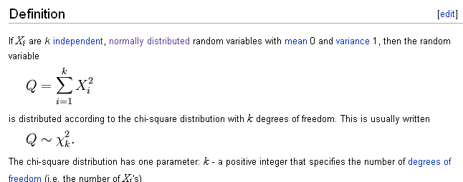
From the uniform normal distributions, we define the chi-square distribution
http://en.wikipedia.org/wiki/Chi-square_distribution

Slide 37
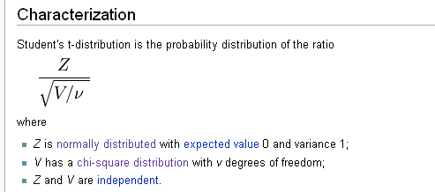
And we build on both to make the t-distribution…
With the z distribution, chi-square distribution and t-distribution,
we will have the z-test, chi-square test and t-test.
And we will talk about those next time…
Review t-test and chi-square test from your 1st semester stats book

Slide 38
Reading:
Canonical statistics text book through t-test and t-distribution

