Slide 1
Using Hidden Markov Models for Ion Channel Biophysics
Using Hidden Markov Models for finding protein domains
Estimating unknown parameters

Slide 2
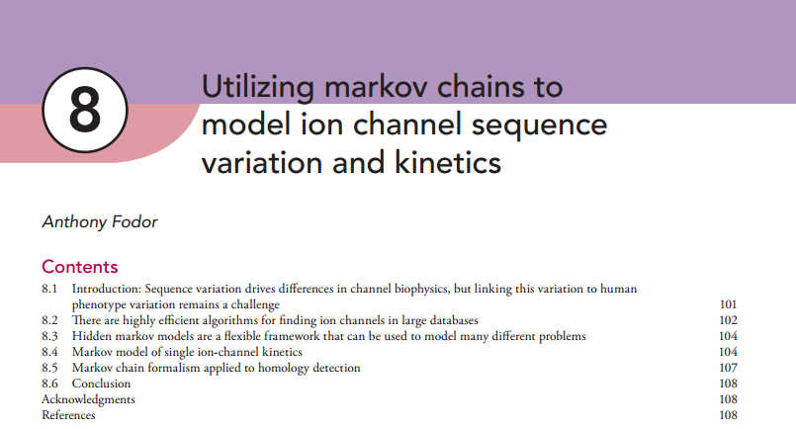
http://afodor.github.io/classes/stats2016/chapter.pdf

Slide 3
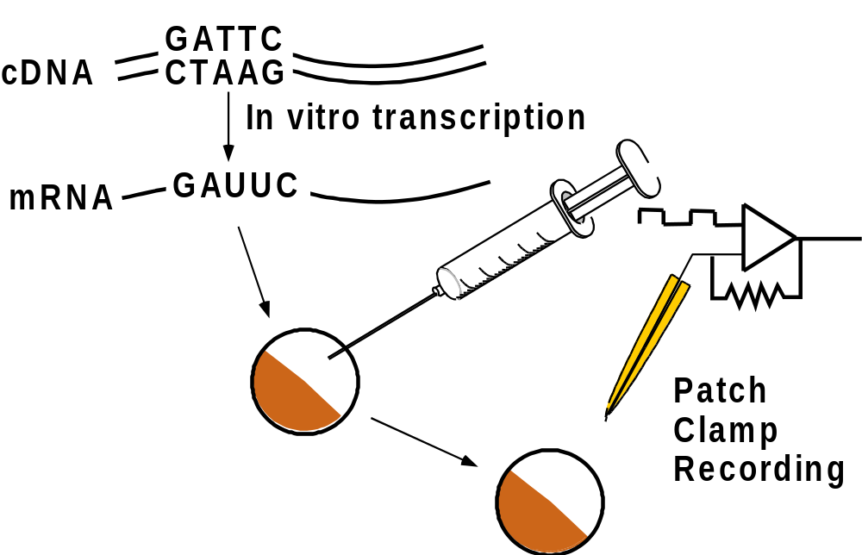
Expression System

Slide 4
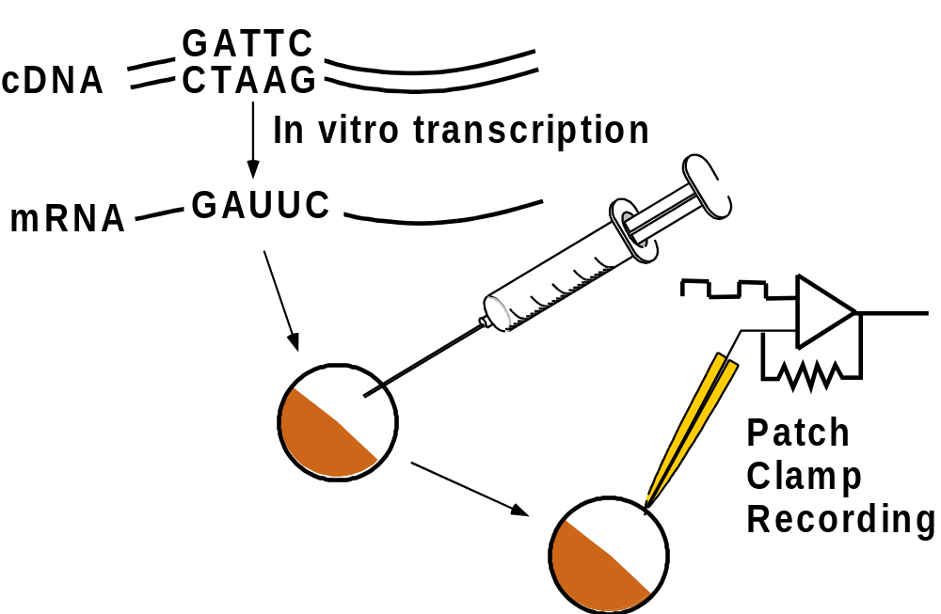
Expression System

Slide 5
Expression System

Slide 6



An isolated ion channel in symmetrical
cation solution
+
Apply a positive voltage to the bath.
Establish a driving force to move
ions through the channels into the pipette.

Slide 7


An isolated ion channel in symmetrical
cation solution
+
Apply a positive voltage to the bath.
Establish a driving force to move
ions through the channels into the pipette.

Slide 8

An isolated ion channel in symmetrical
cation solution
+
Apply a positive voltage to the bath.
Establish a driving force to move
ions through the channels into the pipette.

Slide 9
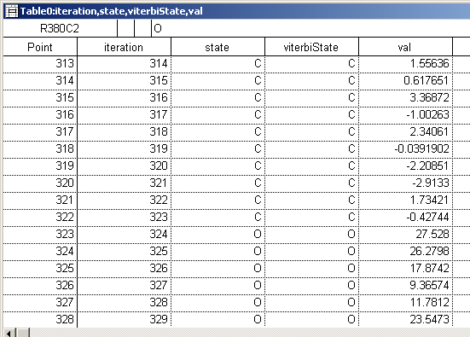
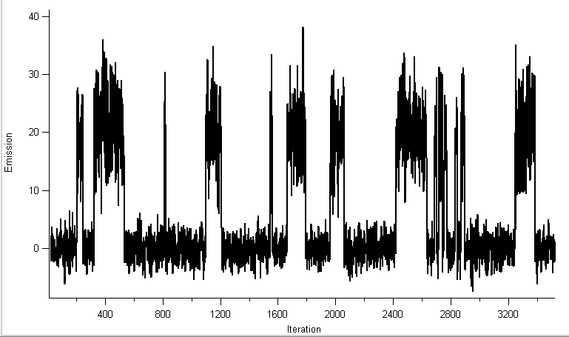
Emissions do not have to be discrete….
Here we put Gaussians in our HMM
“real data”
Mean=0
SD=2
Mean=20
SD=5
Closed (O)
Open (O)
We generate amazingly detailed simulated data from our simple model

Slide 10
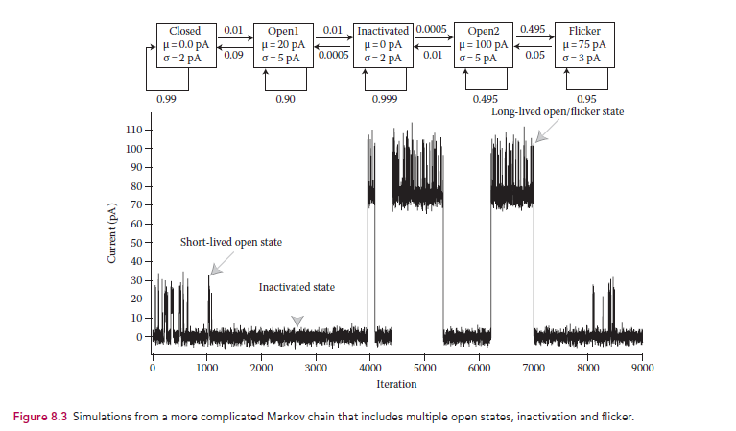

Slide 11
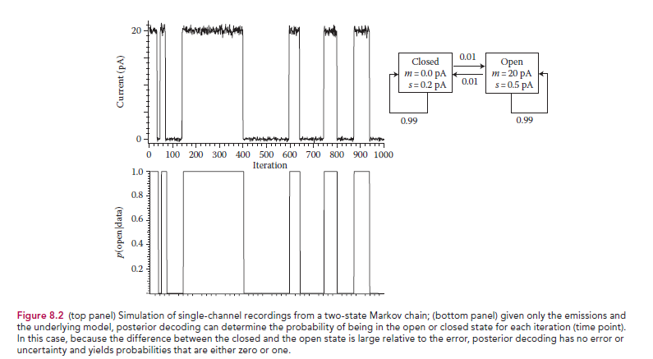
We use the same posterior decoding algorithm we developed last time here as a signal filter…
https://github.com/afodor/IonChannelHMMs/blob/master/IonChannelHMMs/src/gaussianMarkovModels/GenerateChainFromGaussianModel.java

Slide 12
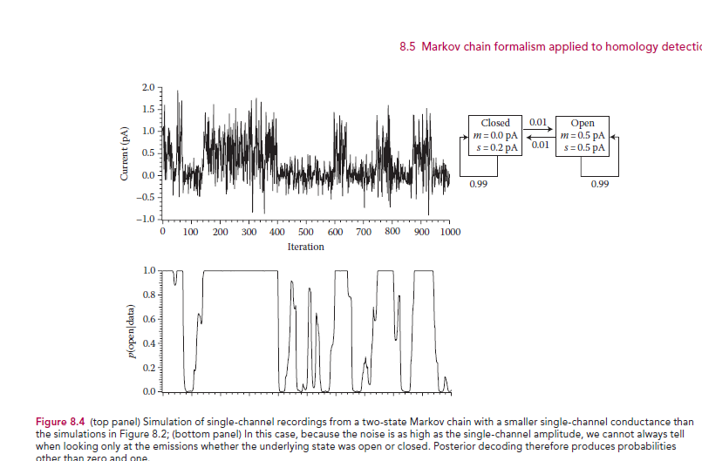
On nosier data, we approach the Bayesian limit and get probabilities other than 0 or 1
https://github.com/afodor/IonChannelHMMs/blob/master/IonChannelHMMs/src/gaussianMarkovModels/GenerateChainFromGaussianModel.java

Slide 13
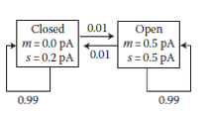
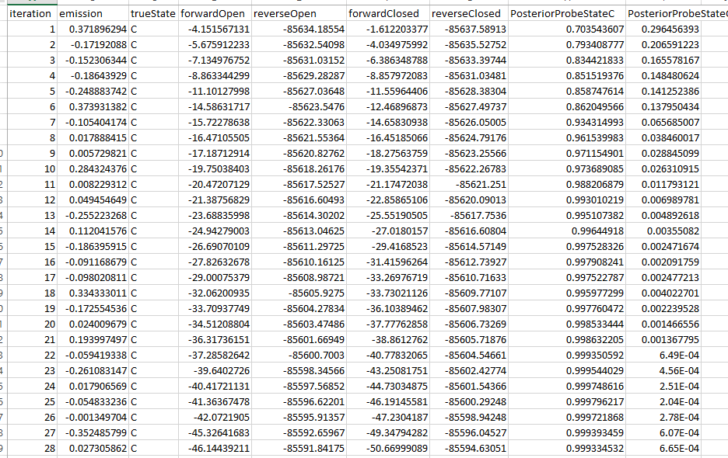
The posterior decoding is the same forward/backward algorithm
The emission probabilities now come from dnorm (rather than the multinomial distribution)
https://github.com/afodor/IonChannelHMMs/blob/master/IonChannelHMMs/src/gaussianMarkovModels/GenerateChainFromGaussianModel.java

Slide 14
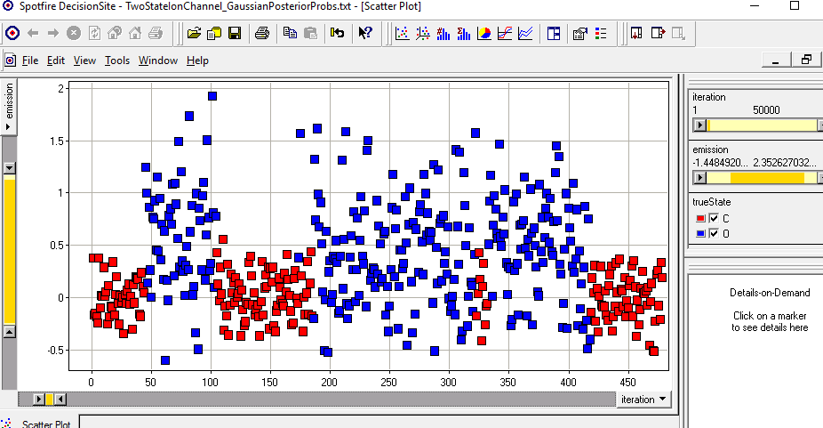
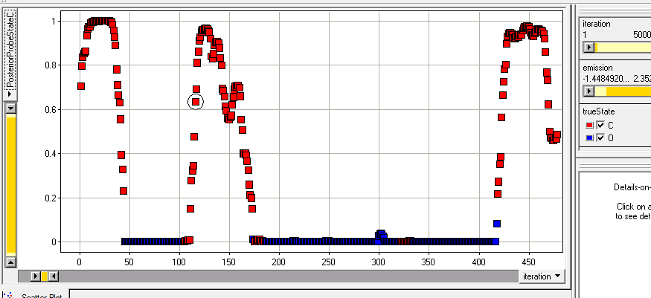
emission
iteration
P(closed|data)

Slide 15
Using Hidden Markov Models for Ion Channel Biophysics
Using Hidden Markov Models for finding protein domains
Estimating unknown parameters

Slide 16
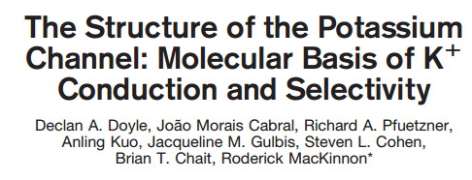
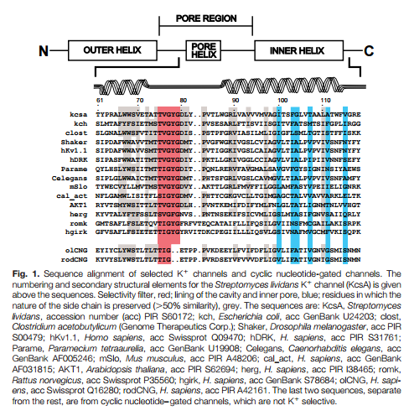
Consider a protein alignment…
We would like an algorithm to find more
proteins that belong to this alignment

Slide 17
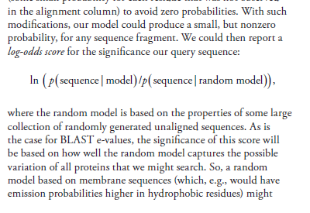
We could recognize one scoring scheme as the familiar log-odds score
How do we calculate p(sequence|model) for an alignment?
http://afodor.github.io/classes/stats2016/chapter.pdf

Slide 18
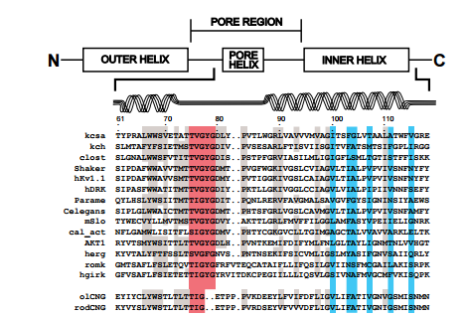
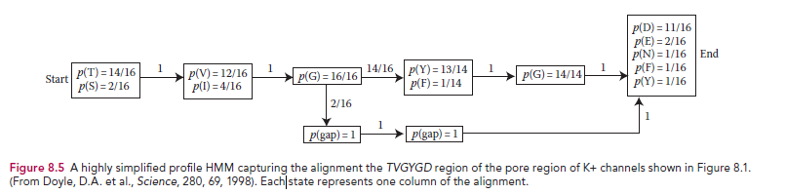
One possibility is posterior decoding from an HMM
We translate our alignment to an HMM
We can then walk along a query sequence; for each residue in the query sequence,
what is the probability that that sequence came from the alignment..

Slide 19
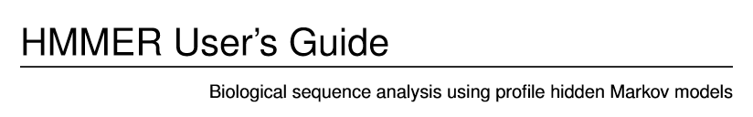
This yields a (highly simplified) view of how the PFAM database works..
For (much much) more information…
http://eddylab.org/software/hmmer3/3.1b2/Userguide.pdf

Slide 20
Using Hidden Markov Models for Ion Channel Biophysics
Using Hidden Markov Models for finding protein domains
Estimating unknown parameters

Slide 21
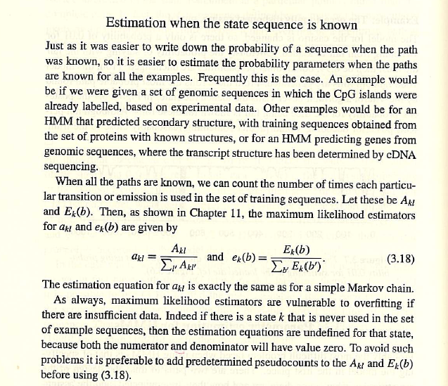
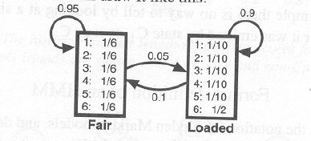
How do we find parameters if we don’t know them?
π
E
If you know π, the parameters are just fitted from the frequencies.
If in the loaded state, you see that 50% of your rolls are 6s then E_{loaded}(6)=0.5.
If 90% of the time you stay in the loaded state, then a_{loaded}__{loaded}=0.9

Slide 22
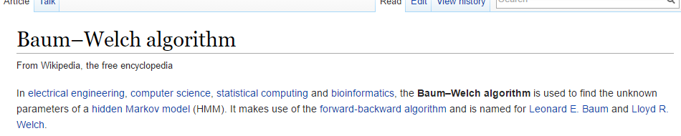
Much more interesting is when you don’t know the state path.
All you have is a model (with no parameters) and the emissions..
https://en.wikipedia.org/wiki/Baum%E2%80%93Welch_algorithm
The Baum-Welch algorithm is not unrelated to MCMC algorithms we used
earlier in the semester…
At this late point in the semester, we skip the details on how the fit occurs!
(Would take a few weeks!)

Slide 23
At this late point in the semester, you are not responsible for the details
on how the fit occurs!(Would take a few lectures!)
There is an implementation here for Gaussian emissions:
https://github.com/afodor/IonChannelHMMs/blob/master/IonChannelHMMs/src/gaussianMarkovModels/GaussianBaumWelch.java
for discrete emissions:
https://github.com/afodor/IonChannelHMMs/blob/master/IonChannelHMMs/src/markovChain/BaumWelch.java

Slide 24
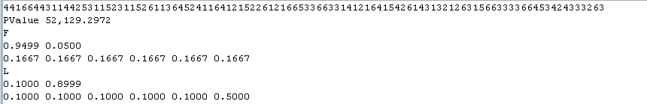
I start with our dishonest casino
-log( p(X))
transmission
emission
Our starting parameters

Slide 25
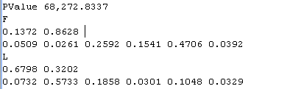
I start with our dishonest casino
Let’s stay I don’t know the parameters and just guess them….
The sequence is much less probable
with random parameters

Slide 26
I start with our dishonest casino
Let’s stay I don’t know the parameters and just guess them….
The sequence is much less probable
with random parameters
The Baum-Welch procedure will iteratively adjust the parameters in
order to make the model more probable…
(Like the MCMC algorithms we used earlier…)
It is dependent on the initial guess.
It can get “stuck” in local mimima

Slide 27
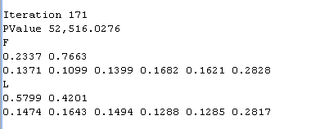
Baum-Welch can get stuck in in-correct local minimums!
Before scramble
After scramble
I run 171 interations of the BaumWelch to
search for better (more likely) parameters
The model’s p(X) is much more likely
171 iterations later, an alternative solution
We change dice frequently
Both dice have more of a chance of a 6

Slide 28
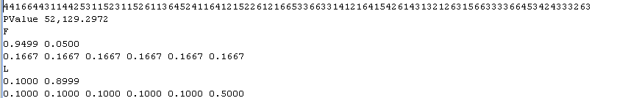
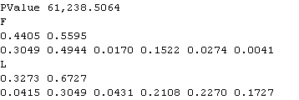
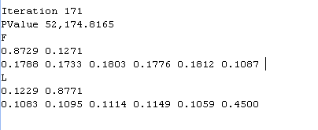
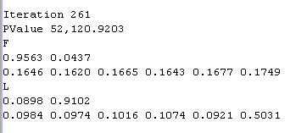
Another run (choosing different random initial parameters ) finds the “correct” (original) solution…
Before scramble
After scramble

Slide 29
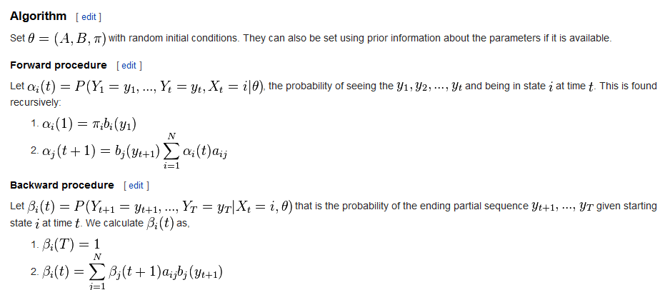
The details you are not responsible for on the final….
Forward algorithm (based on current guess
of transition and emission parameters)
Backwards algorithm (based on current guess
of transition and emission parameters)
https://en.wikipedia.org/wiki/Baum%E2%80%93Welch_algorithm

Slide 30
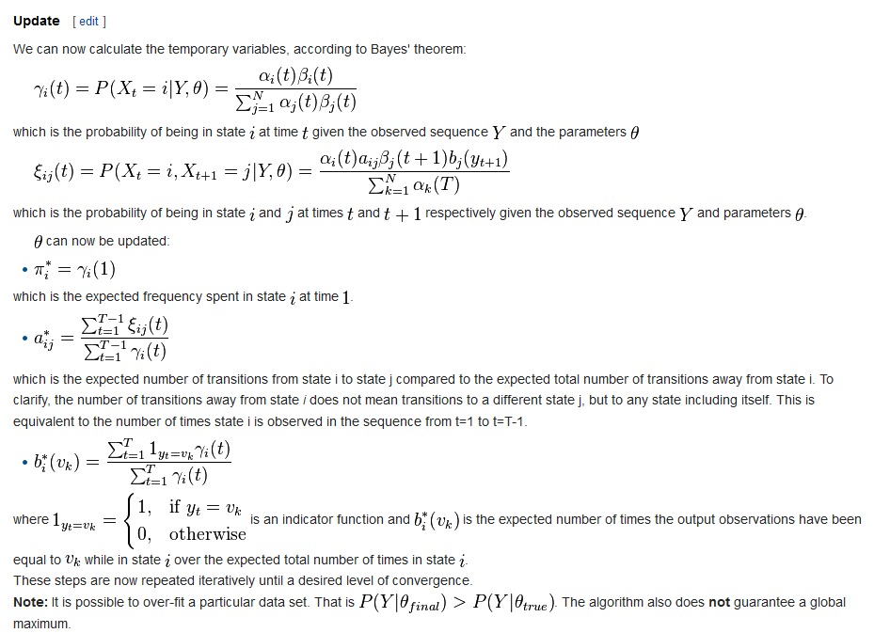
Posterior probability given the current
estimates of forwards and backwards
How frequently you go from i to
j from all the old parameters
Update the transition parameters
Update the emission parameters
Proof of why this works is here: http://www.nature.com/nbt/journal/v26/n8/extref/nbt1406-S1.pdf

Slide 31
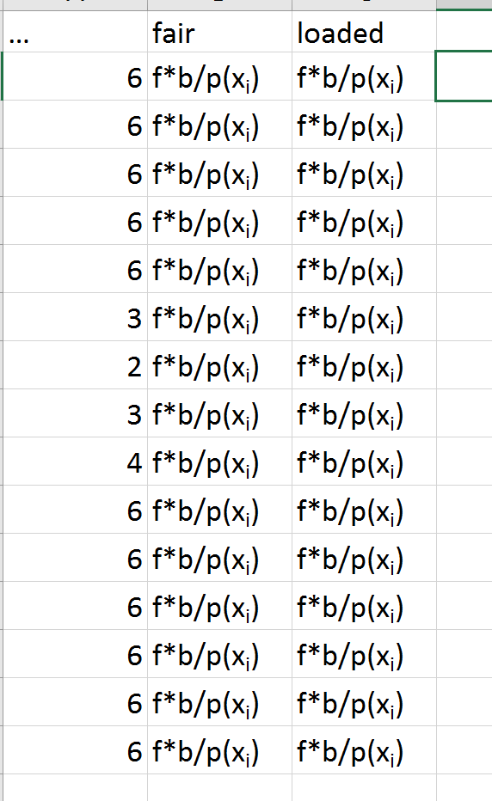
Say we are in a string of rolls from
our dishonest casino….
We have guessed a uniform
distribution for loaded state.
Our forwards and backwards
algorithms are dependent on these
guesses…
We end up with a set of probabilities.

Slide 32
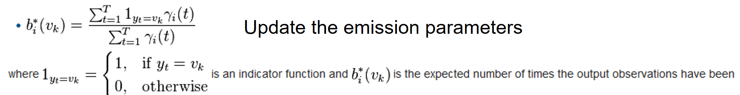
Because we start with a uniform distribution, f*b/p(x_{i}) won’t be higher for 6
in the loaded state, but there are more 6s than non-sixes
At each iteration, when we re-normalize we note that a higher overall probability
is associated with the “6” emission (just because there are more of them)

