Slide 1
Approaches to column normalization
P-values from two conditions under the negative binomial
Our example dataset through DeSeq
False Discovery Rate

Slide 2
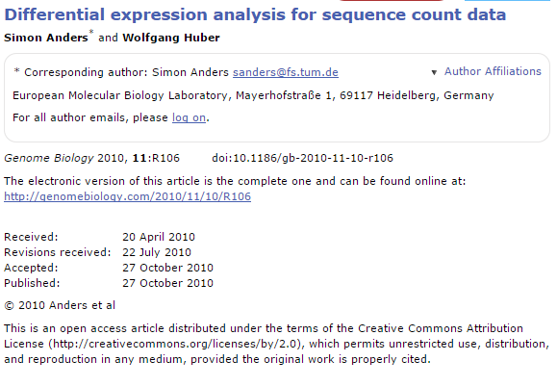
In today’s lab, we will fit the Poisson distribution to this mouse/E. Coli dataset.
We will see that this is a poor model..
In next week’s lab, we will use a better model based on the negative binomial distribution.
To fit the negative binomial distribution to our dataset, we need to have a strategy to:
(i) deal with the fact that different samples have different numbers of sequences
(ii) choose a strategy to estimate mean and variance for each gene.
(iii) use those means and variances to produce p-values from the negative binomial
distribution
We follow the logic and equations in this paper:

Slide 3
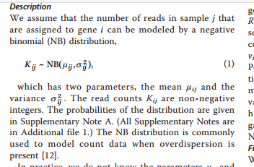
j is an index for samples (columns in our spreadsheet)
i is an index for genes (rows in our spreasheet)
K_{ij} is the # of counts in each cell

Slide 4

Our first step; normalization….
Each sample in our spreadsheet has a different number of sequences.
We need to correct for this (so that we don’t just reflect in our p-values
that there were more sequences in one sample).
This is a highly controversial and complex question that we will
touch on repeatedly over the semester…

Slide 5
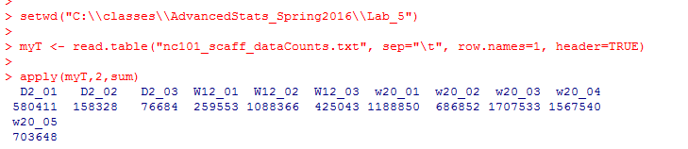
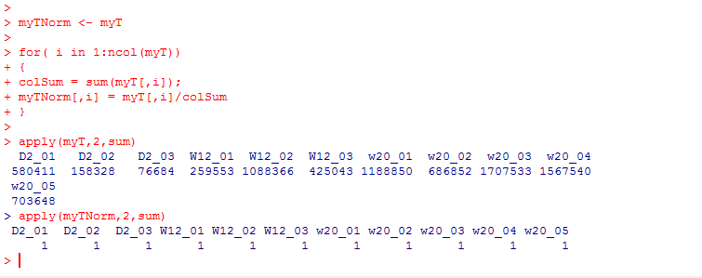
These few lines of code give us the # of sequences in each sample….
“apply” sum to the columns of myT
(if the 2nd parameter were 1, it would be applied to the rows)
One simple normalization scheme is to divide each cell by the sum in the column.
This converts each gene to relative abundance…
https://github.com/afodor/metagenomicsTools/blob/master/src/classExamples/compareNormalizations.txt

Slide 6
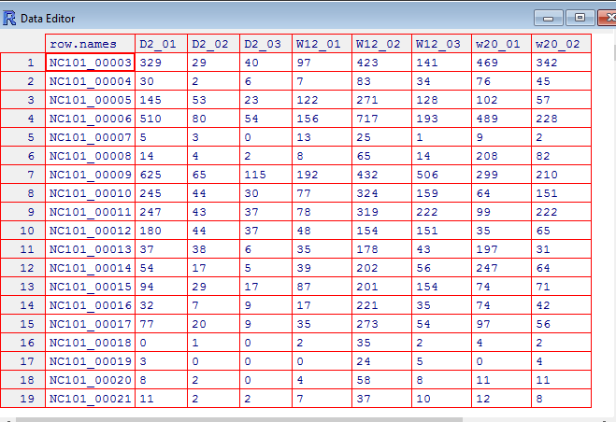
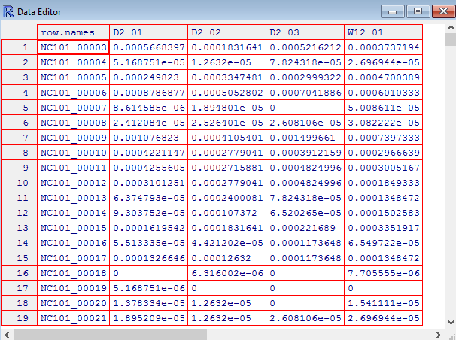
Relative abundance changes counts to fractions (that sum to 1 in each sample)
edit(myT)
edit(myTNorm)

Slide 7
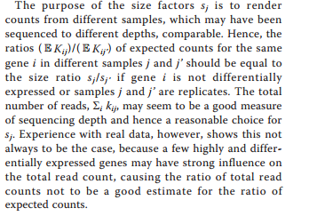
Many people have problems with relative abundance normalization, including the dseq authors
j is an index for samples (columns in our spreadsheet)
i is an index for genes (rows in our spreasheet)
K_{ij} is the # of counts in each cell
They are concerned that outliers may cause problems…
There is also the compositionality problem (which we may talk about more later…)

Slide 8
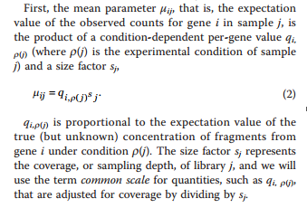
The DeSeq paper formalism describes a “true” expression level and a scaling factor…
q is the true fraction of gene expression under condition p(j)
(in our spreadsheet, p(j) gives us the time 2 weeks, 12, or 20 weeks)
S_{j} is the scaling factor – a normalization factor that will be different for different samples
j is an index for samples (columns in our spreadsheet)
i is an index for genes (rows in our spreasheet)

Slide 9
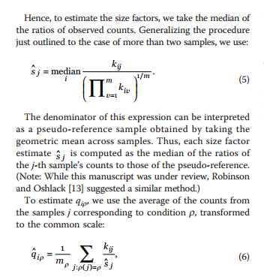
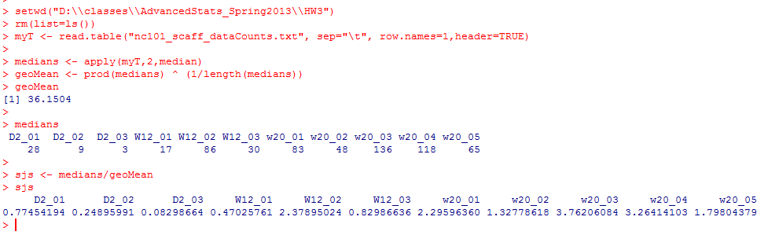
DeSeq proposes an alternative to simple relative abundance….
Geometric mean is sometimes
considered a more robust alternative
to average
To estimate S_{j}, we take the median of each column (and divide by some normalizing constant)

Slide 10
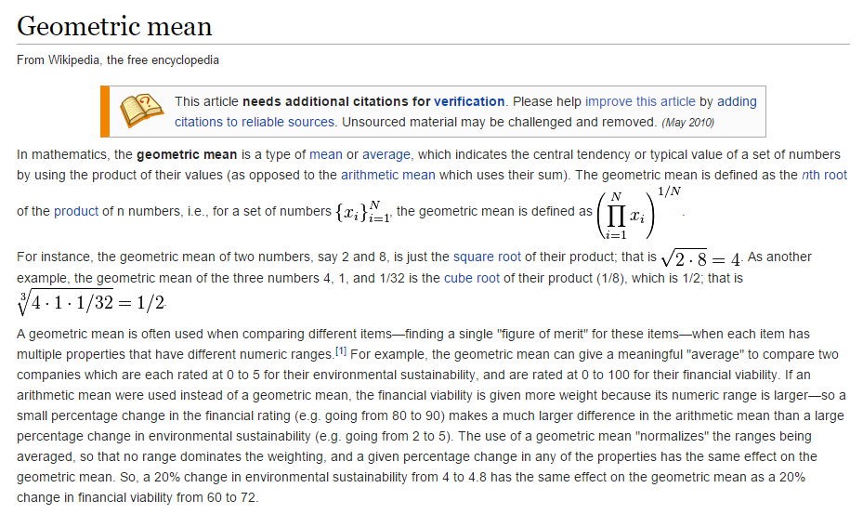

Slide 11
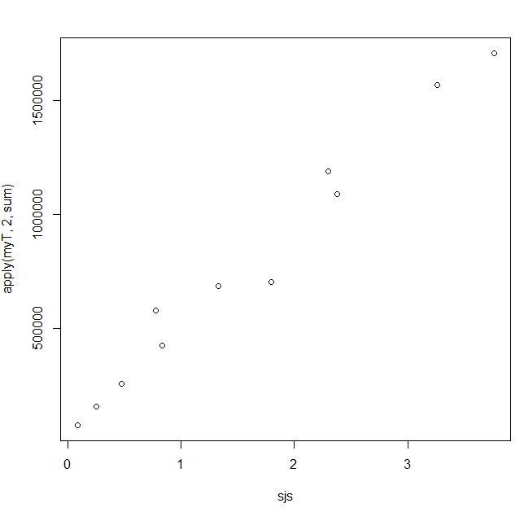
Despite the extra terms, Deseq’s sjs are closely related to the more simple metric
of sequencing depth
plot( sjs, apply(myT,2,sum))
# of replicates in each condition
So in practice (at least for this dataset), dividing by Sj is not that different from
simple relative abundance…

Slide 12
We can use the DeSeq formalism to take weighted averages across our three timepoints
(2 weeks, 12 weeks and 20 weeks)
q_{ip}
will be our estimate of expression, normalized by scaling factor
The times (the p(…) ) in our spreadsheet can be defined by columns…

Slide 13

rm(list=ls())
twoWeeks <- 1:3
twelveWeeks <- 4:7
twentyWeeks <- 7:11
myT <- read.table("nc101_scaff_dataCounts.txt", sep="\t", row.names=1,header=TRUE)
myT <- myT + 1
twoWeeks <- 1:3
twelveWeeks <- 4:7
twentyWeeks <- 7:10
medians <- apply(myT,2,median)
geoMean <- prod(medians) ^ (1/length(medians))
sjs <- medians/geoMean
getQsVals <- function( myT, sjs, range )
{
qs <- vector(length=nrow(myT))
for( i in 1:nrow(myT) )
{
sum = 0;
for ( j in range)
{
sum = sum + myT[i,j] / sjs[j]
}
qs[i] = sum / length(range);
}
return(qs)
}
qsForTwoWeeks <- getQsVals(myT,sjs, twoWeeks)

Slide 14
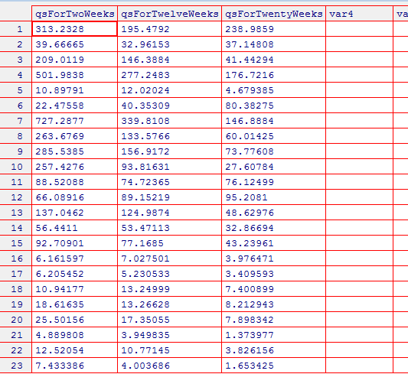
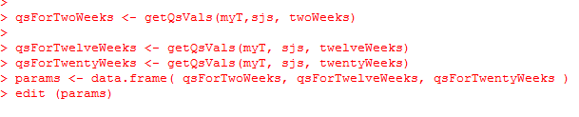

Slide 15
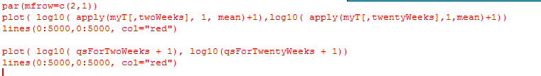
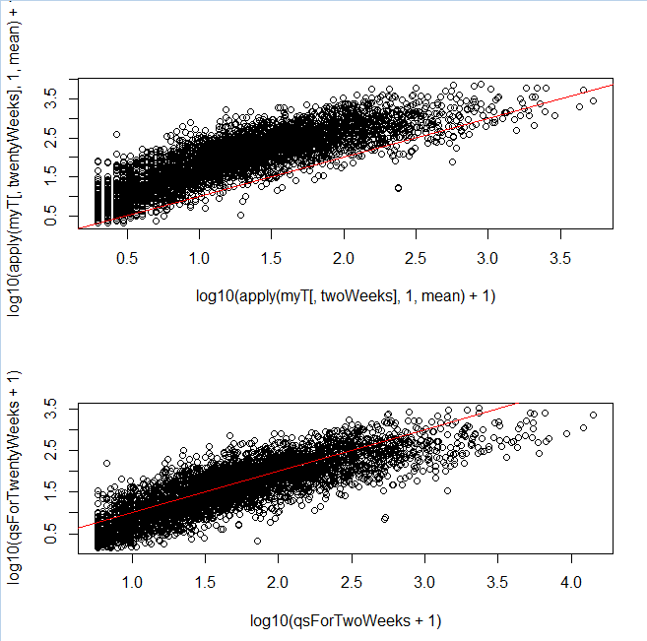
Our normalization makes the different samples more directly comparable…
Without normalization
You can see a local
regression might
have done better!
With normalization

Slide 16
What about the variance?
You might think the variance within a condition would just be something like…
varTwoWeeks <- apply( myT[,twoWeeks], 1, var )
varTwelveWeeks <- apply( myT[,twelveWeeks], 1, var )
varTwentyWeeks <- apply( myT[,twentyWeeks], 1, var )
That is just canonical variance defined within each category
There are going to be numerous reasons why this will not be the variance used in DeSeq

Slide 17
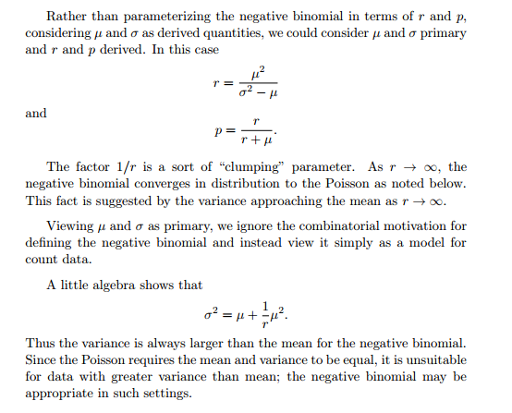
One problem is that the negative binomial distribution is not defined when the variance <= mean!
So if we are going to use the negative binomial, we have to define
the variance as the mean plus something…
http://www.johndcook.com/negative_binomial.pdf

Slide 18

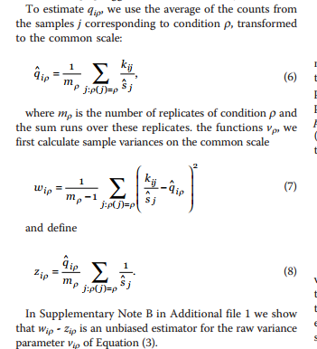
So if we are going to use the negative binomial, we have to define
the variance as the mean plus something…
What the variance would
Be under the poisson
The extra variance
associated with the
negative binomial
Weighted canonical variance
Weighted mean
Raw variance = weighted canonical variance (wip) – weighted mean (zip)
We will see that DeSeq never quite settles on a single way to measure the variance…

Slide 19
Approaches to column normalization
P-values from two conditions under the negative binomial
Our example dataset through DeSeq
False Discovery Rate

Slide 20
From last time, we saw how the negative binomial defines the mean and the variance
while (i) normalizing for different numbers of sequences per lane and (ii)
ensuring that the variance is always higher than the mean
But once you have the mean and the variance for two conditions, how do you perform
gene by gene inference to generate p-values for the null hypothesis of no differential
expression?
We saw a simple way to do this in Lab #6, but DeSeq’s path is a little more complex..

Slide 21
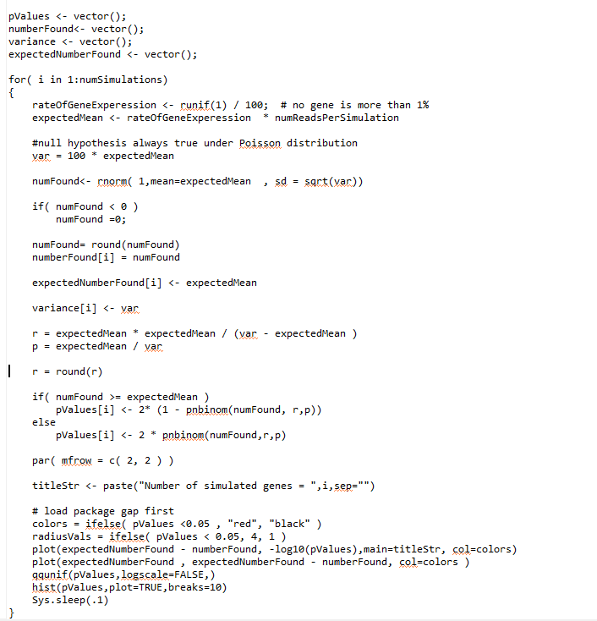
In our previous simulation
we’ve shown that the negative
bimomial can deal with sampling
with non-constant variance.
But that was testing one sample
against a know mean and variance…
We calculate r and p
under our null hypothesis
This is two-sided test

Slide 22
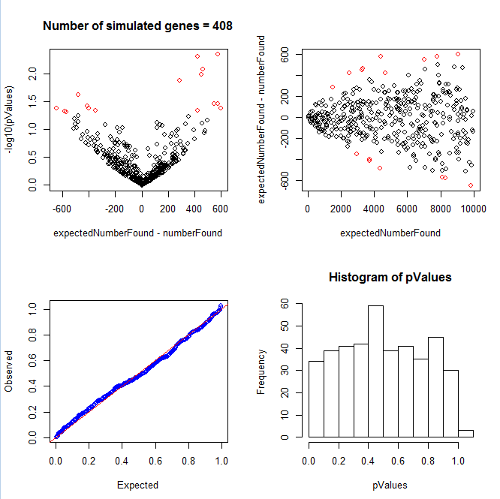
Sampling from a known mean and non-constant variance results in a uniform distribution of p-values

Slide 23
Consider a case where in condition A I have 1,000 reads…
In condition B, I have 1,500 reads.
(Here we don’t consider replicate samples and we assume that the scaling factor Sj is
just 1 for all samples…)

Slide 24
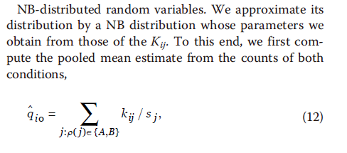
Our algorithm for inference….
Test the null hypothesis that the distribution of the counts of the two conditions is the same.
(1) Calculate the average number of sequences seen in both conditions…
In our example this is just ( 1500 + 1000) / 2 = 1250
i is the index for the gene we are interested in
j is the experiment (rna-seq sample)
s_{j} is a scaling factor that corrects for different # of sequences in each sample
(but here let’s just assume that all samples have the same sequence depth so all Sj=1)
(This is a radical simplification of the math that is actually done in the DeSeq paper
as multiple samples with Sj != 1 make things much more complicated.. )

Slide 25
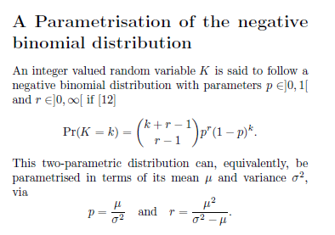
For condition A and B we calculate p and r under the null hypothesis.
Let’s say we have an estimate of the variance from both conditions…
For condition A:
1250 sequences
variance = 5000
For condition B:
1250 sequences
variance = 6000
p_{A}
= 1250/5000 = 0.25
p_{B}
= 1250/6000 = 0.208333
r_{A}
= 1250^2/(5000-1250)= 416.66
r_{B}
= 1250^2/(6000-1250)= 328.94

Slide 26


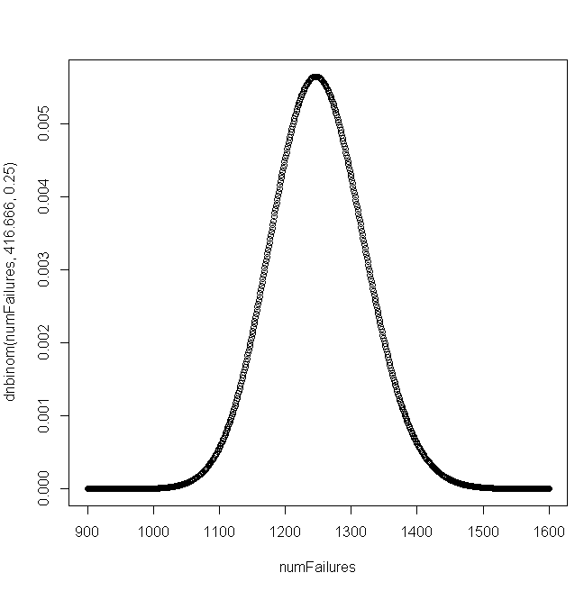
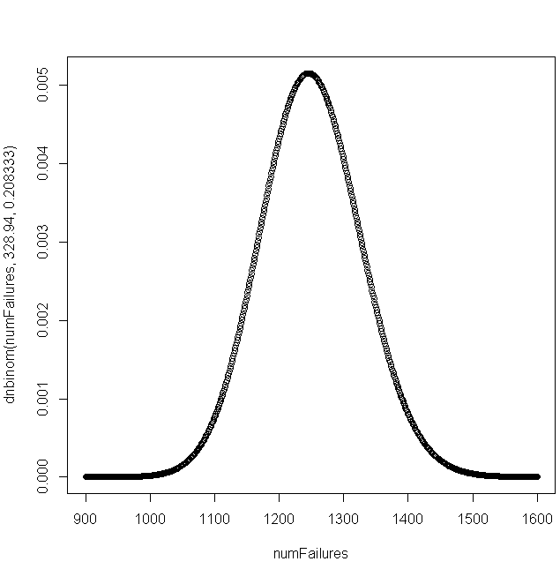
From our two sets of parameters, we can generate two PDFs under the null hypothesis
p_{A}
= 1250/5000 = 0.25
p_{B}
= 1250/6000 = 0.208333
r_{A}
= 1250^2/(5000-1250)= 416.66
r_{B}
= 1250^2/(6000-1250)= 328.94
p(a)
p(b)
Under the null hypothesis, p(a) and p(b) are independent, so we can calculate a joint
probability p(a) * p(b)

Slide 27
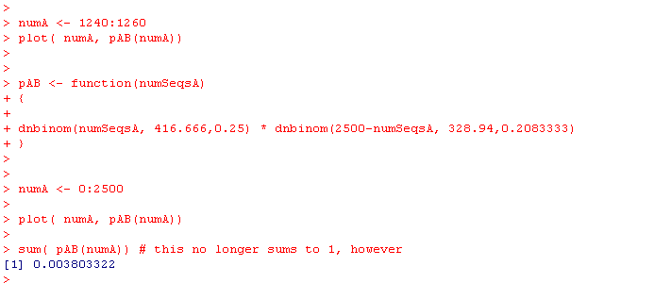
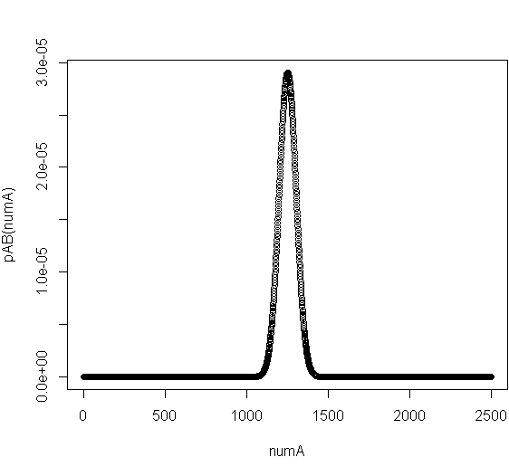
Under the null hypothesis, p(a) and p(b) are independent, so we can calculate a joint
probability p(a) * p(b)
K_{a} = the number of counts we observed in A
K_{b} = the number of counts we observed in B
p(a) * p(b) = dnbinom(K_{a,} 416.666,0.25) * dnbinom(K_{b,} 328.94, 0.208333)
There were a total of 2500 sequences we observed in A or B.
So to graph this out

Slide 28
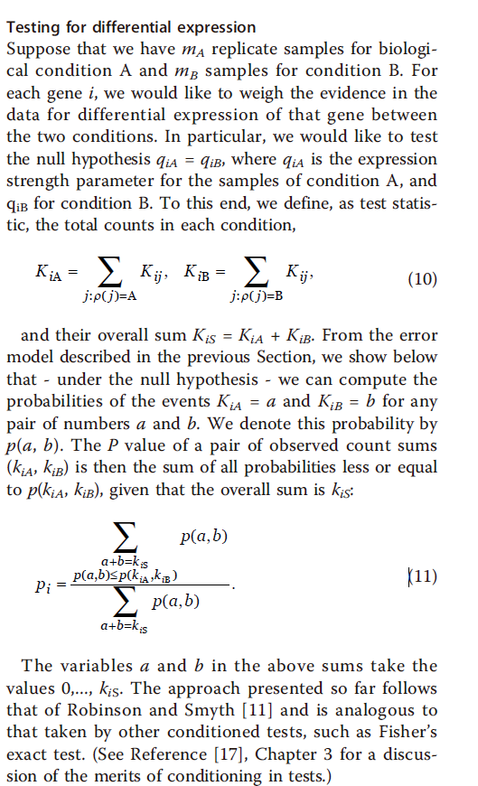
Observed: 1000 from A;
1500 from B
To do a two-sided test:
Every probability that is <= the prob for our observed data
The total area under p(a,b)

Slide 29
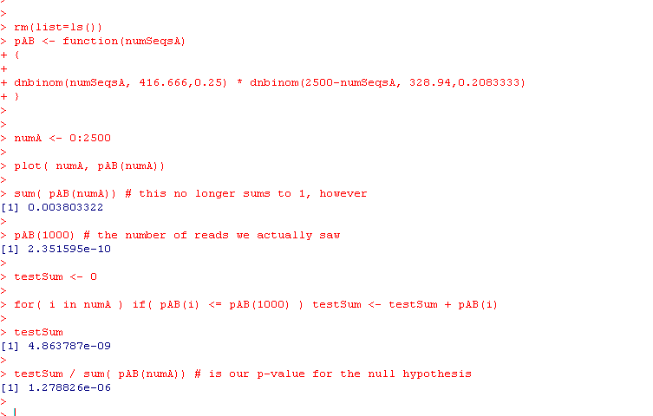
Here, finally, we can calculate the p(seeing 1000 reads in A)
(or, alternatively B as 1,500 reads) under the null hypothesis

Slide 30

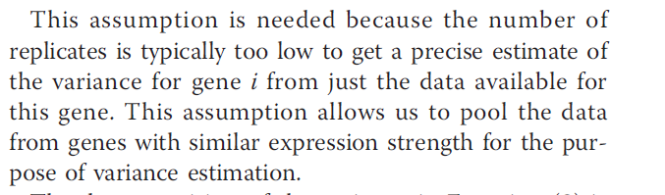
So how do we estimate the variances associated with each sample?
We could use these formulas:
But instead…
because

Slide 31
Approaches to column normalization
P-values from two conditions under the negative binomial
Our example dataset through DeSeq
False Discovery Rate

Slide 32
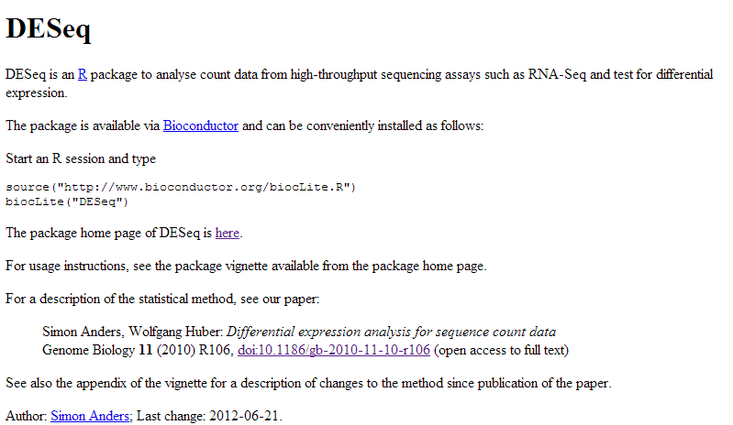
We are going to load the RNA-seq dataset into DSEQ.

Slide 33
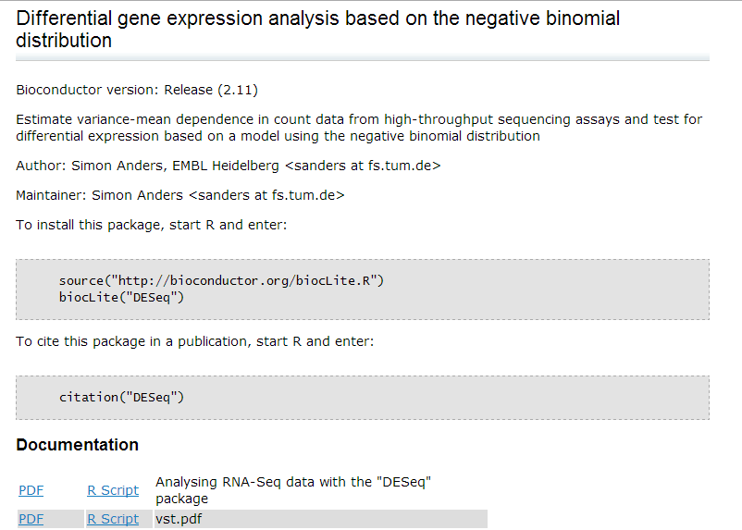
We are going to follow this vignette
(from http://bioconductor.org/packages/release/bioc/html/DESeq.html )
http://bioconductor.org/packages/release/bioc/vignettes/DESeq/inst/doc/DESeq.pdf

Slide 34

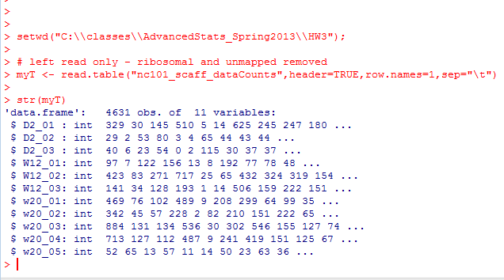
We can install DeSEQ from R…
We start by reading the data in as usual…

Slide 35
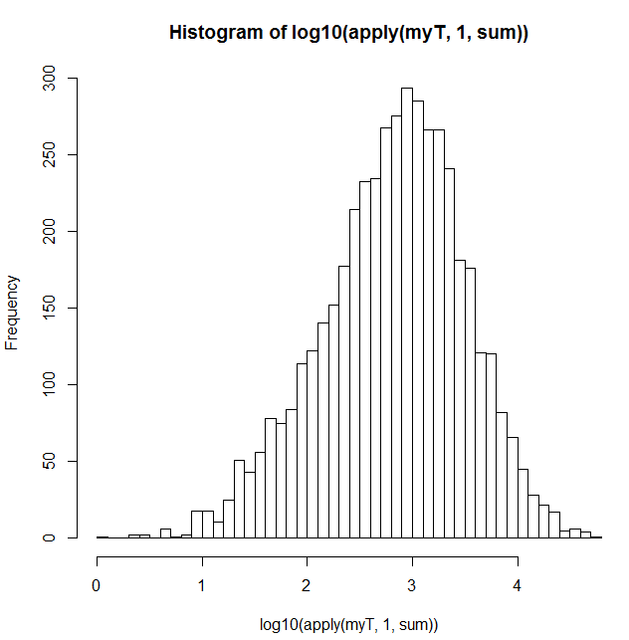


Before we even use DeSeq, we can do some nice QA/QC on the data
Here is a histogram of the number of sequences assigned to each gene..
Apply “sum” to every row in
the data frame.
Returns the number of reads for each gene…

Slide 36

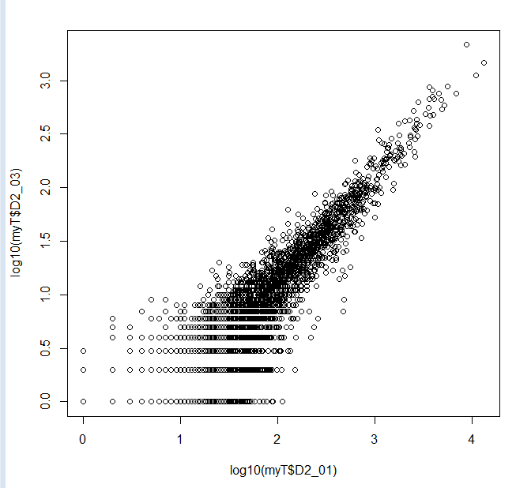
Likewise, we can ask how many reads per sample..
Sample D2_03 (with only 76,684 sequences) seems a little low.
We could think about taking it out…
However, it seems reasonably
well behaved, so we will leave it
in for now…

Slide 37

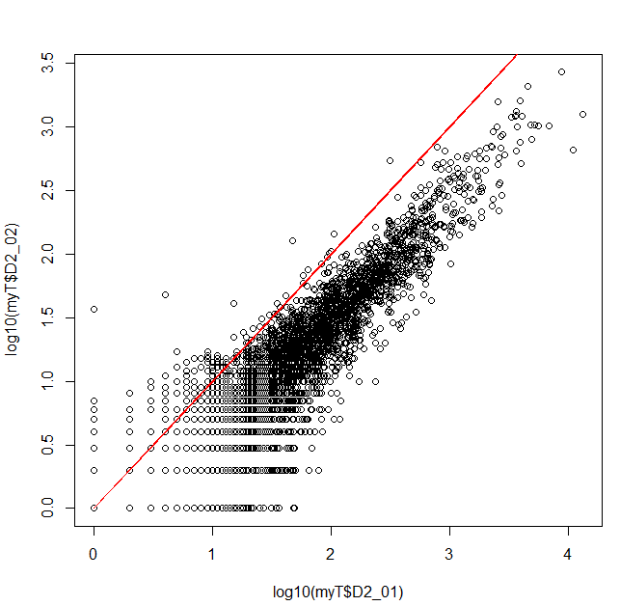
We can take some initial looks at the data…
There is, as we have seen,
a good correlation
between these 2 biological
replicates

Slide 38
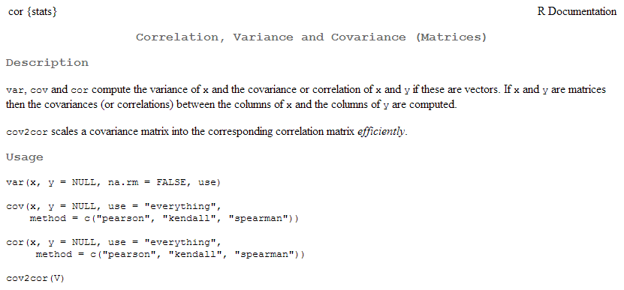
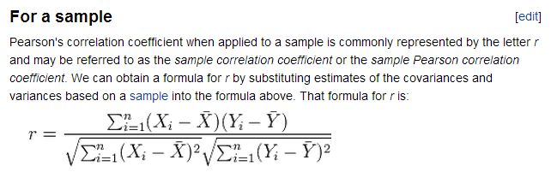
cor gives us the correlation co-efficient…
How much information about the y-axis can you get given the x-axis?
(More on this as we get to linear models in the 2nd half of the class)
http://en.wikipedia.org/wiki/Pearson_product-moment_correlation_coefficient

Slide 39
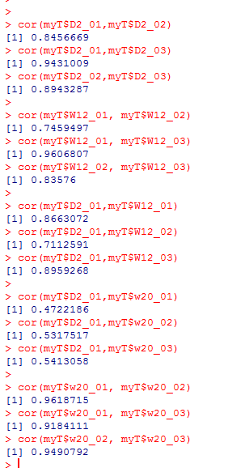
Typing a (very quick and informal) set of commands
suggests there will be a big shift between 2 days and 20 weeks
The day 2 samples seem well correlated with each other
There seems to be a little more variance in the week 12
samples
There was some shift day 2 to week 12
There was a big shift from day 2 to week 20
The week 20s are well correlated to each other

Slide 40


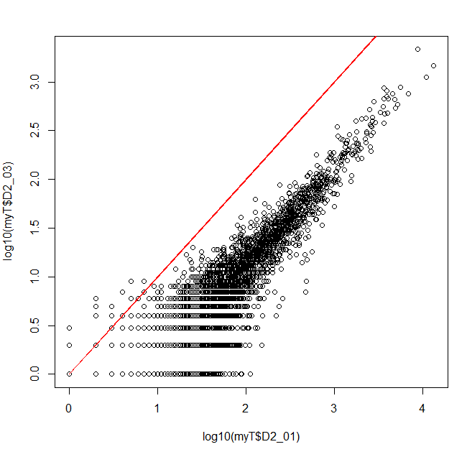
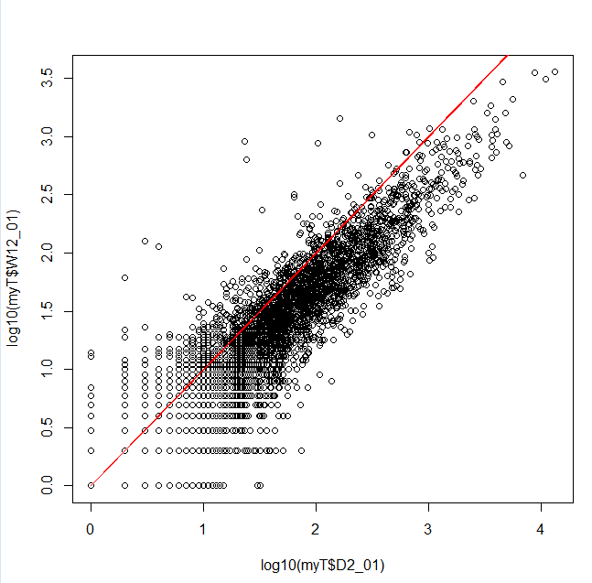
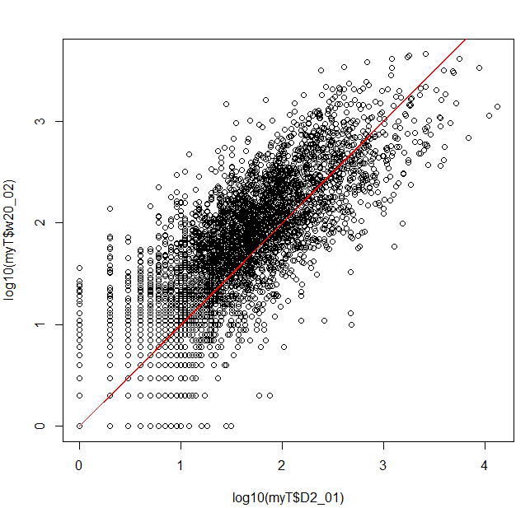
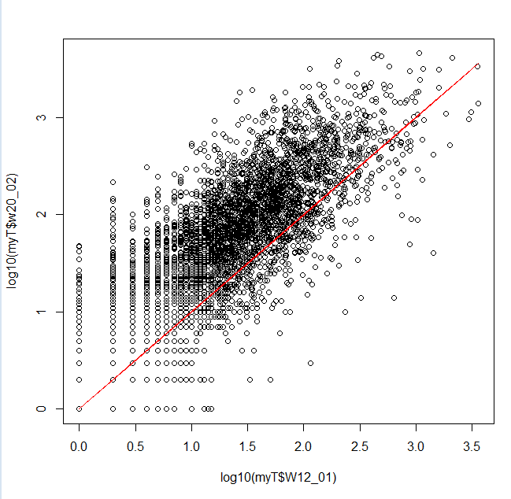


D2 vs D2
D2 vs W12
D2 vs W20
W12 vs W20

Slide 41
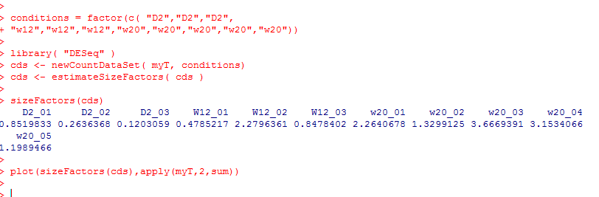
The samples are not on the red lines because each sample has a different number of sequences
The first thing we will use DeSeq for is to normalize the data
(adjust all of the samples so we can treat them as if they had an identical number of reads).
This will allow us to, for example, take an average across samples
We see that the size factor is very
closely related to the total
number of sequences in each
sample

Slide 42
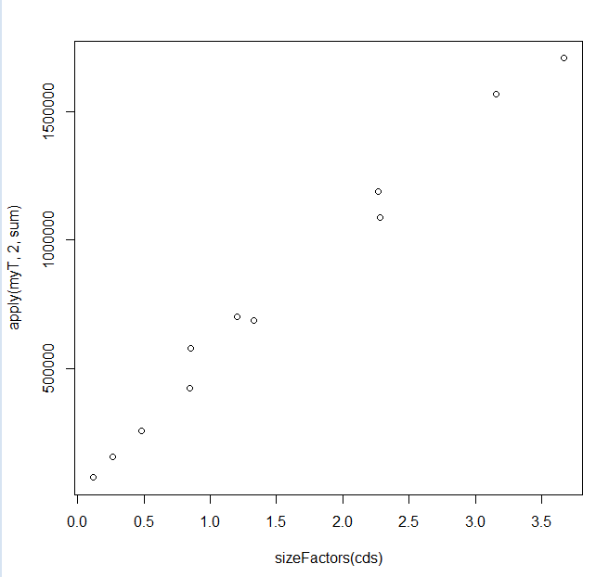
We see that the size factor is very
closely related to the total
number of sequences in each
sample

Slide 43
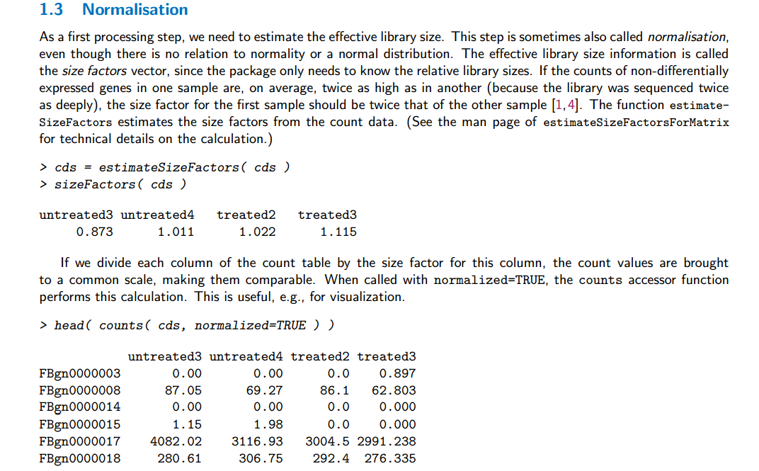
We are here following the directions in the vignette
http://bioconductor.org/packages/release/bioc/vignettes/DESeq/inst/doc/DESeq.pdf

Slide 44
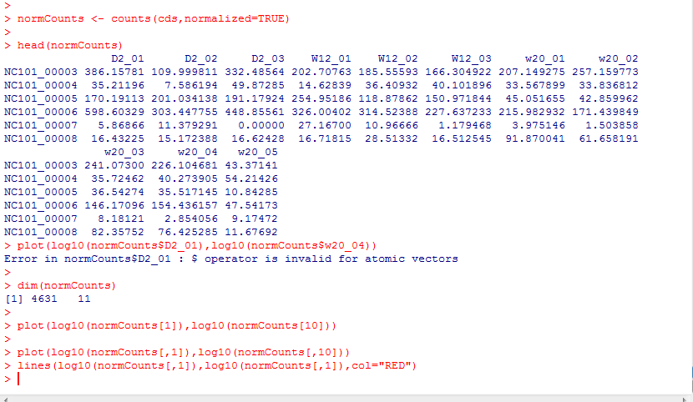
With the normalization done, scatter plots will fall on the identity lines
Accessing by names fails on the returned matrix
We retreat to column indexes

Slide 45
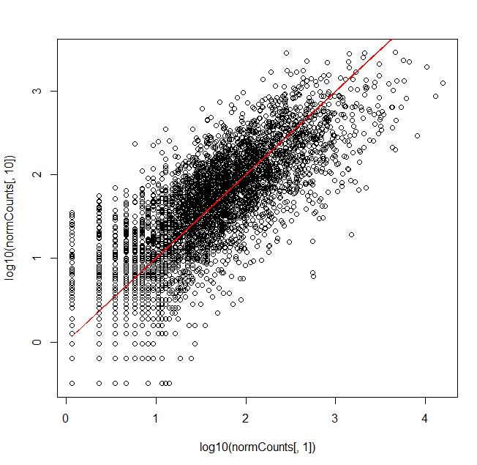
With the normalization done, scatter plots will fall on the identity lines

Slide 46
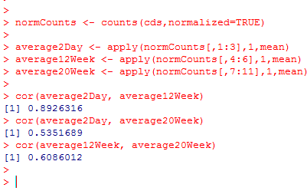
By working with average samples we only have 3 plots to worry about in our visualization

Slide 47


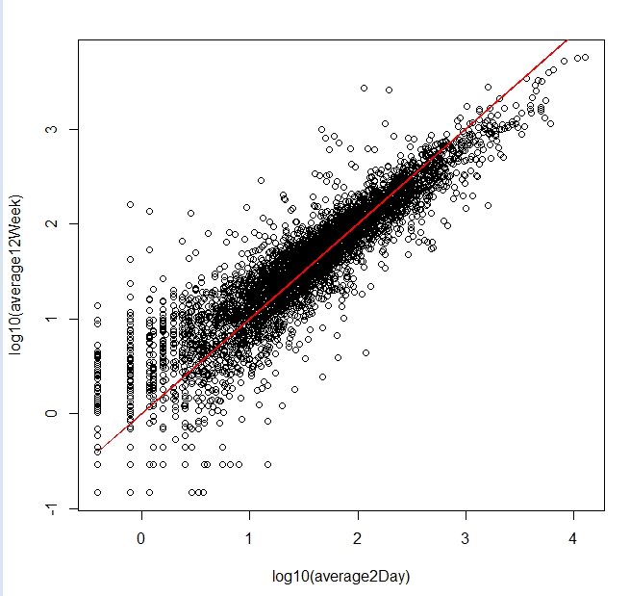
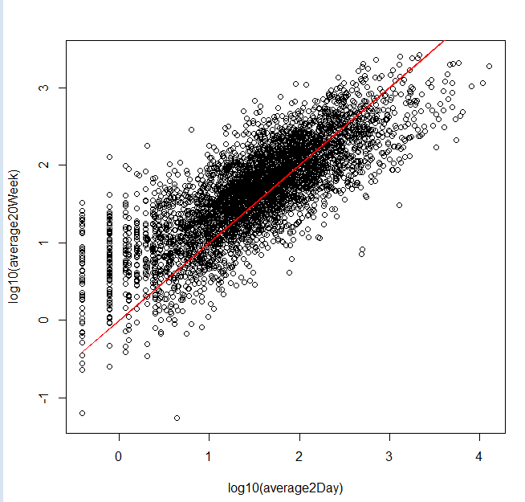


Average 2 day vs 12 weeks
Average 2 day vs. 20 weeks
Average 12 week vs. 20 week

Slide 48


As we would expect, the Poisson assumption (“shot noise”) does not model our data
(here visualized with canonical variance)

Slide 49

Next, we want to see which genes are differentially expressed…
We start by getting our DeSeq variance estimates…
This says get one variance for each gene ignoring the different conditions (we do this here to keep our math a little simpler…)

Slide 50
We will estimate a single
variance across all conditions…
(rather than have 3 variances for
each gene…)
(Just to keep the math simpler…)

Slide 51

According to the vignette there are a number of sets of estimates we might be interested in…
http://bioconductor.org/packages/release/bioc/vignettes/DESeq/inst/doc/DESeq.pdf
fitInfo(cds)$perGeneDispEsts – gives us the Deseq’s formula for the “raw” variance estimated for the gene
i in condition j..

Slide 52



Deseq scales by dividing by the square
of the mean
Cannonical variance
Deseq’s “raw” variance is the
cannonical variance minus the means
(correcting for size factors)

Slide 53


Here is the fitted line based on all of the raw variances.
This allows for pooling of the estimate of the raw variances
In the deSeq paper, this was a local
regression, but according to the
vignette it is now a two-parameter
Gamma function…
(so just some smooth function)

Slide 54




We can, if we want, switch to the “local regression” method.
You can kind of see why they switched…
Some of these variances seem much too small

Slide 55

Another difference with the published paper.
In the published paper, the variance came from the fit.
In the software: the variance for downstream analysis is the max(observed variance, fit variance)
The variance used for downstream analysis can be gotten by fData(cds)[,1]

Slide 56


the raw variance for downstream analysis is the max(observed raw variance, fit raw variance)
Essentially, for some genes,
their method sets a
“floor” of the variance.
This is conservative
(since the variance sets
the width of the
dbinomial distribution).
So the yellow ends up being
DeSeqs (somewhat complicated)
conservative estimate of the extra raw “variance” that is to be provided by the negative binomial
And then they end up doing something else in DeSeq 2!

Slide 57


This procedure belongs in a long history of adding small constants to the variance…
(which often seems poorly justified by theory…)
Adding an arbitrary damper to the variance
(9,951 citations)

Slide 58


Finally, we are ready to perform inference (here we remove the “blind” option for the variance to allow DeSeq to estimate a variance for each condition…)
2 weeks vs. 12 weeks yields only 5 significant genes at a 10% FDR -

Slide 59



However day 2 vs. week 20 yields many more (136) significant genes

Slide 60
Approaches to column normalization
P-values from two conditions under the negative binomial
Our example dataset through DeSeq
False Discovery Rate

Slide 61


You have 20,000 genes in an rna-seq experiment.
You have two conditions (A) and (B).
You run them through DeSeq (or any other stats package).
If the null hypothesis is always true (no difference between A and B),
the p-values will be uniformly distributed…
We can model this pretty simply:

Slide 62

If we use a simple threshold of significance of 0.05, we would
expect about 1,000 genes to be called significant even if the null
hypothesis were always true..
There are 1,016 genes that have p-values <0.05
in this case where the p-values are uniform

Slide 63


One alternative:
Use as a p-value threshold Bonferroni correction.
The desired threshold / number of tests.
In this case 0.05 / 20000 = 2.5e-06
None of our p-vals reach this threshold..
At this threshold, there is a 5% chance of any false positives

Slide 64
Bonferroni correction is sometimes considered too conservative for genomics experiments.
At small sample sizes, you might have few genes with p-values smaller than the
Bonferroni thresholds.
A less conservative alternative, false discovery rate.
At a 5% false discovery rate, we expect 5% of our hits to be false positives.
This is less conservative than Bonferroni correction, where there is a 5% chance
that any of our hits are false positives.

Slide 65


One straight-forward approach to finding genes at a given false-discovery rate
Benjamini and Hochberg FDR
1. Rank all the p-values (smallest first). The rank of each value = K
2. Calculate N * p / k
where N = the # of hypotheses that you are testing
p = the “raw” (uncorrected) p-value.
3. Start at the top of the list. Go down to N * p / k > threshold
(e.g. 0.10 for 10% FDR).
N * p = # of expected false positives at a given p-value
k = # of genes actually observed at that p-value

Slide 66
Note that for the first hit (smallest p-value),
Bonferroni correction is the same as BH FDR.
(Since if k=1,
N * p / K = N * p
which is the same as multiplying the p-value by the number of hypotheses to
do the correction)

Slide 67
So in DeSeq…
FDR adjusted
p-values..
Raw p-values

Slide 68
Next (finally): The normal distribution…

