Slide 1
A simple GUI in javascript/React

Slide 2
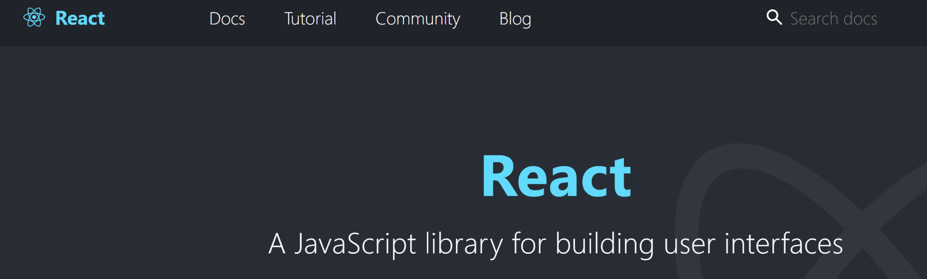
React is a javascript library for making modern browser-based UIs

Slide 3

Javascript is very confusing (we are only touching it here)
I found this book to be helpful…

Slide 4
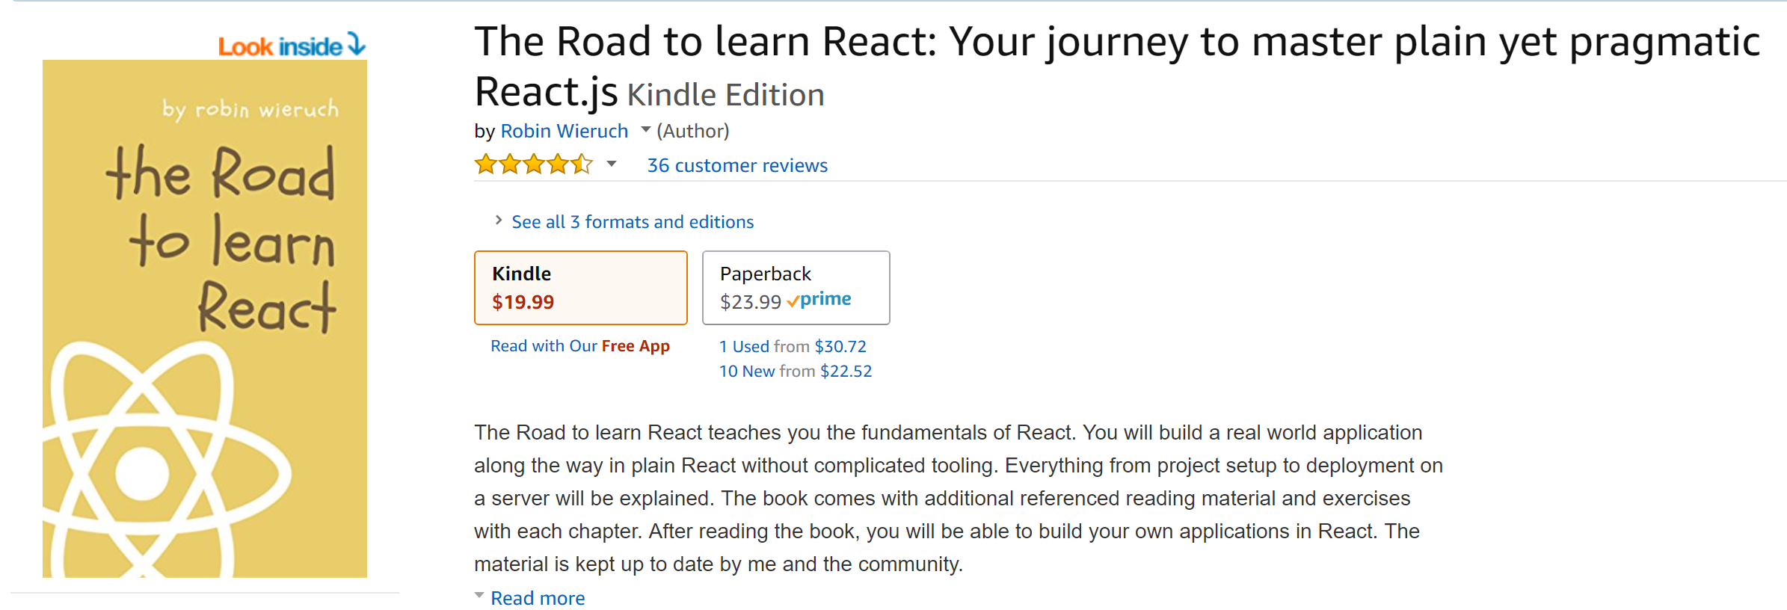
I found this book useful, but you need to understand
the prototype model of OO (which we might cover later…)

Slide 5
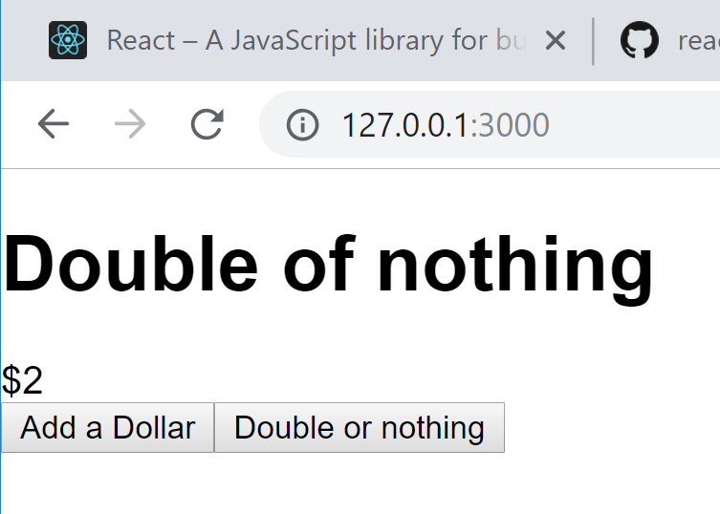
https://github.com/afodor/reactExamples/blob/master/tdemos/src/App3.js

Slide 6
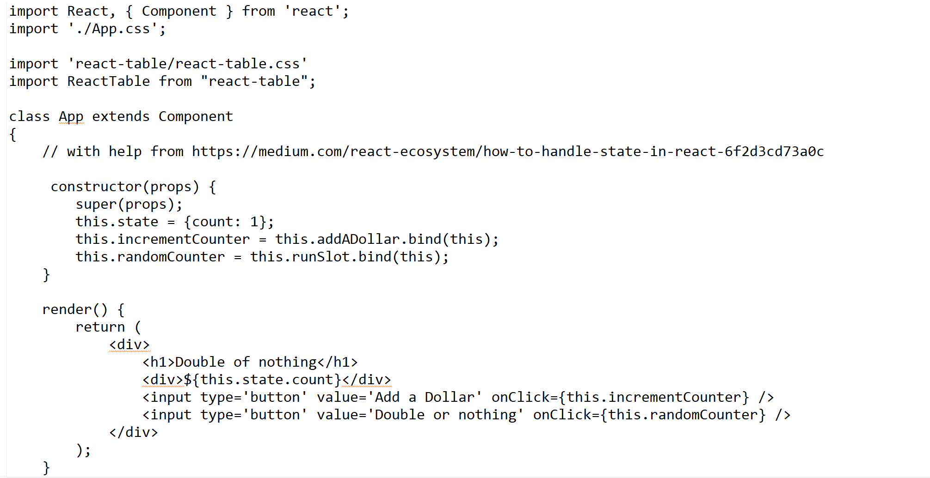
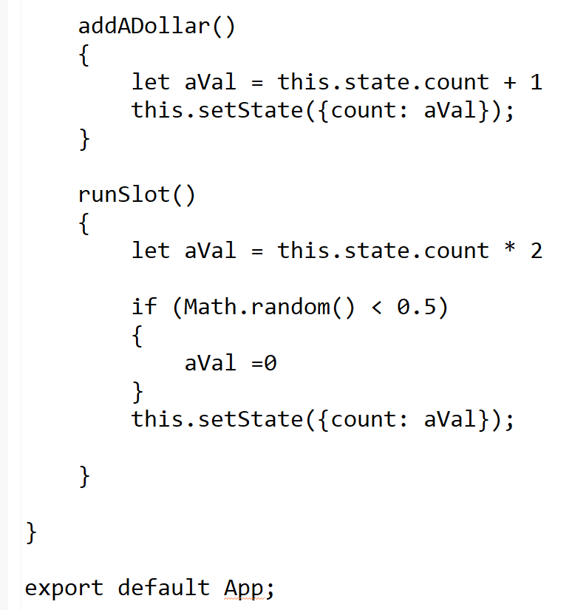
https://github.com/afodor/reactExamples/blob/master/tdemos/src/App3.js

Slide 7
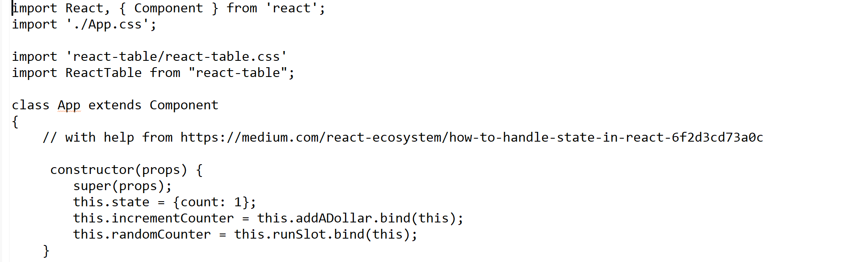
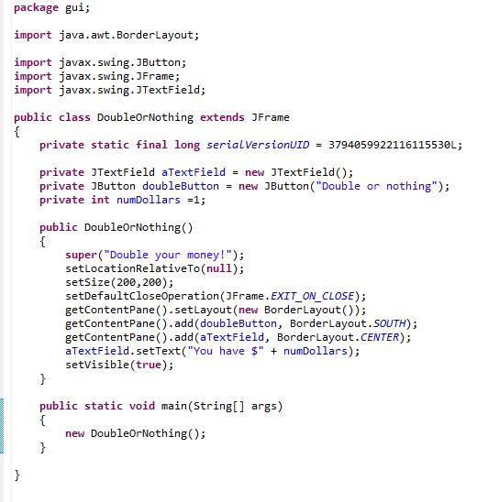
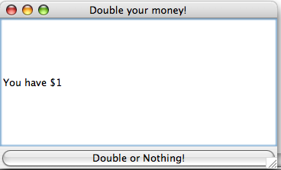
In both JavaScript/react and
Java, you are working in a larger
framework and you need to
override key methods…

Slide 8
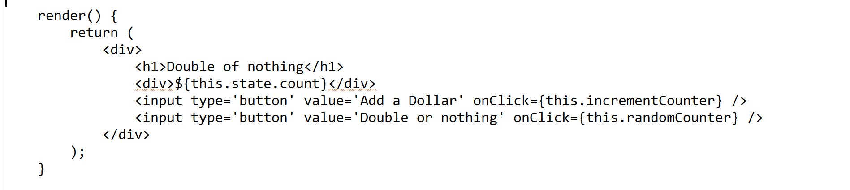
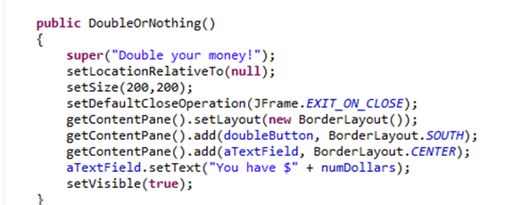
In Javascript react, you directly “paint” your UI using HTML
elements…
In Java, you use a Layout manager to control the display of
Swing components…

Slide 9
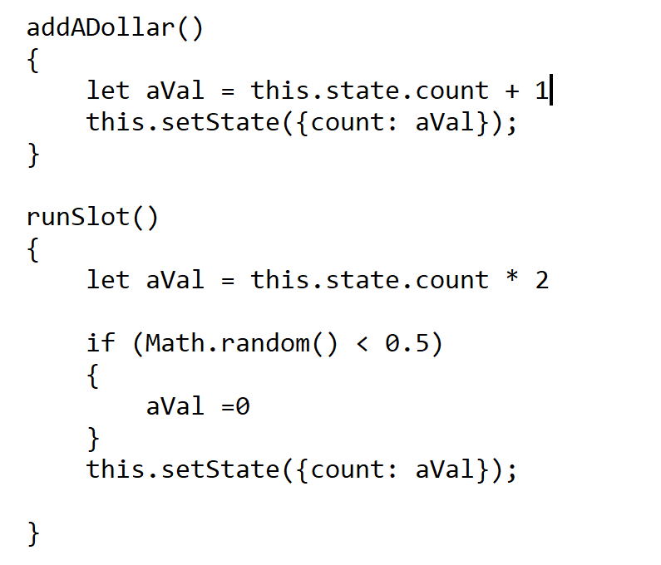
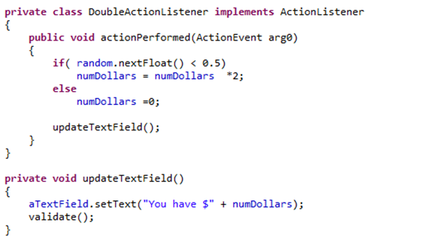
In Javascript react, you just change the state of your program
and the rendering components update themselves.
In Java, you have to manage each update

Slide 10
As we will see, Java GUIs have an AWT thread (that updates
the interface) and other threads (that may run on other cores
on a multi-core CPU).
Main() thread
AWT thread()
Sends a request
to the AWT thread
repaint()
Calls paint(Graphics g)
(when it is not doing
anything else)
Returns
immediately
Javascript by contrast is single-threaded
https://www.red-gate.com/simple-talk/dotnet/asp-net/javascript-single-threaded/

Slide 11
Like R, Javascript is…
complex
unruly
easy to get started in, hard to master
ubiquitous
inevitably highly useful
Depending on our time, we may return to Javascript
later in the semester…

