Slide 1

Understanding Health and Demographic Surveillance Data
Agincourt Case Study
Sulaimon A. Afolabi
MRC/Wits Rural Public Health and Health Transitions
Research Unit,
School of Public Health, University of the Witwatersrand, Johannesburg.

Slide 2
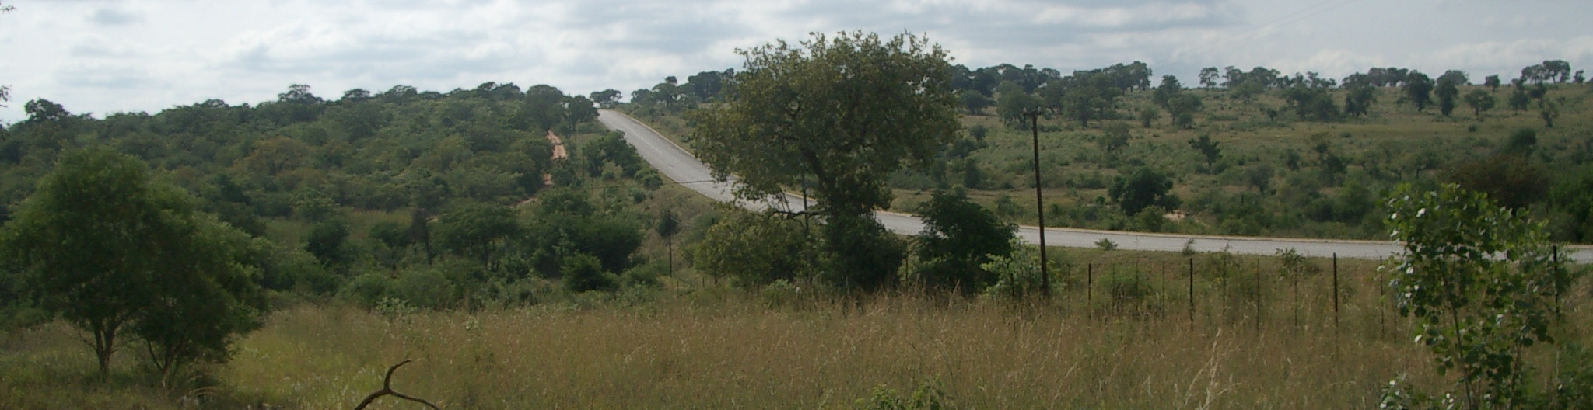
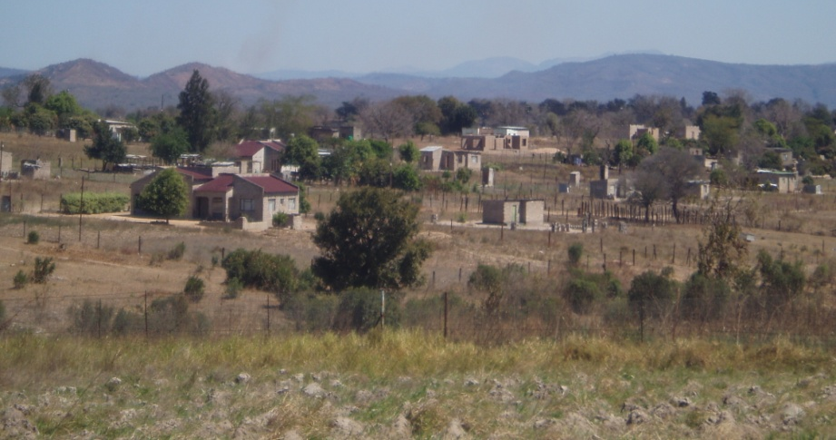
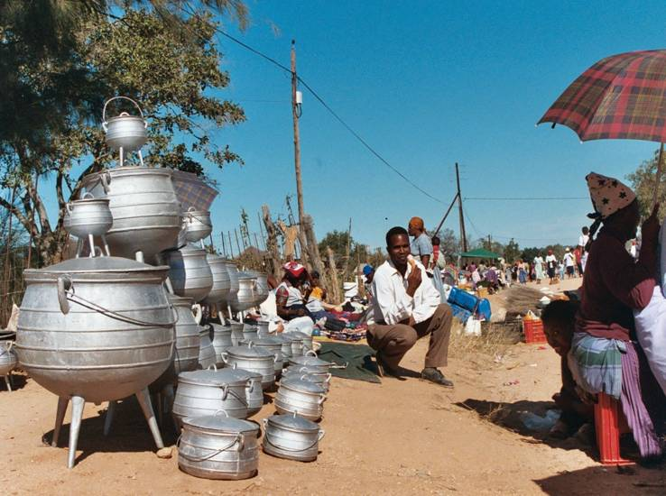
Agincourt HDSS
Rural north-east area of South Africa
About 500 km from Johannesburg
Former apartheid homeland
80,000 black Africans (still growing)
15,000 households (growing)
About 400 square- km in size;

Slide 3
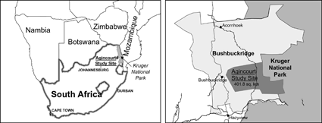
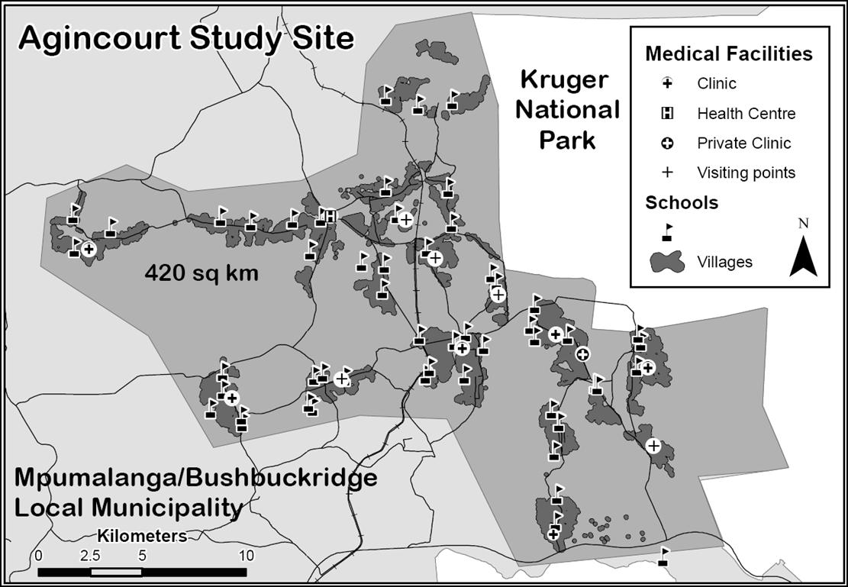

Slide 4
Agincourt HDSS Data structure
Table | Example
Object | Individuals
Event | Birth, Death, In-migration & out-migration
Episode | Residence, Membership, Union
Observation | Education Status, Labour Status

Slide 5
Birth
Death
Residence
Pregnancy
Birth Weight
Residence
Death Local
DiedAt
Event
Event
Individual
Id
Gender
DoB
DoD
Gender
Object
Object
Observation
Labour Status
Education Status
Observation
Residence
Residence
Id
Start Event
End Event
StartDate
EndDate
In-migration
Episode
Episode
Out-migration
Event
Residence
Internal Migration
Move Type
Residence
Internal Migration
Move Type
Event

Slide 6
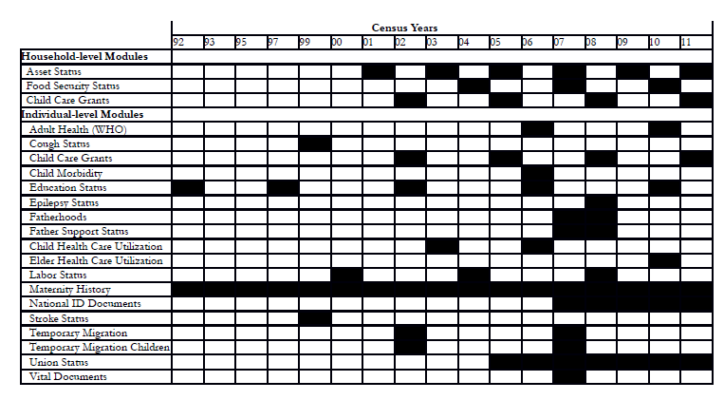

Slide 7
1-in-10 AHDSS Sample Database
Contains a 10% sample of locations from the full AHDSS database and all observed data at those locations
Can be used as an evaluation tool for developing data
requests and for familiarizing an analyst with the structure
and availability of data within the AHDSS database
Can also be used as a teaching tool for demographic methods and the management of DSS data
The data it contains CAN NOT be analysed for publication
Can be freely downloaded from the AHDSS Data website:
http://www.agincourt.co.za/DataSection/DataDownloads.htm

Slide 8
Data Analysis

Slide 9
Checklist
Import data into STATA from MS Access Database using ODBC
Explore the data
Merge or Join imported tables
Recode and rename the variables
Check the data for consistency
Data cleaning
Change data format –short to long
Create a data quality matrix
Perform basic analysis

