Slide 1

Capstone Project
An analysis of Toronto postcodes to determine possible locations for a new Fast food restaurant

Slide 2
Introduction
What locations are ideal for your new fast food restaurant? To help you answer this question, I am going to use data to answer the following three questions:
1) How many neighborhoods are there in each postcode area?
2) How many restaurants are there overall in each postcode?
3) How many similar restaurants are there in each postcode?
The answer to these questions will provide some valuable insights into possible locations for highest profitability.

Slide 3
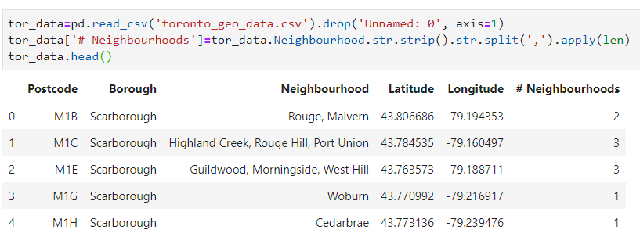
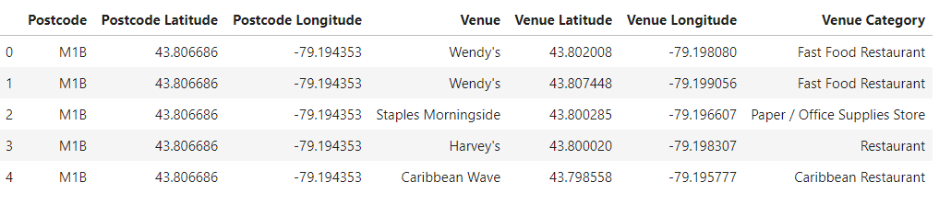
Data
I have data on postcodes, their geospatial location, and their numbers of neighborhood's.
I used this data as input into the foursquare API to gather data on venues near each postcode.

Slide 4
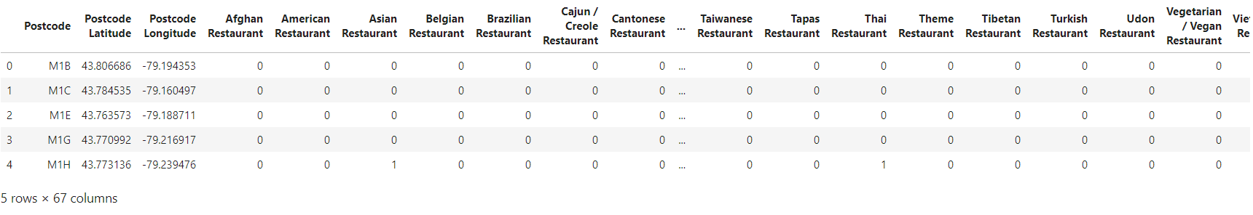
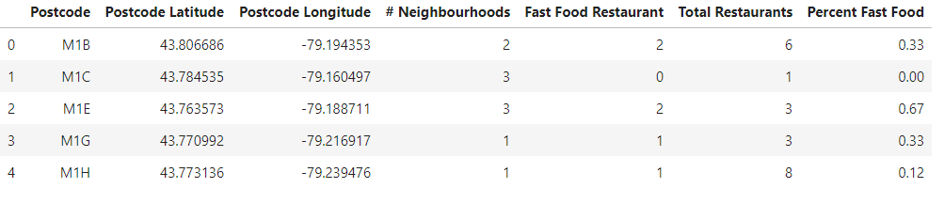
Data Preparation
Through OneHot encoding and filtering of venue categories, I was able to gather data on the number of restaurants in near each postcode and the number of specifically fast food restaurants near each as well.

Slide 5
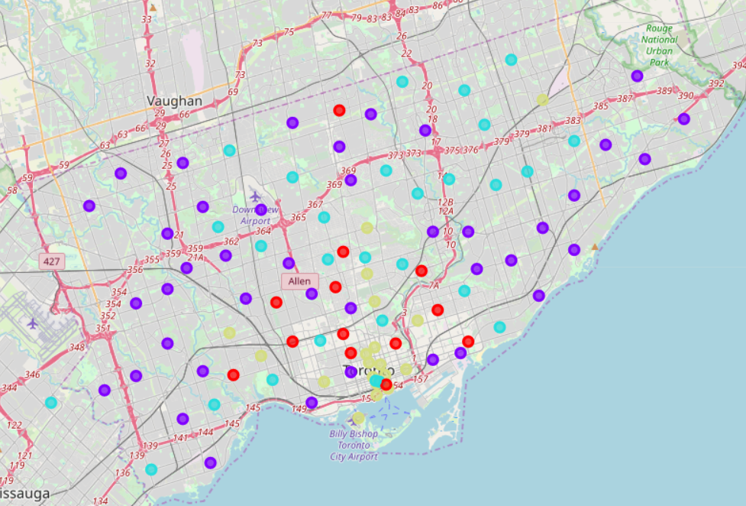
Clustering
Using the k-means algorithm, I was able to cluster the postcodes with similar characteristics.
This clustering allowed us to group postcodes into low, medium, medium-high, and high sets of neighborhoods, total number of restaurants, and percentages of fast food restaurants in each post code.

Slide 6
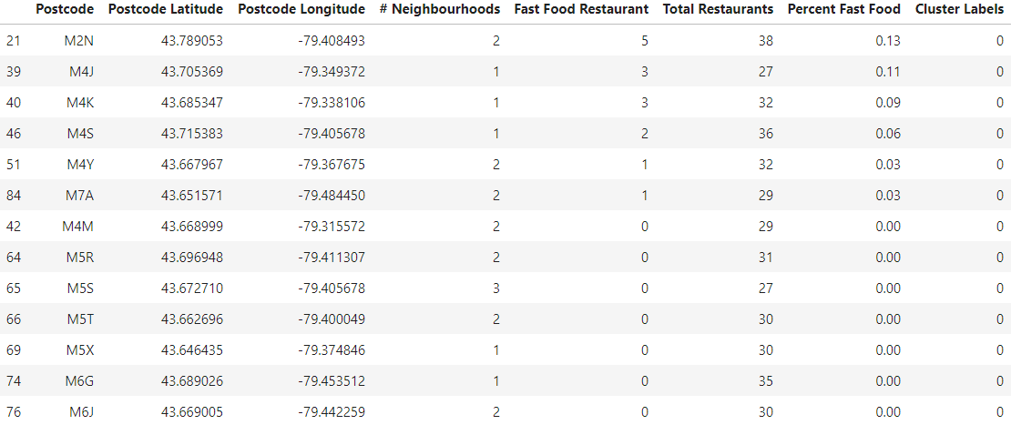
Red Cluster
Number of neighborhoods:
Low
Total Number of Restaurants:
High
Fast Food Market Percent:
Low

Slide 7
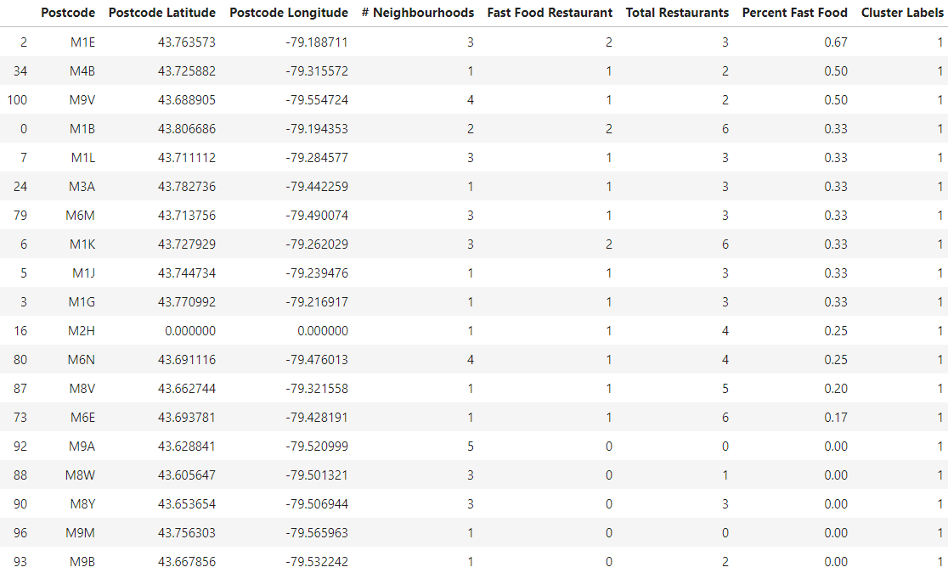
Purple Cluster
Number of neighborhoods:
High
Total Number of Restaurants:
Low
Fast Food Market Percent:
High

Slide 8
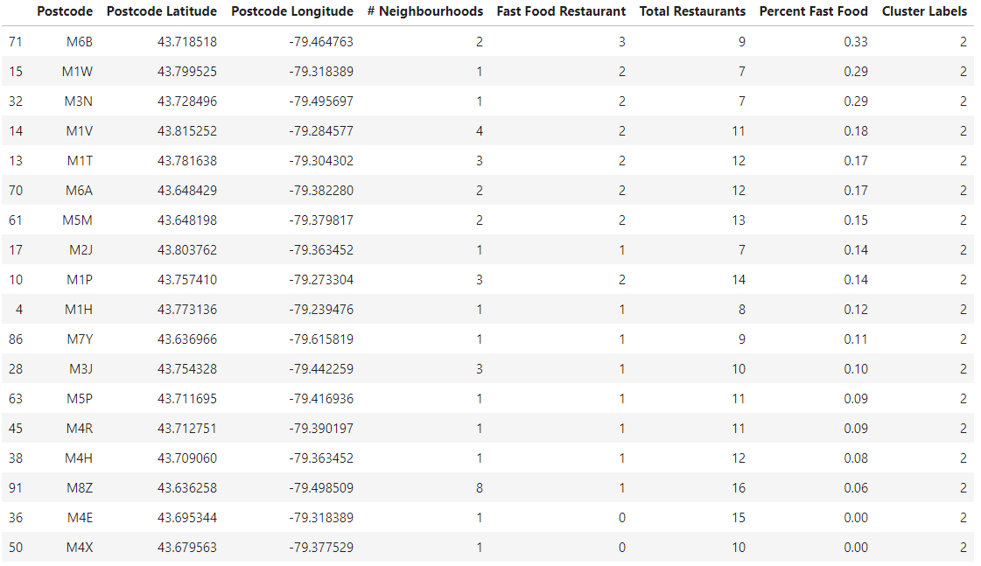
Teal Cluster
Number of neighborhoods:
Medium
Total Number of Restaurants:
Medium
Fast Food Market Percent:
Medium

Slide 9
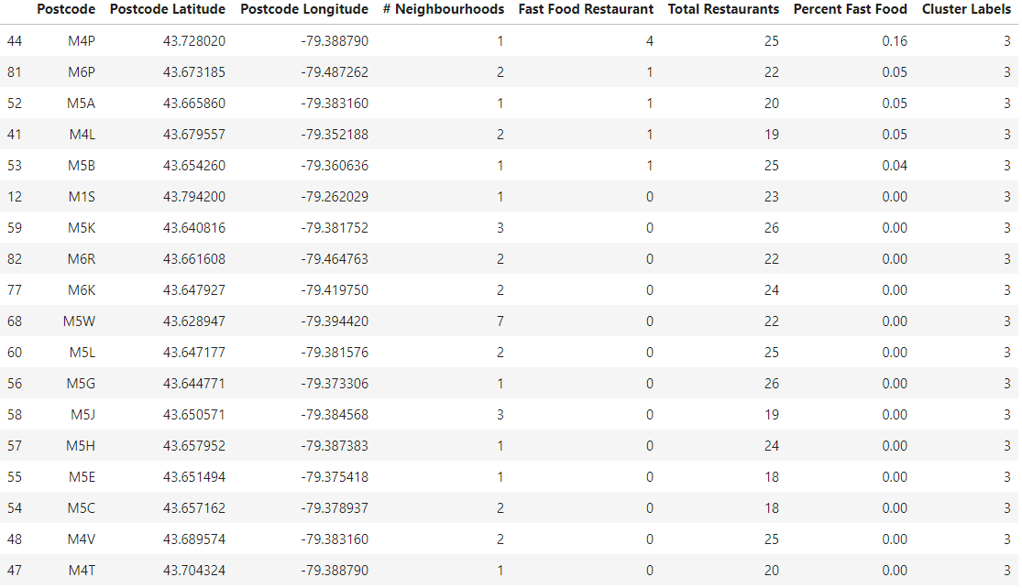
Yellow Cluster
Number of neighborhoods:
Medium
Total Number of Restaurants:
Medium-High
Fast Food Market Percent:
Low

Slide 10
Discussion
My Recommendations based on these results:
1) Purple Cluster: This cluster has postcodes with a high number of total restaurants, but a low percentage of restaurants that are of the fast food category. This would be an ideal mix as it would indicate that there is a lot of people traffic, but low number of direct competitors to a fast food restaurant. It is my first recommendation of postcodes to research.
2) Teal Cluster: While they do have a lower number of total restaurants and a higher percentage of fast food restaurants, they also have a higher number of neighbourhoods, which would suggest more families looking for a quick meal. It also suggests that the cost of ownership in that area is likely lower as well.

Slide 11
Conclusion
There are some meaningful insights to be gained from these data and through a k-means clustering, we were able to identify some postcode areas that are likely better candidates for a new fast food restaurant than others.
It is important to note, though, that while these are powerful data results, more research could be done regarding cost of ownership in certain postcodes and populations sizes as well.
Despite that, I believe we have some excellent information to move forward with seeking a location for your new fast food restaurant.

