Slide 1
Modeling the Change in Grapevine Cold Hardiness in the Okanagan Valley, BC
FRST 507C: Final Project
By Adam Fong

Slide 2
Question
How does air temperature affect cold hardiness in grapevines in the Okanagan Valley, BC?

Slide 3
Introduction
Hardiness is measured by the lowest temperature which can be tolerated before death
A decrease in hardiness is an increase in the lethal temperature threshold
Four Deacclimation filters were used
Growing Degree Days (GDD):
GDD_5 = mean daily temperature – 5 C
Notes:
The start of the Deacclimation phase was defined by the first occurrence of a loss in hardiness on the magnitude of 2.0C, 2.5C, 3.0C, and 3.5C for a given individual.

Slide 4
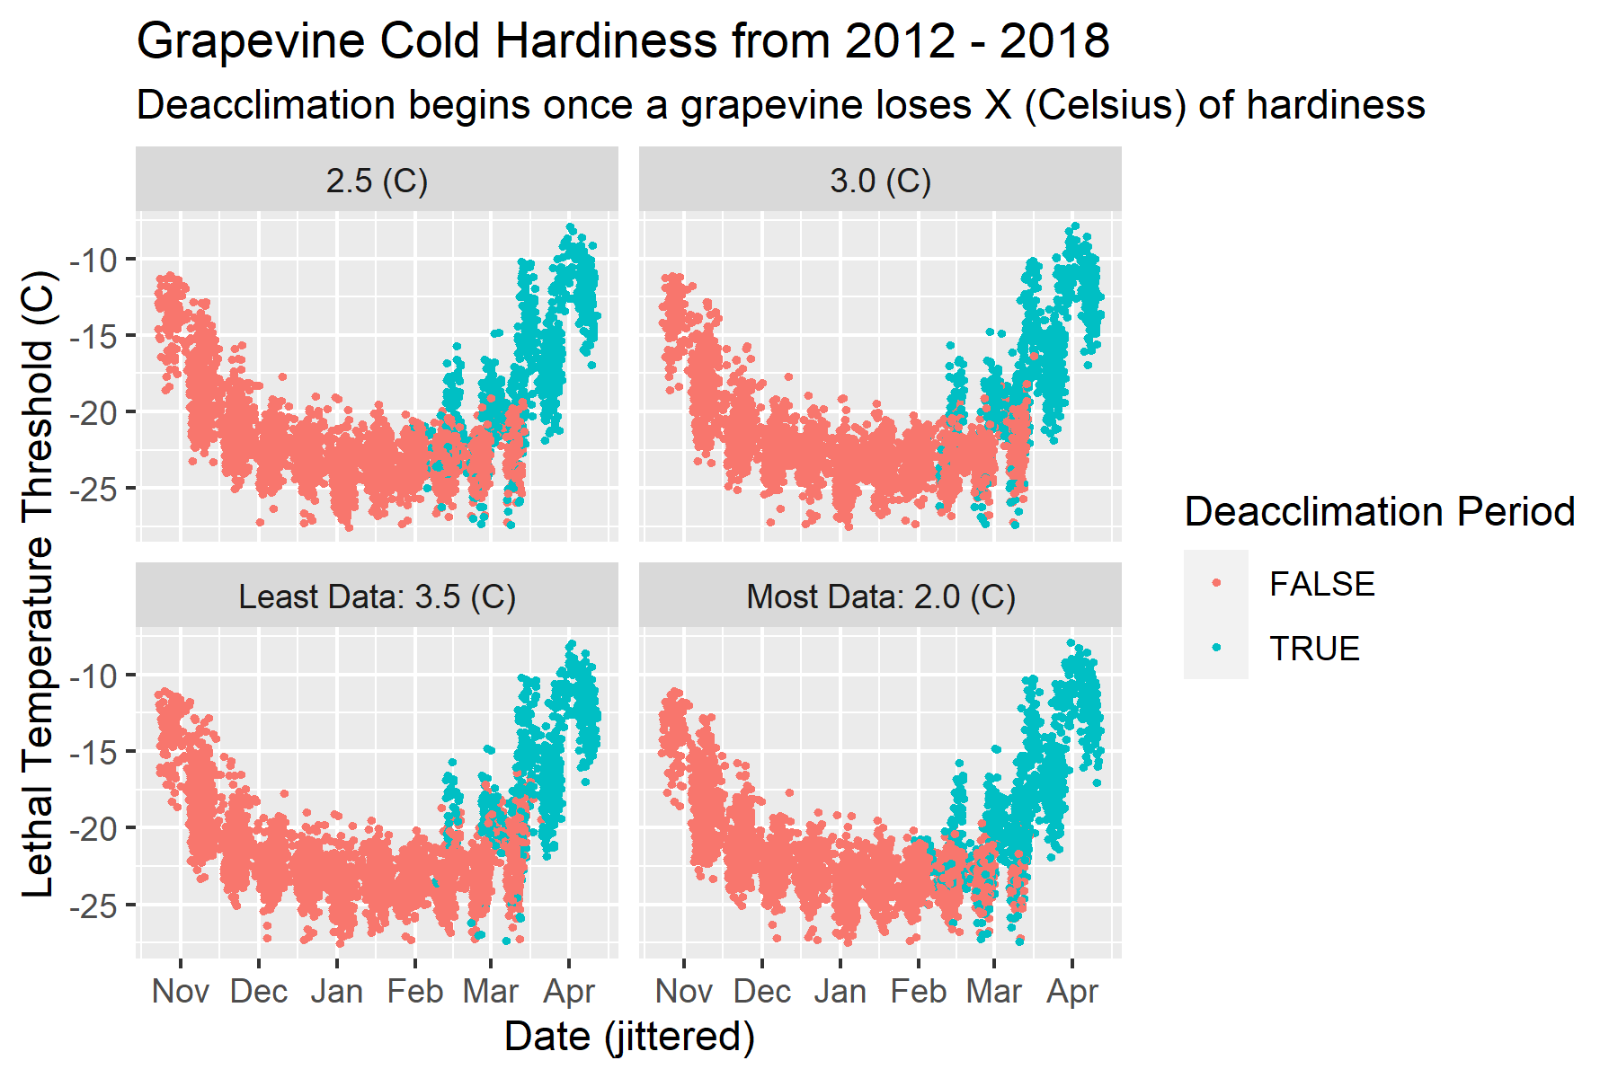
Notes:
This is a plot of cold hardiness between 2012 and 2018.
The blue highlights the deacclimation phase which was modeled.
Each of the facets shows a different threshold which was used to determine deacclimation. The lowest temperature threshold had the most datapoints while the highest temperature threshold has the least.

Slide 5

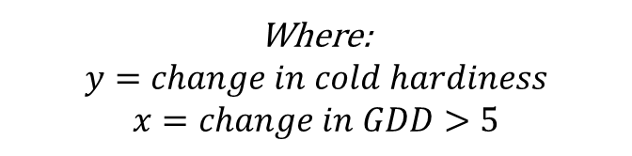
Model Notation
$y \sim Normal\left(μ, σ_{grand}\right)$
$μ_{i} \sim α_{grand}+α_{site, i}+α_{variety, i}+β∗x_{i}$
$α_{site} \sim Normal\left(0, σ_{site}\right)$
$α_{variety}\sim Normal \left(0, σ_{variety}\right)$
Priors:
$α_{grand} \sim Normal\left(2, 1.5\right)$
$β \sim Normal\left(0.2, 0.2\right)$
$σ_{grand} \sim Exponential\left(1\right)$
$σ_{site}\sim Exponential(1)$
$σ_{variety}\sim Exponential(1)$
Where:
$$y=change in cold hardiness$$
$$x=change in GDD>5$$
Notes:
This is the mathematical notation for the model fit to this data.
The change in GDD > 5 between sample dates is the main predictor used in this model.

Slide 6
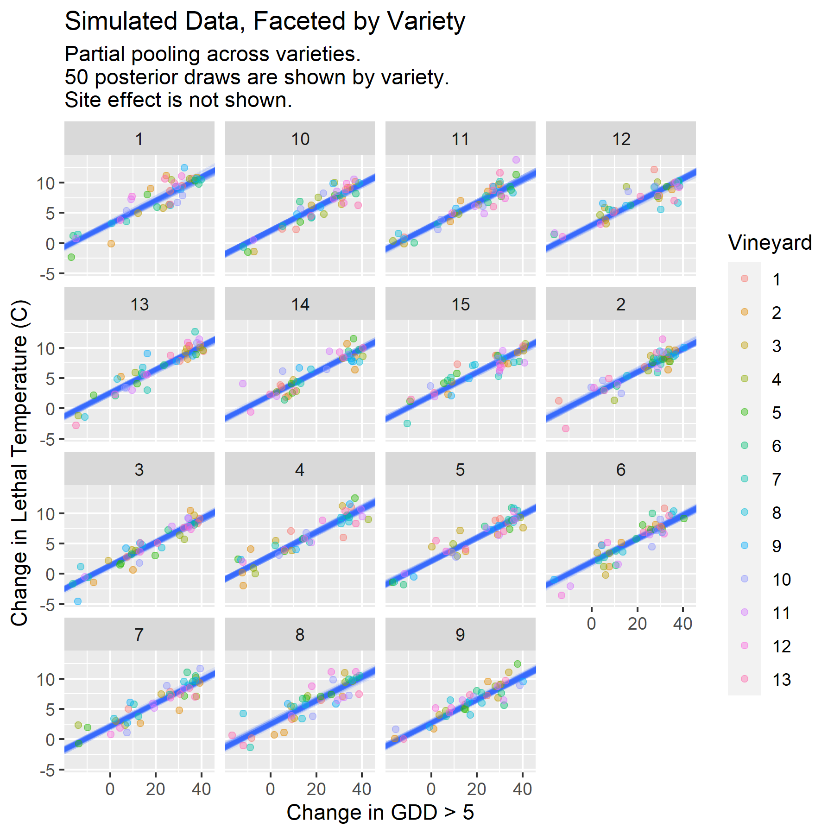
Model Fit of Simulated Data
Notes:
Simulated data was made to confirm the model was performing as expected.
Just like the real data, crossed hierarchical levels were introduced for variety and site.
The alpha and beta parameters were all recovered well.

Slide 7
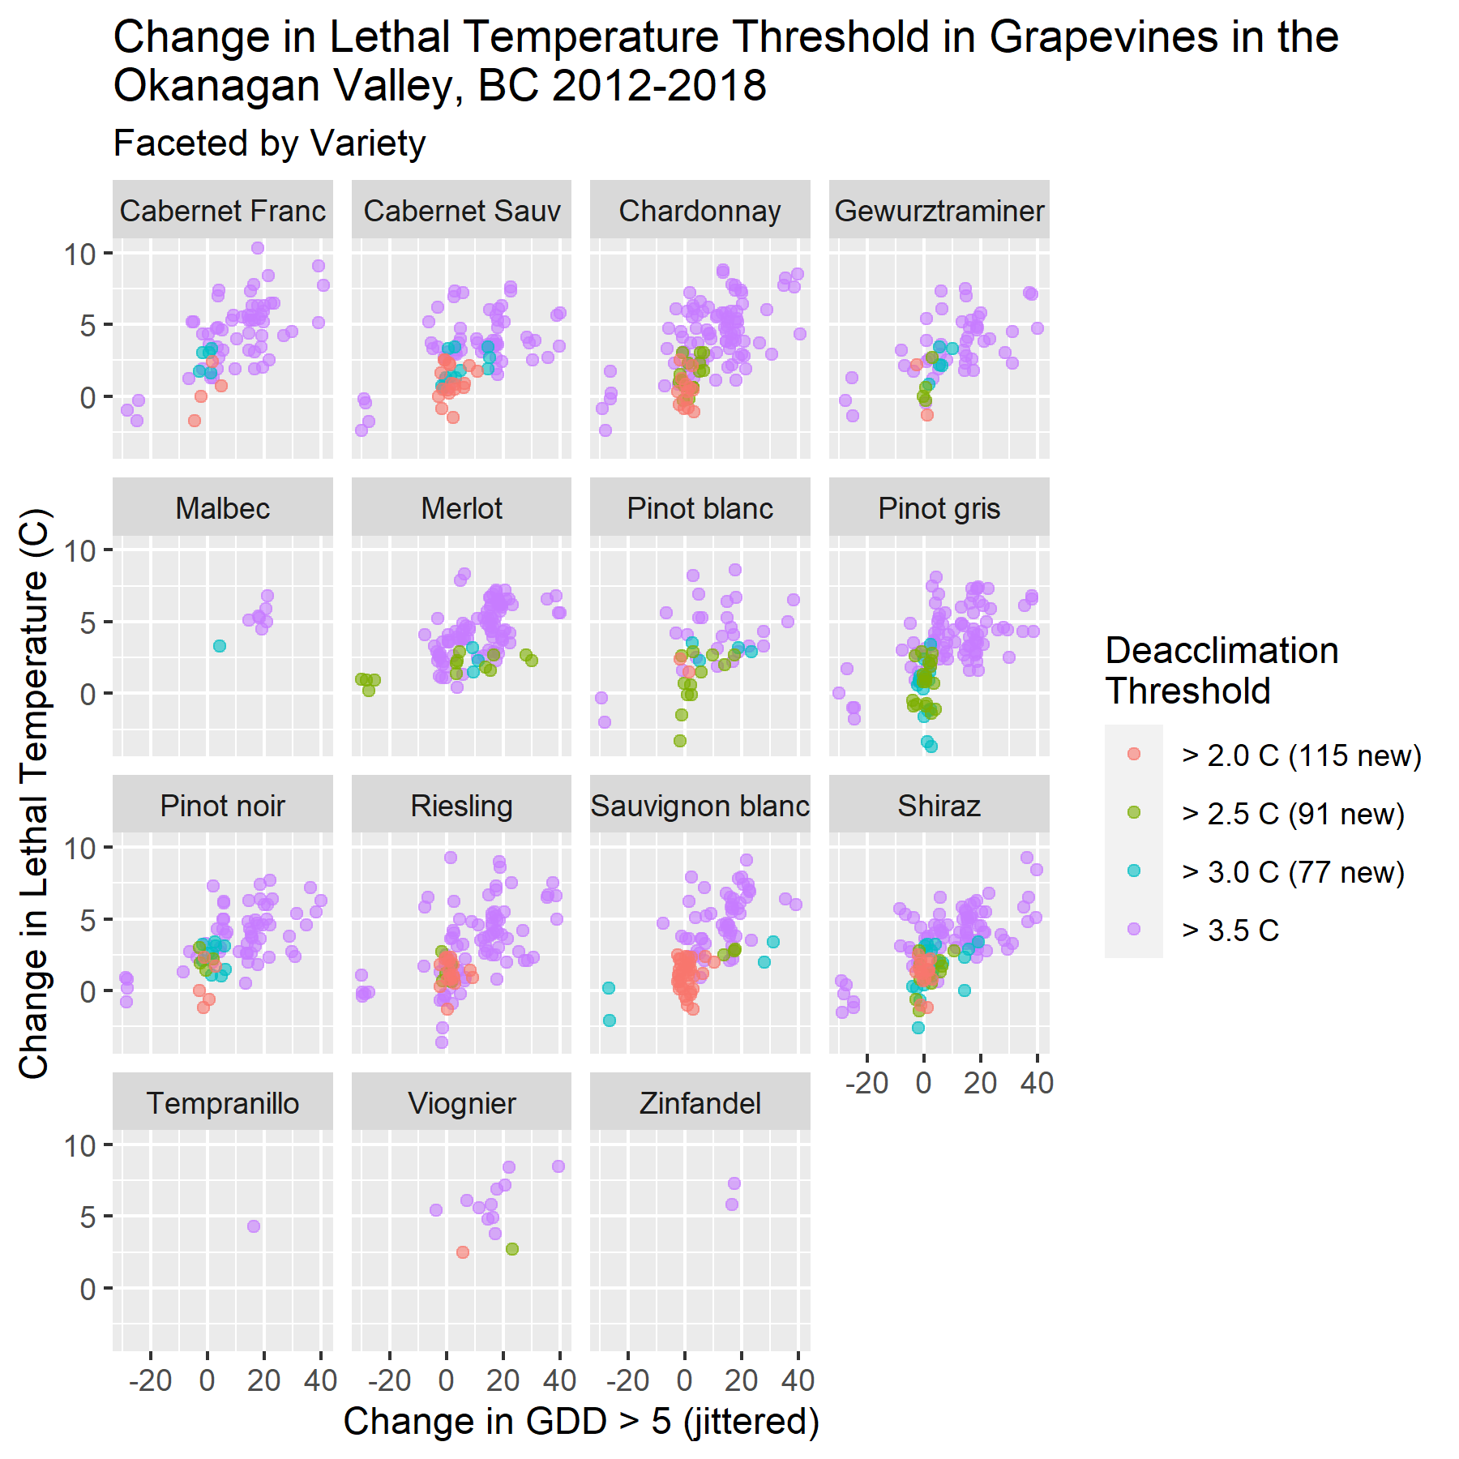
Real Data without Posterior Draws
Notes:
This is the real data without the posterior draws added.
The x shows the main predictor, change in GDD > 5 while the y shows the change in hardiness
The color of the dots emphasizes the additional data added by lowering the threshold when filtering for the deacclimation period
The orange dots had the easiest threshold to surpass which may have allowed data in the deep dormancy period to sneak through, as seen on the dots centered around (0,0)
Partial pooling really shows its benefit with varieties that have little data such as Zinfandel and Tempranillo as their slopes will be shared across all varieties.

Slide 8
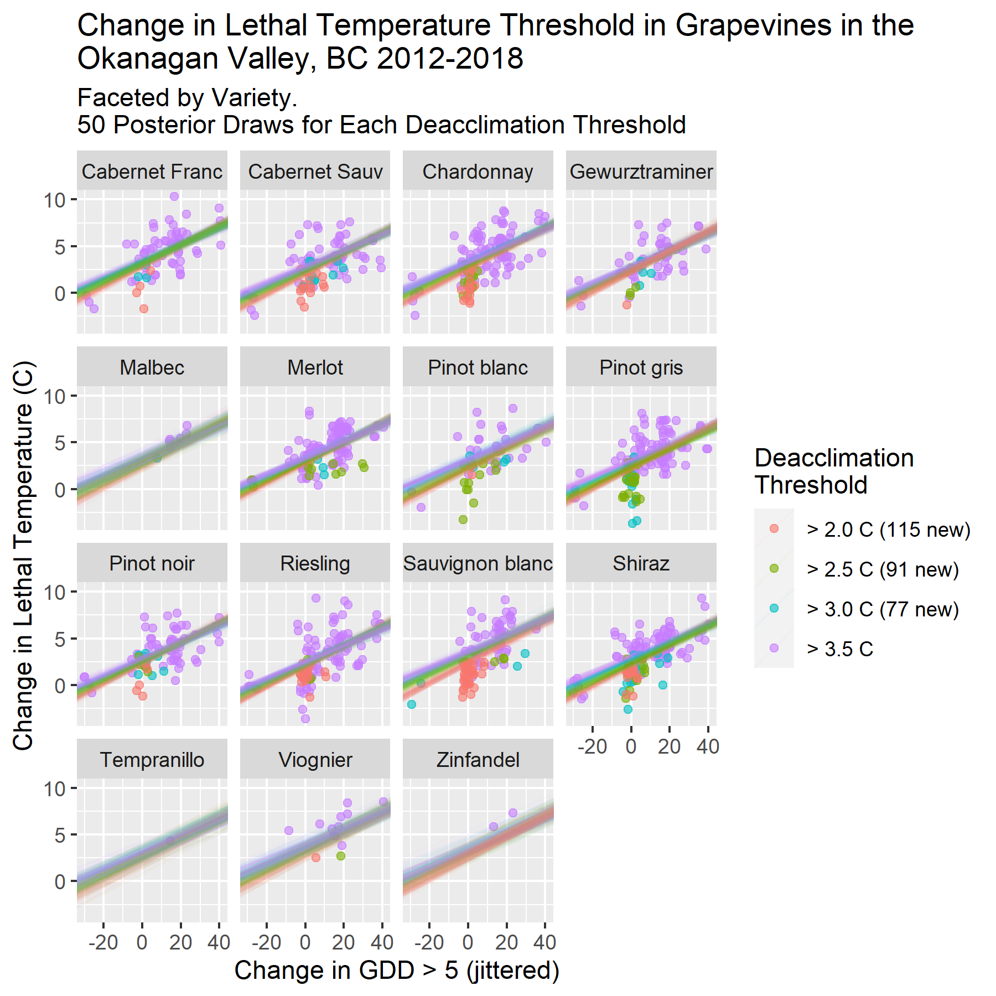
Model Fit to Real Data with Posterior Draws
Notes:
This plot shows adds 50 draws per deacclimation threshold, fitted to the data.
Because of the crossed hierarchical structure, the intercepts are allowed to vary by variety.
The overlap of posteriors is a little hard to see but its easy to see that the orange fit lines seem to be shifted downwards due to the high concentration of new values at (0,0)
The purple lines are consistently the highest as it was the hardest threshold to surpass.

Slide 9
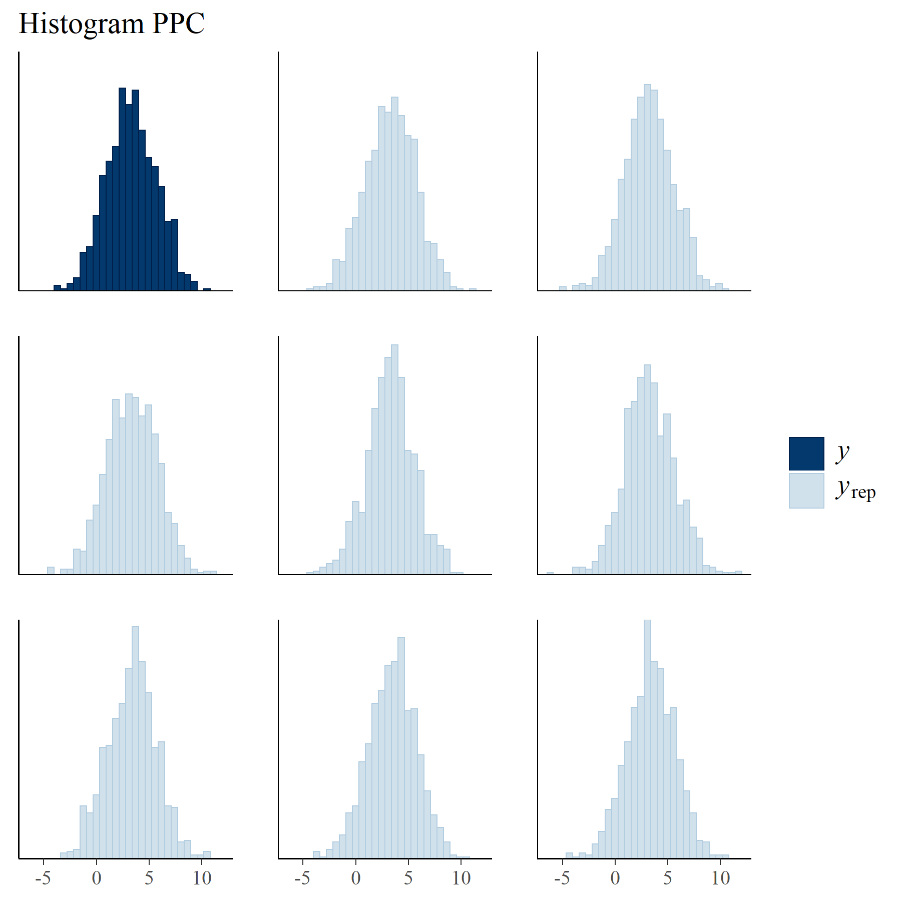
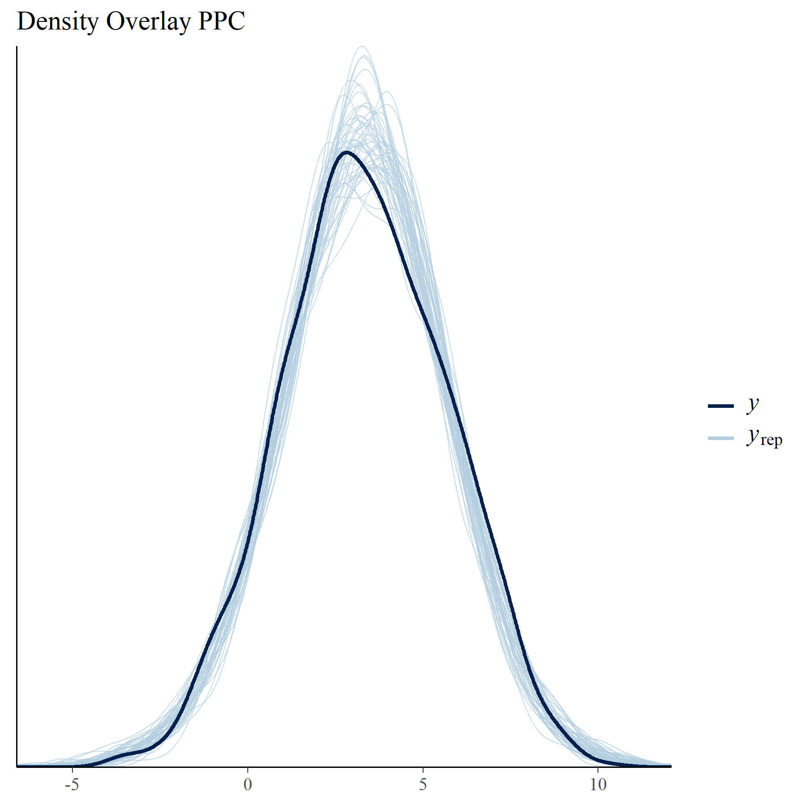
Posterior Predictive Checks
Notes:
Here is a couple of posterior predictive checks to inspect model fit.
The y_rep distributions do not seem to deviate drastically from the real data which is a good sign.

Slide 10
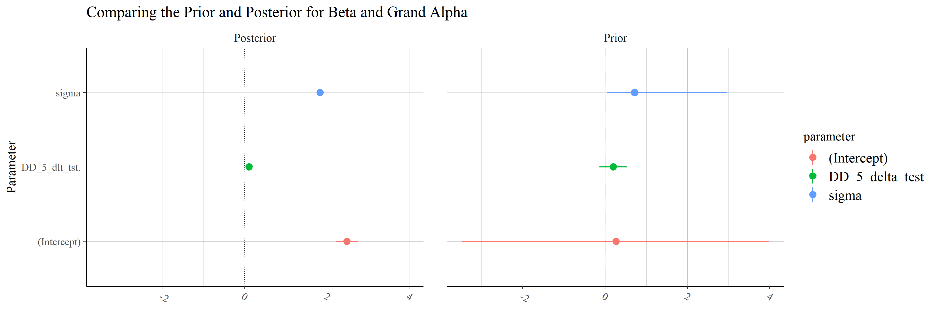
Findings
Notes:
And finally to the findings.
This slide shows the non multilevel parameters.
Each parameter seems to be estimated with a low standard error.

Slide 11
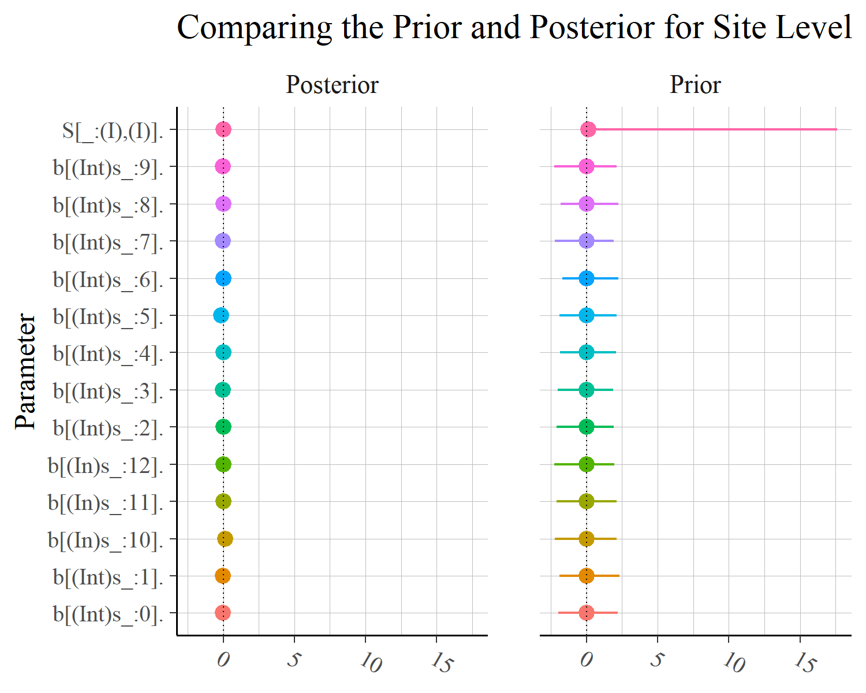
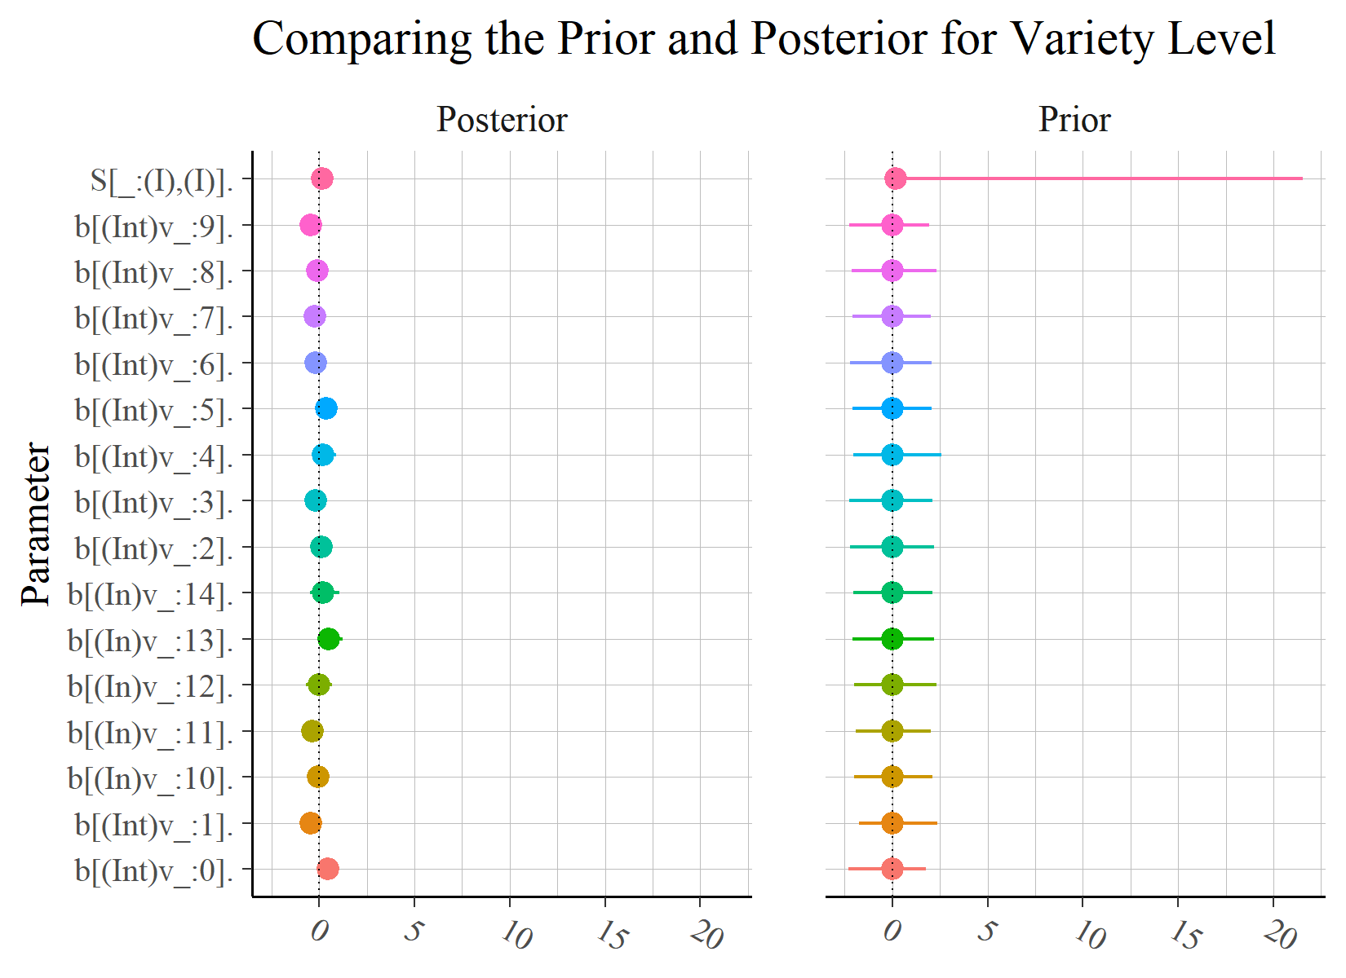
Hierarchical Findings
Notes:
This is the parameter output for the hierarchical levels.
There seems to be only very slight site variation, while variety dances on both sides of the grand alpha.

Slide 12
Next Steps
Extend hardiness modeling beyond the deacclimation phase
Model how the beginning of deep dormancy and deacclimation changes depending on the weather
Notes:
Moving forward, modeling beyond the deacclimation phase would be a good next step.
The relationships between the change in GDD > 5 and change in hardiness seems to continue but modeling this would seem to require a non linear fitting.
Another step could be to create a model which found the start and end of each phase in dormancy to test a different deacclimation filter.

