Slide 1

Modeling the Deacclimation Phase of Grapevine Cold Hardiness in the Okanagan Valley, BC
FRST 507C: Final Project
By Adam Fong

Slide 2
Introduction
Hardiness is measured by the lowest temperature which can be tolerated before death
A decrease in hardiness is an increase in the lethal temperature threshold
Growing Degree Days (GDD):
GDD_5 = mean daily temperature – 5 C

Slide 3
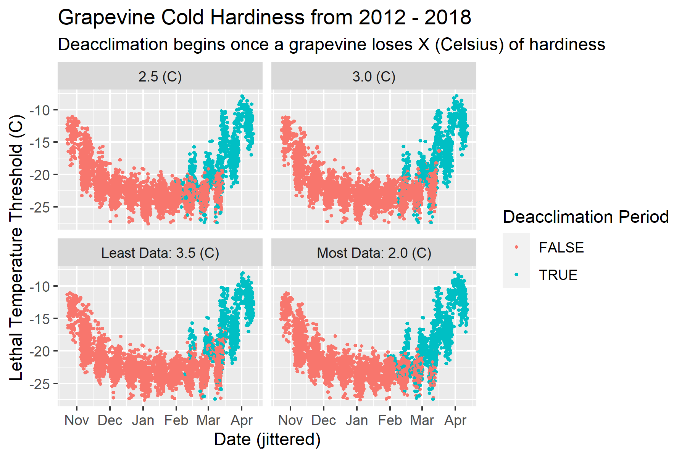

Slide 4

Model
$y \sim Normal\left(μ, σ_{grand}\right)$
$μ_{i} \sim α_{grand}+α_{site, i}+α_{variety, i}+β∗x_{i}$
$α_{site} \sim Normal\left(0, σ_{site}\right)$
$α_{variety}\sim Normal \left(0, σ_{variety}\right)$
Priors:
$α_{grand} \sim Normal\left(2, 1.5\right)$
$β \sim Normal\left(0.2, 0.2\right)$
$σ_{grand} \sim Exponential\left(1\right)$
$α_{site}\sim Uniform\left(−2, 2\right)$
$α_{variety}\sim Uniform(−2, 2)$

Slide 5
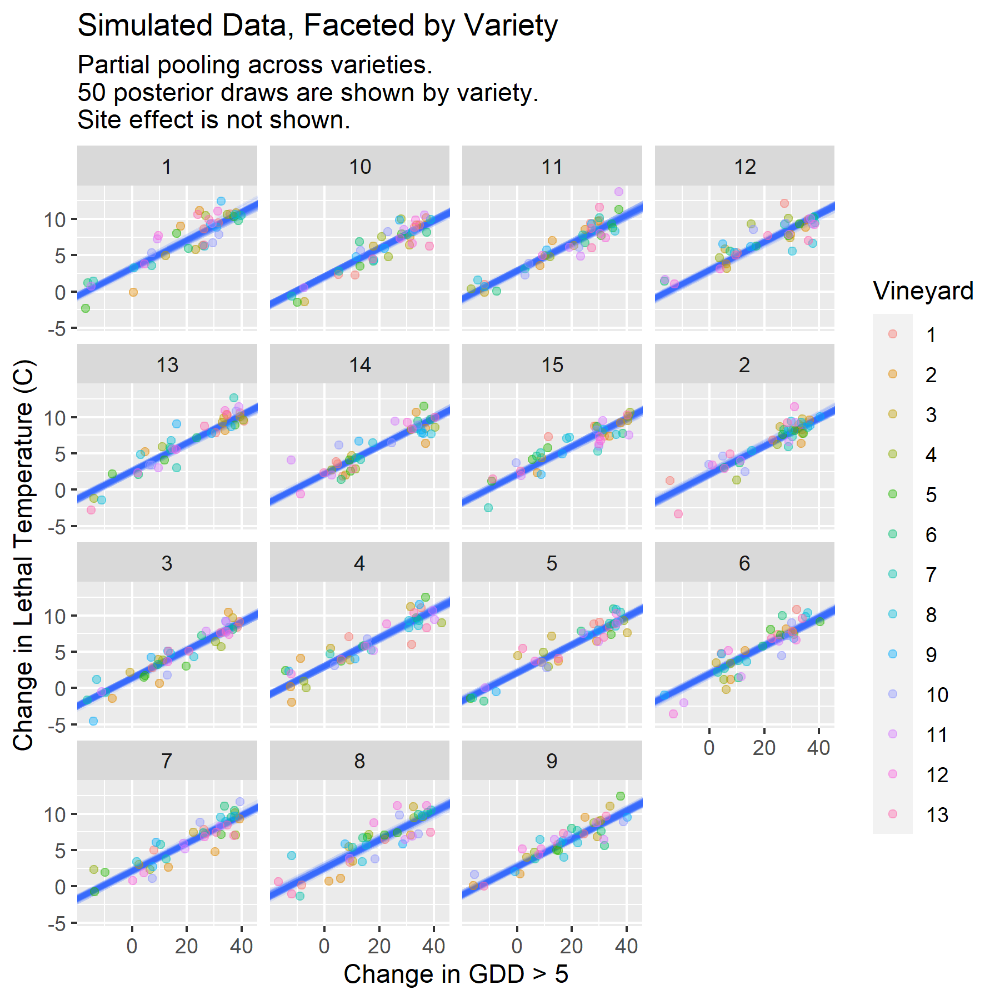
Model Fit of Simulated Data

Slide 6
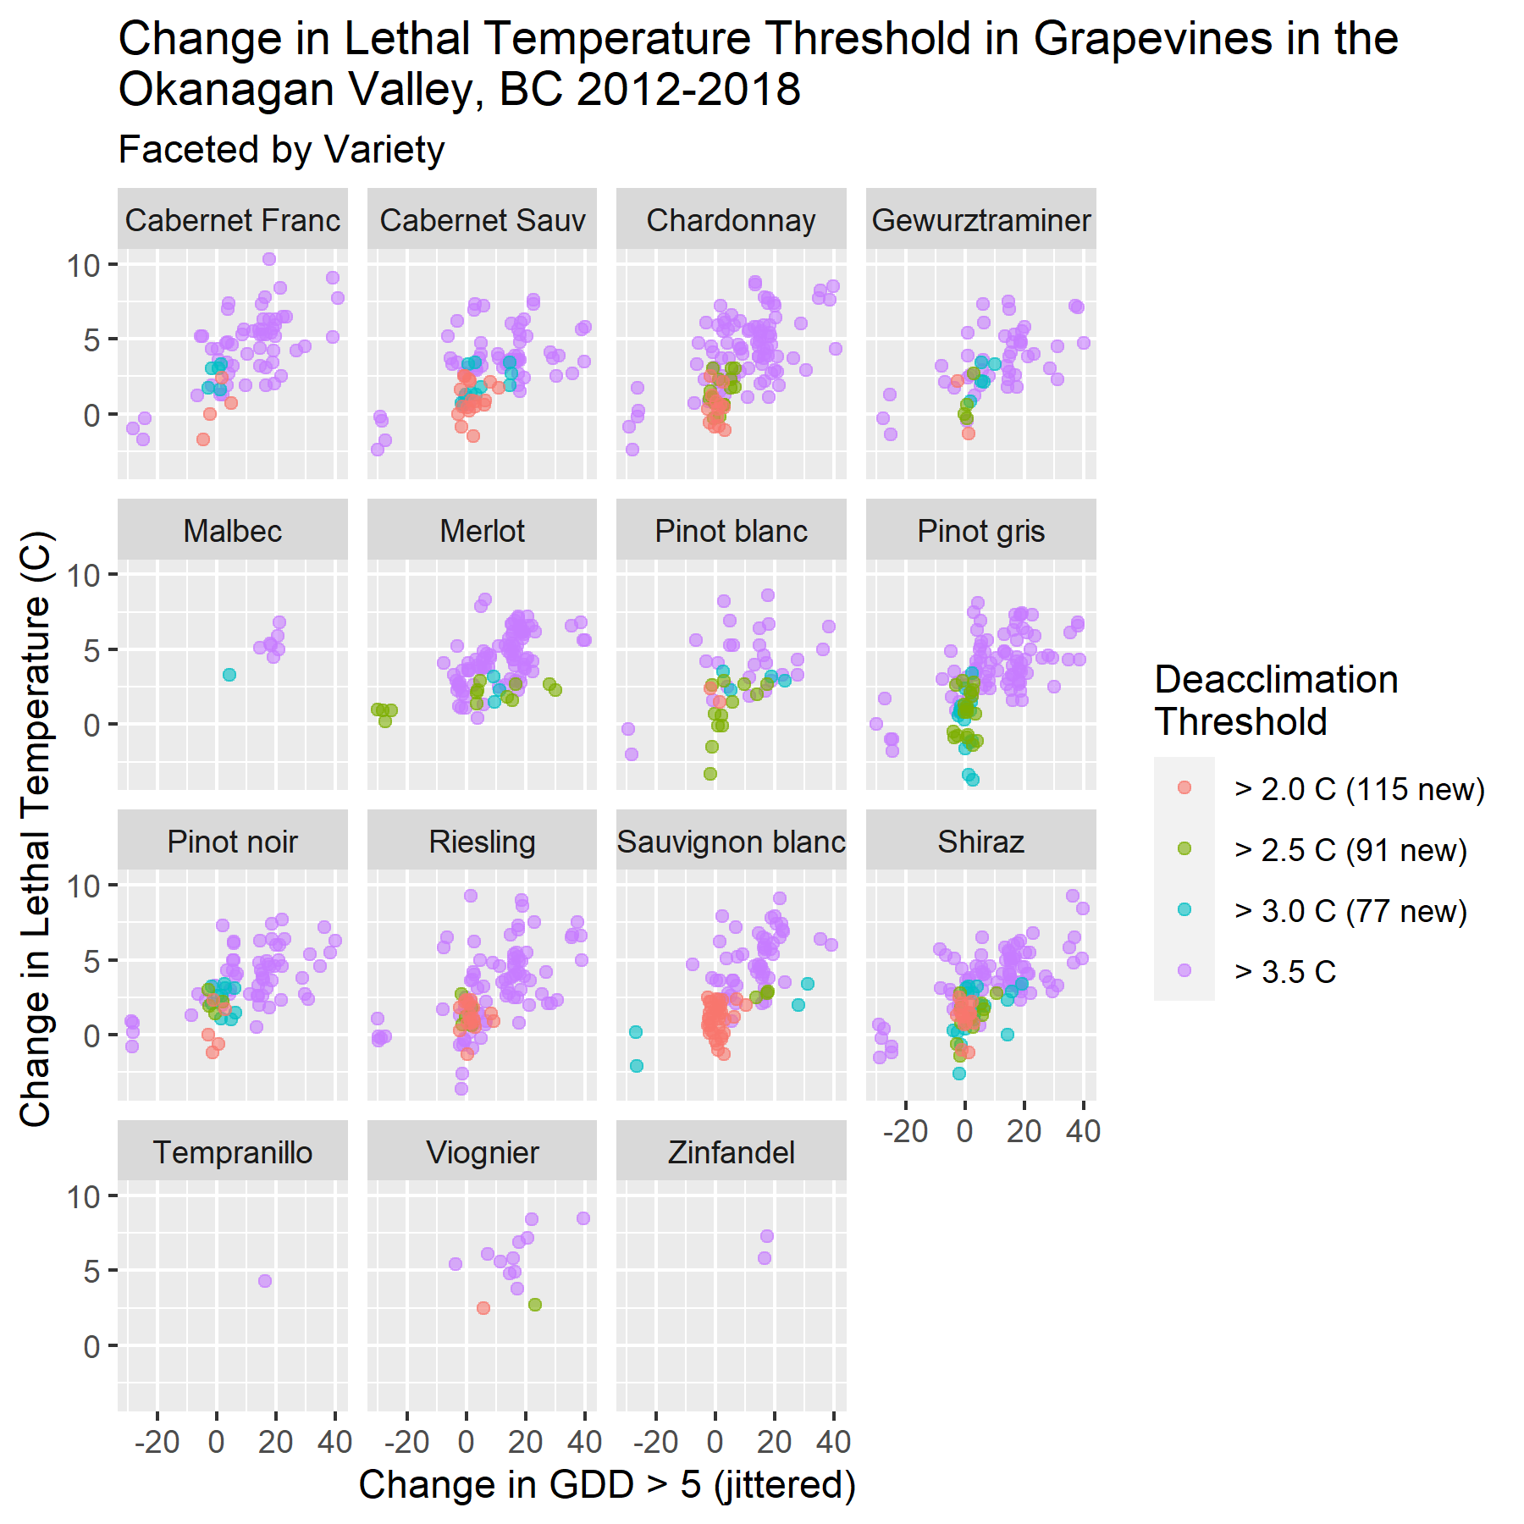
Model fit of Real Data

Slide 7
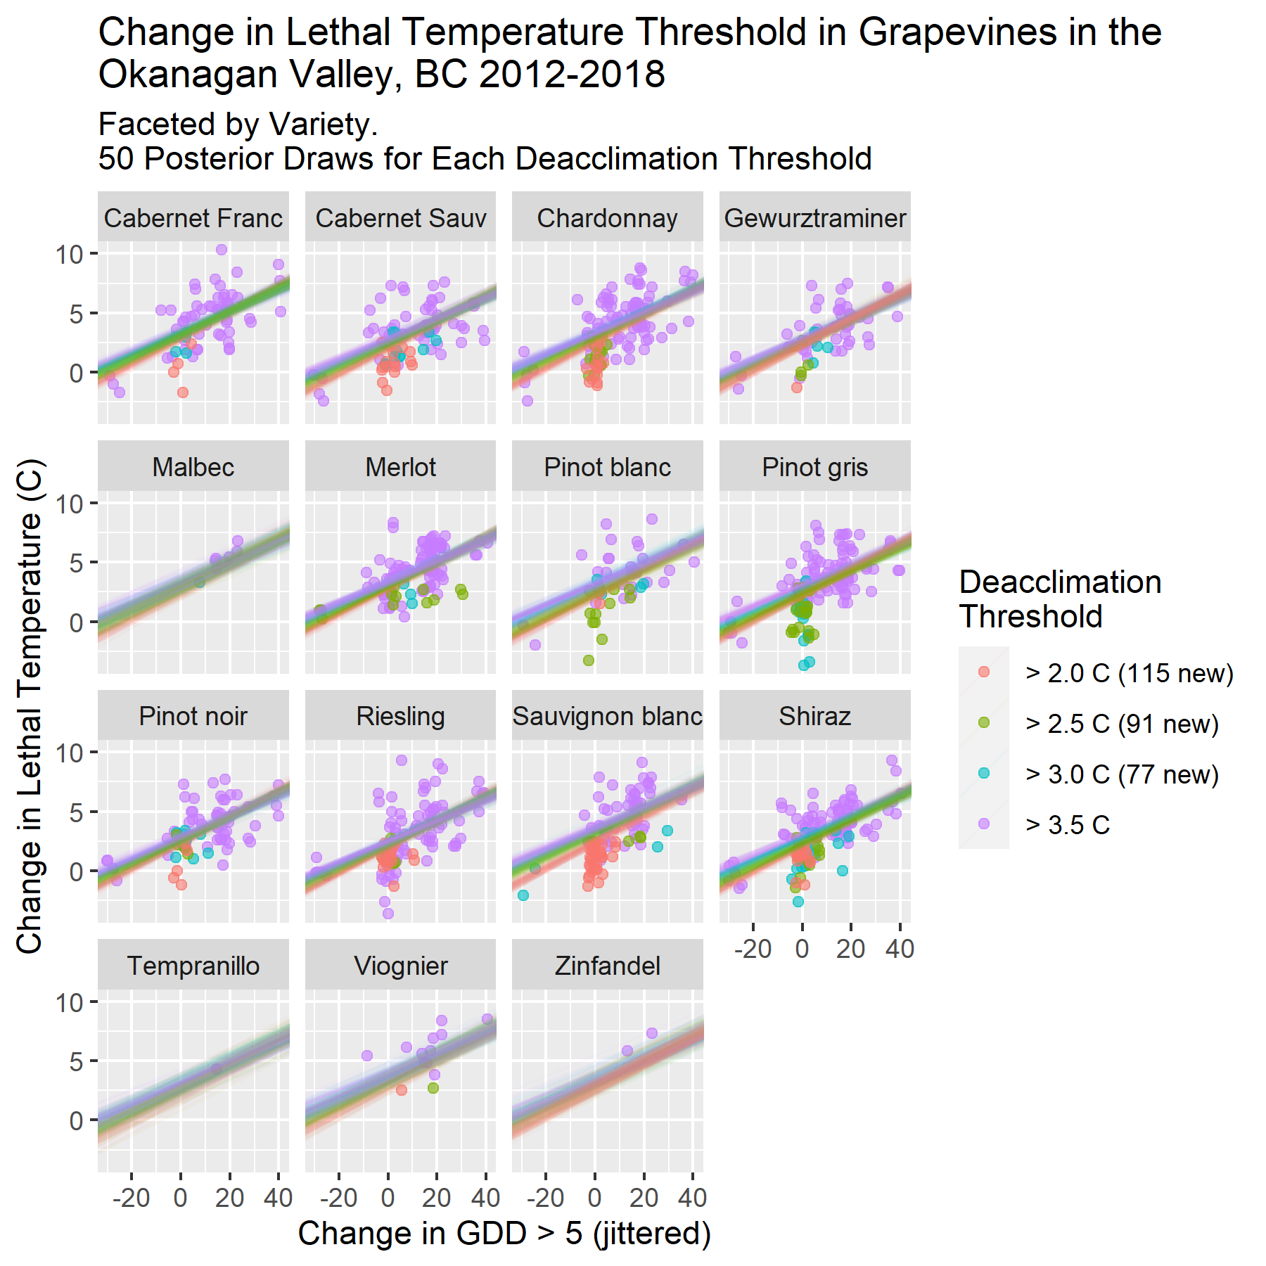
Model Fit to Real Data with Posterior Draws

Slide 8
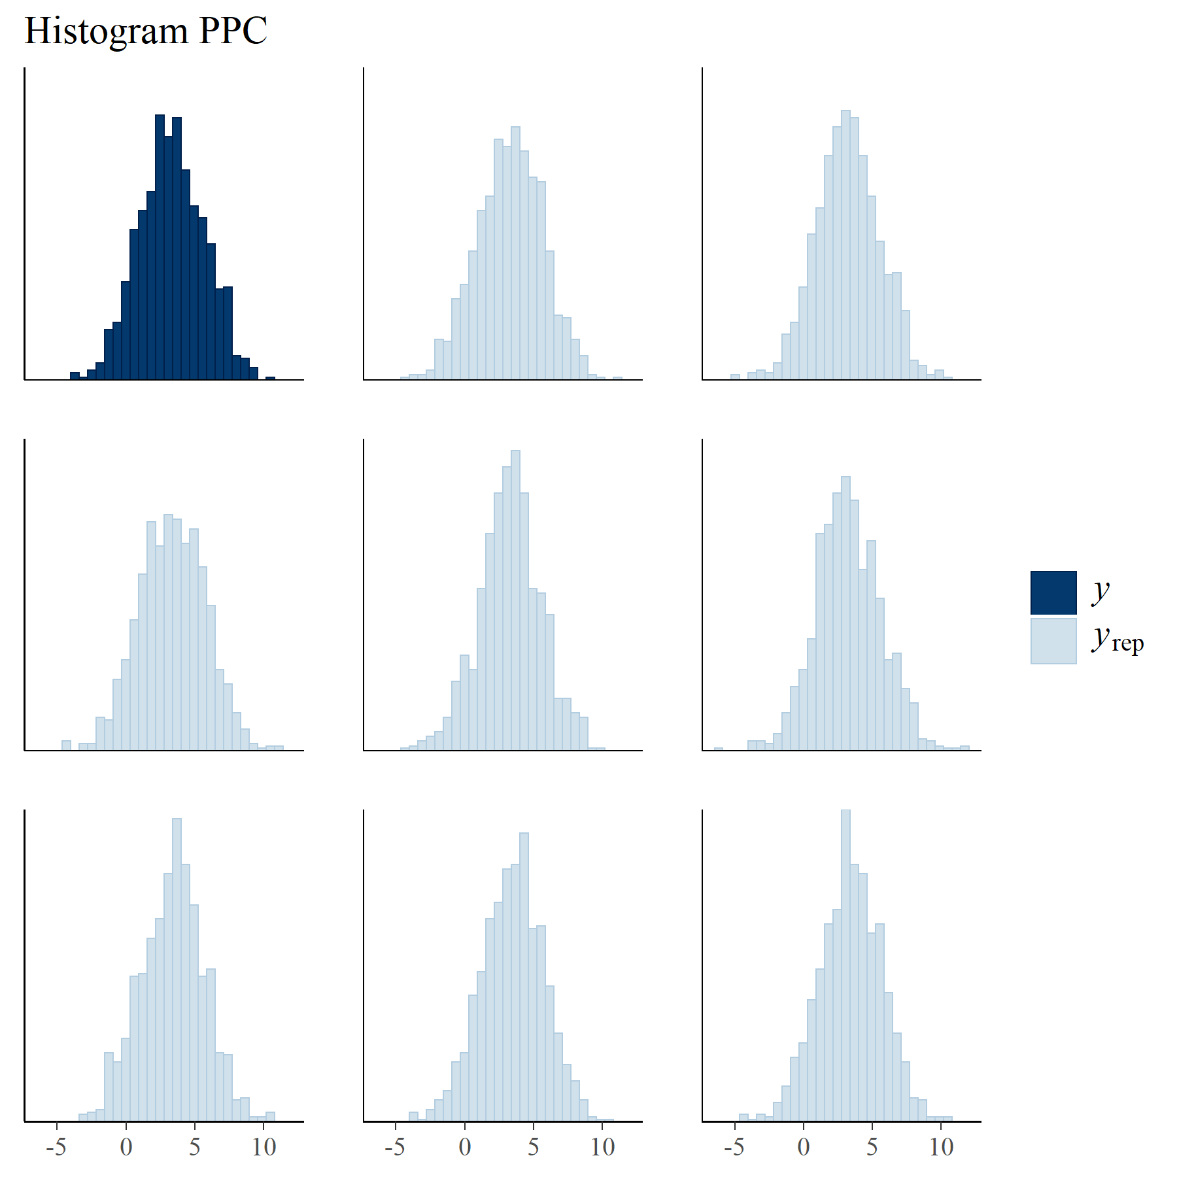
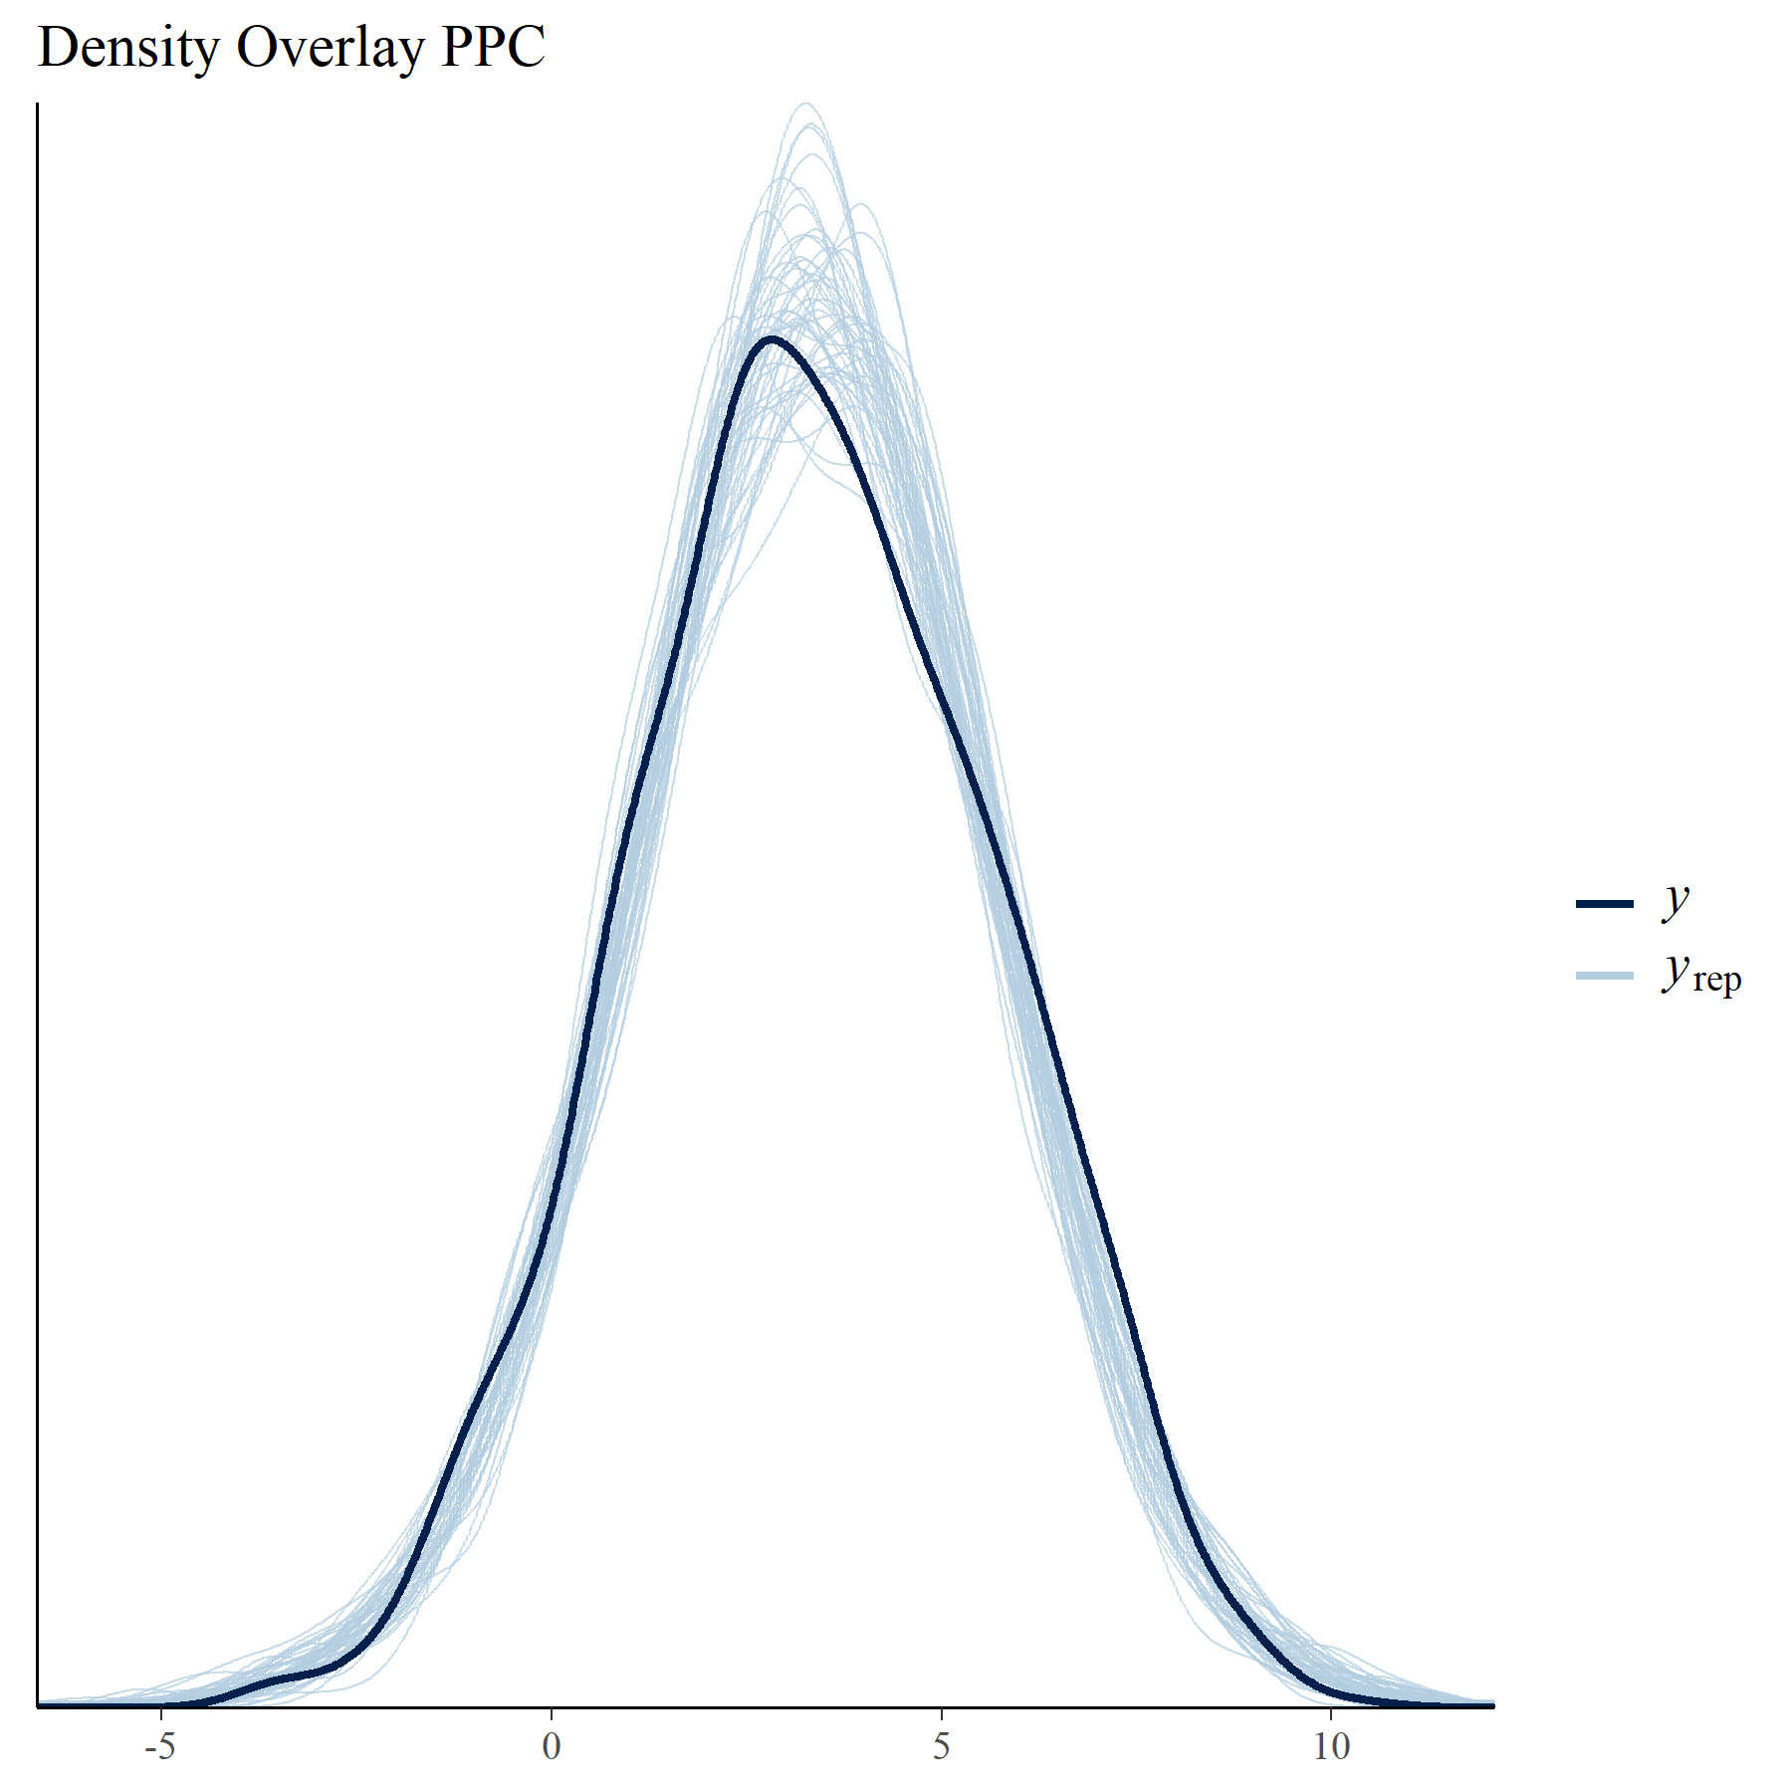
Posterior Predictive Checks

Slide 9
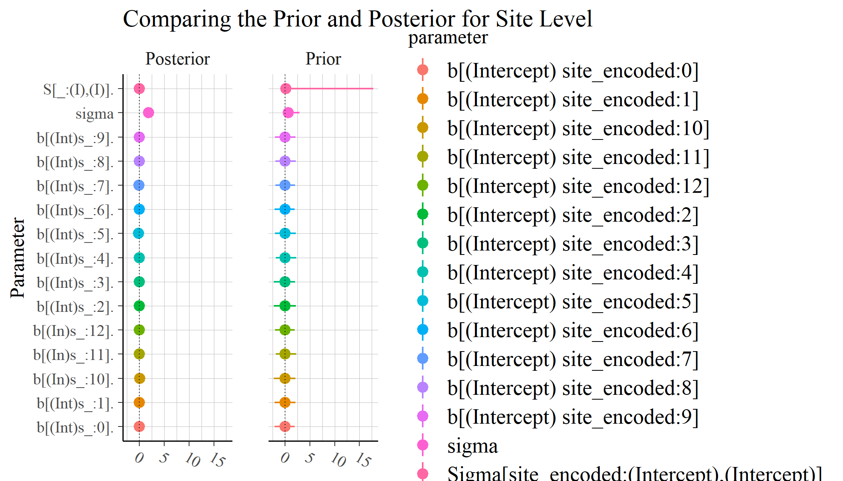
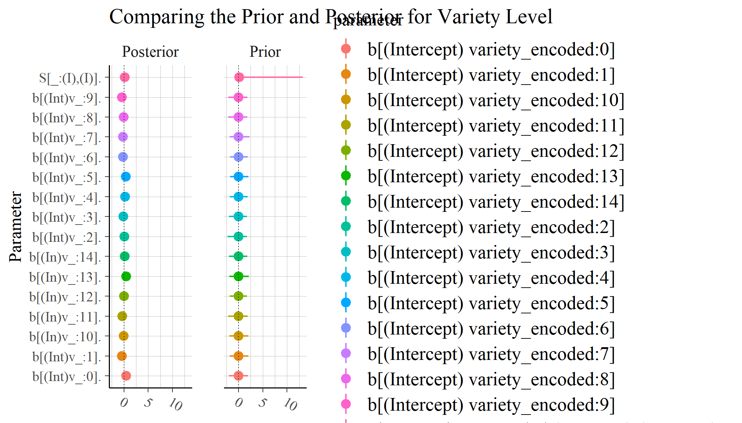
Findings

Slide 10
Next Steps

