Slide 1

React + Redux

Slide 2
Sobre
Zeu Cxb
Dev back-end na Like Online
Canal Eu Programador

Slide 3


Slide 4


Slide 5


Slide 6


Slide 10
E

Slide 11
Ea

Slide 12
Eae

Slide 13
Eae

Slide 14
Eae !

Slide 15
Eae !

Slide 16
Eae !

Slide 17
Eae !
Blz ☺

Slide 18
Chat

Slide 19
MessageList

Slide 20
Message

Slide 21
Form

Slide 22
Input

Slide 23
Button

Slide 29


Slide 30
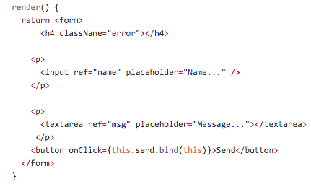
JSX

