Slide 1

Saddleback College CONTRACT EDUCATION
Excel 2016
VBA and Pivot Tables
Alan Foote, PhD
Saddleback College, Mission Viejo

Slide 2
Topics for the course
Excel Tables
VBA/Macros
PivotTables
External Data Objects
Charts and Graphs

Slide 3
Excel Tables
Plan and create a Excel table
Add, edit, and delete records in an Excel table
Filters/Sort/Totals
Slicer

Slide 4
Filtering Data
Filtering hides records that do not meet the criteria
Data can be:
Sorted
Copied
Formatted
Charted
Printed

Slide 5
Using a Slicer to Filter Data
Slicer to filter a table
Every slicer contains a button for each unique value
Format the slicer and its buttons, changing its style, height, and width

Slide 6
Creating Sparklines
A sparkline is a chart that is displayed entirely within a worksheet cell
Sparklines are compact in size
Sparklines are useful when you need a simple chart

Slide 7
Creating Data Bars
Conditional format that adds a horizontal bar to background
Length based on value of each cell
Dynamic—lengths of data bars changes if cell’s value changes
Modifying a Data Bar Rule

Slide 8
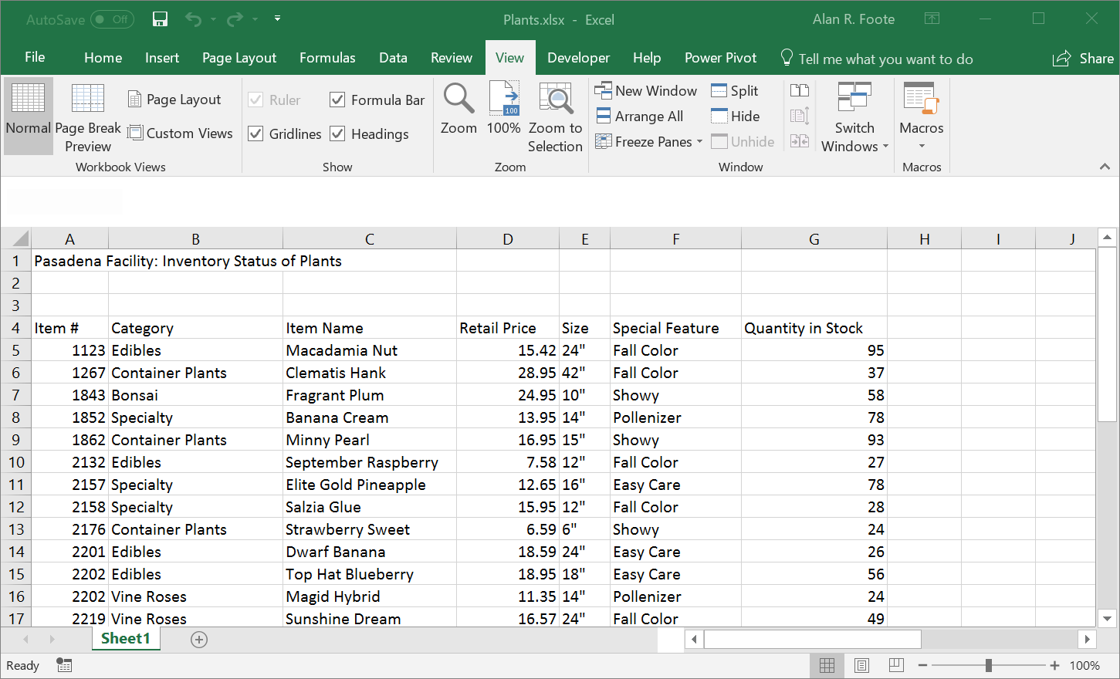
Freezing Rows and Columns
Freezing a row or column keeps headings visible as you work with data in a large worksheet

Slide 9
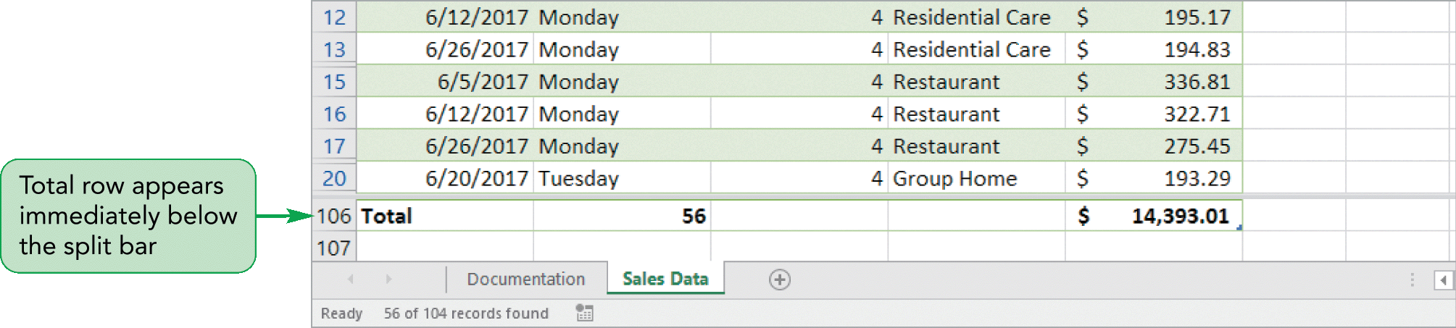
Splitting the Worksheet Window into Panes
Easily view data from several areas of the worksheet at the same time
Ribbon processing – View/Window/Split

Slide 10
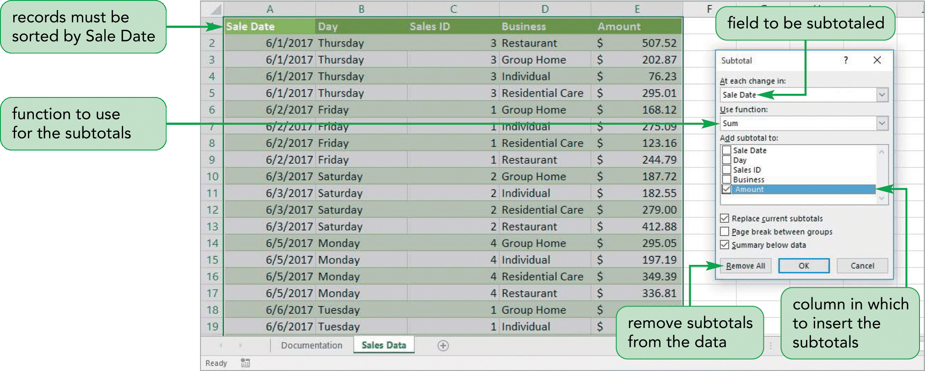
Inserting Subtotals

Slide 11
Using LOOKUP Functions
VLOOKUP(lookup_value,table_array,col_index_num[range_lookup])
HLOOKUP(lookup_value,table_array,row_index_num[,range_lookup])
Sort the table_array from lowest to highest
Major difference between HLOOKUP and VLOOKUP functions is the way lookup tables are organized

Slide 12
Excel Table Exercise
Open OpticalSunglases.xlsx
Convert Range A2:G16 to a table – Optical
Add Total Row and Total 2018-2020
Filter by Shape
Sort by Product Code
Add data bars to 2018
In Cell B21 – Enter Product Code
In Cell B22 – Vlookup for 2018 Sales (Column E)
In Cell B23 – Vlookup for 2019 Sales (Column F)
In Cell B24 – Vlookup for 2020 Sales (Column G)

Slide 13
Creating an Application
Use defined names in formulas
Add defined names to existing formulas
Create validation rules for data entry
Protect the contents of worksheets and workbooks
Add, edit, and delete comments
Macros and VBA

Slide 14
Naming Cells and Ranges
Must begin with a letter or _ (an underscore)
Letters and numbers as well as periods and underscores
No spaces
Up to 255 characters
Not case sensitive

Slide 15
Validating Data Entry
Validation rule provides criteria for the data
Input and error alert messages
Input message, and the error alert

Slide 16
Validating Data Entry by Creating an Input Message
Reduce data-entry error by displaying an input message
Additional information about the type of data
Input messages appear as ScreenTips
Can add an input message to a cell without a validation rule

Slide 17
Data Entry List Validation Rules
Data validation feature to accept only entries that are on a list
List box with the possible values appears for the user
Test validation rules by entering incorrect values that violate the validation rules

Slide 18
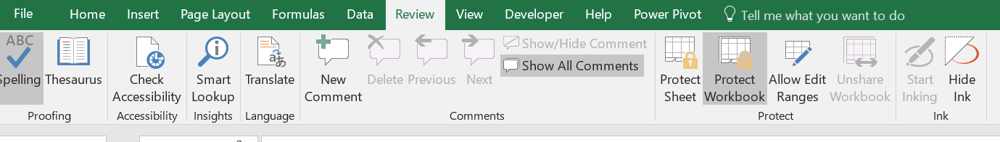
Protecting Worksheet and Workbook
Worksheet protection prevents users from changing cell contents
Workbook protection also prevents users from changing the workbook’s organization
Can keep users from viewing the formulas

Slide 19
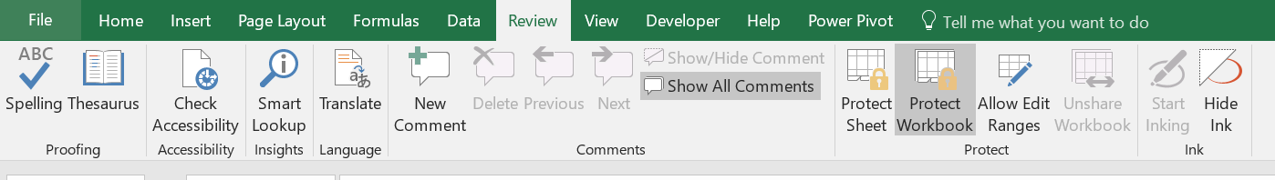
Inserting Comments
Comments are added to
Explain the contents of a particular cell
Provide instructions to users
Share ideas and notes

Slide 20
Automating Tasks with Macros
Macros automate any task you perform repeatedly
Macros perform repetitive tasks consistently and faster than you can.
After the macro is created and tested, you can be assured the tasks are done exactly the same way each time
To create and run macros, you need to use the Developer tab

Slide 21
Recording a Macro
Macro stored in the current workbook (only available with that workbook)
Store the macro in the Personal Macro workbook, a hidden workbook named Personal.xlsb that opens whenever you start Excel
Can store the macro in a new workbook

Slide 22
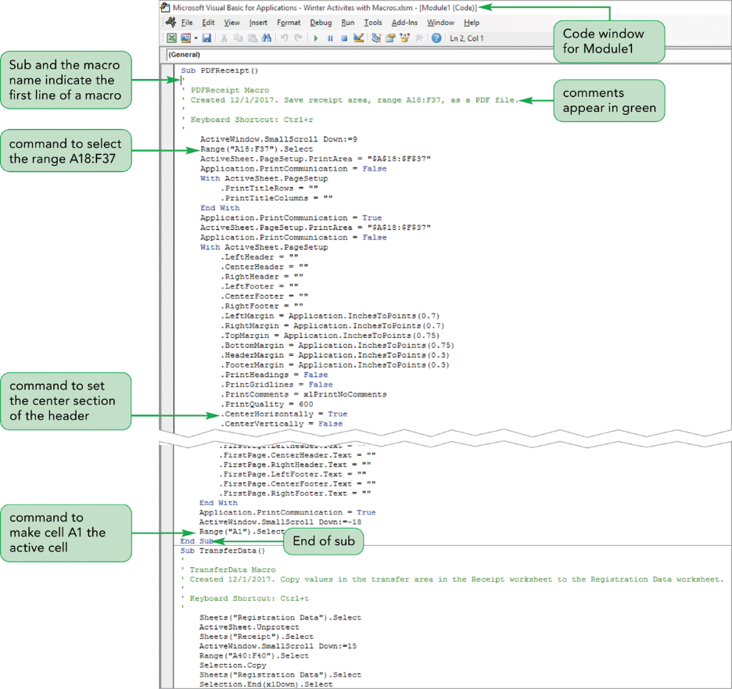
Working with the Visual Basic Editor

Slide 23
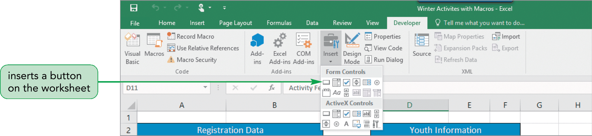
Creating Macro Buttons
Run a macro with a button on the worksheet
Macro buttons are often a better way to run macros
Clicking a button (with a descriptive label) is simpler for users than trying to remember different combinations of keystrokes

Slide 24
Macro Exercise
Open OpticalDataEntry.xlsx
Create Macro –AddtoTable
The macro transfer data from the DataEntry worksheet –Cells (A10:G10) to end of table on SunglassData worksheet.
Use Type and Material as rows
Totals for 2018, 2019 and 2020
Filter by Shape
Add a Clustered Column Pivot Chart
Add a linear trendline based upon Sales for 2020

Slide 25
PivotTables
Create and modify a PivotTable
Apply PivotTable styles and formatting
Filter a PivotTable
Insert a slicer to filter a PivotTable
Insert a recommended PivotTable

Slide 26
Adding Fields to a PivotTable
Summary data fields are Values fields
Grouping the values into Category fields
PivotTable Fields pane is divided into two sections:
The Fields section lists the names of each field in the data source
Lower Section - adds field to the FILTERS, ROWS, COLUMNS, or VALUES area

Slide 27
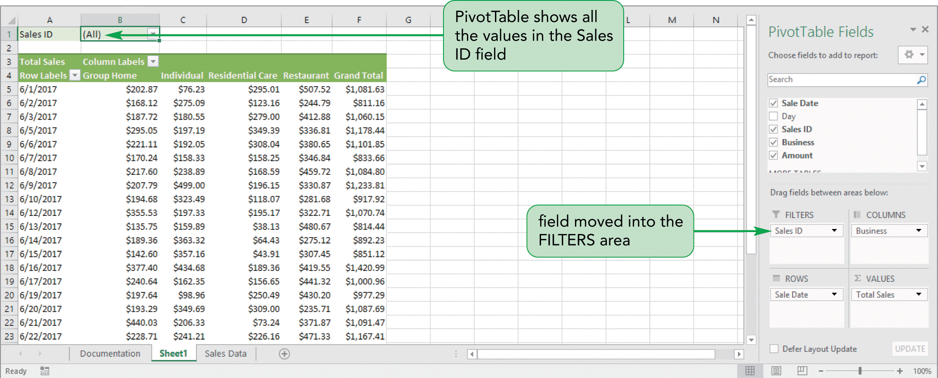
Filtering a PivotTable

Slide 28
Creating a Slicer to Filter a PivotTable
Filter a PivotTable is with a slicer
Slicer for any field in the PivotTable Fields pane
Slicer for each unique value in that field
Format the slicer by changing its style, height, and width
More than one slicer at a time

Slide 29
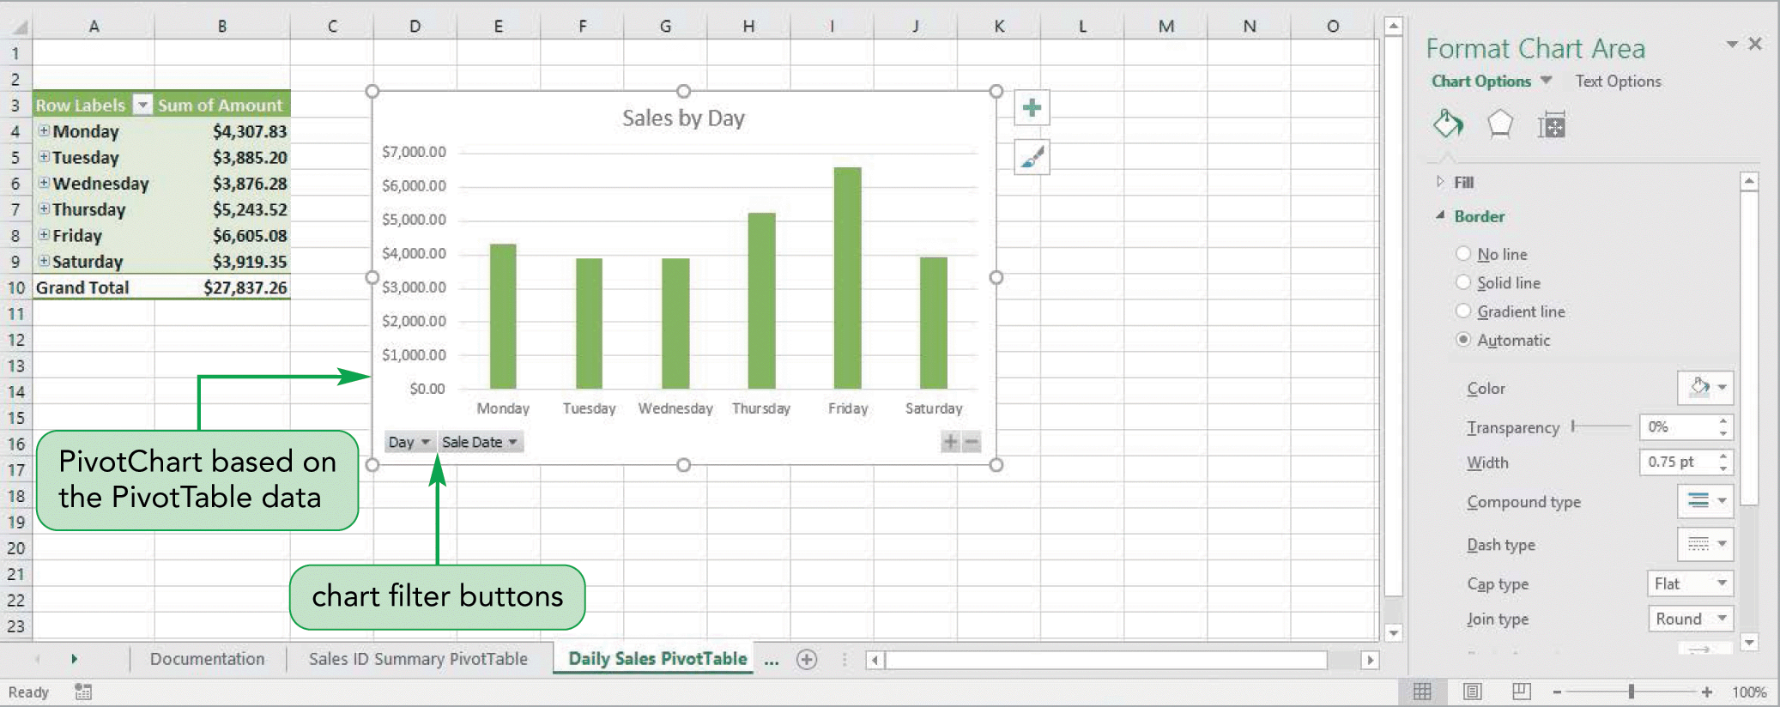
Creating a PivotChart

Slide 30
PivotTable Exercise
Open OpticalAllProducts.xlsx
Create PivotTable on new Worksheet
Use Type and Material as rows
Totals for 2018, 2019 and 2020
Filter by Shape
Add a Clustered Column Pivot Chart
Add a linear trendline based upon Sales for 2020

Slide 31
Using Templates
A template workbook is a model from which you create new workbooks
Any changes or additions made to the new workbook do not affect the template file

