Slide 1
UYGULAMA-1
Bilgisayar Mimarisi

Slide 2



Instruction Formats

Slide 3
Mnemonic | Meaning | Type | Opcode | Funct
add | Add | R | 0x00 | 0x20
addi | Add Immediate | I | 0x08 | NA
addiu | Add Unsigned Immediate | I | 0x09 | NA
addu | Add Unsigned | R | 0x00 | 0x21
and | Bitwise AND | R | 0x00 | 0x24
andi | Bitwise AND Immediate | I | 0x0C | NA
beq | Branch if Equal | I | 0x04 | NA
bne | Branch if Not Equal | I | 0x05 | NA
div | Divide | R | 0x00 | 0x1A
divu | Unsigned Divide | R | 0x00 | 0x1B
j | Jump to Address | J | 0x02 | NA
jal | Jump and Link | J | 0x03 | NA
jr | Jump to Address in Register | R | 0x00 | 0x08
jalr | Jump to Address in Register and Link | R | 0x00 | 0x09
0000 0000
0000 0100

Slide 4
lbu | Load Byte Unsigned | I | 0x24 | NA
lhu | Load Halfword Unsigned | I | 0x25 | NA
lui | Load Upper Immediate | I | 0x0F | NA
lw | Load Word | I | 0x23 | NA
mfhi | Move from HI Register | R | 0x00 | 0x10
mflo | Move from LO Register | R | 0x00 | 0x12
mfc0 | Move from Coprocessor 0 | R | 0x10 | NA
mult | Multiply | R | 0x00 | 0x18
multu | Unsigned Multiply | R | 0x00 | 0x19
nor | Bitwise NOR (NOT-OR) | R | 0x00 | 0x27
xor | Bitwise XOR (Exclusive-OR) | R | 0x00 | 0x26
or | Bitwise OR | R | 0x00 | 0x25
ori | Bitwise OR Immediate | I | 0x0D | NA
sb | Store Byte | I | 0x28 | NA

Slide 5
Shift-right bölme
işlemi yapar

Slide 6
Jr
The jr instruction loads the PC register with a value stored in a register.
As such, the jr Instruction can be called as such:
jr $t0
assuming the target jump location is located in $t0.
Jalr
The same as the jr instruction, except that the return address is loaded into the $ra register.

Slide 7
JAL
Jump and Link instructions are similar to the jump instructions,
except that they store the address of the next instruction (the one immediately after the jump) in the return address ($ra; $31) register. This allows a subroutine to return to the main body routine after completion.
Example:
Let's say that we have a subroutine that starts with the label MySub. We can call the subroutine using the following line:
jal MySub ...
And we can define MySub as follows to return to the main body of the parent routine:

Slide 8
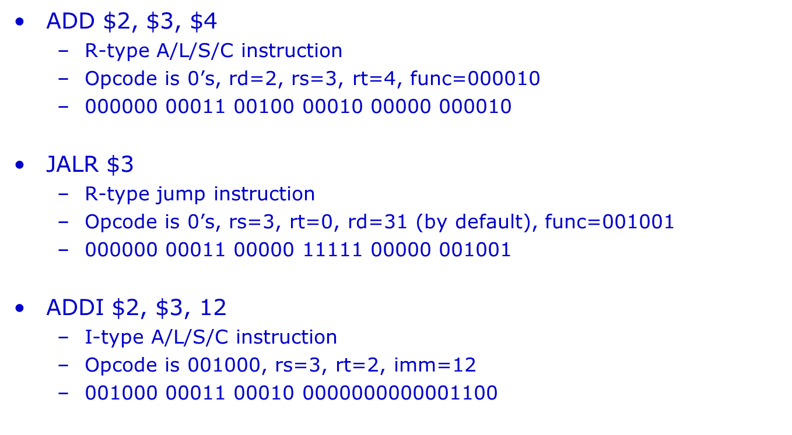
SORU 1: Aşağıdaki komutların makine kodu karşılıklarını bulunuz?
rd-rs-rt
R type op code her zaman 0 olur
100000
Bu komut için rd her zaman 31 yani 0001 1111

Slide 9
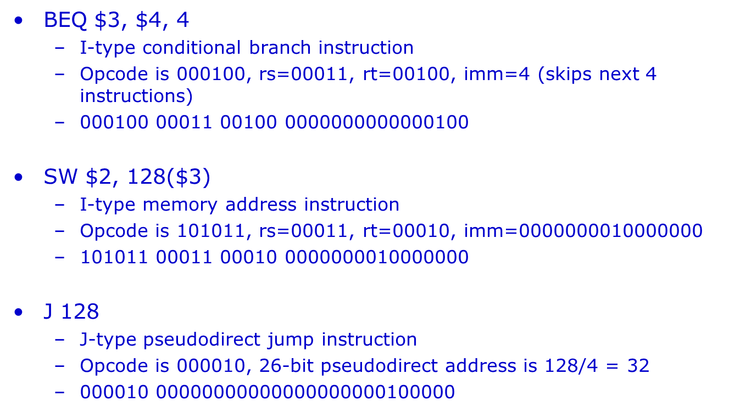
128 hesapla soldan 4 sağdan 2 at geri kalanı opcode un yanına al

Slide 10
SORU 2 : Aşağıdaki pseudo komutların gerçek makine komutları cinsinden karşılığını yazınız?
li $s0, 17 assembler pseudo-instruction
Actual machine instruction
addiu $s0, $zero, 17 (addi, ori or other equivalent answers also ok)
(b) bge $s0, $t0, there assembler pseudo-instruction
Actual machine instruction
slt $at, $s0, $t0 # $at = 1 if <, or 0 if ≥
beq $at, $zero, there

Slide 11
SORU 3 :
Suppose we have a 32-bit MIPS word containing the value 0x008A1021.
We would like to know what MIPS machine instruction this represents.
Write this instruction word in binary.
0 0 0 0 0 0 0 0 1 0 0 0 1 0 1 0 0 0 0 1 0 0 0 0 0 0 1 0 0 0 0 1
op rs rt rd shamt funct
(b) What is the format of this instruction? (circle)
R I J
c) Translate this instruction to assembly language. Use symbolic register names like
$t8 instead of absolute register numbers like $24.
addu $v0, $a0, $t2

Slide 12
SORU 4 : Suppose we execute the following MIPS instructions
li $t0, 2
li $t1, 5
slt $t2, $t1, $t0
beq $t2, $zero, skip
addi $t1, $t2, 3
skip:
li $v0, 42
In the table, write down each of the registers changed during execution and their values after the code has executed.
Register $t0 $t1 $t2 $v0
Value 2 5 0 42
t1 t0 dan küçükse t2 ye 1 ata
t2 ile zero ya bak eşitse atla

Slide 13
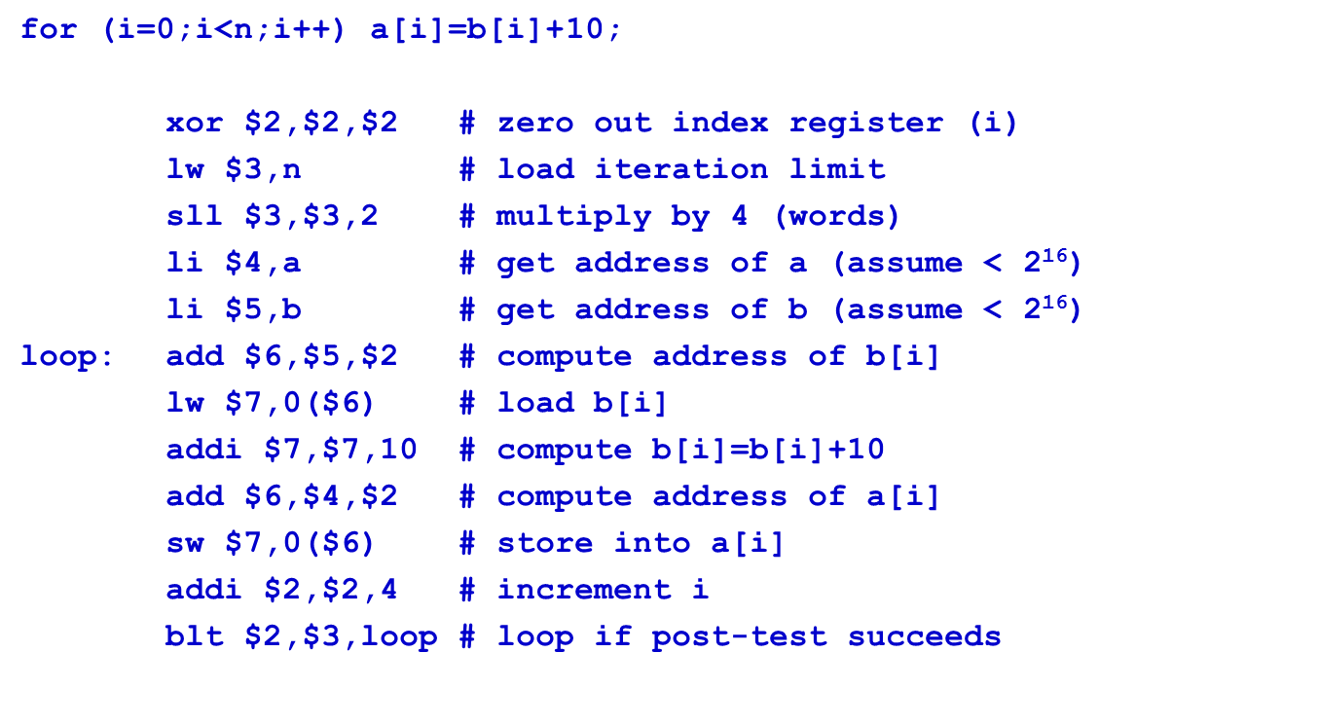
SORU 5 : DİZİN ELEMANLARINI SABİTLE TOPLAYIP BAŞKA BİR DİZİNE ATAMA PROGRAMINI MIPS KOMUTLARIYLA YAZINIZ?

Slide 14
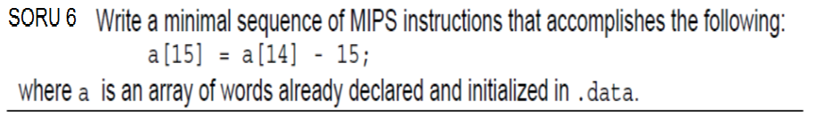
li $t0, a
lw $t1, 56($t0)
addi $t1, $t1, -15
sw $t1, 60($t0)
or the slightly longer:
addi $t0, $0, 56
lw $t1, a($t0)
addi $t1, $t1, -15
addi $t0, $0, 60
sw $t1, a($t0)

Slide 15
Mıps mimarisi 32 bit yüklemeye izin vermez.
Bu sebeple 16 bit olarak ayırmamız gerekir
beq $t1, $t2, long
j fin
long: lui $t0, 0xffff
addi $t0, $t0, 0xfffc
jr $t0
fin:

Slide 16
000100 10100 11101 0000 0000 0000 0001

Slide 17
0 register ı ile 35 i topla t3 e kaydet. T3 ile t0 ı çarp.
div $t1, $t2
mflo $t0
addi $t3, $0, 35
mult $t3, $t0
mflo $t3
addi $t3, $t3, 14

Slide 18
Sağa kaydırıp sola kaydırması son bitin
kesin 0 olması anlamına gelir.
T0 atanan bit(kaydırılan bit 0…0 or 0…1)
srl $t0, $a0, 31
lui $t2, 0xffff
ori $t2, $t2, 0xfffe
and $t1, $a0, $t2
or $a0, $t1, $t0
also srl $t0, $a0, 31
srl $a0, $a0, 1
sll $a0, $a0, 1
or $a0, $ao, $t0

