Slide 1
BİLGİSAYAR MİMARİSİ
COMPUTER ARCHITECTURE
2017-2018 Bahar Yarıyılı
Prof.Dr. Ahmet SERTBAŞ
İstanbul Üniversitesi
Bilgisayar Mühendisliği
Notes:
credential:
bring a computer
die photo
wafer
:
This can be an hidden slide. I just want to use this to do my own planning.
I have rearranged Culler’s lecture slides slightly and add more slides. This covers everything he covers in his first lecture (and more) but may
We will save the fun part, “ Levels of Organization,” at the end (so student can stay awake): I will show the internal stricture of the SS10/20.
Notes to Patterson: You may want to edit the slides in your section or add extra slides to taylor your needs.

Slide 2
Değerlendirme
Yıliçi Sınavı % 30
Proje % 20
Final % 50
Notes:
credential:
bring a computer
die photo
wafer
:
This can be an hidden slide. I just want to use this to do my own planning.
I have rearranged Culler’s lecture slides slightly and add more slides. This covers everything he covers in his first lecture (and more) but may
We will save the fun part, “ Levels of Organization,” at the end (so student can stay awake): I will show the internal stricture of the SS10/20.
Notes to Patterson: You may want to edit the slides in your section or add extra slides to taylor your needs.

Slide 3
DERSİN KAYNAKLARI
Computer Architecture : A Quantitaive Approach
David A. Patterson and John Hennessy – Morgan Kaufmann Publ.
Computer Organization and Architecture
Linda Null and Julia Lobur- Jones and Bartlett Computer Science- 2003
Computer System Architecture
M.Morris Mano- Pritice Hall Int. - Third Edition
Notes:
credential:
bring a computer
die photo
wafer
:
This can be an hidden slide. I just want to use this to do my own planning.
I have rearranged Culler’s lecture slides slightly and add more slides. This covers everything he covers in his first lecture (and more) but may
We will save the fun part, “ Levels of Organization,” at the end (so student can stay awake): I will show the internal stricture of the SS10/20.
Notes to Patterson: You may want to edit the slides in your section or add extra slides to taylor your needs.

Slide 4
Dersin İçeriği
Bilgisayar Mimarisine Giriş
Komut Kümesi Tasarımı
Temel Pipeline Sistemi
İleri Pipeline Yapısı – Komut Seviyesinde Paralellik
Bellek Organizasyonu
Veri Saklama Sistemleri
Giriş-Çıkış Organizasyonu
Performans Ölçümü ve Analizi
Çoklu İşlemci Mimarileri
Alternatif Bilgisayar Mimariler
Notes:
credential:
bring a computer
die photo
wafer
:
This can be an hidden slide. I just want to use this to do my own planning.
I have rearranged Culler’s lecture slides slightly and add more slides. This covers everything he covers in his first lecture (and more) but may
We will save the fun part, “ Levels of Organization,” at the end (so student can stay awake): I will show the internal stricture of the SS10/20.
Notes to Patterson: You may want to edit the slides in your section or add extra slides to taylor your needs.

Slide 5
BİLGİSAYAR MİMARİSİNE GİRİŞ
Bilgisayar Mimarisi Nedir?
Bilgisayarın Ana Bileşenleri
Von Neumann Mimarisi
Komut Seti Mimarisi Nelerle İlgilenir?
Teknolojik Gelişme ve Performans İlişkisi
Bilgisayar Performans Ölçümü
CPU Performans Denklemi
Amhdall Kanunu
Zaman Ölçümü ile Performans Belirleme
Notes:
credential:
bring a computer
die photo
wafer
:
This can be an hidden slide. I just want to use this to do my own planning.
I have rearranged Culler’s lecture slides slightly and add more slides. This covers everything he covers in his first lecture (and more) but may
We will save the fun part, “ Levels of Organization,” at the end (so student can stay awake): I will show the internal stricture of the SS10/20.
Notes to Patterson: You may want to edit the slides in your section or add extra slides to taylor your needs.

Slide 6
Bilgisayar Mimarisi Nedir?

Slide 7
Bir programcıya görünen, program icrası üzerine doğrudan etkiye sahip sistemin tüm unsurlarıdır.
3 ana kategoriye ayrılabilir:
1. Komut Kümesi Mimarisi (ISA): Assembler programcının gördüğü tüm komutlar, bellek adres modları, data ve adres formatları vs.
2. Mikromimari (Bilgisayar Organizasyonu): Daha alt seviyede sistem tanımlama, sistemi oluşturan parçaların nasıl bağlanacağı ve ISA yı gerçeklemek için bu sistemin nasıl çalışacağı ile ilgilidir.
3. Sistem Tasarımı (Donanım): Bir hesaplama sistemi içinde yeralan tüm donanımların tasarımı
Sistem arabağlantı yolları (ortakyol – buses) ve anahtarlar
Bellek kontrol elemanı ve bellek düzeni
Doğrudan Bellek Erişim Ünitesi
Çokluişleme
Notes:
credential:
bring a computer
die photo
wafer
:
This can be an hidden slide. I just want to use this to do my own planning.
I have rearranged Culler’s lecture slides slightly and add more slides. This covers everything he covers in his first lecture (and more) but may
We will save the fun part, “ Levels of Organization,” at the end (so student can stay awake): I will show the internal stricture of the SS10/20.
Notes to Patterson: You may want to edit the slides in your section or add extra slides to taylor your needs.

Slide 8
Gerçekleme
ISA ve mikromimari belirlendikten sonra, bilgisayarı donanımsal olarak tasarımına gerçekleme işlemi denilir, bu tasarım mühendisliği işidir.
Lojik Gerçekleme: Mikromimaride tanımlanan blokların tasarımı
Bu RTL ve kapı seviyesinde bir tasarımdır.
Devre gerçekleme : Tranzistor seviyesinde gerçekleme
Temel kapılar, mux elemanları ve tutucu gibi elemanlar
Daha büyük ALU veya cep bellek tasarımları
Fiziksel Gerçekleme : Çip düzeyinde devre elemanları ile gerçekleme
Örneğin CPU tasarımı tüm aşamaları içerir.
Notes:
Design state of art organization in 1990

Slide 9
Computer Architecture is the science and art of selecting and interconnecting hardware components to create computers that meet functional, performance and cost goals.” -
WWW Computer Architecture Page

Slide 10
Bilgisayar Mimarisi İşlemi
Application
Operating
System
Compiler
Firmware
Instruction Set
Architecture
Instr. Set Proc.
I/O system
Datapath & Control
Digital Design
Circuit Design
Layout
Çeşitli Seviyelerdeki işlemlerin koordinasyonu
Tasarım, Ölçüm ve Değerlendirme

Slide 11
Mimariye etki eden faktörler
Technology
Programming
Languages
Applications
Computer
Architecture
Operating
Systems
History
Notes:
History/Applications matters because
1) People buy computers to run programs
2) Most people don;’t write own programs
3) Documented IDA interface means people ship binary machine code

Slide 12
What is Computer Architecture?
The role of a building architect:
Construction
Buildings
Houses
Offices
Apartments
Stadiums
Museums
Plans
Materials
Design
Goals

Slide 13
What is Computer Architecture?
The role of a computer architect:
Computers
Desktops
Servers
Phones
Supercomputers
Game Consoles
Embedded
Manufacturing
Plans
“Technology”
Design
Goals
Important differences: age (~60 years vs thousands), rate of change,
automated mass production (magnifies design)

Slide 14
Computer Architecture Is Different…
Age of discipline
  60 years (vs. five thousand years)
Rate of change
  All three factors (technology, applications, goals) are changing
  Quickly!
Automated mass production
  Design advances magnified over millions of chips
Boot-strapping effect
  Better computers help design next generation

Slide 15
Design Goals & Constraints
Functional
  Needs to be correct
  What functions should it support
Reliable
  Does it continue to perform correctly?
  Hard fault vs transient fault
High performance
  “Fast” is only meaningful in the context of a set of important tasks
  Not just “Gigahertz” – truck vs sports car analogy
  Impossible goal: fastest possible design for all programs

Slide 16
Design Goals & Constraints
Low cost
  Per unit manufacturing cost (wafer cost)
  Cost of making first chip after design (mask cost)
  Design cost
Low power/energy
  Energy in (battery life, cost of electricity)
  Energy out (cooling and related costs)
Challenge: balancing the relative importance of these goals
  And the balance is constantly changing
    No goal is absolutely important at expense of all others
  Our focus: performance, only touch on cost, power, reliability
Notes:
Two reasons for large design teams: (1) more transistors, more work to do (2) volumes justify more up-front fixed-cost investment

Slide 17
Shaping Force: Applications/Domains
Another shaping force: applications (usage and context)
  Applications and application domains have different requirements
    Domain: group with similar character
  Lead to different designs
Scientific: weather prediction, genome sequencing
  First computing application domain: naval ballistics firing tables
  Need: large memory, heavy-duty floating point
  Examples: CRAY T3E, IBM BlueGene
Commercial: database/web serving, e-commerce, Google
  Need: data movement, high memory + I/O bandwidth
  Examples: Sun Enterprise Server, AMD Opteron, Intel Xeon

Slide 18
More Recent Applications/Domains
Desktop: home office, multimedia, games
  Need: integer, memory bandwidth, integrated graphics/network?
  Examples: Intel Core 2, Core i7, AMD Athlon
Mobile: laptops, tablets, phones
  Need: low power, integer performance, integrated wireless
  Laptops: Intel Core 2 Mobile, Atom, AMD Turion
  Smaller devices: ARM chips by Samsung, Qualcomm, Apple
Embedded: microcontrollers in automobiles
  Need: low power, low cost
  Examples: ARM chips, dedicated digital signal processors (DSPs)
  Over 6 billion ARM cores sold in 2010 (multiple per phone)

Slide 19
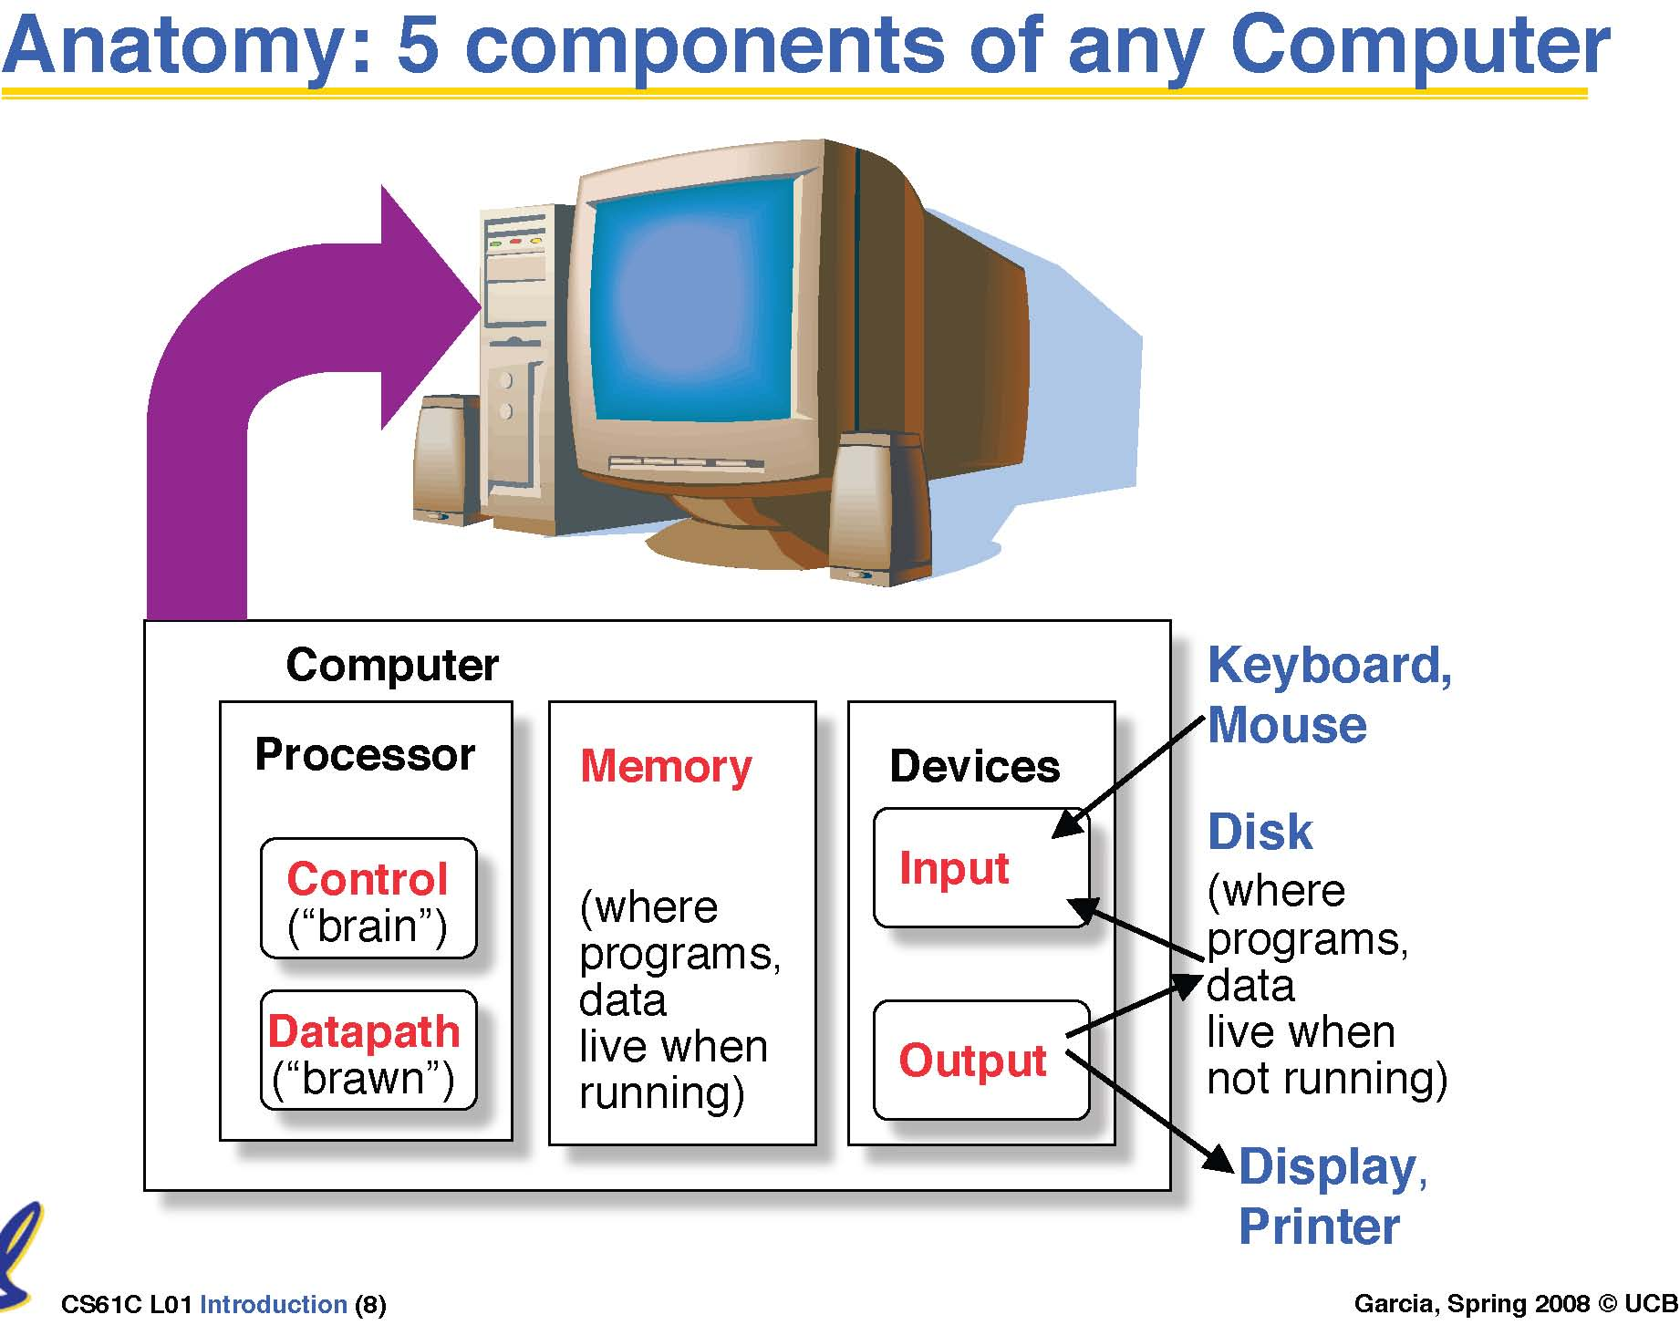
Bilgisayarın Ana Bileşenleri
Notes:
That is, any computer, no matter how primitive or advance, can be divided into five parts:
1. The input devices bring the data from the outside world into the computer.
2. These data are kept in the computer’s memory until ...
3. The datapath request and process them.
4. The operation of the datapath is controlled by the computer’s controller.
All the work done by the computer will NOT do us any good unless we can get the data back to the outside world.
5. Getting the data back to the outside world is the job of the output devices.
The most COMMON way to connect these 5 components together is to use a network of busses.

Slide 20
Bilgisayarın Ana Bileşenleri
Tüm bilgisayarlar 5 ana bileşenden oluşurlar:
  İşlemci (1) datapath (2) Kontrol
  (3) Bellek
  (4) Giriş elemanları ve (5) Çıkış elemanları
Bellek tek bir eleman değildir…
  Cep (cache): hızlı (pahalı)bellek işlemciye daha yakın
  Ana bellek daha ucuz ve kapasitesi yüksek
Giriş-Çıkış elemanları (I/O) düzensiz organizasyona sahiptir:
  Hızları farklı: klavye ve grafik
  Gereksinimleri farklı: hız, standart, fiyat ...
  Daha az araştırma yapılmış
Notes:
Let me summarize what I have said so far.
The most important thing I want you to remember is that: all computers, no matter how complicated or expensive, can be divided into five components:
(1) The datapath and (2) control that make up the processor.
(3) The memory system that supplies data to the processor.
And last but not least, the (4) input and (5) output devices that get data in and out of the computer.
One thing about memory is that Not all “memory” are created equally.
Some memory are faster but more expensive and we place them closer to the processor and call them “cache.”
The main memory can be slower than the cache so we usually use less expensive parts so we can have more of them.
Finally as you can see from the last few slides, the input and output devices usually has the messiest organization. There are several reasons for it:
(1) First of all, I/O devices can have a wide range of speed.
(2) Then I/O devices also have a wide range of requirements.
(s) Finally to make matters worse, historically I/O has attracted the least amount of research interest. But hopefully this is changing.
In this class, you will learn about all these five components and we will try to make this as enjoyable as possible. So have fun.

Slide 21
Typical computer structure (stored-program)
Data Path (DP)
Memory
data
bus A
bus B
R0
R1
decoder
instruction
DP control
ALU control
ALU
Controller
R31
condition
Registers
shifter
bus C
von Neumann vs. Harvard architecture

Slide 22
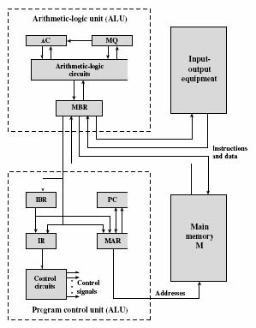
Tipik bilgisayar yapısı (program saklamalı)
Memory buffer register (MBR
Memory address register (MAR): Instruction register (IR):.
Instruction buffer register (IBR): Program Counter (PC):
Accumulator (AC) Multiplier quotient (MQ):

Slide 23
CPU
Register file
ALU
PC
System bus
Memory bus
Main
memory
Bus interface
I/O
bridge
I/O bus
Expansion slots for
other devices such
as network adapters
USB
controller
Graphics
adapter
Disk
controller
Mouse
Keyboard
Display
Disk
hello executable
stored on disk

Slide 24
BUS (genelde 32 bit (4 byte) veya 64 bit (8 byte)
I/O bus
2 adet giriş elemanı Mouse, klavye
1 adet çıkış elemanı Display ,
1 adet Hard Disk (uzun süreli data/program saklama için)
(I/O elemanlar adaptor veya controller ile bağlı)
Controller: Eleman çipinin içinde veya anaboard üzerinde
Adaptor: Anaboard üzerine takılı slotlarda
Ana Bellek: DRAM
CPU (Merkezi İşlem Ünitesi)

Slide 25
CPU
Register file
ALU
PC
System bus
Memory bus
Main
memory
"hello"
Bus interface
I/O
bridge
I/O bus
Expansion slots for
other devices such
as network adapters
USB
controller
Graphics
adapter
Disk
controller
Mouse
Keyboard
Display
Disk
User
types
"hello"

Slide 26
CPU
Register file
ALU
PC
System bus
Memory bus
Main
memory
"hello,world\n"
Bus interface
I/O
bridge
hello code
I/O bus
Expansion slots for
other devices such
as network adapters
USB
controller
Graphics
adapter
Disk
controller
Mouse
Keyboard
Display
Disk
hello executable
stored on disk
"hello,world\n"

Slide 27
Komut İcra Çevrimi
Bellekten komut alımı
Instruction
Fetch
Instruction
Decode
Komut çözülerek gereken işlemlerin belirlenmesi
Operand
Fetch
Operand datasını al ve ilgili saklayıcılara yerleştir.
Execute
Sonuçları ve status hesapla
Result
Store
Daha sonra kullanım için sonuçları sakla
Next
Instruction
Bir sonraki komutu belirle

Slide 28
Komut Kümesi Mimarisi : Neler Belirlenmeli?
° Komut Formatı ve kodları
– Nasıl kod çözüleceği ?
°operand ve sonuçların tutulacağı yer
– bellekten başka nerede saklanacağı?
– operand türü?
– bellek operandlarının nasıl yerleştirildiği ?
° Data türü ve miktarı
° İşlemler
° Dallanma komutları
– jumps, conditions, branches

Slide 29
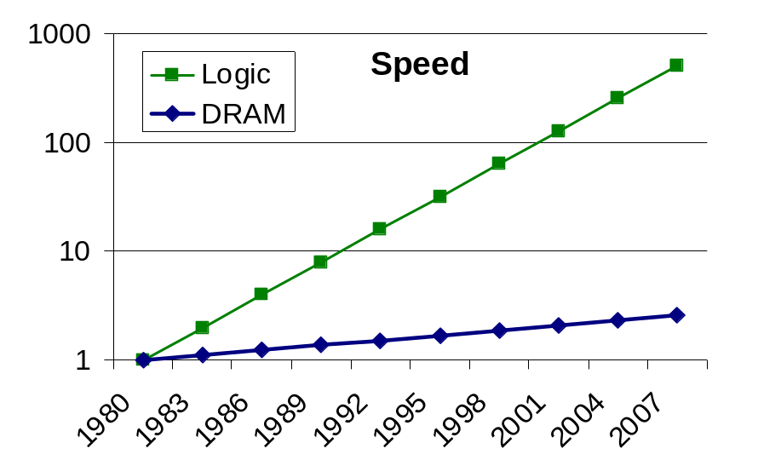
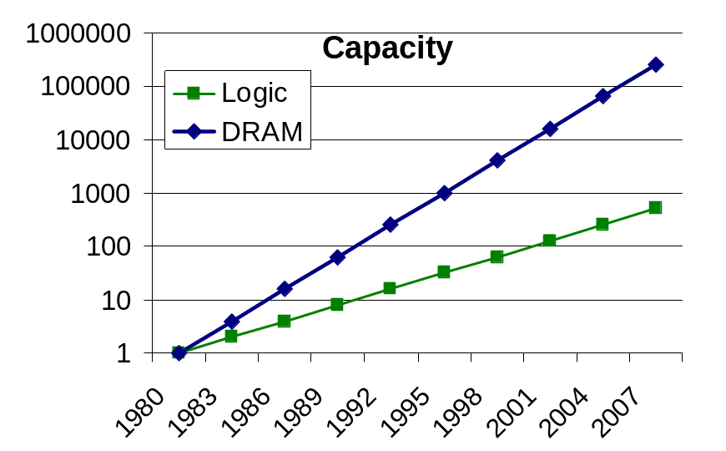
Teknolojik Gelişme ve Performans
CPU speed and Memory speed grow apart
2× in 3 years
4× in 3 years
1.1× in 3 years
2× in 3 years
Moore kanunu: Performanse her 18 ayda 2 kat artar.
  Eğim azalıyor: ‘process scaling’ azalırken, güç artıyor.
  Gonzalez, transistör boyutlarının çok küçük olduğunu şöyle açıklıyor: 'Şu an 32nm ile çalışıyoruz (bir metrenin 32 milyarda biri) ve çok yakında 22nm'e ineceğiz. Bu, grip virüsünden bile küçük ve bir saç telinin çapından 10 bin kez küçük bir transistör anlamına geliyor.'

Slide 30
Teknoloji : Büyük değişimi
Moore kanunu
  Chip yoğunluğu (transistors) her 18 ayda 2 kat artar
İşlemci
  Lojik kapasitesi: her yıl 30% artıyor
  clock rate: yılda 20% artıyor..
Bellek
  DRAM kapasite: 60% yıl başına (4x her 3 yılda)
  Bellek hızı: 10% yıl başına
  Bit başına maliyet: 25% yıldaki artış oranı
Disk
  Kapasite: 60% yıl başına

Slide 31
İşlemci Performansı (SPEC)
•Şuanki durum
  •İşlemci hızları : 4,000 MegaHertz
  (4.0 GigaHertz)
  5.2 GHz (IBM-zEnterprise teknolojisi dört çekirdekli 1.4 milyar transistor-512 milimetre karelik alan)
  • Bellek kapasitesi: 65,536 MegaBytes
  (64.0 GigaBytes)
  • Disk capacity: 2,000 GigaBytes
  (2.0 TeraBytes)
  Seagate dünyanın ilk 3 TB kapasiteli hard diskini üretti. Bu diske Freeagent Goflex Desk adını verdi
New units! Mega , Giga, Tera
Peta, Exa, Zetta , Yotta
Yotta = 10²⁴)

Slide 32
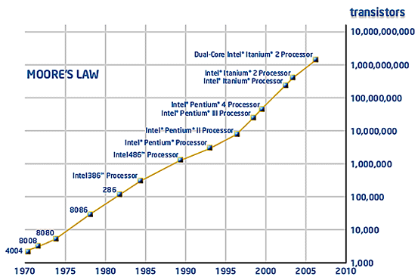
Moore’s Law
Graph taken from: http://www.intel.com/technology/mooreslaw/index.htm

Slide 33
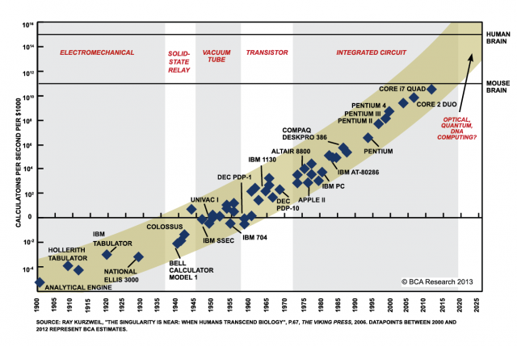
MOORE’s LAW

