Slide 1
Bilgisayar Mimarisi
Komut Seti Mimarisi
Instruction Set Architecture
Prof. Ahmet Sertbaş
Notes:
Wecome. I am Alok Choudhary.
This class deals with fundamental of computer architecture.

Slide 2
Komut Seti Mimarilerinin Sınıflandırılması
Komut Seti Mimari Tasarımı Etkileyen Faktörler
  Operandlar- Operands
  İşlemler - Operations
  Bellek Adresleme- Memory Addressing
  Komut Formatları - Instruction Formats
Komut Sırasını Düzenleme
Dil ve Derleyici Etkisi

Slide 3
Komut Seti Tasarımı
software
instruction set
hardware
Multiple Implementations: 8086 → Pentium 4
ISAs evolve: MIPS-I, MIPS-II, MIPS-II, MIPS-IV, MIPS,MDMX, MIPS-32, MIPS-64

Slide 4
Typical Processor Execution Cycle
Instruction
Fetch
Obtain instruction from program storage
Instruction
Decode
Determine required actions and instruction size
Operand
Fetch
Locate and obtain operand data
Execute
Compute result value or status
Result
Store
Deposit results in register or storage for later use
Next
Instruction
Determine successor instruction

Slide 5
Instruction and Data Memory: Unified or Separate
Programmer's View
Computer
Program
(Instructions)
ADD
SUBTRACT
AND
OR
COMPARE
.
.
.
01010
01110
10011
10001
11010
.
.
.
CPU
Memory
I/O
Computer's View

Slide 6
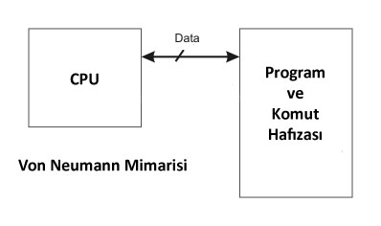
Princeton (Von Neumann) Architecture
Von Neuman mimarisi Princeton Üniversitesi tarafından diğeri de adından da anlaşılacağı üzere Harvard Üniversitesi tarafından tasarlanmıştır.
Von Neuman Mimarisinde’, komut ve veriler aynı yol kullanılarak iletilirler. Bu durum, komut ve verinin iletilmesinin gerektiği durumlarda veri ile ilgili iletişim sistemlerinin, komut ile ilgili iletişim işlemlerini beklemesini gerektirir.
Von Neuman Mimarisi’ kullanan mikroişlemcilerde de komutlar bellekten alındıktan sonra kodu çözülerek gerekli işlemler gerçekleştirilir ve elde edilen sonuçlar belleğe tekrar gönderilir.
Bu işlemler sırasında, yolların hızının mikroişlemcinin hızına yetişememesi nedeni ile sistemde darboğaz (bottleneck) olarak isimlendirilen olay gerçekleşebilir.
Detaylandırılan sakıncayı ortadan kaldırmaya ve Von Neuman Mimarisi kullanan sistemlerin performansını artırmaya yönelik olarak önbellek (cache) sistemi geliştirilmiştir. Önbellekler, işlenecek komutların ve verilerin ana bellekten getirilerek işlem birimine yakın bir bellekte tutulması amacıyla kullanılmaktadır. Ana bellekten alınan komut ve veriler ayrı önbelleklere yerleştirilerek hem ayrıştırılması sağlamakta, hem de oluşan darboğaz ortadan kaldırılmaktadır.
Günümüz kişisel bilgisayarları da Von Neuman mimarisinde çalışmaktadırlar sistemde sadece tek bellek (RAM) vardır ve tüm komutlar ve veriler aynı ortamda saklanır. Mikroişlemcili sistemlerin büyük çoğunluğu Von Neuman mimarisinde çalışırken mikrodenetleyici sistemlerin çoğu Harvard mimaride çalışır.

Slide 7
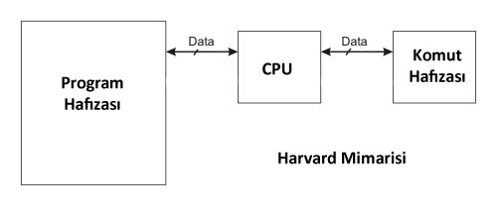
Harvard Architecture
Harvard Mimarisi Komutlar ve veri ile ilgili bilgilerin ayrı belleklerde saklandığı ‘Harvard Mimarisi’ kullanan mikroişlemcili sistemlerde, veri ve komutları iletmek amacıyla kullanılan yollar birbirinden
bağımsızdır.
İletim için kullanılan yolların farklı olması, aynı anda veri ve komutun iletilmesini mümkün hale getirir. Diğer bir ifadeyle, komut kod bellekten okunurken, komutun gerçekleştirilmesi sırasında ihtiyaç duyulan veri, veri belleğinden okunabilir.
Harvard Mimarisi, performansın çok önemli olduğu sistemlerde ve günümüzde özellikle sayısal
işaret işleme görevini yapan tümleşik devrelerde (DSP: Digital Signal Processor) ve güvenliğin
önemsendiği mikrodenetleyicilerde tercih edilmektedir.

Slide 8
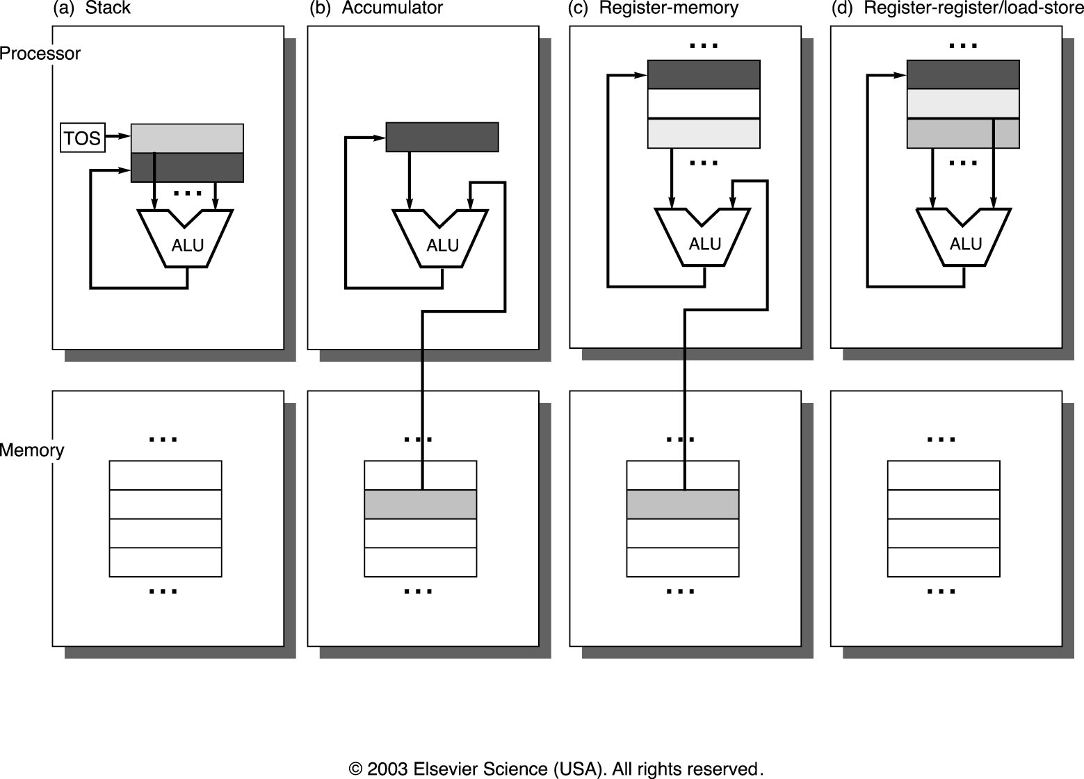
Basic Addressing Classes

Slide 9
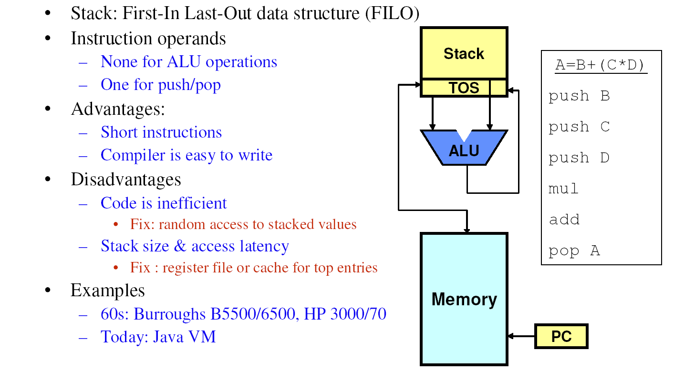
Stack Architectures

Slide 10
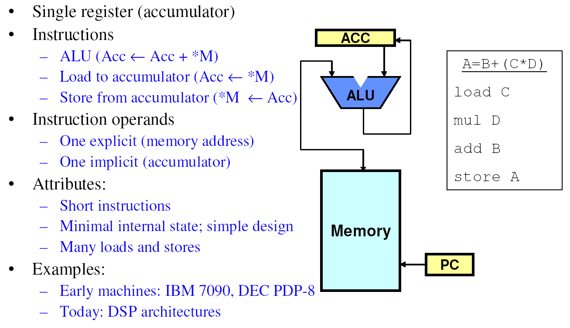
Accumulator Architectures

Slide 11
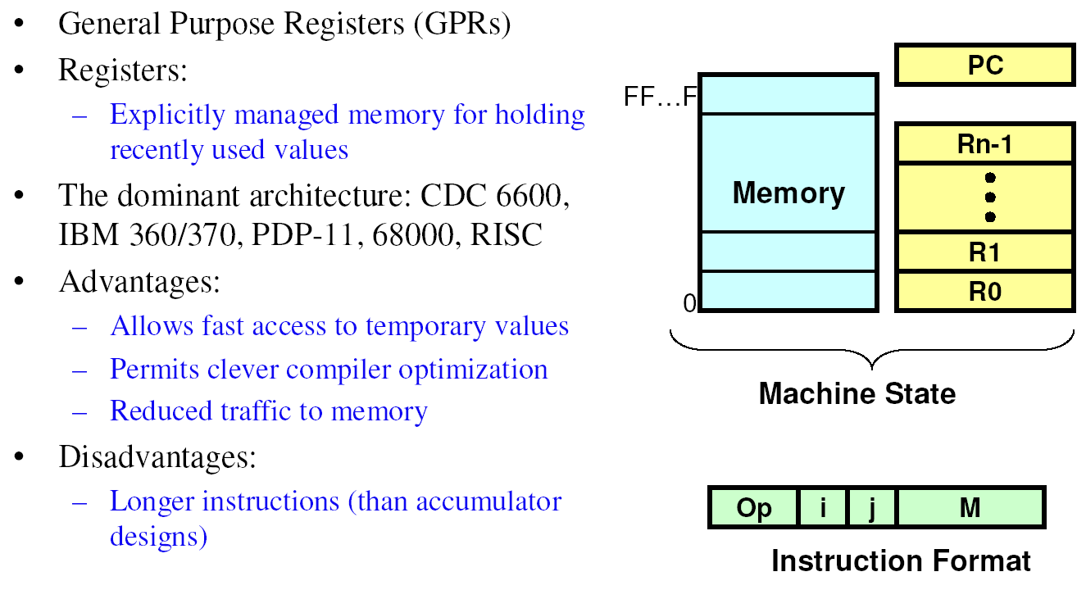
Register-Set Architectures

Slide 12
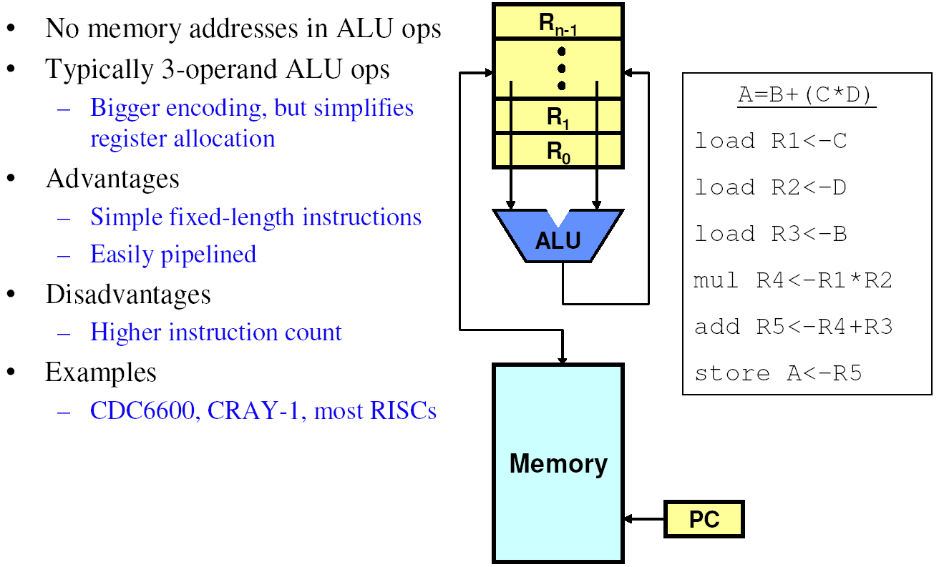
Register-to-Register: Load-Store Architectures

Slide 13
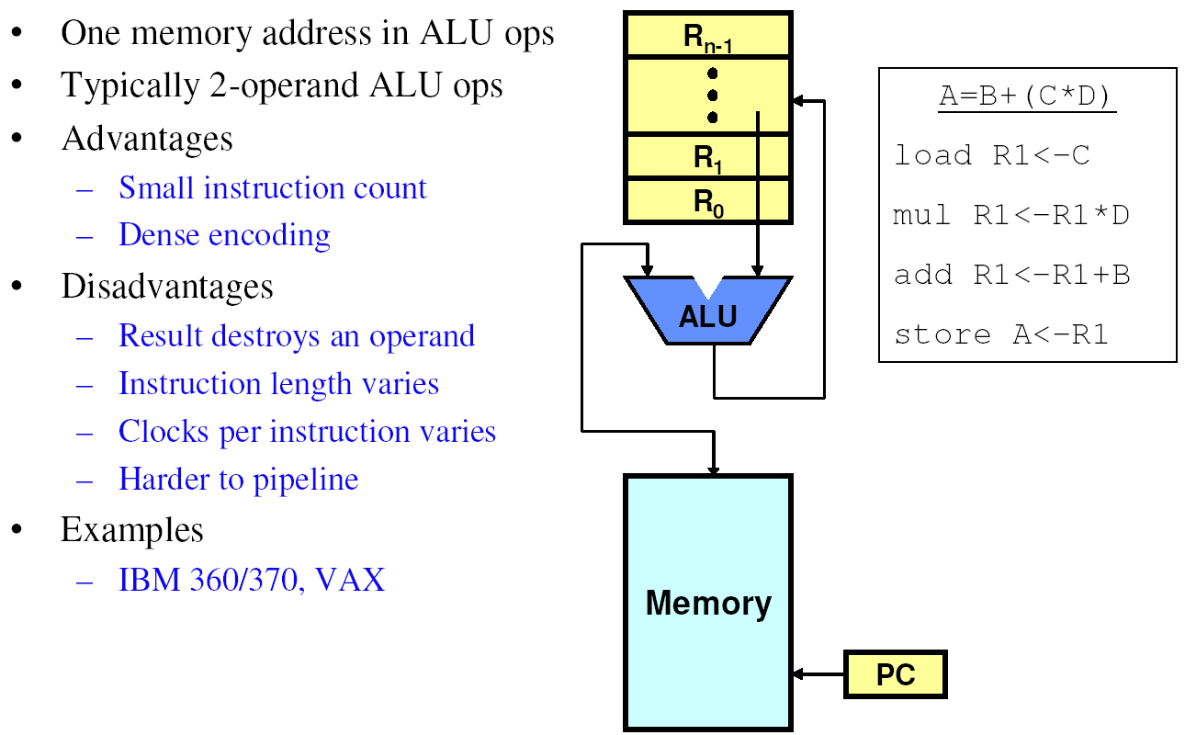
Register-to-Memory Architectures

Slide 14
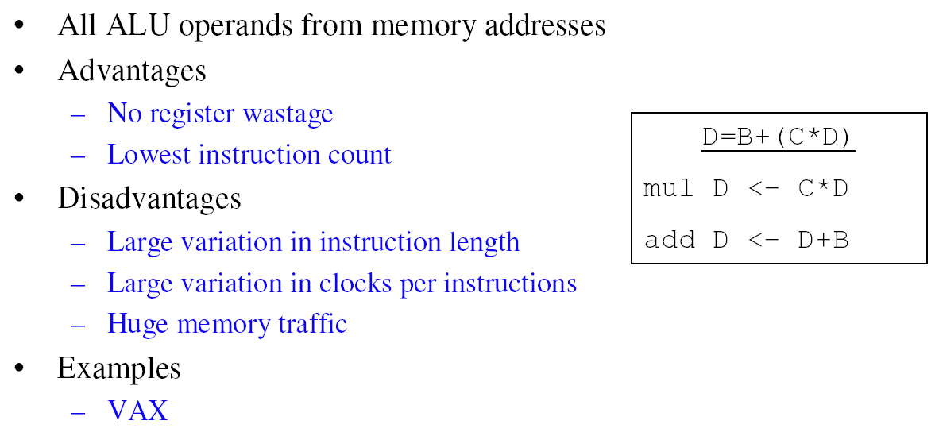
Memory-to-Memory Architectures

Slide 15
Instruction Set Architecture Design Decisions
Notes:
“Speed” is often an important design criteria. However, other applications have other criteria – e.g., power, reliability, EMI, …

Slide 16
Basic Issues in Instruction Set Design
What data types are supported. What size.
What operations (and how many) should be provided
  LD/ST/INC/BRN sufficient to encode any computation, or just Sub and Branch!
  But not useful because programs too long!
How (and how many) operands are specified
Most operations are dyadic (eg, A <- B + C)
  Some are monadic (eg, A <- ~B)
Location of operands and result
  where other than memory?
  how many explicit operands?
  how are memory operands located?
  which can or cannot be in memory?
  How are they addressed
How to encode these into consistent instruction formats
  Instructions should be multiples of basic data/address widths
  Encoding
Typical instruction set:
32 bit word
basic operand addresses are 32 bits long
basic operands, like integers, are 32 bits long
in general case, instruction could reference 3 operands (A := B + C)
Typical challenge:
encode operations in a small number of bits

Slide 17
Operands
Notes:
“Speed” is often an important design criteria. However, other applications have other criteria – e.g., power, reliability, EMI, …

Slide 18
Comparing Number of Instructions
Code sequence for (C = A + B) for four classes of instruction sets:
Register
Register
Stack
Accumulator
(register-memory)
(load-store)
Push A
Load A
Load R1,A
Load R1,A
Push B
Add B
Add R1,B
Load R2,B
Add
Store C
Store C, R1
Add R3,R1,R2
Pop C
Store C,R3

Slide 19
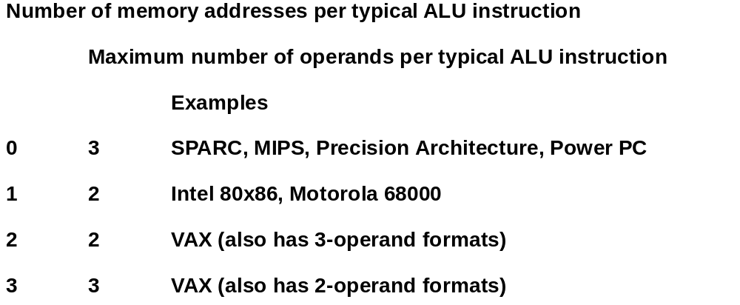
Examples of Register Usage

Slide 20
General Purpose Registers Dominate
1975-2002 all machines use general purpose registers
Advantages of registers
  Registers are faster than memory
  Registers compiler technology has evolved to efficiently generate code for register files
    E.g., (A*B) – (C*D) – (E*F) can do multiplies in any order
    vs. stack
  Registers can hold variables
    Memory traffic is reduced, so program is sped up
    (since registers are faster than memory)
  Code density improves (since register named with fewer
  bits than memory location)
  Registers imply operand locality

Slide 21
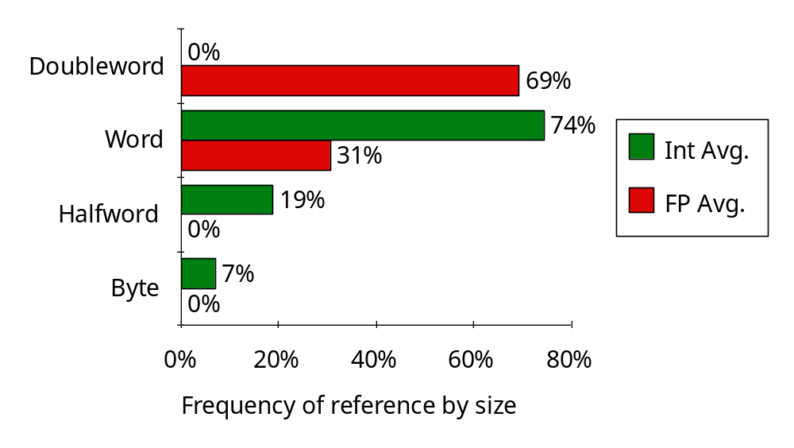
Operand Size Usage
Support for these data sizes and types:
8-bit, 16-bit, 32-bit integers and
32-bit and 64-bit IEEE 754 floating point numbers

Slide 22
Operations
Notes:
“Speed” is often an important design criteria. However, other applications have other criteria – e.g., power, reliability, EMI, …

Slide 23
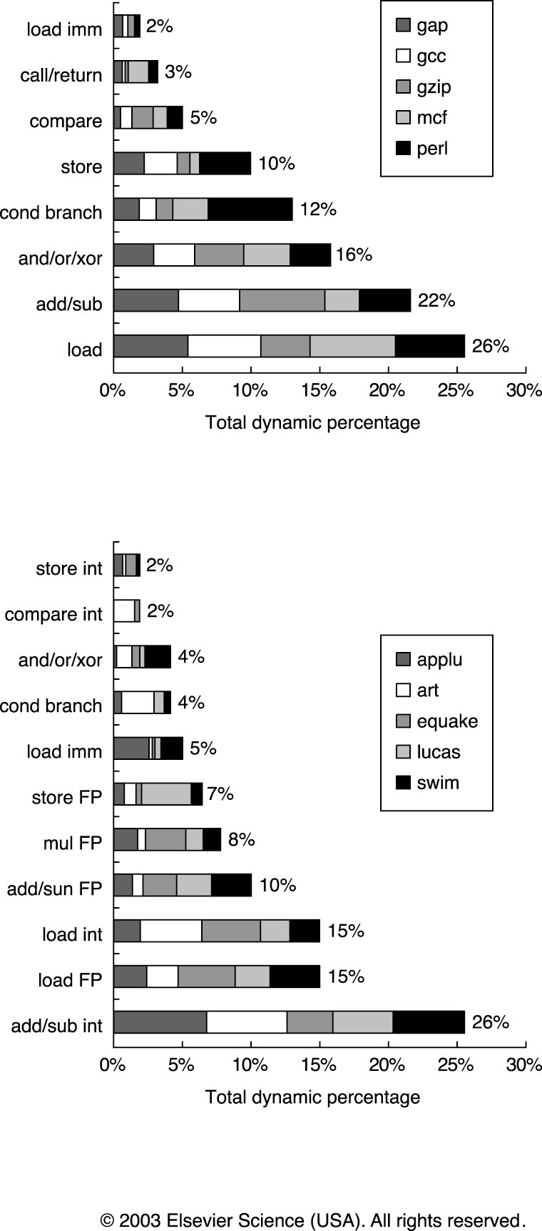
Typical Operations (little change since 1960)
Data Movement
Load (from memory)
Store (to memory)
memory-to-memory move
register-to-register move
input (from I/O device)
output (to I/O device)
push, pop (to/from stack)
Arithmetic
integer (binary + decimal) or FP
Add, Subtract, Multiply, Divide
Shift
shift left/right, rotate left/right
Logical
not, and, or, set, clear
Control (Jump/Branch)
unconditional, conditional
Subroutine Linkage
call, return
Interrupt
trap, return

Slide 24
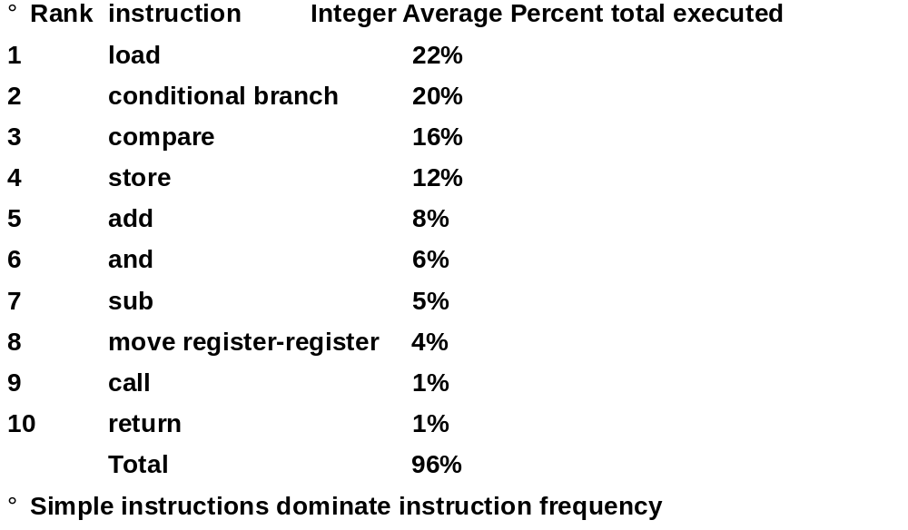
Top 10 80x86 Instructions

Slide 25
Memory Addressing
Notes:
“Speed” is often an important design criteria. However, other applications have other criteria – e.g., power, reliability, EMI, …

Slide 26
Memory Addressing
Since 1980, almost every machine uses addresses to level of 8-bits (byte)
Two questions for design of ISA:
  Since could read a 32-bit word as four loads of bytes from sequential byte address of as one load word from a single byte address, how do byte addresses map onto words?
  Can a word be placed on any byte boundary?

Slide 27
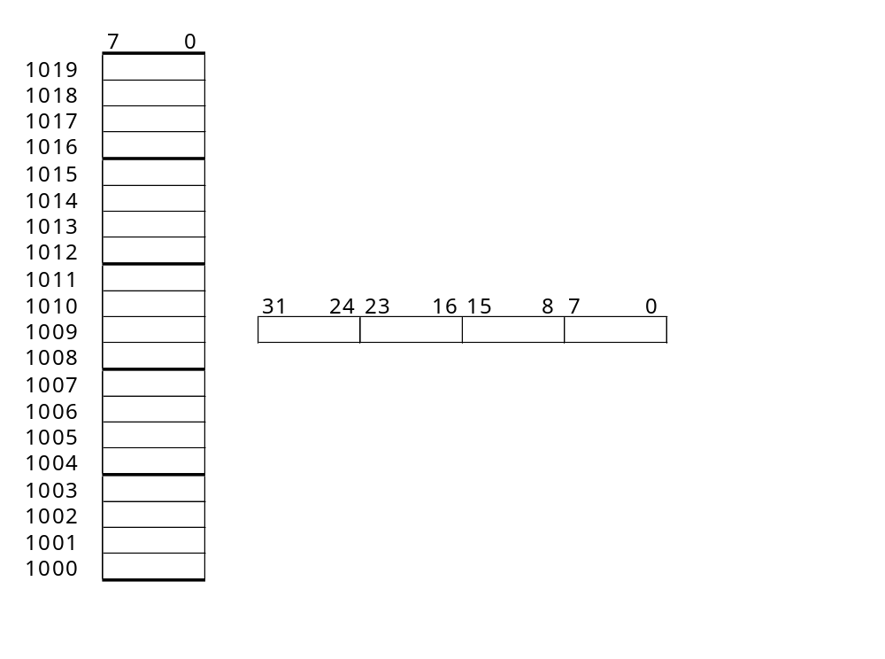
Mapping Word Data into a Byte Addressable Memory: Endianess
Big Endian: address of most significant byte = word address (xx00 = Big End of word)
IBM 360/370, Motorola 68k, MIPS, Sparc, HP PA
Big Endian
Little Endian
Little Endian: address of least significant byte = word address (xx00 = Little End of word)
Intel 80x86, DEC Vax, DEC Alpha (Windows NT)

Slide 28
Mapping Word Data into a Byte Addressable Memory: Alignment
0 1 2 3
Aligned
Not
Aligned
Alignment: require that objects fall on address that is multiple of their size.

Slide 29
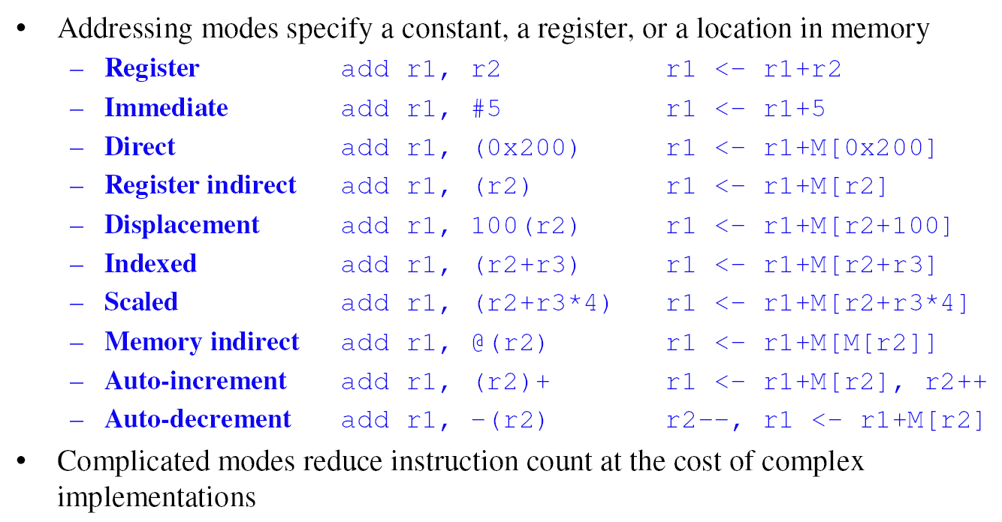
Addressing Modes

Slide 30
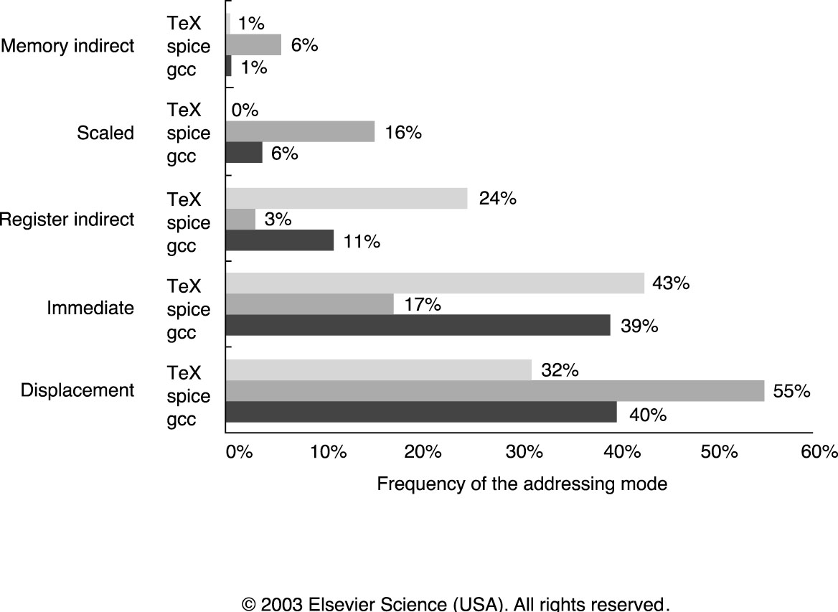
Common Memory Addressing Modes
Measured on the VAX-11
Register operations account for 51% of all references
~75% - displacement and immediate
~85% - displacement, immediate and register indirect

Slide 31
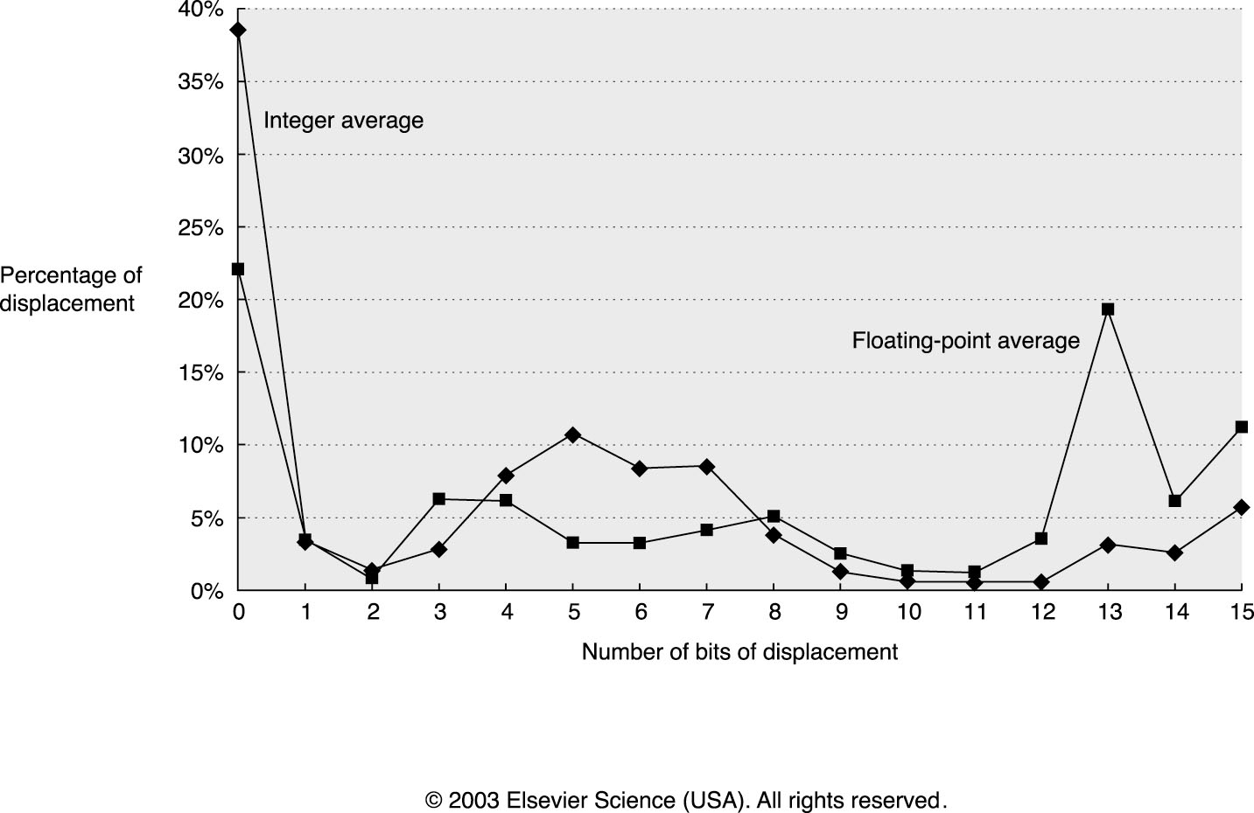
Displacement Address Size
Average of 5 SPECint92 and 5 SPECfp92 programs
~1% of addresses > 16-bits
12 ~ 16 bits of displacement cover most usage (+ and -)

Slide 32
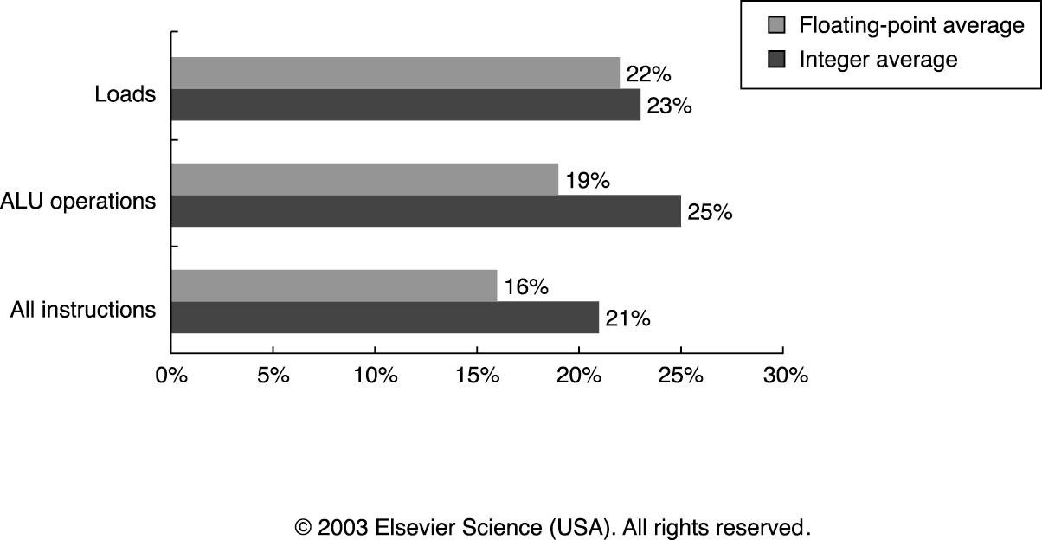
Frequency of Immediates (Instruction Literals)
~25% of all loads and ALU operations use immediates
15~20% of all instructions use immediates

Slide 33
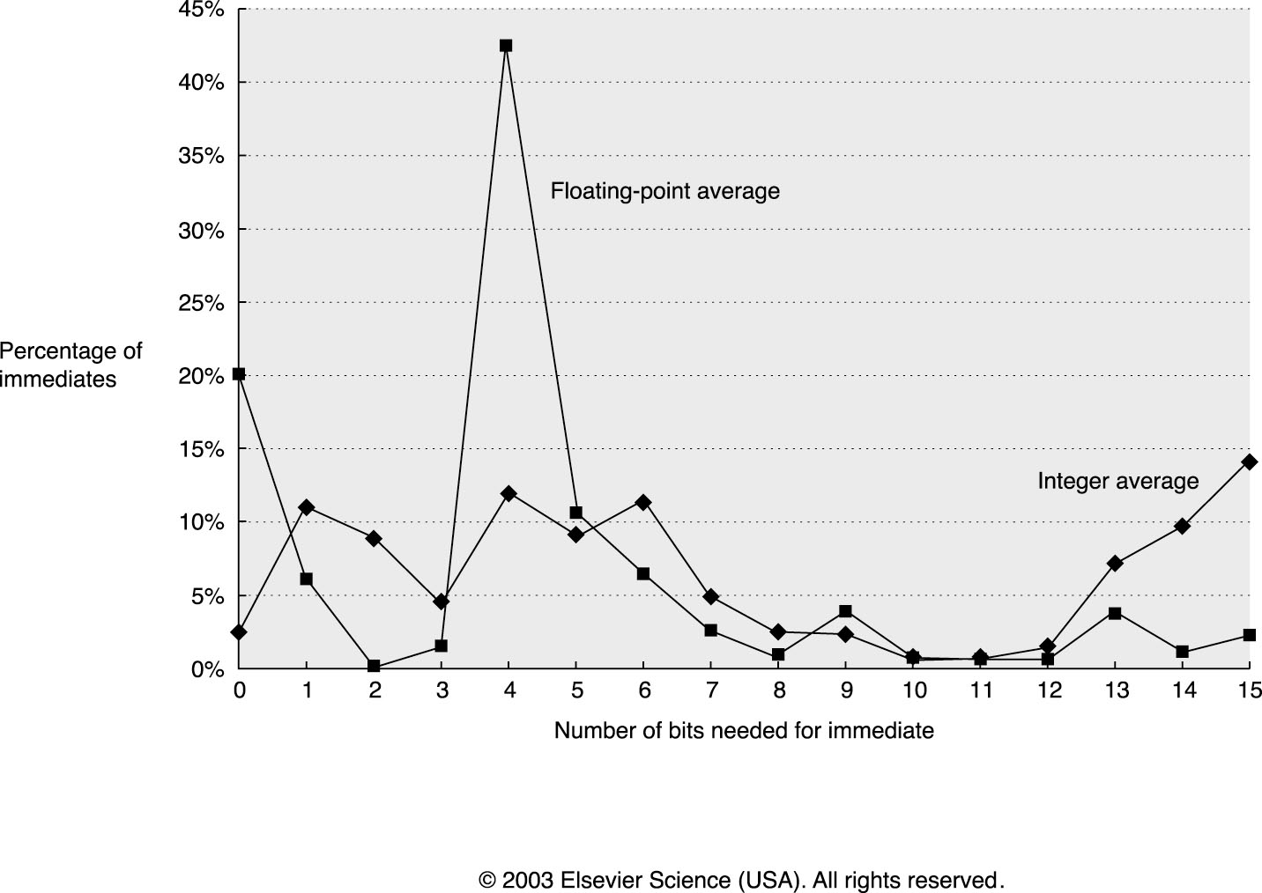
Size of Immediates
50% to 60% fit within 8 bits
75% to 80% fit within 16 bits

Slide 34
Addressing Summary
Data Addressing modes that are important:
  Displacement, Immediate, Register Indirect
Displacement size should be 12 to 16 bits
Immediate size should be 8 to 16 bits

Slide 35
Instruction Formats
Notes:
“Speed” is often an important design criteria. However, other applications have other criteria – e.g., power, reliability, EMI, …

Slide 36
Instruction Format
Specify
  Operation / Data Type
  Operands
Stack and Accumulator architectures have implied operand addressing
If have many memory operands per instruction and/or many addressing modes:
  Need one address specifier per operand
If have load-store machine with 1 address per instruction and one or two addressing modes:
  Can encode addressing mode in the opcode

Slide 37
Encoding
Variable:
Fixed:
Hybrid:
…
…
If code size is most important, use variable length instructions
If performance is most important, use fixed length instructions
Recent embedded machines (ARM, MIPS) added optional mode to execute subset of 16-bit wide instructions (Thumb, MIPS16); per procedure decide performance or density

Slide 38
Operation Summary
Support these simple instructions, since they
will dominate the number of instructions executed:
load,
store,
add,
subtract,
move register-register,
and,
shift,
compare equal, compare not equal,
branch,
jump,
call,
return;

Slide 39
Example: MIPS Instruction Formats and Addressing Modes
All instructions 32 bits wide
Register (direct)
op
rs
rt
rd
register
Immediate
op
rs
rt
immed
Base+index
op
rs
rt
immed
Memory
register
+
PC-relative
op
rs
rt
immed
Memory
PC
+

Slide 40
Instruction Set Design Metrics
Static Metrics
  How many bytes does the program occupy in memory?
Dynamic Metrics
  How many instructions are executed?
  How many bytes does the processor fetch to execute the program?
  How many clocks are required per instruction?
CPI
Instruction Count
Cycle Time

Slide 41
Instruction Sequencing
Notes:
“Speed” is often an important design criteria. However, other applications have other criteria – e.g., power, reliability, EMI, …

Slide 42
Instruction Sequencing
The next instruction to be executed is typically implied
  Instructions execute sequentially
  Instruction sequencing increments a Program Counter
Sequencing flow is disrupted conditionally and unconditionally
  The ability of computers to test results and conditionally instructions is one of the reasons computers have become so useful
Instruction 1
Instruction 2
Instruction 3
Instruction 1
Instruction 2
Conditional Branch
Instruction 4
Branch instructions are ~20% of all instructions executed

Slide 43
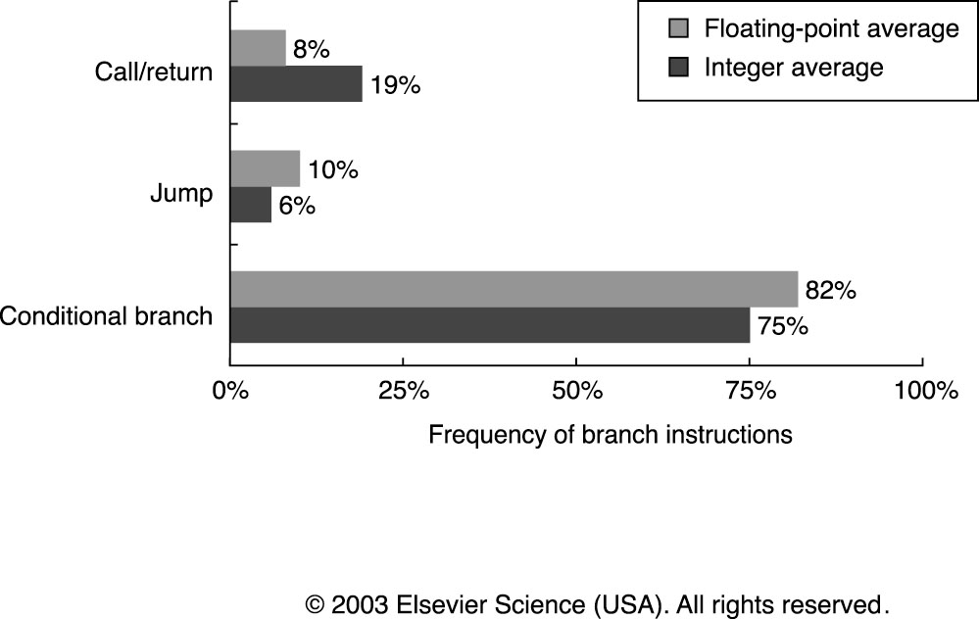
Dynamic Frequency

Slide 44
Condition Testing
° Condition Codes
Processor status bits are set as a side-effect of arithmetic instructions (possibly on Moves) or explicitly by compare or test instructions.
ex: add r1, r2, r3
bz label
° Condition Register
Ex: cmp r1, r2, r3
bgt r1, label
° Compare and Branch
Ex: bgt r1, r2, label

Slide 45
Condition Codes
Setting CC as side effect can reduce the # of instructions
X: .
.
.
SUB r0, #1, r0
BRP X
X: .
.
.
SUB r0, #1, r0
CMP r0, #0
BRP X
vs.
But also has disadvantages:
--- not all instructions set the condition codes
which do and which do not often confusing!
e.g., shift instruction sets the carry bit
--- dependency between the instruction that sets the CC and the one
that tests it
ifetch
read
compute
write
Old CC read
New CC computed
ifetch
read
compute
write

Slide 46
Branches
--- Conditional control transfers
Four basic conditions:
N -- negative
Z -- zero
V -- overflow
C -- carry
Sixteen combinations of the basic four conditions:
Always
Never
Not Equal
Equal
Greater
Less or Equal
Greater or Equal
Less
Greater Unsigned
Less or Equal Unsigned
Carry Clear
Carry Set
Positive
Negative
Overflow Clear
Overflow Set
Unconditional
NOP
~Z
Z
~[Z + (N + V)]
Z + (N + V)
~(N + V)
N + V
~(C + Z)
C + Z
~C
C
~N
N
~V
V

Slide 47
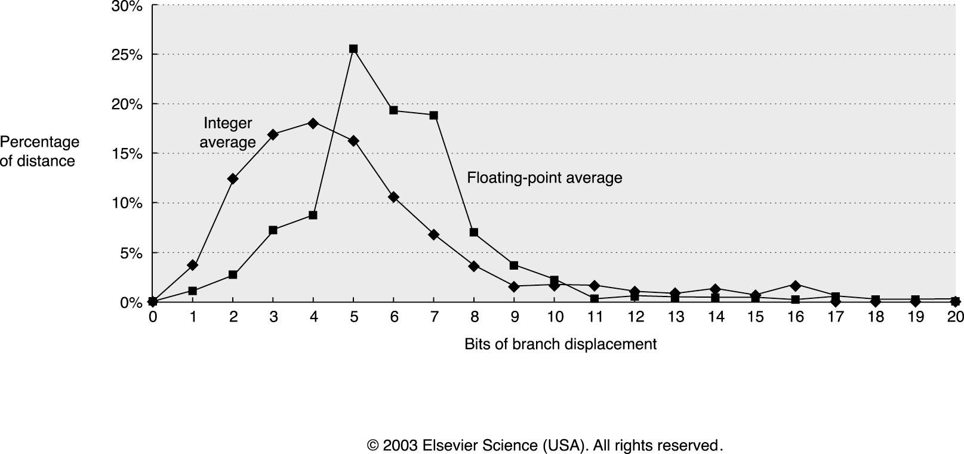
Conditional Branch Distance
PC-relative (+-)
25% of integer branches are 2 to 4 instructions
At least 8 bits suggested (± 128 instructions)

